Slide 1



Multilevel Regression
Part 1: Traditional repeated measures models
Ben Meuleman, Ph.D.
Swiss Center for Affective Sciences
Université de Genève
March 1–4, 2022

Slide 2

Personal background
2003 – 2007 Bachelor in Psychology
2007 – 2009 Master in Psychology
2009 – 2010 Master in Statistical Data Analysis
2011 – 2015 Ph.D. in Psychology
2016 – 2019 Postdoc in Psychology
2019 – … Statistician
Part-time statistical assistant at the Swiss Center for Affective Sciences (2011–2022), offering consulting services for researchers.
Contributor of regular workshops (machine learning, multilevel regression, statistics tips) and presented twice at the R Lunch series of UNIGE.*
Inadvertently specialized in multilevel regression due to the high frequency of questions on this topic…
* http://use-r-carlvogt.github.io/prochains-lunchs/

Slide 3
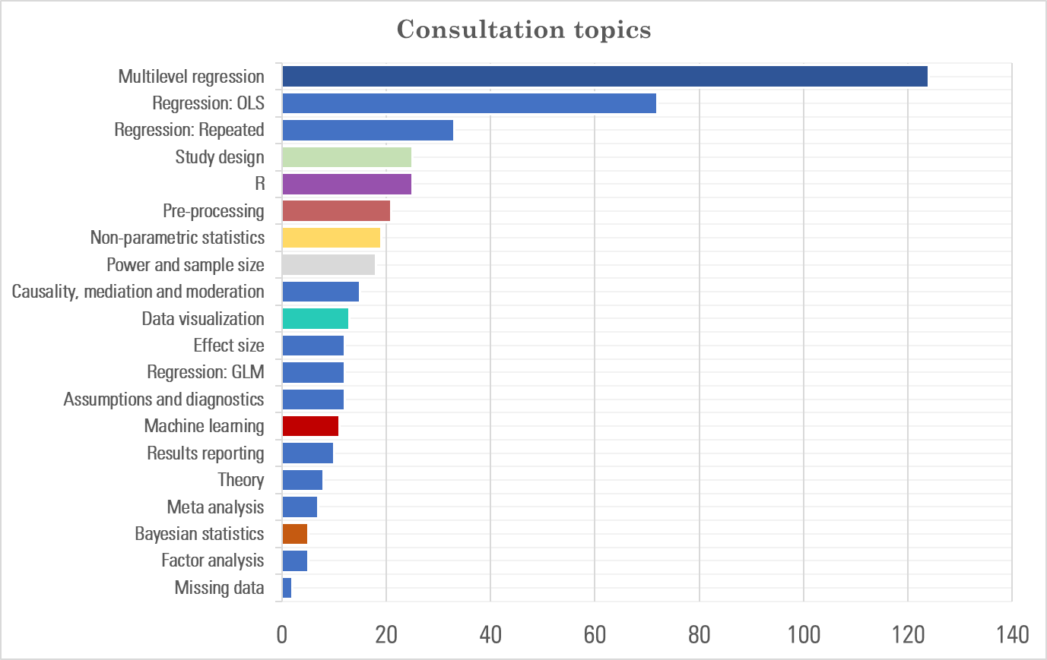
Consultation topics 2019–2022

Slide 4


This workshop – Post-covid Edition
This workshop is the fifth version of material taught in 2016, 2018, and 2020 (×2). Originally it was taught as a 4-hour workshop for a single afternoon. If you attended a previous version: the material has largely the same structure and examples since 2018, but with some important updates and refinements. This version should become your new primary reference.
Because the workshop was planned when pandemic restrictions were still active, we opted for the Zoom format. The advantage of staying with this is a lighter program, no limit on participants, and recording of lectures for later re-viewing.
Today we will discuss multilevel regression, which can be followed without having participated in any prior workshop of mine. A sequel workshop is being planned on logistic regression, in which I will also discuss multilevel models for repeated categorical outcomes (e.g., GLMER, GEE). Today we focus exclusively on continuous outcomes.
Throughout my slides, I will provide R code that you can execute in parallel with the presentation (see attached scripts). Data are sourced directly from switchdrive, so there is no need to have data files pre-loaded.
https://www.r-project.org/

Slide 5
Contents
Traditional repeated measures models
  Standard linear model
  Non-independent data
  Challenges to classic approaches
Random intercept and random slope model
  Random intercept model
  Random slope model
Model selection and diagnostics for multilevel models
  Selection of random and fixed effects
  Model fit and effect sizes
  Problems and residual diagnostics
Hierarchical, trial-level, and longitudinal data
  Hierarchical data and post-hoc tests
  Crossed random effects and trial-level analysis
  Longitudinal data analysis
Miscellaneous topics in multilevel models

Slide 6
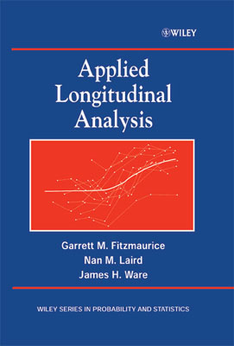
Background literature
Fitzmaurice, Laird & Ware (2004). Applied Longitudinal Analysis. John Wiley and Sons.
Clear and accessible treatment of repeated measures data and their analysis. Detailed examples and calculations in each chapter. One of the best books I ever read!
Mathematics behind the analyses are surprisingly easy to understand and to apply to your own models (should you need it).
Special topics include discussions on missing data, growth curve modelling, and
generalized linear mixed models.
I own a copy which you can borrow upon request
Highly recommended!

Slide 7
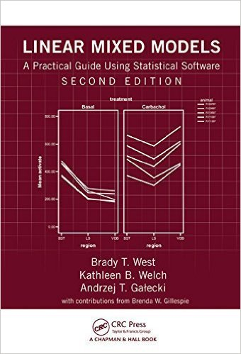
Background literature
West, Welch & Galecki (2014). Linear Mixed Models: A Practical Guide Using Statistical Software. Chapman and Hall.
Practical treatment of different types of multilevel datasets, with extensive discussion of modelling and troubleshooting.
Full example code in SPSS, SAS, Stata and R! Excellent reference guide for code (although maybe slightly outdated at this point for R).
I can share a high quality PDF upon request!

Slide 8
Frequently Asked Questions – Reference
Before moving on to the course materials, I provide a handy reference here for key slides in this workshop that will answer many Frequently Asked Questions (FAQ) about multilevel models:
  P1–S33 Covariance assumptions in repeated measures (M)ANOVA
  P1–S55 Reasons to use a multilevel model (versus traditional methods)
  P2–S31:32 Dangers with the use of the random intercept model
  P2–S42 General formula syntax in lme4
  P3–S05 Recommended steps to fit a multilevel model
  P4–S18 Which variables should be fixed or random?
  P4–S19 How many random effects do we need in our final model?
  P3–S13 Which fixed effects should be removed in our final model?
  P4–S11:15 ANOVA and pairwise contrasts for multilevel models
  P3-S16 R-squared in multilevel models
  P3–S37 Residual diagnostics for multilevel models (with DHARMa package)
  P4–S38 Advantages of trial-level analysis with multilevel models
  P4–S58:59 Comparing models for longitudinal changes
  P5–S15:16 Power and sample size in multilevel models
  P5–S19:21 Troubleshooting with lme4 (errors and warnings)

Slide 9
1. Traditional repeated measures models
A. Standard linear model

Slide 10
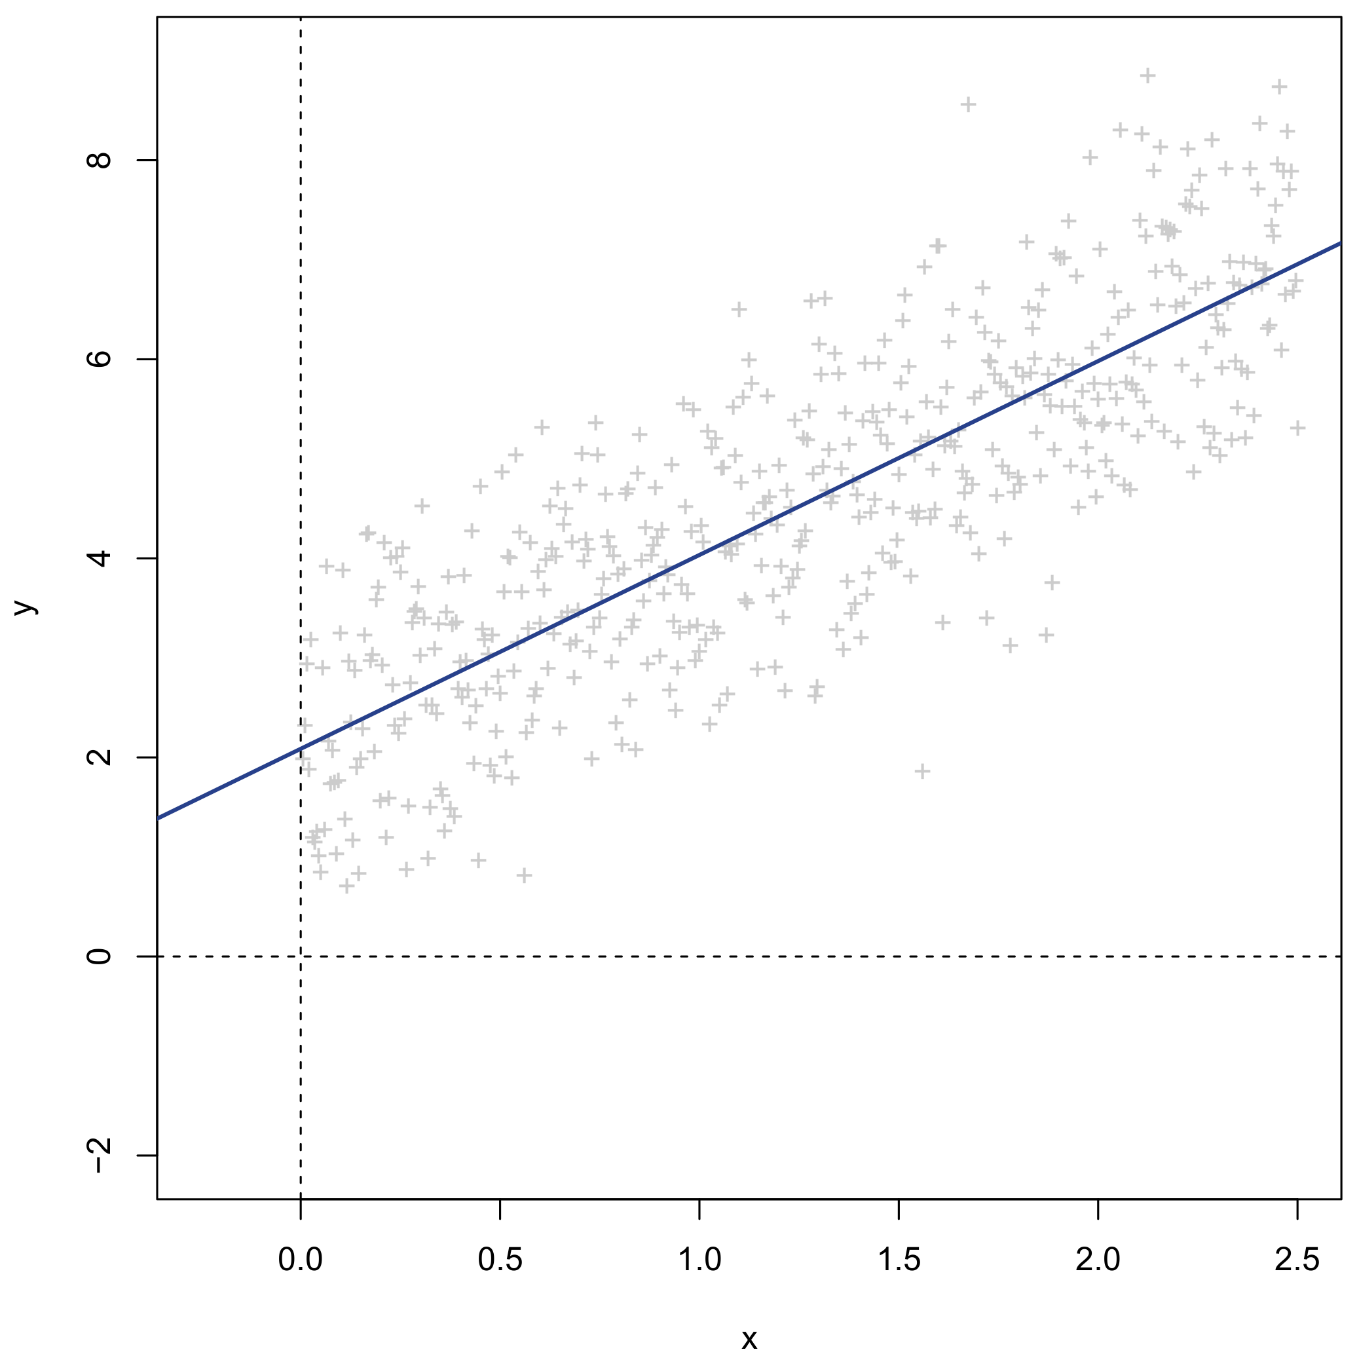
Linear regression
Continuous dependent/response Y
Continuous independent/predictor X
Linear regression of Y on X
= Linear approximation of Y using X

Slide 11
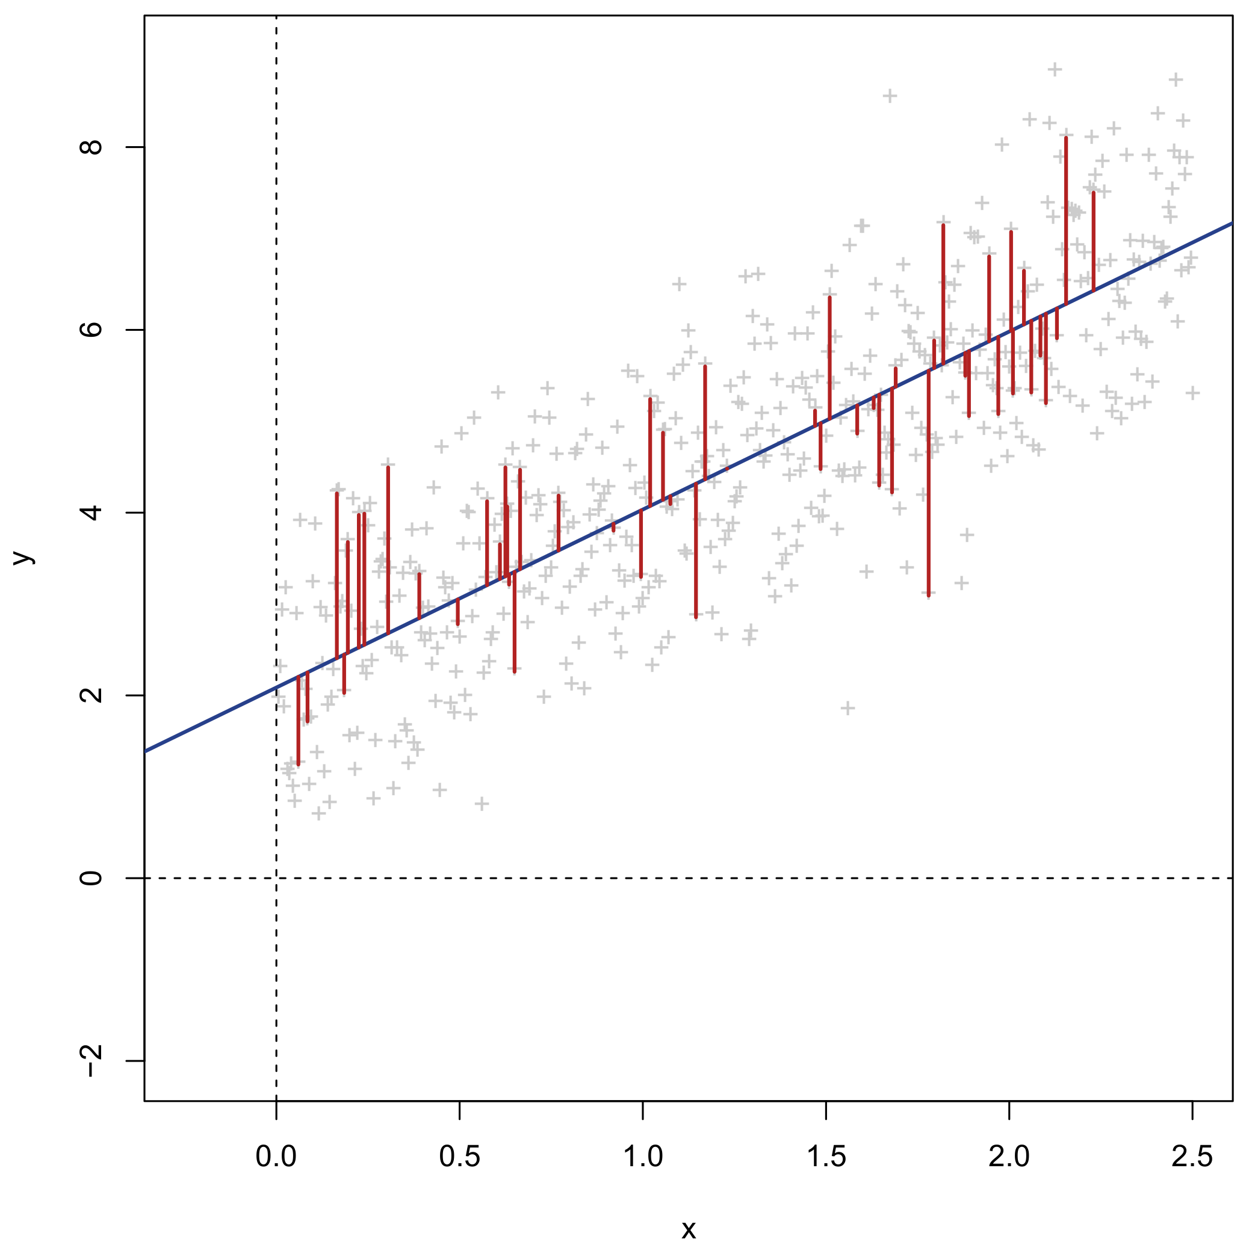
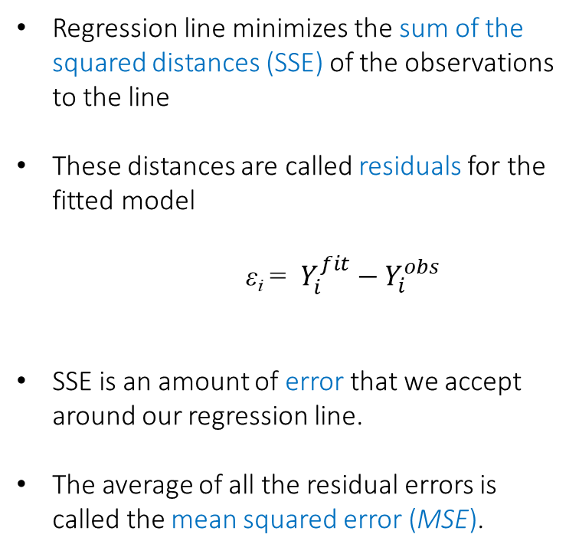
Linear regression
Regression line minimizes the sum of the squared distances (SSE) of the observations to the line
These distances are called residuals for the fitted model
ε_{i} = $Y_{i}^{fit}−Y_{i}^{obs}$
SSE is an amount of error that we accept around our regression line.
The average of all the residual errors is called the mean squared error (MSE).

Slide 12
Linear regression
Y_{i} = β₀ + β₁X_{i} + ε_{i}
β₀ Intercept. Expected/average value of Y when X equals 0 (intersection of the model with the Y-axis)
β₁ Slope. Expected/average increase in Y when X increases by 1 unit
β₁ slope
β₀ intercept

Slide 13
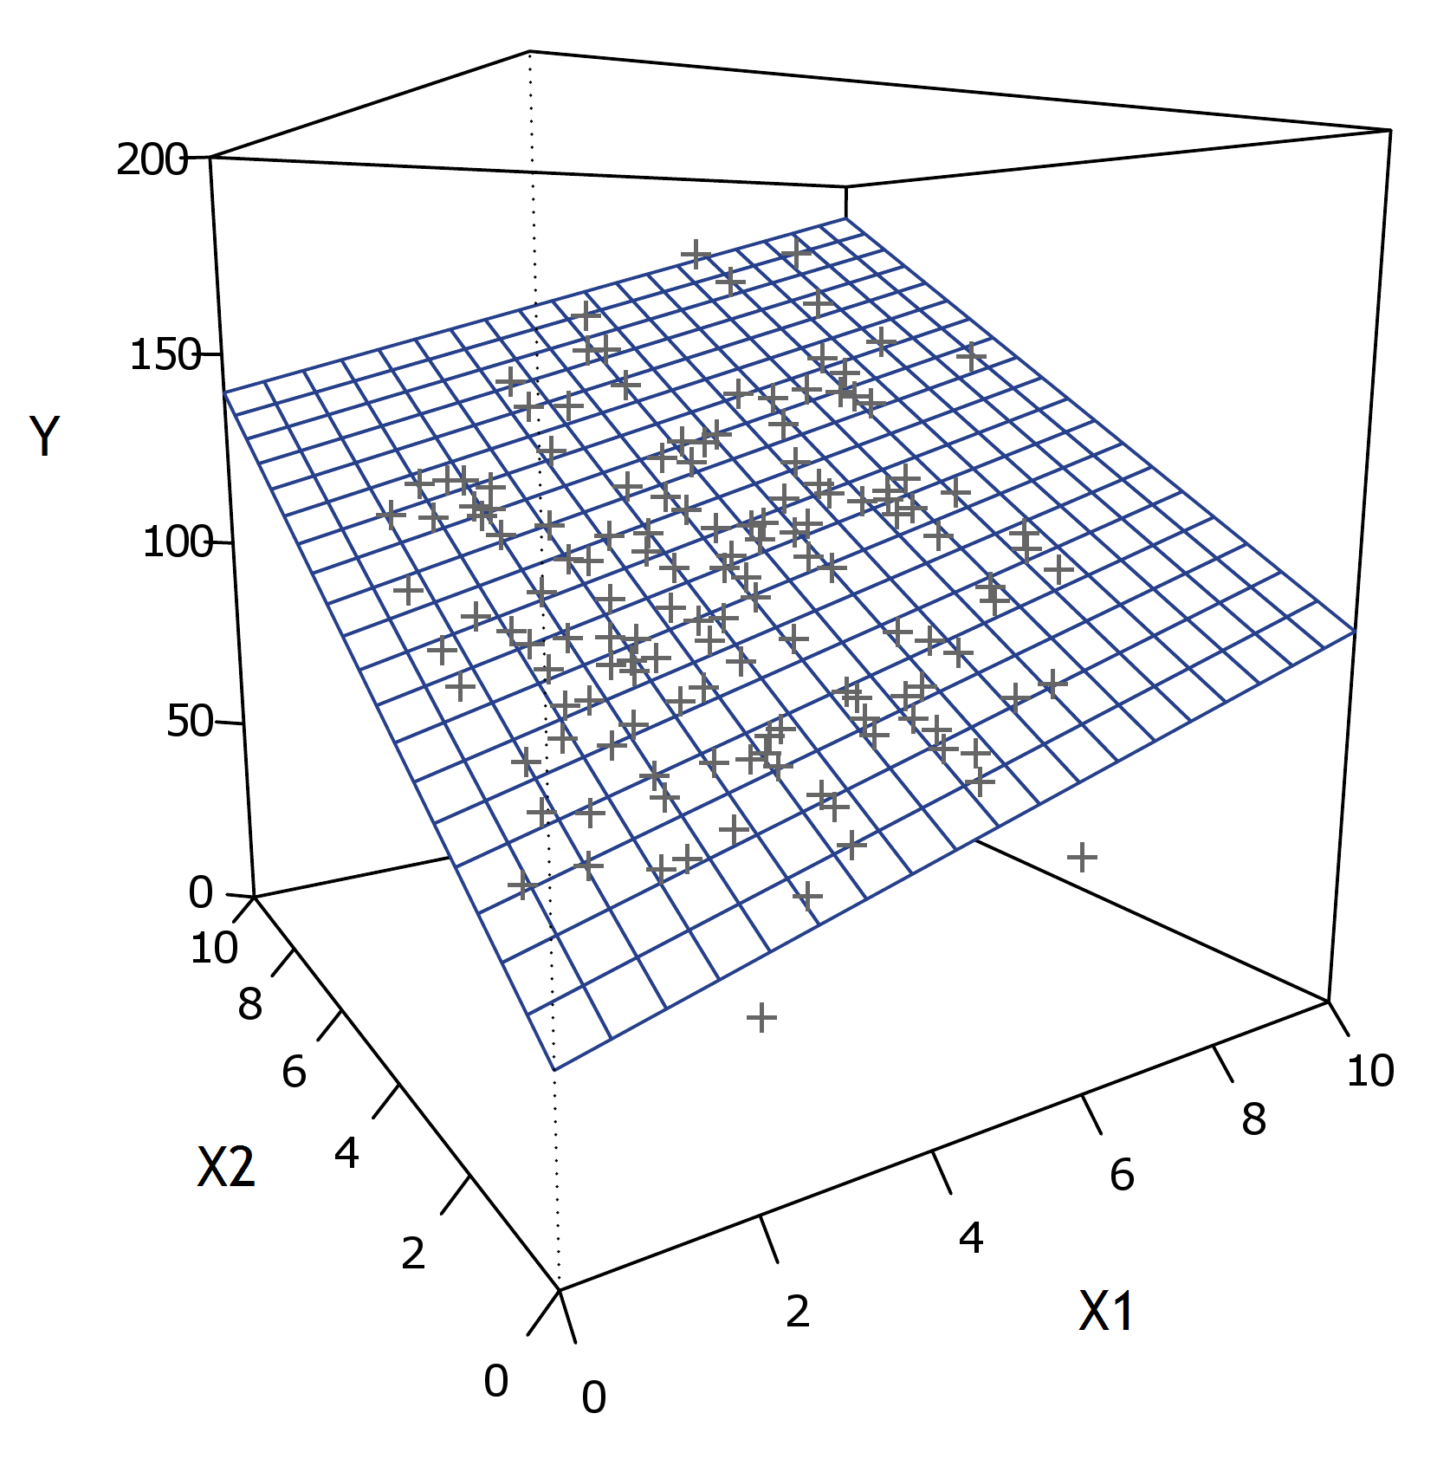
Multiple linear regression
β₂
β₁
β₀
Y_{i} = β₀ + β₁X_{i1} + … + β_{p}X_{ip} + ε_{i}

Slide 14
Multiple linear regression – Special cases
Analysis name | Dependent / response | Independent / predictor
One-way regression | 1 continuous | 1 continuous
Multiple regression | 1 continuous | >1 continuous
Independent samples t-test | 1 continuous | 1 categorical (2 levels)
One-way ANOVA | 1 continuous | 1 categorical (>2 levels)
Multi-way ANOVA | 1 continuous | >1 categorical
ANCOVA | 1 continuous | >1 continuous and categorical
Pearson correlation | 1 standardized continuous | 1 standardized continuous
One-sample t-test | 1 continuous | Intercept only
Paired t-test | 1 continuous difference score | Intercept only
Hotelling's T-test | >1 continuous | 1 categorical (2 levels)
MANOVA | >1 continuous | 1 categorical (>2 levels)
Multivariate multiple regression | >1 continuous | >1 continuous and categorical

Slide 15
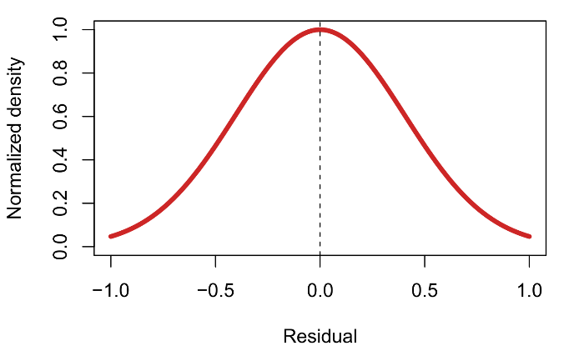
Assumptions in linear regression
Normal distribution
Y_{i} = β₀ + β₁X_{i} + ε_{i}
ε_{i} ~ N(0,σ²)
cor(ε_{i},ε_{j}) = 0
Residuals are assumed to be:
  Normally distributed
  Independent
  With constant variance σ²
  = Gauss-Markov assumptions

Slide 16

H₀
Example of a regression model
H₀
H₀
What predicts the degree of belief in Santa Claus (-4 to 4) in a sample of 300 children?
Researchers collected data on the degree of belief, and on the demographical characteristics of each child. The following regression model was fitted in R, yielding this output:
lm(Belief ~ Age + Gender + Siblings + Rank + Easter_bunny)
Coefficients:
Estimate Std. Error t value Pr(>|t|)
(Intercept) 5.487031 0.312914 17.535 < 2e-16 ***
Age -0.769430 0.029532 -26.054 < 2e-16 ***
Gendergirl 0.022870 0.145955 0.157 0.876
Siblings 0.002239 0.073478 0.030 0.976
Rank 0.069784 0.130941 0.533 0.594
Easter_bunny 0.152862 0.030902 4.947 1.27e-06 ***
---
Signif. codes: 0 ‘***’ 0.001 ‘**’ 0.01 ‘*’ 0.05 ‘.’ 0.1 ‘ ’ 1
Residual standard error: 1.253 on 294 degrees of freedom
Multiple R-squared: 0.7667, Adjusted R-squared: 0.7627
F-statistic: 193.2 on 5 and 294 DF, p-value: < 2.2e-16

Slide 17

H₀
Example of a regression model
H₀
H₀
What predicts the degree of belief in Santa Claus (-4 to 4) in a sample of 300 children?
Researchers collected data on the degree of belief, and on the demographical characteristics of each child. The following regression model was fitted in R, yielding this output:
lm(Belief ~ Age + Gender + Siblings + Rank + Easter_bunny)
Coefficients:
Estimate Std. Error t value Pr(>|t|)
(Intercept) 5.487031 0.312914 17.535 < 2e-16 ***
Age -0.769430 0.029532 -26.054 < 2e-16 ***
Gendergirl 0.022870 0.145955 0.157 0.876
Siblings 0.002239 0.073478 0.030 0.976
Rank 0.069784 0.130941 0.533 0.594
Easter_bunny 0.152862 0.030902 4.947 1.27e-06 ***
---
Signif. codes: 0 ‘***’ 0.001 ‘**’ 0.01 ‘*’ 0.05 ‘.’ 0.1 ‘ ’ 1
Residual standard error: 1.253 on 294 degrees of freedom
Multiple R-squared: 0.7667, Adjusted R-squared: 0.7627
F-statistic: 193.2 on 5 and 294 DF, p-value: < 2.2e-16
RMSE = $\sqrt{MSE}$

Slide 18
Gauss-Markov assumptions in matrix notation
Covariance matrix of residuals ε_{i} through ε_{N} matrix. Gauss-Markov assumptions: Constant variance (σ² = MSE) across residuals, and no correlation between pairs of residuals.
ε | 1 | 2 | 3 | 4 | 5 | 6 | 7 | 8 | 9 | ... | N
1 | σ² | 0 | 0 | 0 | 0 | 0 | 0 | 0 | 0 | ... | 0
2 | 0 | σ² | 0 | 0 | 0 | 0 | 0 | 0 | 0 | ... | 0
3 | 0 | 0 | σ² | 0 | 0 | 0 | 0 | 0 | 0 | ... | 0
4 | 0 | 0 | 0 | σ² | 0 | 0 | 0 | 0 | 0 | ... | 0
5 | 0 | 0 | 0 | 0 | σ² | 0 | 0 | 0 | 0 | ... | 0
6 | 0 | 0 | 0 | 0 | 0 | σ² | 0 | 0 | 0 | ... | 0
7 | 0 | 0 | 0 | 0 | 0 | 0 | σ² | 0 | 0 | ... | 0
8 | 0 | 0 | 0 | 0 | 0 | 0 | 0 | σ² | 0 | ... | 0
9 | 0 | 0 | 0 | 0 | 0 | 0 | 0 | 0 | σ² | ... | 0
... | ... | ... | ... | ... | ... | ... | ... | ... | ... |  | 0
N | 0 | 0 | 0 | 0 | 0 | 0 | 0 | 0 | 0 | 0 | σ²
ε_{i} ~ N(0,σ²)
cor(ε_{i},ε_{j}) = 0

Slide 19
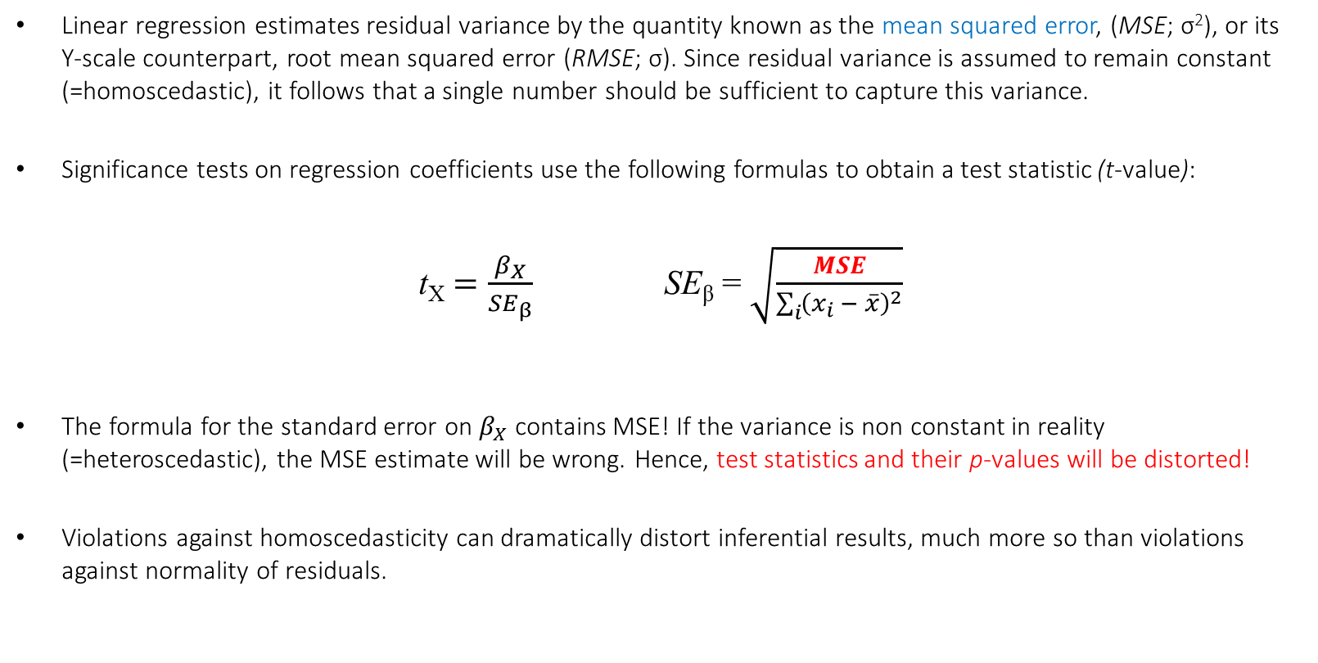
Impact of assumptions on inference
Linear regression estimates residual variance by the quantity known as the mean squared error, (MSE; σ²), or its Y-scale counterpart, root mean squared error (RMSE; σ). Since residual variance is assumed to remain constant (=homoscedastic), it follows that a single number should be sufficient to capture this variance.
Significance tests on regression coefficients use the following formulas to obtain a test statistic (t-value):
t_{X} $=\frac{β_{X}}{{SE}_{β}}$ SE_{β} = $\sqrt{\frac{MSE}{\sum_{i}{{\left(x_{i} − \overline{x}\right)}^{2}}}}$
The formula for the standard error on $β_{X}$ contains MSE! If the variance is non constant in reality (=heteroscedastic), the MSE estimate will be wrong. Hence, test statistics and their p-values will be distorted!
Violations against homoscedasticity can dramatically distort inferential results, much more so than violations against normality of residuals.

Slide 20

H₀
Impact of assumptions on inference
H₀
H₀
lm(Belief ~ Age + Gender + Siblings + Rank + Easter_bunny)
Coefficients:
Estimate Std. Error t value Pr(>|t|)
(Intercept) 5.487031 0.312914 17.535 < 2e-16 ***
Age -0.769430 0.029532 -26.054 < 2e-16 ***
Gendergirl 0.022870 0.145955 0.157 0.876
Siblings 0.002239 0.073478 0.030 0.976
Rank 0.069784 0.130941 0.533 0.594
Easter_bunny 0.152862 0.030902 4.947 1.27e-06 ***
---
Signif. codes: 0 ‘***’ 0.001 ‘**’ 0.01 ‘*’ 0.05 ‘.’ 0.1 ‘ ’ 1
Residual standard error: 1.253 on 294 degrees of freedom
Multiple R-squared: 0.7667, Adjusted R-squared: 0.7627
F-statistic: 193.2 on 5 and 294 DF, p-value: < 2.2e-16
RMSE = $\sqrt{MSE}$

Slide 21
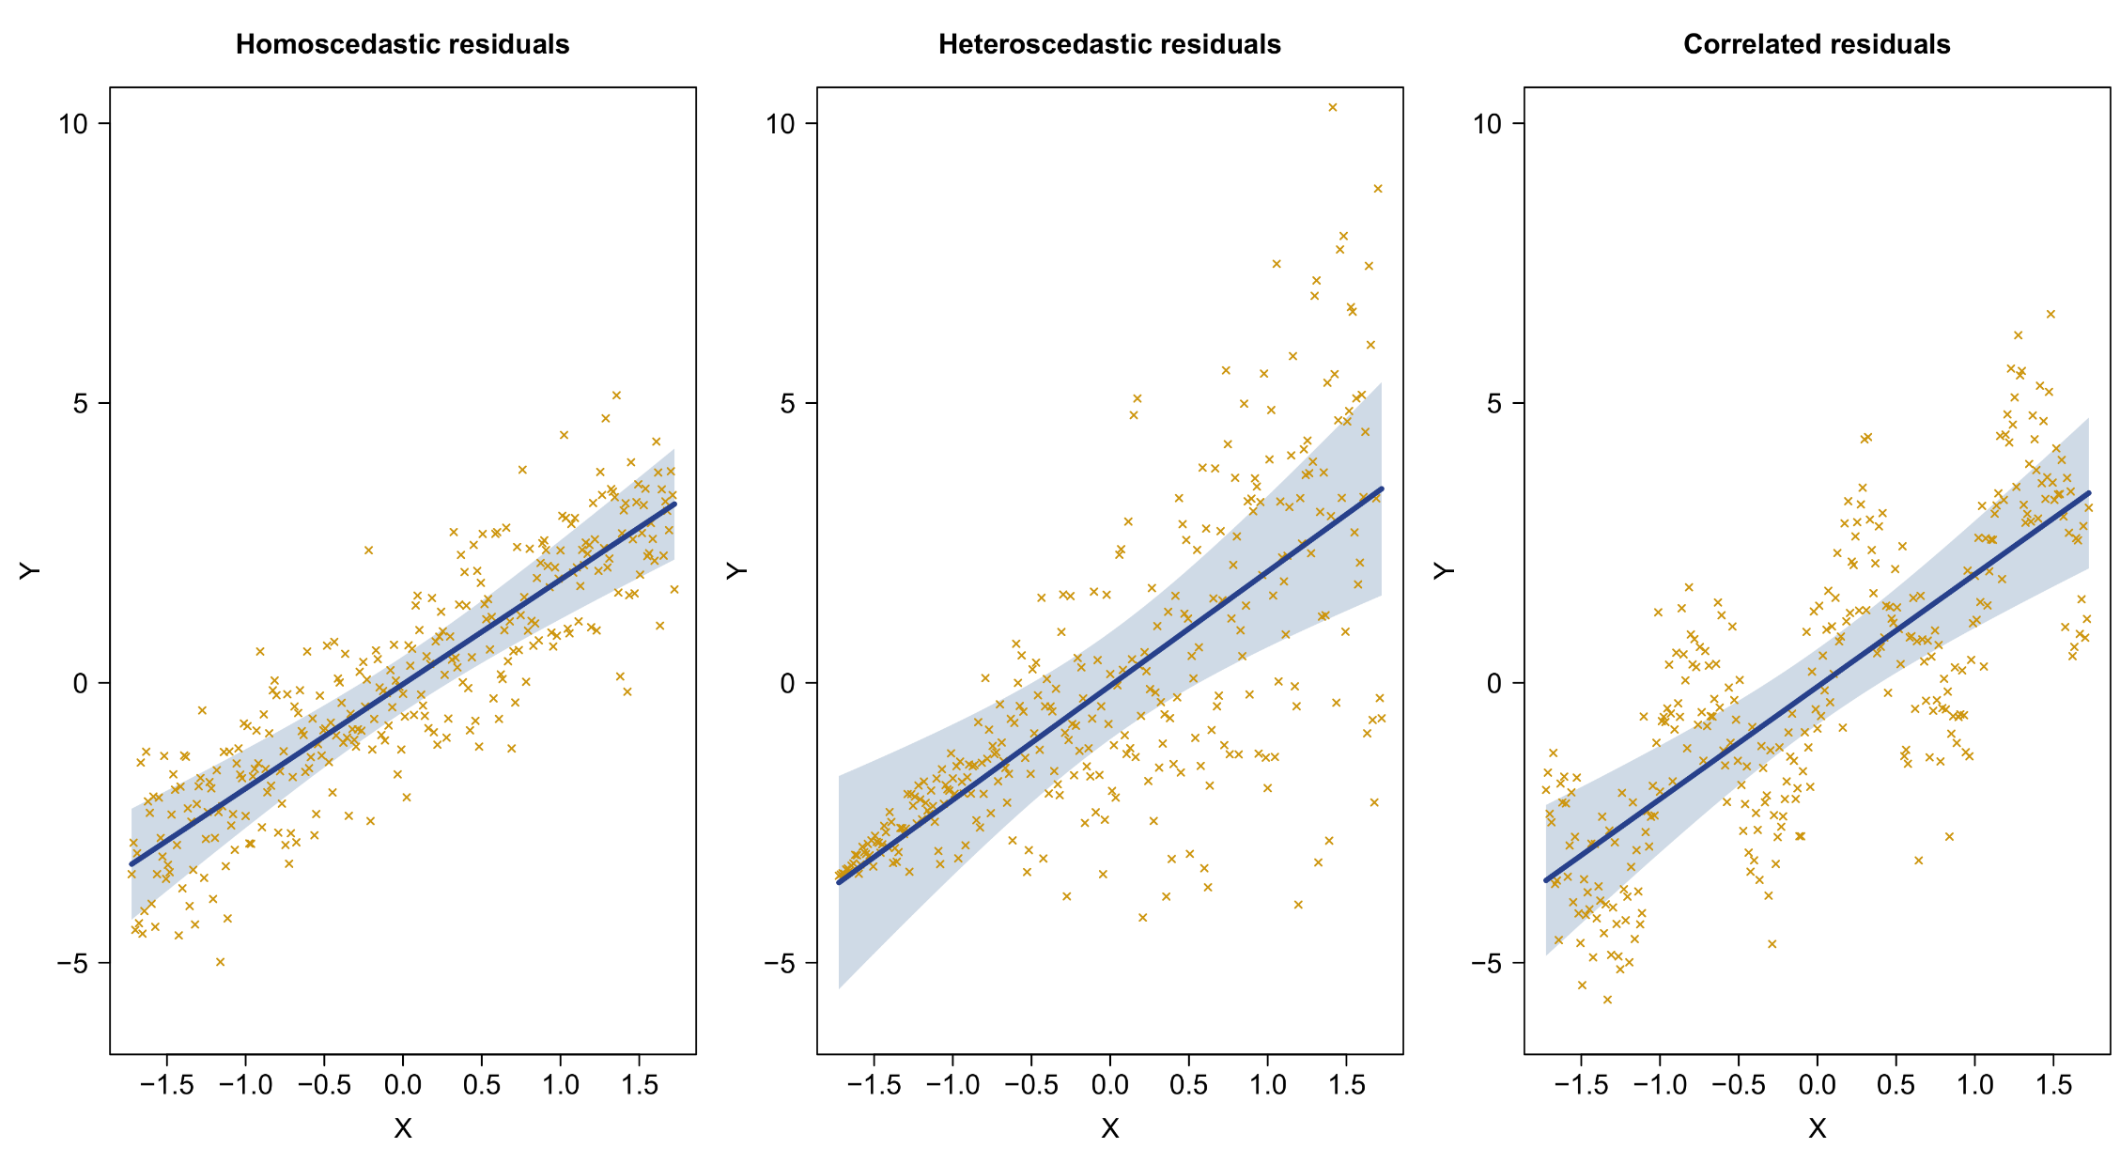
Violations of covariance assumptions

Slide 22
1. Traditional repeated measures models
B. Non-independent data

Slide 23
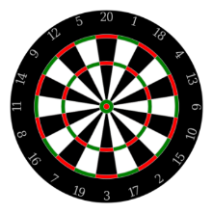
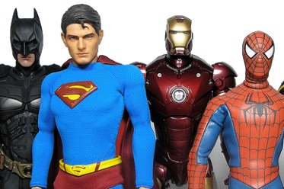

Non-independent data
In general, violation of variance-covariance assumptions in regression is because observations are not independent.
Non-independence is often a consequence of naturally clustered data, which can happen by design or by accident:
  Repeated measurements taken from the same subject
  Multiple subjects measured in the same family / region / country
  Measurements taken at consecutive time points (i.e., temporal correlation)
  Measurements taken in adjacent regions (i.e., spatial correlation)
  Combinations of all of the above… (e.g., fMRI data)
Example: 20 super heroes play darts. Each hero gets 3 throws (N=60 total). Could we fit a standard regression model that tests if average points differ between the three throws (e.g., is the last throw the best one)?
Obs. | Subject | Throw | Points
1 | Batman | T1 | 60
2 | Batman | T2 | 40
3 | Batman | T3 | 50
4 | Hulk | T1 | 1
5 | Hulk | T2 | 10
6 | Hulk | T3 | 25
7 | Spider-Man | T1 | 50
8 | Spider-Man | T2 | 15
9 | Spider-Man | T3 | 11
... | ... | ... | ...
60 | Iron Man | T3 | 19
Y_{i} = β₀ + β₁T2_{i} + β₂T3_{i} + ε_{i} ...?

Slide 24
Super heroes play darts – Covariance of residuals
The covariance matrix of residuals ε_{i} imposed by the Gauss-Markov assumptions is not tenable for these data:
ε | 1 | 2 | 3 | 4 | 5 | 6 | 7 | 8 | 9 | ... | N
1 | σ² | 0 | 0 | 0 | 0 | 0 | 0 | 0 | 0 | ... | 0
2 | 0 | σ² | 0 | 0 | 0 | 0 | 0 | 0 | 0 | ... | 0
3 | 0 | 0 | σ² | 0 | 0 | 0 | 0 | 0 | 0 | ... | 0
4 | 0 | 0 | 0 | σ² | 0 | 0 | 0 | 0 | 0 | ... | 0
5 | 0 | 0 | 0 | 0 | σ² | 0 | 0 | 0 | 0 | ... | 0
6 | 0 | 0 | 0 | 0 | 0 | σ² | 0 | 0 | 0 | ... | 0
7 | 0 | 0 | 0 | 0 | 0 | 0 | σ² | 0 | 0 | ... | 0
8 | 0 | 0 | 0 | 0 | 0 | 0 | 0 | σ² | 0 | ... | 0
9 | 0 | 0 | 0 | 0 | 0 | 0 | 0 | 0 | σ² | ... | 0
... | ... | ... | ... | ... | ... | ... | ... | ... | ... |  | 0
N | 0 | 0 | 0 | 0 | 0 | 0 | 0 | 0 | 0 | 0 | σ²

Slide 25
Super heroes play darts – Covariance of residuals
Every three observations belong to the same subject. Good players probably throw well every time, and bad players badly every time. Hence, those three throws are probably correlated within subjects:
ε | 1 | 2 | 3 | 4 | 5 | 6 | 7 | 8 | 9 | ... | N
1 | σ² | ? | ? | 0 | 0 | 0 | 0 | 0 | 0 | ... | 0
2 | ? | σ² | ? | 0 | 0 | 0 | 0 | 0 | 0 | ... | 0
3 | ? | ? | σ² | 0 | 0 | 0 | 0 | 0 | 0 | ... | 0
4 | 0 | 0 | 0 | σ² | ? | ? | 0 | 0 | 0 | ... | 0
5 | 0 | 0 | 0 | ? | σ² | ? | 0 | 0 | 0 | ... | 0
6 | 0 | 0 | 0 | ? | ? | σ² | 0 | 0 | 0 | ... | 0
7 | 0 | 0 | 0 | 0 | 0 | 0 | σ² | ? | ? | ... | 0
8 | 0 | 0 | 0 | 0 | 0 | 0 | ? | σ² | ? | ... | 0
9 | 0 | 0 | 0 | 0 | 0 | 0 | ? | ? | σ² | ... | ?
... | ... | ... | ... | ... | ... | ... | ... | ... | ... |  | ?
N | 0 | 0 | 0 | 0 | 0 | 0 | 0 | 0 | ? | ? | σ²

Slide 26
Repeated measures covariance
For repeated measures designs in psychology, the covariance matrix of the repeated measurements is often called the within-subjects covariance. This covariance matrix is a bit easier to grasp when we transform our repeated data set into the more familiar “wide format”:
Obs. | Subject | Throw | Points
1 | Batman | T1 | 60
2 | Batman | T2 | 40
3 | Batman | T3 | 50
4 | Hulk | T1 | 1
5 | Hulk | T2 | 10
6 | Hulk | T3 | 25
7 | Spider-Man | T1 | 50
8 | Spider-Man | T2 | 15
9 | Spider-Man | T3 | 11
... | ... | ... | ...
60 | Iron Man | T3 | 19
Obs. | Subject | T1 | T2 | T3
1 | Batman | 60 | 40 | 50
2 | The Hulk | 1 | 10 | 25
3 | Spider-Man | 50 | 15 | 11
... | ... | ... | ...
20 | Iron Man | 5 | 12 | 19
 | T1 | T2 | T3
T1 | σ₁² | σ₁₂ | σ₁₃
T2 | σ₁₂ | σ₂² | σ₂₃
T3 | σ₁₃ | σ₂₃ | σ₃²
Wide format data
Within-subjects covariance
3 variances
3 covariances
Long format data

Slide 27
Long and wide-format data
Long format data:
  Each row of the data matrix corresponds to only one repeated measurement for one subject of the dependent variable
  One column corresponds to all measurements of the dependent
  The independent variable is listed explicitly as a leveled factor
  Format is analogous to that for univariate regression
Wide format data:
  Each row of the data matrix corresponds to all repeated measurements for one subject of the dependent variable
  Multiple columns correspond to the repeated measurements of the dependent
  The independent variable is not listed explicitly
  Format is analogous to that for multivariate regression
Wide format data are the default format for conducting repeated measures (M)ANOVA in SPSS and Statistica, and some procedures in R.* As part of the analysis the user must manually specify the within-subjects design matrix.
*Wide format is required for Anova{car}. Long format is required for aov{base} and ezANOVA{ez}

Slide 28

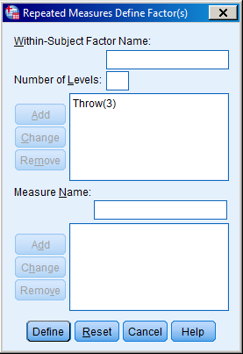
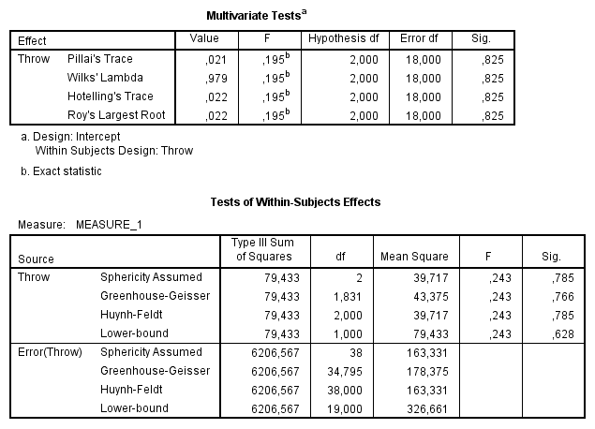
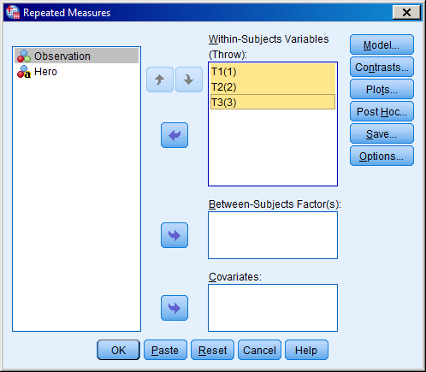
Repeated measures (M)ANOVA in SPSS
rm-MANOVA
rm-ANOVA
Specifying the within-variable in SPSS.
ANOVA output

Slide 29
Repeated measures (M)ANOVA in R
In R, repeated measures (M)ANOVA follows the same procedure as SPSS but with manual design coding:
within.design <- data.frame(Throw=as.factor(c("T1","T2","T3")))
model <- lm(cbind(T1,T2,T3)~1,data=darts.wide)
Where within.design specifies a factorial design as a data frame, and model creates a multivariate regression model with the three throws as DVs, and an intercept as IV. This makes the underlying regression explicit! Next, using the car library, we run the Anova function on our model object:
library(car)
result <- Anova(model,type=2,test="Wilks", idesign=~Throw,idata=within.design)
result
Where type specifies the type of ANOVA (2 or 3), test specifies the multivariate test statistic from which the final F-statistic is derived (default is Wilks' lambda), and the within design is specified with a formula (~Throw) that references the design matrix object we created earlier (within.design object).

Slide 30
Repeated measures (M)ANOVA in R
The result returns repeated measures MANOVA output
To see test results for a univariate repeated measures ANOVA, we must run the summary function on our result object:
Type II Repeated Measures MANOVA Tests: Wilks test statistic
Df test stat approx F num Df den Df Pr(>F)
(Intercept) 1 0.29845 44.662 1 19 2.171e-06 ***
Throw 1 0.97879 0.195 2 18 0.8245
---
Signif. codes: 0 ‘***’ 0.001 ‘**’ 0.01 ‘*’ 0.05 ‘.’ 0.1 ‘ ’ 1
Univariate Type II Repeated-Measures ANOVA Assuming Sphericity
Sum Sq num Df Error SS den Df F value Pr(>F)
(Intercept) 32620 1 13877.0 19 44.6625 2.171e-06 ***
Throw 79 2 6206.6 38 0.2432 0.7854
---
Signif. codes: 0 ‘***’ 0.001 ‘**’ 0.01 ‘*’ 0.05 ‘.’ 0.1 ‘ ’ 1

Slide 31
Repeated measures (M)ANOVA in R
The overall test on throw is not significant. Normally, we would not conduct follow-up tests. If we did wish to run these, we could either run separate paired t-tests directly with the t.test(...,paired=TRUE) function, or use a package to automate calculation of pairwise contrasts, e.g., with emmeans:
reference <- ref_grid(model, mult.names="Throw")
pairs(reference, adjust="none")
We will return to the purpose of the emmeans functions (ref_grid, pairs) at a later point…
contrast estimate SE df t.ratio p.value
1 Points.T1 - 1 Points.T2 -2.70 4.61 19 -0.586 0.5650
1 Points.T1 - 1 Points.T3 -0.65 3.79 19 -0.171 0.8658
1 Points.T2 - 1 Points.T3 2.05 3.65 19 0.561 0.5813
---
Signif. codes: 0 ‘***’ 0.001 ‘**’ 0.01 ‘*’ 0.05 ‘.’ 0.1 ‘ ’ 1

Slide 32
Repeated measures (M)ANOVA as a marginal model
Modelling the covariance matrix of repeated measures is the central challenge for any repeated measures analysis. Repeated measures (M)ANOVA is often considered the classic approach (in social sciences) to achieve this.
rm-(M)ANOVA is often called a marginal approach to the modelling of repeated measures, which is contrasted to the hierarchical approach represented by multilvel regression:
  Marginal approach: Explicitly models the repeated measures covariance by
  specifying a parametric structure for it (e.g., sphericity, unstructured, autoregressive).
  Hierarchical approach: Implicitly models the repeated measures covariance,
  by the introduction of random effects (e.g., random intercepts, random slopes).
rm-ANOVA and rm-MANOVA crucially differ with regard to the parametric structure they impose on the repeated measures covariance. The former is most widely known…
 | T1 | T2 | T3
T1 | σ₁² | σ₁₂ | σ₁₃
T2 | σ₁₂ | σ₂² | σ₂₃
T3 | σ₁₃ | σ₂₃ | σ₃²
Which model? How many parameters…?

Slide 33
Repeated measures (M)ANOVA
rm-ANOVA
rm-MANOVA
σ² | σ₁ | σ₁
σ₁ | σ² | σ₁
σ₁ | σ₁ | σ²
σ₁² | σ₁₂ | σ₁₃
σ₁₂ | σ₂² | σ₂₃
σ₁₃ | σ₂₃ | σ₃²
Sphericity / Compound symmetry
2 parameters
Unstructured
sum(K:1) parameters
Variances constrained to be equal
Covariances constrained to be equal
Very sparse (2 parameters no matter the design)
More powerful inferential tests if it holds
Needs to be validated with a test (Mauchly)
Mauchly's test is fatally flawed
Underparametrized for many covariance matrices
No constraints on individual variances and covariances (≈ sample variance-covariance estimates)
Never incorrect
Parameter number increases exponentially with design
Overparametrized for many covariance matrices
Weakens power of statistical tests

Slide 34
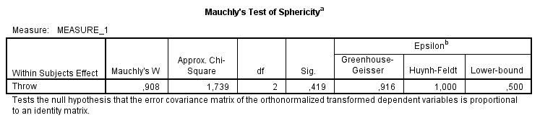
Mauchly’s test of sphericity
Mauchly’s test of sphericity tests whether the within-subject covariance matrix departs significantly from a sphericity structure. Sphericity is the null-hypothesis, hence we want this test to be non-significant.
The degree of departure from sphericity is measured by epsilon.
The closer epsilon to its lower bound, the more severe the
departure from sphericity.
Two corrections for violation of sphericity are available, Huyn-Feldt
and Greenhouse-Geisser, although GG is most popular. These
correctes shrink the degrees of freedom for inferential tests. The lower
epsilon, the close the DF will approach the DF of rm-MANOVA!
Mauchly Tests for Sphericity
Test statistic p-value
Throw 0.90789 0.41908
Greenhouse-Geisser and Huynh-Feldt
Corrections for Departure from Sphericity
GG eps Pr(>F[GG])
Throw 0.91566 0.7663
HF eps Pr(>F[HF])
Throw 1.008416 0.7853512

Slide 35
Covariance model problem
Accepting sphericity is practically complicated due to the fact that Mauchly’s test is fatally flawed in many settings: small samples, large samples, weak departures from normality (Keselman, Rogan, Mendoza & Breen, 1980). It should probably be rejected by default.*
As a rule, one should never report an uncorrected rm-ANOVA, since that model will greatly overestimate the DFs for significance tests. The solution seems to use either rm-MANOVA, or apply a correction to the DFs.
The rm-MANOVA imposes no constraints on covariance parameters but for that reason (a) yields very conservative DFs for significance tests, (b) requires larger samples for reliability, and (c) tends to be overparametrized for many repeated measures data. It assumes a complete departure from sphericity, which is rarely expected to be true.
It seems that we are stuck with two undesirable alternatives between repeated measures ANOVA and MANOVA. Is anything else available…?
* For within-subjects factors with only 2 levels, sphericity holds by definition! Repeated measures ANOVA and MANOVA will return identical results for these effects.

Slide 36
Other covariance model alternatives?
Standard linear regression
Rm-ANOVA
Random intercept LMM
σ² | 0 | 0
0 | σ² | 0
0 | 0 | σ²
σ² | σ₁ | σ₁
σ₁ | σ² | σ₁
σ₁ | σ₁ | σ²
ρσ² | ρ | ρ²
ρ | ρσ² | ρ
ρ² | ρ | ρσ²
Independence
1 parameter
Compound symmetry / sphericity
2 parameters
First-order auto-regressive
2 parameters
Rm-MANOVA
σ² | σ₁ | σ₂
σ₁ | σ² | σ₁
σ₂ | σ₁ | σ²
λ₁² + d₁ | λ₁λ₂ | λ₁λ₃
λ₁λ₂ | λ₂² + d₂ | λ₂λ₃
λ₁λ₃ | λ₂λ₃ | λ₃²+ d₃
σ₁² | σ₁₂ | σ₁₃
σ₁₂ | σ₂² | σ₂₃
σ₁₃ | σ₂₃ | σ₃²
Banded
K parameters
Factor-analytic
K*d parameters
Unstructured
sum(K:1) parameters

Slide 37
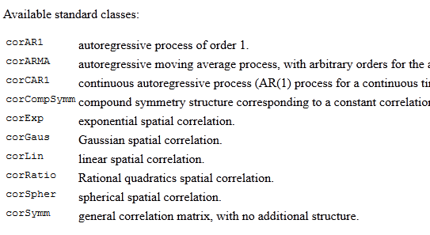
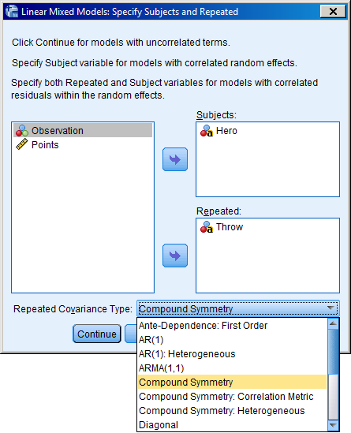
Other covariance model alternatives?
A large number of structures is available for the repeated measures covariance. Some are tailored to specific data types (e.g., time series, spatial data).
Major software packages have options for specifying the structure directly (SPSS, SAS, R) and for comparing their goodness-of-fit (e.g., by AIC or BIC).
Some software (SAS) even allow complete freedom in which covariance parameters to constrain and which ones not!
Identifying an optimal the structure directly would provide insight into why our repeated measurements are correlated.
This seems attractive but is all this modelling it worth the trouble…?
nlme package in R
Linear mixed models in SPSS

Slide 38


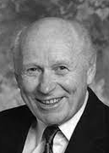
The magic wand solution
In practice, choosing the right model for a repeated measures covariance structure can be a statistical rabbit hole. There may be no “best” choice, and once we try some structures, why not all of them?
For these reasons, one may be inclined to return to the original dilemma, and choose either rm-MANOVA results, or a corrected rm-ANOVA (e.g., Greenhouse-Geisser correction).
In fact, the GG-correction is quite appealing, since it corrects the ANOVA only to the degree of sphericity violation (by epsilon), and adjusts DFs accordingly. This blind applicability makes it something of a magic wand solution for a misspecified covariance structure…

Slide 39
1. Traditional repeated measures models
C. Challenges to classic approaches

Slide 40
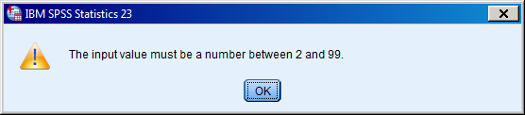
Problem case 1: More repeats than subjects
40 subjects participate in an EEG experiment. They view pleasant and unpleasant pictures (valence factor), 50 of each. EEG recordings are isolated to 2000 milliseconds after stimulus onset: 2000 recorded time points (1000 Hz sampling).
Average time series are calculated across trials, per subject per valence, yielding a wide format data matrix with 40 rows and 2 × 2000 columns.
The design for rm-(M)ANOVA suggests a valence (2) × time (2000) analysis. Some software (SPSS) does not even accept this many columns for an analysis…

Slide 41
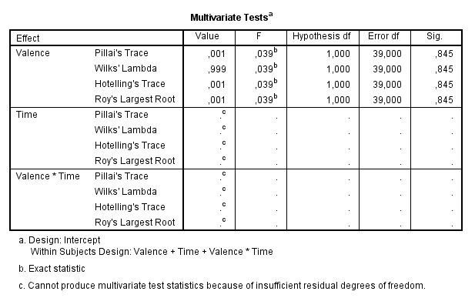
Problem case 1: More repeats than subjects
Even if we did manage to run this, we would encounter the following issues:
  No multivariate tests for effects where the number of levels > N
  No results for Mauchly’s test of sphericity
  SPSS does print rm-ANOVA output, but R returns nothing at all*
The underlying problem is that an unstructured correlation matrix from data where P > N will be rank-deficient.
A rank-deficient matrix has no inverse and may have complex or negative eigenvalues. This is a problem for multivariate tests rely on these values…
*In R this will still work with the aov{base} approach, but not with Anova{car}

Slide 42
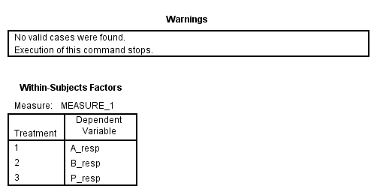
Problem case 2: Partial within-designs
30 subjects participate in a clinical trial study, contrasting a new drug (A), to an existing drug (B) and to a placebo treatment (P). Each subject participates in two sessions, one placebo and one drug (A or B) session, in random order. Effects of the treatment are measured on a physiological response (e.g., blood pressure). Researchers run an rm-ANOVA with drug condition as a within-factor:
Subject | Order | A_resp | B_resp | P_resp
ID02 | 0 | 1.01 | ? | 0.82
ID10 | 1 | 0.99 | ? | 0.76
ID04 | 0 | ? | 1.23 | 0.91
ID27 | 0 | 0.86 | ? | 0.83
… | … | … | … | …
ID74 | 1 | ? | 1.15 | 0.77
Most software conducts a complete case analysis for repeated measures analyses. Each subject with at least one missing value will be deleted from the analysis model. For partial-within designs, this means everyone will end up deleted!

Slide 43
Problem case 3: Continuous within-variables
100 patients are tracked for 1 year following lung surgery. Each patient has 12 visits scheduled for follow-up. Respiratory capacity is measured upon visit.
Researchers attempt to schedule visits evenly throughout the year but this is not always possible. Moreover, not all patients visit the hospital on the same day, and some patients miss appointments (or drop out of the study completely). Patients have no respiratory data for the days that other patients visited. Again, we deal with systematic missingness:
 | Day of visit
Patient | 2 | 6 | 12 | 14 | 41 | 44 | 47 | 49 | 67 | 68 | 72 | 80 | … | 366
AH | ? | ? | 0.12 | ? | ? | ? | ? | 0.14 | ? | ? | ? | 0.09 | … | ?
BM | ? | ? | ? | 0.05 | ? | 0.09 | ? | ? | 0.04 | ? | ? | ? | … | ?
KG | 0.13 | ? | ? | ? | ? | ? | 0.21 | ? | ? | ? | 0.20 | ? | … | ?
VS | ? | 0.01 | ? | ? | 0.10 | ? | ? | ? | ? | 0.11 | ? | ? | … | ?
… | … | … | … | … | … | … | … | … | … | … | … | … | … | …
EP | ? | ? | ? | ? | ? | ? | ? | ? | ? | ? | ? | ? | … | 0.02

Slide 44
Problem case 3: Continuous within-variables
We could ignore the exact day of the visits and simply focus on their order. This is still not satisfying, since there will still be missing values due to missed appointments and drop-out. Once again, complete-case-analysis would remove these subjects from the analysis altogether.
A more fundamental problem here is that the wide-format represents time as a categorical variable…
 | Visit number
Patient | 1 | 2 | 3 | 4 | 5 | 6 | 7 | 8 | 9 | 10 | 11 | 12
AH | 0.12 | 0.14 | 0.09 | 0.10 | 0.11 | 0.11 | 0.19 | 0.20 | 0.18 | 0.22 | 0.15 | 0.12
BM | 0.05 | 0.09 | 0.04 | 0.04 | ? | 0.01 | 0.06 | 0.10 | 0.09 | ? | 0.11 | 0.10
KG | 0.13 | 0.21 | 0.20 | 0.25 | 0.28 | ? | ? | ? | ? | ? | ? | ?
VS | 0.01 | 0.07 | 0.08 | 0.14 | 0.18 | 0.26 | 0.23 | 0.23 | 0.27 | 0.28 | 0.28 | 0.31
… | … | … | … | … | … | … | … | … | … | … | … | …
EP | ? | 0.01 | 0.10 | 0.04 | 0.11 | 0.07 | 0.08 | 0.11 | 0.11 | 0.11 | 0.19 | 0.20

Slide 45
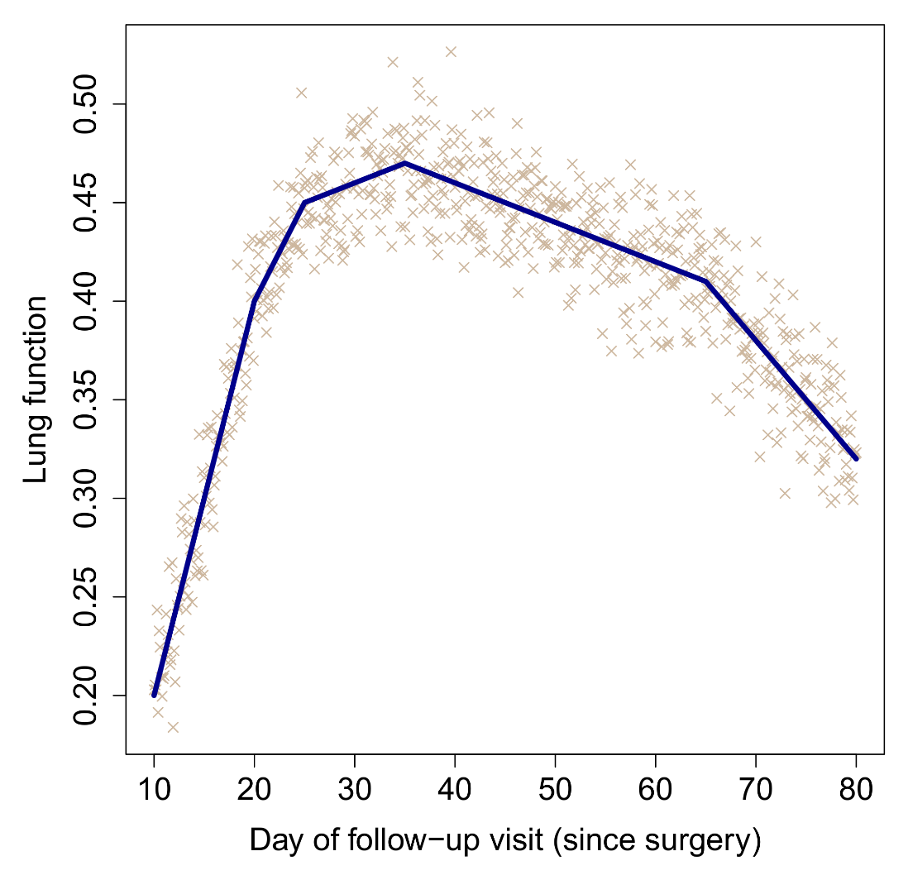
Problem case 3: Continuous within-variables
Wide-format data treats within-subjects variables as categorical, with columns corresponding to qualitative levels of the within-subjects variable. Implicitly, it is often assumed that levels are spaced equally apart.
For the lung example, even if all patients had their visits on exactly the same 12 days, rm-(M)ANOVA would test whether any pair of visits differs significantly in their mean observed response. This is clearly not of interest.
Time in this analysis should be treated as a continuous variable. Ideally, we would like to estimate a trend over time, e.g., a regression slope that captures the evolution of lung function after surgery. This is a classic problem of longitudinal data analysis.
Continuous within-subjects variables cannot be integrated into classic rm-(M)ANOVA. This model can only integrate continuous between-subjects variables (e.g., age, gender)!

Slide 46
Problem case 4: Paired correlations
40 high school students are trained to think about mathematical problems visually. Before and after training, they submit to a visual/spatial ability test and a numerical ability test. Researchers would like to find out whether the correlation between visual and numerical ability increases due to the training.
Student | Vis_Pre | Num_Pre | Vis_Post | Num_Post
ID1 | 64 | 59 | 67 | 60
ID2 | 78 | 57 | 80 | 63
ID3 | 53 | 45 | 54 | 53
ID4 | 66 | 66 | 68 | 69
ID5 | 64 | 70 | 62 | 70
… | … | … | … | …
ID40 | 83 | 91 | 86 | 92
No obvious way to compare cor^{T1}(vis,num) with cor^{T2}(vis,num) with rm-(M)ANOVA.
Paired correlation problem is a variation on the continuous within-variable problem. Both visual and numerical ability vary continuously within subjects. In long format:
Student | Time | Vis | Num
ID1 | Pre | 64 | 69
ID1 | Post | 67 | 60
ID2 | Pre | 78 | 57
ID2 | Post | 80 | 63
… | … | … | …
ID40 | Post | 86 | 92
cor^{T1}(vis,num)
cor^{T2}(vis,num)

Slide 47
Problem case 5: Trial-level data
50 university students perform a lexical decision task (decide whether a letter string is a word or not). Reaction times (RT) are measured. The interest is to know whether RTs are slower for longer words. Each subject performed 250 trials, corresponding to 125 words sampled randomly from a dictionary, alternated with 125 random letter strings.
Word-length varies on a trial-by-trial basis. Researchers would like to analyze the trial data directly, such that they can also control for adaptation effects over time, and potential carry-over effects from one trial to the next (e.g., faster RT when a word-trial follows another word-trial).
Data represent a combination of several challenges:
  Word-length is a continuous variable and varies within-subjects on each trial
  Some trials are missing because of deleted outliers, absent key-presses, etc.
  Not clear how trial-level data could be entered in an rm-(M)ANOVA. Should “trial number” be added as a 250-level within-subjects factor…? But there is no interest in doing pairwise comparisons between all pairs of trials!

Slide 48
Problem case 6: Complex non-independence
Researchers conduct a longitudinal study on life-satisfaction. In 20 countries, they track 300 families each, containing between 2 to 8 people each (thousands of subjects). Data have a complex levelled structure:
Country | Family | Subject | Time | Gender | Age | … | LS
Belgium | FBE_101 | SFBE101_02 | 02/03/1990 | M | 6.2 | … | 4.2
Belgium | FBE_101 | SFBE101_02 | 11/06/1990 | M | 6.5 | … | 3.0
Belgium | FBE_101 | SFBE101_02 | 12/10/1991 | M | 7.8 | … | 2.9
Belgium | FBE_101 | SFBE101_02 | 01/02/1992 | M | 8.1 | … | 3.1
Belgium | FBE_101 | SFBE101_02 | 22/07/1992 | M | 8.6 | … | 4.6
Iceland | FIS_009 | SFIS009_01 | 04/04/1994 | F | 25.1 | … | 0.3
Iceland | FIS_009 | SFIS009_01 | 15/06/1995 | F | 26.3 |  | 0.7
Iceland | FIS_009 | SFIS009_01 | 19/10/1998 | F | 29.8 |  | 0.5
… | … | … | … | … | … | … | …
Canada | FCA_078 | SFCA078_04 | 14/08/2001 | F | 32.4 | … | 4.5

Slide 49
Problem case 6: Complex non-independence
Multiple sources of non-independence simultaneously: time points < subjects < families < countries (4 levels!).
Hierarchical nesting of subjects within families and countries. These levels cannot be treated like a factorial design (e.g., a person cannot be observed in multiple families/countries). Moreover, there would not be an interest in conducting pairwise contrasts between pairs of subjects or pairs of families.
Independent variables that vary at different levels of the hierarchy: time-varying (e.g., age), subject-varying (e.g., gender), family-varying (e.g., socio-economic status), and country-varying (e.g., GDP). Many of these are continuous and not categorical.
Missing values due to non-overlapping measurement times (see problem case 3), dropout/attrition, and possibly partial-within designs if there is also some experimental/observational assignment to conditions.
Basically, these data represent some combination of all of the previous problem cases…

Slide 50

Solution to these problems?
MLM
All of these problems cannot be handled by traditional repeated measures
(M)ANOVA, or any marginal model for repeated measures:
  More within-subject conditions than subjects
  Partial within-designs
  Continuous within-variables
  Paired correlation problem
  Trial-level analyses
  Hierarchical/multilevel data structures
  Missing values for within-subject variables
  Unequally spaced levels for within-subject variables
If only there was an alternative model that could come to the rescue…

Slide 51
1. Traditional repeated measures models
D. More repeated measures (M)ANOVA

Slide 52
Repeated measures (M)ANOVA
The preceding slides did not give a detailed discussion of repeated measures (M)ANOVA. This topic could cover its own 3-hour workshop, and would reveal how profoundly “weird” this model this.
As an extension, I have added some slides that are not strictly part of the multilevel workshop but could be a useful reference for other repeated measures analyses later. This covers the following aspects:
  Difference between rm-MANOVA and classical MANOVA
  Doubly multivariate models
  Paired t-test as repeated measures (M)ANOVA
  3-level within-subjects factor
  Between-subjects covariates in rm-(M)ANOVA
  2×2×3 repeated measures MANOVA example

Slide 53
Repeated measures MANOVA versus MANOVA
Repeated measures MANOVA should not be confused with “classical” MANOVA. Both models use multivariate data (>1 DVs) but have different requirements and purposes:
Classical MANOVA: Test mean differences among K between-subjects groups for 2 or more DVs simultaneously.
  Presence of a between-subjects grouping factor required!
  DVs can be on incommensurate scales (e.g., shoe size, test performance, feeling intensity)
  No formal comparison between DVs is performed
  Always a multivariate omnibus test
Repeated measures MANOVA: Test mean differences between 2 or more DVs.
  Presence of between-subjects grouping factors is not required
  DVs must be on commensurate scales (e.g., test performance measured at T1, T2, T3)
  Different DVs are treated as categorical levels of a within-subjects factor
  Not always a multivariate omnibus test

Slide 54
Classical MANOVA
Soil samples were taken from nuclear sites near Chernobyl and Rostov, and decomposed chemically into various (radioactive) isotopes:
We could run 4 separate t-tests to check if the mean presence of each isotope differs between the Chernobyl and Rostov samples.
Classical MANOVA performs this test on all DVs simultaneously. It requires a between-subjects grouping variable, and more than one DV.*
If significant, it means that the groups differ in the mean value of at least one DV. Follow-up t-tests then need explore which DVs have different group means.
Sample | Source | Cs-137 | I-131 | C-12 | Zr-95
SAA | Chernobyl | 0.231 | 0.111 | 0.625 | 0.002
SDB | Chernobyl | 0.561 | 0.104 | 0.981 | 0.000
SDD | Rostov | 0.080 | 0.005 | 0.678 | 0.000
SHW | Rostov | 0.012 | 0.013 | 0.944 | 0.000
SGZ | Chernobyl | 0.249 | 0.207 | 0.876 | 0.009
… | … | … | … | … | …
SKJ | Rostov | 0.022 | 0.071 | 0.888 | 0.001
*For 2 groups, the test is known as Hotelling’s T-test.

Slide 55
Classical MANOVA
In R, the primary function for MANOVA is manova, which is applied to a fitted multivariate regression model:
set.seed(238)
radio <- data.frame(Sample=paste("S",1:50,sep=""),
Source=rep(c("Chernobyl","Rostov"),each=25),
Cs137=c(rnorm(25,0.6,0.01),rnorm(25,0.1,0.05)),
I131=c(rnorm(25,0.7,0.01),rnorm(25,0.15,0.05)),
C14=rnorm(50,0.9,0.01), Zr95=abs(rnorm(50,0,0.001)))
mult <- lm( cbind(Cs137,I131,C14,Zr95)~ Source, data=radio)
maov <- manova(mult)
summary(maov, test="Wilks", intercept=TRUE)
Df Wilks approx F num Df den Df Pr(>F)
(Intercept) 1 0.0001587 70893 4 45 < 2.2e-16 ***
Source 1 0.0070060 1595 4 45 < 2.2e-16 ***
Residuals 48
---
Signif. codes: 0 ‘***’ 0.001 ‘**’ 0.01 ‘*’ 0.05 ‘.’ 0.1 ‘ ’ 1

Slide 56
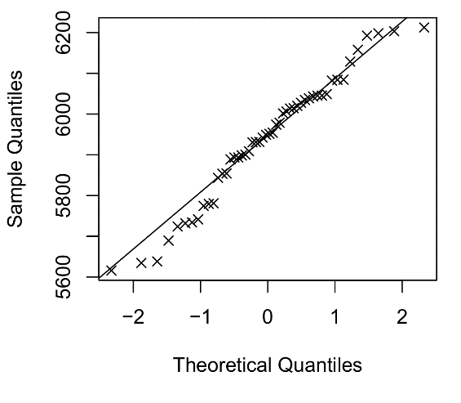
Classical MANOVA
Four test statistics are available for deriving a multivariate F-value: Wilks lambda, Pillai trace, Hotelling-Lawley trace, and Roy’s largest root. Wilks’ lambda is the most popular, although Pillai trace is the default in R and is more robust against violations of multivariate normality.
Classical MANOVA assumes that the DVs are multivariate normal distributed in each group, with equal covariance matrices. Multivariate normality can be checked by calculating the mahalanobis distances of the multivariate model’s residuals, and checking these distances against a normal distribution:
mah.dist <- mahalanobis(radio[,3:6],center=colMeans(residuals(mult)),
cov=cov(radio[,3:6]))
qqnorm(mah.dist) ; qqline(mah.dist)
Testing equality of K independent covariance matrices is done by Box’s M-test:
library(MVTests)
BoxM(radio[,3:6],group=radio$Source)
Box's M Test
Chi-Squared Value = 96.28002 , df = 10 and p-value: 3.02e-16

Slide 57
Repeated measures MANOVA versus MANOVA
Confusion arises with data where both rm-(M)ANOVA and classical MANOVA would be applicable. For example, an intervention study compare mindfulness training against language training on anxiety, with self-reported anxiety measured before and after the intervention (T1, T2):
  MANOVA: Test simultaneous group differences in mean
  anxiety for T1 and T2.
  RM-(M)ANOVA: Test whether group differences in mean
  anxiety differ between T1 and T2.
The latter represents the Group × Time interaction, and hence
is the correct test for checking if the intervention had an effect.
Significant group differences at T2 are not sufficient to
conclude that the intervention worked!
For both tests, the follow-up tests may be the same t-tests,
however!
Subject | Group | Anx_T1 | Anx_T2
ID56 | Language | 60 | 63
ID44 | Mindfulness | 76 | 51
ID41 | Language | 62 | 54
ID01 | Mindfulness | 58 | 39
ID09 | Mindfulness | 81 | 63
… | … | … | …
ID16 | Language | 44 | 38

Slide 58
Doubly multivariate models
To add even more confusion, it is possible for a model to contain within-subjects factors and multiple DVs, which is a type of analysis known as “doubly multivariate”. For example, in the preceding example, researchers may have measured stress levels with cortisol at T1 and T1, in addition to self-reported anxiety:
SPSS allows such models by making an explicit distinction between within-subjects factors and multiple “measures”. The resulting tests may be very complicated to interpret, however!
Subject | Group | Anx_T1 | Anx_T2 | Cort_T1 | Cort_T2
ID56 | Language | 60 | 63 | 0.23 | 0.20
ID44 | Mindfulness | 76 | 51 | 0.21 | 0.16
ID41 | Language | 62 | 54 | 0.40 | 0.46
ID01 | Mindfulness | 58 | 39 | 0.17 | 0.19
ID09 | Mindfulness | 81 | 63 | 0.34 | 0.29
… | … | … | … | …
ID16 | Language | 44 | 38 | 0.23 | 0.34
WS factors
DVs

Slide 59
Paired t-test as repeated measures (M)ANOVA
To appreciate how rm-(M)ANOVA works, it is worthwhile to examine the simplest case, which is the paired t-test. We return to the mindfulness intervention example, and ignore the between-subjects groups for the moment. Let us consider simply anxiety differences between T1 and T2.
A paired t-test in this case is nothing more than a one-sample t-test on the difference scores T1 – T2!
Subject | Anx_T1 | Anx_T2 | Diff_Anx
ID56 | 60 | 63 | -3
ID44 | 76 | 51 | 25
ID41 | 62 | 54 | 8
ID01 | 58 | 39 | 19
ID09 | 81 | 63 | 18
… | … | … | …
ID16 | 44 | 38 | 6
One-sample t-test on difference scores

Slide 60
Paired t-test in R
Recall that a one-sample t-test tests whether the mean of a single sample is significantly different from 0. Usually this test is not interesting or even meaningful (e.g., average IQ in a group), unless an average of 0 is expected. The latter is true for difference scores.
As such, there are three equivalent ways in R to run
a paired t-test:
Diff <- mind$T1_Anx-mind$T2_Anx
t.test(mind$T1_Anx,mind$T2_Anx,paired=TRUE)
t.test(Diff)
summary(lm(Diff~1))
In other words, an intercept-only regression model
amounts to a one-sample t-test, and hence a paired
t-test when the DV is a difference score!
Paired t-test
data: mind$T1_Anx and mind$T2_Anx
t = 9.0084, df = 35, p-value = 1.211e-10
alternative hypothesis: true difference in means is not equal to 0
mean of the differences
8.75
One Sample t-test
data: Diff
t = 9.0084, df = 35, p-value = 1.211e-10
alternative hypothesis: true mean is not equal to 0
mean of x
8.75
Coefficients:
Estimate Std. Error t value Pr(>|t|)
(Intercept) 8.7500 0.9713 9.008 1.21e-10 ***
---
Residual standard error: 5.828 on 35 degrees of freedom

Slide 61
Paired t-test as repeated measures MANOVA
We can also run our paired t-test as an explicit repeated measures (M)ANOVA, as illustrated earlier:
mult <- lm(cbind(T1_Anx,T2_Anx)~1,data=mind)
within.design <- data.frame(Time=as.factor(c("T1","T2")))
Anova(mult, type=2, test="Wilks", idesign=~Time, idata=within.design)
So once again we obtain exactly the same p-value! This implies that the rm-MANOVA did not run a literal multivariate test, but first transformed the T1_Anx and T2_Anx variables into a difference score, and then fitted a univariate regression model to the difference score, with only an intercept as IV.
How does this extend to more general factorial within-subjects designs…?
Type III Repeated Measures MANOVA Tests: Wilks test statistic
Df test stat approx F num Df den Df Pr(>F)
Time 1 0.30133 81.151 1 35 1.211e-10 ***
---
Signif. codes: 0 ‘***’ 0.001 ‘**’ 0.01 ‘*’ 0.05 ‘.’ 0.1 ‘ ’ 1

Slide 62
2 × 2 design
Let us consider a general A × B within-subjects design, with each factor having 2 levels only. As before, different tests can be constructed manually, be first calculating the right difference score.
A main effect: A1 average
−
A2 average
The A main effect data can be obtained by averaging the two A1 columns, the two A2 columns, and calculating their difference.
The B main effect data can be obtained by averaging the two B1 columns, the two B2 columns, and calculating their difference.
The A × B interaction data can be obtained by averaging the two outer columns (A1_B1, A2_B2), the two inner columns (A1_B2, A2_B1), and calculating their difference.
Subject | A1_B1 | A1_B2 | A2_B1 | A2_B2
ID56 | ~ | ~ | ~ | ~
ID44 | ~ | ~ | ~ | ~
ID41 | ~ | ~ | ~ | ~
… | … | … | … | …
ID16 | ~ | ~ | ~ | ~
B main effect: B1 average − B2 average

Slide 63
2 × 2 × … × 2 design
For each effect in our 2×2 design, we will end up with a single difference score, which will be entered into a separate univariate regression. This implies some oddities about rm-(M)ANOVA tables:
  Each effect in the above list is a separate lm object, with its own particular data transformation as DV. In other words, there is no single underlying model to rm-(M)ANOVA but several! This also explains why assumptions in rm-(M)ANOVA (e.g., sphericity) must be checked for each effect separately.
  Each effect is a test on its model’s intercept! Recall that in ordinary linear regression, intercept tests are otherwise rarely interesting.
  Each effect has the same DF, and hence the same power, no matter how many more 2-level factors would be added to the within-design. A 6-way interaction in a 2×2×2×2×2×2 design has the same power as any of its main effects! This would never be true for a between-subjects factorial ANOVA.
Type III Repeated Measures MANOVA Tests: Wilks test statistic
Df test stat approx F num Df den Df Pr(>F)
A 1 0.98831 0.34298 1 29 0.56265
B 1 0.99967 0.00972 1 29 0.92215
A:B 1 0.92845 2.23502 1 29 0.14572
---
Signif. codes: 0 ‘***’ 0.001 ‘**’ 0.01 ‘*’ 0.05 ‘.’ 0.1 ‘ ’ 1

Slide 64
3-level within-subjects factor
When the within-subjecs design includes factors with >2 levels, rm-(M)ANOVA still analyzes separate difference scores for each effect. For effects with Q within-levels, this will require a matrix of Q−1 simultaneous difference scores. For example, in the intervention study with mindfulness training, the researcher may have measured 3 emotions at each time point. The T1 data could look like this:
There are 3 possible difference scores, but for the analysis, it suffices to use only two.
Subject | Group | T1_Anx | T1_Sad | T1_Joy | D_{anx-sad} | D_{anx-joy} | D_{sad-joy}
ID56 | Language | 60 | 63 | 51 | -3 | 9 | 12
ID44 | Mindfulness | 76 | 39 | 79 | 37 | -3 | -40
ID41 | Language | 62 | 63 | 82 | -1 | -20 | -19
ID01 | Mindfulness | 58 | 44 | 83 | 14 | -25 | -39
ID09 | Mindfulness | 81 | 41 | 45 | 40 | 36 | -4
… | … | … | … | … | … | … | …
ID16 | Language | 44 | 38 | 21 | 6 | 23 | 17

Slide 65
3-level within-subjects factor
In R, we could proceed manually as follows. To test the Emotion effect, we only ever need two out of three difference scores. Which pair does not matter!
mind$D12 <- mind$T1_Anx-mind$T1_Sad
mind$D13 <- mind$T1_Anx-mind$T1_Joy
mind$D23 <- mind$T1_Sad-mind$T1_Joy
mlm <- lm(cbind(D12,D13)~1,data=mind)
summary(manova(mlm),intercept=TRUE)
mlm <- lm(cbind(D12,D23)~1,data=mind)
summary(manova(mlm),intercept=TRUE)
mlm <- lm(cbind(D13,D23)~1,data=mind)
summary(manova(mlm),intercept=TRUE)
ID Group T1_Anx T1_Sad T1_Joy T2_Anx T2_Sad T2_Joy
6 ID6 Language 65 18 83 54 17 74
3 ID3 Language 38 16 81 25 12 86
19 ID19 Mindfulness 85 16 72 78 13 72
23 ID23 Mindfulness 30 25 83 17 25 87
34 ID34 Mindfulness 71 5 80 52 4 68
30 ID30 Mindfulness 82 4 64 74 2 70
...

Slide 66
3-level within-subjects factor
When we compare this with the official repeated measures MANOVA approach, we end up with the exact same F-test! The difference with the 2-level designs is that this time we are running proper multivariate F-tests, because we have more than one difference score simultaneously in the underlying model.
mlm <- lm(cbind(T1_Anx,T1_Sad,T1_Joy)~1,data=mind)
within.design <- data.frame(Emotion=as.factor(c("Anxiety","Sadness","Joy")))
Anova(mlm,test="Pillai",idesign=~Emotion,idata=within.design)
MANOVA on Difference Scores
---------------------------
## ANX-SAD, ANX-JOY
Df Pillai approx F num Df den Df Pr(>F)
(Intercept) 1 0.90106 154.82 2 34 < 2.2e-16 ***
Residuals 35
## ANX-SAD, SAD-JOY
Df Pillai approx F num Df den Df Pr(>F)
(Intercept) 1 0.90106 154.82 2 34 < 2.2e-16 ***
Residuals 35
## ANX-JOX, SAD-JOY
Df Pillai approx F num Df den Df Pr(>F)
(Intercept) 1 0.90106 154.82 2 34 < 2.2e-16 ***
Residuals 35
Repeated measures MANOVA
------------------------
Type III Repeated Measures MANOVA Tests: Pillai test statistic
Df test stat approx F num Df den Df Pr(>F)
(Intercept) 1 0.97715 1496.88 1 35 < 2.2e-16 ***
Emotion 1 0.90106 154.82 2 34 < 2.2e-16 ***
---
Signif. codes: 0 ‘***’ 0.001 ‘**’ 0.01 ‘*’ 0.05 ‘.’ 0.1 ‘ ’ 1

Slide 67
Between-subjects covariates in rm-(M)ANOVA
The use of difference scores to test within-subjects effects has a peculiar consequence when the model also contains between-subjects covariates. Analysis output by default will return the between-subject effect and all its interactions with within-subjects effects. Why is that?
This would not be expected in an ordinary regression model, where interactions with covariates must be added explicitly. The reason for this difference lies indeed in the use of difference scores. For example, returning to the mindfulness study, let us add Group (0=Language,1=Mindfulness) to the model that compares T1−T2 anxiety scores.
Let us the compare the following two models:
mind$Diff_Anx <- mind$T1_Anx-mind$T2_Anx
summary(lm(Diff_Anx~1,data=mind))
summary(lm(Diff_Anx~Group,data=mind))
Diff_Anx~1: Coefficients:
Estimate Std. Error t value Pr(>|t|)
(Intercept) 8.7500 0.9713 9.008 1.21e-10 ***
Diff_Anx~Group: Coefficients:
Estimate Std. Error t value Pr(>|t|)
(Intercept) 8.3125 1.4748 5.636 2.56e-06 ***
GroupM 0.7875 1.9787 0.398 0.693

Slide 68
Between-subjects covariates in rm-(M)ANOVA
In the first model, the intercept reflects the average T1−T2 anxiety difference, regardless of Group. Hence this represents the main effect of Time (equivalent to the earlier paired t-test), and which is highly significant.
In the second model, the presence of Group modifies the interpretation of the intercept. The intercept now reflects the T1−T2 anxiety contrast when Group=0. Because we set Language=0 (a.k.a., the reference level), this means the intercept reflects the Time effect within the Language group.
We would be mistaken to think that the Group effect in the second model is the “main effect” of Group, but this is not true! The Group effect is the difference in the average T1−T2 difference between the Language and Mindfulness groups. This is a difference of differences, and hence the Time × Group interaction effect.
Diff_Anx~1: Coefficients:
Estimate Std. Error t value Pr(>|t|)
(Intercept) 8.7500 0.9713 9.008 1.21e-10 ***
Main effect of Time
Diff_Anx~Group: Coefficients:
Estimate Std. Error t value Pr(>|t|)
(Intercept) 8.3125 1.4748 5.636 2.56e-06 ***
GroupM 0.7875 1.9787 0.398 0.693
Time contrast for Group=0
Time × Group interaction

Slide 69
Between-subjects covariates in rm-(M)ANOVA
IVs in the second model will always reflect interaction effects with Time, when the DV is a T1−T2 difference score. So how can we obtain a proper main effect of Group? It turns out that this requires a different DV altogether:
mind$Mean_Anx <- (mind$T1_Anx+mind$T2_Anx)/2
summary(lm(Mean_Anx~Group,data=mind))
This time the intercept reflects average anxiety (averaged across T1 and T2) in the Language group. The Group effect reflects the difference in average anxiety between the Language and Mindfulness group, so the proper main effect!
This makes apparent once again that for repeated measures (M)ANOVA to break down a factorial design of effects (e.g., Group × Time), it must fit a separate regression model for each effect, often requiring different transformations of the within-subjects data.
Mean_Anx~Group: Coefficients:
Estimate Std. Error t value Pr(>|t|)
(Intercept) 45.406 4.617 9.835 1.78e-11 ***
GroupM 4.544 6.194 0.734 0.468
Main effect of Group

Slide 70
Between-subjects covariates in rm-(M)ANOVA
To prove the point, let us compare the manual output we obtained to the one from the official repeated measures (M)ANOVA procedure in R:
mlm <- lm(cbind(T1_Anx,T2_Anx)~Group,data=mind)
within.design <- data.frame(Time=as.factor(c("T1","T2")))
Anova(mlm,test="Wilks",idesign=~Time,idata=within.design)
Type II Repeated Measures MANOVA Tests: Wilks test statistic
Df test stat approx F num Df den Df Pr(>F)
(Intercept) 1 0.12296 242.502 1 34 < 2.2e-16 ***
Group 1 0.98442 0.538 1 34 0.4682
Time 1 0.30035 79.200 1 34 2.115e-10 ***
Group:Time 1 0.99536 0.158 1 34 0.6931
---
Signif. codes: 0 ‘***’ 0.001 ‘**’ 0.01 ‘*’ 0.05 ‘.’ 0.1 ‘ ’ 1
Diff_Anx~1: Coefficients:
Estimate Std. Error t value Pr(>|t|)
(Intercept) 8.7500 0.9713 9.008 1.21e-10 ***
Diff_Anx~Group: Coefficients:
Estimate Std. Error t value Pr(>|t|)
(Intercept) 8.3125 1.4748 5.636 2.56e-06 ***
GroupM 0.7875 1.9787 0.398 0.693
Mean_Anx~Group: Coefficients:
Estimate Std. Error t value Pr(>|t|)
(Intercept) 45.406 4.617 9.835 1.78e-11 ***
GroupM 4.544 6.194 0.734 0.468

Slide 71
Between-subjects covariates in rm-(M)ANOVA
The p-value for the Time main effect seems not exactly identical? Is this merely a rounding artefact?
In fact, Anova{car} uses the Diff_Anx~Group model to obtain the Time main effect, by performing a marginal test on the intercept that averages across Group levels. The groups are weighted proportionally to their frequency, rather than being (implicitly) weighted equally in Diff_Anx~1.
Because the groups are slightly imbalanced (16 vs 20), there is a slightly different p-value. We can get the exact result of Anova{car} manually by:
Mind$Group.prop <- ifelse(Group=="Language",-1/16,1/20)
summary(lm(Diff_Anx~Group.prop,data=mind))
Diff_Anx~Group.prop: Coefficients:
Estimate Std. Error t value Pr(>|t|)
(Intercept) 8.7500 0.9832 8.899 2.11e-10 ***
Group.prop 7.0000 17.5882 0.398 0.693

Slide 72
2×2×3 repeated measures MANOVA
Let us run a full analysis of the mindfulness data with repeated measures MANOVA. This time we are looking at the full 2×2×3 design of Group × Time × Emotion. The researchers hypothesized that emotion levels would change between T1 and T2, but only for anxiety and only for the mindfulness group. This concerns a three-way interaction.
The basic model and Type II ANOVA is easy to obtain by now:
mlm <- lm(cbind(T1_Anx,T1_Sad,T1_Joy,T2_Anx,T2_Sad,T2_Joy)~Group,data=mind)
within.design <- data.frame(Time=as.factor(rep(c("T1","T2"),each=3)),
Emotion=as.factor(rep(c("Anxiety","Sadness","Joy"),times=2)))
The design matrix now includes all 6 columns of the Time × Emotion
within-subjects effects. The matrix encodes exactly which column
corresponds to which condition.
Time Emotion
1 T1 Anxiety
2 T1 Sadness
3 T1 Joy
4 T2 Anxiety
5 T2 Sadness
6 T2 Joy

Slide 73
2×2×3 repeated measures MANOVA
Anova(mlm,test="Wilks",idesign=~Time*Emotion,idata=within.design)
No evidence for a three-way interaction, nor for any effect involving Group. It does appear that there is a strong two-way interaction of Time × Emotion. To explore this interaction, we could refit our model with Group omitted. However, the emmeans package allows to run Time × Emotion contrasts within the full fitted model.
Type II Repeated Measures MANOVA Tests: Wilks test statistic
Df test stat approx F num Df den Df Pr(>F)
(Intercept) 1 0.02513 1318.70 1 34 < 2.2e-16 ***
Group 1 0.99692 0.11 1 34 0.7477
Time 1 0.42542 45.92 1 34 8.605e-08 ***
Group:Time 1 0.99764 0.08 1 34 0.7783
Emotion 1 0.09860 150.85 2 33 < 2.2e-16 ***
Group:Emotion 1 0.95648 0.75 2 33 0.4799
Time:Emotion 1 0.46732 18.81 2 33 3.538e-06 ***
Group:Time:Emotion 1 0.99613 0.06 2 33 0.9380
---
Signif. codes: 0 ‘***’ 0.001 ‘**’ 0.01 ‘*’ 0.05 ‘.’ 0.1 ‘ ’ 1

Slide 74
2×2×3 repeated measures MANOVA
First we must construct a reference grid for the factors (and their values) that we wish to obtain tests for. For repeated measures MANOVA, this requires us to re-declare our within-subject design in the ref_grid function, e.g.:
rgrid <- ref_grid(mlm,at=list(Time=c("T1","T2"),Emotion=c("Anxiety","Sadness","Joy")),
mult.names=c("Emotion","Time"),
mult.levs=list(Emotion=c("Anxiety","Sadness","Joy"),
Time=c("T1","T2")),
nuisance="Group",wt.nuis="proportional")
Caution: ref_grid{emmeans} uses a reverse factor ordering from Anova{car}. Hence, Emotion precedes Time in our declaration this time. Otherwise the procedure is identical to how we created our within.design object earlier, with names and levels identifying the 6 columns of our multivariate data matrix.
To get rid of any Group effects, we declare it as a “main effect” variable, specifying proportional weighting of group sizes (as done by Anova{car}).

Slide 75
2×2×3 repeated measures MANOVA
Now we can enter the newly created rgrid object into testing functions. Since we have a significant Time x Emotion interaction, we first wish to test the Time effect by Emotion levels, with omnibus F-tests. This can be accomplished with joint_tests:
joint_tests(rgrid,by="Emotion") joint_tests(rgrid,by="Time")
It appears that there was a significant T1-T2 change only in anxiety levels, regardless of Group.
Emotion = Anxiety:
model term df1 df2 F.ratio p.value
Time 1 34 79.200 <.0001
Emotion = Sadness:
model term df1 df2 F.ratio p.value
Time 1 34 0.026 0.8726
Emotion = Joy:
model term df1 df2 F.ratio p.value
Time 1 34 1.357 0.2521
Time = T1:
model term df1 df2 F.ratio p.value
Emotion 2 34 158.828 <.0001
Time = T2:
model term df1 df2 F.ratio p.value
Emotion 2 34 143.605 <.0001

Slide 76
2×2×3 repeated measures MANOVA
A complete list of pairwise contrasts for the Time × Emotion interaction can be obtained by the pairs function. It performs automatic p-value adjustments, which you may want to switch off to make your own preferred corrections later:
pairs(rgrid,adjust="none")
contrast estimate SE df t.ratio p.value
Anxiety T1 - Sadness T1 31.111 4.115 34 7.561 <.0001
Anxiety T1 - Joy T1 -24.056 3.674 34 -6.548 <.0001
Anxiety T1 - Anxiety T2 8.750 0.983 34 8.899 <.0001
Anxiety T1 - Sadness T2 30.972 4.116 34 7.525 <.0001
Anxiety T1 - Joy T2 -23.028 3.632 34 -6.341 <.0001
Sadness T1 - Joy T1 -55.167 3.111 34 -17.735 <.0001
Sadness T1 - Anxiety T2 -22.361 3.873 34 -5.774 <.0001
Sadness T1 - Sadness T2 -0.139 0.859 34 -0.162 0.8726
Sadness T1 - Joy T2 -54.139 3.226 34 -16.780 <.0001
Joy T1 - Anxiety T2 32.806 3.753 34 8.740 <.0001
Joy T1 - Sadness T2 55.028 3.156 34 17.438 <.0001
Joy T1 - Joy T2 1.028 0.882 34 1.165 0.2521
Anxiety T2 - Sadness T2 22.222 3.957 34 5.616 <.0001
Anxiety T2 - Joy T2 -31.778 3.724 34 -8.534 <.0001
Sadness T2 - Joy T2 -54.000 3.228 34 -16.729 <.0001
Results are averaged over the levels of: 1 nuisance factors

