Slide 1



Multilevel Regression
Part 4: Hierarchical, trial-level and longitudinal data
Ben Meuleman, Ph.D.
Swiss Center for Affective Sciences
Université de Genève
March 1–4, 2022

Slide 2
Contents
Traditional repeated measures models
Standard linear model
Non-independent data
Challenges to classic approaches
Random intercept and random slope model
Random intercept model
Random slope model
Model selection and diagnostics for multilevel models
Selection of random and fixed effects
Model fit and effect sizes
Problems and residual diagnostics
Hierarchical, trial-level, and longitudinal data
Hierarchical data and post-hoc tests
Crossed random effects and trial-level analysis
Longitudinal data analysis
Miscellaneous topics in multilevel models

Slide 3
4. Hierarchical, trial-level and longitudinal data
A. Hierarchical data and post-hoc tests

Slide 4


Hierarchical random effects
A consumer magazine tests the trustworthiness of Michelin star ratings for French restaurants. In five regions of France, six restaurants are sampled each: 2 two-star, 2 one-star, and 2 zero-star restaurants.
Each restaurant is visited and rated by 5 unique critics. Critics evaluate quality from 0 to 100, on four different criteria: ambience, service, creativity, food.
Nested sampling design of the study: Criteria < Critics < Restaurants < Regions
This time, we still have repeated measurements within subjects/critics (i.e., four quality ratings), but subjects are themselves repeats within restaurants, and restaurants are repeats within regions.
5 Regions
1
2
3
4
5
30 Restaurants
0
0
1
1
2
2
150 Critics
600 Criteria ratings
1 2 3 4

Slide 5
Hierarchical random effects
The magazine is not interested in the quality of specific regions or restaurants. It merely wants to investigate average quality differences star levels (0, 1, or 2). For that purpose, the chosen regions and restaurants are considered merely to be a representative random sample from the population of regions and restaurants.
Likewise, the army of critics are considered as a random sample from a population of critics (or restaurant-goers). Thus, there are three nested sources of random variation to consider: regions, restaurants, and critics.
A sample of 6 observations from the data:
resto[sample(1:600,6),]
Region Location Restaurant Opensince Critic Service Gender Stars Criterion Quality
107 Grand Est North Les Bistrottinettes 1994 ID27 Dinner Female 2 Creativity 77
17 Grand Est North Chez Quelqu'un 1997 ID5 Dinner Female 0 Ambience 78
124 Occitanie South Le Food 2000 ID31 Lunch Female 0 Food 66
500 Pr-Alpes-Côte d'Azur South Carte Blanche 1974 ID125 Lunch Female 0 Food 71
426 Île-de-France North Brasserie les 6 Reines 1997 ID107 Lunch Male 1 Service 73
262 Normandy North Le Presse-purée d'Or 1995 ID66 Lunch Male 0 Service 45
...

Slide 6
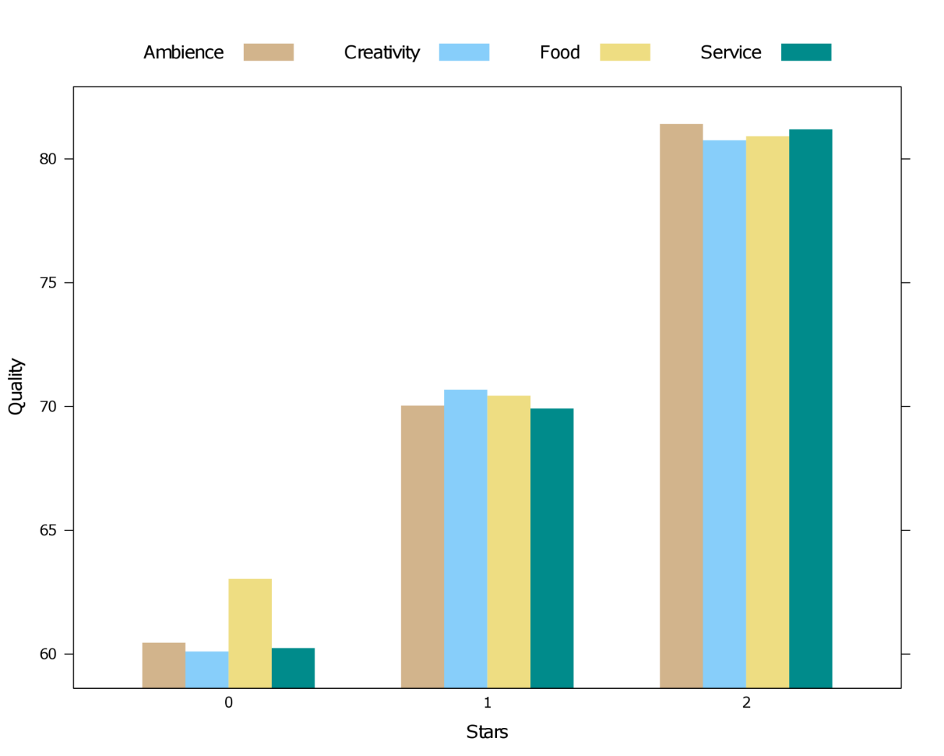
Hierarchical random effects
Visualizing the observed star × criteria averages gives us an indication of what to expect for a model.
It seems that there is a strong main effect of star category (restaurants with more stars are rated more highly on all criteria)
As well, there seems to be a small interaction such that zero-star restaurants may be rated more highly on food than the other three criteria.
Let’s fit a multilevel model to these data...

Slide 7

Hierarchical random effects
A three-level hierarchical model in R is specified as follows:
mod1 <- lmer(Quality~Starcat*Criterion+(1|Region)+(1|Restaurant)+(1|Critic),data=resto)
This time we have three separate random effects formulas, one for each hierarchical level. The formula specifies that there should be random intercepts for regions, restaurants and critics. Separating these intercepts implies that these sources of random variation are independent/uncorrelated.
In other words, error variance in ratings is assumed to be a sum of random variance in regions, restaurants, and critics. All of these levels and their values are allowed to deviate from the population profile of ratings by a constant number.
A summary of random effects for the three-intercept model:
Random effects:
Groups Name Variance Std.Dev.
Critic (Intercept) 29.63861 5.4441
Restaurant (Intercept) 131.62709 11.4729
Region (Intercept) 0.02551 0.1597
Residual 4.87305 2.2075
Number of obs: 600, groups: Critic, 150; Restaurant, 30; Region, 5

Slide 8
Restaurant data – Random effects selection
It appears that most of the error variance in quality scores is due to within-critic correlation and within-restaurant correlation. Less important is variance due to regions and due to pure measurement error. Can we drop the random intercept for regions altogether…?
Random effects model | AIC
(1|Region) | 4668
(1|Restaurant) | 3887
(1|Critic) | 3401
(1|Region)+(1|Restaurant) | 3889
(1|Region)+(1|Critic) | 3394
(1|Restaurant)+(1|Critic) | 3252
(1|Region)+(1|Restaurant)+(1|Critic) | 3254
ranova(mod1)
ANOVA-like table for random-effects: Single term deletions
Model:
Quality ~ Starcat + Criterion + (1 | Restaurant) +
(1 | Critic) + (1 | Region) + Starcat:Criterion
npar logLik AIC LRT Df Pr(>Chisq)
<none> 16 -1602.9 3237.8
(1 | Restaurant) 15 -1673.6 3377.2 141.42 1 <2e-16 ***
(1 | Critic) 15 -1921.0 3871.9 636.10 1 <2e-16 ***
(1 | Region) 15 -1602.9 3235.8 0.00 1 0.9989
---
Signif. codes: 0 ‘***’ 0.001 ‘**’ 0.01 ‘*’ 0.05 ‘.’ 0.1 ‘ ’ 1

Slide 9
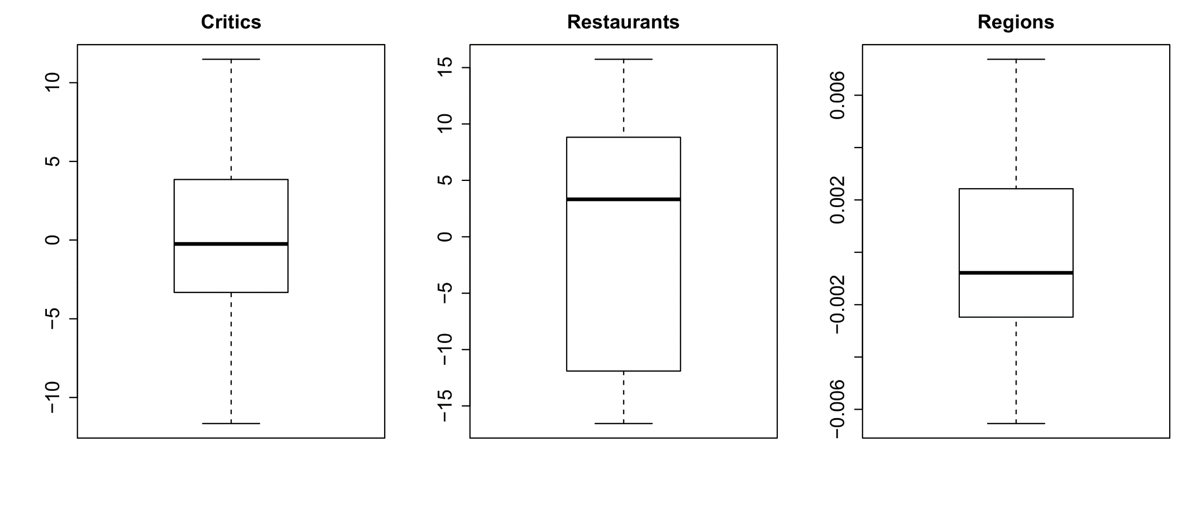
Restaurant data – Random effects outliers
Before we proceed with fixed effects selection, it is also worthwhile to inspect the random effects values to see if any of our units are outlying at their level of measurement. To check this we can generate boxplots on the estimated random effects values returned by the ranef function:

Slide 10
Restaurant data – Fixed effects selection
Now that we have chosen a suitable random effects structure. We can proceed to inspect main effects. We re-estimate the model with ML estimation, and ask for summary output of the model parameters:
mod3 <- lmer(Quality~Starcat*Criterion+(1|Restaurant)+(1|Critic),data=resto,REML=FALSE)
summary(mod3)
Fixed effects:
Estimate Std.Error df t-val P-val
(Intercept) 70.7683 2.0334 30.00 34.803 < 2e-16 ***
Starcat1 -9.8083 2.8756 30.00 -3.411 0.00187 **
Starcat2 -0.4983 2.8756 30.00 -0.173 0.86358
Criterion1 -0.1283 0.1545 450.00 -0.831 0.40670
Criterion2 -0.2550 0.1545 450.00 -1.650 0.09960 .
Criterion3 0.6983 0.1545 450.00 4.519 7.94e-06 ***
Starcat1:Criterion1 -0.3717 0.2185 450.00 -1.701 0.08968 .
Starcat2:Criterion1 -0.1017 0.2185 450.00 -0.465 0.64199
Starcat1:Criterion2 -0.6050 0.2185 450.00 -2.768 0.00586 **
Starcat2:Criterion2 0.6650 0.2185 450.00 3.043 0.00248 **
Starcat1:Criterion3 1.3817 0.2185 450.00 6.323 6.21e-10 ***
Starcat2:Criterion3 -0.5283 0.2185 450.00 -2.418 0.01602 *
---
Signif. codes: 0 ‘***’ 0.001 ‘**’ 0.01 ‘*’ 0.05 ‘.’ 0.1 ‘ ’ 1
How do we even interpret these??

Slide 11
Restaurant data – Fixed effects selection
Fortunately, lmerTest comes with a handy anova function, which performs omnibus tests and Type II and Type III breakdowns of model parameters. Type II ANOVA is almost always preferred! The function can be run as follows:
anova(mod3,type=2)
Which returns:
Evidence for an interaction between the number of stars a restaurant has and the criteria on which the restaurants were rated. But we already suspected that from our data-based plot. Does a model-based plot agree...?
Type II Analysis of Variance Table with Satterthwaite's method
Sum Sq Mean Sq NumDF DenDF F value Pr(>F)
Starcat 78.033 39.016 2 30 8.1700 0.0014706 **
Criterion 100.258 33.419 3 450 6.9980 0.0001311 ***
Starcat:Criterion 222.977 37.163 6 450 7.7818 5.569e-08 ***
---
Signif. codes: 0 ‘***’ 0.001 ‘**’ 0.01 ‘*’ 0.05 ‘.’ 0.1 ‘ ’ 1

Slide 12
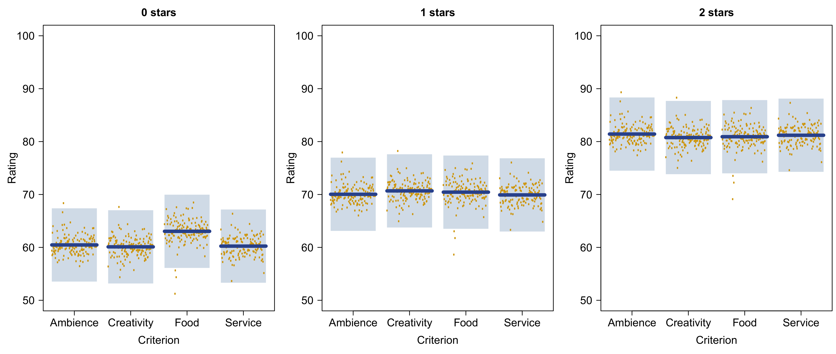
Restaurant data – Fixed effects selection

Slide 13
Restaurant data – Follow-up tests
The interaction test was a 3 × 4 omnibus test involving multiple parameters simultaneously. It does not return pairwise contrasts. To investigate these, we should proceed with conducting follow-up tests. In practice, there are four ways to do this in R, each with advantages and disadvantages:
Subsetting: We subset our data to a contrast of interest. (+) This is fast and simple but (−) you lose statistical power. Generally not the desired approach!
Manual dummy recoding: We manually recode our dummy variables to correspond to interesting contrasts, and get our test results directly from the model's summary/parameter output. (+) Will yield correct tests without loss of power but (−) can be tedious to run manually for large designs.
Difflsmeans: We run the difflsmeans function from the lmerTest library on our model and obtain every pairwise contrast. (+) Fast, efficient, and correct but (−) only handles factors and allows no custom contrasts (e.g., sliced joint tests).
General linear hypothesis: We construct the desired contrasts with a general linear hypothesis (GLH), using e.g., linearHypothesis{car}, or contest{lmerTest}. (+) Offers complete flexibility but (−) requires a thorough understanding of how to create contrast matrices.

Slide 14
Restaurant data – Follow-up tests
In practice, the difflsmeans function will often be the most helpful method. However, manual dummy recoding or GLHs may be necessary in models that contain both continuous and categorical predictors.
difflsmeans(mod3)
This produces a massive table with 75 pairwise contrasts: all main effects contrasts and all possible interaction contrasts. For example, the main effects contrasts for star category are:
The contrast table can be cumbersome to navigate for large designs but it is exhaustive! Likewise, the lmerTest package has an ls_means function which will print model-based averages per condition, their adjusted standard errors, and significance tests. For multilevel models, model-based averages and SEs are generally preferred over data-based averages and SEs! The presence of the random effects can sometimes make these two kinds substantially different...
Estimate Std.Err df t-val lower upper Pr(>|t|)
Starcat0 - Starcat1 - 9.310 4.980 30.0 -1.869 -19.482 0.862 0.071 .
Starcat0 - Starcat2 -20.115 4.980 30.0 -4.038 -30.287 -9.942 0.000 ***
Starcat1 - Starcat2 -10.805 4.980 30.0 -2.169 -20.977 -0.632 0.038 *

Slide 15
Restaurant data – Sliced joint tests
difflsmeans does not allow the user to conduct sliced joint tests, that is, omnibus tests of an effect conditioned on levels of another effect.
After establishing the significant star × criteria interaction, we may wish to proceed first with testing the criterion effect within each star category.
Some authors refer to such tests as “simple effects” (Maxwell & Delaney, 2004). The software SAS calls these sliced tests.
Once again, we could subset our data (and lose power) or construct a custom general linear hypothesis (which is complicated). In R we can use either contest{lmerTest}, or the easier joint_tests{emmeans} .
library(emmeans)
joint_tests(mod3,by="Starcat")
Starcat = 0:
model term df1 df2 F.ratio p.value
Criterion 3 459.18 19.955 <.0001
Starcat = 1:
model term df1 df2 F.ratio p.value
Criterion 3 459.18 1.274 0.2828
Starcat = 2:
model term df1 df2 F.ratio p.value
Criterion 3 459.18 0.882 0.4503

Slide 16
Restaurant data – Model fit
Since no fixed effects are also random effects, it is a bit safer to run a partial-R² breakdown. Unfortunately, r2beta{r2glmm} is not useful because it returns partial-R² for individual (dummy) parameters, when we really want an omnibus value for an entire effect. Instead we can manually compare R², using r.squaredGLMM{MuMIn}:
Note that, although the interaction model achieves the best fit, the increase in R² from adding the interaction is practically negligible (versus Starcat+Criterion). The partial-R² does not seem to capture well the importance of the interaction.
Fixed effects model (ML) | Marginal R² | Conditional R² | AIC
1 | 0.000 | 0.975 | 3302
Starcat | 0.308 | 0.975 | 3293
Criterion | 0.000 | 0.976 | 3290
Starcat+Criterion | 0.308 | 0.976 | 3281
Starcat*Criterion | 0.309 | 0.978 | 3248

Slide 17
Restaurant data – Effect size
For effect sizes, we cannot use our standardized regression coefficients directly, since these represent dummy variables. For an ”omnibus” effect size, we could refit our model with Quality standardized, run difflsmeans, and take the maximal contrast among pairwise contrasts as effect size for the main effects, e.g.:
For the interaction, we need to chose an appropriate difference of contrasts. For example, we could look at the Creativity–Food contrast for each star level, and take the maximal difference among those, which is -0.198−0.016 = -0.214:
Estimate Std. Error df t value Pr(>|t|)
Starcat0 - Starcat1 -0.62658079 0.33521240 30.0 -1.8692 0.0713845 .
Starcat0 - Starcat2 -1.35377794 0.33521240 30.0 -4.0386 0.0003434 ***
Starcat1 - Starcat2 -0.72719715 0.33521240 30.0 -2.1694 0.0381075 *
CriterionAmbience - CriterionCreativity 0.00852491 0.01698283 450.0 0.5020 0.6159326
CriterionAmbience - CriterionFood -0.05563625 0.01698283 450.0 -3.2760 0.0011342 **
CriterionAmbience - CriterionService 0.01256302 0.01698283 450.0 0.7397 0.4598384
CriterionCreativity - CriterionFood -0.06416116 0.01698283 450.0 -3.7780 0.0001793 ***
CriterionCreativity - CriterionService 0.00403811 0.01698283 450.0 0.2378 0.8121628
CriterionFood - CriterionService 0.06819927 0.01698283 450.0 4.0158 6.942e-05 ***
Estimate Std. Error df t value Pr(>|t|)
Starcat0:CriterionCreativity - Starcat0:CriterionFood -0.19786762 0.02941513 450.0 -6.7267 5.286e-11 ***
Starcat1:CriterionCreativity - Starcat1:CriterionFood 0.01615246 0.02941513 450.0 0.5491 0.5831949
Starcat2:CriterionCreativity - Starcat2:CriterionFood -0.01076831 0.02941513 450.0 -0.3661 0.7144770

Slide 18

Random or fixed effect?
A recurring question for multilevel models is how do I decide which variables should be a random effect? The following considerations can be taken into account for random intercepts and slopes.
For the restaurant data, region could be motivated as fixed and random! If the interest was to contrast pairs of regions, fixed makes more sense. If the interest was to generalize other effects to the population of regions, random makes more sense. However, 5 region levels is low to estimate a reliable variance!
Random intercepts | Random slopes
Should be categorical variables There is (natural) repeated data clustering within the levels of the variable (e.g., subjects, stimuli, cities) The levels are considered a random sample from a population of levels The analysis wants to generalize its finding to this population of levels The number of distinct levels is at least >5 or >10 There is no interest in direct contrasts between pairs of levels | Can be categorical or continuous variables Fixed variables that are measured repeatedly within random intercept variables (e.g., a time effect within subjects) They are measured at least >5 times within those random intercepts Within these units of data clustering, the fixed variable is expected to have a relationship with the dependent that deviates from the population level effect of the fixed variable

Slide 19
How many random effects?
A second recurring question is how many random effects one should potentially include into a model. Should one exhaustively fit all possibilities and just retain the one with minimal AIC? Or should there be some minimal complexity regardless of AIC?
This question has been controversial in the literature, with some arguing that the random effects should always be maximal (Bar et al., 2013), and others countering that sparse structures are preferred, subject to Occam’s razor philosophy (Bates et al., 2015; Matuschek et al., 2017). Two considerations can be added to this:
The model with only one random intercept is overly simplistic, and should never be your final structure, unless there is empirical evidence against more complex alternatives!
Recall that random slopes tend to shrink the degrees of freedom for fixed effects tests to more plausible values! For this reason, AIC is generally recommended for random effects selection, since it is more liberal (versus BIC). Even when a more complex random effects structure has a slightly higher AIC (or produces computational warnings), it may be preferred for its shrinkage of the degrees of freedom.

Slide 20
How many random effects?
For the restaurant data, we have so far ignored a number of additional covariates that could be considered as fixed and random effects. For each level of the hierarchy, we have available the following covariates:
Region-level: Location of the region in France (categorical; north or south)
Restaurant-level: Year when restaurant opened (continuous; 1961–2014)
Critic-level: Gender of critic (categorical; male or female) and time of service when critic visited (categorical; lunch or dinner service)
resto[sample(1:600,6),]
Region Location Restaurant Opensince Critic Service Gender Stars Criterion Quality
107 Grand Est North Les Bistrottinettes 1994 ID27 Dinner Female 2 Creativity 77
17 Grand Est North Chez Quelqu'un 1997 ID5 Dinner Female 0 Ambience 78
124 Occitanie South Le Food 2000 ID31 Lunch Female 0 Food 66
500 Pr-Alpes-Côte South Carte Blanche 1974 ID125 Lunch Female 0 Food 71
426 Île-de-France North Brasserie les 6 Reines 1997 ID107 Lunch Male 1 Service 73
262 Normandy North Le Presse-purée d'Or 1995 ID66 Lunch Male 0 Service 45
...

Slide 21
How many random effects?
As a rule, a random slope is only possible within an intercept if its values vary within that intercept. This implies that a lower-level IV can only be a random effect within higher levels of measurement (e.g., Gender in Restaurants, but not in Critics)
Let us start by considering the most complex structure we could fit here (colors highlighting hierarchy):
model <- lmer(Quality ~ Starcat*Criterion+Service+Gender+Opensince+Location+
(1+Opensince+Gender+Service|Region)+
(1+Gender+Service|Restaurant)+
(1|Critic),data=resto)
As usual, we entertain a maximal fixed-effects structure when fitting these random effects. Note the mixing of IVs at all levels of hierarchy here! In a multilevel this poses absolutely no problem.
Running this code works but comes with a warning from lme4 that the model is singular with negative eigenvalues in the parameter covariance matrix (=Hessian matrix). Usually that is a first indication something might be misspecified. Let us inspect the summary of random effects…

Slide 22
How many random effects?
This model has a total of 18 random effects parameters, 3 random intercepts, 5 random slopes, 9 correlations between intercepts and slopes, and 1 residual variance (AIC=3299.706).
The first targets for exclusion are 0 variances or perfect correlations, for example the random slope for the age of the restaurant (Opensince) in regions. A good strategy would be to eliminate the most redundant parameters in a backward fashion, one at a time, until AIC no longer decreases. Doing so for these data eliminates all random slopes and the random region intercept (final AIC=3246.959).
Random effects:
Groups Name Variance Std.Dev. Corr
Critic (Intercept) 2.390e+01 4.888410
Restaurant (Intercept) 3.058e+01 5.530121
GenderMale 9.526e+00 3.086363 0.34
ServiceLunch 7.487e+00 2.736316 0.44 0.29
Region (Intercept) 6.017e+00 2.452993
Opensince 1.546e-06 0.001243 -1.00
GenderMale 3.440e+00 1.854745 0.04 -0.04
ServiceLunch 7.285e+00 2.699081 0.00 0.00 -0.44
Residual 5.439e+00 2.332142
Number of obs: 600, groups: Critic, 150; Restaurant, 30; Region, 5

Slide 23
More data hierarchies
The restaurant example could be extended to any other type of data hierarchy, with nested levels of repeated data clustering.
Meta-analysis could be formulated as a multilevel modelling problem! This is more flexible than traditional approaches to meta-analysis, which require effect sizes from one design type only (all between-subjects or all within-subjects).
DV | Level 1 | Level 2 | Level 3
Reaction time | Trials | Subjects
Closeness rating | Subjects | Dyads (e.g., couples)
Life satisfaction | Subjects | Families | Cities
Pollution level | Cities | Countries
Effect size | Conditions | Experiments | Studies

Slide 24
4. Hierarchical, trial-level and longitudinal data
B. Crossed random effects and trial-level analysis

Slide 25
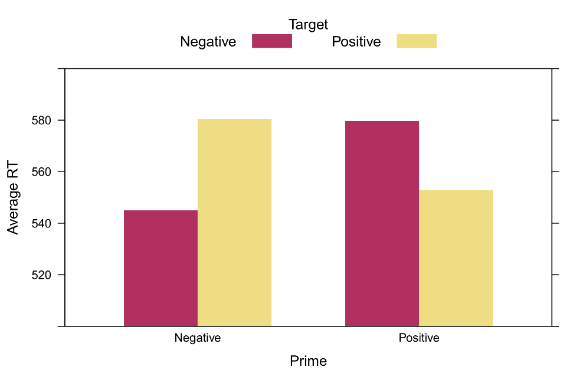
Crossed random effects
Consider again an affective priming experiment. 30 subjects performed the lexcial decision task (word or no word?) with affective priming. Target words (positive or negative) are preceded by prime words (positive or negative). We are interested in analyzing the reaction times (RT) to word trials for all subjects.
Typical trial-level data for one subject have the following structure, with population averaged effect as shown on the right. RTs tend to be facilitated when the prime-target valences match.
Subject Trial Pword Tword Prime Target RT
24088 ID7 1 smile pain Positive Negative 515.4
24089 ID7 2 rainbow grave Positive Negative 552.3
24090 ID7 3 friend fun Positive Positive 519.5
24091 ID7 4 hate summer Negative Positive 574.0
24092 ID7 5 kitten friend Positive Positive 582.0
24093 ID7 6 summer joy Positive Positive 528.4
24094 ID7 7 puppy pain Positive Negative 554.6
24095 ID7 8 grave death Negative Negative 525.8
24096 ID7 9 grave fear Negative Negative 541.5
24097 ID7 10 life heaven Positive Positive 517.6
...

Slide 26
Crossed random effects
The data contain two primary sources of random variation: subjects and words, which are both sampled from a population of subjects and words.
There were 15 positive and 15 negative words, which were presented in all possible combinations to each subject, representing 900 trials total. With 900 trials for subjects, the trial-level data contains 27000 observations!
Since each subject was presented with each word, one cannot say that words are nested in subjects, since one could also say subjects are nested in words. Instead, we say that subjects and words are crossed random effects:
Subjects
1
2
3
30
…
Words

Slide 27
Crossed random effects in R
It turns out that lme4 makes no practical distinction between hierarchical and crossed random effects in its formula syntax. The specification is exactly the same, e.g.:
model <- lmer(RT~Prime*Target+(1|Subject)+(1|Pword)+(1|Tword),data=priming)
Once again, we simply have multiple random intercepts. The estimates for the random effects variances are:
So strong within-subject correlation of RTs, and relatively weak within-word correlation of RTs, as well as a sizeable residual variance.
Random effects:
Groups Name Variance Std.Dev.
Subject (Intercept) 467.020 21.611
Pword (Intercept) 8.827 2.971
Tword (Intercept) 10.280 3.206
Residual 437.257 20.911
Number of obs: 26759, groups: Subject, 30; Pword, 30; Tword, 30

Slide 28
Random interaction in subjects
The estimated word variances seem small, but including these intercepts still reduces AIC by a total of 898 points, suggesting strong evidence for within-word correlation of RTs.
This time we can also include random effects for the prime × target interaction within subjects. Specifically, we can compare:
model2 <- lmer(RT~Prime*Target+(1+Prime+Target|Subject)+(1|Pword)+(1|Tword),data=priming)
model3 <- lmer(RT~Prime*Target+(1+Prime*Target|Subject)+(1|Pword)+(1|Tword),data=priming)
AIC(model2) ; AIC(model3)
Both models achieve substantially lower AIC than the one with only a random intercept, with the lowest AIC for model3, suggesting substantial evidence that individual subjects differ with respect to the affective priming effect.
Some subjects may be sensitive to priming effects, others not. The multilevel model allows us to model these individual differences with random slopes. Likewise, we can use these individual differences to identify groups of participants who respond particularly well to a manipulation! Let us first have a look at the estimated variances.

Slide 29
Random interaction in subjects and words
It appears that the variance in subjects due to the prime × target interaction is indeed larger than due to the corresponding main effects (which are virtually negligable). We may wonder if we truly need those correlation parameters, but their values are neither very close to -1 or 1, so we choose to keep them.
One last complication we can consider are random priming effects within target words. That is, we may expect that the priming effect is particularly strong when a specific word is presented as the target:
model5 <- lmer(RT~Prime*Target+(1+Prime*Target|Subject)+(1|Pword)+(1+Prime*Target|Tword), data=priming)
Random effects:
Groups Name Variance Std.Dev. Corr
Subject (Intercept) 555.7439 23.5742
PrimePositive 0.5263 0.7254 -0.79
TargetPositive 0.6392 0.7995 -0.50 0.78
PrimePositive:TargetPositive 235.8438 15.3572 -0.45 0.08 0.39
Pword (Intercept) 8.8913 2.9818
Tword (Intercept) 10.3335 3.2146
Residual 392.6760 19.8161
Number of obs: 26759, groups: Subject, 30; Pword, 30; Tword, 30

Slide 30
Random interaction in subjects and words
We now have an incredibly complex random-effects structure, with 22 parameters total! While it is conceivable that individual differences in priming are observed both at the subject- and word-level, the model with the random interaction within words in fact has higher AIC than the one without.
We therefore re-fit the simpler model and proceed to inspect the estimated random effects values.
Random effects:
Groups Name Variance Std.Dev. Corr
Subject (Intercept) 535.12450 23.13276
PrimePositive 0.35763 0.59802 -0.94
TargetPositive 0.22919 0.47874 -0.80 0.63
PrimePositive:TargetPositive 236.27535 15.37125 -0.45 0.16 0.69
Pword (Intercept) 8.83650 2.97262
Tword (Intercept) 14.10888 3.75618
PrimePositive 0.00965 0.09823 -1.00
TargetPositive 16.95090 4.11715 -0.74 0.74
PrimePositive:TargetPositive 0.28549 0.53431 0.21 -0.21 -0.75
Residual 392.70667 19.81683
Number of obs: 26759, groups: Subject, 30; Pword, 30; Tword, 30

Slide 31
Estimated models for individual subjects
The deviations outputted by ranef tell us how much each subject differs from the population-level effect. But to find out which subjects actually have the priming effect and which ones do not, it is more informative the run the coef function, yielding the estimated models for each level of the data hierarchy:
In fact, it turns out all subjects have the interaction coefficient in the right direction, with the effect the weakest for ID24. Let us finally proceed to examining the fixed (population-level) effects…
$Subject
(Intercept) PrimePositive TargetPositive PrimePositive:TargetPositive
ID1 563.8600 34.25174 34.85309 -69.00360
ID10 531.4469 35.56245 35.19199 -87.85222
ID11 521.2424 35.29354 35.66193 -54.18632
ID12 542.9348 34.50430 35.54369 -42.78127
ID14 522.7242 35.46541 35.54556 -66.22361
...
ID21 533.5693 34.91992 35.39599 -56.04192
ID23 537.3949 34.93249 35.68735 -52.98352
ID24 518.4398 35.20141 35.99754 -38.93960
ID25 524.1329 35.58202 35.99245 -61.58406
ID26 537.1024 35.06212 35.72891 -57.45621
ID27 580.8640 34.27371 34.78813 -88.02207

Slide 32
ANOVA breakdown of fixed effects
The Type II ANOVA table for the fixed effects of the affective priming model, and semi-partial marginal R²:
model3 <- lmer(RT~Prime*Target+(1+Prime*Target|Subject)+(1|Pword)+(1|Tword),
data=priming,REML=FALSE)
anova(model3,type=2)
r2beta(model3,method="nsj")
Which returns:
Recall that we previously discussed the controversy over random effects complexity. Here, by including the two word intercepts and the random interaction within subjects, the degrees of freedom shrink to practically our nominal N of 30 subjects, despite the trial-level data containing 27000 observations!
Type II Analysis of Variance Table with Satterthwaite's method
Sum Sq Mean Sq NumDF DenDF F value Pr(>F)
Prime 1586 1586 1 52.178 4.0393 0.04964 *
Target 1939 1939 1 53.176 4.9374 0.03056 *
Prime:Target 188861 188861 1 28.999 480.9584 < 2e-16 ***
---
Signif. codes: 0 ‘***’ 0.001 ‘**’ 0.01 ‘*’ 0.05 ‘.’ 0.1 ‘ ’ 1
Effect Rsq
1 Model 0.213
4 Prime:Target 0.208
3 Target 0.145
2 Prime 0.141

Slide 33
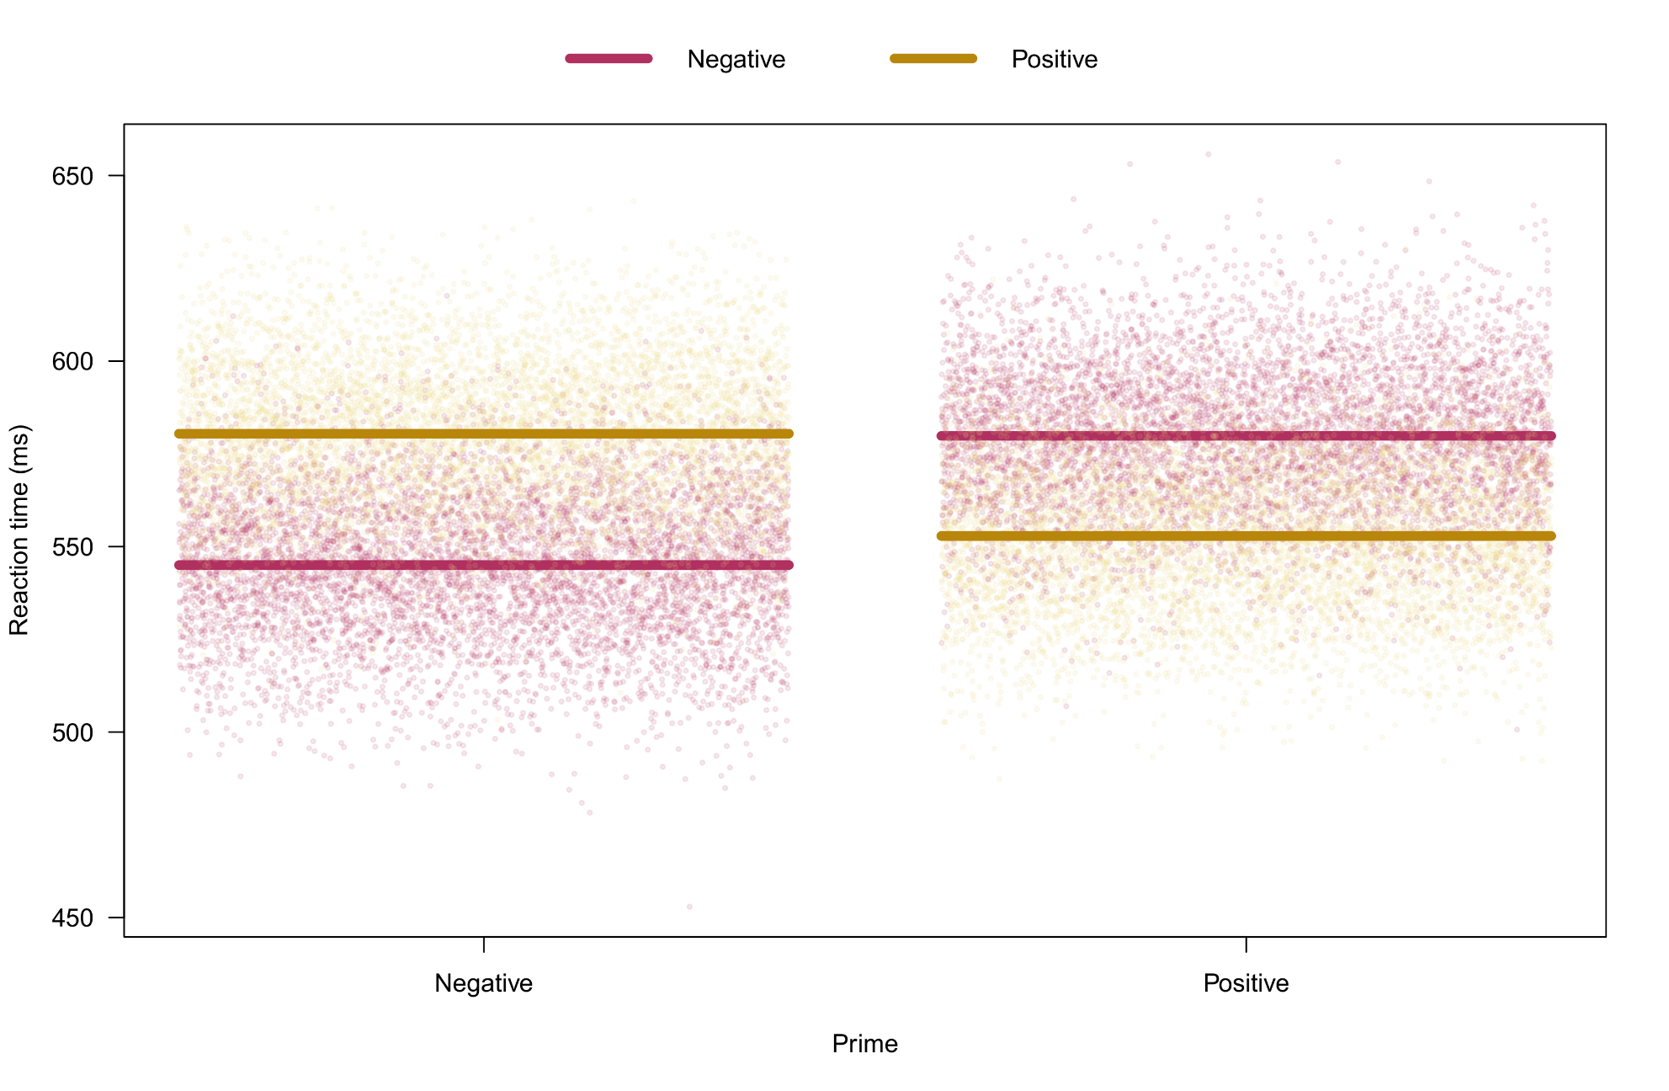
Model-based predicted condition means

Slide 34
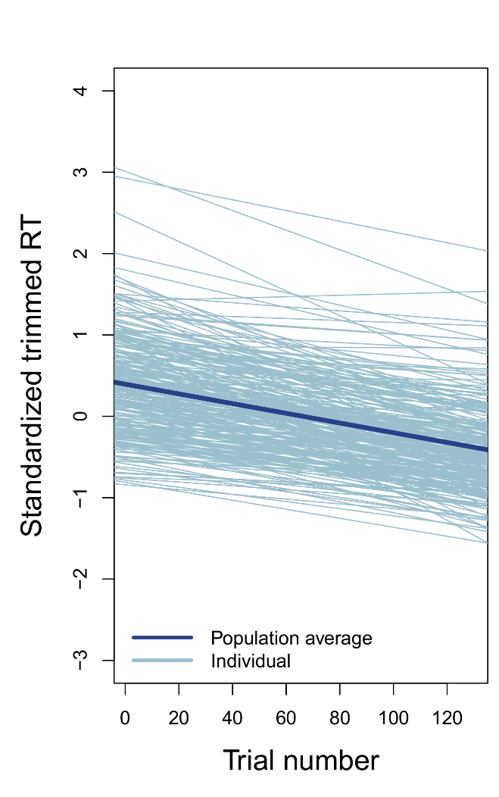
Adaptation and carry-over effects
The preceding models were not nearly as complex as they could have been. Trial-level analyses may also want to incorporate (a) adaptation effects over trials, and (b) carry-over effects between consecutive trials.
Normally, I would have included a trial effect in the priming model, both as fixed and random effect, e.g.:
RT~Prime*Target+Trial+ (1+Prime*Target+Trial|Subject)+
(1|Pword)+(1|Tword)
This would allow to explore how RT improved or declined during the task, and how individual participants differed in those changes. Generally speaking though, adaptation effects are not expected to confound the design effects. Why is that?
However, absence of confounding does not exclude the possibility of moderation. Some design effects may (dis)appear only when a certain level of skill has been achieved in the task. Modelling this requires interactional formulas, e.g., RT~Prime*Target*Trial.
Illustration of individual differences in RT adaptation (different data set).

Slide 35

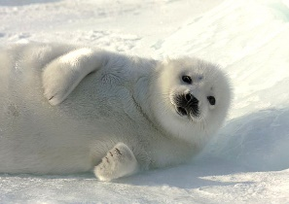

Adaptation and carry-over effects
Especially with intense stimuli, effects may last beyond the current trial, reflecting so-called carry-over effects, e.g.,:
For the priming data, we could create “lagged design variables” that represent the valence of prime and target on the preceding trial*:
priming$Prime_lag <- as.factor(c(NA,as.character(priming$Prime[-nrow(priming)])))
priming$Prime_lag[priming$Trial==1] <- NA
priming$Target_lag <- as.factor(c(NA,as.character(priming$Target[-nrow(priming)])))
priming$Target_lag[priming$Trial==1] <- NA
Trial t−1
Trial t
Trial t+1
*Example R code only works if trial data are ordered by trial number per subject!

Slide 36
Adaptation and carry-over effects
Using the lagged variables, we may expand our model formula to contain 2×2×2×2 design effects:
RT ~ Prime_lag*Target_lag*Prime*Target +
(1+ Prime_lag*Target_lag*Prime*Target|Subject) +
(1|Pword)+(1|Tword)
Doing this moves our model into the direction of time series analysis, where typically a longitudinal outcome Y_{t} is modelled not just by X_{t} but especially Y_{t-p} and X_{t-p}, with p a chosen amount of time lag. In fact we could consider to expand our affective priming formula similarly:
RT ~ Prime_lag*Target_lag*Prime*Target*RT_lag
This allows the previous RT to influence the current RT, and moderate design effects. While this may seem attractive, this is a bad idea conceptually and practically! If RTs have moderate-to-strong auto-correlation, RT_lag will have a highly significant effect, to the point that it may drown out the design effects in the model.
As well, the association is between RT_lag and RT is causally trivial. A significant effect of RT_lag does not mean ”reaction time changed because of reaction time”.

Slide 37
What should be our maximal complexity?
Adaptation and carry-over effects severely complicate the traditional two-step fitting approach for a multilevel model. Exactly what should be the maximal effect complexity we consider? Combining everything we have seen for the priming example, we could have:
RT ~ Prime_lag*Target_lag*Prime*Target*Trial+
Age+Gender+STAI_S+
(1+Prime_lag*Target_lag*Prime*Target*Trial|Subject)+
(1+Prime_lag*Target_lag*Prime*Target*Trial+Age+Gender+STAIS|Pword)+
(1+Prime_lag*Target_lag*Prime*Target*Trial+Age+Gender+STAIS|Tword)
For crossed random effects, subject-varying covariates could even be random effects within stimuli! It becomes clear that some restriction on model complexity needs to be imposed a-priori. Some sensible considerations:
Subject-level covariates should not be random effects within stimuli
Adaptation effects should be purely additive (no interactions)
Carry-over effects should be restricted to the previous trial, and only if the number of trials allows them!

Slide 38
Trial-level analysis benefits
Despite the issues just raised, trial-level analysis remains one of the most powerful applications of multilevel models, and comes with numerous benefits:
All available information is used without the need for data aggregation
Missing trials (e.g., errors, absent responses) and even missing conditions pose no problem
Statistical tests will generally have more power
Trial-by-trial variance is taken into account, unlike in conventional repeated measures (M)ANOVA, where condition-averaging ignores this variance
Trial-varying covariates can be included, e.g., “trial number” to control for adaptation effects
Carry-over effects from one trial to the next can be investigated
Provided there are enough repeated measures, complex random effects structures can be fitted
In the preceding example, having both subjects and words as random effects allows the model to generalize to both populations (subjects and words) simultaneously.
Individual differences toward the experimental manipulations can be modelled
In my opinion trial-level analyses of experimental data should become the future norm…!

Slide 39
4. Hierarchical, trial-level and longitudinal data
C. Longitudinal data analysis

Slide 40

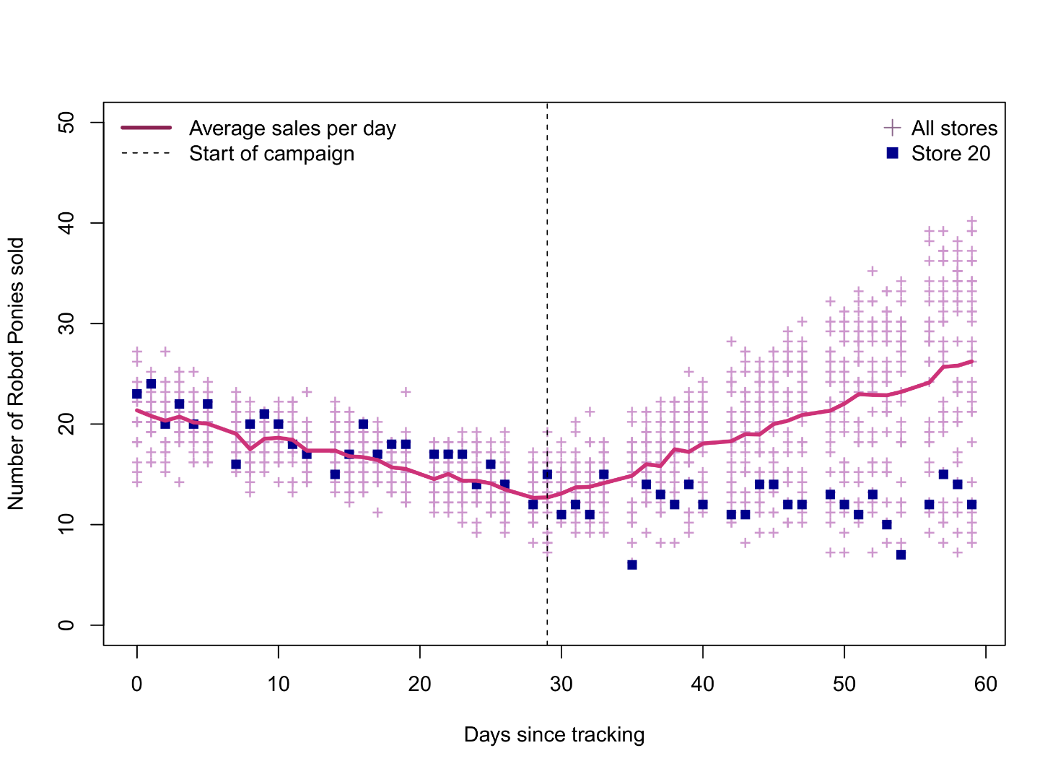

Longitudinal data analysis
Toy retailer Dreamland is tracking the sales of its products. In particular, a new line of robot ponies is showing declining sales over the past month.
The advertising department launches a new television campaign to promote the toys. Sales analysts want to test the effectiveness of the campaign.
Sales data from 30 Dreamland stores, for a 60 day period, 30 days before the advertising campaign, and 30 days afterwards. Every day, store employees log the number of robot ponies sold.

Slide 41
Longitudinal data analysis – Time dynamics problem
Multiple analysis challenges occur simultaneously in this dataset:
Systematic missingness on Sundays
Changing sales trends before and after the start of the advertising campaign
No visual evidence for random time trends before advertising
Visual evidence for random time trends after advertising
Potential auto-correlation of time series
The primary challenge for these data is how to model the sales trends over time. Clearly, a single regression slope is not adequate to capture the sales changes over time. In general, longitudinal data will exhibit non-linear dynamics. How can we take these dynamics into account in a multilevel model?
Perhaps we can start with something very simple first…

Slide 42
Time dynamics – Paired t-test approach
Why not just average the pre- and post-advertizement sales, and run a paired t-test? This is not an incorrect approach, e.g.:
ponies$Phase <- as.factor(ifelse(ponies$Time>30,"T2_post","T1_pre"))
sales.averaged <- aggregate(Sales~Phase+Store,data=ponies,FUN=mean)
t.test(Sales~Phase,data=sales.averaged,paired=TRUE)
So a significant average increase in sales of nearly 3 ponies after advertizing (≈17 to 20). However, this method ignored the individual time points within the pre- and post-phases (by averaging them). In a multilevel model, we could do a pre-post comparison but using all available time points…
Paired t-test
data: Sales by Phase
t = -3.0327, df = 29, p-value = 0.005067
alternative hypothesis: true difference in means is not equal to 0
95 percent confidence interval:
-4.9360095 -0.9598917
sample estimates:
mean of the differences
-2.947951

Slide 43
Time dynamics – Categorical multilevel approach (2 levels)
We simply enter our new Phase variable into our multilevel model, both as fixed and random effect, using the raw longitudinal data:
catmod1 <- lmer(Sales~Phase+(1+Phase|Store),data=ponies,REML=FALSE)
summary(catmod1)
The result is nearly identical to the paired t-test. Note that the DFs are ≈30, even though 1560 observations total were available. The presence of the random Phase effect is responsible for this shrinkage!
Random effects:
Groups Name Variance Std.Dev. Corr
Store (Intercept) 0.4846 0.6962
PhaseT2_post 25.9975 5.0988 -0.32
Residual 18.2380 4.2706
Number of obs: 1560, groups: Store, 30
Fixed effects:
Estimate Std. Error df t value Pr(>|t|)
(Intercept) 16.8827 0.1966 29.9991 85.852 < 2e-16 ***
PhaseT2_post 2.9480 0.9557 29.9991 3.085 0.00435 **
---
Signif. codes: 0 ‘***’ 0.001 ‘**’ 0.01 ‘*’ 0.05 ‘.’ 0.1 ‘ ’ 1

Slide 44
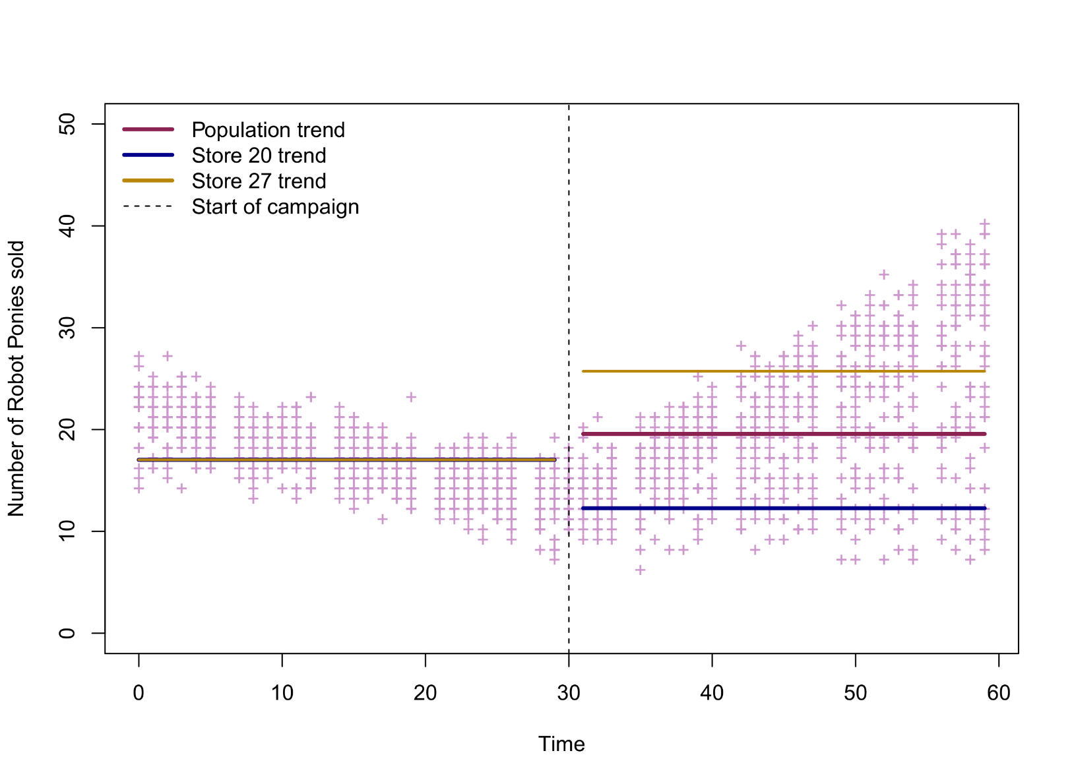
Time dynamics – Categorical multilevel approach (2 levels)
Fitted values for the pre-post model, with random pre-post effects for stores 20 and 27:

Slide 45
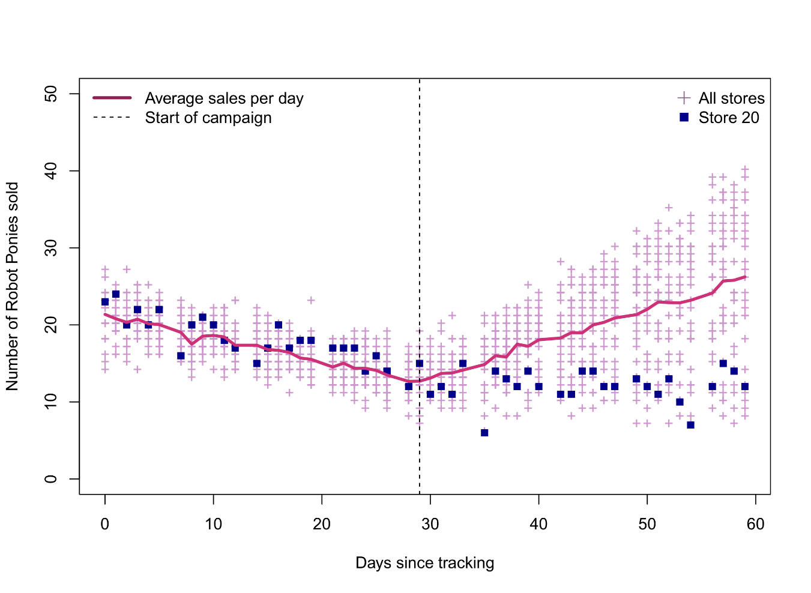
Time dynamics – Categorical multilevel approach (2 levels)
The simple pre-post comparison is not satisfactory here, and somewhat misleading. The fitted averages ignore that sales were declining and increasing with time, before and after the advertizing campaign.
The estimated difference in pre-post sales suggests there was an average increase of 3 ponies sold, which ignores that nearly 10 ponies more were being sold on average, between the sales low point at day 30 and the maximum achieved at day 60.
Likewise, while the model supports individual differences in store sales after advertizing (random Phase effect), it again does not capture the invidual store trends.

Slide 46
Time dynamics – Categorical multilevel approach (9 levels)
Instead of using a broad pre-post comparison, what about looking at weekly averages? We could define a new Week factor (9 levels), consisting of 6 measurements per week per store, and enter it into a multilevel model as before. Because the point of intervention (and minimum of sales) corresponds to Week 5, it makes sense to modify the contrast coding and set Week 5 as the reference level:
ponies$Week <- as.factor(rep(paste("Week ",rep(1:9,
times=c(6,6,6,6,6,6,6,6,4)),sep=""),times=30))
contrasts(ponies$Week) <- contr.treatment(levels(ponies$Week),base=5)
catmod2 <- lmer(Sales~Week+(1+Week|Store),data=ponies, REML=FALSE)
summary(catmod2)
anova(catmod2,type=2)
The ANOVA returns a massively significant Week effect:
Type II Analysis of Variance Table with Satterthwaite's method
Sum Sq Mean Sq NumDF DenDF F value Pr(>F)
Week 7440 929.99 8 66.964 219.55 < 2.2e-16 ***
---
Signif. codes: 0 ‘***’ 0.001 ‘**’ 0.01 ‘*’ 0.05 ‘.’ 0.1 ‘ ’ 1

Slide 47
Time dynamics – Categorical multilevel approach (9 levels)
Parameter estimates:
Random effects:
Groups Name Variance Std.Dev. Corr
Store (Intercept) 1.6971 1.3027
WeekWeek 1 1.3472 1.1607 -0.37
WeekWeek 2 0.4579 0.6767 -0.87 0.74
WeekWeek 3 0.9274 0.9630 -0.71 0.84 0.87
WeekWeek 4 0.5409 0.7355 -0.55 0.84 0.88 0.70
WeekWeek 6 4.6944 2.1667 0.22 -0.84 -0.57 -0.81 -0.65
WeekWeek 7 19.3285 4.3964 0.22 -0.86 -0.57 -0.81 -0.66 1.00
WeekWeek 8 42.6634 6.5317 0.15 -0.85 -0.53 -0.76 -0.65 1.00 1.00
WeekWeek 9 72.8651 8.5361 0.20 -0.87 -0.55 -0.81 -0.64 1.00 1.00 0.99
Residual 4.2359 2.0581
Number of obs: 1560, groups: Store, 30
Fixed effects:
Estimate Std. Error df t value Pr(>|t|)
(Intercept) 13.3444 0.2830 31.3437 47.149 < 2e-16 ***
WeekWeek 1 7.2278 0.3033 32.4106 23.833 < 2e-16 ***
WeekWeek 2 4.9056 0.2497 58.4915 19.649 < 2e-16 ***
WeekWeek 3 3.0778 0.2792 44.6202 11.022 2.54e-14 ***
WeekWeek 4 0.9722 0.2551 43.9494 3.811 0.000428 ***
WeekWeek 6 3.2389 0.4512 31.4824 7.179 4.13e-08 ***
WeekWeek 7 6.2389 0.8315 30.1100 7.503 2.25e-08 ***
WeekWeek 8 9.2056 1.2121 30.0190 7.595 1.80e-08 ***
WeekWeek 9 12.1222 1.5772 30.0166 7.686 1.42e-08 ***
---
Signif. codes: 0 ‘***’ 0.001 ‘**’ 0.01 ‘*’ 0.05 ‘.’ 0.1 ‘ ’ 1
How can we interpret these random variances, especially the problematic ones?
Parameter estimates automatically contrast to Week 5 sales!

Slide 48
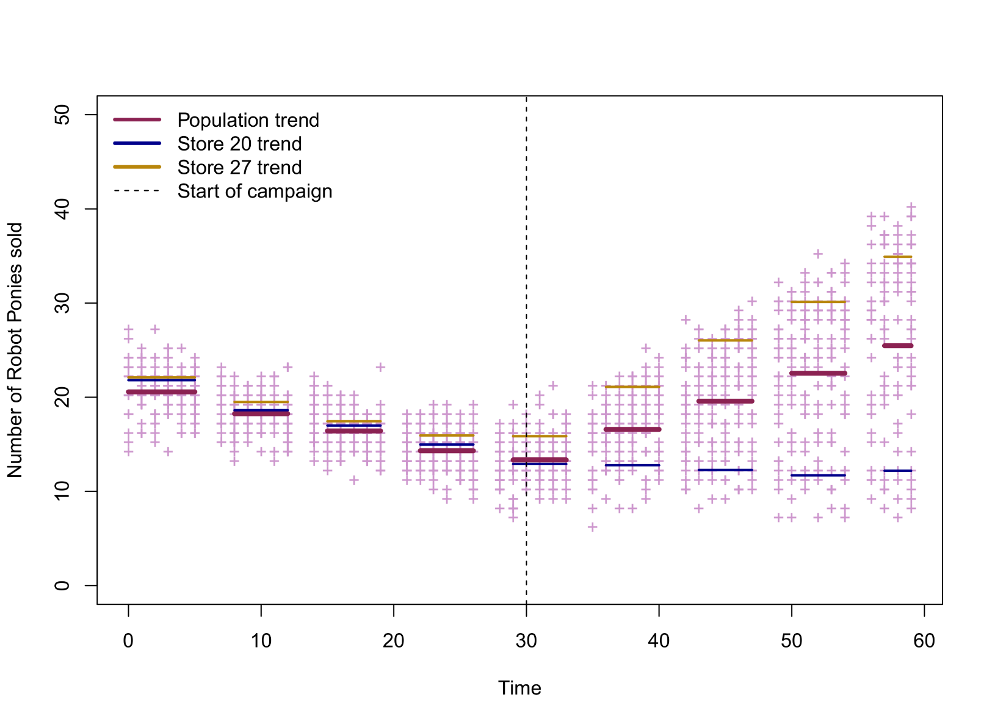
Time dynamics – Categorical multilevel approach (9 levels)
Fitted values for the week model, with random week effects for stores 20 and 27:

Slide 49
Time dynamics – Categorical multilevel approach (9 levels)
The categorical approach using weekly data is not bad at all! The model now reflects the declining and increasing sales with time, and we can make broad comparisons between sales-averages per week. For a company, this would be a useful report.
Unfortunately, from a statistical perspective, there are still many problems:
Week 5 captures time points before and after the advertising campaign, so not an ideal reference point for pairwise contrasts.
The random effects are overparametrized. It seems there was no random variance among stores before Week 5, and the random variance after Week 5 seems to increase linearly, so the variance parameters for Weeks 1–5 are entirely redundant, and Weeks 6–9 we probably don’t need 4 separate variance parameters (or their correlations).
The fixed effects are overparametrized, since we are using 8 Week-dummy parameters, when probably the entire sales trend could be captured by single curve…

Slide 50
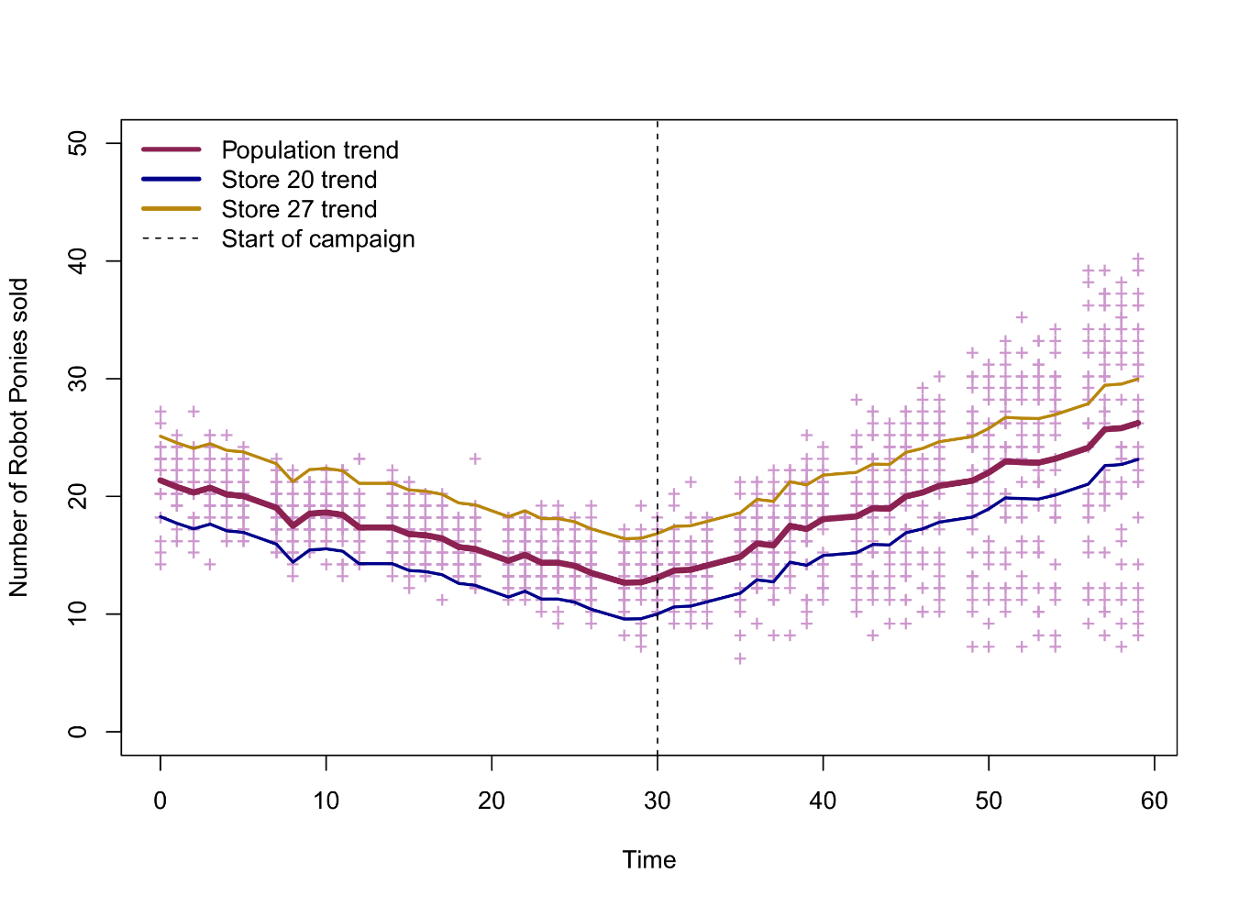
Time dynamics – Categorical multilevel approach (60 levels)
A final categorical option would be to all 60 days as separate levels of a time factor. The resulting fit would mirror the moving average shown earlier in the data-based sales graph (R code in script).
While this model seems to reflec the daily averages the most accurately, it comes with massive drawbacks:
A random day effect cannot be integrated, since for the daily data there is only one “repeated” measurement per store. Recall that variances cannot be estimated if there are fewer than 3 repeated measures.
The fixed effects are massively overparametrized. Apart from not needing 59 dummy parameters to capture two linear trends, we are not interested in pairwise contrasts between every possible pair of days…
No more random store effect!

Slide 51
Time dynamics – Quadratic multilevel approach
What about using a continuous version of time and fitting a curve? An obvious choice for these data would be the use of polynomials, that is, quadratic or cubic curves:
quadmod <- lmer(Sales~Time+I(Time^2)+(1+Time+I(Time^2)|Store),data=ponies)
Two new operators appear in this formula: the power operator ^, which transforms the time variable to the second power, and the priority operator I, which instructs R that time must be squared before entering it into the model. When entering the formula above, however, you may also receive a warning...
The lmer function can experience difficulties in its numerical optimization algorithm with large variable values, which are likely to occur with quadratic transformations. For this reason, it is recommended to standardize time:
ponies$Time.z <- scale(ponies$Time)
quadmod <- lmer(Sales~Time.z+I(Time.z^2)+(1+Time.z+I(Time.z^2)|Store),data=ponies)
Warning messages:
1: Some predictor variables are on very different scales: consider rescaling
2: In checkConv(attr(opt, "derivs"), opt$par, ctrl = control$checkConv, :
Model failed to converge with max|grad| = 2.09415 (tol = 0.002, component 1)

Slide 52
Time dynamics – Quadratic multilevel approach
The random effects also include the quadratic term, which means that individual stores can have a quadratic trend that differs from the population quadratic trend. A comparison of AIC for this model (AIC=7100) with a model that omits the random quadratic term (AIC= 7532) confirms the importance of this effect.
Random effects:
Groups Name Variance Std.Dev. Corr
Store (Intercept) 1.772 1.331
Time.z 8.650 2.941 0.58
I(Time.z^2) 2.044 1.430 0.54 1.00
Residual 4.759 2.181
Number of obs: 1560, groups: Store, 30
Fixed effects:
Estimate Std. Error df t value Pr(>|t|)
(Intercept) 14.7842 0.2568 29.0850 57.573 < 2e-16 ***
Time.z 1.4273 0.5398 29.0000 2.644 0.0131 *
I(Time.z^2) 3.5180 0.2683 29.0580 13.112 9.88e-14 ***
---
Signif. codes: 0 ‘***’ 0.001 ‘**’ 0.01 ‘*’ 0.05 ‘.’ 0.1 ‘ ’ 1

Slide 53
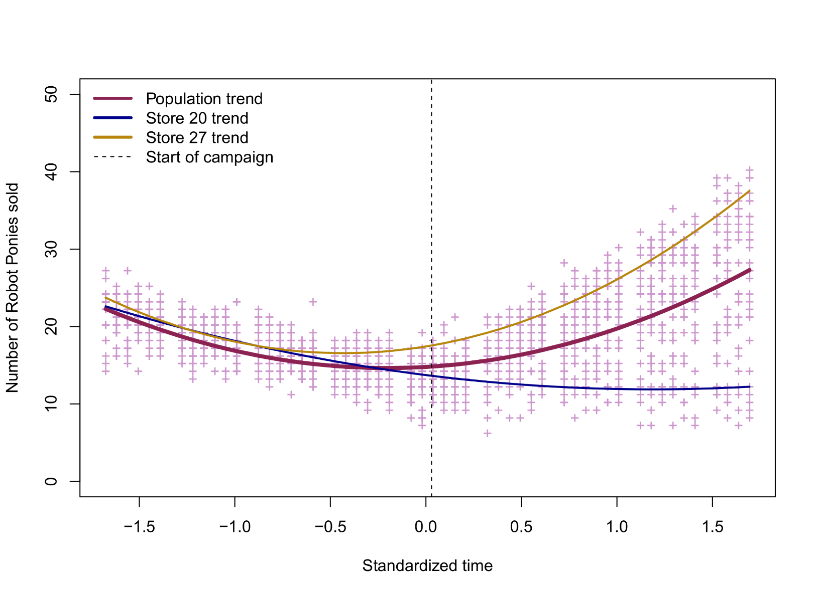
Time dynamics – Quadratic multilevel approach
Predicted profiles for the population and the two stores:

Slide 54
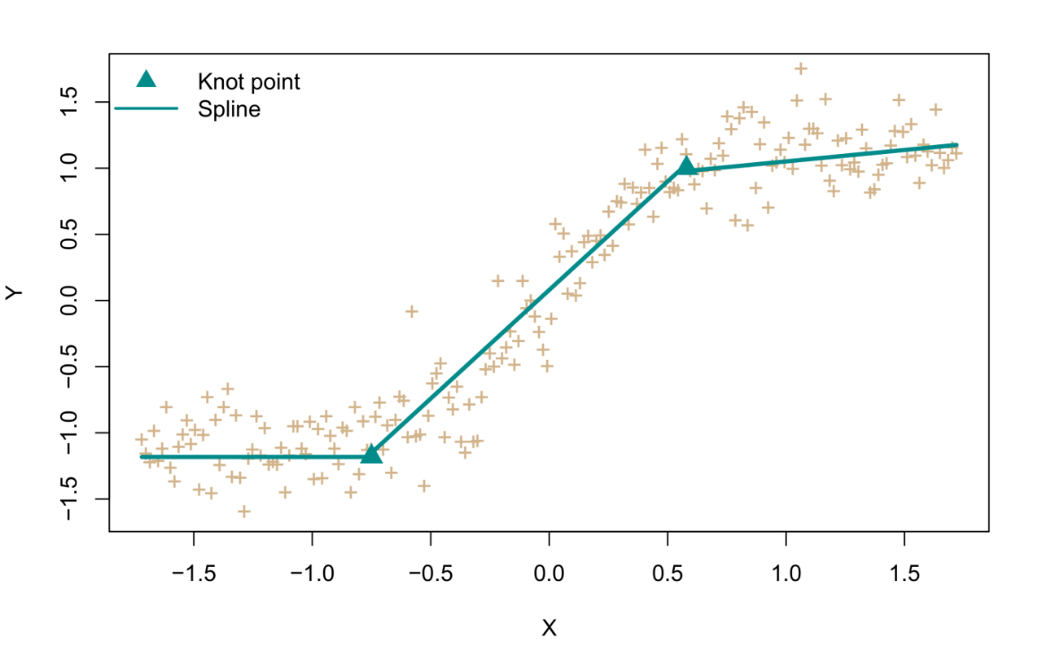
Time dynamics – Spline multilevel approach
The results look nice but in reality quadratic regression is not easy to interpret. We can clearly see that sales increased after the advertising campaign but the effect is hard to quantify. The model did not allow us to test two hypotheses:
Did advertising have a significant effect on the sales trend?
Are there random differences in stores with respect to the advertising effect?
Another problem with polynomial models are their behavior outside of the observed data. The quadratic curves on both sides would extrapolate to never-ending exponential sales.
Can we not find a model that solves these issues...?
An alternative approach to trend-modelling or curve-fitting with polynomials is to use piecewise linear regression. Instead of fitting one linear slope, we fit multiple linear slopes, joined by knot points. Such pieces are called splines.

Slide 55
Time dynamics – Spline multilevel approach
For the pony data, we can add a spline effect to our model by creating a new time variable, that is only ”switched-on” (non-zero) after the start of the advertising campaign. For the standardized time variable, this is done as follows:
ponies$Time.s <- ifelse(ponies$Time<0.03, 0, ponies$Time-0.03)
Next we enter it into our model:
splinemod <- lmer(Sales~Time.z+Time.s+(1+Time.z+Time.s|Store),data=ponies)
However, it turns out that this model is not identifiable by R (=overparametrized) unless we restrict the random time and the random spline effect to be uncorrelated.
splinemod <- lmer(Sales~Time.z+Time.s+(1+Time.z+Time.s||Store),data=ponies)

Slide 56
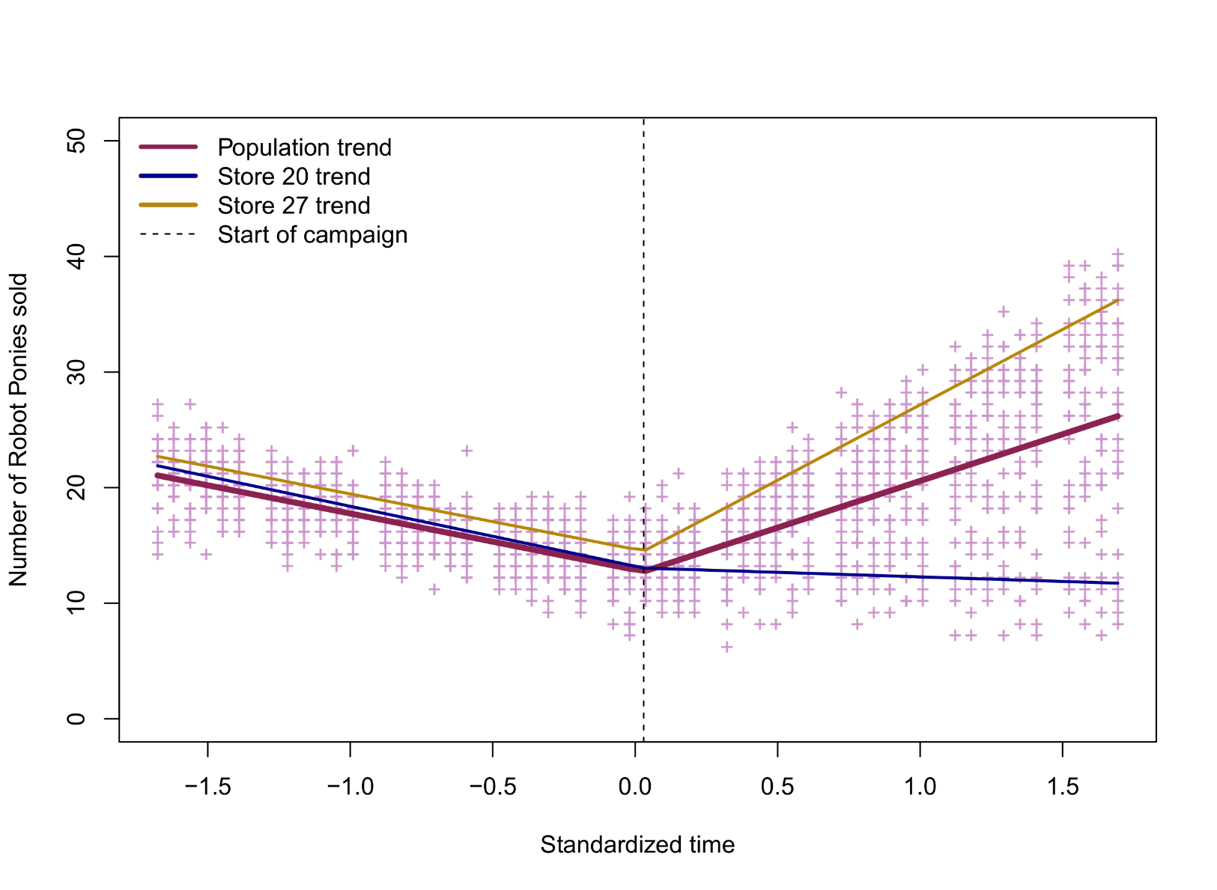
Time dynamics – Spline multilevel approach
Predicted profiles for the population and the two stores:

Slide 57
Time dynamics – Spline multilevel approach
Testing the two hypotheses:
Random variation in store sales after advertising is supported by AIC, showing lower values for the model with a random spline effect (AIC=6827) than one without (AIC=7406). As well, the LRT is significant.
Summary output indicates that there is a significant fixed spline effect. In other words, the linear trend of sales changes significantly after the start of the advertising campaign, -4.87 versus -4.87+12.95=8.08
npar logLik AIC LRT Df Pr(>Chisq)
<none> 7 -3406.6 6827.2
(1 | Store) 6 -3458.6 6929.2 104.05 1 < 2e-16 ***
Time.z in (0 + Time.z | Store) 6 -3408.0 6828.0 2.84 1 0.09209 .
Time.s in (0 + Time.s | Store) 6 -3697.2 7406.5 581.28 1 < 2e-16 ***
---
Fixed effects:
Estimate Std.Error df t-val P-val
(Intercept) 12.8889 0.2203 34.2200 58.50 < 2e-16 ***
Time.z -4.8730 0.1329 34.5300 -36.66 < 2e-16 ***
Time.s 12.9516 1.0505 29.6500 12.33 3.38e-13 ***
---
Signif. codes: 0 ‘***’ 0.001 ‘**’ 0.01 ‘*’ 0.05 ‘.’ 0.1 ‘ ’ 1

Slide 58
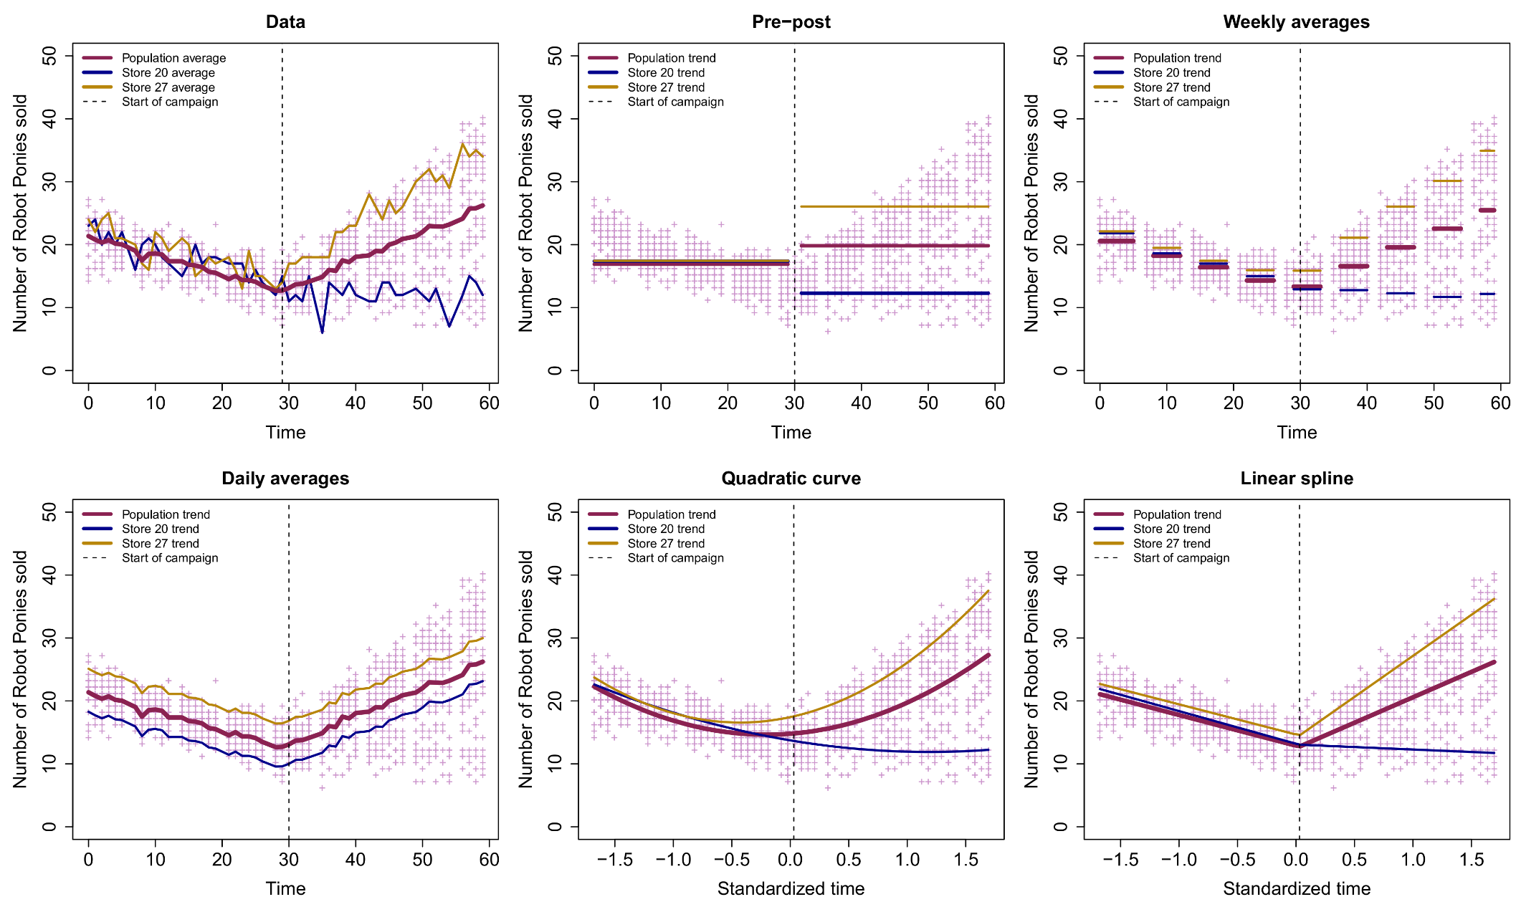
Time dynamics – Which model do we choose?

Slide 59
Time dynamics – Which model do we choose?
Since we fitted all our models by ML, we can make a comparison by their parameter number, R², and AIC value. Note that none of these models are nested,* and so could never be compared with ANOVA F-tests!
There is a clear preference for the spline model, which minimizes AIC (by ≈200 points) and has a good marginal R² for only 7 parameters total! The next best model, the weekly averages, requires 55 parameters to achieve similar fit! As well, the spline model allows formal tests of the two sales hypotheses.
 | Parameters |  |  |  | Goodness-of-fit
Model | Fixed | Random | Total |  | Marg. R² | Cond. R² | AIC
Pre-post | 2 | 4 | 6 |  | 0.067 | 0.435 | 9090.27
Weekly averages | 9 | 46 | 55 |  | 0.379 | 0.869 | 7034.88
Daily averages | 60 | 2 | 62 |  | 0.395 | 0.564 | 8752.53
Quadratic curve | 3 | 7 | 10 |  | 0.369 | 0.853 | 7096.61
Linear splines | 3 | 4 | 7 |  | 0.387 | 0.878 | 6825.57
*Parameters in the reduced model are a subset of the parameters in the full model

Slide 60
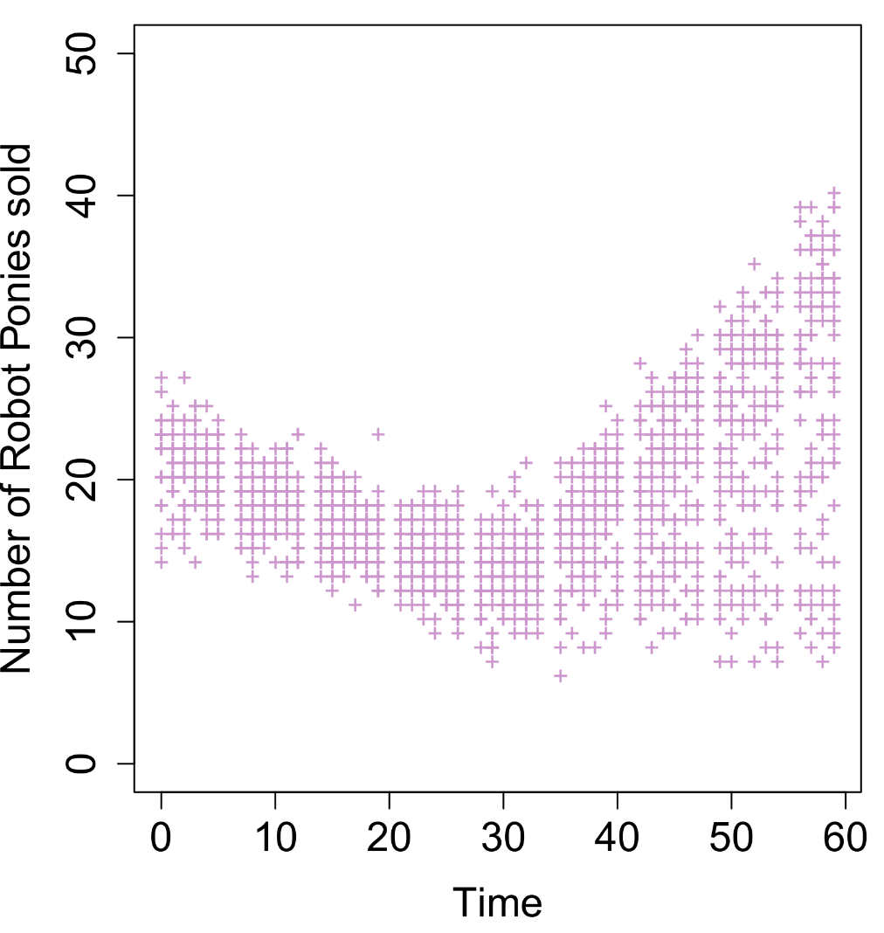
Choosing the longitudinal shape
Modelling for the longitudinal example proceeded differently than I previously recommended (= random effects, then fixed effects).
For these data, one has to decide first on the parametric shape of the longitudinal association (e.g., weekly averages, daily averages). Choosing this shape will necessarily involve a simultaneous selection of fixed and random effecs for that shape.
Exploring longitudinal changes with scatter smoothers (LOESS) or moving averages could give a good first idea of which shape may be needed!
Once the final shape has been chosen by model selection, one could add other variables and proceed according to the normal two-step strategy. This may involve new random effects, if there are time-varying covariates in the data.

Slide 61
Experimental intervention studies
Often in interventional studies, there will be two or more experimental groups present, such as:
Experimental group: Receives the intervention of interest (e.g, advertising, surgery, therapy)
Passive control group: Receives no intervention
Active control group: Receives a “placebo” intervention (e.g., mock stimulation, memory training)
While many studies only have the first two groups, having all three is recommended to exclude all trivial causal effects of the experimental intervention, primarily (II) mere time passing and (III) mere intervention.
The primary interest of experimental intervention will be to test the Group × Time interaction on the DV, in the sense that changes over time are expected to be different between groups.
The presence of passive and active controls allows the causal effect of the intervention to be inferred. However, this conclusion may be invalid in the presence of longitudinal confounding!

Slide 62
Longitudinal confounding
Longitudinal confounding occurs when the intervention (represented by the primary “Time” variable) covaries with other changes in the participant or environment (e.g., aging, seasonal changes). As a consequence, a significant Group × Time interaction may not have been caused by the intervention, but rather by these longitudinal changes, e.g.:
Type | Examples
Relative time | Days since launch of the study, days to intervention, days since intervention,…
Absolute time | Month of the year, day of the week, school semester,…
Dynamic environmental states | Covid19 severity, infection rate, death rate,…
Dynamic participant states | Biological cycles [sleep, stress], illness, mood,…
… | …
Month
Group
Time
Anxiety
Variables traditionally considered as longitudinal confounders include explicit time variables, and dynamic personal and environmental states. Some of these states may themselves be influenced by the the study’s intervention

Slide 63
Solutions to longitudinal confounding
Excluding longitudinal confounding can be started at the design-stage of the study, by (a) inclusion of a passive control group and (b) randomized condition assignment (RCA).
According to RCA, participants should have equal probability of being assigned to a group, regardless of their personal or environmental characteristics, including the time of the year (e.g, not all interventions in January and all controls in August).
At the analysis stage, longitudinal confounding should be excluded, by testing for group differences in (relative) timing. Specifically, one should establish:
That measurement times occurred on average at the same moment for all groups.
That the total amount of time participated in the study was on average the same for all groups.
That the relative time to intervention was on average the same for the intervention and active control groups.
That the relative time after intervention was on average the same for the intervention and active control groups.

Slide 64
Solutions to longitudinal confounding
The preceding checks could be accomplished by simple t-tests. If any test tuns up significant, any subsequent analyses need to adjusted for longitudinal confounders, e.g.:
lmer(Y ~ Group*Time +Duration+Month +Age+Gender+ (1+Time|ID)
This is not different than other forms of regression adjustment, such as adding age and gender covariates to exclude age and gender confounding. The multilevel model is flexible in that it allows covariates to vary at any level of measurement.
Recall that having time-varying covariates is not possible in traditional repeated measures (M)ANOVA, due to the wide format of the data!
This adjustment can fail if there is perfect longitudinal confounding (=collinearity) between groups and a time-varying variable (e.g., all interventions in January, all controls in August). In this case the analysis cannot exclude that the causal effect of intervention was actually due to other time-varying changes!

Slide 65
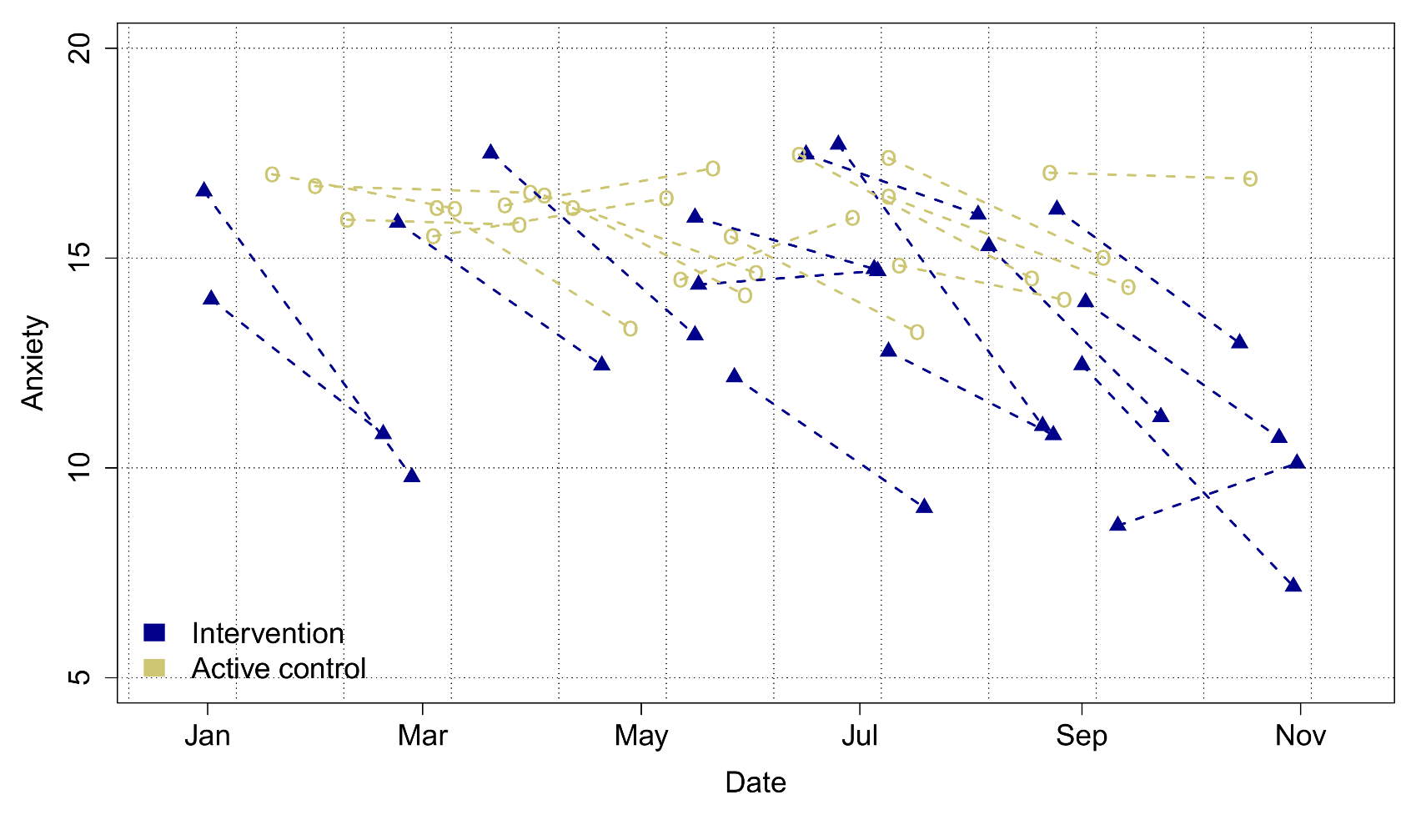
Unequal intervention times
In the example with the Robot Ponies, the intervention time was fixed to a single date for all stores. This will often not be true in intervention studies, with participants receiving their intervention at different times. Moreover, the duration between visits and intervention may also be unequal. For example:
Date of intervention

Slide 66
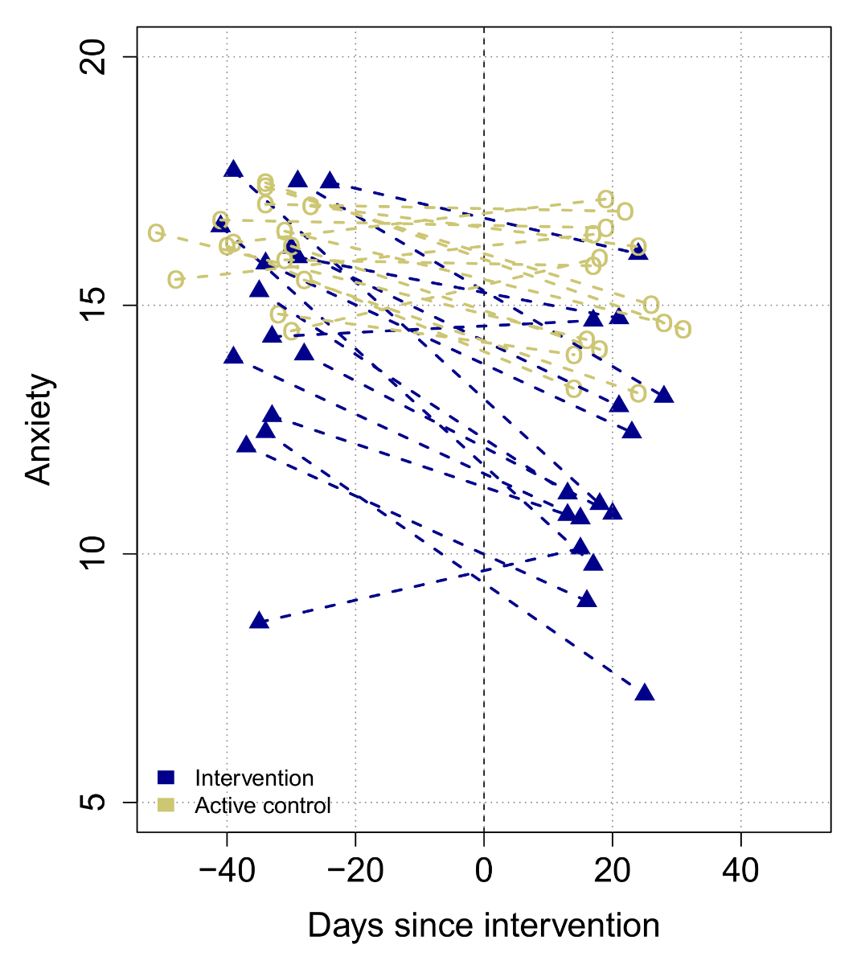
Unequal intervention times
With unequal intervention times, it is not possible to use an absolute time variable as a continuous IV.
The solution is to either (a) use categorical time representations (e.g., V0,V1; pre-post), or (b) anchor the continuous times to the intervention moment to yield a relative time IV.
The relative time IV can once again be used in a multilevel model as before, with the 0 time a natural knot point for spline models. Longitudinal confounders can still be added as before.
Caution: Computing relative times cannot be done with a passive control group, since there is no intervention for that group! Be careful when planning longitudinal studies like this!
Intervention date

