Slide 1



Common Misconceptions in Statistics
Ben Meuleman, Ph.D.
Swiss Center for Affective Sciences
Université de Genève
CISA retreat, Geneva
November 19, 2021

Slide 2

Personal background
2003 – 2007 Bachelor in Psychology
2007 – 2009 Master in Psychology
2009 – 2010 Master in Statistical Data Analysis
2011 – 2015 Ph.D. in Psychology
2016 – 2019 Postdoc in Psychology
2019 – … Statistician
Part-time statistical assistant at CISA (2011–2020), offering regular consulting services for researchers, and contributor of occasional workshops. Presented at the R Lunch series of UNIGE.
Next workshop on machine learning on 2-3 December!
http://use-r-carlvogt.github.io/prochains-lunchs/

Slide 3
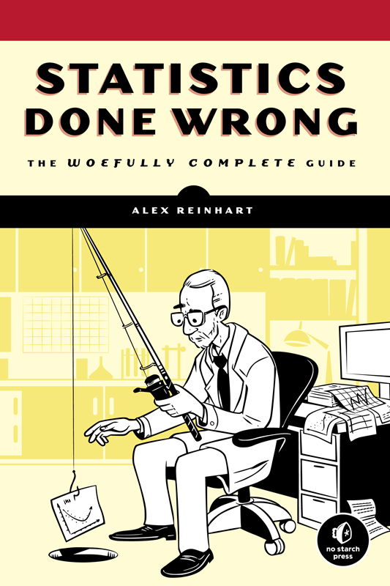
Background literature
For this workshop we will examine common misconceptions in statistics. The format will be rather informal and interactive.
However, as a background reference I recommend to check out the website and book Statistics Done Wrong, by Alex Reinhart (2015).
The author claims that no prior knowledge of statistics is assumed, and can be used with any level of expertise!
“Statistics Done Wrong is a guide to the most popular statistical errors and slip-ups committed by scientists every day, in the lab and in peer-reviewed journals. Many of the errors are prevalent in vast swaths of the published literature, casting doubt on the findings of thousands of papers.”
https://www.statisticsdonewrong.com/

Slide 4

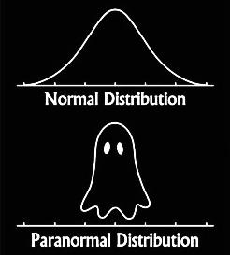
Source of the workshop
Present material was cannibalized from a longer, 2-hour workshop on «Common Pitfalls in Statistics». I decided to adapt the format for this retreat (shorter and more to the point).
Stat Tips
European Tour
2016–2021
10-10-16 – CISA peers
16-03-17 – CAL meeting
31-01-18 – CDSB meeting
02-04-18 – Aberdeen
19-11-21 – CISA retreat

Slide 5



Format of the workshop
Instead of making this a one-sided lecture, I will pose questions in a quiz format, to test your statistical knowledge.
We vote simply by show of hands. Players that choose a wrong answer will be eliminated.

Slide 6

Format of the workshop
Or maybe we’ll keep it non-violent…
For each question, we will vote and I will immediately discuss the—sometimes surprising—answer and its explanation.
If you like, keep track of how many questions you manage to answer correctly. The grand prize for today’s winner is to Bask in Eternal Glory for a good 5 minutes.
As a general structure, we will discuss issues according to the stages of study design:
Design
Data processing
Data analysis
Inter-pretation
Results reporting

Slide 7

1. Design and planning

Slide 8
Q1. Complex hypotheses require complex analyses
TRUE
FALSE

Slide 9
A1. FALSE
There is not necessarily a connection between the complexity of the hypothesis and the complexity of the analysis.
If a simple t-test is sufficient to test your hypothesis, then this should be preferred method for analysis.
Complex analyses introduce assumptions that you may not be aware of (e.g., SEM, random effects models, machine learning). You should only use these if (a) the study necessitates it and (b) you know what you are doing.
On the other hand, do not force your hypothesis to suit a t-test! Use a complex analysis if it is appropriate and can be motivated. Sometimes this requires challenging establishments…

Slide 10
Q2. Exploratory data analysis is BAD
TRUE
FALSE
It depends…

Slide 11
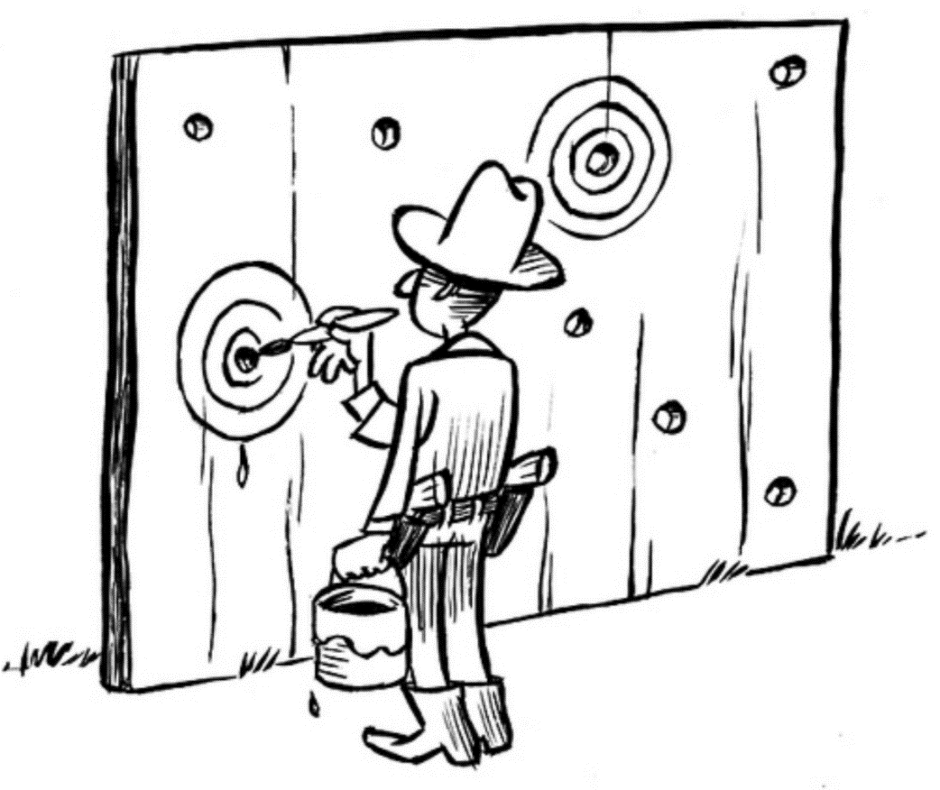
A2. It depends…
Data exploration
Devise hypothesis based on exploration
Test hypothesis on same data
One of the biggest problems in research today is that too much research/analyses are exploratory. Exploration is fine but not as a tool for inference!
Avoid circular inference with exploratory analyses! Hypotheses derived from exploratory analysis should be confirmed on independent data (i.e., cross-validation) or in future studies.
Texas sharpshooter fallacy: paint a target after the gun has been fired!

Slide 12
Q3. Randomized condition assignment prevents
Confounding
Mediation
Both
Neither

Slide 13
A3. Confounding
RCA of participants is intended to exclude confounding due to participant characteristics.
In the limit of an infinite sample size, RCA should guarantee that samples in different conditions are approximately equal. In practice, samples are often small. Is the RCA assumption still valid…?
RCA does not prevent mediating processes to intervene between the manipulation and the observed outcome!
RCA does not prevent confounding due to other experiment characteristics (e.g., experimenter, stimulus, setup)!
Participant confounding
Mediating processes
RCA
Y

Slide 14
Q4. Within-subjects designs are superior to between-subjects designs…
…in statistical power
…in the ability to draw causal conclusion
Both
Neither

Slide 15

A4. Both
Within-subject designs have more statistical power than the corresponding between-subjects design (Maxwell & Delaney, 2004).
This is because the analysis model (e.g., repeated measures ANOVA) takes out measurement error that can be attributed to participant differences. As a consequence, fewer participants will generally be needed to detect the same effect.
In addition, within-subjects designs permit stronger causal inferences, due the participant sample remaining exactly the same across conditions.
Within-subjects designs may require randomized order assignment, however!
Condition A
Condition B
BS
WS

Slide 16
Q5. It is okay to design and run the study first, and worry about the analysis afterwards
TRUE
FALSE

Slide 17
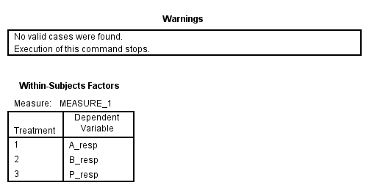
A5. FALSE
This is not so much a common misconception as a common malpractice, unfortunately!
When designing a study, plan your data analysis in advance. The design should be created with the analysis in mind!
Failing to be careful here frequently leads to problems, especially with so-called partial within-subjects designs! Assign participants either fully between or fully within conditions.
Many analyses can handle only complete cases!
ID | P | A | B
S1 | 0.21 | 0.56 | .
S2 | 0.32 | . | 0.56
S3 | 0.78 | 0.05 | .
…
SN | 0.22 | 0.37 | .

Slide 18
2. Data processing

Slide 19
Q6. Median split is a reasonable statistical procedure
TRUE
FALSE

Slide 20
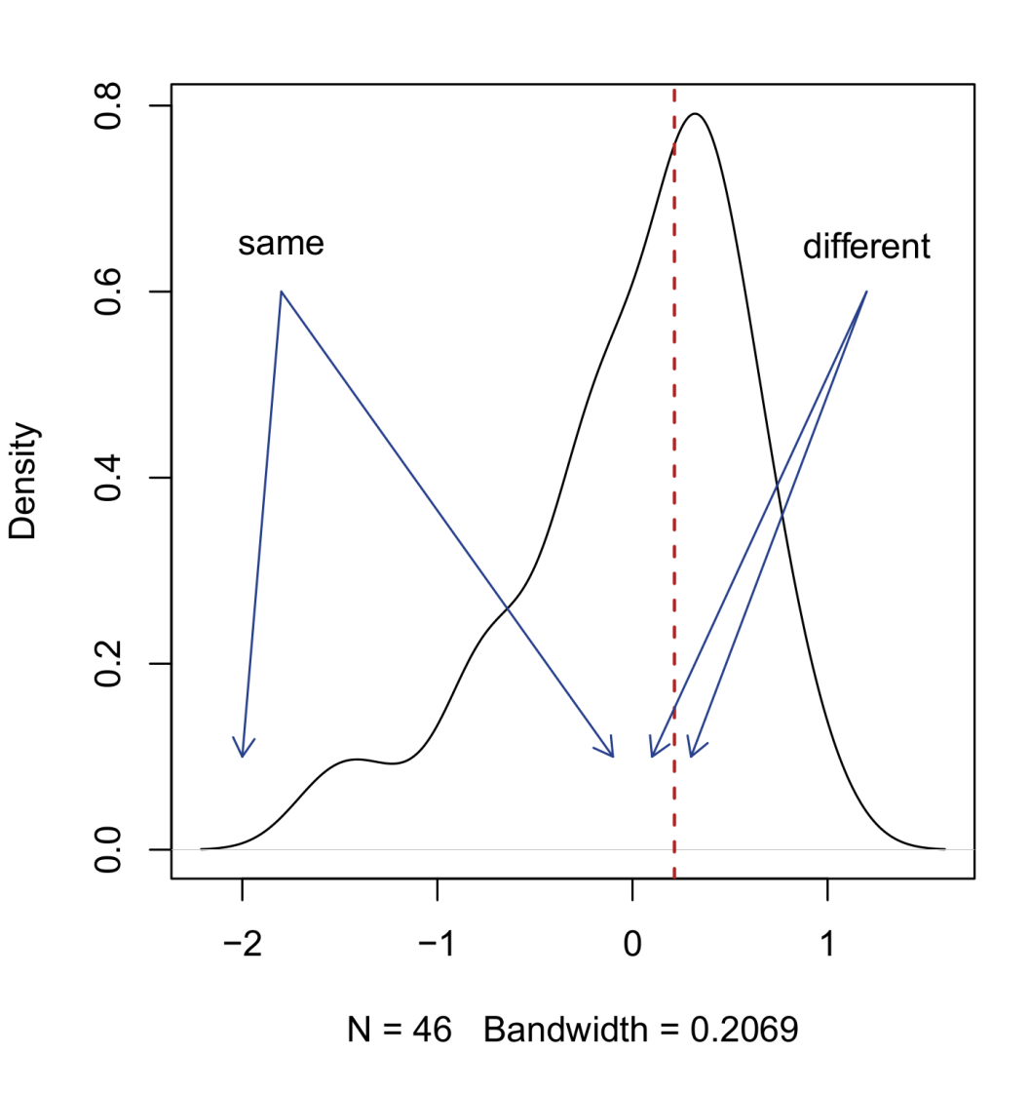
A6. FALSE
Sometimes researchers transform a continuous variable into a categorical variable with a median split. All values below the median become one category (e.g., 0), and all values above the median another (e.g., 1).
Median split is a bad idea for four reasons:
Loss of power in hypothesis testing (Preacher et al., 2005)
Variability of the median across samples
Arbitrariness of categorization close to the median
Loss of continuous/linear information
Should only be used for exploratory purposes, or when the underlying data is bimodal (latent categorical)!

Slide 21
Q7. A good criterion for removing outliers is the 2.5 SD cutoff
TRUE
FALSE

Slide 22
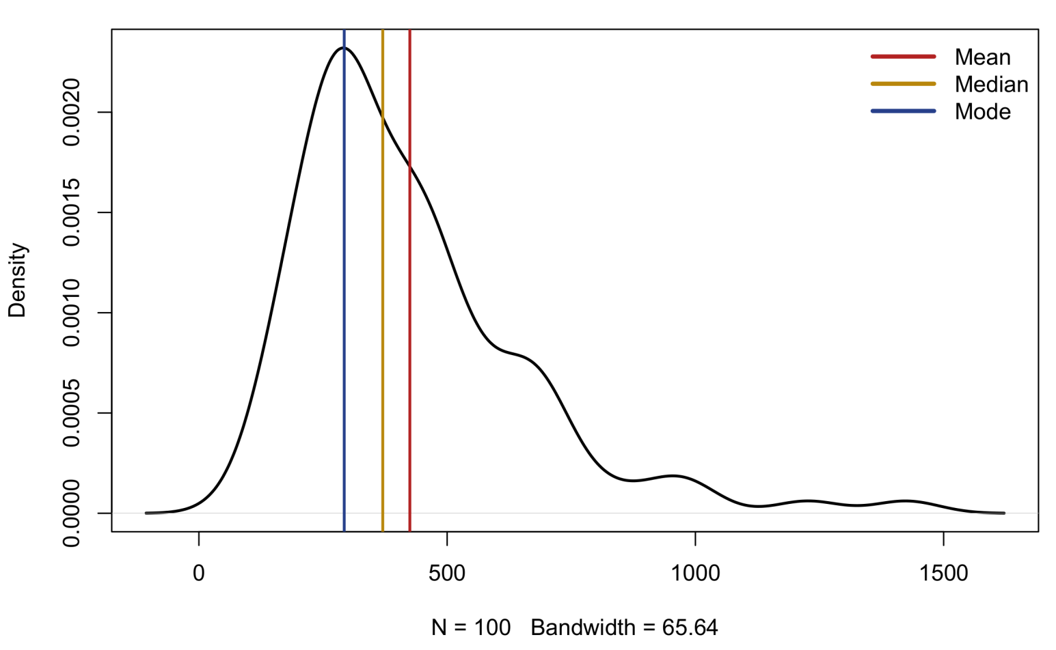
A7. FALSE
The SD is itself sensitive to outliers! This is not a weakness for rank statistics, such as median and interquartile distance, which are produced by boxplots.
For reaction times (RT) in multiple-trial experiments, the 2.5 SD cutoff is often a step toward creating a “trimmed mean” per condition.
However, think about the point of having multiple trials! Usually this is because we want to get a good estimate of a person’s typical response in a condition, not just a single response at a particular trial.
Does an average/mean always reflect a person’s typical response…?

Slide 23
3. Data analysis

Slide 24
Q8. Pearson correlation coefficient is a standardized regression coefficient
TRUE
FALSE

Slide 25
Q8. TRUE
Many researchers are not aware that the Pearson correlation between two variables is identical to the standardized regression coefficient for the equivalent one-way regression.
The t- and p-values will be identical between the regression ANOVA and the correlation test.
The order of X-Y does not matter in this scenario! For a regression with multiple predictors, this equivalence will no longer be true!
> lm(Height~Volume,data=trees)
Coefficients:
(Intercept) Volume
69.0034 0.2319
> cor(trees$Volume,trees$Height)
[1] 0.5982497
> lm(scale(Height)~scale(Volume),data=trees)
Coefficients:
(Intercept) scale(Volume)
1.392e-16 5.982e-01

Slide 26
Q9. Which of these is NOT a special case of multiple linear regression?
ANOVA
Repeated measures MANOVA
Pearson correlation
Paired t-test
All are special cases

Slide 27
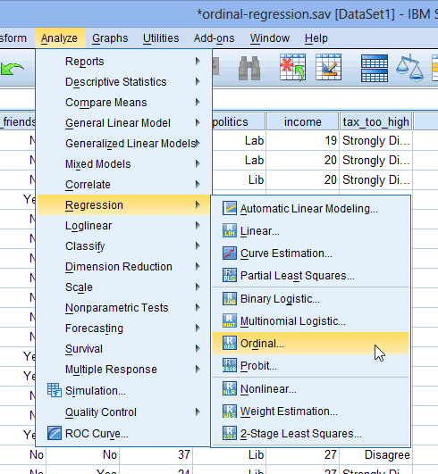
A9. All are special cases
Analysis name | Dependent / outcome | Independent / predictor
One-way regression | 1 continuous | 1 continuous
Multiple regression | 1 continuous | +1 continuous
Independent samples t-test | 1 continuous | 1 categorical (2 levels)
One-way ANOVA | 1 continuous | 1 categorical (+2 levels)
Multi-way ANOVA | 1 continuous | +1 categorical
ANCOVA | 1 continuous | +1 continuous and categorical
Pearson correlation | 1 standardized continuous | 1 standardized continuous
One-sample t-test | 1 continuous | Intercept only
Paired t-test | 1 continuous difference score | Intercept only
Hotelling's T-test | +1 continuous | 1 categorical (2 levels)
MANOVA | +1 continuous | 1 categorical (+2 levels)
Multivariate multiple regression | +1 continuous | +1 continuous and categorical
SPSS, confusing researchers since 1968!

Slide 28
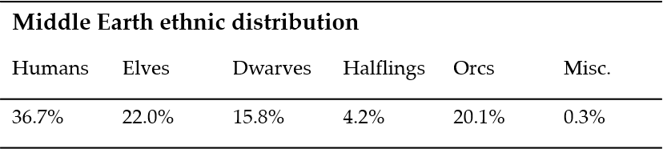
Q10. A chi-square test can be applied to a one-dimensional frequency table
TRUE
FALSE

Slide 29
A10. TRUE
It is a common misconception that a chi-square test can only be applied to a two-dimensional table. Adding to confusion, some software only accept two-dimensional tables for analysis!
However, the chi-square test can just as well be applied to a one-dimensional table, including the case where there are only two proportions to compare!
The interpretation of a significant one-dimensional chi-square test is that, for a variable A with a (categorical) levels, at least one pair of observed frequencies is significantly different from each other

Slide 30
Q11. Bayesian statistics are a class of non-parametric statistics
TRUE
FALSE

Slide 31
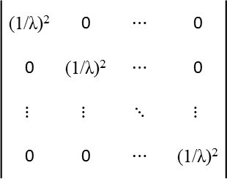



Q11. FALSE
Bayesian statistics are more parametric than standard parametric statistics! This is because of the addition of prior distributions, on top of data distributions.
Standard regression only makes a distributional assumption about the residuals. Bayesian normal regression also makes a distributional assumption about the coefficients!
Y = β₀ + β₁X + ε
$$ε \sim N(0,σ^{2})$$
(1/λ)² | 0 | $$⋯$$ | 0
0 | (1/λ)² | $$⋯$$ | 0
$$⋮$$ | $$⋮$$ | $$⋱$$ | $$⋮$$
0 | 0 | $$⋯$$ | (1/λ)²
$${β \sim N}_{P}(0,Σ)$$
$$Σ=$$

Slide 32
Q12. It is possible to infer causality from observational data
TRUE
TRUE-ish
FALSE

Slide 33
A12. TRUE-ish
It is sometimes assumed that causal inference can only be conducted on experimental data. This is not true! Many methods and models for causal inference have been developed precisely for observational data (e.g., the Rubin causal model, SEM).
These methods become necessary in situations where running an experiment would be ethically or practically unfeasible (e.g., smoking and health).
One of the most widely used methods for causal inference in social sciences is structural equation modelling (SEM), which includes its special cases of mediation analysis, path analysis, and confirmatory factor analysis.

Slide 34
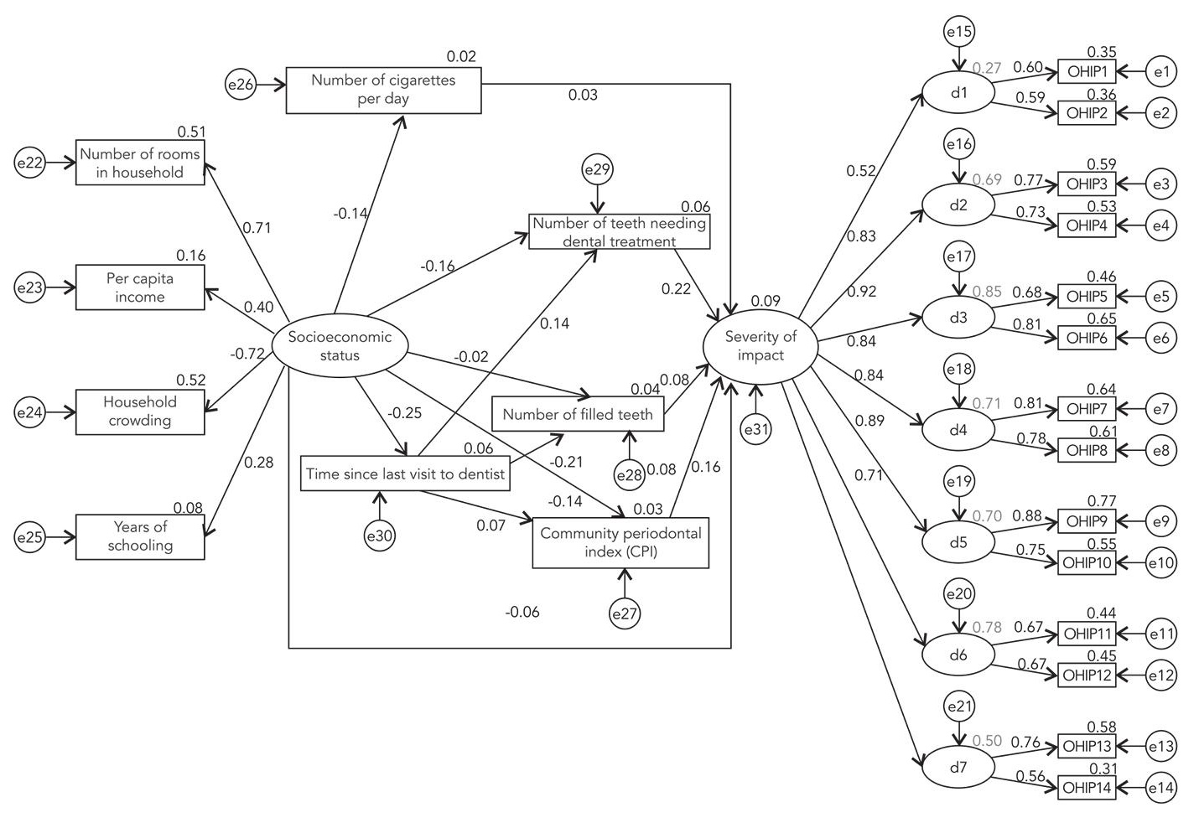
A12. TRUE-ish
Methods for causal inference in observational data typically share the same central assumption: The model includes all relevant confounders and mediators for estimating the targeted causal effect!
In practice this assumption is very unrealistic! Do not take too much faith in a SEM diagram!
Moreover, SEM is one of the least exploratory methods in statistics! You should always apply this in a confirmatory manner, preferably by validating your SEM on external/independent data…
Setting relationships to 0 in a causal diagram is a strong assumption!
(Silveira et al., 2004)

Slide 35
4. Interpretation and follow-ups

Slide 36
Q13. A p-value is the probability that a given null hypothesis is true
TRUE
FALSE

Slide 37
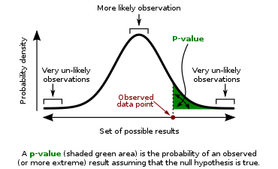
A13. FALSE
A p-value quantifies the probability of observing the estimated value of a statistic (or larger), under the assumption that the null hypothesis is true.
These values are obtained directly from the null distribution of the statistic (e.g., a t-distribution).
When the p-value drops below a fixed threshold (i.e., the significance level), we reject the null hypothesis. Otherwise we conclude that there is insufficient evidence to reject the null hypothesis.*
P-values do not quantify the probability that the null hypothesis is true, nor any alternative hypotheses. Often an infinite number of alternative hypotheses is compatible with a rejection of the null hypothesis.
* This is not the same as accepting the null hypothesis!

Slide 38
Speaking of p-values… Trends!
P-values in the range of 0.05 to 0.10 are sometimes interpreted as marginally significant, or as reflecting trend effects. These are dubious claims for a number of reasons:
The point of having a certain significance level is to maintain an objective treshold for statistical inference. Stretching the level introduces subjective bias to these decisions.
The interpretation of the trend’s direction is basically arbitrary. A trend to significance might as well reflect a trend to insignificance! In fact, if we allow p = 0.06 to be marginally significant we should also allow p = 0.04 to be marginally insignificant!
If the null hypothesis is actually true, p-values for tests have a uniform distribution, meaning you are just as likely to observe p = 0.99 as p = 0.07. This makes insignificant p-values not actually comparable to significant p-values!

Slide 39
Q14. Planned comparisons need to be corrected for multiple testing
TRUE
FALSE

Slide 40
A14. TRUE
It is sometimes claimed that when individual comparisons are planned a-priori, they do not need to be corrected for multiple testing. This is obviously not true!
What is true is that planned comparisons are less likely to turn up false positives, due to them not being guided by post-hoc data exploration. Otherwise a family of planned comparisons should not be treated much differently from any other!
Besides, if not correcting planned comparisons was acceptable, one could «plan» dozens of comparisons and get away with no corrections.
For a completely exploratory family of comparisons, it is recommended to use very conservative corrections, such as the Bonferroni or (better) Scheffé correction (see Maxwell & Delaney, 2004).

Slide 41
Q15. When my overall F-test is significant, follow-up tests do not need to be corrected for multiple testing
TRUE
FALSE
FALSE-ish

Slide 42
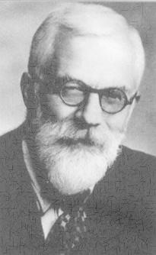

A15. FALSE-ish
It is sometimes claimed that individual tests following a significant overall ANOVA do not have to be corrected for multiple testing.
This approach is known formally as Fisher’s LSD. No explicit correction factor is applied to the p-values. Instead, testing proceeds in two stages: (I) an omnibus test for the family of comparisons (e.g., F-test). If significant, we proceed with (II) individual tests (e.g., t-tests).
The idea is that the omnibus test will act as an initial filter, making it less likely that false positives show up for follow-up tests. This is reasonable intuition but in practice the approach fails when there is an overwhelming number of non-significant tests in the presence of a few significant ones.
In practice, Fisher’s LSD works better in the other direction of reasoning: if an overall test is insignificant, you should not proceed with individual tests!

Slide 43
Q16. Normality of residuals is the most important assumption in linear regression
TRUE
FALSE

Slide 44
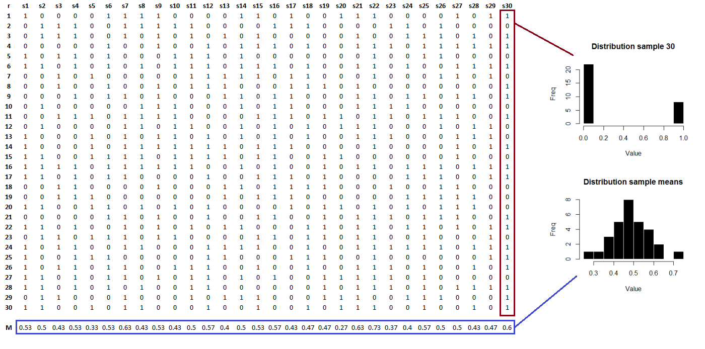
A16. FALSE
Mean of a vector of binary data = proportion of 1s

Slide 45
A16. FALSE
We never conduct statistical inference on raw data. Instead, inference is conducted on aggregated/derived quantities (i.e., “statistics”). It is these quantities that should be normally distributed for the test to be valid, not the raw data.
In fact, it turns out that, thanks to the central limit theorem, aggregated quantities indeed tend to be normally distributed as the sample size increases, no matter the distribution of the raw data. In the previous example the raw data was even binary!
With as little as 30 observations, the normal approximation for the means was quite good for the binary example!
This result is one of the foundations of statistical inference, and clearly illustrates why normality is a vastly overrated assumption. Yet, researchers have been overwhelmingly obsessed with this assumption, at the expense of most others.

Slide 46
Q17. Non-parametric tests can correct for which of the following problems
Confounding
Multicollinearity
Unequal variances (heteroscedasticity)
Auto-correlation
None of the above

Slide 47
A17. None of the above
Assumption | Impact of violation | Solutions | Non-parametric solution?
Multicollinearity | Severely inflated SEs, unstable parameter estimates | Variable removal, factor analysis, ridge regression | 
(Co)variance | Under- or over-estimated SEs | Weighted least squares, random effects, variance models, Greenhouse-Geisser correction | 
Independence | Underestimated SEs | Autoregressive modelling, weighted least squares, repeated measures models | 
Specification | Weak predictive strength. Causal deficiencies |  | 
Outliers/influential cases | Biased means and SEs. Other assumption violations. | Data transformations, robust regression, quantile regression, data deletion, rank tests | 
Linearity | Biased means and SEs. Other assumption violations. | Data transformations, nonlinear modelling, machine learning, rank tests | 
Missingness | Biased means and SEs | Missing data imputation, complete case analysis | 
Sample size | Unreliable means | Exact tests, permutation tests | 
Normality | Biased SEs | Data transformations, rank tests, permutation tests, bootstrap tests | 
Statistical issues and assumptions, ranked by the impact of their violation.

Slide 48
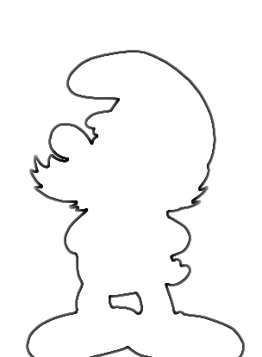
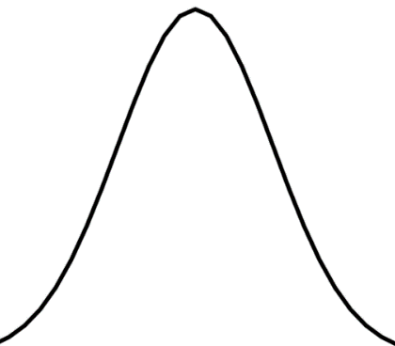
A17. None of the above
Parametric t-test
Permutation t-test
Density
Density
Group A
Group B
Group A
Group B
Gaussian shape
Equal variances
Arbitrary shape
Equal variance!

Slide 49
Q18. Descriptive/visual diagnostics are better than significance tests on assumptions
TRUE
FALSE

Slide 50
A18. TRUE
Test | Assumption | Problems | Reference
F-ratio test | Heteroscedasticity | Collapses in small samples and for departures from normality | Rakotomalala, 2008
Levene's test | Heteroscedasticity | Assumes symmetry of data around the mean, low power | Delacre, Lakens, & Leys, 2017; Nordstokke & Zumbo, 2007
Brown-Forsythe test | Heteroscedasticity | Low power for small to moderate deviations from homoscedasticity | Glass and Hopkins, 1996
Mauchly's sphericity test | Sphericity | Collapses in small and large samples, and for departures of normality | Keselman, Rogan, Mendoza & Breen, 1980
Box's M test | Equality of covariance matrices | Requires multivariate normality, problematic in small and large samples | Manly, 2004; Warner, 2013
Kolmogorov-Smirnov test | Normality | Low power in small samples, conservative bias regardless of sample size | Oztuna, Elhan & Tuccar, 2006; Thode, 2002
Shapiro-Wilk test | Normality | Low power in small samples | Oztuna, Elhan & Tuccar, 2006

Slide 51
Q19. The standard deviation (SD) of a statistic is called the standard error (SE) of that statistic
TRUE
FALSE

Slide 52
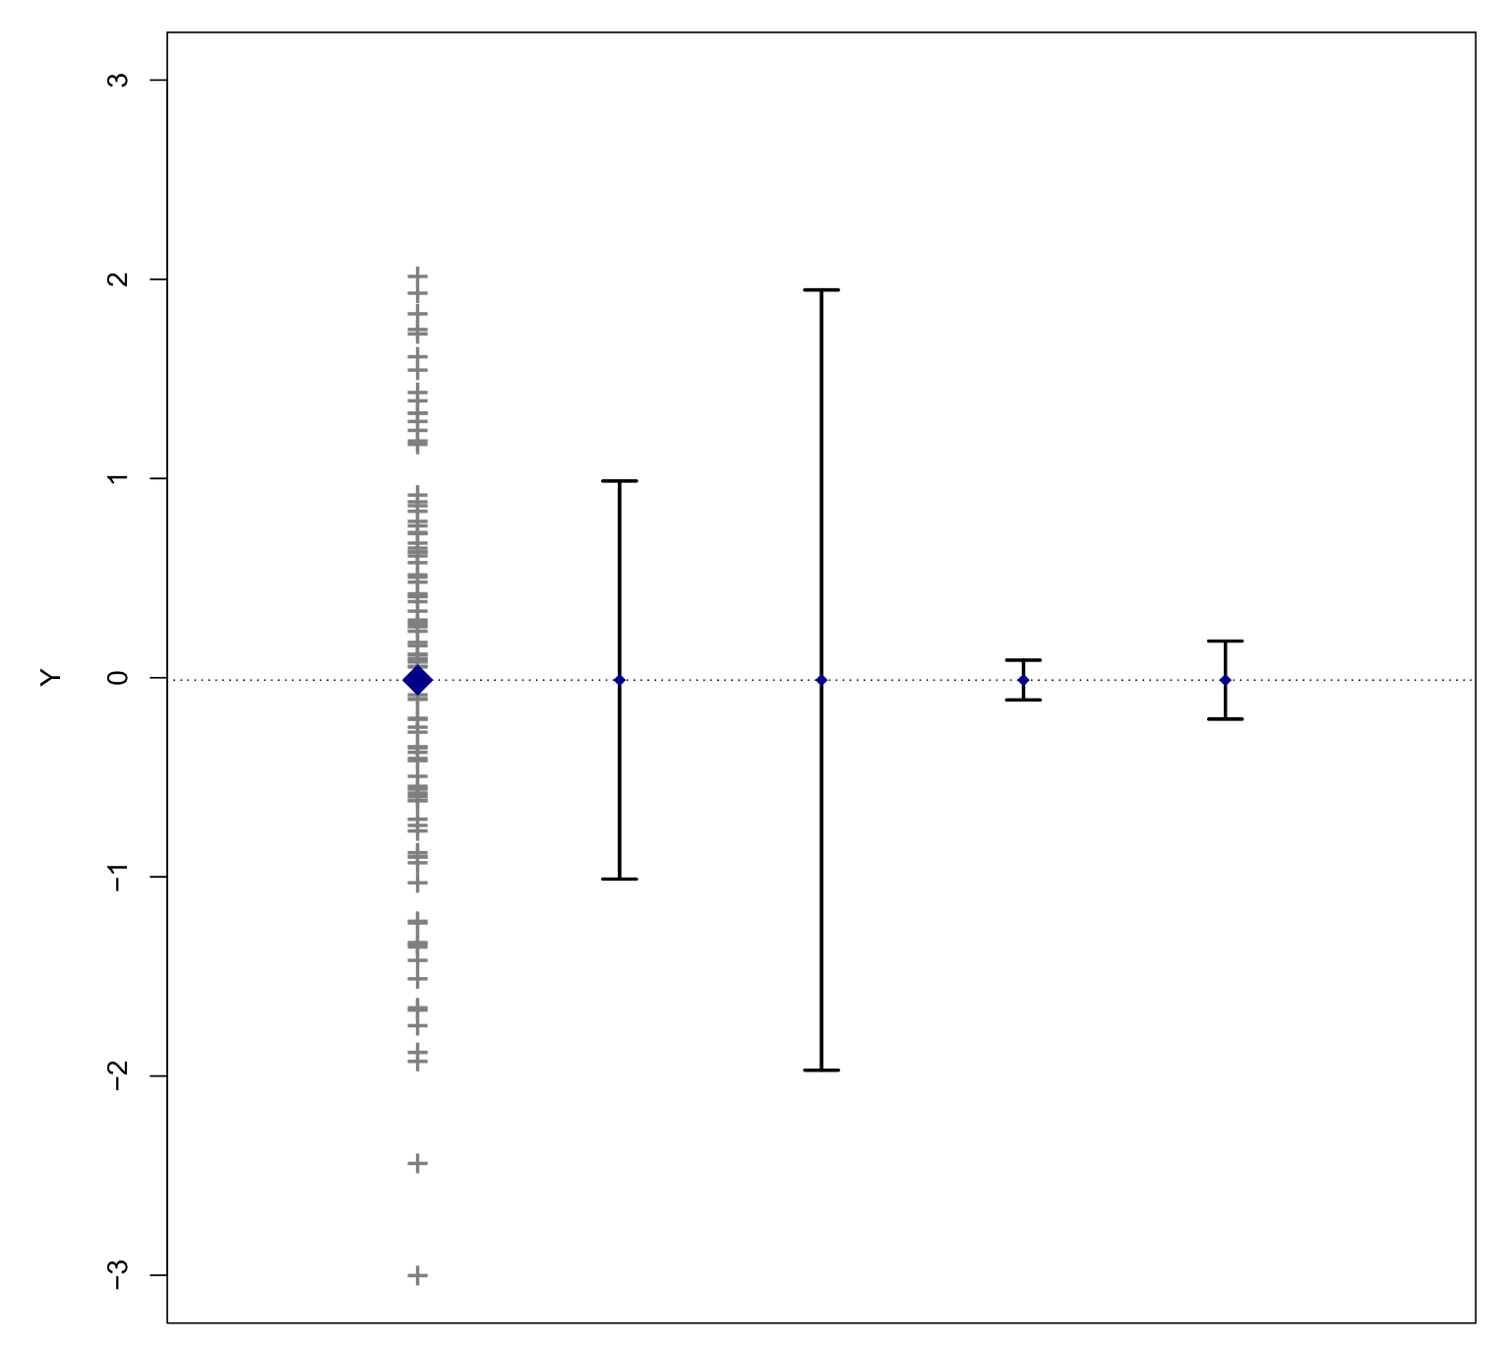
A19. TRUE
Researchers do not always understand the difference between standard deviations (SD) and standard errors (SE), and which to report in a paper.
A standard deviation (SD) generally refers to a measure of spread around an average. Conventionally, this term is reserved for denoting the spread of some sample data around its average.
A standard error (SE) is the standard deviation of an estimated statistic (e.g., an average, a variance, or a regression coefficient). SEs are theoretical quantities, derived from distributional assumptions on the statistic in question.
SEs are directly used for hypothesis testing. Almost all test statistics are constructed by dividing the estimated statistic by its standard error.
Sample data
Sample SD
Sample 95% CI
Mean
SE
Mean
95% CI
Sample average

Slide 53
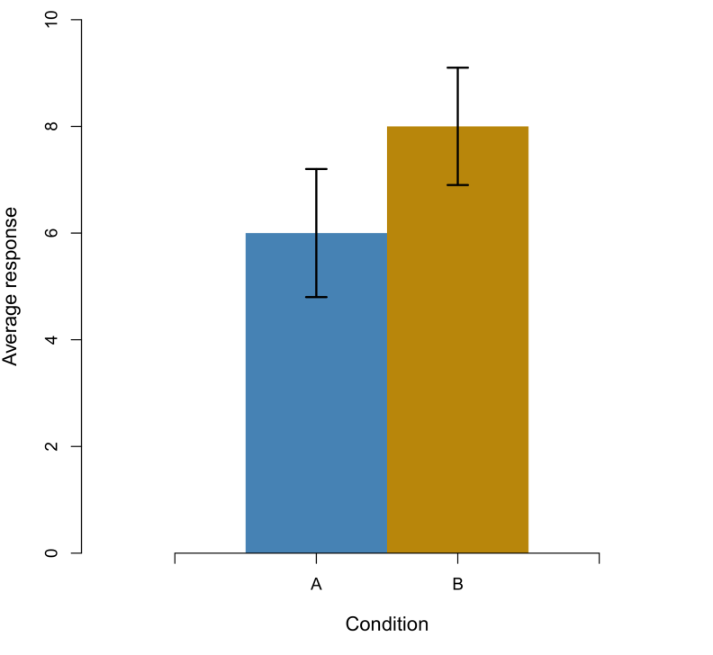
Q20. What can we conclude from this plot?
The group means are significantly different
The group means are not significantly different
There is not enough information to draw conclusions about significant differences
FIG. Average response in two experimental groups, with 95% confidence intervals depicted.

Slide 54
A20. Not enough information
In a paper, it is rarely of interest to report sample SDs. Normally we are interested in making inferences about typical effects (e.g., an average response). Therefore we are also interested in the variation of that typical response, which is quantified by an SE.
Adding error bars to graphs would be recommended but in practice this turns out to be quite complicated.
It is widely misunderstood that overlapping error bars between groups indicate non-significant group differences. This is not true (see Belia et al., 2005)!
For within-subjects designs, error bars should be adjusted for repeated-measures correlation. However, even for between-designs, overlapping error bars do not necessarily indicate non-significant group differences!

Slide 55
Thank you for your attention…!

