Slide 1



Logistic Regression I
Ben Meuleman, Ph.D.
Swiss Center for Affective Sciences
Université de Genève
Workshop series on advanced statistical topics
November 17, 2022

Slide 2

Personal background
2003 – 2007 Bachelor in Psychology
2007 – 2009 Master in Psychology
2009 – 2010 Master in Statistical Data Analysis
2011 – 2015 Ph.D. in Psychology
2016 – 2019 Postdoc in Psychology
2019 – … Statistician
Doctoral dissertation—including two publications—written on the application of machine learning to emotion data.
Part-time statistical assistant at CISA, offering regular consulting services for researchers, bi-monthly mailings, and workshops (machine learning, multilevel regression, statistics tips). Presented twice at the R Lunch series of UNIGE.
http://use-r-carlvogt.github.io/prochains-lunchs/

Slide 3

This workshop series – Post-pandemic Edition
Originally this was the third of 4 monthly workshops for 2020:
25.01 Non-parametric data analysis
17.03 Multilevel regression
21.04 Logistic regression
26.05 + 27.05 Machine learning
The pandemic disrupted this planning, with workshops on machine learning and multilevel regression ultimately preceding logistic regression. Today we will finally discuss LR, in three parts, (a) analysis of frequency tables, (b) logistic regression, and (c) models for paired categorical data.
All three parts can be followed without having participated in previous workshops. A fourth part on multilevel models for categorical outcomes has been postponed for the moment.
Throughout my slides, I will provide R code that you can execute in parallel with the presentation (see attached scripts). Data are sourced directly from switchdrive, so no need to have data files pre-loaded.

Slide 4
Contents
Analysis of frequency tables
Proportions and binomial tests
2 × 2 tables – Odds ratios
A × B tables – Chi-square analysis
A × B × C tables – Log-linear analysis
Binary logistic regression
Two-group difference
Continuous predictor
Multiple predictors
Model fit and diagnostics
Extensions to logistic regression
Analysis of paired categorical data

Slide 5
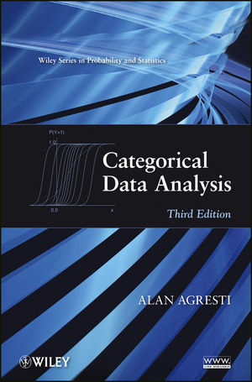
Background literature
Agresti, A. (2012). Categorical Data Analysis (3rd edition). John Wiley and Sons.
Standard reference work on categorical data analysis. Extremely detailed and comprehensive but also highly mathematical and dry.
Up until the 2nd edition, practical examples were for SAS language only, which is an expensive software for which UNIGE does not have a license.
The 3rd edition reportedly has new examples in R, but I have not had a chance to review them.
The 2nd edition is in my book collection and can be borrowed on request!

Slide 6

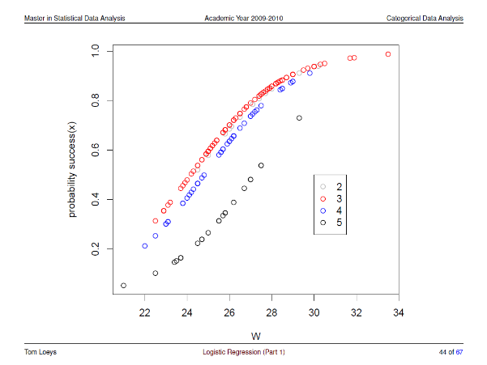
Background literature
Rosseel, Y. (2008). Categorical Data Analysis. Course slides for the Master in Statistical Data Analysis. University of Ghent, 2008–2009.
I have shared in the dropbox folder slides of the course Categorical Data Analysis (2008–2009), which I followed in my master studies on statistics.
These slides broadly follow the outline of Agresti (2002), but adapted for teaching and with numerous practical examples in R. My own lecture was partly inspired by this material.
The teacher of the Ghent course was Prof. Tom Loeys but the slides were originally created by Prof. Yves Rosseel, famous as the author of R package lavaan for structural equation modelling (SEM).

Slide 7
1. Analysis of frequency tables
A. Proportions and binomial tests

Slide 8

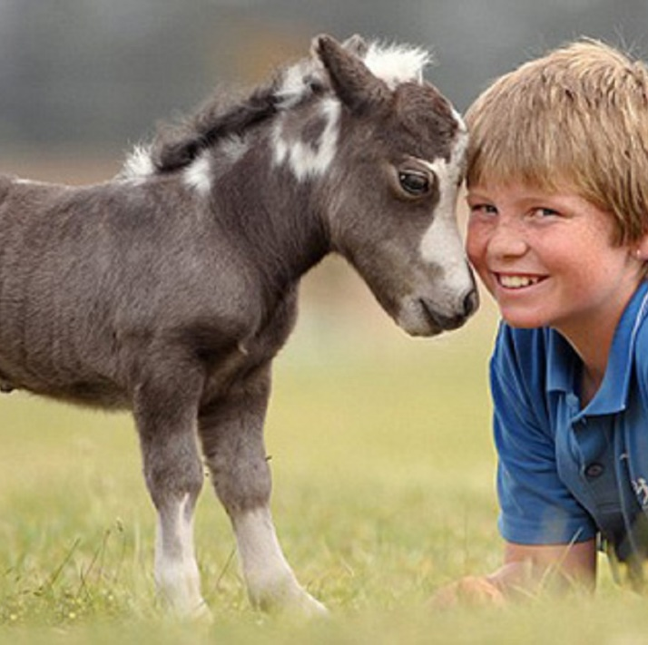
Let me ask you a question…
Would you rather…
Fight 1 horse-sized duck?
Fight 100 duck-sized horses?
A
B

Slide 9
Counting and proportions
Counting is one of the simplest ways to aggregate and collect data. For example:
A | How many people in a group choose A over B in a dilemma?
B | How many men and women in a group?
C | How many people in a group pass an exam?
D | How many times does a coin-flip turn up heads?
E | Which of 6 age categories (baby, child, adolescent, young adult, old adult, elderly) does each person in a group belong to?
F | How many people in a group belong to each of the 12 zodiac signs?
G | How many people own a cat or a dog?

Slide 10
Counting and proportions
In examples (A)–(D), the choices are binary and exclusive. There are two options, and only one option can be realized at a time or per person.
Examples (A)–(D) can be expressed as simple proportions, e.g., [counts A] / [total counts], with the proportion of As complimentary to the proportion of Bs.
In example (E) and (F), there are >2 options to choose from and they are exclusive. In example (F), the categories are ordered, whereas in all other examples, they are purely qualitative.
In example (G), there are two options but they are not necessarily exclusive. A person can own both a cat and a dog, or neither.*
A | How many people in a group choose A over B in a dilemma?
B | How many men and women in a group?
C | How many people in a group pass an exam?
D | How many times does a coin-flip turn up heads?
E | How many people in a group belong to each of the 12 zodiac signs?
F | Which of 6 age categories (baby, child, adolescent, young adult, old adult, elderly) does each person in a group belong to?
G | How many people own a cat or a dog?
Today's lecture will not focus on data of the types (E)–(G)!
* Note that, in example (A), the question forces the respondent to make an exclusive choice.

Slide 11

Test on a single proportion
For binary exclusive choices, we can tabulate the choices simply as:
This reflects the “distribution” of choices for this variable. We might now wonder if the distribution of the two choices is significantly different in this sample. This is equivalent to asking if the proportion of one choice is significantly different from 50%. This can be accomplished with a proportion test. In R:
prop.test(x=13, n=32, p=0.50)
With x the raw count of the option we are interested in, n the total count among both options, and p our null-hypothesis proportion, which is by default assumed to be 0.50.
Which would you rather fight?
 | 1 duck | 100 horses | N
Count | 13 | 19 | 32
Proportion | 0.406 | 0.594 | 1.000

Slide 12

Test on a single proportion
The output will return familiar statistics:
Based on the result, we conclude there is insufficient evidence that the proportion of 1-duck choices significantly outnumbered the proportion of 100-horses choices, $\hat{π}$_{1duck} = 0.406, χ²(1) = 0.781, p = 0.377.
Where are these numbers coming from…?
1-sample proportions test with continuity correction
data: 13 out of 32, null probability 0.5
X-squared = 0.78125, df = 1, p-value = 0.3768
alternative hypothesis: true p is not equal to 0.5
95 percent confidence interval:
0.2421914 0.5921457
sample estimates:
p
0.40625

Slide 13


Inference on binomial parameters
Proportions are binomial parameters. For Gaussian parameters (e.g., linear regression coefficients), we are familiar with the t-value as a test statistic. The t-value equals the estimated parameter divided by its standard error. This way of constructing the test statistic is known as a Wald test.
For binomial parameters, there have been historically three different ways of constructing a test statistic, each with its own confidence interval, but all derived from the parameter's maximum likelihood (ML) function:
Wald test
Score test
Likelihood ratio (LR) test
All three rely on large-sample normality, such that the test statistic converges to a standard normal distribution (z-distribution), or a χ² distribution (χ²-distribution) for increasing sample size. The prop.test function in R returns a score test, but in practice this does not make much difference. Results will be interpreted by the analyst as another generic χ² test.
Wald test statistic
$$\frac{\hat{π}− π_{0}}{\sqrt{SE\left(\hat{π}\right)}}$$
$$=\frac{\hat{π}− π_{0}}{\sqrt{\hat{π}\left(1 − \hat{π}\right)}/n}$$
Having different methods to arrive at a similar test statistic is not unusual. Recall that for multivariate tests, there are four common test statistics to derive an F-value: Wilks' lambda, Pillai trace, Hotelling-Lawley trace, and Roy's largest root.

Slide 14
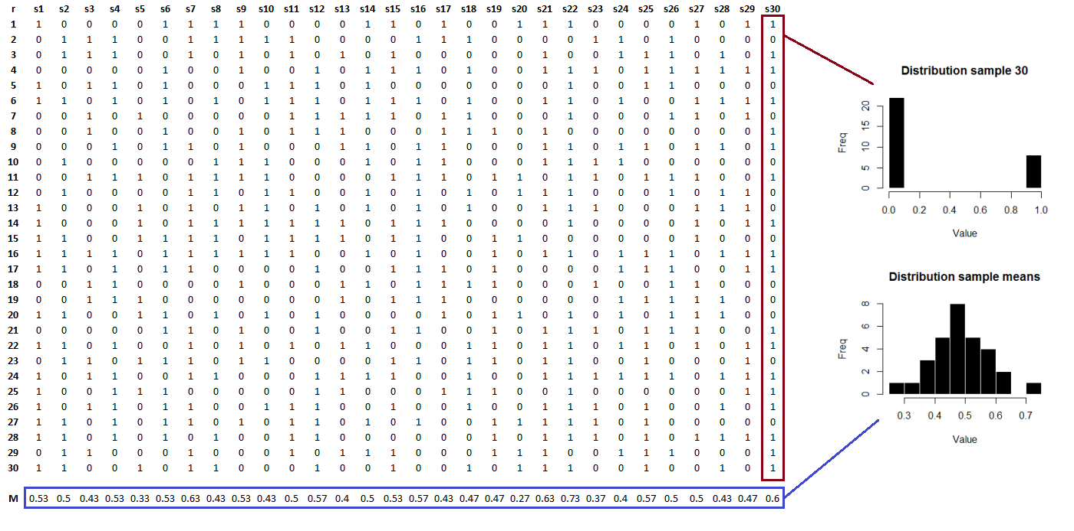
Large sample normality
Proportions are averages! In a sample of binary data, the average = proportion of 1s.

Slide 15

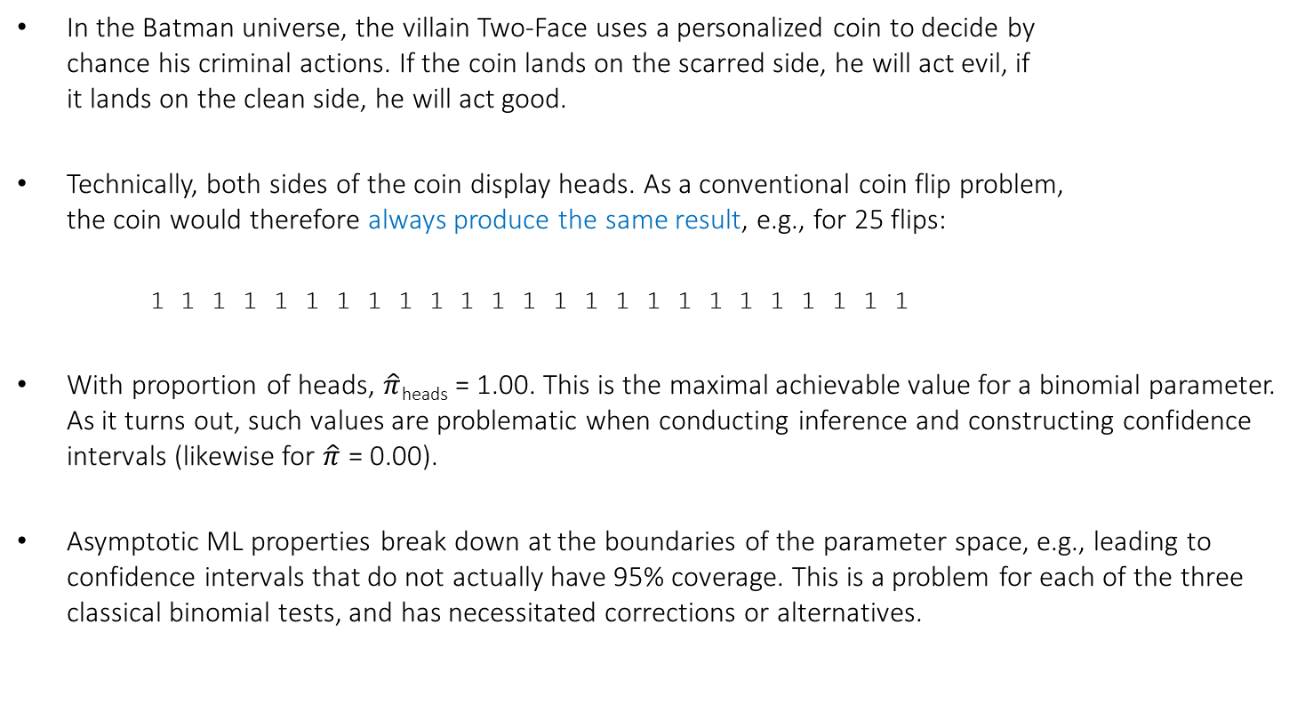
Problems with binomial inference
In the Batman universe, the villain Two-Face uses a personalized coin to decide by chance his criminal actions. If the coin lands on the scarred side, he will act evil, if it lands on the clean side, he will act good.
Technically, both sides of the coin display heads. As a conventional coin flip problem, the coin would therefore always produce the same result, e.g., for 25 flips:
1 1 1 1 1 1 1 1 1 1 1 1 1 1 1 1 1 1 1 1 1 1 1 1 1
With proportion of heads, $\hat{π}$_{heads} = 1.00. This is the maximal achievable value for a binomial parameter. As it turns out, such values are problematic when conducting inference and constructing confidence intervals (likewise for $\hat{π}$ = 0.00).
Asymptotic ML properties break down at the boundaries of the parameter space, e.g., leading to confidence intervals that do not actually have 95% coverage. This is a problem for each of the three classical binomial tests, and has necessitated corrections or alternatives.

Slide 16
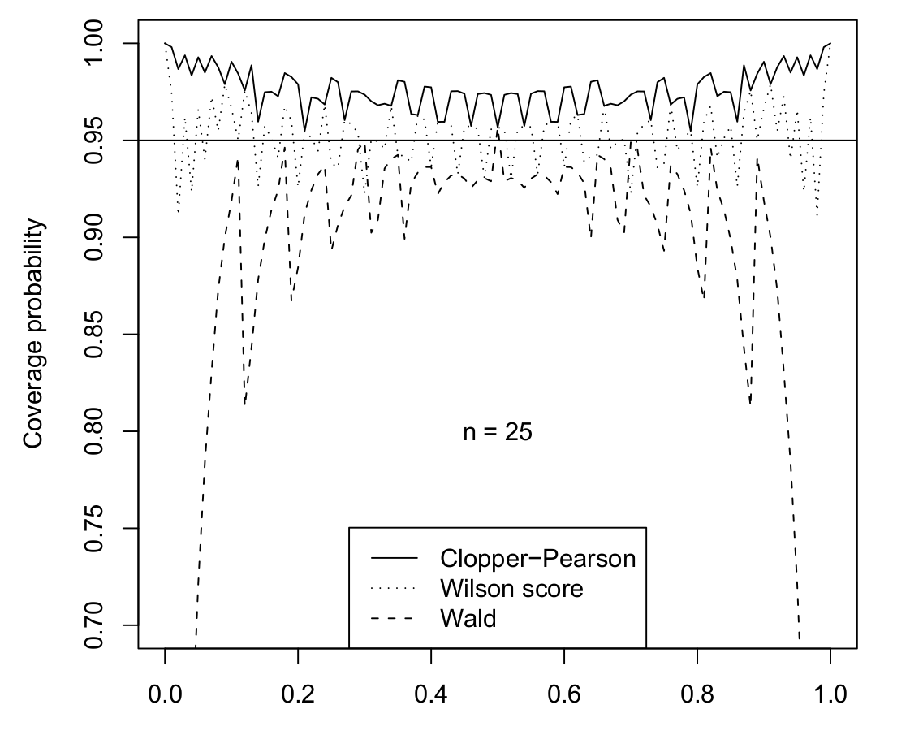
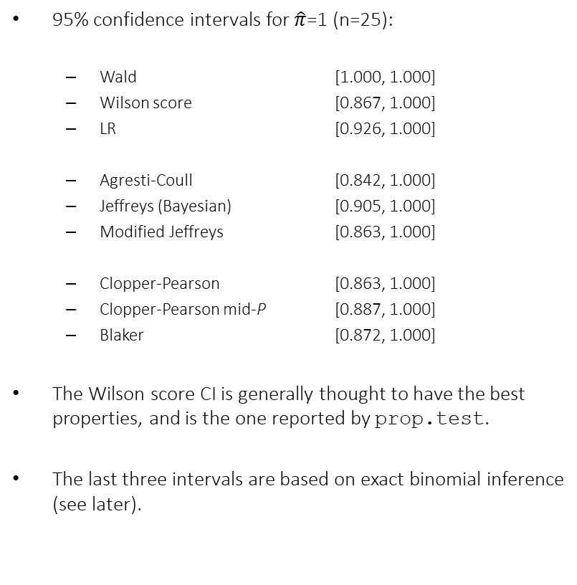
Problems with binomial inference
95% confidence intervals for $\hat{π}$=1 (n=25):
Wald [1.000, 1.000]
Wilson score [0.867, 1.000]
LR [0.926, 1.000]
Agresti-Coull [0.842, 1.000]
Jeffreys (Bayesian) [0.905, 1.000]
Modified Jeffreys [0.863, 1.000]
Clopper-Pearson [0.863, 1.000]
Clopper-Pearson mid-P [0.887, 1.000]
Blaker [0.872, 1.000]
The Wilson score CI is generally thought to have the best properties, and is the one reported by prop.test.
The last three intervals are based on exact binomial inference (see later).

Slide 17
Problems with binomial inference
The Two-Face coin example in R:
prop.test(x=25, n=25)
Another problem with binomial inference is that it assumes that the distribution of the test statistic can be approximated by the continuous χ²-distribution, when in reality its distribution is discrete.
For this reason, a so-called “continuity correction” (Yates, 1934) is often applied, as by default in prop.test. This can be switched off as follows:
prop.test(x=25, n=25, correct=FALSE)
An alternative is to use an exact binomial test…
1-sample proportions test with continuity correction
data: 25 out of 25, null probability 0.5
X-squared = 23.04, df = 1, p-value = 1.587e-06
alternative hypothesis: true p is not equal to 0.5
95 percent confidence interval:
0.834227 1.000000
sample estimates:
p
1
1-sample proportions test without continuity correction
data: 25 out of 25, null probability 0.5
X-squared = 25, df = 1, p-value = 5.733e-07
alternative hypothesis: true p is not equal to 0.5
95 percent confidence interval:
0.8668077 1.0000000
sample estimates:
p
1

Slide 18
Exact binomial inference
An exact binomial test directly uses the binomial distribution of the test statistic, rather than the χ² approximation, to determine the p-value. In R, this can be accomplished with binom.test (never to be confused with prop.test!). For the two earlier examples:
binom.test(x=13, n=32)
binom.test(x=25, n=25)
This returns slightly more conservative CI and p-values than the approximate tests.
The CI is the so-called Clopper-Pearson interval.
Note that the term “exact” does not imply that the test is more correct. Exact CI's have been criticized as not having the nominal coverage probabilities, which is undesirable.
Exact binomial test
data: 13 and 32
number of successes = 13, number of trials = 32, p-value = 0.3771
alternative hypothesis: true probability of success is not equal to 0.5
95 percent confidence interval:
0.2369841 0.5935508
sample estimates:
probability of success
0.40625
Exact binomial test
data: 25 and 25
number of successes = 25, number of trials = 25, p-value = 5.96e-08
alternative hypothesis: true probability of success is not equal to 0.5
95 percent confidence interval:
0.8628148 1.0000000
sample estimates:
probability of success
1

Slide 19
What should I use?
A one sample proportion test would seem to be a simple analysis. However, it turns out there are multiple ways to perform such a test and derive confidence intervals, each with slightly different final results. Which one should we choose?
In general, the defaults of prop.test can be safely used for reliable results, especially for large samples. It can be reported as any ordinary χ²-test. It is useful, however, to be aware that the function technically reports the Score test and that it reports the Wilson score confidence interval.
For approximate tests, Yates' continuity correction may be unnecessary to apply, and tends to overcorrect in small samples. For small samples, exact inference may be preferred at the expense of a more conservative result and unreliable CIs.
More confidence intervals for a binomial parameter are available with BinomCI of the package DescTools, which also offers Bayesian alternatives (Jeffreys and modified Jeffreys intervals). Its help page cites the references for these intervals in detail.
https://en.wikipedia.org/wiki/Binomial_proportion_confidence_interval

Slide 20
1. Analysis of frequency tables
B. 2×2 tables – Odds ratios

Slide 21


Another dilemma…
Would you rather…
Know when you die?
Know how you die?
A
B

Slide 22
Two-dimensional tables
Previously we looked at only one dilemma, with the resulting table one-dimensional. We can combine dilemmas by cross-tabulating the answers in a 2×2 table, e.g., for the fight and death dilemmas:
We could still do binomial inference on individual proportions, but we are rather more interested in the association between the row levels and column levels. The table suggests that people wanting to know how they die are also more likely to prefer fighting 1 horse-sized duck versus 100 duck-sized horses.
Testing such hypotheses can be accomplished with one of the most well-known statistical tests, Pearson's chi-square test.
 | When | How | Total
1 duck | 4 | 13 | 17
100 horses | 9 | 6 | 15
Total | 13 | 19 | N = 32
 | When | How | Prop.
1 duck | 0.125 | 0.406 | 0.531
100 horses | 0.281 | 0.188 | 0.469
Prop. | 0.406 | 0.594 | 1.000

Slide 23
Pearson's chi-square test
freqtable <- array(data=c(4,9,13,6), dim=c(2,2), dimnames=list(Fight=c("One
duck","Hundred horses"), Death=c("When","How")))
freqtable
chisq.test(freqtab, correct=FALSE)
The output is even more minimal than what prop.test reported. The p-value would have exceeded 0.05 if Yates' continuity correction had been applied, so somewhat marginal evidence for significance. How do we interpret this result? There are a number of equivalent ways to state the effect:
> Death
> Fight When How
> One duck 4 13
> Hundred horses 9 6
Pearson's Chi-squared test
data: tab
X-squared = 4.3942, df = 1, p-value = 0.03606
The distribution of fight choices is significantly different between death levels
The distribution of death choices is significantly different between fight levels
Fight preferences are modified by death preferences
The odds of choosing how over when are higher for people who choose to fight one duck than for people who choose 100 horses
The odds ratio is significantly different from 1

Slide 24

Odds ratio
A convenient statistic for summarizing association in a 2×2 table is the odds ratio. As the name suggests, it is the ratio of two odds. Odds themselves are ratios of two complimentary proportions, $\hat{π}/(1−\hat{π})$, e.g.:
Raw counts
Row-conditioned proportions
 | When | How
1 duck | 4 | 13
100 horses | 9 | 6
 | When | How
1 duck | 0.235 | 0.765
100 horses | 0.600 | 0.400
Odds (Ω)
Odds ratio (θ)
 | When | How
1 duck | 0.235/0.765 = 0.307
100 horses | 0.600/0.400 = 1.500
 | When | How
1 duck | 0.307/1.500 = 0.205
100 horses

Slide 25
Odds ratio
Raw counts
Row proportions
Odds (Ω)
Odds ratio (θ)
 | When | How
1 duck | 4 | 13
100 horses | 9 | 6
 | When | How
1 duck | 0.235 | 0.765
100 horses | 0.600 | 0.400
 | When | How
1 duck | 0.235/0.765 = 0.307
100 horses | 0.600/0.400 = 1.500
 | When | How
1 duck | 0.307/1.500 = 0.205
100 horses
For people who chose 1 duck, the probably of choosing when is 0.235, whereas the probability of choosing how is 0.765.
This equals odds of 0.235/0.765 = 0.307, which means choosing when is 0.307 times as likely as choosing how in this group. For people who chose 100 horses, choosing when is 1.5 times as likely as choosing how.
The odds ratio expresses the ratio between the two odds, with 0.307/1.500 = 0.205 meaning that the odds of when versus how for people who chose 1 duck are 0.205 times those odds for people who chose 100 horses.

Slide 26

Odds ratio

Slide 27
Odds ratio
An OR is bounded between 0 and +∞, with a value of 1 signifying complete independence between the row- and column-variables of the table.
The OR will not change value if the rows and columns of the table are reordered
An odds ratio is an effect size, as its value does not depend on the table total N. This makes the OR an ideal choice for statistical reporting of chi-square analyses, and for comparative studies (e.g., meta-analyses). However, the OR is not a standardized measure of effect (see later)!
If one of the cells in the table has a 0 count, the OR would be 0 or infinite. To correct this, a very small nominal value is often added to such cells to make sure the OR is estimable (e.g., +0.5).
Sometimes the log odds ratio is reported (log θ), rather than the regular OR. The log OR is unbounded (−∞, +∞) and symmetric around 0, with 0 denoting complete independence. Later, we will see that log odds (ratios) are important in the context of logistic regression, due to having very desirable properties...

Slide 28
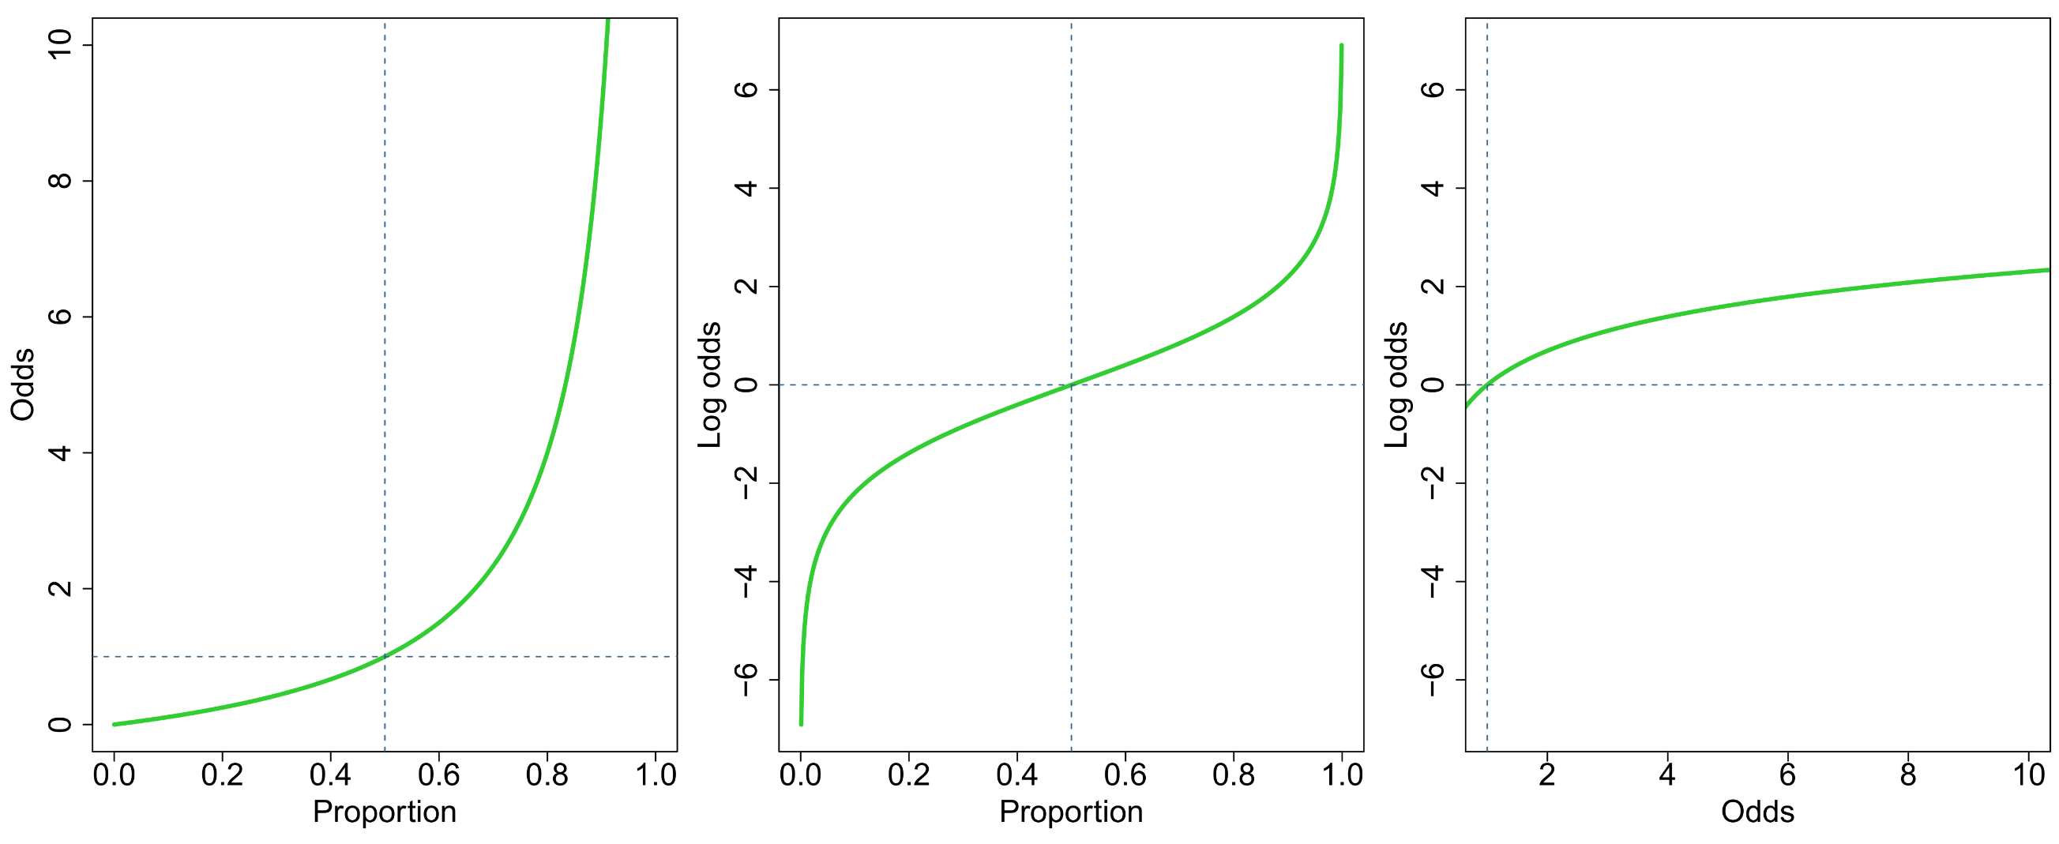
Desirable properties of log odds
Exponential increase!

Slide 29
Odds ratio in R
An OR for a 2×2 table can be calculated by hand easily. A number of R packages also have functions for it, such as OddsRatio from DescTools, and loddsratio from vcd. For the latter, confint can be applied to the output to obtain a 95%CI for the log-OR.
An OR with 95%CI can also be returned from the base function fisher.test, which in fact computes an exact test for association in a 2×2 table. Fisher's test is a permutation test that redistributes the observed counts into all possible arrangements and then calculates an empirical p-value for the original test statistic against those from all possible arrangements.
fisher.test(freqtable)
This time the result is not significant, unlike Pearson’s chi-square test (without continuity correction).
Fisher's Exact Test for Count Data
data: freqtable
p-value = 0.07022
alternative hypothesis: true odds ratio is not equal to 1
95 percent confidence interval:
0.03338258 1.16383845
sample estimates:
odds ratio
0.2166697

Slide 30
1. Analysis of frequency tables
C. A × B tables – Chi-square analysis

Slide 31

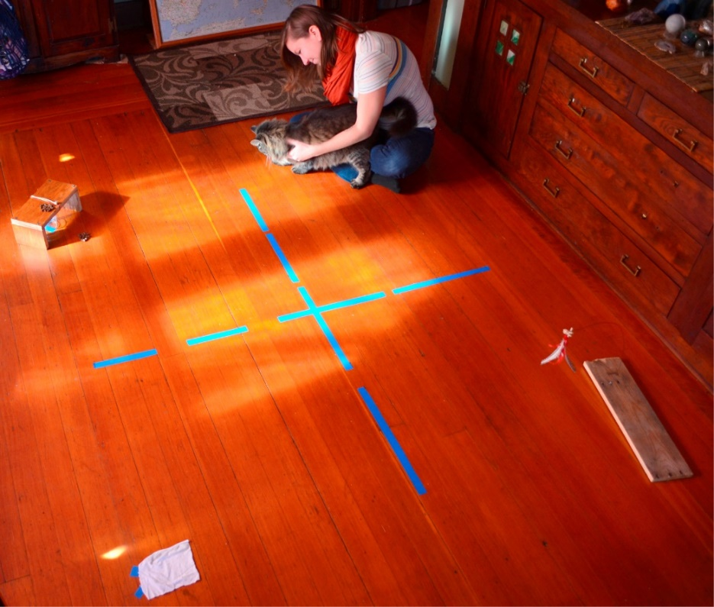
Chi-square analysis for A × B tables
Chi-square analysis generalizes to two-dimensional tables with an arbitrary number of row or column levels, or what we generally call A × B tables.
Shreve, Mehrkam & Udell (2017) investigated differences between pet cats and shelter cats in activity preferences. Activity categories included (1) social, (2) food, (3) toys, and (4) scents. Within each category, cats were first presented with three options to determine the most popular stimulus in that category.
Results for the food preferences among the cats:
 | Food type
Cat type | Chicken | Tuna | Soft meat
Pet cat | 6 | 13 | 2
Shelter cat | 4 | 10 | 3

Slide 32
Chi-square analysis for A × B tables
A chi-square test on the food preferences in R turns up non-significant, despite an overwhelming descriptive preference for tuna. How can this be explained?
catfood <- array(data=c(6,4,13,10,2,3), dim=c(2,3), dimnames=list(Cat_type= c("Pet cat","Shelter cat"), Food_type=c("Chicken","Tuna","Soft meat")))
chisq.test(catfood)
Pearson's Chi-squared test
data: catfood
X-squared = 0.57664, df = 2, p-value = 0.7495
Warning message:
In chisq.test(catfood) : Chi-squared approximation may be incorrect

Slide 33
Chi-square analysis for A × B tables
A chi-square test on the food preferences in R turns up non-significant, despite an overwhelming descriptive preference for tuna. How can this be explained?
A chi-square test analyzes the association between the row- and column-variables in the A × B table, but it is technically an interaction test. It tests if the distribution of A is modified by levels of B. It does not test if the marginal distributions of A or B are themselves unbalanced, unless the analysis is run explicitly on those margin tables, e.g.:
chisq.test(margin.table(catfood,2))
catfood <- array(data=c(6,4,13,10,2,3), dim=c(2,3), dimnames=list(Cat_type= c("Pet cat","Shelter cat"), Food_type=c("Chicken","Tuna","Soft meat")))
chisq.test(catfood)
Pearson's Chi-squared test
data: catfood
X-squared = 0.57664, df = 2, p-value = 0.7495
Warning message:
In chisq.test(catfood) : Chi-squared approximation may be incorrect

Slide 34
Chi-square analysis for A × B tables
Chi-squared test for given probabilities
data: margin.table(catfood, 2)
X-squared = 13.632, df = 2, p-value = 0.00109
This time we have a highly significant p-value, due to the strong marginal preference for tuna versus chicken or soft meat. We can run the same analysis for the other margin table (marginal distribution of pet and shelter cats).
The full 2×3 chi-square analysis is testing the interaction between cat type and food type, whereas the two marginal chi-square analyses are testing the respective “main effects” of cat type and food type. This is analogous to a Type II ANOVA breakdown of the full table (see later).

Slide 35
Chi-square analysis for A × B tables
It is a common misconception that a chi-square test cannot be applied to a one-dimensional table, with even some software only accepting two-dimensional tables for analysis. However, the test can just as well be applied to a one-dimensional table, including the case where there are only two proportions to compare.
The interpretation of a significant one-dimensional chi-square test is that, for a variable A with a (categorical) levels, at least one pair of observed frequencies is significantly different from each other.
Technically, the A × B chi-square test is checking whether the observed distribution of counts in the table deviates significantly from the expected distribution of counts, when assuming independence. This is an omnibus test with degrees of freedom equal to (a − 1) × (b − 1), with a the number of levels in A and b the number of levels in B.
The deviation of observed from expected counts are the table's residuals, and can be inspected to check which cells specifically contributed to a significant chi-square test.

Slide 36
Follow-up tests – Residual analysis
In the following study participants were exposed to four virtual depths (0, 5, 30, 50 m). For each height, the participant chose a word that best described their emotional state. Emotion words were grouped into four families: neutral, fascination, joy, and fear. The data can be tabulated as follows:
A chi-square test is extremely significant, χ²(9) = 114.55, p < 0.0001. Some patterns are self-evident, such as the preference for neutral words at low depths, and the preference for fascination and fear words at high depths. A residual analysis can make clear which table cells specifically contributed to the significant test. Unstandardized Pearson residuals are an invisible output of chisq.test, and can be accessed when stored:
feartest <- chisq.test(feartable)
feartable$residuals
Family
Depth Neutral Joy Fascination Fear
0 43 8 19 11
5 19 19 31 12
30 0 14 37 30
50 0 13 30 38
Family
Depth Neutral Joy Fascination Fear
0 6.985 -1.497 -1.895 -2.463
5 0.889 1.497 0.324 -2.254
30 -3.937 0.136 1.433 1.520
50 -3.937 -0.136 0.139 3.197

Slide 37
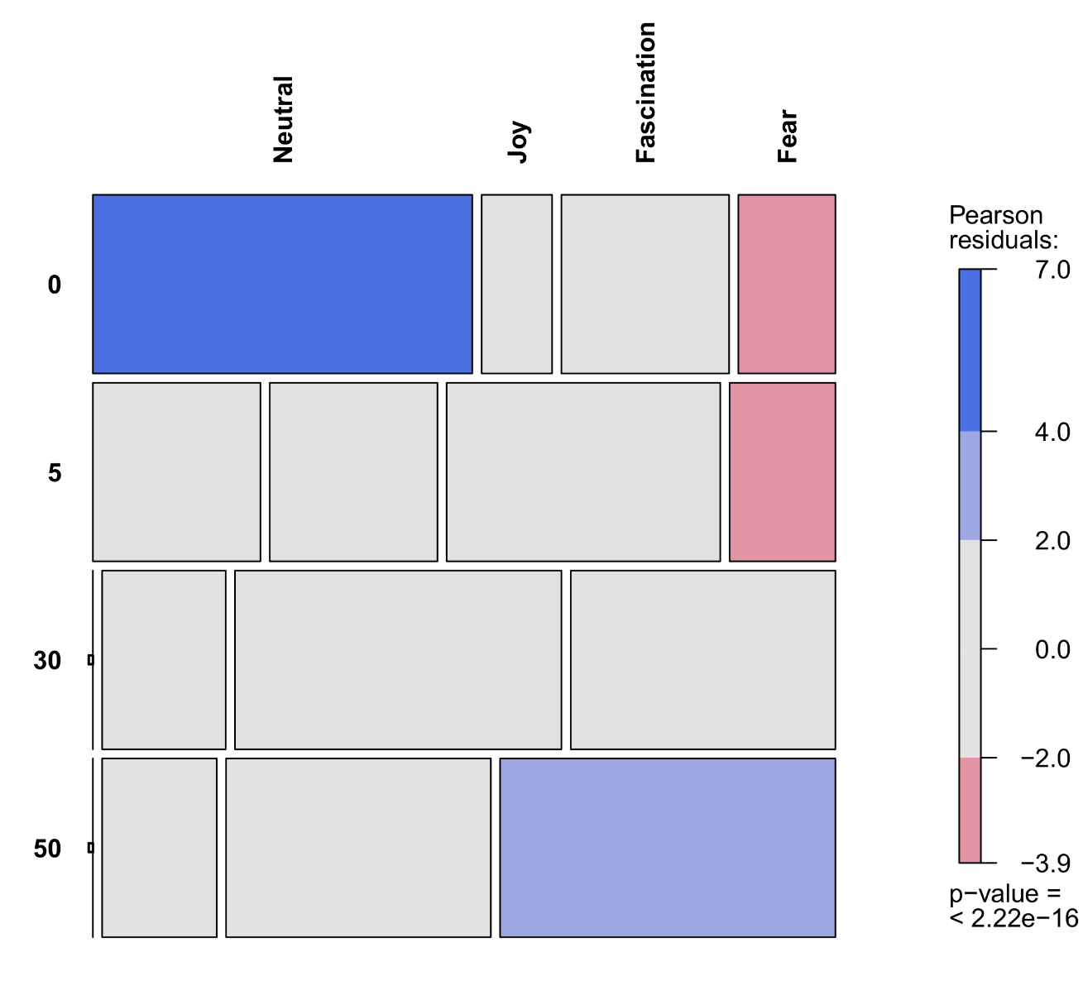
Follow-up tests – Residual analysis
Large positive residuals indicate that this cell had a much higher count than expected under independence, while large negative residuals indicate that the cell had a much lower count than expected under independence.
We can visualize this pattern with a so-called mosaic plot, which shows simultaneously the relative size among cell counts, and their deviation from independence (with color shading).
mosaic(feartable,shade=TRUE)
As we suspected, fear words were chosen much more often at 50 meter depth, and much less often at 0 and 5 meter depths. Cells with 0 counts are identified by an empty dot.
Mosaic plots are especially useful for large tables!

Slide 38
Follow-up tests – Partitioning
An alternative to residual analysis is to follow-up the omnibus chi-square test with further chi-square tests on subsets of the table. This could be any one-dimensional part (e.g., word family choices at 50 meter virtual depth only), or a 2×2 part (allowing results to be expressed as odds ratios), or even a single cell for a proportion test (if it makes sense). For the fear study:
This indicates that joy and fascination words were chosen roughly equally often at each depth. When subsetted to the 2×2 part of [0 m,50 m] and [neutral,fear]:
OddsRatio(feartable[c(1,4),c(1,4)],conf.level=0.95)
chisq.test(feartable[,1]) # Neutral
chisq.test(feartable[,2]) # Joy
chisq.test(feartable[,3]) # Fascination
chisq.test(feartable[,4]) # Fear
> X-squared = 80.581, df = 3, p-value < 2.2e-16
> X-squared = 4.5185, df = 3, p-value = 0.2106
> X-squared = 5.7692, df = 3, p-value = 0.1234
> X-squared = 23.681, df = 3, p-value = 2.911e-05
> odds ratio lwr.ci upr.ci
> 291.26087 16.60617 5108.51642

Slide 39
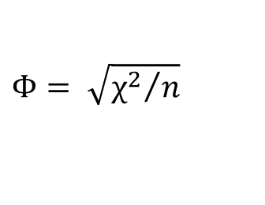
Effect sizes for A × B tables
Any 2×2 subset of a table can be expressed as an odds ratio. However, there also exist effect sizes for the more general A × B structure. Historically the oldest is Pearson's mean-square contingency, Phi (Φ). It is directly based on the χ² test statistic, but adjusted for sample size bias:
For 2×2 tables, Pearson's Φ is equivalent to the Pearson correlation between the two variables, when dummy-coded to 0/1 numerical values (e.g., men=0, women=1). For more general A × B tables, Pearson's Φ can be larger than 1. For this reason, adjustment's to Φ have been proposed, including Pearson's contingency coefficient C, and Cramer's V.
R package DescTools offers a handy function Assocs which collects many effect sizes for frequency tables in a single output. Many of these should only be used if you understand their interpretation, however! Some of them are asymmetric, and depend on which variable is considered the “dependent” in the analysis. Generally speaking, Cramer's V may be the most useful measure for a chi-square test, with V=0 denoting complete independence and V=1 denoting perfect association.
In large tables, these effect sizes can be misleading and reductive, and it is usually more interesting to conduct a residual analysis to identify a specific pattern of effects.
$$Φ= \sqrt{{χ^{2}}/n}$$

Slide 40
Effect sizes for A × B tables
For the cat food and fear data:
Assocs(catfood) # Weak chi-square significance!
estimate lwr.ci upr.ci
Phi Coeff. 0.1232 - -
Contingency Coeff. 0.1223 - -
Cramer V 0.1232 0.0000 0.3734
Goodman Kruskal Gamma 0.1878 -0.3870 0.7626
Kendall Tau-b 0.0985 -0.2059 0.4029
Stuart Tau-c 0.1025 -0.2149 0.4199
Somers D C|R 0.1036 -0.2172 0.4245
Somers D R|C 0.0937 -0.1867 0.3741
Pearson Correlation 0.1066 -0.2206 0.4122
Spearman Correlation 0.1025 -0.2245 0.4088
Lambda C|R 0.0000 0.0000 0.0000
Lambda R|C 0.0588 0.0000 0.3089
Lambda sym 0.0312 0.0000 0.1654
Uncertainty Coeff. C|R 0.0082 -0.0339 0.0503
Uncertainty Coeff. R|C 0.0110 -0.0457 0.0677
Uncertainty Coeff. sym 0.0094 -0.0389 0.0577
Mutual Information 0.0109 - -
Assocs(feartable) # Strong chi-square significance!
estimate lwr.ci upr.ci
Phi Coeff. 0.5946 - -
Contingency Coeff. 0.5111 - -
Cramer V 0.3433 0.2669 0.3950
Goodman Kruskal Gamma 0.5327 0.4333 0.6321
Kendall Tau-b 0.4071 0.3255 0.4886
Stuart Tau-c 0.4006 0.3194 0.4818
Somers D C|R 0.4006 0.3194 0.4818
Somers D R|C 0.4136 0.3298 0.4975
Pearson Correlation 0.4975 0.4108 0.5753
Spearman Correlation 0.4722 0.3830 0.5528
Lambda C|R 0.1546 0.0553 0.2539
Lambda R|C 0.2305 0.1492 0.3117
Lambda sym 0.1956 0.1179 0.2732
Uncertainty Coeff. C|R 0.1504 0.1148 0.1859
Uncertainty Coeff. R|C 0.1453 0.1099 0.1806
Uncertainty Coeff. sym 0.1478 0.1124 0.1832
Mutual Information 0.2906 - -

Slide 41
1. Analysis of frequency tables
D. A × B × C tables – Log-linear analysis

Slide 42
A × B × C tables
Radelet & Pierce (1991) collected data from 674 homicide convictions in Florida between 1976 and 1987 (see Agresti, 2002, p.48). They cross-tabulated three factors: death penalty verdict (yes or no), defendant race (white or black) and victim race (white or black).
We would like to find out if the association between defendant race and death penalty is modified by victim race (i.e., 3-way interaction).
In R, tables with more than 2 dimensions are always called arrays, and can be constructed easily by adding more dimensions, e.g.:
deathpenalty <- array(data=c(53,11,414,37,0,4,16,139), dim=c(2,2,2), dimnames=list(Race_defendant= c("White","Black"),Death_penalty=c("No","Yes"),
Race_victim=c("White","Black")))
Unfortunately (perhaps against expectation), this no longer works:
 |  | Death penalty
Victim race | Defendant race | No | Yes
White | White | 53 | 414
 | Black | 11 | 37
Black | White | 0 | 16
 | Black | 4 | 139
chisq.test(deathpenalty)
> Error in chisq.test(deathpenalty) : invalid 'x'

Slide 43
A × B × C tables
Up until this point I have rarely provided explicit mathematical equations for statistical tests, instead describing what they do in more “conceptual” terms.
The analysis of frequency tables can be understood generally as examples of so-called log-linear analysis, which is a special case of Poisson regression where all of the explanatory variables are categorical. A Poisson regression is a generalized linear model (GLM), just like logistic regression (see part II).
The Poisson regression framework provides a common language for analyzing all types of frequency tables, no matter their dimension, in a way that conforms to familiar factorial ANOVA. Understanding this model is therefore a better gateway to understanding the chi-square test technically.
The first step to understanding the connection between a table and a GLM is in the data structure, however…

Slide 44


Log-linear analysis
Poisson regression

Slide 45
Tables to data frames
We can reformat the death penalty data to the following (grouped) data frame:
Victim race | Defendant race | Death penalty | Frequency
White | White | No | 53
White | White | Yes | 414
White | Black | No | 11
White | Black | Yes | 37
Black | White | No | 0
Black | White | Yes | 16
Black | Black | No | 4
Black | Black | Yes | 139
 |  | Death penalty
Victim race | Defendant race | No | Yes
White | White | 53 | 414
 | Black | 11 | 37
Black | White | 0 | 16
 | Black | 4 | 139

Slide 46
Tables to data frames
We still have the three variables from the table format, but we also have new variable, labelled “frequency”. In the analyses we have seen so far, this frequency was the implied dependent (DV), and the row/column variables the independents (IVs).
In R, conversions between arrays/tables and data frames can be accomplished with the functions as.data.frame.table and xtabs:
dpdf <- as.data.frame.table(deathpenalty)
dpdf
xtabs(Freq ~ Race_defendant+Death_penalty+Race_victim, data=dpdf)
xtabs uses a formula interface. If the data frame includes the frequency count as an explicit variable, then it should be declared as the DV in the formula (left of the ~).
If the data frame does not include it, the lefthand side of the formula can be left empty and the function will simply count the totals observed from the supplied IVs. This is useful for most regular data frames with categorical variables in them (see later).

Slide 47
Log-linear analysis
Now that the data are in the right format, we can analyze them as follows:
library(car)
model <- glm(Freq~Race_defendant*Death_penalty*Race_victim, data=dpdf, family=poisson)
Anova(model, type=2)
No evidence that the death penalty × race victim association is modified by race defendant (i.e., no 3-way interaction). How did we obtain this breakdown of results and how do we make sense of them…?
Analysis of Deviance Table (Type II tests)
Response: Freq
LR Chisq Df Pr(>Chisq)
Race_defendant 130.79 1 < 2.2e-16 ***
Death_penalty 493.52 1 < 2.2e-16 ***
Race_victim 197.93 1 < 2.2e-16 ***
Race_defendant:Death_penalty 5.01 1 0.02514 *
Race_defendant:Race_victim 384.05 1 < 2.2e-16 ***
Death_penalty:Race_victim 20.35 1 6.45e-06 ***
Race_defendant:Death_penalty:Race_victim 0.38 1 0.53769
---
Signif. codes: 0 ‘***’ 0.001 ‘**’ 0.01 ‘*’ 0.05 ‘.’ 0.1 ‘ ’ 1

Slide 48
Log-linear analysis – Models
Data in a multidimensional frequency table consist of count totals for each combination of variable levels. Those totals are aggregated statistics just like averages in a factorial ANOVA design for continuous data. Like those averages, they can be treated as parameters in a model, subject to constraints.
Before returning to the death penalty data, let us consider the simpler cat study, this time on preferences in human social interaction:
We can fit different log-linear (Poisson) models and tabulate their predicted cell counts to see exactly what kind of restrictions they impose. The simplest model will restrict all cell counts to be equal, while the most complex one will allow all cell counts to be unique, with other models in between these two extremes…
 | Social activity
Cat type | Talking | Petting | Playing
Pet cat | 5 | 6 | 10
Shelter cat | 0 | 3 | 14
 | Social activity
Cat type | Talking | Petting | Playing
Pet cat | μ₁₁ | μ₁₂ | μ₁₃
Shelter cat | μ₂₁ | μ₂₂ | μ₂₃
* X-squared = 6.3156, df = 2, p-value = 0.04252

Slide 49
Log-linear analysis – Models
The null model has only an intercept, and therefore constrains all cell counts to be equal:
model0 <- glm(Freq~1, data=cathdf, family=poisson)
predict(model0, type="response")
The model's predictions are clearly far from reality. At the same time, it is difficult to say how these predictions deviate from the observed, e.g., in terms of cat type, social activity, or both? The null model is generally not very useful, except for comparing it to more complex models…
Observed
Expected (null model)
 | Social activity
Cat type | Talking | Petting | Playing
Pet cat | 5 | 6 | 10
Shelter cat | 0 | 3 | 14
 | Social activity
Cat type | Talking | Petting | Playing
Pet cat | 6.33 | 6.33 | 6.33
Shelter cat | 6.33 | 6.33 | 6.33

Slide 50
Log-linear analysis – Models
A one-way main effects model can include an effect for cat type or social activity. Such a model allows that cell counts differ between the levels of the included variable, but not the other, e.g., for cat type:
model1 <- glm(Freq~Cat_type, data=cathdf,
family=poisson)
predict(model1, type="response")
anova(model0,model1, test="Chisq")
An chi-square comparison indicates that this model does not deviate significantly from the null model, suggesting that the (marginal) distribution of shelter cats and pet cats is not significantly different from equality.
Model 1: Freq ~ 1
Model 2: Freq ~ Cat_type
Resid. Df Resid. Dev Df Deviance Pr(>Chi)
1 5 23.850
2 4 23.428 1 0.42183 0.516
Observed
Expected (cat type)
 | Social activity
Cat type | Talking | Petting | Playing
Pet cat | 5 | 6 | 10
Shelter cat | 0 | 3 | 14
 | Social activity
Cat type | Talking | Petting | Playing
Pet cat | 7.00 | 7.00 | 7.00
Shelter cat | 5.66 | 5.66 | 5.66

Slide 51
Log-linear analysis – Models
When we include both main effects, cell counts are allowed to differ between levels of cat type and between levels of interaction type, but not to deviate from the pattern of each marginal distribution:
model2 <- glm(Freq~Cat_type+Social_activity,
data=cathdf, family=poisson)
predict(model2, type="response")
anova(model1,model2, test="Chisq")
The highly significant chi-square comparison suggests that allowing differences in social activity counts improves the model substantially over one that doesn't. However, the predicted cell-counts still seem to deviate a bit from the observed counts.
Model 1: Freq ~ Cat_type
Model 2: Freq ~ Cat_type + Social_activity
Resid. Df Resid. Dev Df Deviance Pr(>Chi)
1 4 23.4278
2 2 8.1988 2 15.229 0.0004932 ***
Observed
Expected (null model)
 | Social activity
Cat type | Talking | Petting | Playing
Pet cat | 5 | 6 | 10
Shelter cat | 0 | 3 | 14
 | Social activity
Cat type | Talking | Petting | Playing
Pet cat | 2.76 | 4.97 | 13.26
Shelter cat | 2.24 | 4.03 | 10.74

Slide 52
Log-linear analysis – Models
Finally we can include the interaction between cat type and social activity, allowing cell counts to be entirely unique and unconstrained. This model is known as the “saturated” model:
model3 <- glm(Freq~Cat_type*Social_activity,
data=cathdf, family=poisson)
predict(model2, type="response")
anova(model1,model2, test="Chisq")
A weakly significant chi-square test suggests indeed that the distribution of preferred activities does differ somewhat between the two cat types (i.e., interaction between cat type and social activity).
Model 1: Freq ~ Cat_type + Social_activity
Model 2: Freq ~ Cat_type * Social_activity
Resid. Df Resid. Dev Df Deviance Pr(>Chi)
1 2 8.1988
2 0 0.0000 2 8.1988 0.01658 *
Observed
Expected (null model)
 | Social activity
Cat type | Talking | Petting | Playing
Pet cat | 5 | 6 | 10
Shelter cat | 0 | 3 | 14
 | Social activity
Cat type | Talking | Petting | Playing
Pet cat | 5 | 6 | 10
Shelter cat | 0.0001 | 3 | 14

Slide 53
Log-linear analysis – Saturated model
The expected cell counts for the saturated model are near-perfect—with the exception of the 0 cell. This would seem the ideal model for our data, right? In truth, the saturated model will have perfect fit by definition! This is a consequence of allowing every cell count in the table to be unconstrained.
Deviance Residuals:
[1] 0 0 0 0 0 0
Coefficients:
Estimate Std. Error z value Pr(>|z|)
(Intercept) 1.6094 0.4472 3.599 0.00032 ***
Cat_typeShelter cat -1.6094 1.0954 -1.469 0.14177
Social_activityPetting 0.1823 0.6055 0.301 0.76334
Social_activityPlaying 0.6931 0.5477 1.266 0.20569
Cat_typeShelter cat:Social_activityPetting 0.9163 1.3038 0.703 0.48220
Cat_typeShelter cat:Social_activityPlaying 1.9459 1.1711 1.662 0.09658 .
---
Signif. codes: 0 ‘***’ 0.001 ‘**’ 0.01 ‘*’ 0.05 ‘.’ 0.1 ‘ ’ 1
Null deviance: 1.8132e+01 on 5 degrees of freedom
Residual deviance: 2.2204e-16 on 0 degrees of freedom
AIC: 32.776
Number of Fisher Scoring iterations: 3

Slide 54
Log-linear analysis – Saturated model
The saturated model has parameters equal to the number of unique cells in the table, hence its perfect fit. Ideally we would like to find a reduced model that requires less parameters without deviating significantly from the fit of the saturated model.* The easiest way to automate this process is by running Anova from the car package on the saturated model, and get the full breakdown of effects:
Anova(model3, type=2)
These effects correspond to the model comparisons listed in the table. Here, we would finally prefer the saturated model since not including the interaction between cat type and social activity still misses significant information. We now have a very handy way to analyze any frequency table…
Effect | LR Chisq | DF | P | Reduced model | Full model
Cat type | 0.4218 | 1 | 0.5160 | 1+Social_activity | 1+Cat_type+Social_activity
Social activity | 15.2290 | 2 | 0.0005 | 1+Cat_type | 1+Cat_type+Social_activity
Cat type × Social activity | 8.1988 | 2 | 0.0166 | 1+Cat_type+Social_activity | 1+Cat_type*Social_activity
* Occam's Razor philosophy!

Slide 55

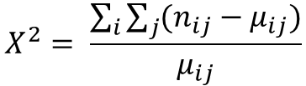
Chi-square test revisited
When I discussed the chi-square test, I did not provide the formula for how the test statistic is calculated. Formally, this is:
Where n_{ij} are the observed frequencies in the I × J table, while μ_{ij} are the expected frequencies of the I × J table under the independence assumption.
It is difficult to understand intuitively where these expected frequencies under independence come from. The log-linear framework makes clear that these values are predictions of the main-effects-only model, and therefore that a chi-square test is essentially performing a model comparison.
A p-value is obtained by evaluating the test statistic against a chi-square distribution with degrees of freedom (I − 1) × (J − 1), at the chosen significance level.
$$X^{2}= \frac{\sum_{i}{\sum_{j}{(n_{ij}−μ_{ij})}}}{μ_{ij}}$$

Slide 56
Log-linear analysis – Three-way example
Let us now return to the death penalty data, where we had a 2×2×2 table. As before, we could fit a Poisson GLM to the data to get the breakdown of effects. However, the introduction of a third variable adds many subtleties to the possible models to be considered.
We could collapse across race victim levels and first test the marginal death penalty × race defendant association. This can be accomplished by running a chi-square analysis on the margin table (grey cells), or by fitting the following Poisson model:
Model <- glm(Freq~Race_defendant*Death_penalty,
data=dpdf, family=poisson)
The interaction test is not significant, χ²(1) = 1.54, p = 0.2152, with OR = 1.44, suggesting that, descriptively, the odds of receiving the death penalty for white defendants is 1.44 times greater than the odds of receiving the death penalty for black defendants.
 |  | Death penalty
Victim race | Defendant race | No | Yes
White | White | 53 | 414
 | Black | 11 | 37
Black | White | 0 | 16
 | Black | 4 | 139
Total | White | 53 | 430
 | Black | 15 | 176

Slide 57
Log-linear analysis – Three-way example
We could run the same analysis for subtables of the full table, e.g., death penalty × race defendant association conditioned on specific race victim values:
model <- glm(Freq~Race_defendant*Death_penalty,
data=dpdf, family=poisson, subset=Race_victim=="White")
Anova(model, type=2)
This time there is a significant death penalty × race defendant association, χ²(1) = 4.53, p = 0.03323, with OR = 0.432, which reverses the marginal association (odds of white defendants receiving the death penalty are 0.432 times the same odds for black defendants, when the victim is white.
For black victims, the association is not significant but the estimated OR is once again in the opposite direction of the marginal association, OR = 0.921. How is this possible??
 |  | Death penalty
Victim race | Defendant race | No | Yes
White | White | OR = 0.432 | 414
 | Black | 11 | 37
Black | White | OR = 0.921
 | Black
Total | White | OR = 1.540
 | Black

Slide 58
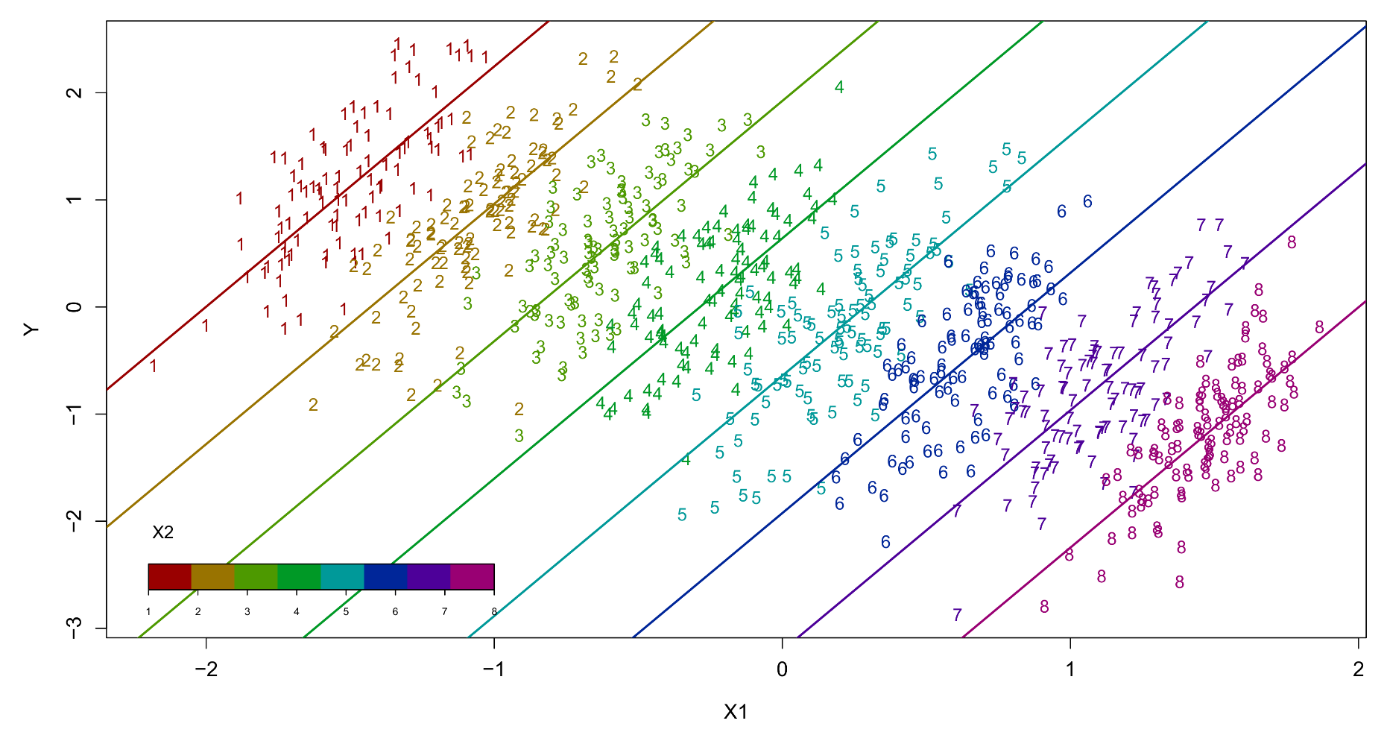
Simpson's paradox
The preceding effect reversal is an example of Simpson's paradox, where a marginal bivariate association (black slope) reverses direction when adjusted for a third variable (colored slopes):
Y ~ X1
Y ~ X1 + X2

Slide 59
Simpson's paradox
The relevant Poisson GLM models for the preceding example are as follows:
The conditional death penalty × race defendant association can be extracted both from model II and III, as the death penalty × race defendant two-way interaction in the Type II ANOVA breakdown. Model III differs only from II in that it allows the death penalty × race defendant association to be modified by levels of race victim (i.e., the three-way interaction).
Model | R formula | Effect
I | Freq ~ Death_penalty*Race_defendant | Marginal/unconditional effect of death penalty × race defendant
II | Freq ~ (Death_penalty+Race_defendant+Race_victim)^2 | Conditional effect of death penalty × race defendant by race victim Homogeneous death penalty × race defendant effect across race victim
III | Freq ~ Death_penalty*Race_defendant*Race_victim | Conditional effect of death penalty × race defendant by race victim Heterogeneous death penalty × race defendant effect across race victim Saturated model

Slide 60
Confounding and non-collapsibility
Factorial breakdowns of log-linear analyses are called “analysis of deviance” in the R output. Very often this term is used interchangeably with analysis of variance (ANOVA). We have also drawn parallels so far between the breakdown of frequency tables and traditional factorial ANOVA for continuous DVs.
However, a critical distinction between the two is that traditional ANOVA is most often applied to experimental designs where the IVs have been manipulated orthogonally. Simpson's paradox is impossible to occur in this scenario because there are no confounding variables in the design.
Frequency tables may give the appearance of an orthogonal design but most often will be purely observational! This is one reason why, e.g., marginal XY associations may change completely when adjusted for a third variable Z.

Slide 61
Confounding and non-collapsibility
Simpson’s paradox can occur even when Z is not confounding the XY association, when the XYZ associations under consideration are odds ratios! This is because odds ratios are generally non-collapsible across levels of a third variable.
As a rule, one should be careful with the choice of whether to interpret marginal or conditional associations in chi-square and log-linear analyses (see Hernán, Clayton & Keiding, 2011, for a discussion).
Non-collapsibility is an important concern when applying models for repeated categorical data (GEE versus GLMM). For GLMMs especially, this issue should not be ignored!

Slide 62

Effect size for A × B × C tables
For complex tables and their corresponding log-linear Poisson models, effect sizes we have seen previously are no longer available, or they would be overly reductive (and hence practically unusable).
Goodness-of-fit for a model could be assessed by looking at the chi-square statistic, or information criteria (AIC, BIC). These measures are relative and require at least two models to be compared but this arises naturally in log-linear analysis, where the lower and upper bound on model complexity is known, i.e., the null model and the saturated model.
Another option is the so-called Gini index of dissimilarity D, which is calculated as:
With i the i-th cell in the table, n_{i} the observed cell count in cell i, μ_{i} the predicted cell count in cell i, and n the total of all counts. The saturated model has D = 0 by definition. For less complex models, values of D < 0.03 are still considered as a “good” fit. The Gini index can also be used to compared predictions of two reduced models, by replacing n_{i} with the count predictions of the more complex model.
$$D= \frac{\sum_{i}{(n_{i}−μ_{i})}}{2n}$$

Slide 63
More on Poisson regression
We will not examine Poisson regression in more detail for this workshop. Its parameters can be inspected like any other GLM (summary function in R) but this is typically unnecessary in the context of log-linear analysis.
For the present workshop, the Poisson model is primarily useful to obtain an effects breakdown for a multi-dimensional frequency table, and to inspect its predicted values or residuals to detect goodness- or lack-of-fit.
Technically, the DV in a Poisson regression is a log-transformed count. This is one reason why cells in frequency tables with 0 counts are problematic, since log(0) is undefined or infinite. As the name of the model implies, the log-transformed count is assumed to be Poisson-distributed.
The Poisson distribution has the unusual property that its mean is equal to its variance.*
* https://en.wikipedia.org/wiki/Poisson_distribution

Slide 64
More on Poisson regression
For one- and two-dimensional tables, it is generally advised to rely on the ordinary chi-square analysis and associated visualizations such as the mosaic plot.
It is useful to keep in mind that the ordinary chi-square analysis is just a special case of Possion regression, and that the test statistic is obtained by comparing the deviation in expected cell counts between two (nested) models.
Mathematically, this comparison involves comparing the log-likelihood of both functions by a specific test (e.g., Wald test, likelihood ratio test).
The more general version of Poisson regression can also incorporate continuous variables, although that normally implies/requires data sets which are in an ungrouped format, with the count data as DV, expressing some rate of occurrence in a given time window (e.g., number of customers in a shop per hour, number of UFO sightings per year). We will not discuss such data in this workshop.
* When this comparison involves the saturated model, the expected cell counts for that model equal the observed cell frequencies.

