Slide 1



Logistic Regression II
Ben Meuleman, Ph.D.
Swiss Center for Affective Sciences
Université de Genève
Workshop series on advanced statistical topics
November 17, 2022

Slide 2
Contents
Analysis of frequency tables
Proportions and binomial tests
2 × 2 tables – Odds ratios
A × B tables – Chi-square analysis
A × B × C tables – Log-linear analysis
Binary logistic regression
Two-group difference
Continuous predictor
Multiple predictors
Model fit and diagnostics
Extensions to logistic regression
Analysis of paired categorical data

Slide 3

2. Binary logistic regression
A. Two-group difference

Slide 4

A data set…
The data gameofdeaths.csv contain information on 208 characters from the television series Game of Thrones (GOT), including demographical characteristics (e.g., age, gender, profession), career details, and whether or not they died.
We would like to find out what characteristics—if any—predict death on Game of Thrones, starting with a simple question. GOT is infamous for its deadly weddings so let us find out if getting married on the series indeed gets you killed. The data look like this:
The marginal death rate is already very high at 68%, meaning you are more likely to die than not on Game of Thrones. The chi-square test for the Wedding × Death effect is non-significant, suggesting that getting married is not especially more fatal than not.
 | Death
Wedding | No | Yes
No | 61 | 131
Yes | 4 | 12
Pearson's Chi-squared test with Yates'
continuity correction
X-squared = 0.078788, df = 1,
p-value = 0.7789
OR = 1.3948

Slide 5
Grouped versus ungrouped data
Indeed the chi-square test is the most straightforward analysis to test our research hypothesis, which we apply directly to the 2×2 frequency table. However, there are other ways of formatting these data…
 | Death
Wedding | No | Yes
No | 61 | 131
Yes | 4 | 12

Slide 6
Grouped versus ungrouped data
We have seen before that a table can be converted into a grouped data frame with an explicit frequency variable to run a log-linear Poisson regression. However, this format does not adequately capture the raw data at the level of the individual GOT characters…
 | Death
Wedding | No | Yes
No | 61 | 131
Yes | 4 | 12
Wedding | Death | Frequency
No | No | 61
No | Yes | 131
Yes | No | 4
Yes | Yes | 12

Slide 7
Grouped versus ungrouped data
The ungrouped data frame records the identity of each character, whether or not they wedded during the series (no or yes), and whether or not they died (no or yes). This format is in fact the one we are most familiar with from our own data sets.
 | Death
Wedding | No | Yes
No | 61 | 131
Yes | 4 | 12
Wedding | Death | Frequency
No | No | 61
No | Yes | 131
Yes | No | 4
Yes | Yes | 12
Character | Wedding | Death
Ned Stark | No | Yes
Roslin Frey | Yes | No
Ramsay Bolton | Yes | Yes
Hodor | No | Yes
Yara Greyjoy | No | No
… | … | …
Khal Drogo | Yes | Yes

Slide 8
Grouped versus ungrouped data
We can code the Death levels as No=0 and Yes=1. It becomes clear now that different data formats imply different analysis types:
 | Death
Wedding | No | Yes
No | 61 | 131
Yes | 4 | 12
Wedding | Death | Frequency
No | No | 61
No | Yes | 131
Yes | No | 4
Yes | Yes | 12
Character | Wedding | Death | Death
Ned Stark | No | Yes | 1
Roslin Frey | Yes | No | 0
Ramsay Bolton | Yes | Yes | 1
Hodor | No | Yes | 1
Yara Greyjoy | No | No | 0
… | … | … | …
Khal Drogo | Yes | Yes | 1
Chi-square analysis
Log-linear analysis
Logistic regression

Slide 9
Same data, different analysis?
These formatting options extend to larger data sets. When all variables are categorical, we can choose between three analyses. Which one do we use? They may seem different but fundamentally they address the same question:
Chi-square analysis: Is the distribution of Death levels modified by Wedding levels?
Log-linear Poisson regression: Is the frequency of occurrence associated with Death levels and modified by Wedding levels?
Logistic regression: Do Wedding levels predict the probability of death versus survival?
All concern how the distribution of levels in one variable is changed or predicted by levels of another variable!
The similarity between the first two models and the third, logistic regression, may not seem apparent, since the first two pose “interaction” questions (e.g., Freq ~ Death × Wedding), whereas the logistic regression poses a “main effect” question (e.g., Death ~ Wedding). We will see shortly that this distinction is illusory, however.

Slide 10
Format restrictions
Suppose we wanted to add character age to our analysis. With the additional column, converting the data to a grouped format becomes awkward, if not impossible. For most combinations of Age × Wedding × Death levels, there are 0 realizations. The presence of Age favors the logistic regression data format…
Age | Wedding | Death | Freq
10 | No | No | 1
10 | No | Yes | 0
10 | Yes | No | 0
10 | Yes | Yes | 0
11 | No | No | 1
11 | No | Yes | 0
11 | Yes | No | 0
11 | Yes | Yes | 0
…
10,000 | No | Yes | 0
Character | Age | Wedding | Death | Death
Ned Stark | 41 | No | Yes | 1
Roslin Frey | 17 | Yes | No | 0
Ramsay Bolton | 27 | Yes | Yes | 1
Hodor | 40 | No | Yes | 1
Yara Greyjoy | 37 | No | No | 0
… | … | … | … | …
Khal Drogo | 33 | Yes | Yes | 1
??

Slide 11

Naive regression approach
Before introducing the logistic regression model formally, why not try a naïve approach and treat the outcome as continuous in a conventional regression model?
GOT <- read.csv("https://drive.switch.ch/index.php/s/WHfgSnHYRwtSTSl/download", header=TRUE,as.is=FALSE)
xtabs(~Death+Wedding, data=GOT)
First we load the data and re-inspect the Wedding × Death frequency table. Next, we simply fit a linear regression model. To do this we first need to create a numerical version of the Death variable, with No=0 and Yes=1:
GOT$DeathBin <- ifelse(GOT$Death=="No",0,1)
model <- lm(DeathBin ~ Wedding, data=GOT)
summary(model)
visreg(model)

Slide 12
Naive regression approach
The model's intercept reflects the proportion of Death=yes for Wedding=no, and is estimated to be about 68.2%. The WeddingYes parameter reflects the increase in Death=yes proportion going from Wedding=no to Wedding=yes. Formally, a difference of two proportions is known as a risk diference.
We can calculate easily from the parameters that the proportion of death for Wedding=yes is 75%. The t-test suggests that the difference in these two proportions is not significant, agreeing entirely with the conclusion of the chi-square test.
Coefficients:
Estimate Std. Error t value Pr(>|t|)
(Intercept) 0.68229 0.03359 20.314 <2e-16 ***
WeddingYes 0.06771 0.12110 0.559 0.577
---
Signif. codes: 0 ‘***’ 0.001 ‘**’ 0.01 ‘*’ 0.05 ‘.’ 0.1 ‘ ’ 1
Residual standard error: 0.4654 on 206 degrees of freedom
Multiple R-squared: 0.001515, Adjusted R-squared: -0.003332
F-statistic: 0.3126 on 1 and 206 DF, p-value: 0.5767

Slide 13
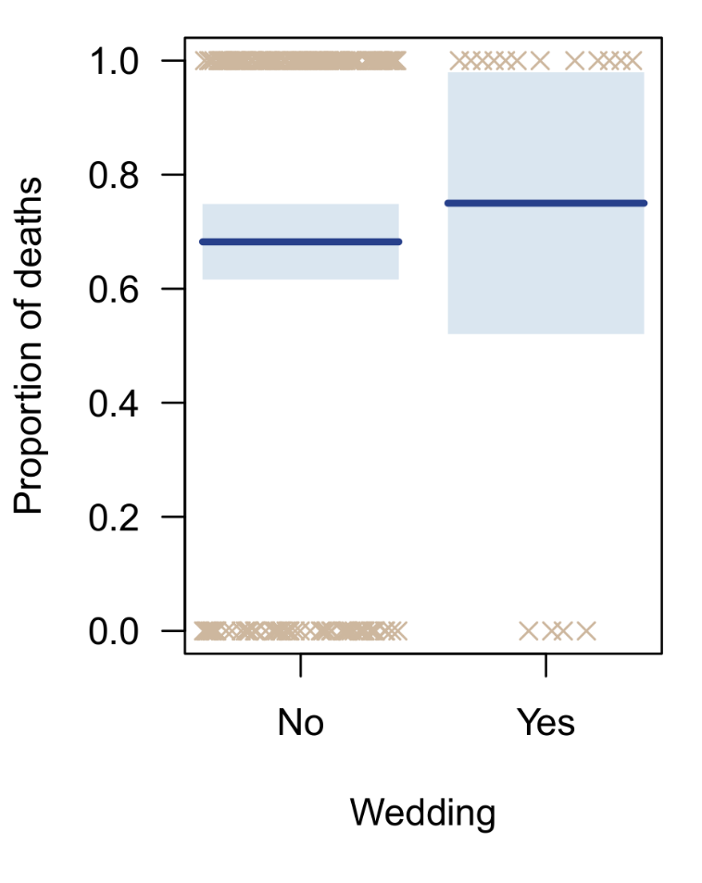
So what is wrong with this?
In regression models with a single IV—regardless if it is categorical or continuous—the least-square estimates will not normally exceed the [0,1] bounds.
If the estimated proportions remain around 50%, a Gaussian distribution is a plausible approximation and standard errors will not be severely misleading. T-tests reach similar qualitative conclusions as a chi-square test.
However, there are scenarios where the model will produce estimates outside of [0,1]!
Standard errors for proportions close to 0 or 1
Standard errors for small groups
Least-square estimates in models with multiple IVs
This behavior is highly undesirable not compatible with the interpretation of the proportions and risk differences as reflecting probabilities!

Slide 14

Binary logistic regression

Slide 15
Logistic regression – GLM representation
Logistic regression (LR) is applied when the dependent variable (DV) is categorical with two levels. One of the levels is coded as 0 (=reference level), and the other as 1, hence the more elaborate name binary logistic regression.
Traditionally, the 0-1 values are often called failures and successes, referring to the realization of some outcome (e.g., passing an exam, death), but they need not have that interpretation (e.g., gender).
Logistic regression is an example of a generalized linear model (GLM), which has the following general form:
Where the right hand is a linear function of predictors X, connected on the left hand to the expected/mean value of Y, which is transformed by a link function g(). In normal regression, there is no link function (no transformation)*, but for other response distributions this will typically be a nonlinear function.
g(E(Y )) = β₀ + β₁X₁ + … + β_{p}X_{p}
* Or it is considered to be the "identity function"

Slide 16
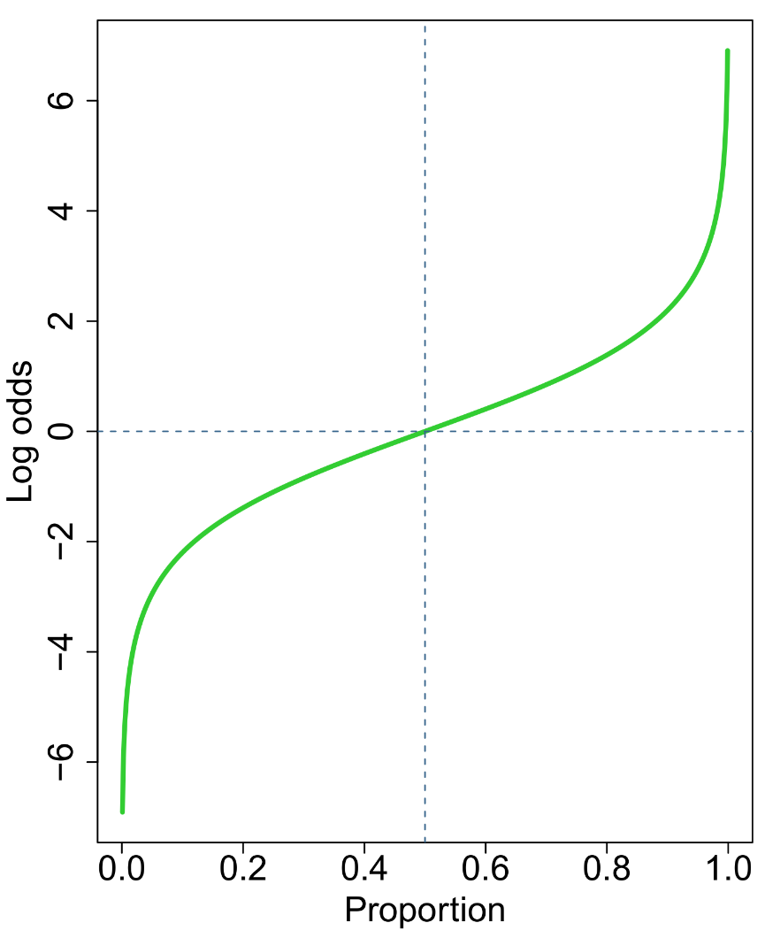

Logistic regression – Logit transformation
An obvious choice of link function for a binary outcome is a log-odds, or logit transformation. That is, rather than modelling the mean proportion, we model:
First we take the odds of the mean (i.e., we divide by its opposite), then we apply a log transformation. Why is this an obvious choice? We have seen previously that log-odds values have desirable properties over raw proportions.
Their bounds are infinite [−∞, +∞] and symmetrical around 0. The problems that we previously encountered with naïve regression cannot exist, since any log-odds value predicted by our linear combination of IVs is possible, and yet can be back-transformed to a proportion strictly within [0,1]!
$$log⁡(\frac{E(Y)}{1−E(Y)})$$
= β₀ + β₁X₁ + … + β_{p}X_{p}

Slide 17



Intercept-only model
Let us consider first the simplest possible model, containing only an intercept term. In continuous regression, the intercept encodes the marginal mean of Y. Likewise, for logistic regression, it encodes the marginal log-odds of Y.
It follows immediately that exp(β₀) is equal to the marginal odds of Y=1/Y=0, and that the original proportions of Y=1 and Y=0 can be recovered with an odds backtransformation.
β₀ =0 corresponds to a log-odds of 1, and a predicted probability of 50% for Y=1 and Y=0. This means that the significance test on the intercept checks if the distribution of Y=1 and Y=0 is significantly unequal.
$$log⁡(\frac{E(Y)}{1−E(Y)})$$
$$\frac{exp⁡(β_{0})}{1−exp⁡(β_{0})}$$
= β₀
$$E(Y)$$
=

Slide 18
Intercept-only model in R
In R we can easily fit the intercept-only model for the GOT death rate:
model <- glm(Death ~ 1, data=GOT, family=binomial(link="logit"))
summary(model)
Deviance Residuals:
Min 1Q Median 3Q Max
-1.5252 -1.5252 0.8657 0.8657 0.8657
Coefficients:
Estimate Std. Error z value Pr(>|z|)
(Intercept) 0.7885 0.1496 5.271 1.36e-07 ***
---
Signif. codes: 0 ‘***’ 0.001 ‘**’ 0.01 ‘*’ 0.05 ‘.’ 0.1 ‘ ’ 1
(Dispersion parameter for binomial family taken to be 1)
Null deviance: 258.37 on 207 degrees of freedom
Residual deviance: 258.37 on 207 degrees of freedom
AIC: 260.37
Number of Fisher Scoring iterations: 4

Slide 19
Intercept-only model in R
The intercept estimate equals 0.7885. This means that the estimated marginal odds of Y=1/Y=0 are exp(0.7885)=2.2. A death is more than twice as likely as survival on GOT.
The z-test on the intercept is highly significant, indicating that the odds of death versus survival are significantly different from 1, and hence that the distribution of death and survival proportions is significantly unequal.
We can calculate the marginal estimated proportions by:
Y=1 2.2/(1+2.2) = 0.6875
Y=0 1 − 2.2/(1+2.2) = 0.3125
But of course we already knew this from the raw proportions we calculated in our original data table. Essentially, we have now learned a model-based way of running a proportion test (see Part I). The z-test reported in the summary is a Wald test.

Slide 20
Two-group difference
Let us now add the Wedding groups to our model. This is a qualitative IV with 2 levels. In order to use it as a predictor, we must convert it to a numerical dummy variable. We choose No=0 and Yes=1. This procedure is identical to how factor variables are treated in ordinary regression:
What is the interpretation of the intercept (β₀) this time?
What is the interpretation of β₁ in this model?
$$log⁡(\frac{E(Y)}{1−E(Y)})$$
= β₀ + β₁Wedding_{yes}

Slide 21
Two-group difference
Let us now add the Wedding groups to our model. This is a qualitative IV with 2 levels. In order to use it as a predictor, we must convert it to a numerical dummy variable. We choose No=0 and Yes=1. This procedure is identical to how factor variables are treated in ordinary regression:
What is the interpretation of the intercept (β₀) this time?
What is the interpretation of β₁ in this model?
$$log⁡(\frac{E(Y)}{1−E(Y)})$$
= β₀ + β₁Wedding_{yes}
 | Death
Wedding | No | Yes
No | 61 | 131
Yes | 4 | 12
LO = β₀
LO = β₀ + β₁

Slide 22
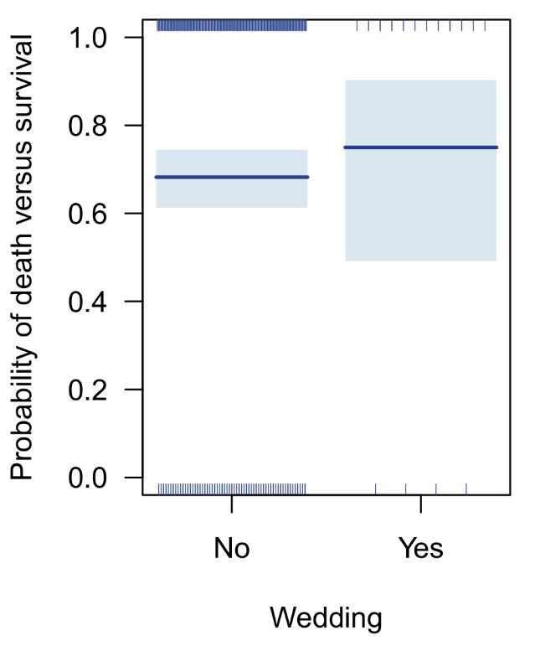
Two-group difference parameter = Odds-ratio!
Recall that the log function changes addition to multiplication. In the Wedding model, a difference of log-odds is therefore equal to a multiplication of odds.
Thus, for a 1-unit increase in Wedding (No to Yes), the odds of Y=1/Y=0 are expected to multiply by exp(β₁). This is an odds ratio! Let's fit the model in R and check…
model <- glm(DeathBin~Wedding, data=GOT, family=binomial)
summary(model)
Thus, exp(0.3343)=1.40 corresponds to the 2×2 Wedding × Death odds ratio. The odds of Death multiply by 1.4 when you get married on GOT, as opposed to not. The z-test suggests this increase is non-significant, confirming our earlier chi-square test.
Coefficients:
Estimate Std. Error z value Pr(>|z|)
(Intercept) 0.7643 0.1550 4.931 8.18e-07 ***
WeddingYes 0.3343 0.5978 0.559 0.576
---
Signif. codes: 0 ‘***’ 0.001 ‘**’ 0.01 ‘*’ 0.05 ‘.’ 0.1 ‘ ’ 1

Slide 23
Main effect or interaction?
On the surface it does not make sense that the Wedding main effect in LR would be equivalent to the Wedding × Death interaction effect in a chi-square test. Which is correct?
It is important to keep in mind that the outcome in LR is already a ratio of proportions (i.e., odds), NOT a single proportion. This means that parameters associated with IVs in the model—categorical or continuous—will reflect contrasts of ratios, or differences of differences. Such effects are interactions.
A useful analogue can be made with paired continuous data. Suppose we have a between-subjects Group factor, and two measurements at T1 and T2. We can create a difference score D=T1−T2. If we use this as a DV in a model with Group as IV, then the Group effect is technically testing group differences of time differences, so the Group × Time interaction!
ID Group T1 T2 D
1 A 6 7 -1
2 A 0 0 0
3 B 3 6 -3
...
lm(D ~ Group)
Difference of differences = interaction

Slide 24
Which test is correct?
We now have three different options of testing the Wedding × Death research hypothesis:
 | Death
Wedding | No | Yes
No | 61 | 131
Yes | 4 | 12
Chi-squared test
X-squared Df Pr(>Chisq)
Wedding:Death 0.0787 1 0.7789
Character | Wedding | Death
Ned Stark | No | Yes
Roslin Frey | Yes | No
Ramsay Bolton | Yes | Yes
Hodor | No | Yes
Yara Greyjoy | No | No
… | … | …
Khal Drogo | Yes | Yes
Logit ANOVA (Binomial)
LR Chisq Df Pr(>Chisq)
Wedding 0.327 1 0.5673
Log-linear ANOVA (Poisson)
LR Chisq Df Pr(>Chisq)
Wedding:Death 0.327 1 0.5673
Wedding | Death | Frequency
No | No | 61
No | Yes | 131
Yes | No | 4
Yes | Yes | 12

Slide 25
Which test is correct?
Upon inspection, the logit and log-linear models produce identical test statistics. In fact, they are statistically equivalent likelihood ratio tests (LRT).
The classical chi-square analysis, by contrast, is running a Score test, and hence produces a different chi-square test statistic and p-value. An LRT equivalent of chi-square analysis has been proposed but is far less known by researchers, called the G-squared test, or just G-test:
library(AMR)
g.test(xtabs(~Wedding+Death, data=GOT))
As expected, we now obtain identical test statistics between all three analyses. In other words, any distinction between these three approaches is entirely illusory. For researchers, the choice of analysis may come down to practical convenience. The chi-square test is fast, while the log-linear produces a full breakdown of the 2×2 design.
G-test of independence
data: xtabs(~Wedding+Death, data=GOT)
X-squared = 0.327, p-value = 0.5673

Slide 26
2. Binary logistic regression
B. Continuous predictor

Slide 27

Continuous predictors
The GOT data has many interesting continuous variables, such as the character's age, how many regions they have visited, how many major battles they participated in, and their (approximate) number of kills.
Let us have a look if character age (Age) predicts the probability of death, using a logistic regression model.
In real life, a strong relationship between age and death is obviously expected. GOT takes place over a span of 8-10 years, on the other hand, during which other factors may influence death more strongly.
Inspecting the data, we immediately have a problem in that several characters have extreme ages of over 400 and 10,000 years (Melisandre and The Night King). We will drop these observations as outliers for the analysis.

Slide 28
Continuous predictors
Structurally speaking, our new model retains a similar form as for the Wedding analysis:
Running this in R is now straightforward:
model <- glm(Death~Age, data=GOT, family=binomial, subset=Age<400)
summary(model)
What is the interpretation of the intercept and Age parameters?
$$log⁡(\frac{E(Y)}{1−E(Y)})$$
= β₀ + β₁Age
Coefficients:
Estimate Std. Error z value Pr(>|z|)
(Intercept) 0.389409 0.352159 1.106 0.269
Age 0.010061 0.008478 1.187 0.235
---
Signif. codes: 0 ‘***’ 0.001 ‘**’ 0.01 ‘*’ 0.05 ‘.’ 0.1 ‘ ’ 1

Slide 29
Continuous predictors
The intercept is non-sensical in this model, since it reflects the mean log-odds of death versus survival when Age=0.
As an exercise, we can still calculate that this translates to an odds of exp(0.389)=1.49, which is far less than the marginal death odds of 2.2. Likewise, the intercept translates to a death probability of 59.8% at Age=0, which is again less than the marginal death probability of 68.8%.
For the Age parameter, it appears we have a positive association. Specifically, for a 1-unit increase in Age (=1 year), the log-odds of death versus survival are expected to increase by 0.01. How does this translate to an odds scale?
Recall again that the logarithmic function turns addition into multiplication. Therefore, we can state that, for a 1-year increase in Age, the odds of death versus survival are expected to multiply by exp(0.01)=1.01. This statement implies an odds-ratio of Age × Death. However, such a general 2×2 table does not exist in our data, or does it…?
Coefficients:
Estimate Std. Error z value Pr(>|z|)
(Intercept) 0.389409 0.352159 1.106 0.269
Age 0.010061 0.008478 1.187 0.235

Slide 30
Parameters are still odds ratios!
For many consecutive ages in the GOT data, we could indeed construct a 2×2 table of Age × Death, e.g.:
However, there are many gaps in Age × Death combinations where no such data is available. Moreover, for some continuous predictors, there may be no data for any +1 unit increase in the variable, due to the variable's scale.
It turns out that the logistic regression model is pooling all +1-unit 2×2 tables into a generalized 2×2 odds ratio that interpolates across the non-existent value combinations. In other words, even continuous LR parameters still reflect odds ratios! One could say that it reflects the X₊₁ × Y odds ratio.
Interpreting continuous LR parameters as odds ratios is nevertheless not recommended…
 | Death
Age | No | Yes
22 | 4 | 4
23 | 1 | 8

Slide 31
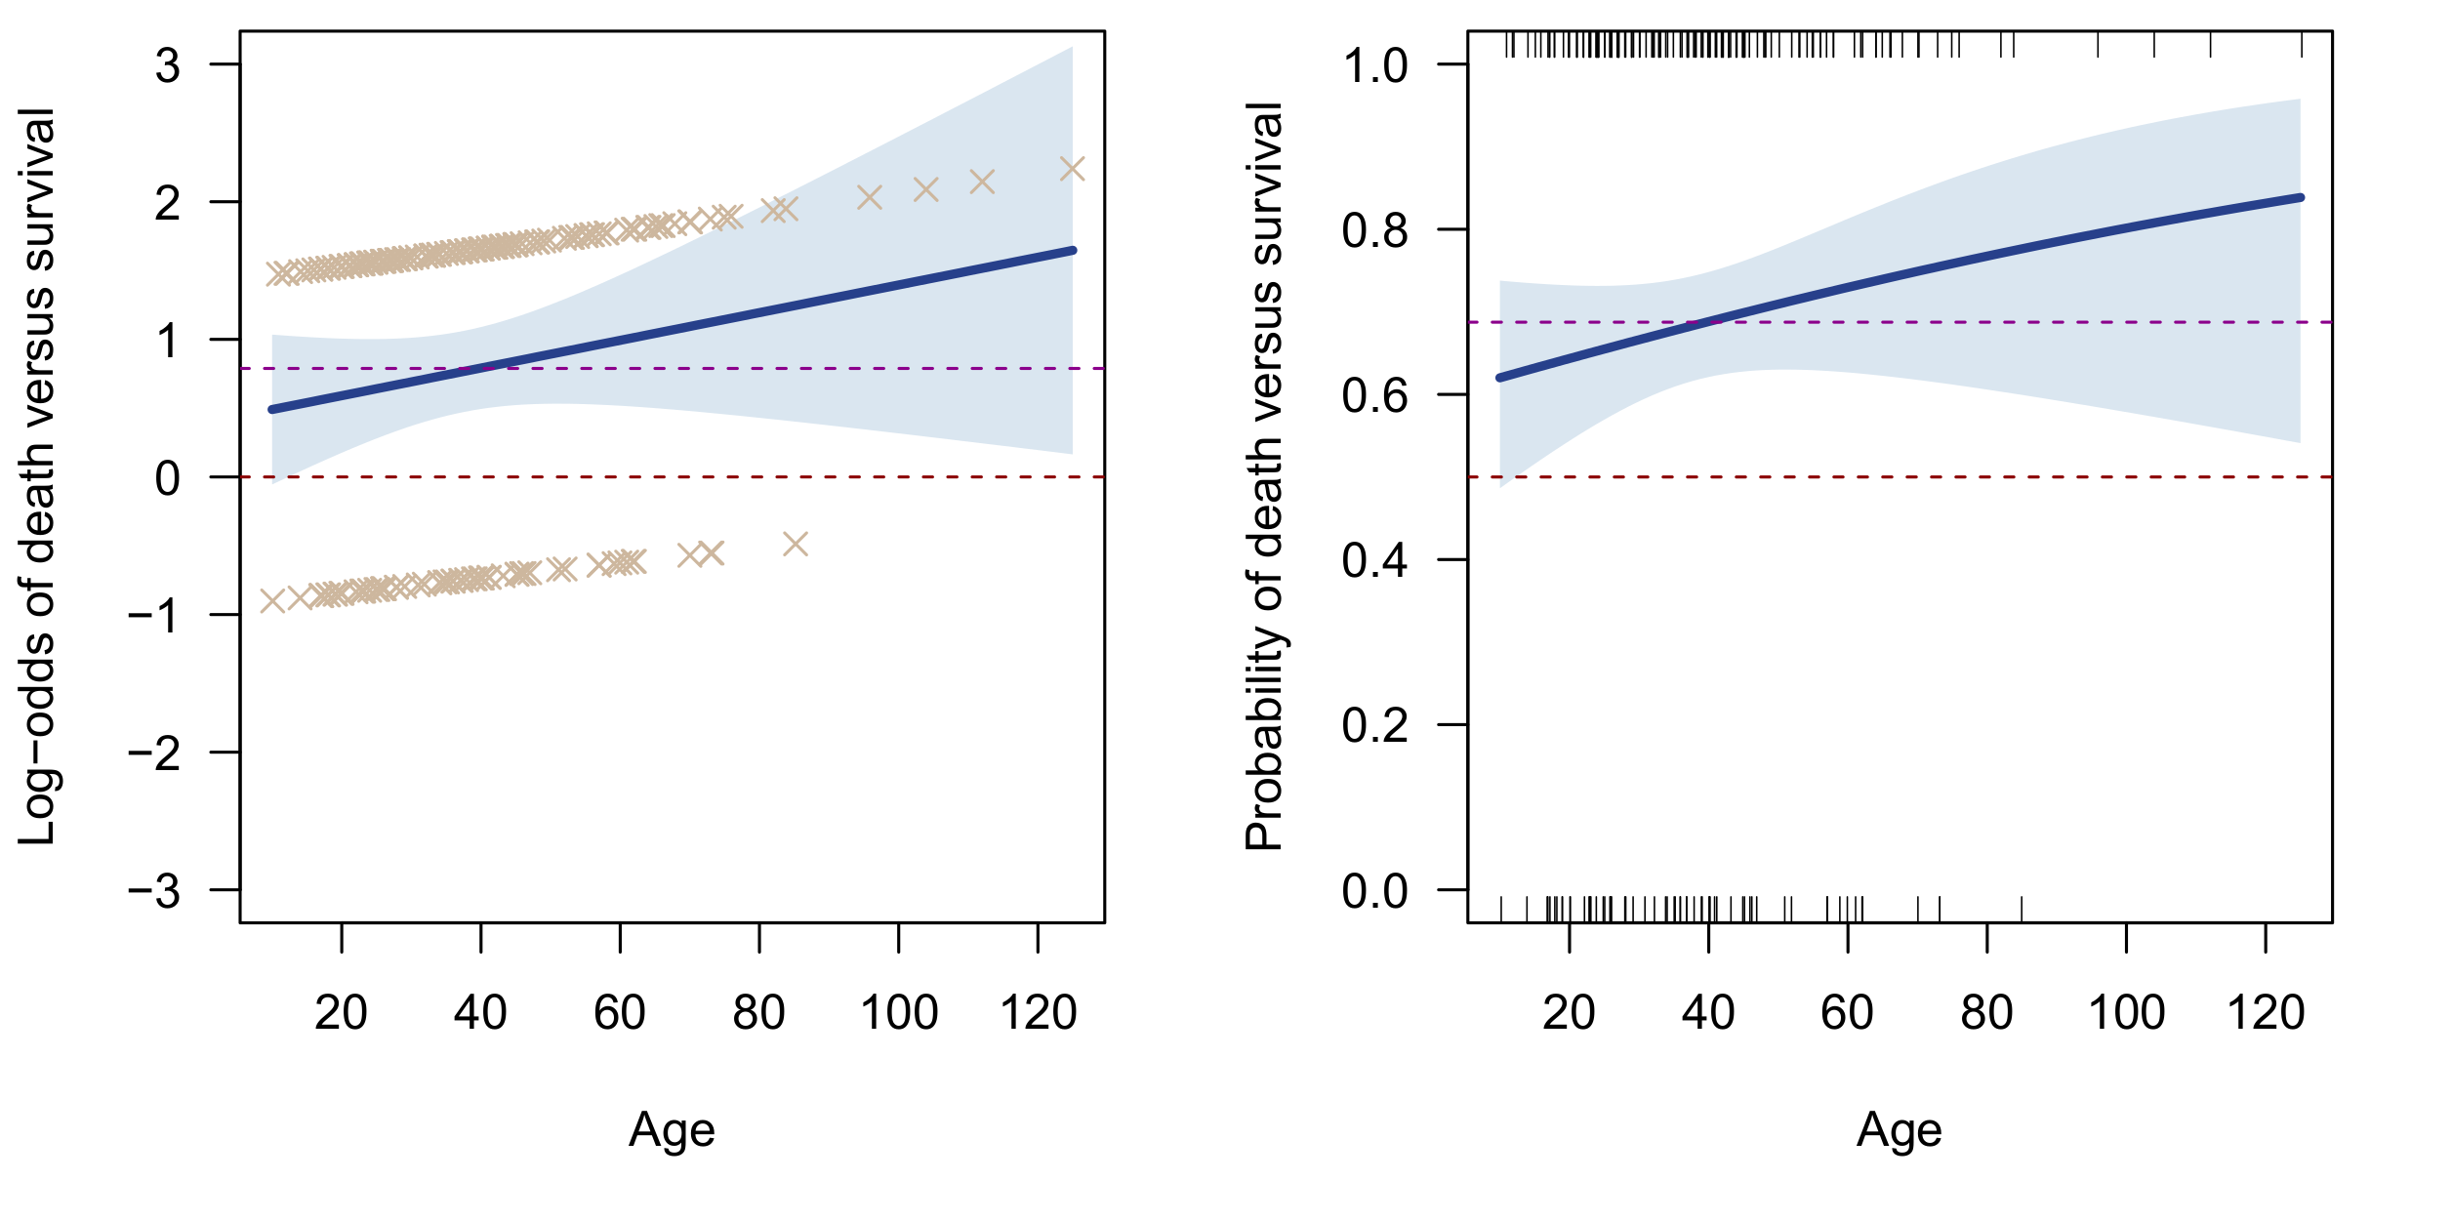
Graphical interpretation
Let us visualize the model's predictions both on a log-odds and probability scale, using the visreg package in R. We can switch between response scales with the scale argument ("linear", "response"):

Slide 32
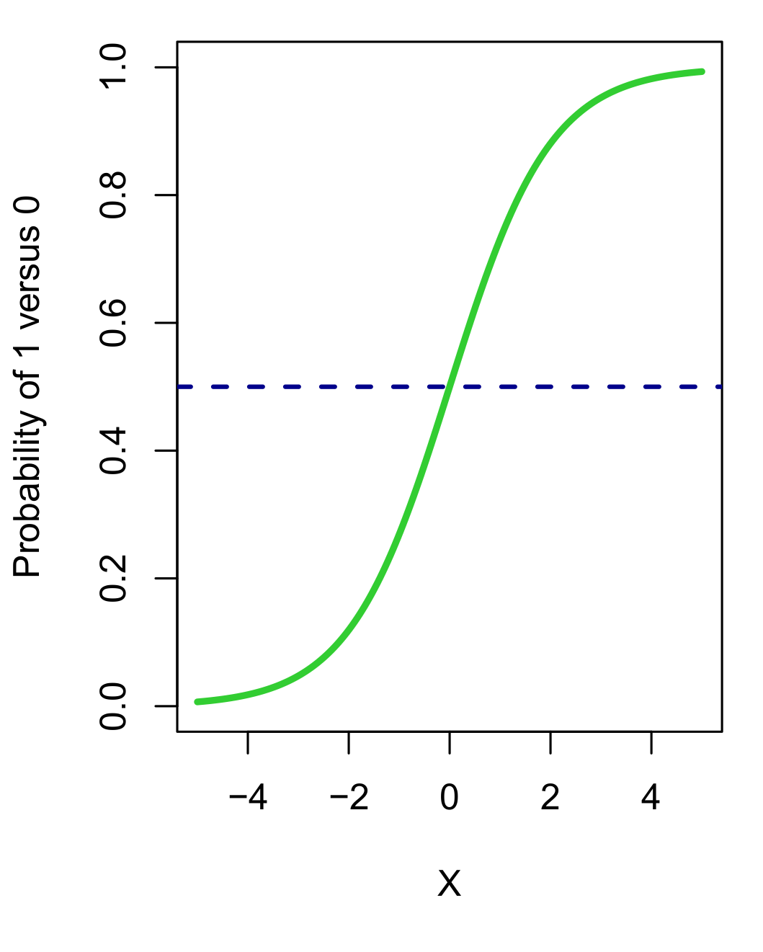
Logistic decision curves
The relation between Age and log-odds is linear!
The relation between Age and probability is non-linear! This was not entirely obvious previously with categorical IVs.
When the response is plotted on a probability scale this graph is called a logistic decision curve, in that it is a probability curve that can be used to make categorical decisions on class membership.
When the probability exceeds a chosen threshold, we could classify a prediction as a 1, and as a 0 otherwise.
The stronger the effect of the continuous IV, the more S-shaped or “sigmoid” the decision curve will be, and hence decisions will be reached more quickly on class 1 versus 0. The weaker the effect of the IV, the more linear the curve will appear, and hence decisions in favor of one class versus another will be reached slowly.
Class 1?
Class 0?

Slide 33
Logistic decision curves
In its prototypical form, the middle section of the logistic decision curve is always approximately linear, with the curvature only apparent at the tail ends.
Conventionally, 50% probability is taken as the decision threshold for classification predictions. However, this may not make sense for data where the marginal odds of Y are biased toward 1, as indeed they are in our GOT example. For some analyses, the decision threshold is optimized for maximal accuracy (see later).
Ideally, we would want a logistic decision curve that (a) is statistically significant and (b) has categorical decision value, i.e., it differentiates class 1 from class 0.
However, it is possible for the effect of an IV to be significant, and not have decision value, and vice-versa! In our case, Age is neither significant nor does it have decision value.
The visreg package also adds a 95% confidence band around the decision curve, which is handy to express the uncertainty in the mean estimates. Moreover, if the null slope is contained within the band, the IV's effect is not significant.

Slide 34



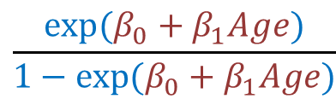
Predicted values
Let us calculate the predicted values for some ages for our model. As before, we simply apply our log-odds backtransformation:
$$\frac{exp⁡(β_{0}+β_{1}Age)}{1−exp⁡(β_{0}+β_{1}Age)}$$
$$E(Y)$$
=
Age | Log-odds | Odds | Prob(Death)
10 | 0.490 | 1.632 | 0.620
… | … | … | …
22 | 0.611 | 1.842 | 0.648
23 | 0.621 | 1.860 | 0.650
24 | 0.631 | 1.879 | 0.653
… | … | … | …
100 | 1.395 | 4.037 | 0.801
Non-linear increments!
Linear increments!

Slide 35
2. Binary logistic regression
C. Multiple predictors

Slide 36

Multiple predictors
Let us now consider the more general model with multiple predictors simultaneously. This time we focus on predicting death using: Age, Gender, Profession, Class, Travelled, Battles, and Killed. We extend our model formula as follows:
Age, Travelled and Battles are all continuous, while the remaining IVs are categorical. Profession has 5 levels and hence requires 4 dummy variables. We use the default treatment coding, with 0/1 dummies against a reference level ("Clergy").
The intercept is even more non-sensical in this model than before, since it reflects the odds of death versus survival when all IVs are equal to 0: a 0-year old, female, cleric, commoner that has not travelled, participated in no battles, and not killed anyone. Even without 0 age such a character may not actually exist.
$$log⁡(\frac{E(Y)}{1−E(Y)})$$
= β₀ + β₁Age + β₂Gender_{male} + β₃Profession_{eco} +
β₄Profession_{mil} + β₅Profession_{no} + β₆Profession_{pol} +
β₇Class_{nob} + β₈Travelled + β₉Battles + β₁₀Killed_{yes}

Slide 37
Multiple predictors
In R, we extend our model formula accordingly, and inspect our parameter output:
model <- glm(Death~Age+Gender+Profession+Class+Travelled+Battles+Killed,
data=GOT, family=binomial, subset=Age<400)
summary(model)
Coefficients:
Estimate Std. Error z value Pr(>|z|)
(Intercept) 0.017573 0.703983 0.025 0.9801
Age 0.008771 0.009925 0.884 0.3768
GenderMale -0.153326 0.422822 -0.363 0.7169
ProfessionEconomy 0.168829 0.652524 0.259 0.7958
ProfessionMilitary 0.712838 0.577340 1.235 0.2169
ProfessionNone -0.433268 0.824013 -0.526 0.5990
ProfessionPolitics 0.669086 0.615190 1.088 0.2768
ClassNobility 0.176589 0.353709 0.499 0.6176
Travelled -0.281354 0.146219 -1.924 0.0543 .
Battles -0.012758 0.126861 -0.101 0.9199
KilledYes 0.725355 0.408607 1.775 0.0759 .
---
Signif. codes: 0 ‘***’ 0.001 ‘**’ 0.01 ‘*’ 0.05 ‘.’ 0.1 ‘ ’ 1

Slide 38

ANOVA
None of the parameters are significant, although we clearly have a problem to interpret the Profession effect, since we only have contrasts available of each level against the reference level ("Clergy"). For this effect, we require an omnibus test. This could be done with a manual ANOVA model comparison:
reduced <- glm(Death~Age+Gender+Class+Travelled+Battles+Killed,data=GOT,
family=binomial, subset=Age<400)
full <- glm(Death~Age+Gender+Profession+Class+Travelled+Battles+Killed,data=GOT,
family=binomial, subset=Age<400)
anova(reduced,full, test="LRT")
Or automatically, using the Anova function of the car library. Anova will return a Type II breakdown of model effects with likelihood ratio tests.
Anova(model)
Resid. Df Resid. Dev Df Deviance Pr(>Chi)
1 199 246.18
2 195 242.13 4 4.0429 0.4002

Slide 39
ANOVA
This is more convenient since we get a full effects breakdown at once. Note again the convention in the table of referring to an ANOVA breakdown of a GLM model as an analysis of deviance!
The Profession effect is not significant, which means we are normally not allowed to conduct pairwise contrasts between levels of Professions. If we did want to do this, we would proceed with a contrast function of the emmeans package.
Analysis of Deviance Table (Type II tests)
Response: Death
LR Chisq Df Pr(>Chisq)
Age 0.8021 1 0.37048
Gender 0.1326 1 0.71576
Profession 4.0429 4 0.40023
Class 0.2497 1 0.61729
Travelled 3.7344 1 0.05330 .
Battles 0.0101 1 0.91999
Killed 3.2325 1 0.07219 .
---
Signif. codes: 0 ‘***’ 0.001 ‘**’ 0.01 ‘*’ 0.05 ‘.’ 0.1 ‘ ’ 1

Slide 40
Pairwise contrasts with emmeans
Using a combination of emmeans and pairs, with unadjusted p-values:
em <- emmeans(model,specs="Profession")
pairs(em, adjust="none")
contrast estimate SE df z.ratio p.value
Clergy - Economy -0.1688 0.653 Inf -0.259 0.7958
Clergy - Military -0.7128 0.577 Inf -1.235 0.2169
Clergy - None 0.4333 0.824 Inf 0.526 0.5990
Clergy - Politics -0.6691 0.615 Inf -1.088 0.2768
Economy - Military -0.5440 0.545 Inf -0.998 0.3183
Economy - None 0.6021 0.791 Inf 0.761 0.4464
Economy - Politics -0.5003 0.598 Inf -0.836 0.4030
Military - None 1.1461 0.751 Inf 1.526 0.1271
Military - Politics 0.0438 0.471 Inf 0.093 0.9260
None - Politics -1.1024 0.713 Inf -1.546 0.1222
Results are averaged over the levels of: Gender, Class, Killed
Results are given on the log odds ratio (not the response) scale.

Slide 41
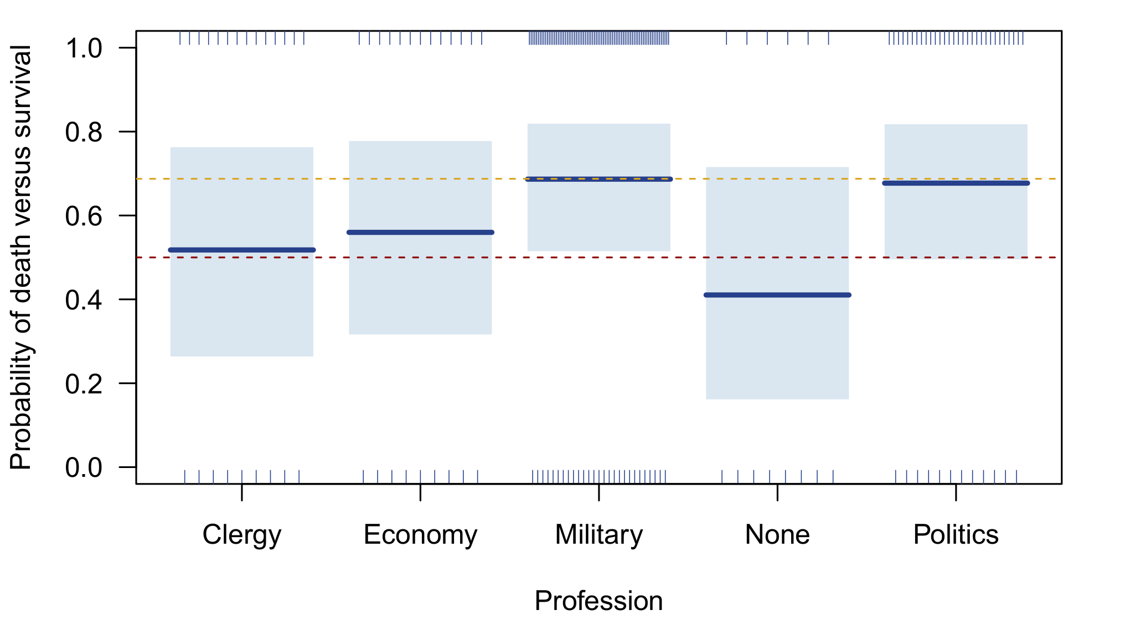
Effect plot
Marginal death rate
50% threshold
visreg(model,xvar="Profession",ylim=c(0,1),scale="response",points.par=list(pch=4,col="bisque3",
cex=1),line.par=list(lwd=3,col="royalblue4"),fill.par=list(col=adjustcolor("steelblue",
alpha=0.2)),ylab="Probability of death versus survival",jitter=TRUE)

Slide 42
Effect interpretation with multiple predictors
Although characters with no profession actually have less than 50% of dying in GOT, the pairwise contrasts with other professions did not reach significance because the group is rather small (and hence the SE is large).
Because there are multiple IVs in the model, the Profession effect should be stated more carefully. That is, it reflects differences between professions in the log-odds of death versus survival…
…when controlling for differences in Age, Gender, Class, Travelled, Battles, and Killed
…adjusting for differences in Age, Gender, Class, Travelled, Battles, and Killed
…given that characters had the same Age, Gender, Class, Travelled, Battles, and Killed values
…while keeping Age, Gender, Class, Travelled, Battles, and Killed levels fixed
These are all equivalent statements, and follow the same interpretation as in ordinary regression. In LR however, predicted probabilities and the ability to classify predictions as 1 or 0 complicates things slightly. For example, keeping age fixed at 100 will flatten out profession differences, since we are already at the tail end of the logistic decision curve.

Slide 43
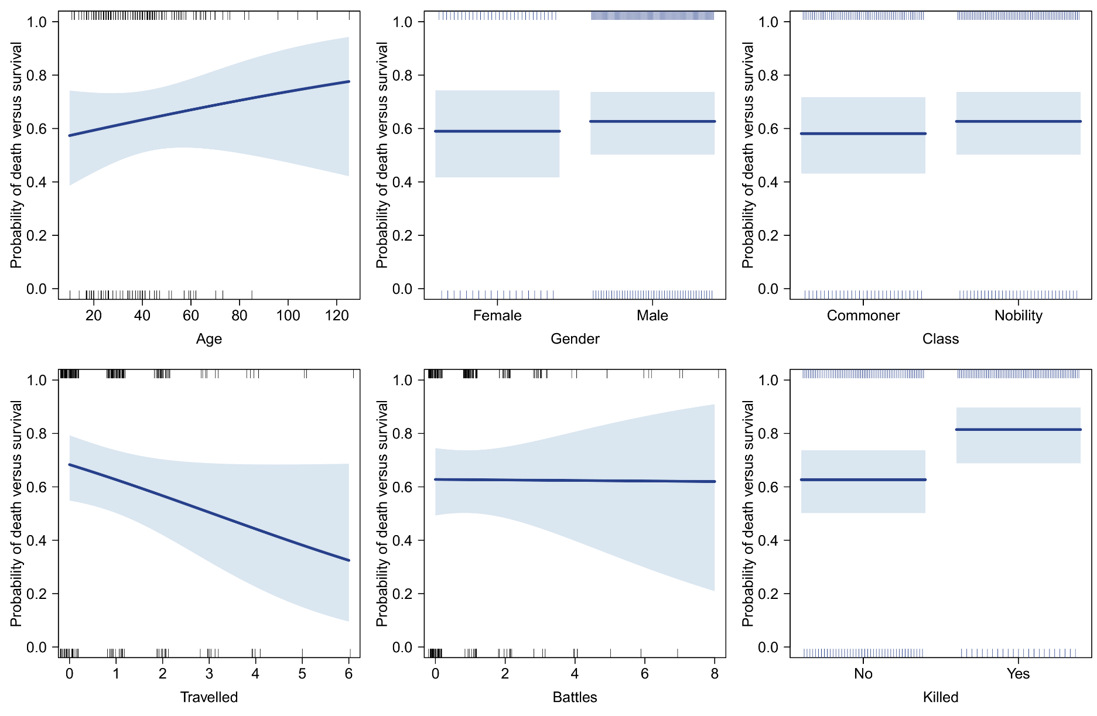
Effect interpretation with multiple predictors

Slide 44
Effect interpretation with multiple predictors
For LR models, rather than interpreting the regression coefficients, it may be more convenient to simply calculate (and plot) the predicted probabilities for various interesting combinations of values. The emmeans package makes this easy. For example, predicted probabilities for Professions and Genders:
emmeans(model,c("Profession","Gender"),type="response")
Profession Gender prob SE df asymp.LCL asymp.UCL
Clergy Female 0.618 0.1267 Inf 0.361 0.822
Economy Female 0.657 0.1272 Inf 0.388 0.852
Military Female 0.767 0.0816 Inf 0.574 0.890
None Female 0.511 0.1563 Inf 0.235 0.781
Politics Female 0.759 0.0862 Inf 0.556 0.888
Clergy Male 0.581 0.1261 Inf 0.334 0.793
Economy Male 0.621 0.1132 Inf 0.390 0.808
Military Male 0.739 0.0469 Inf 0.637 0.820
None Male 0.473 0.1777 Inf 0.182 0.784
Politics Male 0.730 0.0795 Inf 0.551 0.856
Results are averaged over the levels of: Class, Killed
Confidence level used: 0.95
Intervals are back-transformed from the logit scale

Slide 45
Non-collapsibility problem
(Pang, 2012)
In ordinary regression, we often compare the marginal and adjusted effect of a predictor, e.g., Y~A versus Y~A+B. The second model unconfounds the A and B effects. Moreover, when A and B are uncorrelated/orthogonal, then Y~A will produce the same parameter estimate for A as Y~A+B.
While it may be tempting to extend this to logistic regression, we encounter a peculiar problem with odds-ratios called non-collapsibility. The adjusted A odds-ratio (Y~A+B) is not collapsible across the levels of B to equal the marginal A odds ratio (Y~A).
In LR Y~A may differ from Y~A+B, even when A and B are orthogonal! Conversely, Y~A and Y~A+B may produce identical A effects even when A and B are confounded!
Non-collapsibility is a side-effect of LR's link function, the nonlinear log-odds transformation. When back-transforming to an odds scale, it is not possible to express the A odds-ratio as a linear weighted combination of B levels.
Extreme caution should be exercised with comparing marginal and adjusted models for the same effect, especially in the context of repeated measures data (GEE versus GLMER)!

Slide 46

Non-collapsibility

Slide 47

Interactions
As in ordinary regression, we may consider adding interactions to our model. For 7 IVs, we have 21 possible two-way interactions, 35 three-way interactions, 35 four-way interactions, etc. Clearly we need to put some restriction on complexity.
Ideally, interactions are only added to the model for specific hypotheses. For exploratory testing, some rules of thumb should be considered:
Do not go beyond two-way interactions
Avoid interactions that produce empty contingency cells
Test interactions one at a time, not all at once
Let us have a look at a simple example, where we examine how Battles modifies the relation between Age and Death in the GOT data:
model <- glm(Death~Age*Battles, dat=GOT, subset=Age<400, family=binomial)
summary(model)

Slide 48
Interactions
How do we interpret the parameters?
The main effects parameters no longer reflect main effects! E.g., the Age parameter reflects the slope of Age when Battles=0. This is now a conditional contrast! To get genuine marginal main effects, we must run a Type II ANOVA breakdown:
Coefficients:
Estimate Std. Error z value Pr(>|z|)
(Intercept) 0.519188 0.439445 1.181 0.237
Age 0.005478 0.010743 0.510 0.610
Battles -0.163141 0.296366 -0.550 0.582
Age:Battles 0.005489 0.008069 0.680 0.496
---
Signif. codes: 0 ‘***’ 0.001 ‘**’ 0.01 ‘*’ 0.05 ‘.’ 0.1 ‘ ’ 1
LR Chisq Df Pr(>Chisq)
Age 1.49455 1 0.2215
Battles 0.09340 1 0.7599
Age:Battles 0.47331 1 0.4915
---
Signif. codes: 0 ‘***’ 0.001 ‘**’ 0.01 ‘*’ 0.05 ‘.’ 0.1 ‘ ’ 1

Slide 49
Interactions
The interaction is quite difficult to interpret, since it involves two continuous variables:
Exp(0.005)=1.005. For a 1-unit increase in Battles (=1 extra battle participated), the 2×2 odds-ratio of Age₊₁ × Death multiplies by 1.005. Equivalently, one could state that, for a 1-year increase in Age, the 2×2 odds-ratio of Battles₊₁ × Death multiplies by 1.005. We now see how the order/degree of the regression parameter determines its interpretation:
Coefficients:
Estimate Std. Error z value Pr(>|z|)
(Intercept) 0.519188 0.439445 1.181 0.237
Age 0.005478 0.010743 0.510 0.610
Battles -0.163141 0.296366 -0.550 0.582
Age:Battles 0.005489 0.008069 0.680 0.496
---
Signif. codes: 0 ‘***’ 0.001 ‘**’ 0.01 ‘*’ 0.05 ‘.’ 0.1 ‘ ’ 1
Order | Type | Interpretation
0 | Intercept | Multiplication of proportions (=odds)
1 | Main effects | Multiplication of odds (=odds ratio)
2 | 2-way interactions | Multiplication of odds ratios

Slide 50
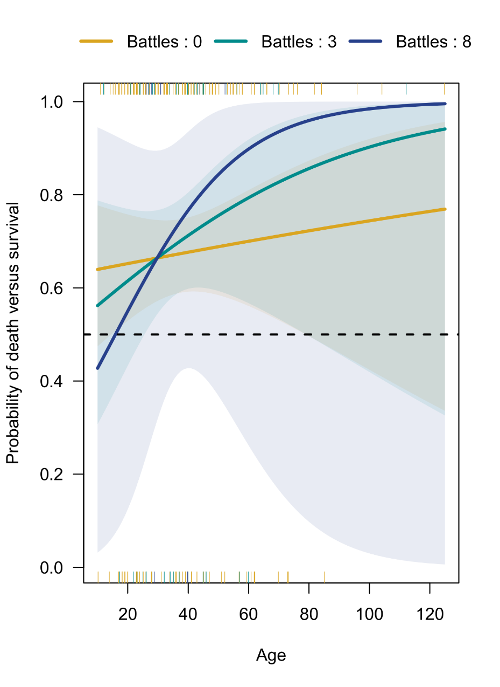
Interactions visualized
Still better is to make an interaction plot, which is made easy by visreg:
Where breaks controls which Battles values will be plotted and overlay plots all curves in a single panel (versus multi-panel plot).
Note the use of adjustcolor to set alpha-transparency for the confidence bands!
palette <- c("goldenrod","darkcyan","royalblue4")
visreg(model,xvar="Age",by="Battles",
breaks=c(0,3,8), overlay=TRUE,
line.par=list(lwd=3,col=palette),
fill.par=list(col=adjustcolor(palette,alpha=0.1)),
ylab="Probability of death versus survival",
jitter=TRUE,scale="response")

Slide 51
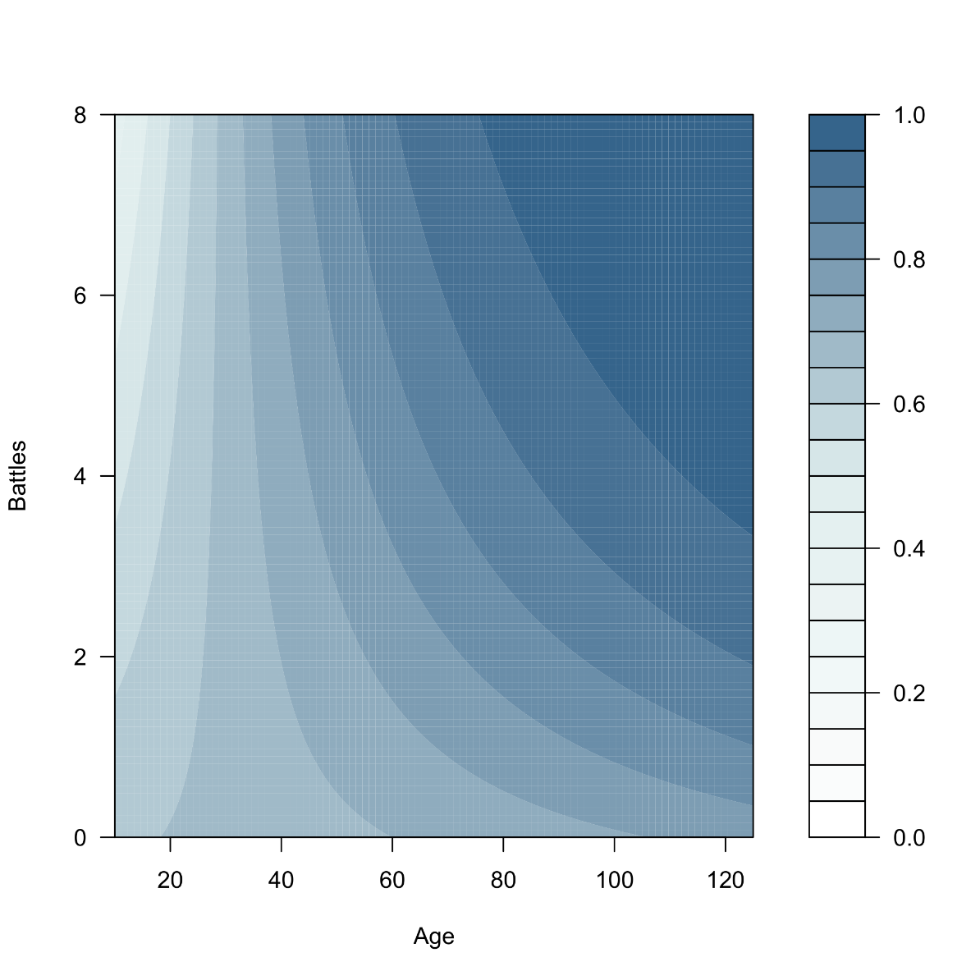
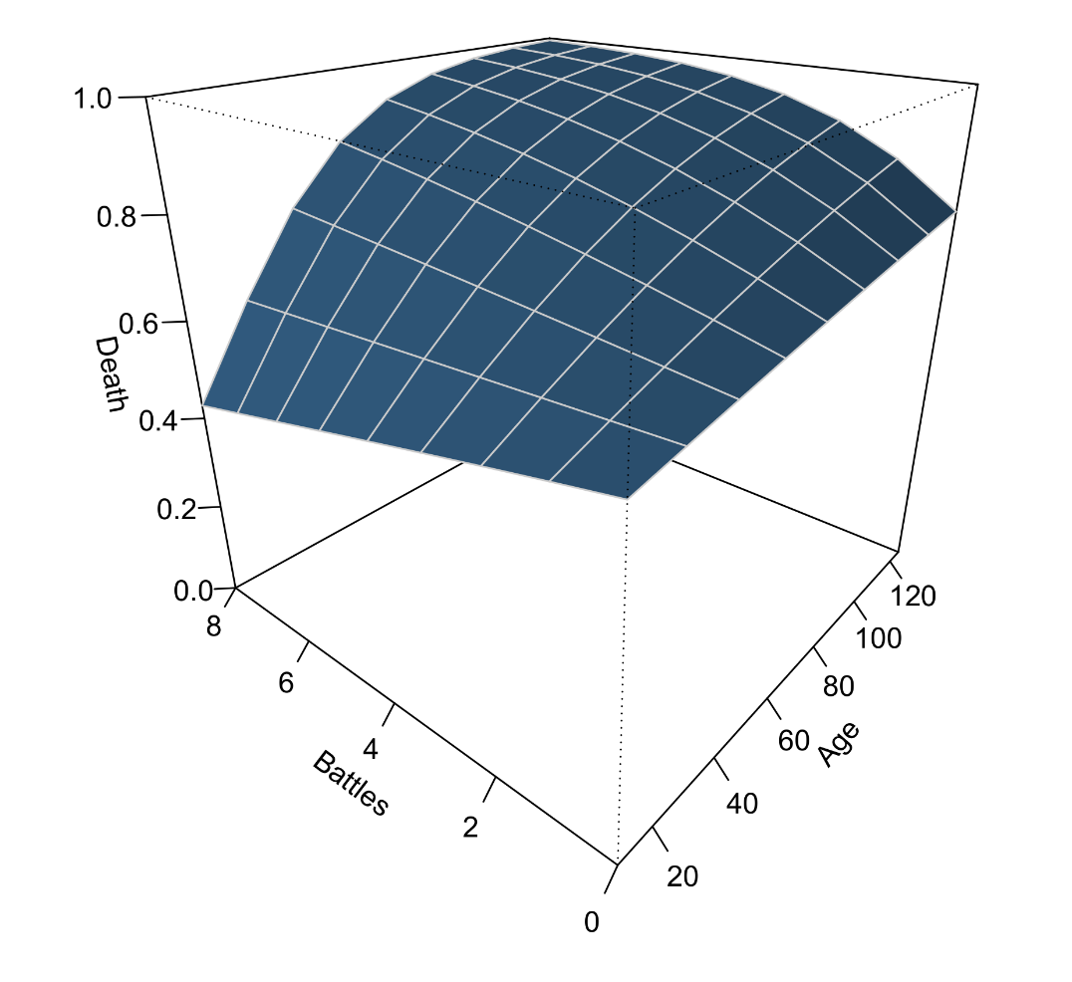
Alternative visualizations
Contour plot
Perspective plot

Slide 52
Effect size – Odds ratio
LR has an advantage over ordinary regression in that its regression coefficients can be directly expressed as an effect size, via the odds ratio.
In fact, it is usually unnecessary to report raw LR coefficients. Instead one reports the OR, its 95% confidence interval, and any relevant test statistics. For example, for our expanded GOT model, we can obtain the 95%CIs using the confint function, which returns LRT intervals by default:
A report would state, e.g., “The effect of Class was not significant, z = 0.50, p = 0.6176, OR = 1.19, 95%CI [0.60, 2.40].”
OR 2.5% 97.5%
(Intercept) 1.02 0.25 4.09
Age 1.01 0.99 1.03
GenderMale 0.86 0.37 1.94
ProfessionEconomy 1.18 0.33 4.32
ProfessionMilitary 2.04 0.65 6.38
ProfessionNone 0.65 0.13 3.25
ProfessionPolitics 1.95 0.58 6.64
ClassNobility 1.19 0.60 2.40
Travelled 0.75 0.56 1.00
Battles 0.99 0.77 1.28
KilledYes 2.07 0.94 4.69

Slide 53
Effect size – Odds ratio
For multi-parameter effects, we have multiple ORs. Which one do we consider? For the Profession effect in our model, we have 10 ORs:
Some possibilities suggest themselves (Maxwell & Delaney, 2002):
Mean OR (= 1.09): The average of all pairwise ORs. May be down-biased for factors with many levels and many irrelevant contrasts.
Max OR (= 3.15): The maximum pairwise OR. May be up-biased in the presence of trivial contrasts.
Mean control OR (= 1.71): The average of the pairwise ORs involving the control condition. The average effect versus “no effect”. Requires a control level in the factor (here "None"?).
Mean hypothesis OR: The average of the pairwise hypothesis ORs. This ignores contrasts that are not the subject of research hypotheses. Makes sense especially for interactions, where certain directions of follow-ups may be irrelevant.
contrast odds.ratio SE df null z.ratio p.value
Clergy / Economy 0.845 0.551 Inf 1 -0.259 0.7958
Clergy / Military 0.490 0.283 Inf 1 -1.235 0.2169
Clergy / None 1.542 1.271 Inf 1 0.526 0.5990
Clergy / Politics 0.512 0.315 Inf 1 -1.088 0.2768
Economy / Military 0.580 0.316 Inf 1 -0.998 0.3183
Economy / None 1.826 1.444 Inf 1 0.761 0.4464
Economy / Politics 0.606 0.363 Inf 1 -0.836 0.4030
Military / None 3.146 2.363 Inf 1 1.526 0.1271
Military / Politics 1.045 0.492 Inf 1 0.093 0.9260
None / Politics 0.332 0.237 Inf 1 -1.546 0.1222

Slide 54
Effect size – Standardized regression coefficients
As a measure of effect, standardized regression coefficients are less useful than ORs. Moreover, their precise calculation in LR is controversial (Menard, 2004), and they may not be comparable across different studies and models.
Standardizing coefficients in LR is only useful for comparing effects within the same model. This can be achieved easily by pre-standardizing all continuous predictors, and then fitting the model. The resulting ORs will now have their interpretation in terms of an SD increase for that predictor. In R we can standardize with the parameters package, e.g.:
standardize_parameters(model, method="refit", two_sd=TRUE, exponentiate=TRUE)
Parameter | Std_Odds_Ratio | 95% CI
(Intercept) | 1.03 | [0.35, 3.09]
Age | 1.39 | [0.68, 2.99]
GenderMale | 0.86 | [0.37, 1.94]
ProfessionEconomy | 1.18 | [0.33, 4.32]
ProfessionMilitary | 2.04 | [0.65, 6.38]
ProfessionNone | 0.65 | [0.13, 3.25]
ProfessionPolitics | 1.95 | [0.58, 6.64]
ClassNobility | 1.19 | [0.60, 2.40]
Travelled | 0.48 | [0.23, 1.01]
Battles | 0.96 | [0.44, 2.15]
KilledYes | 2.07 | [0.94, 4.69]
(Gelman, 2008)

Slide 55
Effect size – Bayes factors
Finally, it is becoming more common to report Bayes factors for models and effects. These quantify the relative evidence for one model versus another, such as the presence or absence of a certain effect. The package BF facilitates their calculation for GLM models, using a fractional Bayes methodology where a flat initial prior is updated to a default prior on a small fraction of the data (Mulder et al., 2019).
The BF function returns posterior probabilities for three hypotheses (β = 0, β > 0, β < 0). The actual Bayes factors have to be accessed in the object, and inverted to obtain the evidence for the alternative hypothesis against the null:
1/BF(model)$BFtu_exploratory
Pr(=0) Pr(<0) Pr(>0)
(Intercept) 0.07 1.02 0.98
Age 0.10 2.65 0.62
GenderMale 0.07 0.78 1.39
ProfessionEconomy 0.07 1.26 0.83
ProfessionMilitary 0.15 4.61 0.56
ProfessionNone 0.08 0.71 1.67
ProfessionPolitics 0.13 3.61 0.58
ClassNobility 0.08 1.62 0.72
Travelled 0.44 0.51 18.41
Battles 0.07 0.93 1.09
KilledYes 0.34 13.18 0.52

Slide 56
2. Binary logistic regression
D. Model fit and diagnostics

Slide 57
Technical details on logistic regression
So far, I have omitted many technical details about the logistic regression model, especially how the parameters are actually estimated. I will largely continue to ignore these, as they are not especially relevant for applying the model in practice. However, I will make a few clarifications:
Deviance Residuals:
Min 1Q Median 3Q Max
-1.5252 -1.5252 0.8657 0.8657 0.8657
Coefficients:
Estimate Std. Error z value Pr(>|z|)
(Intercept) 0.7885 0.1496 5.271 1.36e-07 ***
---
Signif. codes: 0 ‘***’ 0.001 ‘**’ 0.01 ‘*’ 0.05 ‘.’ 0.1 ‘ ’ 1
(Dispersion parameter for binomial family taken to be 1)
Null deviance: 258.37 on 207 degrees of freedom
Residual deviance: 258.37 on 207 degrees of freedom
AIC: 260.37
Number of Fisher Scoring iterations: 4

Slide 58
Technical details on logistic regression
From ordinary regression, we know that residuals reflect a random variable that is Gaussian/normally distributed, with mean equal to the regression equation, and variance estimated by the Mean Squared Error (MSE). The distributional assumption is visible in the output and verifiable with residual diagnostics.
LR's distributional assumption by contrast is not apparent from the output. The model assumes that the outcome Y is Bernoulli distributed. The Bernoulli distribution has only a single parameter, π, the mean or proportion of 1s in Y. The variance of the Bernoulli distribution is not a separate parameter, but a function of the mean, π(π − 1).
The latter is another reason why fitting an ordinary regression model to a binary outcome is inappropriate, since the variance parameter MSE makes no sense for such data. LR does contain a somewhat analogous dispersion parameter, but this is fixed to 1 by definition for ungrouped data.
The Bernoulli distribution is invoked explicitly for parameter estimation, which uses the Maximum Likelihood framework. In ML, a distributional assumption on the data provides the equation to optimize its parameters. This optimization is done practically by Fisher Scoring, an iterative procedure required because of LR's non-linearity. There is no least squares equation in LR!

Slide 59
Model diagnostics
Checking distributional assumptions is not typically a part of LR model diagnostics. This may be surprising considering its comparative importance for ordinary regression. However, the outcome variable in LR is Bernoulli distributed by definition, and its parameters will converge to normality for increasing sample size.
Model diagnostics therefore focus primarily on data and model adequacy, and should involve these checks (in order of importance):
Multicollinearity
Complete separation
Outliers and influential cases
Independence
Linearity
Goodness-of-fit

Slide 60
Multicollinearity
Multicollinearity refers to problematically high correlation among two or more IVs in the model. This causes instabilities in the estimation of parameters and their standard errors, which will be inflated. In ordinary regression, the typical diagnostic is the variance inflation factor (VIF), which has a generalized analogue for GLMs:
library(car)
vif(model)
Any effect whose VIF exceeds 10 should probably be eliminated from the model. This also makes sense conceptually, since if two variables are collinear it means they contain almost the same information.
GVIF Df GVIF^(1/(2*Df))
Age 1.346032 1 1.160186
Gender 1.414780 1 1.189445
Profession 2.642615 4 1.129157
Class 1.288970 1 1.135328
Travelled 1.594950 1 1.262913
Battles 1.728061 1 1.314557
Killed 1.662512 1 1.289384

Slide 61
Complete separation
An issue closely related to multicollinearity is complete separation, which occurs when response levels fall entirely in one category of predictor levels. For example, when cross-tabulating Religion by Death for the GOT data:
 | Death
Religion | No | Yes
Drowned God | 3 | 7
Faith of the Seven | 25 | 51
Ghiscari Graces | 3 | 5
Great Stallion | 1 | 5
Lord of Light | 5 | 14
Many-faced God | 3 | 6
None | 10 | 10
Old Gods of the Forest | 15 | 45
Coefficients:
Estimate Std. Error
(Intercept) 0.8473 0.6901
ReligionFaith of the Seven -0.1343 0.7320
ReligionGhiscari Graces -0.3365 1.0048
ReligionGreat Stallion 0.7621 1.2947
ReligionLord of Light 0.1823 0.8646
ReligionMany-faced God -0.1542 0.9880
ReligionNone -0.8473 0.8223
ReligionOld Gods of the Forest 0.2513 0.7517

Slide 62
Complete separation
Since some combinations of response-predictor levels are missing (or 0), their corresponding log-odds estimates are infinite, leading to highly inflated standard errors.
This problem becomes increasingly likely for observational data with many categorical IVs, especially when interactions are present. In R, you may see the following warning appear:
Usually this is a consequence of sparse data, although in large samples it may still occur when certain predictor levels are perfectly predictive of outcome levels. Essentially, the model is too good. The simple solution is to drop problematic factor levels from the data.
Warning message:
glm.fit: fitted probabilities numerically 0 or 1 occurred

Slide 63


Multicollinearity
Complete separation

Slide 64

Outliers and influential cases
The R warning about numerical probabilities close to 0 or 1 may also happen when extreme outliers or influential cases are present in the data. Screening for such values should ideally take place even before modelling. For a fitted model, a number of influence measures are available, provided by the influence.measures function, e.g., for a model without Age subsetting:
model <- glm(Death~Age, data=GOT, family=binomial)
influence.measures(model)
Some of these quantify the influence of individual cases on specific regression parameters (DFBetas), whereas others quantify the influence on all fitted values (DFFits, Cook's Distance).* The printed output marks problematic cases with a star and are worth inspecting.
The Night King has no problematic influence values, despite being 10,000 years old. This illustrates the critical difference between an outlier an an influential case!
Character dfb.1_ dfb.Age dffit cov.r cook.d hat
The Night King 0.00 0.00 0.00 1.01 0.00 0.00
*See the workshop on non-parametric data analysis for interpretation!

Slide 65
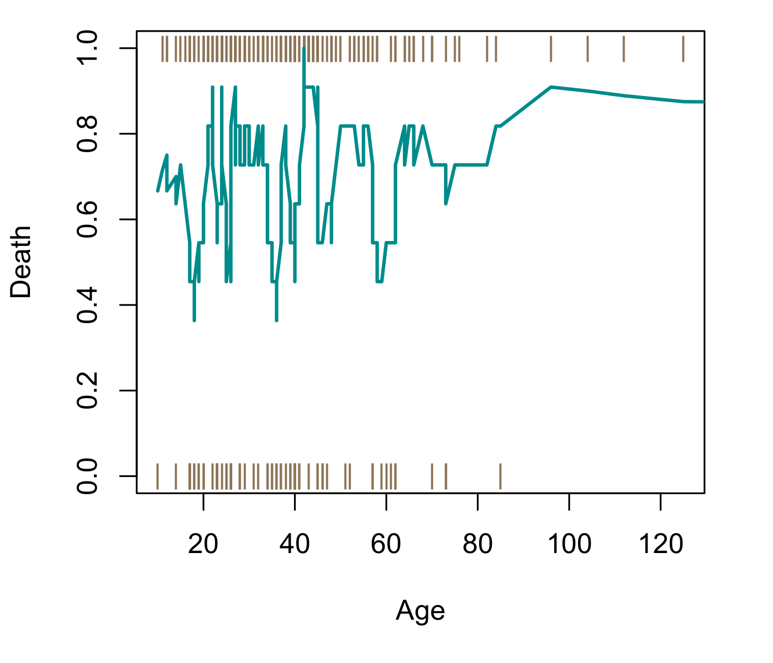
Independence and linearity
Technically a distributional assumption but rarely tested explicitly in practice. However, independence in the practical sense is very much related to how complete the fitted model is, in terms of not omitting important predictor variables or effects.
One possible omission may be non-linear effects, such as interactions between predictors or curvi-linear effects.
For the latter, such screenings are ideally conducted before fitting the model, for example with scatter plot smoothers (e.g., moving average):
library(caTools)
plot(DeathBin~Age,data=GOT,subset=Age<400,pch="|",col="burlywood4",ylab="Death")
lines(runmean(DeathBin,11)~Age, data=GOT[order(GOT$Age),],col="darkcyan",lwd=2)

Slide 66
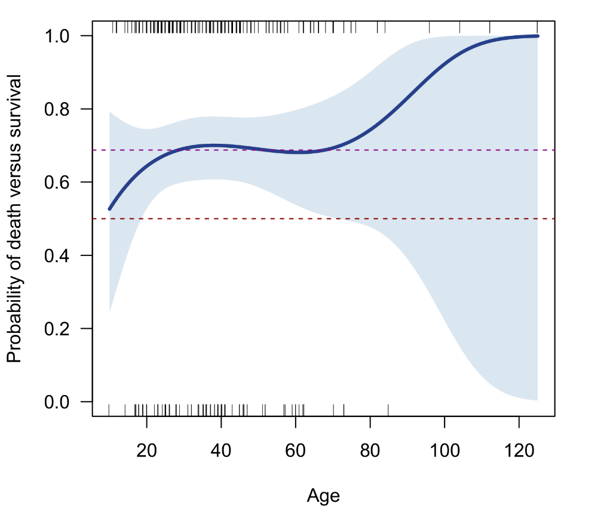
Independence and linearity
Be careful however with non-linear effects. Typically a lot of data is necessary for reliable estimation.
When fitting a cubic curve to the Age-Death association, none of the terms are in fact significant.
Note the use of the poly function inside the formula to construct orthogonal polynomials. This will reduce collinearity and because the function groups the nonlinear terms, Anova will run an omnibus test for the whole cubic curve.
Death ~ poly(Age,2)
Coefficients:
Estimate Std. Error z value Pr(>|z|)
(Intercept) 72279 74746 0.967 0.334
poly(Age, 3)1 14981600 15493187 0.967 0.334
poly(Age, 3)2 678816 701997 0.967 0.334
poly(Age, 3)3 10924 11295 0.967 0.333
---

Slide 67
Goodness-of-fit
In ordinary regression, R² is most often reported as a measure of fit for the model. This corresponds to the proportion of variance in the DV that is explained by the IVs.
Although analogous measures have been proposed for logistic regression (so-called pseudo-R²), they have dubious utility and should not generally be reported (Rosseel, 2008). In LR, much better fit statistics can be derived from the model's predicted/fitted values.
Using a chosen cut-off (e.g., 50%), we can first classify the model's predictions into the 0 or 1 class, and then cross-tabulate these predictions against the observed classes, yielding a 2×2 confusion matrix:
model <- glm(Death~Age+Gender+Profession+Class+Travelled+Battles+Killed,
data=GOT, family=binomial)
GOT$Predicted <- ifelse(predict(model,type="response")>0.5, "Yes","No")
xtabs(~Predicted+Death,data=GOT)
Death
Predicted No Yes
No 11 11
Yes 54 132

Slide 68
Fit statistics from confusion matrices
 | Observed
Predicted | No | Yes
No | 11 | 11
Yes | 54 | 132
 | Observed
Predicted | No | Yes
No | True negative (TN) | False negative (FN)
Yes | False positive (FP) | True positive (TP)
Σ(TN,FP) = N_{neg}
Σ(FN,TP) = N_{pos}

Slide 69
Fit statistics from confusion matrices
Name(s) | Formula | GOT model
Sensitivity, recall, hit rate, or true positive rate (TPR) | TP / (TP + FN) | 92.3%
Specificity, or true negative rate (TNR) | TN / (FP + TN) | 16.9%
Precision, or positive predictive value (PPV) | TP / (TP + FP) | 71.0%
Negative predictive value (NVP) | TN / (TN + FN) | 50.0%
Fall-out, or false positive rate (FPR) | 1 − TNR | 83.1%
False discovery rate (FDR) | 1 − PPV | 29.0%
Miss rate, or false negative rate (FNR) | 1 − TPR | 7.7%
Accuracy (ACC) | (TP + TN) / N_{total} | 68.8%
Error, or misclassification rate (ERR) | 1 – ACC | 31.2%
F1 score | 2TP / (2TP + FP + FN) | 80.2%
Matthews correlation coefficient (MCC) | (TP × TN − FP × FN) / sqrt((TP+FP)(TP+FN)(TN+FP)(TN+FN)) | 13.9%
https://en.wikipedia.org/wiki/Confusion_matrix
https://onlineconfusionmatrix.com/

Slide 70
Matthews correlation coefficient
Many measures of confusion break down when the predictive model is biased, which is especially likely when the outcome itself has a baseline bias. The accuracy of our GOT model seems quite good at 68.8% but this is actually identical to the marginal death rate. The intercept-only model would have achieved the same performance always predicting “Yes”.
A useful unbiased measure of confusion is Matthews Correlation Coefficient (MCC), which balances all four cells of the confusion table and quantifies the discriminability between the two classes in a value between -1 and 1. In fact, it is identical to Pearson's phi coefficient (see Part I) but was developed independently by Matthews.
Interpretation of the MCC coefficient is somewhat analogous to the multiple correlation coefficient R for continuous response variables, with:
For our GOT model we have MCC = 13.9%, which is quite poor. The model does not seem to be much better than guessing…
-1 = | Perfect incorrect discrimination of classes
0 = | No discrimination of classes
1 = | perfect correct discriminable classes

Slide 71
Decision threshold
Previously, we used a decision threshold of 50% to classify predictions as Death=Yes or Death=No. Other thresholds could be chosen, however. For a given model, shifting this threshold will change the tradeoff between sensitivity (=true positive rate) and specificity (=true negative rate) in favor of one or the other. What would be the purpose of doing so?
For some prediction problems, the cost of a false-negative is much greater than the cost of a false-positive. For example, in predicting the probability of a heart attack based on a screening survey, a false negative may mean a preventable death, whereas a false positive may merely mean an unnecessary medical exam. It is clear which we prefer.
Beyond the above concern, shifting the decision threshold may also improve the overall performance of the model, especially when data are biased toward one of the two response classes.
Such analyses are often performed by the use of Receiver Operating Characteristic (ROC) curves.

Slide 72

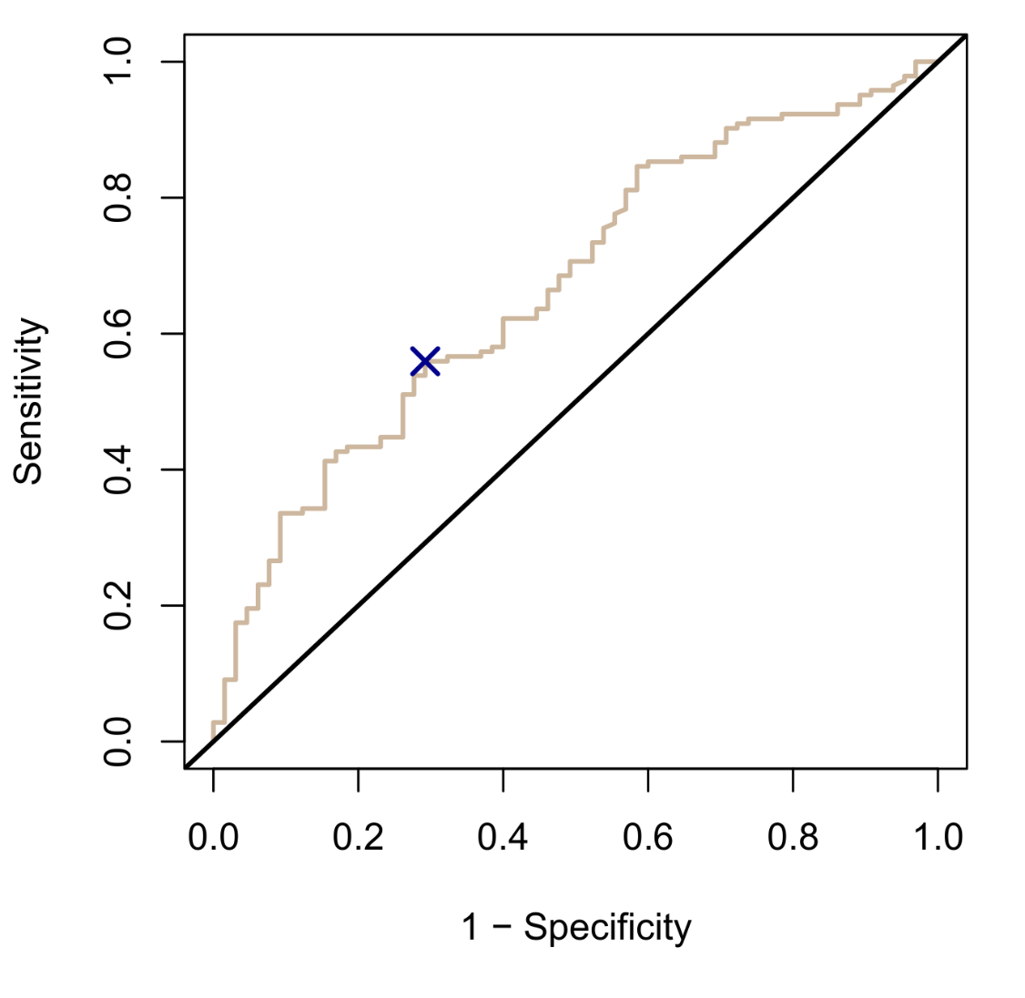
ROC curves
ROC curves plot sensitivity and speciticity values as a function of the increasing decision threshold. The resulting values are compared against the baseline of equal sensitivity-specificity.
The more predictive our model, the more unequal the sensitivity-specificity balance will become, and the more ∩-shaped the graph will be in appearance.
We can calculate from the ROC curve where sensitivity reaches maximal deviation, and to which decision threshold this corresponds.
Moreover, the area under the curve (AUC) is a frequently reported measure of predictive strength. The better the model, the larger the area, with AUC > 0.80 usually taken as “good” performance.
Best trade-off threshold
Area under the curve = 0.669

Slide 73
ROC curves
In R, many packages are available for computing ROC curves, AUC values, and their corresponding (bootstrapped) confidence intervals. For this workshop, I chose the package pROC, which has as primary function roc:
ROC <- roc(GOT$Death,predict(model,type="response"),plot=TRUE)
ROC
The output returns the AUC (with optional 95%CI) and stores the relevant numbers we can use to calculate the optimal trade-off threshold:
max(ROC$sensitivities-(1-ROC$specificities))
best <- which.max(ROC$sensitivities-(1-ROC$specificities))
ROC$threshold[best]
> [1] 0.7176612
Using the new decision cutoff, we can reclassify our predictions and cross-tabulate them against the observed responses. This yields a better balance of true negatives and true positives, with a slightly improved MCC coefficient, MCC = 24.8%.
Death
Predicted_ROC No Yes
No 46 63
Yes 19 80

Slide 74
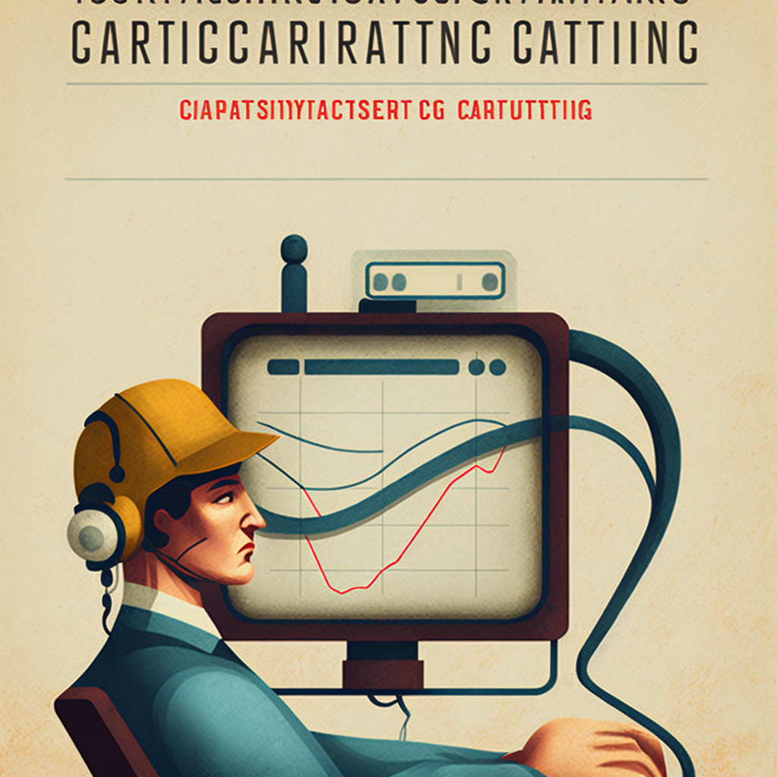
Receiving Operator Characteristic curve

Slide 75
Comparative fit
The preceding shows that quantifying the performance of a single model can be ambiguous without a reference. For this reason, comparing multiple models is often recommended. This should include at the very least the intercept-only model as a worst-case baseline.
Comparative fit also introduces information criteria (AIC, BIC) which quantify the relative evidence of one model versus another (like Bayes factors). For both criteria, one prefers the model that minimizes its value within a margin of 2 points. BIC penalizes models for redundant parameters more harshly.
Measure | Full model | Intercept-only | Random
Accuracy | 68.8% | 68.8% | 54.8%
F1 | 44.5% | 81.4% | 61.8%
MCC / Phi | 13.9% | 0.0% | 10.8%
AUC | 66.9% | 50.0% | 58.5%
Cohen's Kappa | 11.3% | 0.0% | 9.9%
AIC | 264.2 | 260.4 | 286.0
BIC | 300.9 | 263.7 | 289.4

Slide 76
Goodness-of-fit in R
In R a number of functions are available to quantify goodness-of-fit. As shown, the package pROC can be used for ROC curves and AUC. Assocs from DescTools remains handy for collecting a number of different association measures, including MCC and Cramer's V. For the latter, a 95%CI is even reported.
For MCC, I also provide a custom script that generalizes to any K × K confusion matrix (e.g., multiclass prediction). The function MCC will return the matrix of pairwise MCC values.
Information criteria can be calculated using the base AIC and BIC functions. These functions need to be applied to model objects, however, not confusion tables!
In addition, a number of tests and measures are available that quantify strength of agreement in confusion tables (e.g., rater agreement). We will discuss these further in Part III, when dealing with paired categorical data.

Slide 77
2. Binary logistic regression
E. Extensions to logistic regression

Slide 78
LR and machine learning
The preceding material has hinted occasionally at the use of logistic regression as a machine learner (ML). Indeed it can be used for that purpose as another so-called “classifier”, i.e., a model that predicts a categorical DV from a set of IVs.
ML is best understood just another type of data analysis, with simply different names for familiar concepts:
Concept | Traditional regression term | Machine learning term
Data | Observations | Cases
Y variables | Dependents | Responses / Targets / Outcomes
X variables | Independents / Predictors / Regressors | Features / Inputs
Parameters | Coefficients | Weights
Parameter estimation | Fisher scoring | Training / Learning
Model predictions | Fitted values | Predicted values
Relevance evaluation of X variables | Hypothesis testing | Feature selection
Model fit | Goodness-of-fit | Predictive strength

Slide 79
LR and machine learning
The difference between how a social scientist uses LR versus a data scientist is (a) which part of the models' output interests them, and (b) the extent of modelling.
Data scientists are primarily interested in goodness-of-fit, that is, how well the model fits the sample data and especially how it fits new data, i.e., its predictive strength (e.g., accuracy, MCC, AUC). Social scientists are primarily interested in predictor importance, as evaluated by inferential tests.
Data scientists also extend modelling by considering many predictors as well as non-linear effects, such as curvilinear associations and interactions. Social scientists usually restrict their model to a handful of (design) predictors, while interactions are typically only a part of factorial designs.
Finally, a data scientist will try to fit many different types of models to their data (e.g., discriminants, SVM, neural networks), with LR treated as a basic linear baseline to be contrasted to more complicated non-linear models.

Slide 80
Case weights
In the GOT data, we have a high marginal death rate. Technically there is no need to correct for this imbalance in the model, since the intercept takes care of any baseline bias. However, more extreme scenarios occur where the class of interest (e.g., a clinical event) is highly rare compared to the other (e.g., no clinical event), and this may affect parameter estimation.
As noted, we can shift the decision threshold to put more emphasis on avoiding false negatives. Another option is to change parameter estimation itself by adding case weights to the model.
Case weights could be chosen based on which individual observations are the most interesting to predict, or such that the two response classes are balanced, and that parameter estimation does not favor prediction of one class versus another.
Ideally, the case weights should sum to the original N! Large weights can distort inferential tests to be significant, regardless of their effect size.
Sometimes case weights can act as pseudo-Bayesian prior, in that they may be chosen to reflect the population distribution of response classes, if that distribution is distorted in the observed sample.

Slide 81
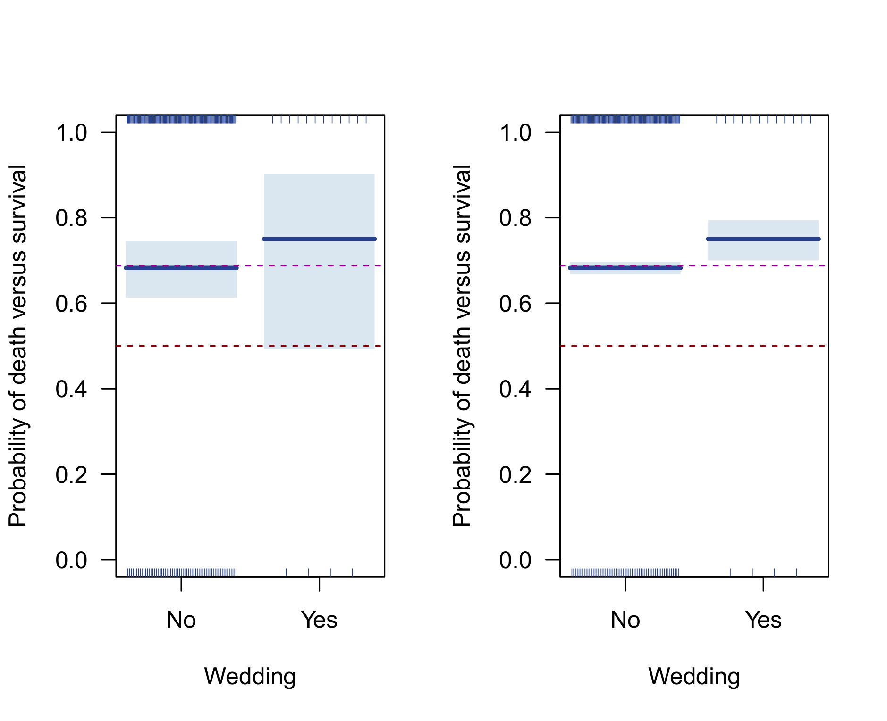
Case weights
Unweighted
Cases × 20
*
z = 0.56, p = 0.576
z = 2.50, p = 0.012

Slide 82
Case weights
Let us apply balanced class weights to our full GOT model with the custom weighting function:
model <- glm(Death~Age+Gender+Profession+Class+Travelled+Battles+Killed,
data=GOT,family=binomial,subset=Age<400, weights=weighting(Death))
Anova(model)
Warning message:
In eval(family$initialize) : non-integer #successes in a binomial glm!
Analysis of Deviance Table (Type II tests)
Response: Death
LR Chisq Df Pr(>Chisq)
Age 0.8161 1 0.36632
Gender 0.0110 1 0.91662
Profession 4.0755 4 0.39589
Class 0.3249 1 0.56867
Travelled 4.1162 1 0.04248 *
Battles 0.0565 1 0.81212
Killed 4.4076 1 0.03578 *
---
Signif. codes: 0 ‘***’ 0.001 ‘**’ 0.01 ‘*’ 0.05 ‘.’ 0.1 ‘ ’ 1

Slide 83
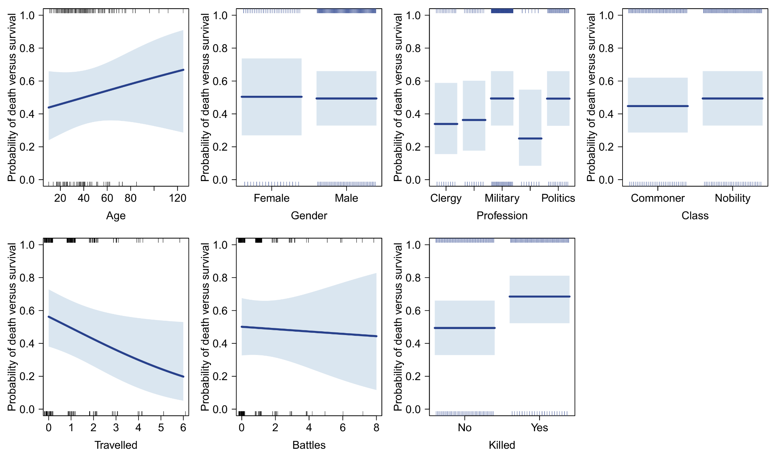
Case weights

Slide 84
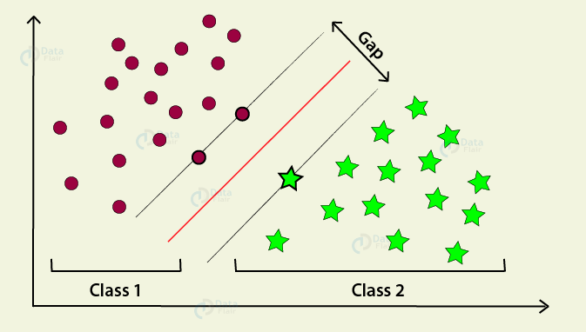
Specific case weighting in ML
Support vector machine (SVM)
Conventional models put most weight for estimation on the prototypical/mean values in each class, but these may be far from the class boundary. SVM weights boundary cases exclusively! A similar approach is used by gradient boosted machines (GBM).

Slide 85
Predictor selection
For experimental data the IVs in the model are usually pre-determined to include the manipulated design variables, possibly supplemented with some controlling covariates.
For observational data with many variables, the analyst has to decide which to include as IV in the model. Normally, preference should go to (1) variables that are the subject of confirmatory research hypotheses, i.e., “design” variables even if they were not manipulated, then to (2) controlling covariates, and last to (3) exploratory covariates.
For observational data, there is a risk that adding controlling and exploratory covariates will change the effect of the confirmatory IVs. Fully exploratory modelling therefore must be structured with strict controls. One way to do this is by stepwise predictor selection:
Define the smallest and largest model to consider (=search scope)
Choose a search direction
Add and/or drop predictor variables according to a criterion in the chosen search direction

Slide 86
Stepwise predictor selection
The search direction probably has the largest impact on the final model. A number of options exist:
Forward search
Forward search with backward elimination sweep
Backward search
Backward search with forward elimination sweep
Fully exhaustive (=best-subset selection)
Some data may not allow backward searches, if the number of predictor variables is greater than the number of observations!
Forward searches are known to overselect predictors, while backward searches may underselect predictors. Fully exhaustive searches may produce models with overly optimistic performance. For any stepwise selection, cross-validation should be considered!
Typically, the best model is selected by AIC or BIC, although any of the criteria previously discussed could be used.

Slide 87
Stepwise predictor selection
Let us try stepwise selection on the GOT data, using the base step function. We simply need to define the search scope and direction, and the function will automatically use AIC to obtain a final model (for BIC we must specify "k=log(N)"):
lower <- glm(Death~1,data=GOT[,-c(1,4)],family=binomial)
upper <- glm(Death~.,data=GOT[,-c(1,4)],family=binomial)
SPS <- step(lower, scope=list(lower=lower,upper=upper),
direction="forward", k=2)
summary(SPS)
Coefficients:
Estimate Std. Error z value Pr(>|z|)
(Intercept) 0.5185 0.2256 2.298 0.02155 *
KilledYes 1.0092 0.3530 2.859 0.00425 **
Travelled -0.2946 0.1308 -2.253 0.02423 *
CrownedYes 1.4043 0.7965 1.763 0.07789 .
Children 0.2973 0.2241 1.326 0.18476
---
Signif. codes: 0 ‘***’ 0.001 ‘**’ 0.01 ‘*’ 0.05 ‘.’ 0.1 ‘ ’ 1

Slide 88
Stepwise predictor selection
For these data, it appears that forward, backward, and exhaustive searches return the same model, except with a different order of effects. In general this will not necessarily be true.
Finally, we seem to have obtained a somewhat decent model, with significant effects as follows:
Travelled: Travelling to more different regions in Westeros and Essos lowers your probability of death.
Killed: Having killed at least once increases your probability of death.
Crowned: Having been declared king/queen increases your probability of death.
Nevertheless, the model's goodness-of-fit is less than impressive, with accuracy still close to the marginal death rate, 68.2%, MCC=9.3%, and AUC=65.0%. When using BIC as the selection criterion, by contrast, the intercept-only model emerges as the preferred choice!
These are red flags that should not be ignored in the context of fully exploratory modelling!

Slide 89
Thank you for your attention…!

