Slide 1



Non-parametric Data Analysis
Part 2: Non-parametric statistics and permutation tests
Ben Meuleman, Ph.D.
Swiss Center for Affective Sciences
Université de Genève
January 17, 2023

Slide 2
Contents
Quiz
Assumptions in parametric statistics
  Importance of assumptions
  Checking assumptions
  Problems with testing assumptions
Introduction to non-parametric statistics
  Terminology
  Rank-based tests
Permutation tests
  Telepathy
  Exact and approximate tests
  General regression permutations
  Component selection in PCA
Bootstrap tests
Tips and conclusions

Slide 3
3. Introduction to non-parametric statistics
A. Terminology

Slide 4
What do we mean with non-parametric?
The term non-parametric is somewhat ambiguous, and most often used in two distinct ways:
  NP1: Non-parametric as not assuming a shape of the distribution of a test statistic (e.g., normally distributed). For example, a permutation t-test does not assume normality of the test statistic.
  NP2: Non-parametric as not assuming a shape of an association. For example, lowess smoothers estimate associations in a data-driven, local way, which does not assume a specific linear or nonlinear association in the data.* This is also a property of prediction models such as K-nearest neighbors.
It is entirely possible for a non-parametric analysis to make one assumption and not the other, or both simultaneously…
* Still assumed to be a functional relationship, however!

Slide 5
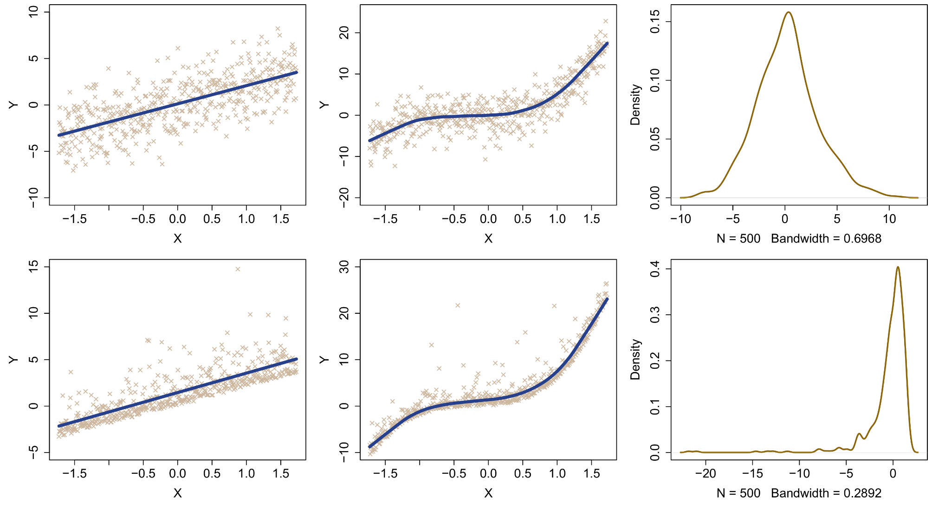
What do we mean with non-parametric?
Shape of association
Linear
Lowess
Residual density
Normal
Shape of distribution
Non-normal

Slide 6
What are the parameters?
Especially in the case of non-parametric associations, it is dubious to claim that the analyses assume no parameters. A one-way linear regression slope requires only two parameters (intercept and slope). A lowess smoother, on the other hand, will estimate dozens of slopes on a moving window and join them together. All these individual slopes could be said to be parameters of the model, so very parametric!
Even in the case of non-parametric distributions, there will always be (a) an implied distributional assumption (e.g., equal shape), and (b) the non-parametric distribution may be derived from the data itself. This puts much more weight on the data as a source of (statistical) decision making, and hence could be said to turn the data themselves into parameters.
Some non-parametric methods take this philosophy to the extreme and make every individual observation a parameter in the analysis, for example in K-nearest neighbors…

Slide 7
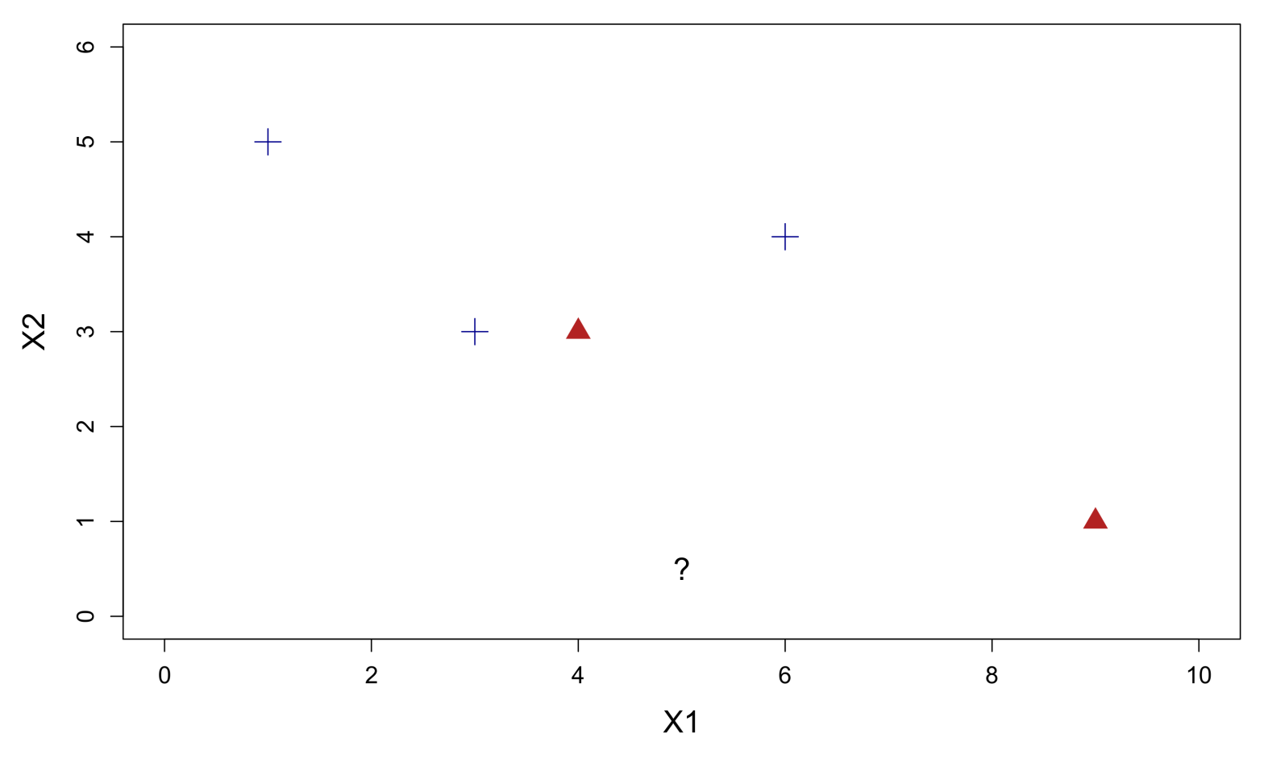
K-nearest neighbors
Patients come in who are suspected of risking an myocardial infarction. An ECG is taken and compared to historical records of known cases:
Known cases:
Myocardial infarction
+
Normal
(Arif, Malagore & Afsar, 2012)
ECG marker B
ECG marker A

Slide 8
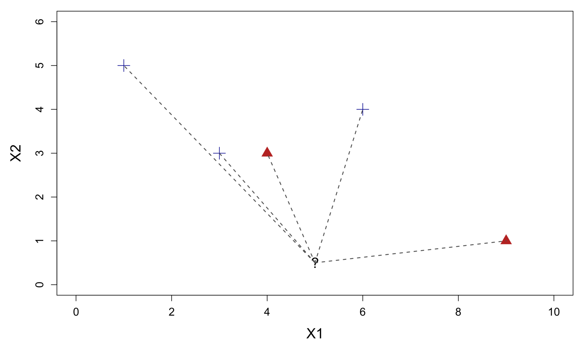
K-nearest neighbors
Using the two measured ECG markers, we calculate the (Euclidean) distance of the undiagnosed patient to the known cases:
Known cases:
Myocardial infarction
+
Normal
ECG marker B
(Arif, Malagore & Afsar, 2012)
ECG marker B
ECG marker A
ECG marker A

Slide 9
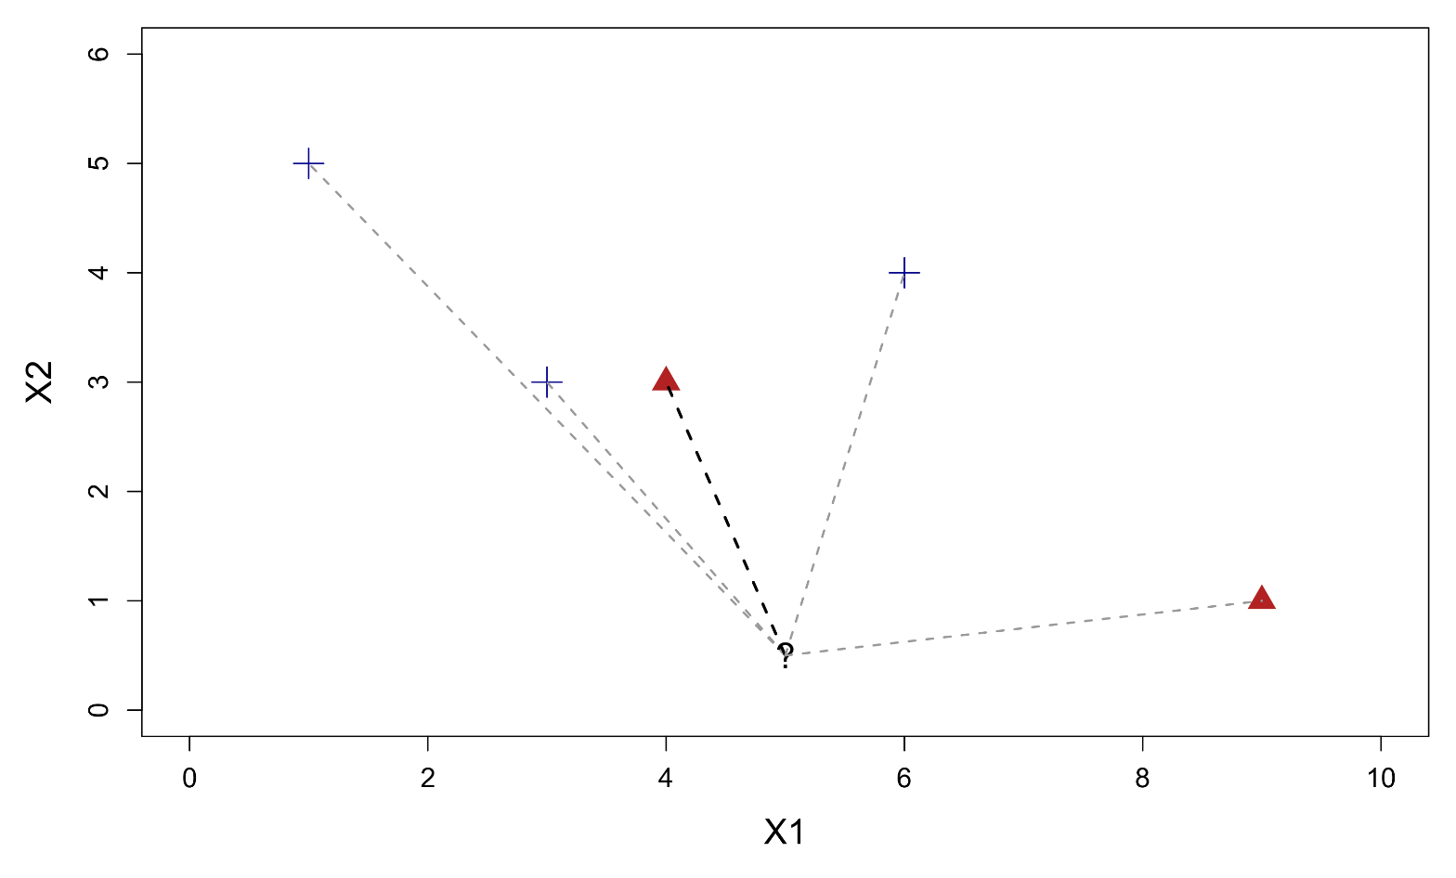
K-nearest neighbors
The nearest neighbor turns out to be an MI case.
Known cases:
Myocardial infarction
+
Normal
Nearest neighbor
ECG marker B
(Arif, Malagore & Afsar, 2012)
ECG marker B
ECG marker A
ECG marker A

Slide 10
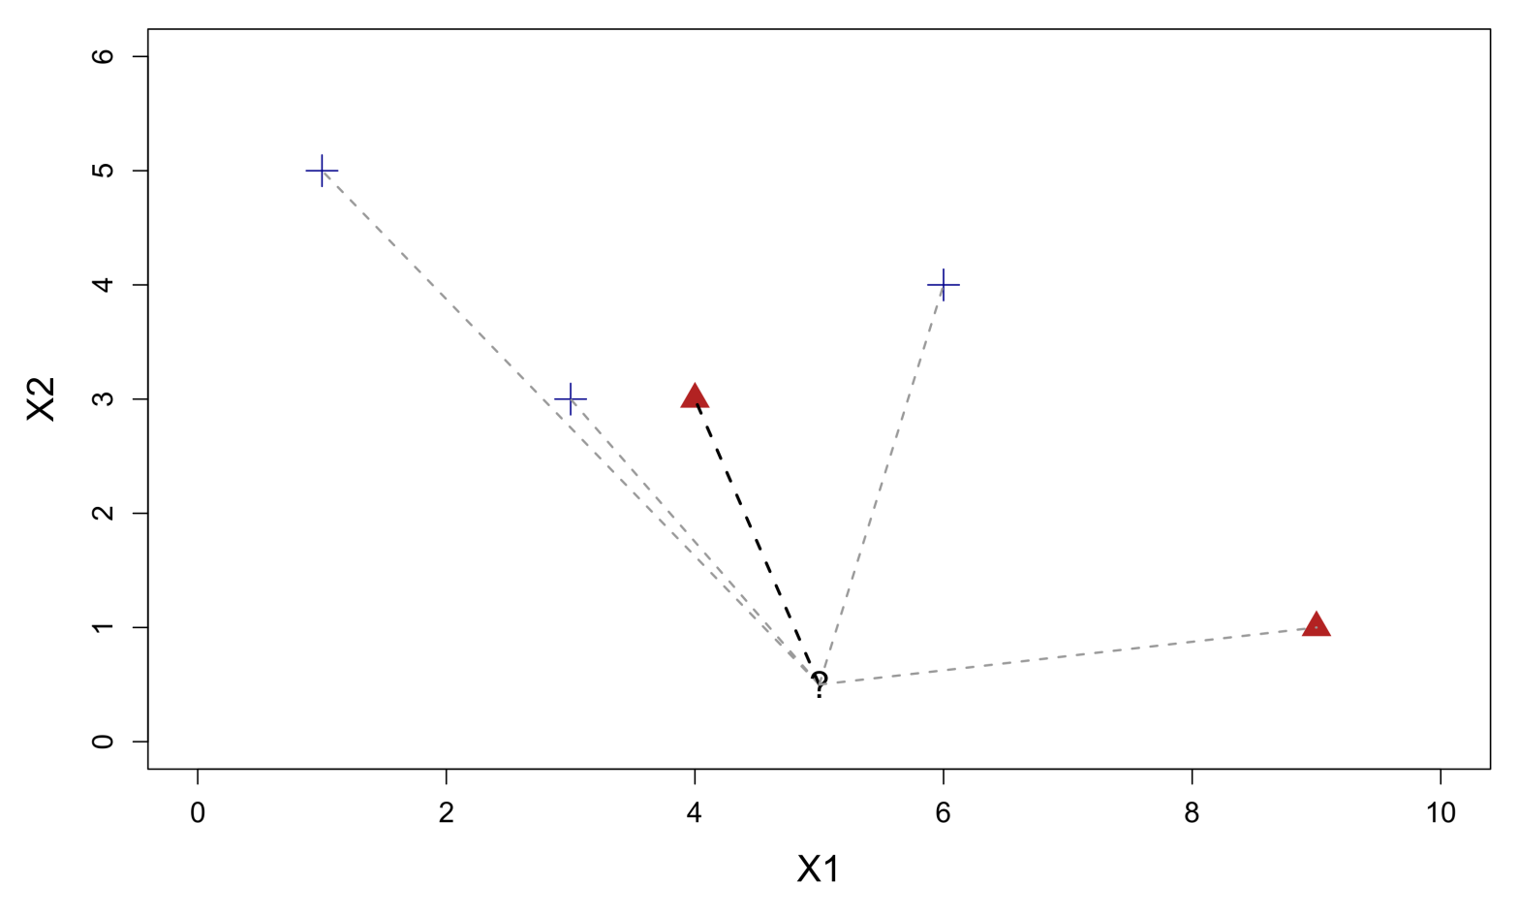
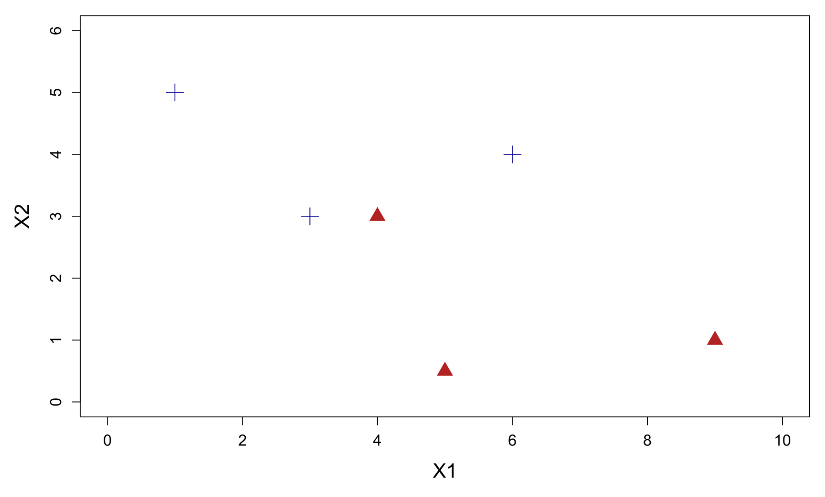
K-nearest neighbors
Therefore, we predict that the new patient has a high probability of impending MI, and the person is referred to secondary care.
Known cases:
+
Nearest neighbor
Myocardial infarction
Normal
Nearest neighbor
ECG marker B
ECG marker B
ECG marker B
(Arif, Malagore & Afsar, 2012)
ECG marker B
Final prediction
ECG marker A
ECG marker A
ECG marker A
ECG marker A

Slide 11
What are the parameters?
In K-nearest neighbors, every observation in the data could potentially be “the model”. If an unclassified case is closest to that observation, then that's the model for prediction. Thus every observation could be said to be a parameter of the overall model.
Sometimes researchers will claim that they are “dealing with non-parametric data”. Technically, data cannot be non-parametric. Firstly, as just shown, data themselves can be turned into parameters. Secondly, all data have some underlying generating process, which is presumably parametric.
In many cases, the data generating process of certain variables is known exactly, for example Poisson processes:
    Number of calls arriving at a call centre per hour
    Number of mutations on a strand of DNA per unit length
    Number of insurance claims occurring in a given period of time
For the remainder of this workshop, I will not further discuss non-parametric methods of the NP2 type, but focus on the NP1 type instead. I will discuss the K-nearest neighbor model in my workshop on machine learning.
https://en.wikipedia.org/wiki/Poisson_distribution

Slide 12

MYTH V
Data can be non-parametric

Slide 13

K nearest neighbors

Slide 14
3. Introduction to non-parametric statistics
B. Rank tests

Slide 15
What non-parametric tests handle
We finally turn our discussion to non-parametric tests. In general there are three families of such tests: rank tests, permutation tests, and bootstrap tests. Some of these could even be combined, e.g., a permutation rank test or bootstrap rank test.
Before we go further, it is important to remind you exactly what these tests can handle with (and hence cannot handle with):
Problem | Rank tests | Permutation tests | Bootstrap tests
Non-normal residuals |  |  | 
Small samples |  |  | 
Outliers | 
Non-linear associations (mild) | 
* Note that, for bootstrap tests, applying them to small samples is not recommended! Bootstrapping is known to increase small-sample bias

Slide 16
List of common rank tests
Test | Parametric counterpart | Null hypothesis | Notes | R function {package}
Mann-Whitney U test | Independent samples t-test | Equality of group distributions | a.k.a., Wilcoxon rank-sum test | wilcox.test {stats}
Dunn's test | Independent samples t-test | Equality of group distributions | Pairwise comparison choice after KW test | dunn.test {dunn.test}
Conover-Iman test | Independent samples t-test | Equality of group medians | Pairwise comparison choice after KW test | conover.test {conover.test}
Kruskal-Wallis test | One-way ANOVA | Equality of group medians |  | kruskal.test {stats}
Wilcoxon signed rank test | Paired t-test | Group differences follow a symmetric distribution around zero median | Pairwise comparison choice after Friedman test | wilcox.test {stats}
Sign test | Paired t-test | Group differences follow an asymmetric distribution around zero median | Pairwise comparison choice after Friedman test | binom.test {stats}
Friedman test | One-way rm-ANOVA | Group differences follow a symmetric distribution around zero median |  | friedman.test {stats}
Spearman rank correlation test | Pearson correlation test | Statistical independence of the two samples |  | cor.test {stats}

Slide 17
Rank-based tests
Rank-tests have long been the more popular choice for conducting non-parametric data analysis. Major software packages (e.g., SPSS, Statistica, SAS) offer most of the tests listed previously. As the name implies, raw data are transformed to ranks, i.e., ordered/numbered from lowest to highest:
rank(c(4,10,100,1,3,9)) # 3 5 6 1 2 4
While rank-tests are often advertized as “counterparts” to specific parametric relatives, this is misleading, since rank-tests address different null hypotheses (e.g., equality of distributions/medians, rather than equality of means). For example ranks cannot be used to estimate means!
This casts doubt on the idea that comparable conclusions could be drawn between a parametric tests and a rank-based alternative, other than generalities (e.g., the two groups are different). Due to these ambiguities, I choose not to explore rank-tests in this workshop.
When results diverge strongly between parametric tests and rank-tests, the reason is usually because of small sample size and/or outlying values. Rarely will distributional assumptions have a strong impact. For this reason, we briefly review the case of the Spearman rank correlation test, which is the rank-based version of the Pearson correlation test.

Slide 18

Spearman rank correlation test
The Spearman rank correlation test is so simple that it can easily be done manually (in R). In essence it is nothing but the Pearson correlation test after X and Y have been rank-transformed. For example, using the exciting trees data set:
cor.test(~Height+Volume,data=trees,method="pearson")
cor.test(~Height+Volume,data=trees,method="spearman")
cor.test(~rank(Height)+rank(Volume),data=trees,
method="pearson")
Whether one rank-transforms first, and then performs the
Pearson test, or one directly performs the Spearman test, the results
should be identical.
For this example, there is not much difference, but we can construct
a better data set to show what rank-transformations can achieve
Pearson's product-moment correlation
data: Height and Volume
t = 4.0205, df = 29, p-value = 0.0003784
cor
0.5982497
Spearman's rank correlation rho
data: Height and Volume
S = 2089.6, p-value = 0.0006484
rho
0.5787101
Pearson's product-moment correlation
data: rank(Height) and rank(Volume)
t = 3.8214, df = 29, p-value = 0.0006484
cor
0.5787101

Slide 19
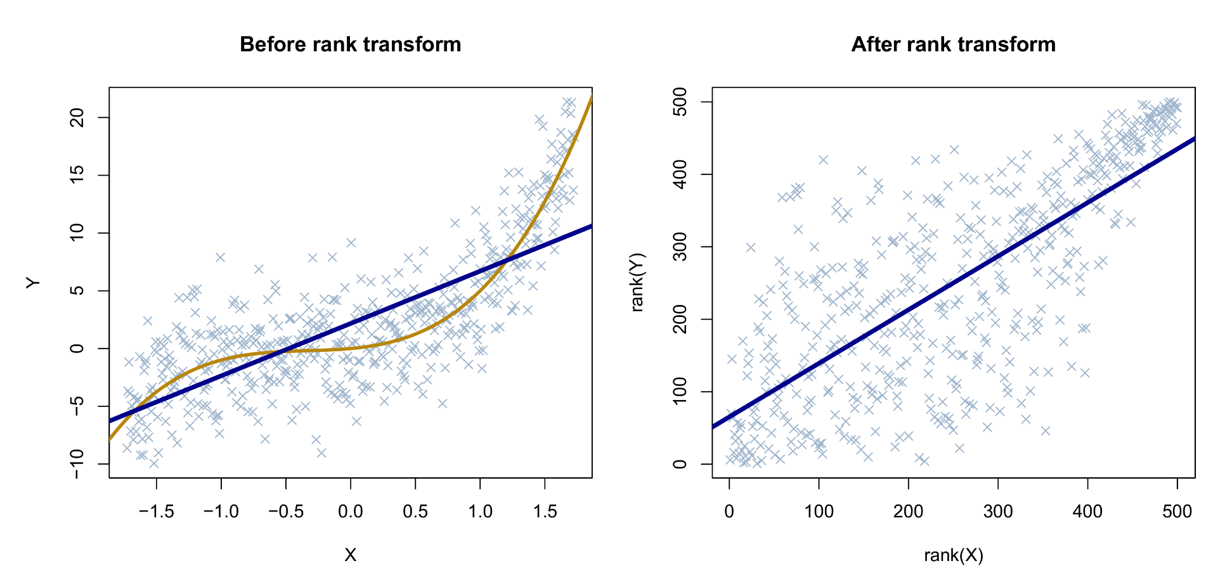
Monotone relationships
Rank transformations reduce the raw data values to their order. As a consequence, it forces all observations to be spaced evenly, e.g., 1-2-3-4. This not only severely reduces the impact of outliers (no matter how large), it also allows to detect relationships that are not linear but still strictly increasing or decreasing. Such relationships are called monotone, since there is a single trend up or down.

Slide 20
Asymptotic relative efficiency (ARE)
An important concept in non-parametric data analysis is asymptotic relative efficiency (ARE). For a two-group comparison of means, we consider the alternative hypothesis as a non-zero difference of the two means Δ, with Δ > 0. N_{t} is the sample size used by the independent samples t-test, and N_{w} by the Mann-Whitney U (MWU) test.
As Δ approaches 0, both tests still have power to detect this difference as long as N_{t} and N_{w} increase to infinity. Under these conditions, the asymptotic relative efficiency of the MWU test to the t-test is the limiting value of Nt/N_{W} so that both tests have the same power. We can calculate the ARE under different data distributions:
This means that the t-test needs, e.g., three times as much data as the MWU test to detect the same difference when the data are exponentially distributed. In fact, the t-test is only more efficient than MWU when the data are truly normally distributed. This would suggest that non-parametric tests generally have superior properties over parametric ones…
Distribution | ARE (Nt/N_{W})
Uniform | 1.00
Normal | 0.95
Laplace | 1.50
Exponential | 3.00
Cauchy | ∞

Slide 21

Asymptotic relative efficiency

Slide 22


No free lunch in statistics!
In 2011, Science published a paper by Reshef et al. (2011) that introduced the maximal information coefficient (MIC). The authors claimed that MIC was capable of detecting linear, nonlinear, and even nonfunctional relations. An editorial in the same issue of Science touted the MIC measure as a “Pearson correlation for the 21st century”.
However, in a critical review, Simon and Tibshirani (2011) presented simulations which showed that the MIC statistic performed poorly in a variety of settings which the original authors had not considered. Tibshirani noted:
Tibshirani's criticism extends directly to non-parametric tests. Although they may enjoy superior robustness
properties in specific settings, they can certainly be outperformed in others. There is no single most powerful test in statistics.
“Any test that claims to offer superior power over existing alternatives usually does so by introducing additional assumptions, or by sacrificing generalizability in important settings”

Slide 23
MYTH VI
Non-parametric tests are assumption-free
There is free lunch in non-parametric tests

Slide 24

Recapitulation of myths
Bayesian statistics are a kind of non-parametric statistics FALSE
Non-parametric tests can correct for heteroscedasticity FALSE
Normality of residuals is an important assumption in statistics FALSE
Significance tests on parametric assumptions are reliable FALSE
Data can be non-parametric FALSE
Non-parametric tests are assumption-free FALSE

Slide 25
4. Permutation tests
A. Telepathy

Slide 26

Anyone watches Rick & Morty?

Slide 27


A decision problem
In S02E05 (“Total Rickall”), Rick and Morty must defend their house from an invasion of alien memory parasites. They must decide if their friends are real or an implanted memory, and risk accidentally killing their real friends:

Slide 28
Let's test your collective psychic powers
I will show you 8 characters. I know which ones are real and which ones are parasites. Focus your mind's eye on me and raise your hand if you believe the character I show to be a parasite:

Slide 29










Let's test your collective psychic powers
?
?

Slide 30
What if we had observed 8 hits?
I will assume that you did not achieve 8 correct hits. But let us assume that you did. Who would be willing to conclude the hypothesis of psychic powers…?
Maybe it's useful to have a look at the probability of getting 8 characters right. Assuming chance level (guessing), any of the following sequence of guesses could have been observed:
C1 | C2 | C3 | C4 | C5 | C6 | C7 | C8 | Sum
0 | 0 | 0 | 0 | 0 | 0 | 0 | 0 | 0
1 | 0 | 1 | 0 | 1 | 0 | 0 | 0 | 3
0 | 0 | 0 | 1 | 0 | 0 | 0 | 1 | 2
0 | 0 | 0 | 0 | 1 | 1 | 1 | 1 | 4
1 | 1 | 0 | 0 | 1 | 0 | 0 | 0 | 3
1 | 1 | 1 | 1 | 0 | 1 | 1 | 0 | 6
… | … | … | … | … | … | … | … | …
1 | 1 | 1 | 1 | 1 | 1 | 1 | 1 | 8

Slide 31
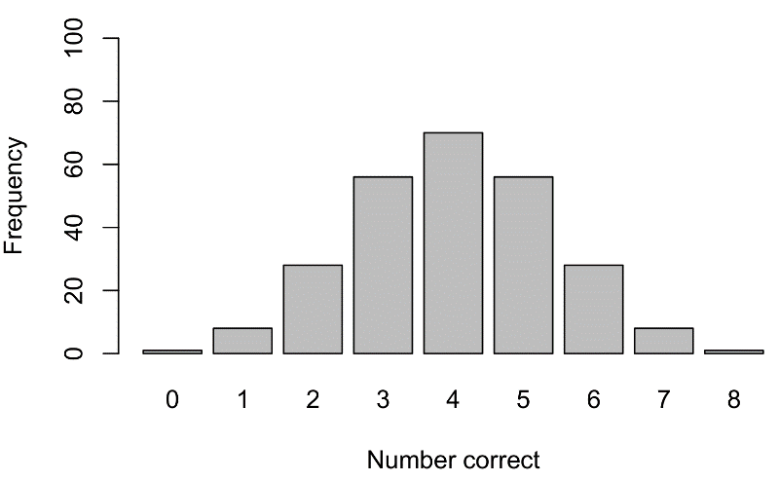
Probability of 8 hits
Under chance, there were 256 possible sequences. Every unique sequence has equal probability of occurring. We can generate these sequences in R with the gtools library:
library(gtools)
permutations(2,8,0:1,repeats=TRUE)
psychic <- permutations(2,8,0:1,repeats=TRUE)
barplot(table(rowSums(psychic)),ylim=c(0,100))
Unlike individual sequences, sums of sequences do not have equal
probability, with 4 hits being the most frequent. This corresponds
to what we expect under chance level. But how rare exactly is it to
observe a sum of 8 hits?
sum(rowSums(psychic)==8)
Out of 256 possible sequences, only 1 sequence produces 8 hits. 1/256 equals a chance of 0.0039 for a sum of 8. If we had observed that sequence, who would now be willing to conclude the hypothesis of psychic powers…? Who would be willing to reject the null hypothesis of guessing…?

Slide 32
We just constructed a basic statistical test
Without perhaps realizing it, we have just constructed a basic statistical test:
However, at no point did we mention an explicit distributional assumption! This is because, in this particular scenario, the null distribution of the test statistic was known and could be enumerated exactly.
1
We observed a pattern of data and calculated a statistic (i.e., sum)
2
We formulated a null-hypothesis, i.e., chance level
3
We enumerated every possible scenario under the null hypothesis, and its resulting sum statistic
= null distribution of sum statistics
4
We calculated the probability of our observed sum occurring under the enumerated null distribution
= p-value

Slide 33
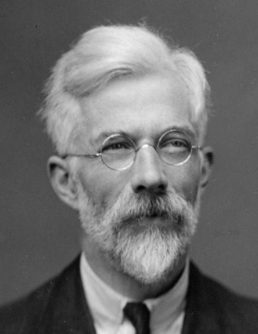
Lady Tasting Tea
The example with the parasites is a variation on a famous experiment conducted by Ronald Fisher, known as the Lady Tasting Tea (1935). Fisher had a friend, Muriel Bristol, who claimed that, when tasting tea, she could tell whether water or milk had been added to the cup first.
Fisher tested her skill by presenting her with 8 cups, 4 of each kind. Allegedly, Muriel guessed all cups correctly, which has a 1/256 chance of occurring (0.0039). Under this p-value, Fisher would have concluded her skill to be real or, more prudently, to reject the null hypothesis of chance guessing.
This test is one of the earliest statistical tests invented, and is known today as an exact permutation test.
  It is a permutation test because the null distribution of the test statistic is constructed empirically based on possible permutations of the original observed pattern, when summarized as a 2×2 table.
  It is exact because all possible permutations can be enumerated exhaustively. Hence, the final probability is the exact chance of the observed scenario occurring. Exact ≠ more correct.
Tests in software called Fisher's exact test refer to this test, and is appropriate for the analysis of small frequency tables

Slide 34
4. Permutation tests
B. Exact and approximate tests

Slide 35
A permutation t-test
Let us now apply the principle of the Lady Tasting Tea to an ordinary independent two-group comparison. We consider the following scenario: Professor Ned is running a team of five PhD students. General morale is low,* so he decides to run an intervention. In quasi-experimental fashion, he randomly assigns two students to a mentoring program. After one year, he measures the improvement in morale as times participated in the monthly lab drinks, and observes the following data:
Although the observed means are in the right direction (more participation by the mentored students), it is hard to conclude if the intervention was truly effective. A parametric t-test is not significant, t(3) = -0.9922, p = 0.3942. With this small sample size, standard distributional assumptions are highly questionable. Checking them seems entirely pointless…
No mentoring Mentoring
Jon 5 Sansa 10
Robb 7 Bran 5
Arya 4
Mean 5.33 Mean 7.5
* In reality Ned’s poor management is to blame but he lacks the self-awareness to understand this

Slide 36
A permutation t-test
Perhaps we can exploit the observed data a bit more, by simulating some alternate scenarios. Our null hypothesis would say that the intervention had no effect. If this was true, it implies we do not really have two groups of people, but one group. Under the null hypothesis, Sansa's value of 10 could have been observed in the no mentoring group, or Arya's value of 4 could have been observed in the mentoring group. We say that, under the null hypothesis, data are exchangeable.
We can simulate that type of data shuffle, simply by swapping people between groups. This swap would result in a permutation of the original data:
We recompute our test statistic for this permutation and obtain a t-value of 1.4815. Now we can repeat this process, enumerate every possible permutation of these data, and recompute our test statistic. It turns out that there are 10 such permutations in total.
No mentoring Mentoring
Jon 5 Sansa 10
Robb 7 Bran 5
Arya 4
Mean 5.33 Mean 7.5
No mentoring Mentoring
Jon 5 Arya 4
Robb 7 Bran 5
Sansa 10
Mean 7.33 Mean 4.5

Slide 37
A permutation t-test
These are the 10 permutations in full, written out as reshufflings of the mentoring group labels (Yes or No):
We now have a collection of t-statistics (in red), calculated under the assumption of exchangeability (no group differences).
S | Y | O | P1 | P2 | P3 | P4 | P5 | P6 | P7 | P8 | P9 | P10
Jon | 7 | N | N | Y | Y | Y | Y | N | N | N | N | N
Robb | 5 | N | N | N | N | Y | N | Y | Y | Y | N | N
Arya | 4 | N | Y | N | N | N | Y | Y | N | N | Y | Y
Sansa | 10 | Y | N | Y | N | N | N | N | Y | N | Y | N
Bran | 5 | Y | Y | N | Y | N | N | N | N | Y | N | Y
t |  | -0.99 | 1.48 | 1.48 | -0.55 | 0.13 | -3.19 | 0.48 | 0.89 | -0.99 | 1.48 | 0.13

Slide 38
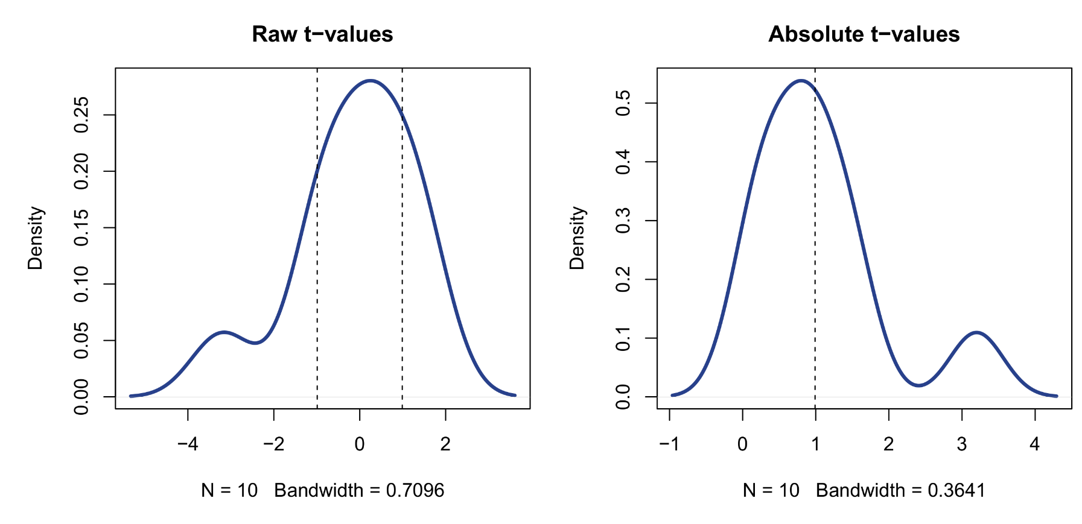
A permutation t-test
In these t-statistics, the proportion of values equal or larger than the original observed t-statistic, is 0.50. This is much larger than 0.05, and hence we conclude there is insufficient evidence to reject the null hypothesis. We reached this conclusion without reference to any theoretical t-distribution! As the density plot shows, our empirical t-distribution is clearly non-normal!

Slide 39
Permutation t-test example in R
These are the 10 permutations in full, written out as reshufflings of the mentoring group labels (Yes or No):
phd <- data.frame(student=c("Jon","Robb","Arya","Sansa","Bran"),
mentoring=rep(c("No","Yes"),times=c(3,2)),drinks=c(5,7,4,10,5))
t.test(drinks~mentoring,data=phd,var.equal=TRUE)
Next we need a for-loop to cycle through all possible permutations. Enumerating these is done with the combn function, and is mostly a cumbersome process. Later we will simplify this part with approximate permutation tests.
permutations <- combn(c("Jon","Robb","Arya","Sansa","Bran"),3)
tvals <- foreach(i=1:ncol(permutations),.combine="c") %do% {
select <- c(match(permutations[,i],phd$student),(1:5)
[-match(permutations[,i],phd$student)])
print(select)
t.test(drinks[select]~mentoring,data=perm,var.equal=TRUE)$stat
}
mean(abs(tvals)>=0.99)
The two-sided test is then given by calculating which of the absolute permutation t-values are equal or larger than the absolute original t-value. We could also construct a one-sided test but this is generally not recommended.

Slide 40

Generalizability in exact tests
Exact tests are appropriate for small sample problems, since all possible permutations can be
enumerated, and as such an exact probability can be calculated under the null hypothesis.
Exact tests are also attractive because they improve the in-sample generalizability of the conclusion somewhat. That is, by simulating alternate scenarios with the same data, we get a much better idea of how (un)usual our original result really was. It's as if we were able to run an experiment on our own data.
This does not mean the test improves generalizability to the population of interest. However, there may be situations were the population of subjects is itself small (e.g., rare medical conditions), and hence permutations could be an important tool to maximize the information in our data. In the PhD example, the professor may even be satisfied simply with the descriptive increase in drinks participation, if that is the entire population of interest.
The permutation principle can be extended to tests in larger samples as well. However, one problem is that the number of possible permutations grows exponentially with the number of observations. For this reason, we run approximate permutation tests instead. Rather than enumerating all possible permutations, we will draw a random sample of permutations…

Slide 41
Approximate permutation t-test
In R it is trivial to generate random permutations. Consider a data set with measurements Y and a grouping factor G:
set.seed(1606)
x <- scale(-150:150)
g1 <- sample(rep(0:1,times=c(150,151)))
g <- sample(rep(c("A","B"),times=c(150,151)))
y <- 2*g1+ifelse(g1==0,rnorm(150,0,0.8),rnorm(151,0,3))
data <- data.frame(y,x,g)
We can add a permuted version of G to the data by the sample function:
set.seed(2337)
data$gp1 <- sample(data$g)
Note that it is important to precede random draws by set.seed(), to ensure reproducibility of your script! With the new permuted columns we can rerun our test and generate a statistic for our permutation null distribution. We can repeat this P times, e.g., a 999 random permutations:

Slide 42
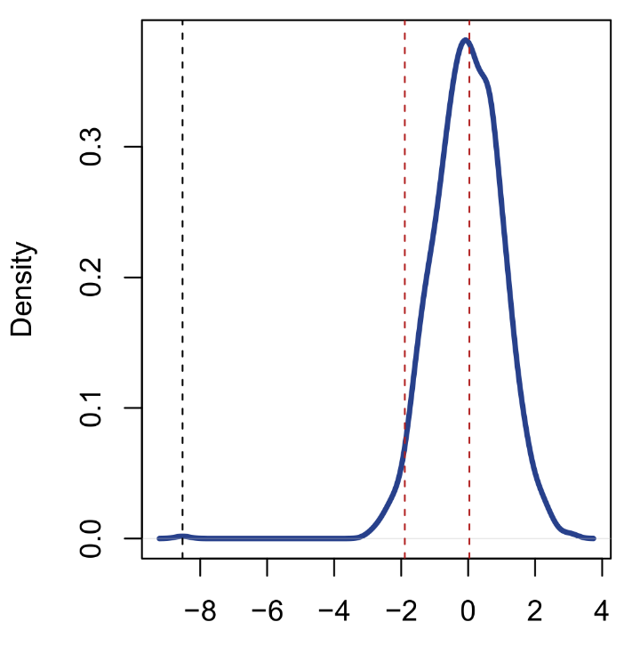
Approximate permutation t-test
Observed t
0.025 critical rejection t
tvals <- foreach(P=1:999,.combine="c") %do% {
set.seed(P)
data$gp <- sample(data$g) # random permutation of group labels
t.test(y~gp,data=data,var.equal=TRUE)$stat
}
tvals <- c(tvals,t.test(y~g,data=data,var.equal=TRUE)$stat)
plot(density(tvals))
quantile(abs(tvals),0.95)
mean(abs(tvals)>=abs(tvals[1000]))
> 95%
> 1.890885
> 0.001
Enormous evidence against the null hypothesis. No permutation t-value was larger or equal to the observed one, hence p = 0.001. Note that we took 999 random permutations because we later added the original observed t-value to our null distribution, to round out to 1000.

Slide 43
Permutation t-test with the DAAG package
While it is useful to how to script a manual permutation test, in practice we can use existing implementations, ssuch as from the DAAG package. It is useful to keep in mind, however, that a basic permutation test will usually involve these components:
  Sample a random permutation of the predictor of interest (e.g., sample(x))
  Run an analysis with the original dependent and the permuted predictor (e.g., lm, cor.test, t.test)
  Extract the statistic of interest
  Repeat steps 1–3 in a for-loop for P times
  Collect all outputted statistics in a vector and add the original test statistic from the unpermuted analysis
  Calculate the fraction of permutation statistics larger or equal than the original one (=p-value)
For short, we can use twotPermutation from the DAAG package:
twotPermutation(y[g=="A"],y[g=="B"], nsim=2000)
> p-value:
> 0
Which is an extremely stripped down version of the information we obtained with our manual test construction. Only a p-value is reported. Not even the null distribution is stored.

Slide 44
Degrees of freedom and p-values
The twotPermutation function outputted a p-value of exactly 0? This is not a rounding error, but a consequence of not adding the original test statistic (from the unpermuted analysis) to the vector of permutation test statistics. If the effect is large, it is likely that none of the permutation test statistics exceed the observed ones, hence 0 p-value.
Although this practice is not uncommon in permutation tests, having p-values equal to 0 tends to raise eyebrows in statistical reporting, and preferably should be avoided. When reporting such values, it is in any case important to use some subscripting, e.g., p_{perm} = 0.0001, and even if the p-value were 0 then, e.g., p_{perm} ≈ 0, is preferred to denote that the result is approximate.
Likewise, permutation tests do not have (conventional) degrees of freedom associated with them. Reporting the DF from the original test is not recommended, since these refer to theoretical distributions of test statistics, whereas the permutation distribution is constructed entirely empirically. It is not clear exactly how to quantify the DF in such a distribution.
Once again, for reporting, degrees of freedom could be omitted as follows, e.g., t(*) = -0.99, or t(P) = -0.99. Note also that the data analysis section of your paper should always specify which analysis was run, which test statistic was extracted, and how the data were permuted!

Slide 45
Which statistic to construct our permutation null distribution?
In the previous examples, we used t-values to construct our permutation null distribution. However, one of the great flexibilities of permutation testing is that we can basically choose any test statistic we want. Recall in the telepathy example that our test statistic was a simple sum of hits.
Not only do we have freedom to choose our test statistic, we can run permutation tests on quantities that might otherwise be difficult to test, such as variances, covariances, random effects, factor loadings, fit statistics and effect sizes. This is a property that permutation testing has in common with boostrap testing (see later).
In fact, one could argue that t-values are among the less interesting quantities to simulate, and instead we should choose something interpretable like an effect size, or even a simple value on the dependent variable's original scale. For added robustness, we could also consider permutation rank tests (e.g., permutation Spearman test)!
Once you start running your own permutation tests, try different statistics and see how the conclusions might be altered…

Slide 46
Dangers with random permutations
In our previous example the data were generated to be heteroscedastic. So what about instead running a permutation Welch test, instead of an uncorrected t-test? Spoiler: the result will be identical. Why is that…?
  Firstly, the Welch correction is primarily applied to the test's DF for calculating the p-value, not so much the t-value.
  Secondly, permuting the grouping factor G breaks not just the mean differences in Y between the groups, it also destroys any difference in variances!
Some permutations among the 999 may have exhibited the same heteroscedasticity as the original data, but the vast majority will not. In that sense, drawing 999 random permutations when the exact number could be billions is very limited. Unfortunately, even with P = 99,999 we are unlikely to find enough permutations that preserve heteroscedasticity, and checking would be extremely cumbersome.
For the heteroscedasticity case, we will later examine a solution using the bootstrap. However, in general, the previous example illustrates that if we want to generalize the principle of the two-group permutation t-test to other models, we will need to be cautious in how we permute.

Slide 47
Permutation paired t-test
This time we have a paired data sample. All the PhD students in the Thrones department took part in the mentoring intervention and we recorded their combined output (papers, posters, talks) for 2017 and 2018, which is pre- and post mentoring:
As well, we calculate difference scores (2018−2017), as we would for a paired t-test. It seems that students generally improved their output after mentoring, except for Jon and Theon.
The sample is not extremely small so a paired t-test may not be invalid, but we are interested in relaxing the distributional assumption of normality for the difference scores.
How do we construct suitable permutations for this example…?
Student | PI | 2017 | 2018 | Diff
Jon | Ned | 7 | 4 | -3
Robb | Ned | 4 | 6 | 2
Arya | Ned | 3 | 6 | 3
Sansa | Ned | 6 | 8 | 2
Bran | Ned | 8 | 10 | 2
Theon | Balon | 2 | 1 | -1
Yara | Balon | 3 | 4 | 1
Cersei | Tywin | 5 | 5 | 0
Jaime | Tywin | 1 | 3 | 2
Tyrion | Tywin | 6 | 8 | 2

Slide 48
Permutation paired t-test
This time the two groups are paired. We can still swap values between groups, but not across subjects!
The reason is that swapping values across subjects would break the (within-subjects) correlation between 2017 and 2018, which must be preserved to obtain a valid test! For permutation tests of repeated measures data, this is an extremely important caution.
Swapping between subjects but not between groups (e.g., permuting 2017) would allow for a valid permutation correlation test on the 2017–2018 correlation. This is not our interest for the example, however.
Since we are only allowed to swap groups within subjects, there are only two possible permutations per subject, and hence two possible difference scores, a negative and a positive one.
Student | PI | 2017 | 2018 | Diff | PDiff
Jon | Ned | 4 | 7 | -3 | 3
Robb | Ned | 6 | 4 | 2 | -2
Arya | Ned | 3 | 6 | 3 | 3
Sansa | Ned | 6 | 8 | 2 | 2
Bran | Ned | 10 | 8 | 2 | -2
Theon | Balon | 2 | 1 | -1 | -1
Yara | Balon | 3 | 4 | 1 | 1
Cersei | Tywin | 5 | 5 | 0 | 0
Jaime | Tywin | 3 | 1 | 2 | -2
Tyrion | Tywin | 6 | 8 | 2 | 2

Slide 49
Permutation paired t-test
This restriction allows a handy shortcut for generating permutations for a paired t-test.
Rather than literally permuting across groups, we can simply calculate our difference score, and generate a permutation by randomly flipping the sign of the values (+ or −).
In R, we can achieve this as follows:
thrones <- read.csv("thrones_phd.csv")
thrones$Diff <- thrones$X2018-thrones$X2017
set.seed(1027)
flips <- sample(c(-1,1),size=nrow(thrones), replace=TRUE)
thrones$Diff*flips
Basically, we just sample a random vector of -1 and 1 values, and multiply it with our original difference score.
Student | PI | 2017 | 2018 | Diff | PDiff
Jon | Ned | 4 | 7 | -3 | +3
Robb | Ned | 6 | 4 | 2 | -2
Arya | Ned | 3 | 6 | 3 | +3
Sansa | Ned | 6 | 8 | 2 | +2
Bran | Ned | 10 | 8 | 2 | -2
Theon | Balon | 2 | 1 | -1 | -1
Yara | Balon | 3 | 4 | 1 | +1
Cersei | Tywin | 5 | 5 | 0 | +0
Jaime | Tywin | 3 | 1 | 2 | -2
Tyrion | Tywin | 6 | 8 | 2 | +2

Slide 50
Permutation one-sample t-test
Once again, we can choose to proceed with the DAAG package, and apply the onet.permutation function to our difference score:
onet.permutation(thrones$Diff)
> 0.158
Once again extremely minimal output (just a p-value). However, the function illustrates that, just like the parametric paired t-test, the permutation paired t-test is actually a one-sample test on a difference score. Hence, why the DAAG function is called onet.permutation.
In other words, the principle of random sign flips for generating permutations extends to the one-sample case. Given data X, and a null hypothesis value for a statistic, e.g., μ₀ = 10, a permutation one-sample t-test would proceed as follows:
  Create a difference score by calculating X − 10
  Enter the difference score into a permutation test with random sign flipping (e.g., onet.permutation)
t.test(thrones$X2017,thrones$X2018,paired=TRUE)
> Paired t-test
> t = -1.7321, df = 9, p-value = 0.1173
> mean of the differences
> -1

Slide 51


Exact permutation test
Approximate permutation test

Slide 52
4. Permutation tests
C. General regression permutations

Slide 53
General permutation regression approach
Let us now consider the general case of multiple regression. We expand our Thrones example further with age and gender variables. This time our interest is to check if the mentoring effect on output (Diff variable) differs by PI. Crucially, we would like to control for the covariates age and gender. How do we construct a suitable permutation test for the PI effect…?
Student | PI | Age | Gender | 2017 | 2018 | Diff
Jon | Ned | 25 | M | 7 | 4 | -3
Robb | Ned | 25 | M | 4 | 6 | 2
Arya | Ned | 19 | F | 3 | 6 | 3
Sansa | Ned | 22 | F | 6 | 8 | 2
Bran | Ned | 18 | M | 8 | 10 | 2
Theon | Balon | 29 | M | 2 | 1 | -1
Yara | Balon | 27 | F | 3 | 4 | 1
Cersei | Tywin | 36 | F | 5 | 5 | 0
Jaime | Tywin | 36 | M | 1 | 3 | 2
Tyrion | Tywin | 32 | M | 6 | 8 | 2
We cannot simply draw random permutations of PI, since this would break not only its association with the outcome, but also its association with the covariates.
We could permute all predictors jointly*, but this still breaks the association between the covariates and the outcome, so not a proper controlling procedure.
Somehow we need to preserve the correlation structure between PI and covariates, and between covariates and outcome.
* Whenever we swap a PI label, its connected age and gender values gets swapped along with it

Slide 54
General permutation regression approach
In the general regression setting for permutation, the effects of interest are usually denoted as X, while controlling covariates are considered as “nuisance variables”, denoted D. Various strategies exist for conducting a permutation test of X on y while dealing with D. Many of these attempt to partial out the nuisance variables D by first creating appropriate residual values…
Student | PI | Age | Gender | 2017 | 2018 | Diff
Jon | Ned | 25 | M | 7 | 4 | -3
Robb | Ned | 25 | M | 4 | 6 | 2
Arya | Ned | 19 | F | 3 | 6 | 3
Sansa | Ned | 22 | F | 6 | 8 | 2
Bran | Ned | 18 | M | 8 | 10 | 2
Theon | Balon | 29 | M | 2 | 1 | -1
Yara | Balon | 27 | F | 3 | 4 | 1
Cersei | Tywin | 36 | F | 5 | 5 | 0
Jaime | Tywin | 36 | M | 1 | 3 | 2
Tyrion | Tywin | 32 | M | 6 | 8 | 2
Effect variable X
Nuisance variables D
Response y

Slide 55
General permutation regression approach
In the table below, whenever a variable is preceded by “p”, it denotes a permuted version of the original variable, while “r.” denotes a variables residualized from another variable “.”:
Reference | Permutation strategy | Implied model | Notes
Draper & Stoneman (1966) | Permute X, not y or D | Y ~ pX + D | Preserves (D,y) association but ignores (X,D) association.
Manly (1991) | Permute y, not D or X | pY ~ X + D | Preserves (X,D) association but ignores (D,y) association.
Dekker et al. (2007) | Permute X after residualizing X from D | Y ~ pX_{rD} + D | Preserves (X,D) and (D,y) association. Appropriate for unbalanced X designs
Kennedy (1995) | Permute y after residualizing (X,y) from D | pY_{rD} ~ X_{rD} | Preserves (X,D) and (D,y) association. Loss of exchangeability of residuals!
Huh & Jhun (2001) | Permute y after residualizing (X,y) from D + QR transformation |  | Correction to the Kennedy method to preserve exchangeability of residuals. Reduces dimensionality of the data
Freedman & Lane (1983) | Permute y after residualizing y from D, then add the permuted y-values to the original y values | (Y + pY_{rD}) ~ X + D | Default in permuco R package
Ter Braak (1992) | Permute y after residualizing y from (X,D), then add the permuted y-values to the original y values | (Y + pY_{rXD}) ~ X + D | Similar to Freedman & Lane method
(Frossard & Renaud, 2019)

Slide 56
Permuco package in R
The good news is that we do not need decide on the permutation strategies by ourselves. In R, the permuco package (Frossard & Renaud, 2019) can execute it all for us, with the recommended default being the Freedman & Lane method for permutation.* The package further includes functions to handle repeated measures ANOVA, and signal comparison.
For the Thrones data set, we may proceed with a general regression analysis as follows:
set.seed(2128)
lmperm(Diff~PI+Gender+Age,data=thrones, np=5000, method="freedman_lane")
No significant effects and little difference between the parametric and non-parametric p-values. However, the PI effect is broken down into individual dummy-level contrasts. Ideally, we would like an omnibus F-test for this variable…
> Table of marginal t-test of the betas
> Permutation test using freedman_lane to handle nuisance variables and 5000 permutations.
> Estimate Std. Error t value parametric Pr(>|t|) perm. Pr(<t) perm. Pr(>t) perm. Pr(>|t|)
> (Intercept) 11.4757 7.053 1.6271 0.1647
> PINed -1.2199 2.205 -0.5533 0.6039 0.3070 0.6932 0.6270
> PITywin 4.0930 2.346 1.7446 0.1415 0.9298 0.0704 0.1442
> GenderM -0.5751 1.215 -0.4733 0.6560 0.3370 0.6632 0.6608
> Age -0.3996 0.251 -1.5920 0.1723 0.0610 0.9392 0.1500
* Simulations indicate that also the Dekker, Huh & Jhun, and ter Braak methods perform well (Kherad-Pajouh & Renaud 2010; Winkler et al., 2014).

Slide 57
Permuco package in R
To get a more general breakdown of effects we can use the aovperm function, which provides a Type III ANOVA:
set.seed(2128)
aovperm(Diff~PI+Gender+Age,data=thrones, method="freedman_lane")
We can compare the p-values from the different methods. Only the Kennedy method gives substantially different p-values. However, the Kennedy method may be unreliable without the Huh & Jhun correction!
> Anova Table
> Permutation test using freedman_lane to handle nuisance variables and 5000 permutations.
> SS df F parametric P(>F) permutation P(>F)
> PI 10.446 2 1.556 0.2983 0.2602
> Gender 0.752 1 0.224 0.6560 0.6682
> Age 8.509 1 2.535 0.1723 0.1422
> Residuals 16.786 5
> freedman_lane terBraak dekker kennedy manly draper_Stoneman huh_jhun
> 0.276 0.298 0.271 0.174 0.269 0.260 0.314
> 0.666 0.650 0.664 0.583 0.673 0.693 0.657
> 0.142 0.173 0.155 0.078 0.157 0.168 0.232

Slide 58
Permutation ANOVA with factorial designs
The preceding principles extend to multiway ANOVA with factorial designs. For example, let’s say we have a simple 2 × 3 design of factors A × B. Then we need to find a way to correctly conduct an interaction and main effects permutation tests.
There is debate in the literature whether these permutations should be conditional (e.g., never permute A without residualizing B) or fully unconditional (e.g., everything can be permuted), and for which tests. If the factors are orthogonal (e.g., experimental manipulations), there is no need to residualize, strictly speaking.
However, a critical question would be what to do with the interaction terms in the model, when we want to get a permutation test for a main effect. However, if one follows a Type II ANOVA philosophy, then this problem should not matter. Recall that Type II and Type III ANOVA imply the following model comparisons:
Full model: Y ~ 1 + A + B + A:B
Type III – A effect Y ~ 1 + A + B + A:B
Y ~ 1 + B + A:B
Type II – A effect Y ~ 1 + A + B
Y ~ 1 + B
In Type II ANOVA, higher-order terms are always removed when testing effects of lower-order terms!

Slide 59
Permutation ANOVA with factorial designs
In other words, for testing the highest-order interaction, one could permute A and B independently (i.e., resamplings of A do not depend on resamplings of B), and compute the interaction test statistic.
For testing the main effects, we first remove the interaction from our model and proceed with our permutation regression on this model. Because the permuco package only performs Type III ANOVA, we need to run our Type II ANOVA “manually”. For example, for a three-way A × B × C design on Y:
aovperm(Y ~ A*B*C, data=mydata) # look only at the three-way interaction here
aovperm(Y ~ (A+B+C)^2, data=mydata) # look only at the two-way interactions here
aovperm(Y ~ A+B+C, data=mydata) # main effects only from this model
Be cautioned, however, that interpreting lower-order effects in the presence of higher-order effects may not be a good idea! Recall that a “main effect” by definition contradicts the idea of an interaction (e.g., main effect of A implies that the effect stays the same across levels of B; an interaction states the reverse). If you choose to report such effects they should be supported by descriptive/visual evidence that they do not contradict the interaction.

Slide 60
Permutation repeated measures ANOVA
The permuco package extends its functionalities to repeated measures ANOVA. It borrows the formula notation from R’s base aov function for this and requires that the data are in “long format”, i.e.:
Obs. | Subject | Time | Score
1 | AH | T1 | 60
2 | AH | T2 | 40
3 | AH | T3 | 50
4 | LL | T1 | 1
5 | LL | T2 | 10
6 | LL | T3 | 25
7 | KW | T1 | 50
8 | KW | T2 | 15
9 | KW | T3 | 11
... | ... | ... | ...
36 | AZ | T3 | 19
Obs. | Subject | T1 | T2 | T3
1 | AH | 60 | 40 | 50
2 | LL | 1 | 10 | 25
3 | KW | 50 | 15 | 11
... | … | ... | ...
12 | AZ | 5 | 12 | 19
Wide format data
Long format data

Slide 61
Permutation repeated measures ANOVA
For the Thrones data, we can achieve this conversion quickly with the reshape function:
thrones <- read.csv("thrones_phd.csv")
thrones2 <- reshape(thrones,direction="long",varying=c("X2017","X2018"), idvar=c("Student","PI","Age","Gender"),times=c(2017,2018),
v.names=c("Output"),timevar="Year")
Next we run aovperm using a modified formula to specify an additional error term for repeated measures in subjects:
set.seed(1856)
aovperm(Output~Year*PI + Error(Student/Year),data=thrones2, method="Rde_kheradPajouh_renaud")
> Permutation test using Rde_kheradPajouh_renaud to handle nuisance variables and 5000 permutations.
> SSn dfn SSd dfd MSEn MSEd F parametric P(>F) permutation P(>F)
> PI 1.264 2 55.93 7 0.6319 7.990 0.07908 0.9248 0.9220
> Year 3.105 1 55.93 7 3.1054 7.991 0.38862 0.5528 0.5542
> Year:PI 1.267 2 55.93 7 0.6333 7.991 0.07926 0.9246 0.9222
> Warning message:
> In checkBalancedData(fixed_formula = formula_f, data = cbind(y, :
> The data are not balanced, the results may not be exact.

Slide 62
Notes on aovperm output
A couple of points are worth noting for this example. Firstly, the default permutation method for rm-ANOVA in aovperm is "Rd_kheradPajouh_Renaud", whereas the authors themselves recommend "Rde_kheradPajouh_Renaud" as more secure (Kherad-Pajouh & Renaud, 2015).
Secondly, once again the p-values barely differ between the parametric and non-parametric tests, despite the fact that the sample size is very small (N=2 for PI Balon!).
Thirdly, the rm-ANOVA allowed us to formulate our hypothesis test explicitly as an interaction test of PI × Year. For the conventional regression examples we saw previously, the Year effect was encoded into our difference score Diff. However, it is technically the same test as the explicit interaction formulated in the rm-ANOVA (i.e., is the difference in academic output influenced by PI?).
Fourthly, the rm-ANOVA would also allow us to test the main effects of PI and Year on output, the latter thus being a permutation paired t-test. However, in order to obtain correct Type II main effects, one would first have to refit the model as "Output~Year+PI + Error(Student/Year)".
Fifthly, be warned that this output does not provide a Greenhouse-Geisser correction to the tests of within-subjects! The aovperm assumes sphericity, which is a serious limitation of this procedure (see earlier).

Slide 63
More permutation models…
The permuco package provides an intuitive interface for general regression permutation and basic repeated measures permutation tests (paired t-test, and spherical repeated measures ANOVA). A custom script is also available with this workshop for a permutation repeated measures MANOVA (PRMM.r), which comes with some cautions:
  The function currently does not handle between-variables. The within-design can be of arbitrary complexity, however.
  The specification of the design is handled similarly as for the Anova function in the car package (see slide 52 of this workshop), with the difference that design levels should be coded purely numerically.
  Within subjects, observations are permuted unconditionally. This means, e.g., for an A × B design, when testing the A main effect, the B effect is not fixed by not allowing permutations of B values. This can be considered a drawback.
  F-statistics are derived from the Pillai trace test statistic, rather than the more common Wilks' lambda.
  Current practice suggests that the permutation p-values rarely differ from the parametric p-values (let me know if you ever find substantial discrepancies)
Finally, one might wonder if permutation testing could be adapted to even more general designs, such as complex repeated measures and multilevel designs (e.g., lmer models in R). For such models, random effects complicate what permutations are allowed and, for this reason, bootstrap testing is recommended instead. Bootstrap resamples will preserve all dependencies in the original data (see later).

Slide 64
4. Permutation tests
D. Component selection in PCA

Slide 65
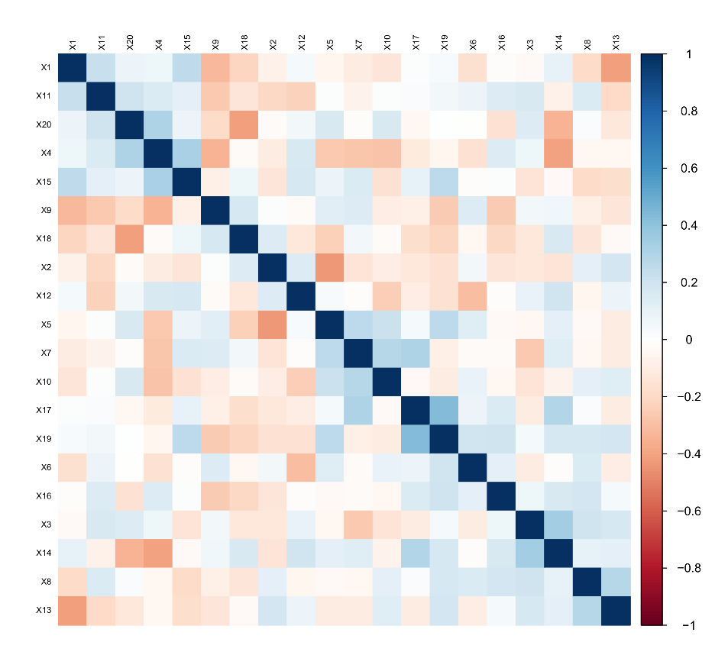
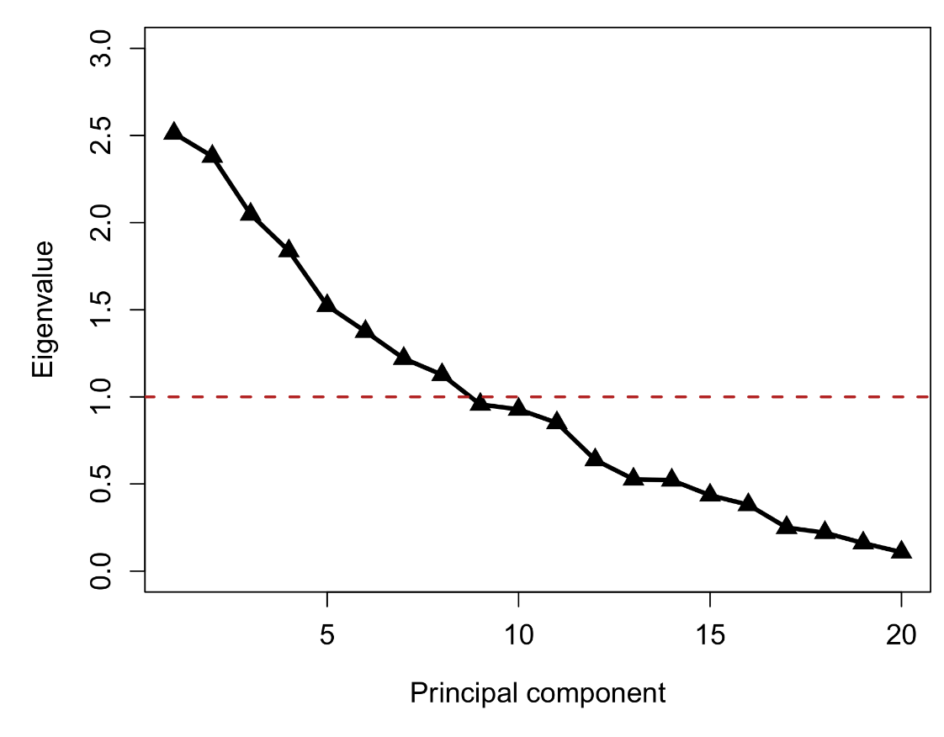
Component selection in PCA
Permutation principles can be applied to the problem of selecting components in principal component analysis (PCA). Typically, we will have some intercorrelated data that we wish to reduce to a number of latent components. This is achieved by performing an eigen-decomposition on the covariance or correlation matrix of the data, and inspecting the ordered eigenvalues (scree plot):
Eigendecomposition
Correlation matrix of a 40 × 20 random data set

Slide 66

Component selection in PCA
Two popular rules for retaining components are Cattell's scree test and Kaiser's rule:
  Scree test: look for an elbow in the scree plot and select to retain components above the elbow
  Kaiser's rule: Retain all components with an eigenvalue greater than 1
For completely uncorrelated data, all components should have an eigenvalue of roughly 1. Values larger than 1 point to potentially meaningful correlation.
However, in small data sets eigenvalues larger than 1 are frequently observed, even when the data are completely random. This is a finite sample bias that needs to be taken into account when applying Kaiser's rule
Elbow?
Kaiser's rule
8 components > 1

Slide 67
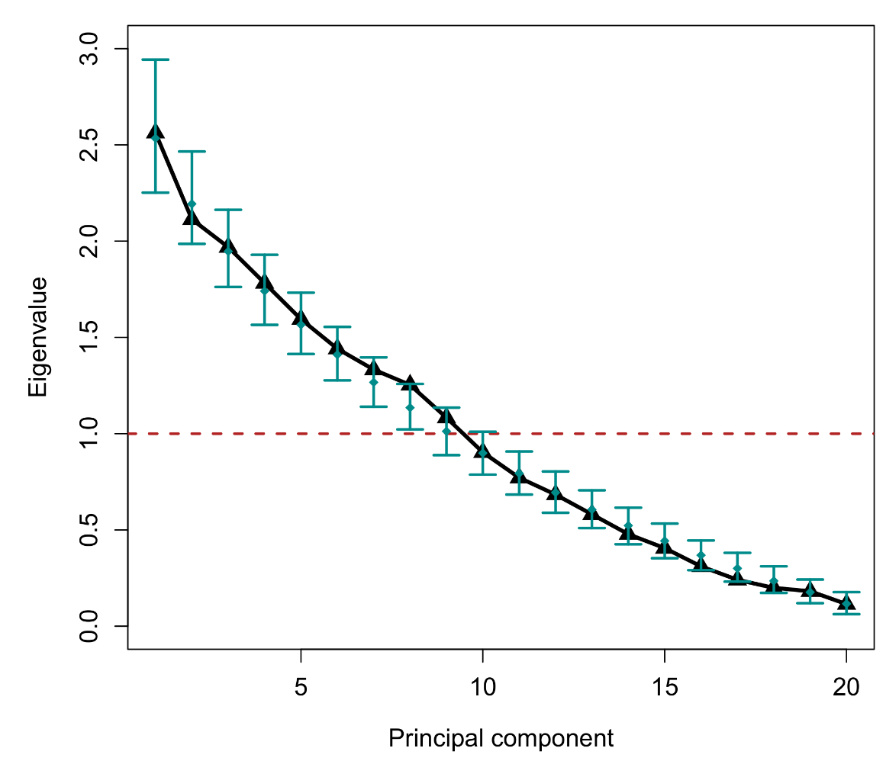
Component selection in PCA
Distribution of random eigenvalues for
1000 data sets of dimension 40 × 20

Slide 68
Horn's parallel analysis
Finite sample bias on principal components motivated Horn's (1965) parallel analysis criterion for component selectio, which proceeds as follows:
  Generate S data sets with the same dimension as the original data (N × P), where each variable is either (a) randomly sampled numbers or (b) a random permutation of values from the original variable
  For each data set, perform the eigen-decomposition and keep the ordered eigenvalues (S × P matrix)
  For each order of eigenvalue, calculate the desired quantiles across the S values (e.g., 0.05, 0.50, 0.95), to be used as cutoffs.
  Retain principal components in the original data set only when their eigenvalue exceeds the cutoff quantile for that order in the random/permuted data
The traditional cutoff is the mean or the 50% quantile (median), but one could also use the 95% quantile for an inferential test. Doing so makes PA a permutation test for principal component importance. In the example, none of the components exceed the 95% cutoff!
Whether the data in PA were sampled randomly or permuted from the original data does not make much difference! In R, parallel analysis is implemented in the paran package.

Slide 69
5. Bootstrap tests

Slide 70
Three common resampling methods
Two methods that are closely related to permutation are the bootstrap and the jackknife. All three are based on resampling observed data, but with some important differences. For example, if we had a data set with variables X, Y, Z, and were interested in resampling X, then:
  Permutation: X is randomly resampled without replacement, and without moving Y or Z values (=unconditional resampling). The permuted version of X has the same size as the unpermuted original.
  Bootstrap: X is randomly resampled with replacement, and moved along with the corresponding Y and Z values (=conditional resampling). The bootstrapped version of these data has the same size as the original data.
  Jackknife: X is randomly resampled without replacement , and moved along with the corresponding Y and Z values (=conditional resampling). The jackknifed version of these data has a smaller size as the original data (often simply N − 1).
Where permutation deliberately breaks the association between X and Y-Z, bootstrapping leaves this association intact by always resampling entire observations.
From a hypothesis testing point of view, permuting is therefore equivalent to simulating data under a null hypothesis, while bootstrapping is equivalent to simulating under an alternative hypothesis. Both methods can be used to construct confidence intervals and conduct inferential tests.

Slide 71

Bootstrap resampling
Historically, bootstrapping was proposed/invented after permutation tests and the jackknife (Efron, 1979). The term “bootstrapping” references a folk tale of a man who was able to pull himself out of quicksand by his own bootstraps. The implied concept is that one could generate something out of nothing (free lunch at last).
However, boostrapping is ultimately not that different from subsampling. In a large data set, we could imagine splitting into subsamples to estimate empirically the variation of certain parameters. Bootstrapping is a type of approximation of that scenario.
In many cases, it leads to quite useful and robust estimates for parameters, and can be used as a non-parametric alternative to parametric estimation/inference.
Baron Munchausen pulling himself and his horse out of a swamp
ID | Gender | Shoe size
1 | Male | 42
2 | Female | 39
3 | Female | 37
4 | Male | 43
ID | Gender | Shoe size
4 | Male | 43
2 | Female | 39
4 | Male | 43
4 | Male | 43
ID | Gender | Shoe size
3 | Female | 37
1 | Male | 42
2 | Female | 39
2 | Female | 39
Original sample
Bootstrap sample 1
Bootstrap sample 2

Slide 72
Bootstrap confidence intervals
By generating B bootstrap samples of our original data, and each time calculating our statistic of interest (θ), we will end up with an empirical distribution of bootstrap statistics. This distribution could be used to calculate a 95% bootstrap confidence interval, which turns out to be less straightforward than expected. A massive literature on this subject has produced a number of different proposals:
  Normal: We use the SE of the bootstrap distribution to set a theoretical interval in the standard fashion, e.g., [θ − 1.96 × SE, θ + 1.96 × SE]. Naïve and probably the worst way to construct a CI, since the least non-parametric.
  Simple percentiles (Efron's CI): We use the empirical 95% quantile limits of the bootstrap distribution, similar to how we set critical values in permutation distributions. This method is intuitive and non-parametric but has been controversial, since it can be shown to consistently undercover the true 95% confidence limits.
  Backwards (Hall's CI): Same as the simple percentile limits, but with the lower and upper limit's transposed. Also undercovers.
  Bias-corrected percentiles: Estimates the bias of the bootstrap estimates and corrects the CI accordingly.
  Accelerated bias-corrected percentiles (ABC): Same as the BC percentiles but with an additional acceleration constant calculated from the bootstrap estimates, which is used to additionally correct the CI.
  Studentized: Uses second-stage bootstrap resampling (i.e., a bootstrap of a bootstrap) to estimate empirically the standard error of each bootstrap statistic, which is estimated as the standard deviation of the same statistic calculated from its second-stage samples.
For an in-depth discussion of strengths, weaknesses, and applications check:
https://influentialpoints.com/Training/bootstrap_confidence_intervals-principles-properties-assumptions.htm

Slide 73
Bootstrap hypothesis testing
Any of the preceding CIs could be used for a bootstrap test. That is, for a given test statistic (θ) and a null hypothesis value (θ₀), we could bootstrap θ, construct our CI and check if θ₀ is contained within the interval. If not, we reject the null hypothesis. If yes, we conclude there was insufficient evidence to reject the null hypothesis.
However, none of this is helpful if we do not know which CI to use for this. Especially when the effect being tested is small or weak, there will likely be large discrepancies between the conclusions offered by different intervals.
Moreover, the CIs listed on the previous slide tend to perform the best when the original data sample is large and the statistic of interest is a “well-behaved” quantity like a mean, a difference of means, or a regression coefficient. Bootstrapping other statistics such as the median, or the maximum, introduces further complexities, and may require additional smoothing of the bootstrap distribution of statistics.
Such procedures, as well as assumptions that the bootstrap distribution is normal or can be transformed to a normal distribution, make bootstrap testing less non-parametric than might be assumed. Whenever your software outputs results for bootstrap tests, inform yourself well of the underlying procedure!
https://influentialpoints.com/Training/nonparametric-or-parametric_bootstrap.htm

Slide 74
boot function in R
The theory and practice on bootstrapping is too vast and complex to be covered in this workshop. I therefore refer you to more specialized courses and workshops on this topic. However, I do want to give a short demonstration of how to use R's boot function (from the boot package), since its interface is not entirely intuitive for inexperienced users.
Let us say we create a two-sample comparison and want to bootstrap our t-test:
set.seed(1606)
x <- scale(-150:150)
g <- sample(rep(0:1,times=c(150,151)))
y <- 0.5*g1+ifelse(g1==0,rnorm(150,0,1),rnorm(151,0,1))
problem <- data.frame(y,x,g)
t.test(y~g,data=problem,var.equal=TRUE)
To bootstrap the t-values, we need to write a custom function that takes a data set (d) and an index (i) as its arguments, and outputs our statistic of interest. The index i is later used by the boot function to generate bootstrap samples:
library(boot)
tfunc <- function(d,i) { t.test(y~g,data=d[i,],var.equal=TRUE)$statistic }

Slide 75
boot function in R
Now we can apply the boot function to our analysis, and return CI with the boot.ci function:
set.seed(105)
btvals <- boot(problem,tfunc, R=999, stype="i")
btvals$t
boot.ci(btvals)
> BOOTSTRAP CONFIDENCE INTERVAL CALCULATIONS
> Based on 999 bootstrap replicates
>
> CALL :
> boot.ci(boot.out = btvals)
>
> Intervals :
> Level Normal Basic
> 95% (-6.018, -2.125 ) (-5.987, -2.089 )
>
> Level Percentile BCa
> 95% (-6.039, -2.142 ) (-6.172, -2.292 )
> Calculations and Intervals on Original Scale
> Warning message:
> In boot.ci(btvals) : bootstrap variances needed for studentized intervals

Slide 76
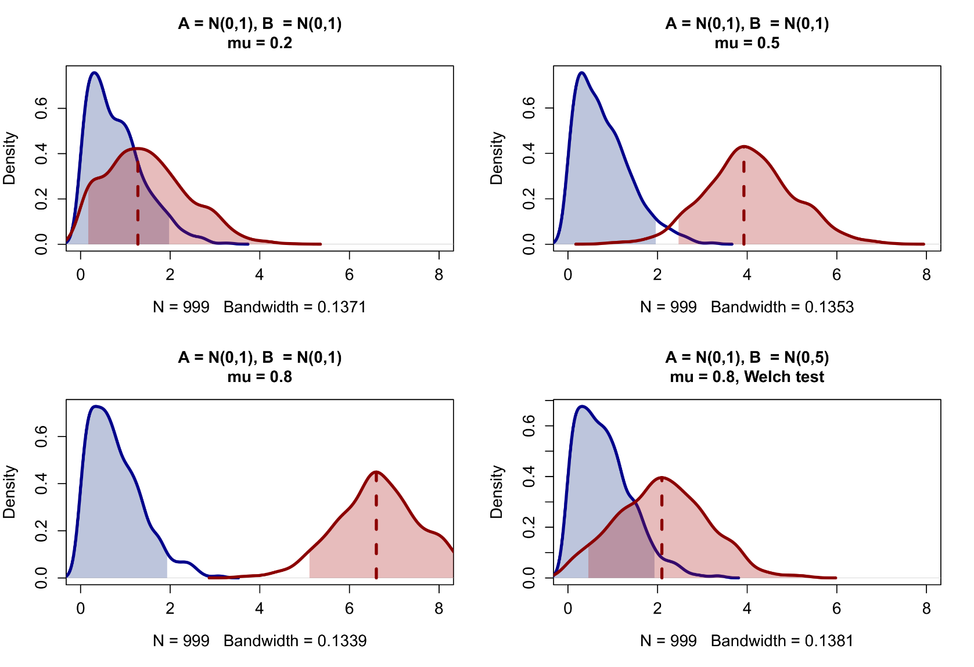
Permutation versus bootstrapping
In the previous example, the difference in means was set to 0.5, and variances were set to be equal. What happens if we increase the difference under heteroscedastic conditions?
On the right, we compare the observed permutation distribution to the observed bootstrap distribution, with 95% quantile limits in shaded areas.
Should we reject the null hypothesis if the mean bootstrap value falls into the 95% permutation rejection region? Or if the 95% bootstrap limit falls into this region…?
The Welch test can lead to a dramatically different conclusion for unequal variances!

Slide 77
Permutation versus bootstrapping
Permutation testing is more appropriate for the purposes of (classical frequentist) inference, and is compatible with Fisher's idea of the p-value. It is perfectly suited to problems of small-sample inference, and easy to apply to simple models (e.g., t-test, ANOVA, correlation test).
Bootstrapping is more appropriate for obtaining empirical standard errors for statistics that otherwise have unknown or complex theoretical SEs. Bootstrapping is preferred in complex models where the correct rules for permutation may otherwise be complicated (e.g., multilevel regression). In contrast to permutation, bootstrapping should generally not be applied to small samples, since it may worsen small-sample bias.
A number of applications of bootstrapping include:
  Bootstrapped tests of mediation in structural equation modelling (Preacher & Hayes, 2004)
  Bootstrap aggregation in machine learning (e.g., random forest)
  Empirical confidence intervals for parameters in multilevel models
The jackknife is mainly used to estimate the bias and variance on parameters, and is less well-known outside of resampling literature. Resampling methods in statistics are also sometimes called Monte Carlo methods, or computer-intensive methods. These include other parametric/model-based resampling methods used in missing data imputation and Bayesian modelling (e.g., MCMC sampling).

Slide 78
6. Tips and conclusions

Slide 79
Non-parametric tests are great! Except when they're not…
The “superiority” of non-parametric tests over parametric tests is often assumed. Firstly, this may not be entirely true (no free lunch in statistics!). Secondly, researchers have been curiously reluctant to adopt them. A number of reasons can be proposed for this:
  Researchers do not understand how to interpret rank-based tests and their implied null hypotheses
  Researchers may lack the scripting skill to implement their own permutation tests
  The p-values of non-parametric tests rarely differ dramatically from their parametric counterparts
  If the p-values do differ, the reason is most likely to be outliers/influential values, which can also be fixed in alternative ways
  If the p-values do differ, the test is more likely to be non-significant, where the parametric counterpart is not, so more conservative
  Non-parametric tests ultimately do not solve most problems with conventional parametric assumptions (see slide 22)
Like other procedures in statistics which are agreed to be “good practice” on paper (e.g., a-priori sample size calculation, multiple testing correction), non-parametric tests often lead to undesirable results, mainly non-significant p-values.
Researchers are probably more likely to report them when the original parametric test is already highly significant, and the non-parametric test underscores that significance under more robust conditions.

Slide 80
What to take home?
We have now absorbed a lot of information in a short amount of time (maybe too much), but I do hope that some important take-home messages were emphasized. Chiefly, this includes the following:
  To be aware of what non-parametric statistics can and cannot correct (e.g., six myths)
  To check assumptions in their order of importance and impact
  To apply non-parametric tests that you know how to interpret
  To understand the principle of permutation testing, and that it can be applied to virtually any statistical model
  To understand how to create permutations in R with sampling and simple for-loops, and to use packages like permuco
  To understand basic differences between permutation and bootstrap resampling
Despite the large amount of information, this workshop was unable to go into detail on many important topics. We have largely skipped rank-based tests in favor of permutation tests, given only surface treatment to bootstrap testing, and almost completely ignored non-parametric methods for quantifiying associations (e.g., LOWESS smoothers).
Other non-parametric methods include nearest-neighbor prediction (briefly discussed) and hierarchical clustering. The former will be revisited in the future workshop on machine learning, however!

Slide 81
Thank you for your attention…!

