Slide 1



Non-parametric Data Analysis
Part 1: Assumptions in parametric statistics
Ben Meuleman, Ph.D.
Swiss Center for Affective Sciences
Université de Genève
January 17, 2023

Slide 2

Personal background
2003 – 2007 Bachelor in Psychology
2007 – 2009 Master in Psychology
2009 – 2010 Master in Statistical Data Analysis
2011 – 2015 Ph.D. in Psychology
2016 – 2019 Postdoc in Psychology
2019 – … Statistician
Doctoral dissertation—including two publications—written on the application of machine learning to emotion data.
Permanent statistician at CISA since 2011(50%), offering regular consulting services for researchers, and contributor of occasional workshops (machine learning, multilevel regression, statistics tips). Presented twice at the R Lunch series of UNIGE.
http://use-r-carlvogt.github.io/prochains-lunchs/

Slide 3


Today's workshop
This is a revised version of a workshop first taught on February 25, 2020 (shortly before the covid19 lockdowns). This version includes extensions for permutation PCA and for bootstrap tests but otherwise the material is 90% the same.
The content of this workshop is divided in two parts, (1) assumptions in parametric statistics and (2) permutation testing. However, the details of executing non-parametric data analyses are less important to me than understanding why they are useful, and especially when they are NOT.
Throughout the workshop, I will dispel several common myths regarding non-parametric data analysis.
The workshop largely follows a lecture/seminar format but R code is included in the slides that can be executed in parallel with the theoretical explanation. As well, there are some quizzes and interactive demonstrations to participate in.
Data that are used in the R scripts are sourced directly from switchdrive, so there is no need to have data files pre-loaded.
https://www.r-project.org/

Slide 4
Contents
Quiz
Assumptions in parametric statistics
Importance of assumptions
Checking assumptions
Problems with testing assumptions
Introduction to non-parametric statistics
Terminology
Rank-based tests
Permutation tests
Telepathy
Exact and approximate tests
General regression permutations
Component selection in PCA
Bootstrap tests
Tips and conclusions

Slide 5

1. Quiz time!

Slide 6

Q1. In linear regression, it is assumed that the independent variables
are normally distributed.
TRUE
FALSE

Slide 7
Q2. Normality of residuals is the most important statistical assumption
in linear regression.
TRUE
FALSE

Slide 8
Q3. Data can be non-parametric.
TRUE
FALSE

Slide 9
Q4. Non-parametric methods can correct for problems with
outliers and influential values.
TRUE
FALSE

Slide 10
Q5. Bayesian statistics are a kind of non-parametric statistics.
TRUE
FALSE

Slide 11
Q6. Non-parametric tests can improve generalizability.
TRUE
FALSE
TRUE-ISH

Slide 12
Q7. Non-parametric tests can be applied for dealing with:
Confounding
Multicollinearity
Unequal variances (heteroscedasticity)
Auto-correlation
None of the above

Slide 13
2. Assumptions in parametric statistics
A. Importance of assumptions

Slide 14
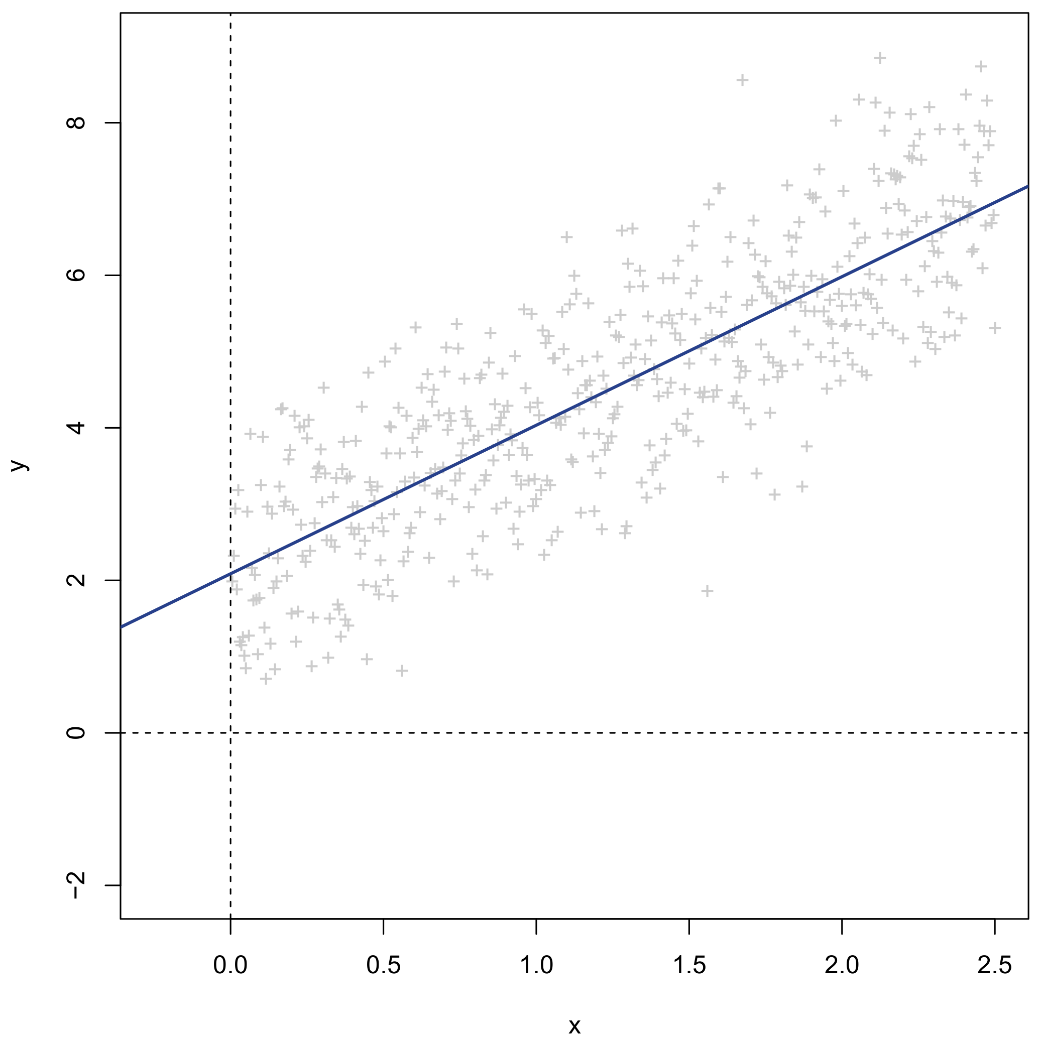
Linear regression
Continuous dependent/response Y
Continuous independent/predictor X
Linear regression of Y on X = Linear approximation of Y using X

Slide 15
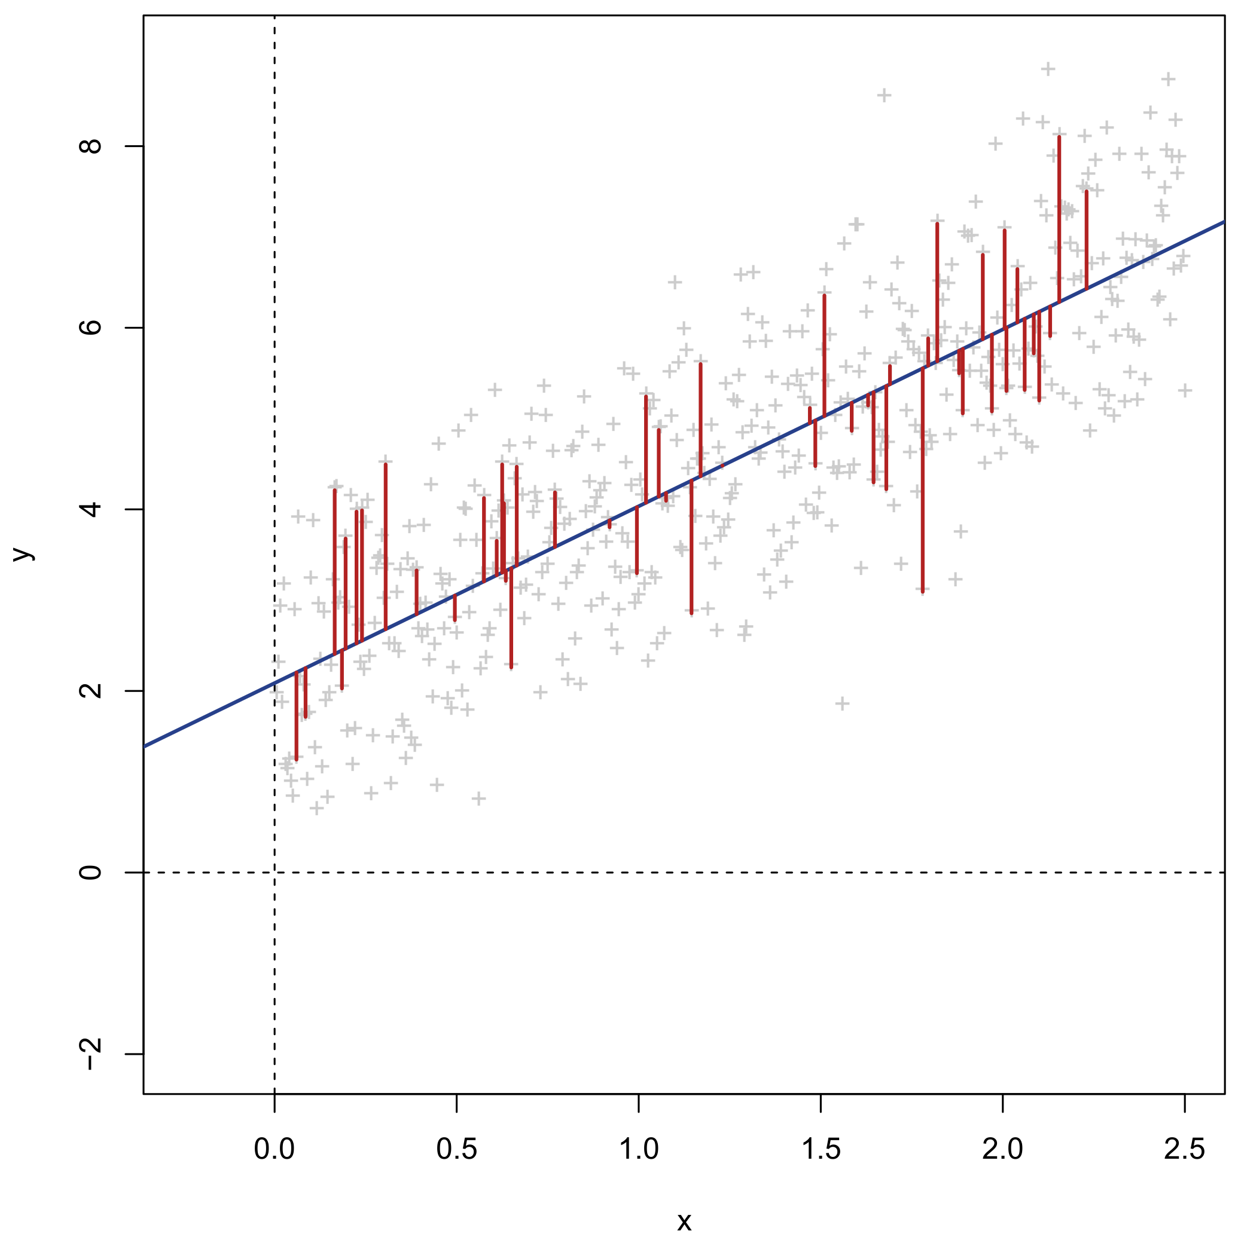
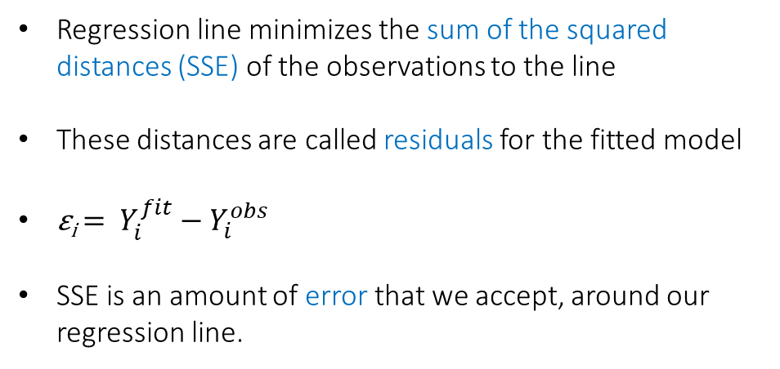
Linear regression
Regression line minimizes the sum of the squared distances (SSE) of the observations to the line
These distances are called residuals for the fitted model
ε_{i} = $Y_{i}^{fit}−Y_{i}^{obs}$
SSE is an amount of error that we accept, around our regression line.

Slide 16
Linear regression
Y_{i} = β₀ + β₁X_{i} + ε_{i}
β₀ Intercept. Expected/average value of Y when X equals 0 (intersection of the model with the Y- axis)
β₁ Slope. Expected/average increase in Y when X increases by 1 unit
β₁ slope
β₀ intercept

Slide 17
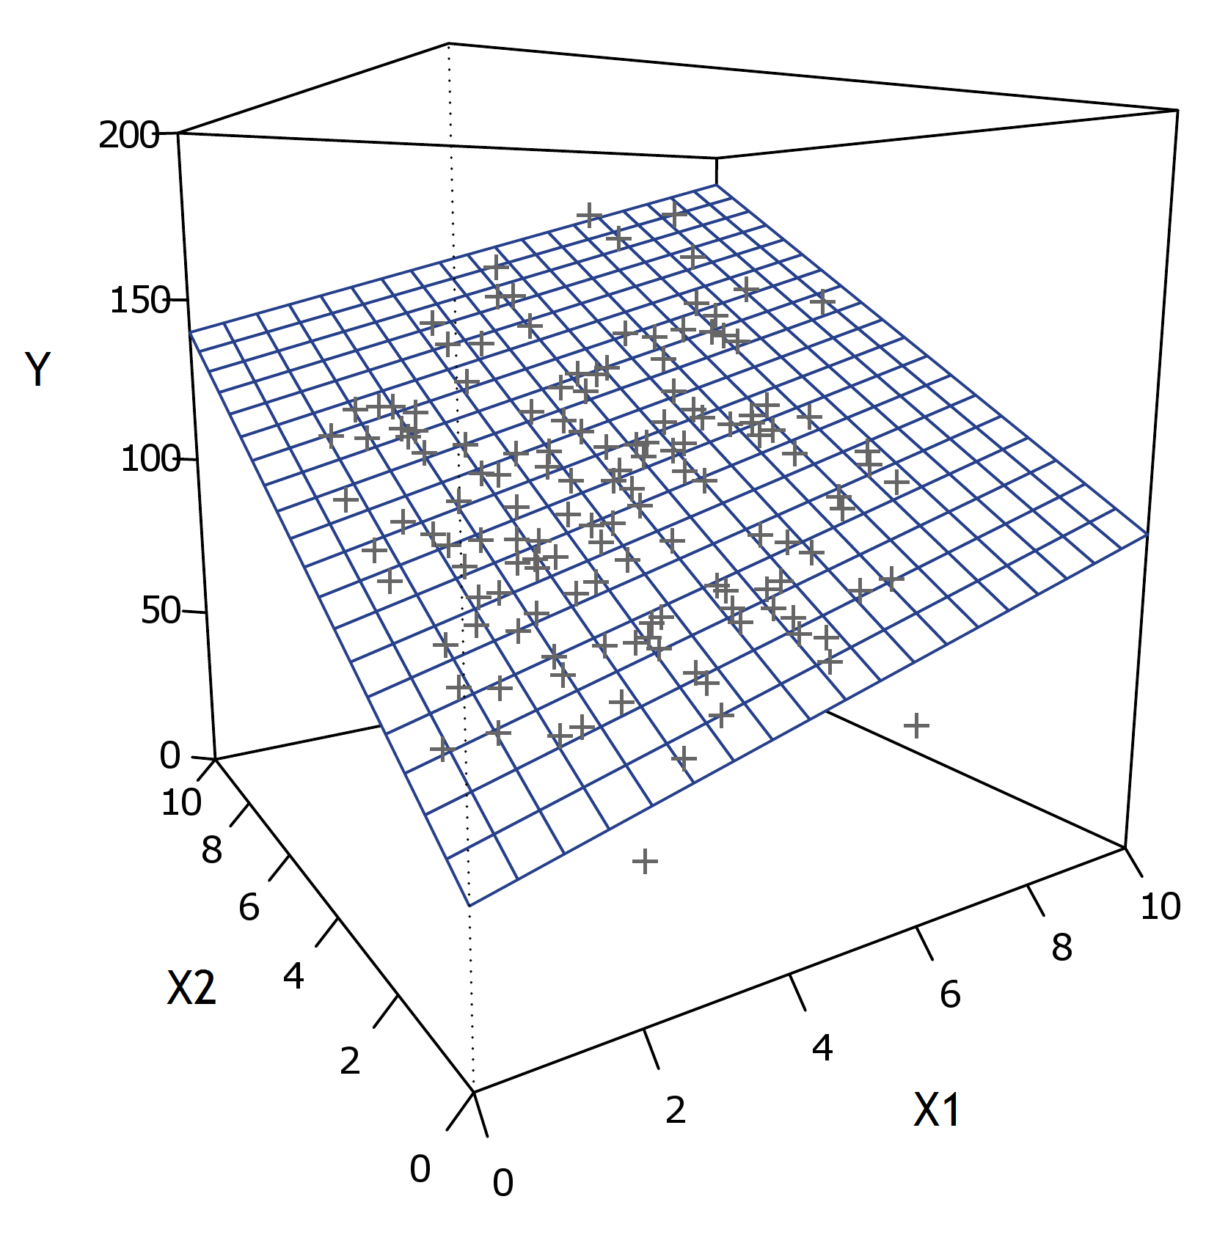
Linear regression
β₂
β₁
β₀
Y_{i} = β₀ + β₁X_{i1} + … + β_{p}X_{ip} + ε_{i}

Slide 18
Linear regression – Special cases
Analysis name | Dependent / response | Independent / predictor
One-way regression | 1 continuous | 1 continuous
Multiple regression | 1 continuous | +1 continuous
Independent samples t-test | 1 continuous | 1 categorical (2 levels)
One-way ANOVA | 1 continuous | 1 categorical (+2 levels)
Multi-way ANOVA | 1 continuous | +1 categorical
ANCOVA | 1 continuous | +1 continuous and categorical
Pearson correlation | 1 standardized continuous | 1 standardized continuous
Spearman correlation | 1 standardized ranked continuous | 1 standardized ranked continuous
One-sample t-test | 1 continuous | Intercept only
Paired t-test | 1 continuous difference score | Intercept only
Hotelling's T-test | +1 continuous | 1 categorical (2 levels)
MANOVA | +1 continuous | 1 categorical (+2 levels)
Multivariate multiple regression | +1 continuous | +1 continuous and categorical

Slide 19
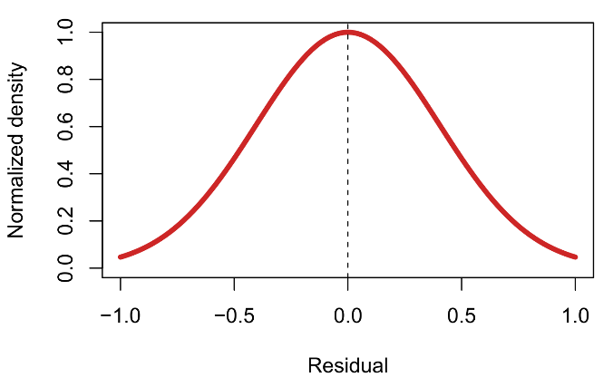
Assumptions in linear regression – Explicit
Y_{i} = β₀ + β₁X_{i} + ε_{i}
ε_{i} ~ N(0,σ²)
cor(ε_{i},ε_{j}) = 0
Residuals are assumed to be:
Normally distributed
Independent
With constant variance σ²
= Gauss-Markov assumptions
Normal distribution

Slide 20
Assumptions in linear regression – Implicit
Additional explicit assumptions feature in specialized analyses, e.g.:
Repeated measures ANOVA Sphericity of the covariance matrix of repeated measures
Time series analysis Stationarity of mean and/or covariance over time
Bayesian inference Distributional assumptions on model parameters
Multiple imputation Missing data can be recovered from observed data (MAR)
Many of these methods also share important implicit assumptions:
Specification Model is correctly specified. No important predictors omitted.
Outliers No outliers/influential cases
Multicollinearity No multicollinearity between predictors
Linearity Linear relationships between predictors and response
Missingness No missing data, or data are missing completely at random (MCAR)
Sample size Sufficient sample size for reliable estimation and inference
Violations of some implicit assumptions may be more harmful than of some explicit assumptions…

Slide 21
Assumptions, ranked by impact
Type | Assumption | Impact of violation | Solutions | Non-parametric solution?
I | Multicollinearity | Severely inflated SEs, unstable parameter estimates | Variable removal, factor analysis, ridge regression | 
E | (Co)variance | Under- or over-estimated SEs | Weighted least squares, random effects, variance models, Greenhouse-Geisser correction | 
E | Independence | Underestimated SEs | Autoregressive modelling, weighted least squares, repeated measures models | 
I | Specification | Weak predictive strength. Causal deficiencies |  | 
I | Outliers/influential cases | Biased means and SEs. Other assumption violations. | Data transformations, robust regression, quantile regression, data deletion, rank tests | 
I | Linearity | Biased means and SEs. Other assumption violations. | Data transformations, nonlinear modelling, machine learning, rank tests | 
I | Missingness | Biased means and SEs | Missing data imputation, complete case analysis | 
I | Sample size | Unreliable means | Exact tests, permutation tests | 
E | Normality | Biased SEs | Data transformations, rank tests, permutation tests, bootstrap tests | 
E = Explicit, I = Implicit, SE = Standard error

Slide 22
In which order should I check?
Often multiple violations of assumptions will co-occur for the same model. This is particularly true when outliers and/or non-linearity are present, since these problems tend to distort homoscedasticity and normality, even when there is not really an issue.
As a rough guideline, the following order of checking and solving assumptions probably makes sense:
Multicollinearity
Outliers and influential cases
Linearity
Variance
Independence
Normality
Data and model adequacy
Distributional assumptions

Slide 23
2. Assumptions in parametric statistics
B. Checking assumptions

Slide 24
Multicollinearity
When predictor variables are weakly or moderately correlated, it is a good idea to keep them together in the model, since this will separate unique effect of each on the response variable. This type of adjustment is common in linear regression to exclude confounding.
When correlation becomes very high the predictors may be (multi)collinear. In this case, keeping both in the model is NOT recommended! Multicollinearity can severely distort parameter estimates, inflate standard errors, and produce invalid inferential tests. The entire model becomes unstable.
For this reason, checking multicollinearity should be the first step, since running any further diagnostics would otherwise make no sense.
The instability of multicollinear models arises due to the fact that more parameters are required to be estimated than there is unique information available to estimate them…
Age
Health complaints
LS
Relation of health complaints to life satisfaction (LS) is confounded by age.

Slide 25
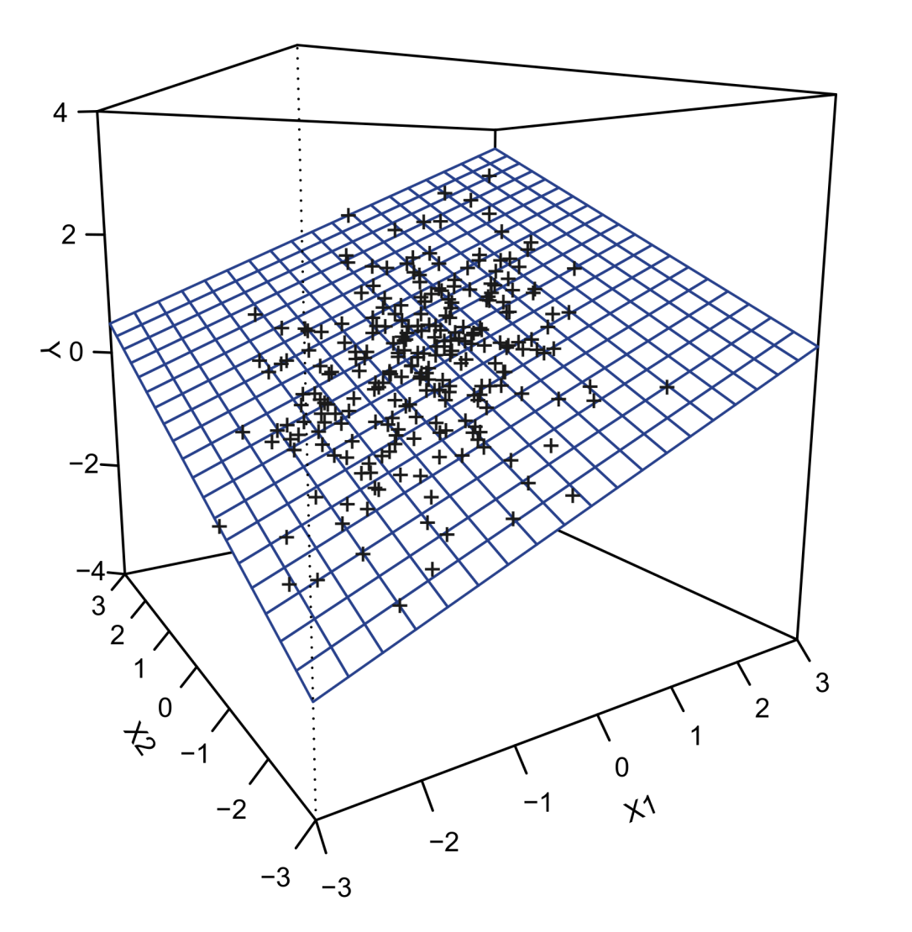
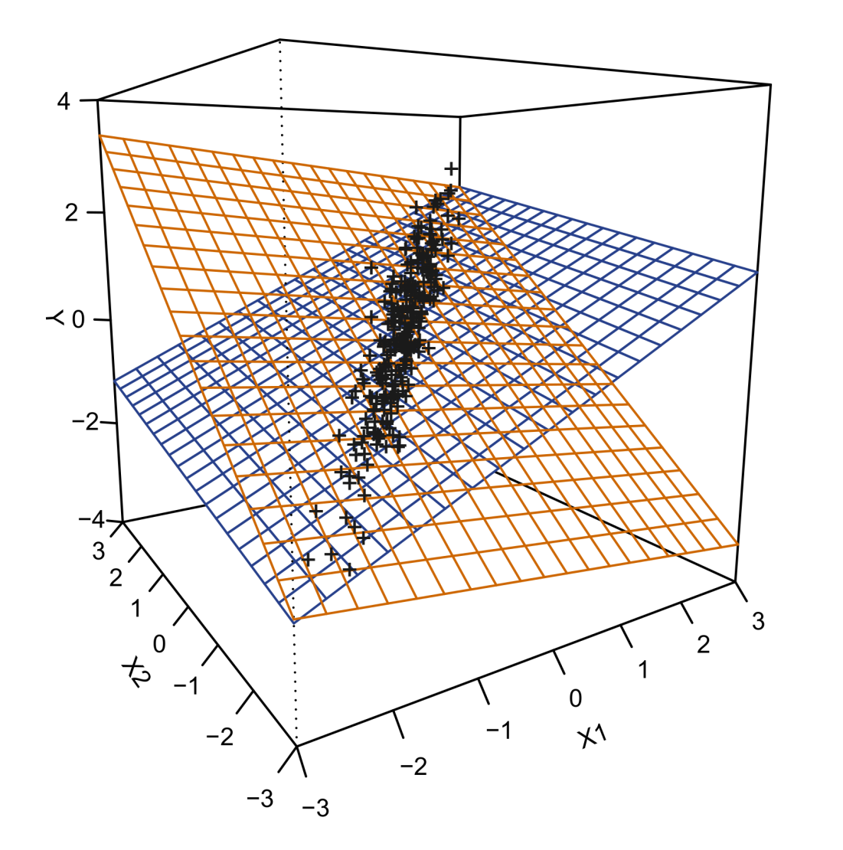
Model instability due to multicollinearity
r_{(X1,X2)} = 0.30
r_{(X1,X2)} = 0.99

Slide 26
Diagnosing multicollinearity
There are several ways of diagnosing multicollinearity:
Screen bivariate correlations for high values (e.g., > 0.90)
Check the size of standard errors in your fitted model. Are they unusually large? Are all inferential tests non-significant?
Calculate variance inflation factors (VIF) for your fitted model. Variables with a VIF > 10 may be problematic.
The last option is generally recommended, since it can detect complex collinearity that may not be visible in bivariate correlations (e.g., A is collinear with B and C together, but not with either separately). In R, the car library has a vif function that can be applied to regular (lm, glm) and multilevel (lmer, glmer) linear models. As well, it computes omnibus VIFs for categorical predictors with +2 levels:
model <- lm(y~x+g2+x:g2,data=data)
vif(model)
> x g2 x:g2
> 2.005591 1.001864 2.003712

Slide 27

Variance inflation factor

Slide 28
Solutions for multicollinearity
In models with interactions, the interaction terms will be somewhat collinear with their corresponding main effects terms (by definition). This type of collinearity can be reduced by centering the predictors before the analysis.
The simplest solution to multicollinearity is to remove the collinear variables. If two variables are collinear, it means they contain virtually the same information, and so one should be redundant. Another option is to merge the variables, by averaging or by factor analysis.
If there is a desire to keep the collinear variables in the model, one could run a ridge regression, which is a quasi-Bayesian model that imposes restrictions on the regression parameters. These restrictions correspond to a simplified Bayesian prior, which allow that parameter values can still be estimated even when data are deficient or absent!
Prior distributions are the reason why Bayesian statistics are the opposite of non-parametric! Bayesian regression requires distributional assumptions about both the residuals and the parameters.

Slide 29

MYTH I
Bayesian statistics are a kind of non-parametric statistics

Slide 30
Residual diagnostics
Once multicollinearity has been checked, the remaining assumptions generally concern so-called residual diagnostics. It is important to emphasize that assumptions almost always relate to a model’s residuals:
Residuals = the data, conditional on the fitted model!
When checking regression assumptions, one therefore checks the residuals, not the raw unconditional data. This can be especially important for outliers and normality.
Researchers often verify these assumptions for each variable separately (in a univariate manner), not conditioned on the fitted model. The following example shows the potential pitfall with this procedure…

Slide 31
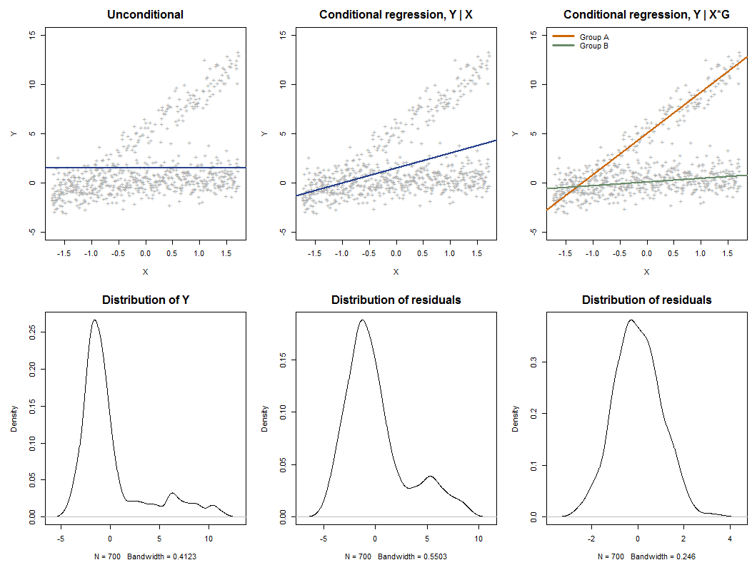
Assumptions are conditional!
We attempt to model Y using a combination of a continuous X and a categorical G (with levels [A,B])
Unconditional regression is equivalent to the intercept-only model, Y|1, or simply the raw univariate Y data.
The raw residuals and those conditioned on X are non-normal.
When G and its interaction with X is included, the residuals become normal!

Slide 32
Residuals in repeated measures models
Checking residuals can be particularly confusing in repeated measures models, (e.g., paired t-test, repeated measures ANOVA).
ID | Group | Time1 | Time2 | Diff_{T2-T1} | Mean_{T2-T1}
1 | A | 5 | 10 | 5 | 7.5
2 | A | 6 | 10 | 4 | 8
3 | B | 4 | 9 | 5 | 6.5
4 | A | 8 | 11 | 3 | 9.5
5 | B | 9 | 9 | 0 | 9
6 | B | 5 | 12 | 7 | 8.5
7 | A | 8 | 7 | -1 | 7.5
…
N | B | 10 | 8 | -2 | 9
Technically, the paired t-test is merely a one-sample t-test on the difference score of the two paired measures.
Therefore, assumptions (e.g., normality) should hold for the difference score, rather than T1 and T2
When between-covariates are added to such models (e.g., rm-ANOVA), each effect may imply different residuals to be checked:
Time main: residuals of Diff|1
Group main: residuals of Mean|Group
Time by group: residuals of Diff|Group
paired t-test = one-sample t-test

Slide 33
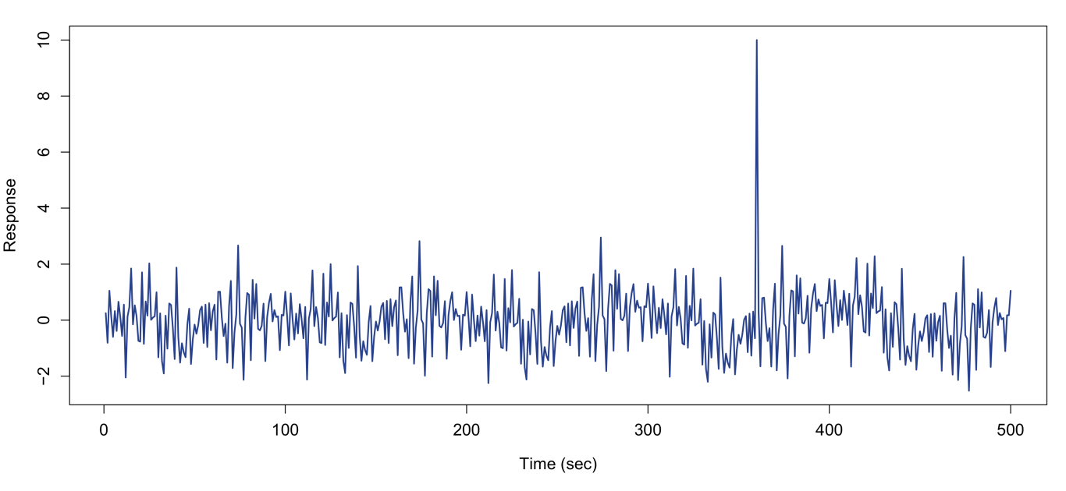
Outliers
Often researchers do not inspect their data sufficiently before running analyses. This should be your first step once you have collected data!
Always check your data for oddities such as missing values and outliers. Inspect your data visually with univariate and multivariate plots (e.g., time series, barcharts, scatter plots). Does everything look the way it should look?

Slide 34
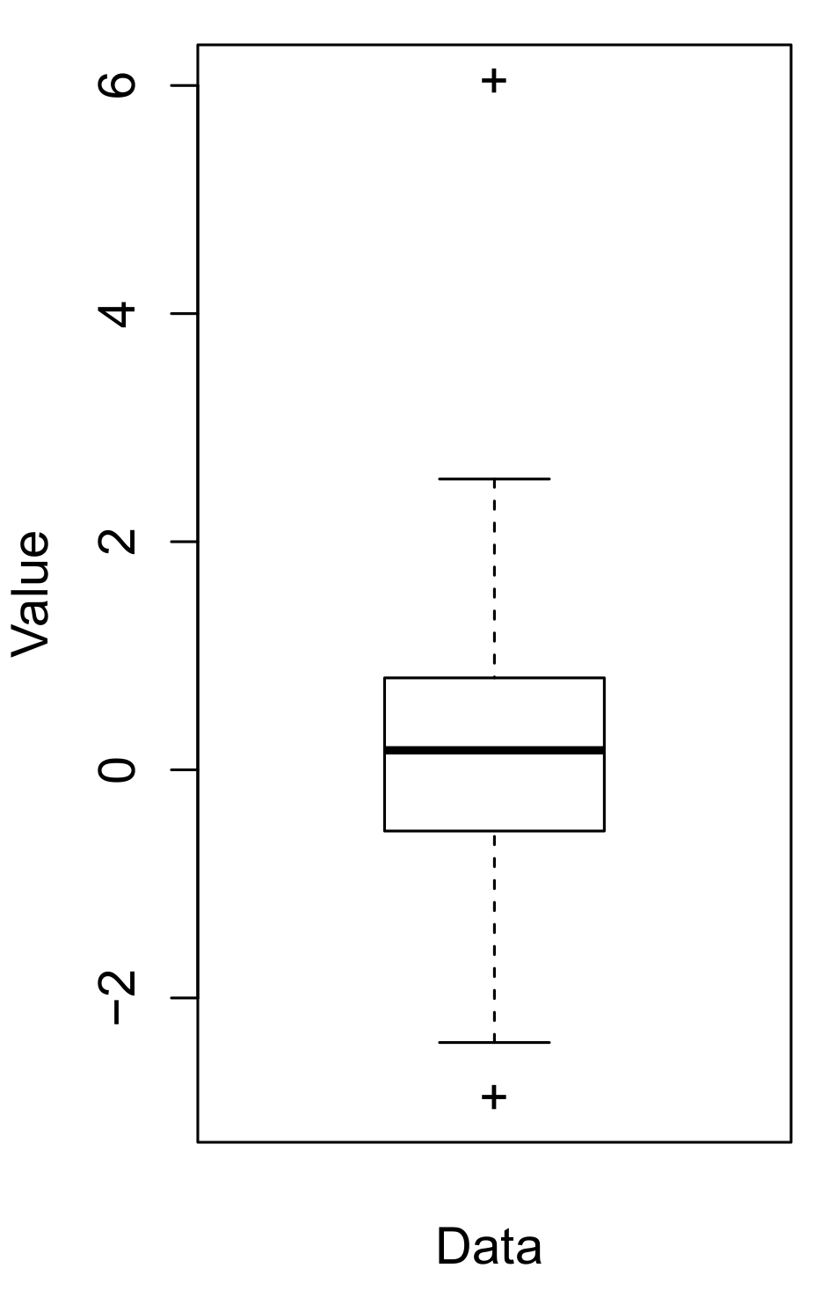
Identifying outliers
The quickest method for inspecting outlyingness—apart from eyeballing your dataset—is to generate boxplots for all your variables.
Boxplots show interesting quantiles of each variable (25%, 50%=median, 75%), as well as the most extreme observations that are still within an acceptable range (i.e., the interquartile distance). The latter are visualized as the so-called whiskers.
Observations beyond the whiskers are identified as outliers and may be problematic.
Note that observations can also be outliers in a multivariate sense. Identifying these is more complicated, however…
whiskers
box
median

Slide 35
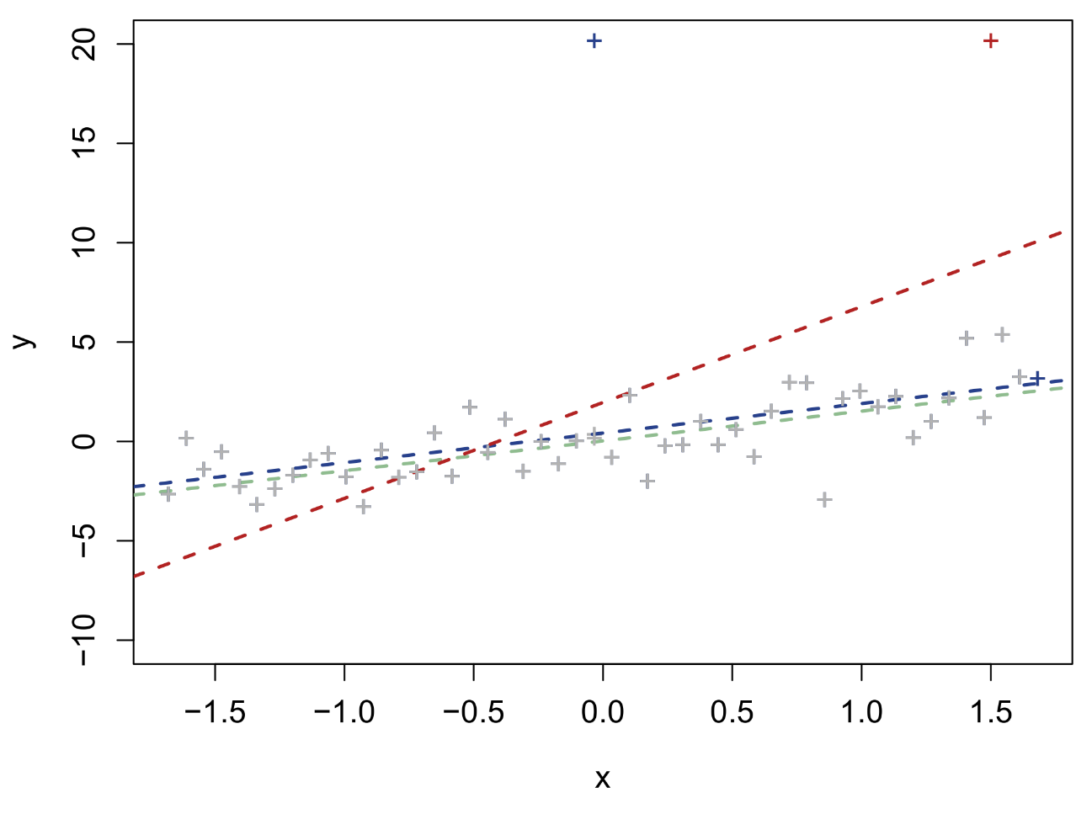
Outliers versus influential cases
Outlying data points are not necessarily influential cases, that is, observations that change the results of your analysis.
Generally, outlying cases tend to have less impact near the center/mean of the model than at its edges.
For this reason, diagnosing outliers and influential cases is best done by residual analysis.
outlier
influential

Slide 36
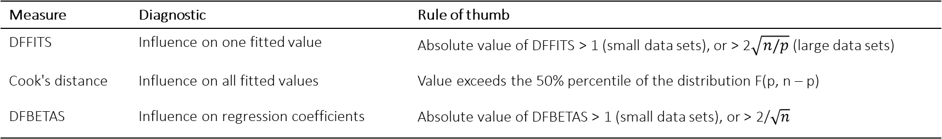
Influence measures
Various influence measures have been proposed (see Kutner et al., 2005, pp. 400-406, for a detailed discussion), usually derived from so-called deleted residuals, i.e., the value a residual would have if the model had excluded its observation from parameter estimation. Large deleted residuals mean they are probabily influential.
Three important such measures are DFFITS, Cook's Distance, and DFBETAS. In R, there is a handy function called influence.measures, which will output these measures for a fitted lm object. The car library provides some additional plotting functionalities, and extends these measures to lmer objects.
Some rules of thumb for deciding whether an observation is influential:
Measure | Diagnostic | Rule of thumb
DFFITS | Influence on one fitted value | Absolute value of DFFITS > 1 (small data sets), or > 2$\sqrt{n/p}$ (large data sets)
Cook's distance | Influence on all fitted values | Value exceeds the 50% percentile of the distribution F(p, n – p)
DFBETAS | Influence on regression coefficients | Absolute value of DFBETAS > 1 (small data sets), or > 2/$\sqrt{n}$

Slide 37
Influence measures
Let us generate some random data in R, with an outlier, and split them into two groups (A and B):
set.seed(1805)
randomdata <- data.frame(y=rnorm(200,0,10),g=rep(c("A","B"),each=100))
randomdata[2,] <- 50 #Create outlier on purpose
model <- lm(y ~ g, data=randomdata)
summary(model)
> Coefficients:
> Estimate Std. Error t value Pr(>|t|)
> (Intercept) 1.296 1.119 1.159 0.248
> gB -1.397 1.582 -0.883 0.378
> ---
> Signif. codes: 0 ‘***’ 0.001 ‘**’ 0.01 ‘*’ 0.05 ‘.’ 0.1 ‘ ’ 1
As expected, no significant group differences. Let's run the influence diagnostics:
influence.measures(model)
infIndexPlot(model)

Slide 38
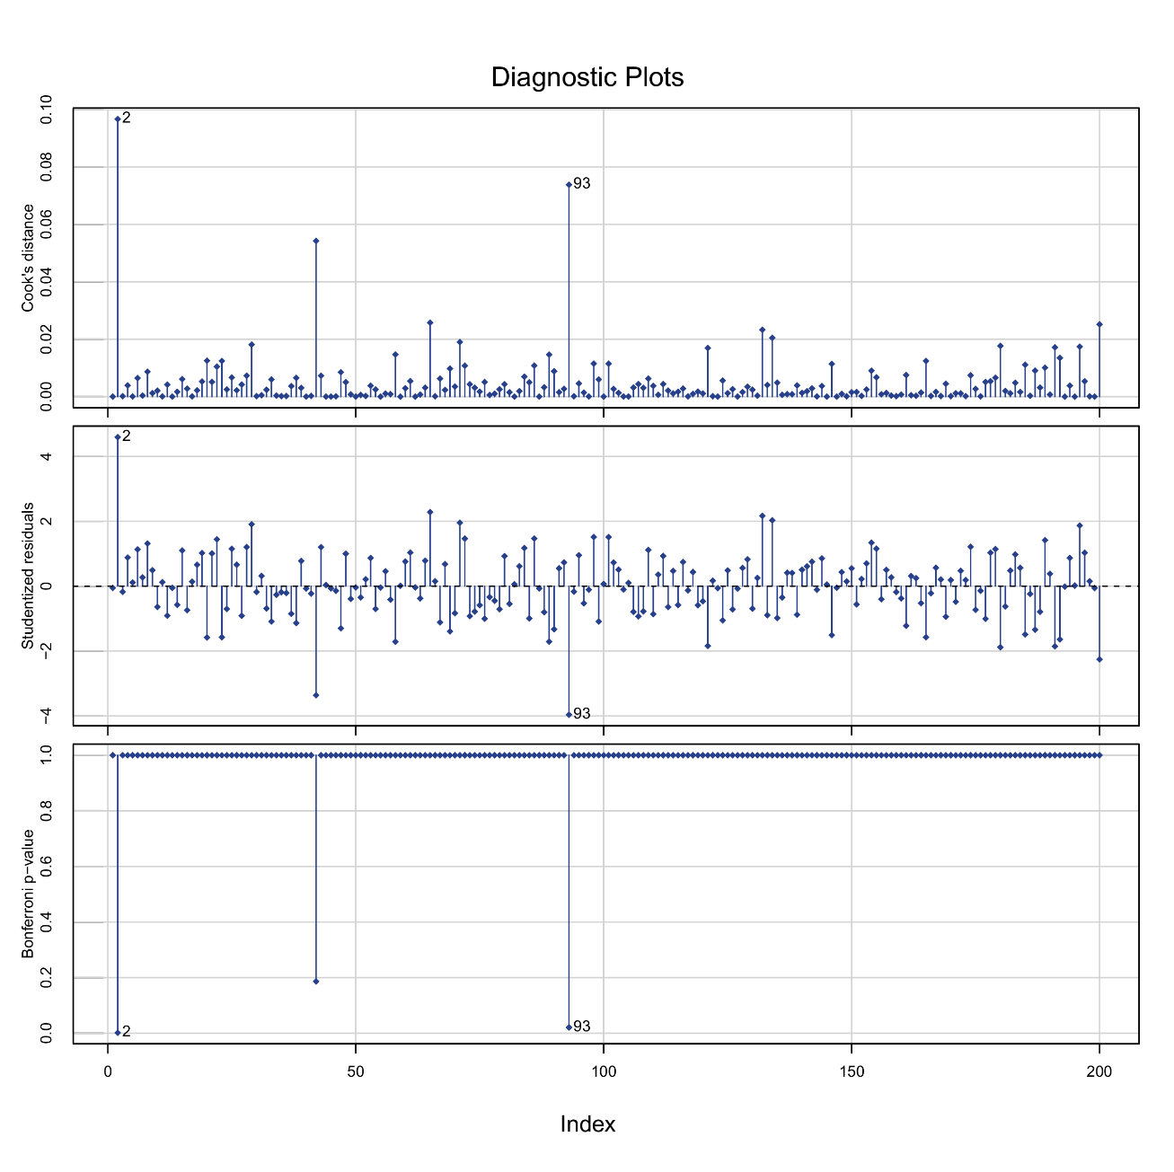
Influence measures
Influence measures of
lm(formula = y ~ g, data = randomdata) :
dfb.1_ dfb.gB dffit cov.r cook.d hat inf
1 -5.51e-03 0.003900 -0.00551 1.020 1.53e-05 0.01
2 4.61e-01 -0.326301 0.46146 0.833 9.67e-02 0.01 *
3 -1.76e-02 0.012435 -0.01759 1.020 1.55e-04 0.01
4 8.85e-02 -0.062592 0.08852 1.012 3.92e-03 0.01
5 1.13e-02 -0.008004 0.01132 1.020 6.44e-05 0.01
6 1.14e-01 -0.080441 0.11376 1.007 6.46e-03 0.01
7 2.71e-02 -0.019178 0.02712 1.020 3.70e-04 0.01
8 1.32e-01 -0.093386 0.13207 1.003 8.69e-03 0.01
9 4.94e-02 -0.034897 0.04935 1.018 1.22e-03 0.01
10 -6.43e-02 0.045480 -0.06432 1.016 2.07e-03 0.01
11 1.23e-02 -0.008713 0.01232 1.020 7.63e-05 0.01
12 -9.14e-02 0.064636 -0.09141 1.012 4.18e-03 0.01
13 -5.23e-03 0.003696 -0.00523 1.020 1.37e-05 0.01
...

Slide 39

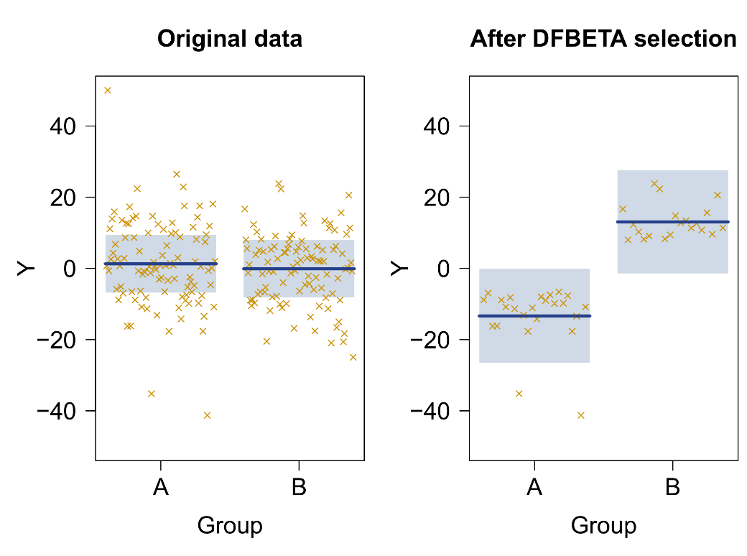
DFBETAS
Let us say I wanted my experiment to show that the mean of B was larger than the mean of A:
influence.measures(model)$infmat[,2]>0.05
cherrypick <- influence.measures(model)$infmat[,2]>0.05
model2 <- lm(y ~ g, data=randomdata[cherrypick,])
summary(model2)
> Coefficients:
> Estimate Std. Error t value Pr(>|t|)
> (Intercept) -13.342 1.422 -9.382 7.28e-12 ***
> gB 26.402 2.109 12.517 9.21e-16 ***
> ---
> Signif. codes: 0 ‘***’ 0.001 ‘**’ 0.01 ‘*’ 0.05 ‘.’ 0.1 ‘ ’ 1
>
> Residual standard error: 6.967 on 42 degrees of freedom
> Multiple R-squared: 0.7886, Adjusted R-squared: 0.7836
> F-statistic: 156.7 on 1 and 42 DF, p-value: 9.209e-16

Slide 40
Solutions for influential cases
A number of solutions can be considered for dealing with influential cases. The most important rule, however, is to always compare! Delete the influential cases and refit your model. Is the impact on inferential tests dramatic? If not, keep all data in your final model. If yes, consider an alternative strategy:
Apply a rank transformation to variables with unusually large values
Switch to robust regression models:
Least absolute deviation (LAD) regression
Iteratively reweighted least squares (IRLS) robust regression
Least median squares (LMS) regression, and its generalization quantile regression
For clusters of outliers or zero-inflated data, switch to mixture regression or zero-inflated models
Simply delete the influential observations altogether
Deletion should generally be the least preferred course of action. Unless a value is objectively erroneous (e.g., impossible RTs, equipment failures), the data point should be a valid observation.

Slide 41
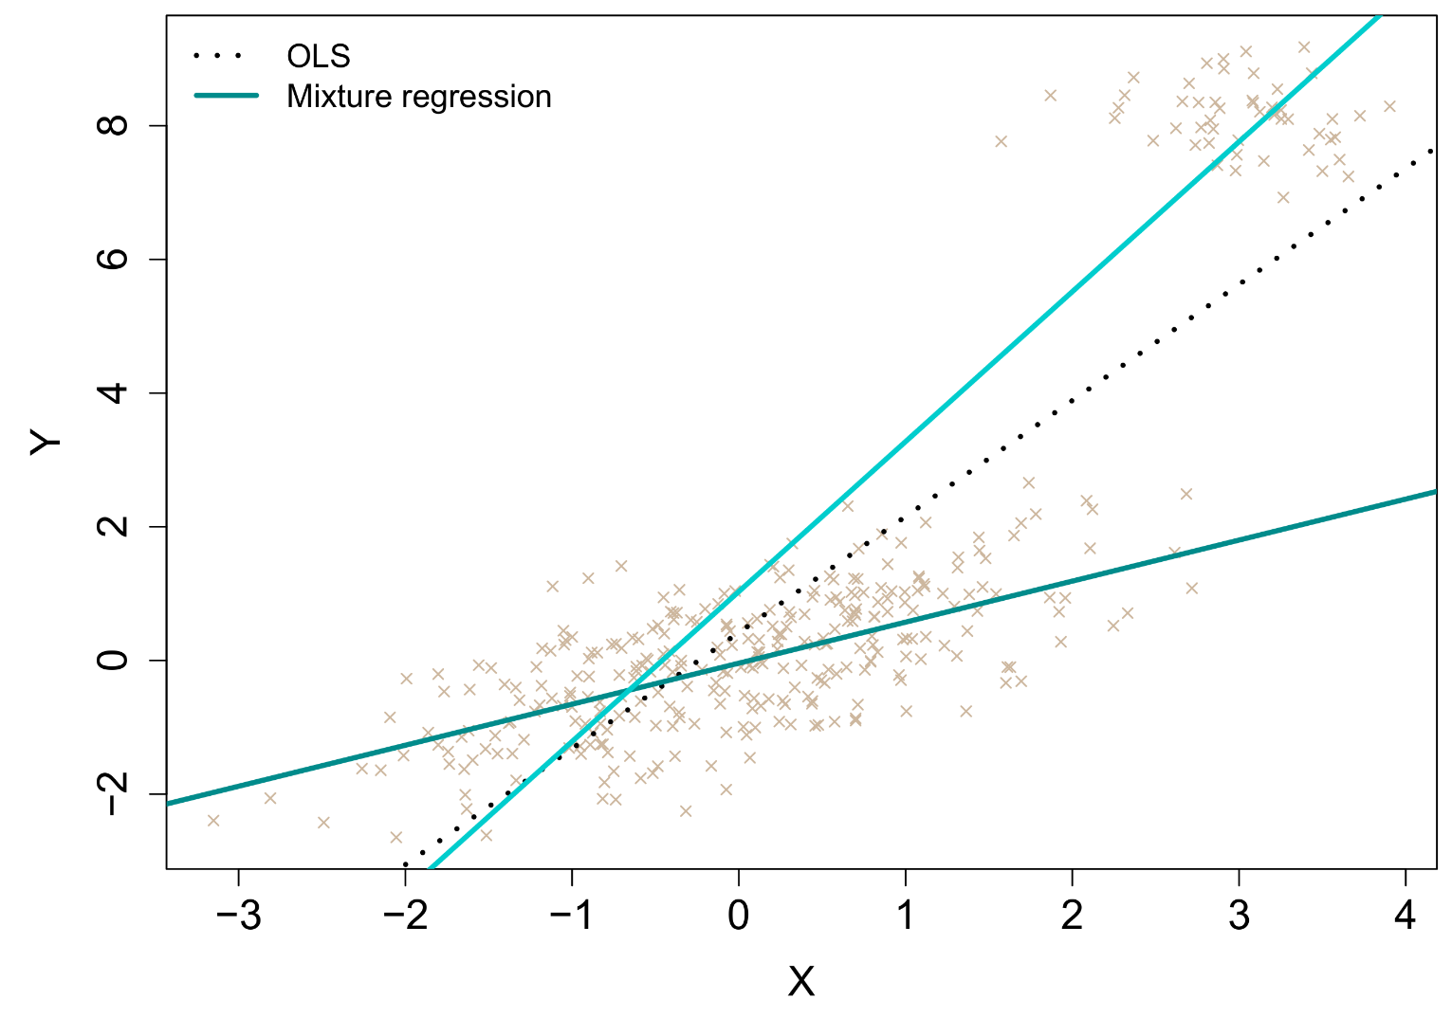
Clustered outliers & mixture regression
Mixture regression can be useful when outliers are clustered (for unknown reasons).
The model estimates the optimal number of clusters and then fits a separate regression in each cluster.
In the example, the OLS model would otherwise be strongly biased by the outlying cluster.
In R, the package flexmix can perform this type of analysis.

Slide 42

Outliers and influential cases

Slide 43
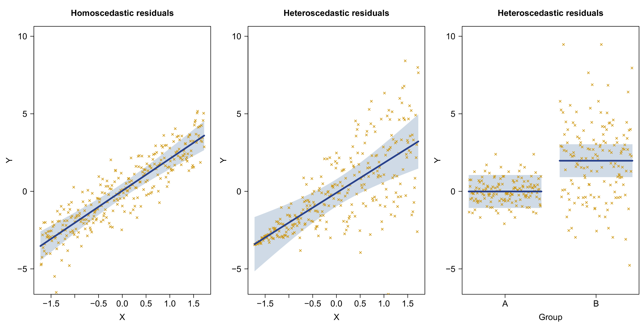
(Co)variance assumptions in regression

Slide 44
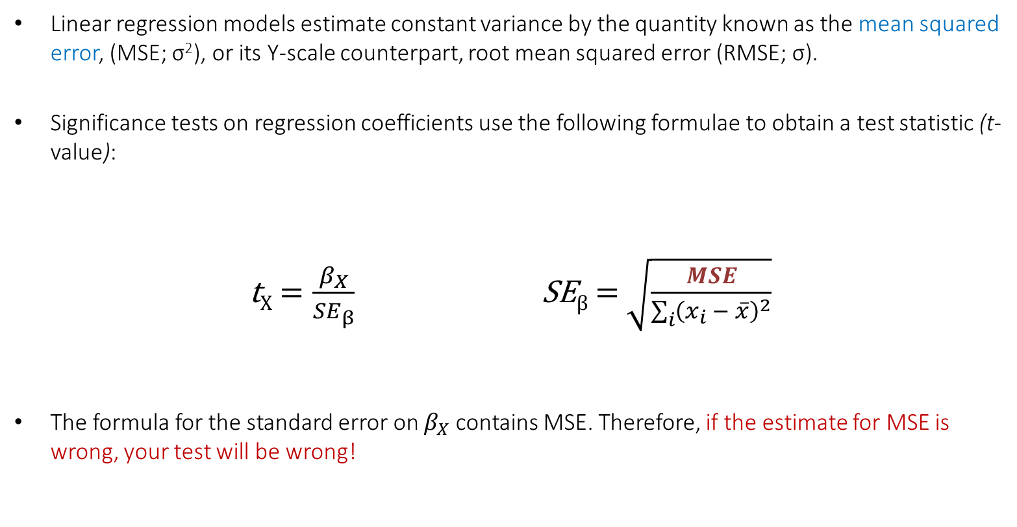
(Co)variance assumptions in regression
Linear regression models estimate constant variance by the quantity known as the mean squared error, (MSE; σ²), or its Y-scale counterpart, root mean squared error (RMSE; σ).
Significance tests on regression coefficients use the following formulae to obtain a test statistic (t-value):
t_{X} $=\frac{β_{X}}{{SE}_{β}}$ SE_{β} = $\sqrt{\frac{MSE}{\sum_{i}{{\left(x_{i} − \overline{x}\right)}^{2}}}}$
The formula for the standard error on $β_{X}$contains MSE. Therefore, if the estimate for MSE is wrong, your test will be wrong!

Slide 45
The two-group case
In R, we can generate the data from the previous plots as follows:
set.seed(1606)
x <- scale(-150:150)
g1 <- sample(rep(0:1,times=c(150,151)))
g2 <- ifelse(g1==0,"A","B")
y <- 2*x+rnorm(301)
y2 <- 2*x+rnorm(301,0,seq(0,3,length.out=301))
y3 <- 2*g1+ifelse(g1==0,rnorm(150,0,0.8),rnorm(151,0,3))
data <- data.frame(y,y2,y3,x,g1,g2)
For the two-group example, there are two equivalent ways of testing the group difference:
t.test(y3~g2, data=data, var.equal=TRUE)
model <- lm(y3~g2, data=data)
summary(model)

Slide 46
The two-group case
Output is identical:
Although the t.test function is more intuitive, the explicit lm approach will often be more useful for checking and testing assumptions. For example, the earlier plot showing heteroscedasticity can be generated with the visreg package:
library(visreg)
visreg(model,xvar="g2")
Two Sample t-test
data: y3 by g2
t = 9.343, df = 299, p-value < 2.2e-16
alternative hypothesis: true difference in means is not equal to 0
95 percent confidence interval:
-2.400674 -1.565316
sample estimates:
mean in group A mean in group B
-0.007615055 1.975379881
Coefficients:
Estimate Std. Error t value Pr(>|t|)
(Intercept) -0.007615 0.150328 -0.051 0.96
g2B 1.982995 0.212243 9.343 <2e-16 ***
---
Signif. codes: 0 ‘***’ 0.001 ‘**’ 0.01 ‘*’ 0.05 ‘.’ 0.1 ‘ ’ 1
Residual standard error: 1.841 on 299 degrees of freedom
Multiple R-squared: 0.226, Adjusted R-squared: 0.2234
F-statistic: 87.29 on 1 and 299 DF, p-value: < 2.2e-16

Slide 47
The two-group case
The plot already suggested unequal variances. For the t-test, we can formally test equality of variances with a so-called F-ratio test, or its generalization to more than 2 groups, Levene's test. In R, we proceed with the car package:
library(car)
leveneTest(model,center=mean)
> Levene's Test for Homogeneity of Variance (center = mean)
> Df F value Pr(>F)
> group 1 100.05 < 2.2e-16 ***
> 299
> ---
> Signif. codes: 0 ‘***’ 0.001 ‘**’ 0.01 ‘*’ 0.05 ‘.’ 0.1 ‘ ’ 1
Highly significant, so our parameter tests may be severely biased. For the t-test, a special correction exists for this scenario called the Welch t-test:
t.test(y3~g2, data=data, var.equal=FALSE)
Welch Two Sample t-test
data: y3 by g2
t = 9.3685, df = 180.1, p-value < 2.2e-16

Slide 48
General regression case
Levene's test generalizes to the residuals of any multiple regression model. Several such tests are available: Breusch-Pagan (a.k.a., score test), Brown-Forsythe, Goldfeld-Quandt, Harrison-McCabe, and White tests. The BF-test is preferred due to not requiring normality of the residuals (Kutner et al., 2005). In R, these tests are scattered across different packages:
library(lmtest)
bptest(y3~g2, data=data, studentize=FALSE) #identical to ncvTest
library(car)
ncvTest(model)
library(lawstat)
levene.test(data$y3,data$g2,location="median")
> Breusch-Pagan test
>
> data: y3 ~ g2
> BP = 99.906, df = 1, p-value < 2.2e-16
> Non-constant Variance Score Test
> Variance formula: ~ fitted.values
> Chisquare = 99.90563, Df = 1, p = < 2.22e-16
> Modified robust Brown-Forsythe Levene-type
> test based on the absolute deviations from the
> median
>
> data: temp$y
> Test Statistic = 163.14, p-value < 2.2e-16

Slide 49
Brown-Forsythe test
Be cautioned that there are two distinct tests proposed by Brown and Forsythe, (a) one to test equality of variances among k independent groups, and (b) one to test mean differences among k independent groups.
The latter is a robust alternative to the F-test like the Welch test, and sometimes called the F* test. It is implemented in package onewaytests as bf.test. However, it should not be confused with the Brown-Forsythe test for equality of variances!
To add to the confusion, the BF-test for equality of variances is typically treated as a special case of Levene's test, using group medians rather than means in constructing its test statistic. In car::leveneTest and lawstat::levene.test, medians are in fact the default!
Across R, multiple packages have functions named levene.test, including car as a now-defunct alternative to leveneTest. For caution, it can sometimes be a good idea to invoke the correct package when calling the desired function, e.g.:
lawstat::levene.test(data$y3,data$g2,location="median")

Slide 50
Solutions to heteroscedasticity
There is no Welch fix for heteroscedasticity in the general regression case. The traditional solution is to re-weight observations by their variance and re-fit the model. This is known as weighted least squares regression. Variance weights can be calculated manually in several ways (see Kutner et al., 2005; pp. 425–429), although inferences on weighted models are technically invalid without further adjustments.
Alternatively, robust standard errors are available due to White (1980) and Huber.
library(lmtest)
library(car)
model <- lm(y3~g2, data=data)
Anova(model, white.adjust=TRUE)
hccm(model,type="hc0")
coeftest(model,vcov=hccm,type="hc0")
The last example illustrates a so-called generalized least squares (GLS) estimator for standard errors. This estimator allows a fully empirical variance-covariance structure for the residuals. While this estimator would normally be ideal, it requires large sample sizes to produce reliable and unbiased estimates.
t test of coefficients:
Estimate Std. Error t value Pr(>|t|)
(Intercept) -0.0076151 0.0640122 -0.1190 0.9054
g2B 1.9829949 0.2109633 9.3997 <2e-16 ***
---
Signif. codes: 0 ‘***’ 0.001 ‘**’ 0.01 ‘*’ 0.05 ‘.’ 0.1 ‘ ’ 1

Slide 51

More cautions with heteroscedasticity
The preceding strategies might work if heteroscedasticity follows a simple pattern (e.g., strictly increasing variance with Y-values). If it does not, or heteroscedasticity is due to some other problem (e.g., outliers), then both the mean/parameter estimates and their SEs may be biased!
In that case, replacing only the SEs by robust estimates could make the resulting model (and inferential tests) more incorrect than the original model. Additional diagnostics should therefore be conducted to identify the likely source of the variance problem!
As a rule, one should never blindly run diagnostic tests! Plotting is essential to understand why a model may be deficient.
Meanwhile, note that the preceding corrections do not fall into the domain of non-parametric statistics. Non-parametric statistics cannot correct for heteroscedasticity! Like multicollinearity, correcting heteroscedasticity requires the introduction of more parametric assumptions. Moreover, non-parametric tests themselves assume homoscedasticity.

Slide 52
MYTH II
Non-parametric tests can correct heteroscedasticity

Slide 53
Covariance assumptions in repeated measures data
In repeated measures models (e.g., rm-ANOVA and MANOVA), additional assumptions are made for the covariance matrix of repeated measures. For rm-ANOVA, one assumes a spherical structure, which (approximately) constrains variances to be equal, and covariances to be equal:
 | T1 | T2 | T3
T1 | σ₁² | σ₁₂ | σ₁₃
T2 | σ₁₂ | σ₂² | σ₂₃
T3 | σ₁₃ | σ₂₃ | σ₃²
Obs. | Subject | T1 | T2 | T3
1 | AH | 60 | 40 | 50
2 | LL | 1 | 10 | 25
3 | KW | 50 | 15 | 11
4 | RS | 60 | 60 | 60
5 | RP | 50 | 36 | 25
6 | AS | 17 | 6 | 18
7 | AA | 36 | 3 | 8
8 | LN | 12 | 24 | 15
9 | RM | 11 | 5 | 13
10 | CD | 9 | 45 | 15
11 | CC | 25 | 50 | 18
12 | AZ | 20 | 14 | 25
σ² | σ₁ | σ₁
σ₁ | σ² | σ₁
σ₁ | σ₁ | σ²
=
Covariance matrix of the repeated measures within subjects
Sphericity

Slide 54
Covariance assumptions in repeated measures data
The sphericity assumption is commonly tested by Mauchly's test of sphericity, which is reported by default in SPSS and Statistica, and can be obtained in R using the Anova function of the car library, e.g.:
within.design <- data.frame(Time=as.factor(c("T1","T2","T3")))
model <- lm(cbind(T1,T2,T3)~1,data=mydata)
library(car)
result <- Anova(model,type=2,test="Wilks",idesign=~Throw,idata=within.design)
result
First we create a matrix that specifies the factorial within-design, consisting of leveled factors that encode combinations of conditions. These should be in the same order as the condition columns in the data set.
Next, we fit a multivariate regression model and run Anova on it, specifying the within-design with a special formula, connected to the design matrix defined earlier.
The main output yields the repeated measures MANOVA results. This model does not make the assumption of sphericity, but assumes an unstructured covariance matrix for the repeated measures. We can get the rm-ANOVA results and Mauchly's test of sphericity as follows:
summary(output)

Slide 55
Covariance assumptions in repeated measures data
There is a dramatic difference in degrees of freedom between the two methods.
This is because the models differ in how many extra parameters they require to be estimated. For rm-ANOVA, the number is always 2 (equal variances and equal covariances). For rm-MANOVA, the number increases with the number of repeated measures.
When sphericity holds, rm-ANOVA has much more power than rm-MANOVA.
Here, Mauchly's test is not significant, so we would proceed with the “uncorrected” tests.
Type III Repeated Measures MANOVA Tests: Wilks test statistic
Df test stat approx F num Df den Df Pr(>F)
(Intercept) 1 0.29845 44.662 1 19 2.171e-06 ***
Time 1 0.97879 0.195 2 18 0.8245
---
Signif. codes: 0 ‘***’ 0.001 ‘**’ 0.01 ‘*’ 0.05 ‘.’ 0.1 ‘ ’ 1
--------------------------------------------------------------
Univariate Type III Repeated-Measures ANOVA Assuming Sphericity
Sum Sq num Df Error SS den Df F value Pr(>F)
(Intercept) 32620 1 13877.0 19 44.6625 2.171e-06 ***
Time 79 2 6206.6 38 0.2432 0.7854
---
Signif. codes: 0 ‘***’ 0.001 ‘**’ 0.01 ‘*’ 0.05 ‘.’ 0.1 ‘ ’ 1
Mauchly Tests for Sphericity
Test statistic p-value
Time 0.90789 0.41908
Greenhouse-Geisser and Huynh-Feldt Corrections
for Departure from Sphericity
GG eps Pr(>F[GG])
Time 0.91566 0.7663
HF eps Pr(>F[HF])
Time 1.008416 0.7853512

Slide 56
Greenhouse-Geisser correction
When sphericity is rejected for the repeated measures covariance, one should never report an uncorrected rm-ANOVA, since that model will greatly overestimate the degrees of freedom for significance tests. Either we switch to the rm-MANOVA, or we apply a correction to the degrees of freedom.
The rm-MANOVA imposes no constraints on (co)variance parameters but for that reason (a) yields very conservative DFs for significance tests, (b) requires larger samples for reliability, and (c) tends to be overparametrized for many repeated measures data sets. It assumes a complete departure from sphericity which is rarely expected to be true.
A correction to the DFs for the rm-ANOVA is a more appealing option, since the correction will make an educated guess about the amount of departure from sphericity, and correct accordingly. The most popular such correction is the one due to Greenhouse and Geisser (1959). Like the Welch correction to the independent samples t-test, the GG-correction yields fractional degrees of freedom.
Note that, for within-subjects variables with only 2 levels, sphericity holds by definition! Mauchly’s test is redundant in this case. Repeated measures ANOVA and MANOVA will return identical effects tests for 2-level within-variables.

Slide 57
Sphericity and homoscedasticity
It's important to note that sphericity in rm-ANOVA and homoscedasticity in ordinary regression are independent assumptions. In fact, for an rm-ANOVA one should also check for homoscedasticity, separately from sphericity. This will not be necessary if the model does not contain any between-covariates, e.g.:
cbind(T1,T2,T3)~1
However, when it does, e.g.:
cbind(T1,T2,T3)~Age+Gender
Then the model is assuming not just sphericity on the within-side of measurement, but also that this spherical structure remains constant across levels of the between measurements (=homoscedasticity). This is routinely ignored by almost all researchers using rm-ANOVA!
The solution is unfortunately not very simple. Recall that residual diagnostics for a repeated measures model require the correct residuals to be extracted…

Slide 58
Sphericity and homoscedasticity
For the data below, the correct residuals should be constructed by creating two difference contrasts (since 3 within-levels), regressing them on gender, and returning two residuals columns. The covariance matrix of these residuals should remain constant between levels of gender:
Obs. | Subject | Gender | T1 | T2 | T3 | D_{(T1-T2)} | D_{(T1-T3)} | R_{(T1-T2)} | R_{(T1-T3)}
1 | AH | M | 60 | 40 | 50 | -20 | -10 | -8.17 | -1.83
2 | LL | M | 1 | 10 | 25 | 9 | 24 | 20.83 | 32.17
3 | KW | M | 50 | 15 | 11 | -35 | -39 | -23.17 | -30.83
4 | RS | M | 60 | 60 | 60 | 0 | 0 | 11.83 | 8.17
5 | RP | M | 50 | 36 | 25 | -14 | -25 | -2.17 | -16.83
6 | AS | M | 17 | 6 | 18 | -11 | 1 | 0.83 | 9.17
7 | AA | F | 36 | 3 | 8 | -33 | -28 | -33.67 | -24.83
8 | LN | F | 12 | 24 | 15 | -12 | 3 | -12.67 | 6.17
9 | RM | F | 11 | 5 | 13 | -6 | 2 | -6.67 | 5.17
10 | CD | F | 9 | 45 | 15 | 36 | 6 | 35.33 | 9.17
11 | CC | F | 25 | 50 | 18 | 25 | -7 | 24.33 | -3.83
12 | AZ | F | 20 | 14 | 25 | -6 | 5 | -6.67 | 8.17
σ² | σ₁ | σ₁
σ₁ | σ² | σ₁
σ₁ | σ₁ | σ²
Male
=
σ² | σ₁ | σ₁
σ₁ | σ² | σ₁
σ₁ | σ₁ | σ²
Female

Slide 59
Sphericity and homoscedasticity
An alternative would be to retain the initial difference contrasts, and testing explicitly between the two gender levels whether the covariance matrices of the difference contrasts are significantly different. This could be accomplished with Box’s M Test (Box, 1949). In R, this test is available in the package heplots:
library(heplots)
mlm <- lm(cbind(T2-T1,T3-T1)~Gender, data=repeated)
boxM(mlm)
> Box's M-test for Homogeneity of Covariance Matrices
>
> data: Y
> Chi-Sq (approx.) = 6.0711, df = 3, p-value = 0.1082
In reality, the utility of this test is very limited, since (a) it cannot be applied when the between-covariates are continuous, (b) it will almost certainly be significant for large within-designs, and (c) it is not clear what the correction should be in case of a violation.
For the time being, it seems that checking assumptions in rm-ANOVA will continue to focus overwhelmingly on sphericity and normality.

Slide 60
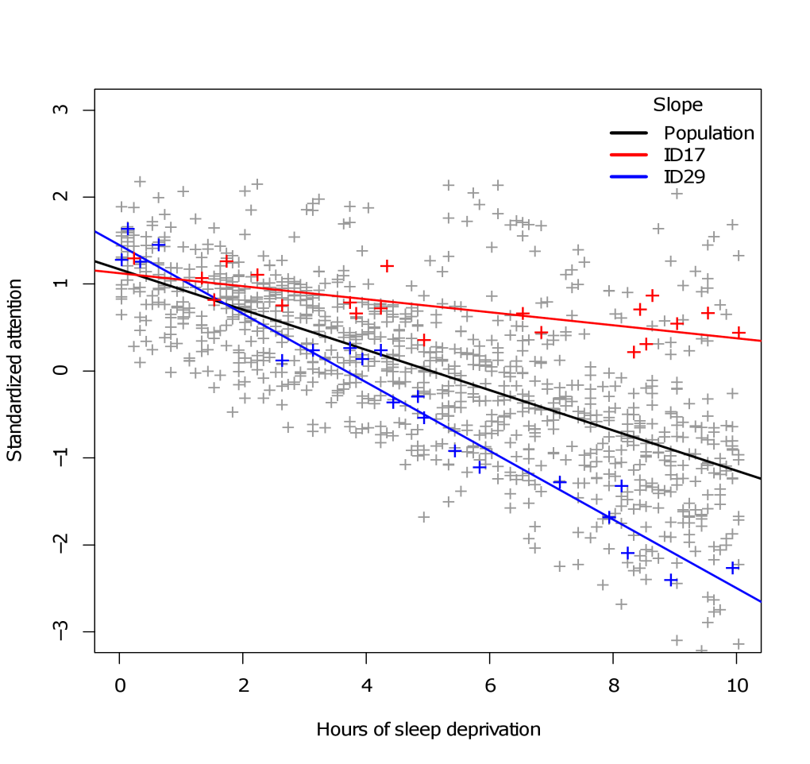
Heteroscedasticity in multilevel models
A final point of note for repeated measures data is the case of multilevel regression. It turns out that such models can naturally incorporate heteroscedasticity of repeated measures by the inclusion of so-called random slopes (see multilevel workshop).
Random slopes imply by definition that error variance is non-constant, and depends on predictor values. As such, random slopes are a natural form of weighted least squares regression.
However, general heteroscedasticity of the model, especially related to variables not repeatedly measured must still be diagnosed in the ordinary way. Statistical tests for the more general case have not been developed (or recommended) so far (Zuur et al., 2010).

Slide 61


Homoscedasticity
Heteroscedasticity

Slide 62
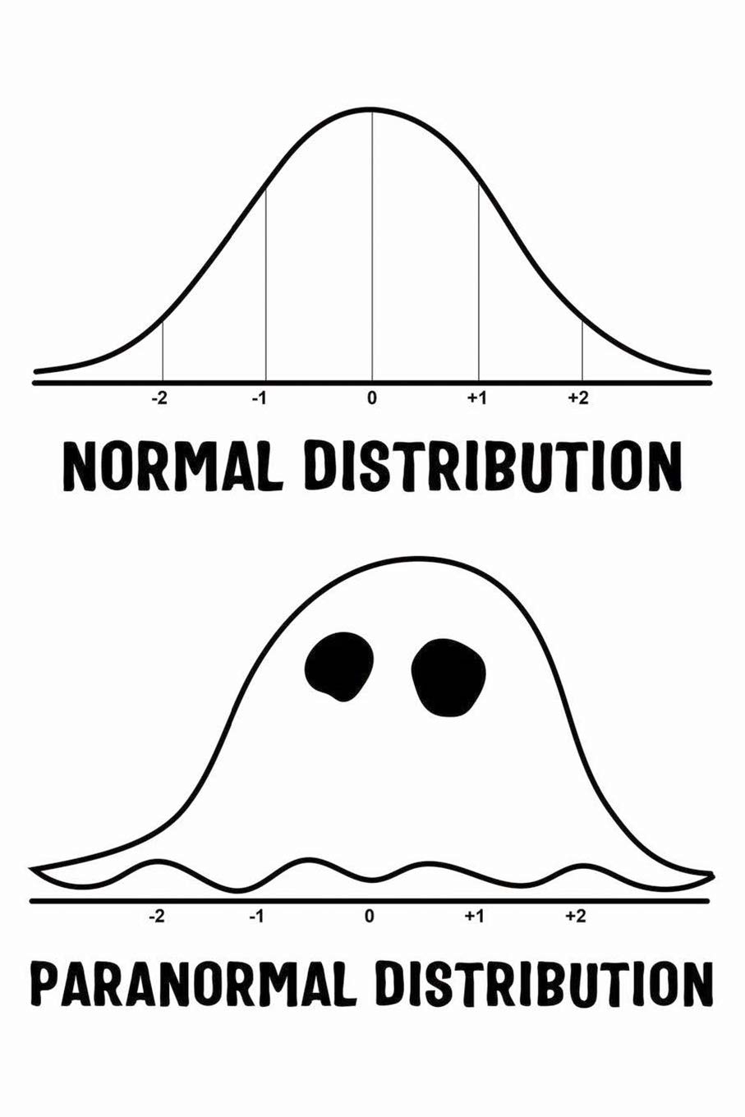
Finally, let's talk about normality…
Normal distribution
Paranormal distribution

Slide 63

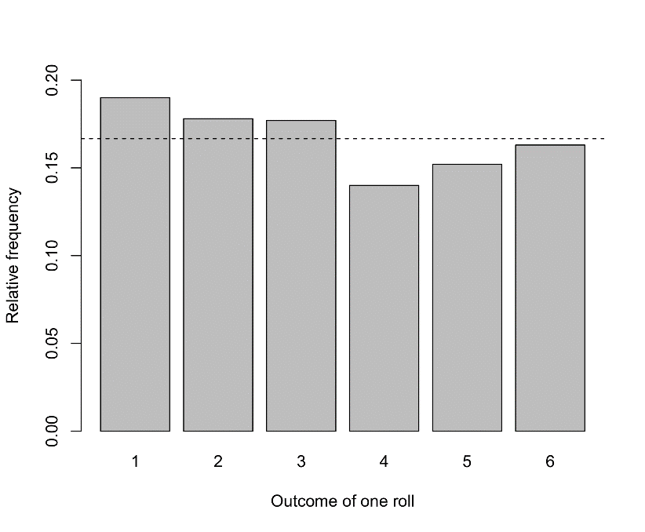
Let’s simulate a die roll
When we roll a die, there are six possible outcomes with equal probability. We can simulate a single roll with the sample function in R:
sample(1:6,size=1)
If we roll 1000 times, we expect each of the six numbers to come up roughly equally. Using the foreach package, we can write a loop to repeat the rolls and collect the outcomes in a vector:
library(foreach)
rolls <- foreach(i=1:1000,.combine="c") %do% {
sample(1:6,size=1)
}
barplot(table(rolls)/1000)
Indeed, our virtual die seems to be “fair”:

Slide 64
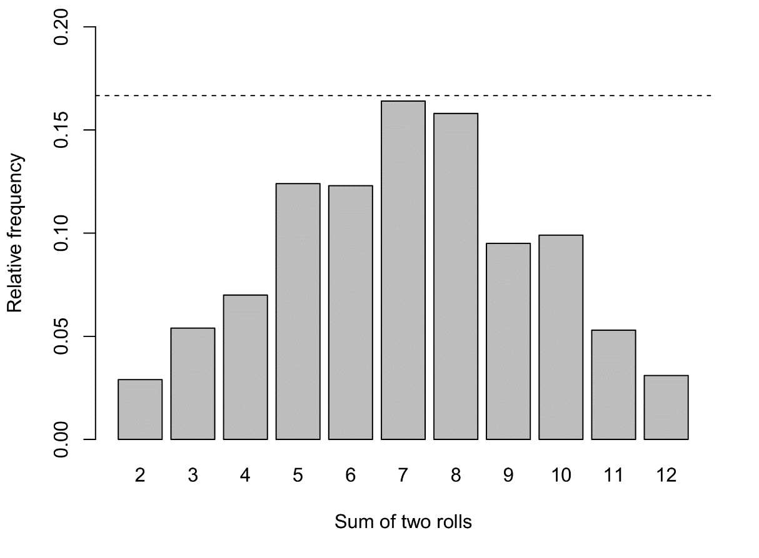
Let’s simulate two dice rolls
What happens now if, on each trial, we roll twice and sum the two numbers?
rolls <- foreach(i=1:1000,.combine="c") %do% { sample(1:6,size=1)+sample(1:6,size=1) }
barplot(table(rolls)/1000)
This shape seems somewhat familiar…

Slide 65
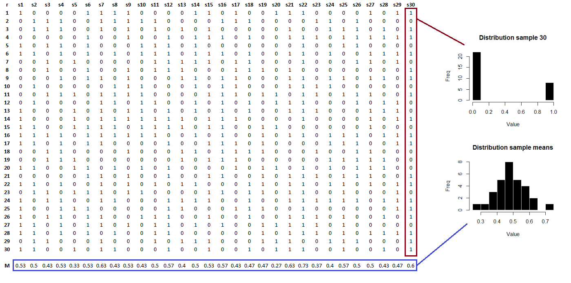
Central limit theorem
Mean of a vector of binary data = proportion of 1s

Slide 66
Central limit theorem
We never run a statistical test on raw sample data. Instead, the target of inference is some aggregated/derived quantity (i.e., a “statistic”). It is these quantities that should be normally distributed for the test to be valid, not the raw data!
It turns out that, thanks to the central limit theorem, aggregated quantities indeed tend to be normally distributed as the sample size increases, no matter the distribution of the raw data. In the previous example the raw data was even binary! With as little as 30 observations, the normal approximation for the means was quite good.
This result is one of the foundations of statistical inference, and clearly illustrates why normality is a vastly overrated assumption. Yet, researchers have been overwhelmingly obsessed with this assumption, at the expense of most others.

Slide 67
MYTH III
Normality of residuals is an important assumption in statistics

Slide 68

Central limit theorem

Slide 69
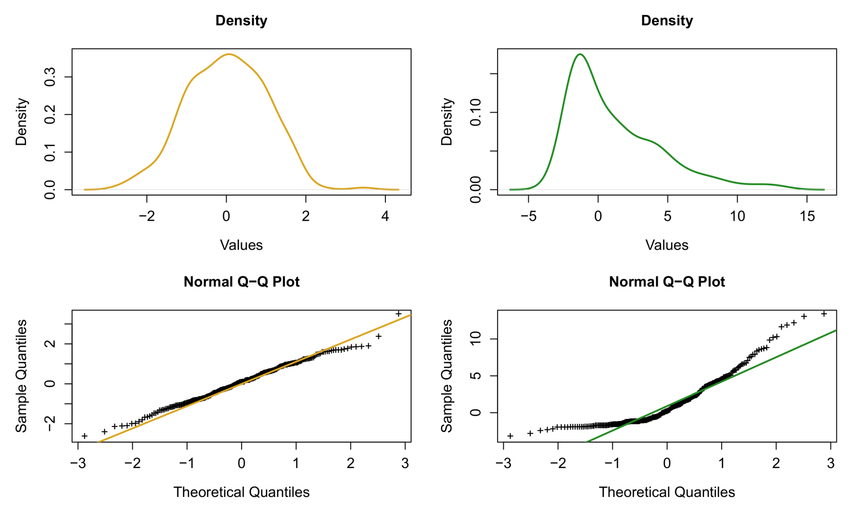
Checking normality the right way
When checking for normality of residuals, the recommended diagnostics are density plots and quantile-quantile plots (QQ-plots) of the model's residuals, e.g.:
QQ-plots will compare the residuals' observed quantiles against the quantiles expected under a normal distribution with the same mean and variance.
As a rule, the data points in a QQ-plot should be roughly on the diagonal line. Some deviations at the edges are typically observed, however.
In R, generating these plots is as simple as:
plot(density(residuals(model)))
qqnorm(residuals(model)) ; qqline(residuals(model))
Normal versus skewed

Slide 70
Checking normality the wrong way
A number of tests have been proposed to test the hypothesis that residuals are normally distributed (e.g. the Kolmogorov-Smirnov, Shapiro-Wilk). In R, they are part of the base functions, as ks.test and shapiro.test, respectively. For example, let's say we applied these tests to data from a log-normal distribution (which has a long right tail):
set.seed(1985)
skewed <- rlnorm(500,0,1)
ks.test(skewed,"pnorm")
shapiro.test(skewed)
ks.test(skewed,"plnorm")
The Kolmogorov-Smirnov test is even more general than the Shapiro-Wilk test, since data can be compared to any reference distribution.
As we shall see in a moment, these tests may not be entirely useful…
> One-sample Kolmogorov-Smirnov test
>
> data: skewed
> D = 0.53089, p-value < 2.2e-16
> alternative hypothesis: two-sided
> Shapiro-Wilk normality test
>
> data: skewed
> W = 0.71444, p-value < 2.2e-16
> One-sample Kolmogorov-Smirnov test
>
> data: skewed
> D = 0.025538, p-value = 0.9002
> alternative hypothesis: two-sided

Slide 71

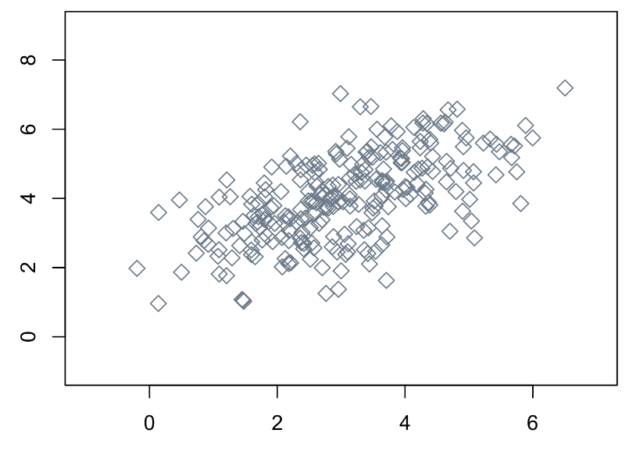
Multivariate normality
The normality assumption as discussed so far is a univariate assumption, since it applies to a single vector of data (e.g., one variable, residuals from a model). However, some models require that multiple variables are jointly normal, i.e., multivariate normal. This is an assumption of PCA, classical MANOVA, and linear discriminant analysis (LDA).
There is a surprisingly efficient shortcut for checking multivariate normality of a data set. That is, we can transform our multivariate data to a univariate vector of so-called Mahalanobis distances. This quantity measures the distance of an observation to the center of the data, weighted by the data's covariance matrix. In R, this transformation can be achieved simply with the mahalanobis function.
It turns out that, if the Mahalanobis distances are normally distributed, then the original data are multivariate normal! Hence we can simply check normality on these distances.
As well, these distances are commonly used to identify multivariate outliers (e.g., a boxplot on the Mahalanobis distances).

Slide 72
What to do with non-normal data?
Generally speaking, even when your residuals appear to be non-normal, the recommended action is to do nothing! Thanks to the central limit theorem, your inferential tests should be valid even for moderately small sample sizes.
If you insist on correcting non-normality, the appropriate correction will depend on what kind of non-normality you are dealing with. In the first place, you should check if the data does not contain outliers or influential cases, and if your model was correctly specified (see earlier).
If you suspect (or know certainly) that your residuals have a specific distribution (e.g., gamma, zero-inflated poisson, beta), then it may be wiser to switch to a generalized linear model (GLM), and fit your data to the correct distribution.
If it is unclear what the true underlying distribution of the residuals is, then many researchers apply log- or power-transformations, for example to dampen the impact of outlying values. However, such corrections may be better handled by robust regression methods. Moreover, log-transformations severely complicate the interpretation of regression coefficients and differences of means. Use these at your own caution…

Slide 73
2. Assumptions in parametric statistics
C. Problems with testing assumption

Slide 74
Hypothesis tests on assumptions
We have seen several statistical tests for regression assumptions. To many researchers, these tests hold obvious appeal. Unfortunately, their utility has been greatly overestimated:
Test | Assumption | Problems | Reference
F-ratio test | Heteroscedasticity | Collapses in small samples and for departures from normality | Rakotomalala, 2008
Levene's test | Heteroscedasticity | Assumes symmetry of data around the mean, low power | Delacre, Lakens, & Leys, 2017; Nordstokke & Zumbo, 2007
Brown-Forsythe test | Heteroscedasticity | Low power for small to moderate deviations from homoscedasticity | Glass and Hopkins, 1996
Mauchly's sphericity test | Sphericity | Collapses in small and large samples, and for departures of normality | Keselman, Rogan, Mendoza & Breen, 1980
Box's M test | Equality of covariance matrices | Requires multivariate normality, problematic in small and large samples | Manly, 2004; Warner, 2013
Kolmogorov-Smirnov test | Normality | Low power in small samples, conservative bias regardless of sample size | Oztuna, Elhan & Tuccar, 2006; Thode, 2002
Shapiro-Wilk test | Normality | Low power in small samples | Oztuna, Elhan & Tuccar, 2006

Slide 75

Hypothesis tests on assumptions
Most significance tests of assumptions turn out to be problematic in both small and large samples, and have low power for small to moderate assumption violations. Some tests depend themselves on distributional assumptions, such as normality of the test statistic, leading potentially to infinite regress of testing assumptions.
The result of the assumption test will directly influence the target analysis. For example, for the F-ratio test:
In small samples, we will often incorrectly accept homogeneity of variances, and proceed with an uncorrected t-test. Our uncorrected test will be too optimistic and thus inflate the Type I error rate.
In large samples, we will often incorrectly reject homogeneity of variances, and proceed with a Welch test. Our corrected test will be too conservative, and thus inflate the Type II error rate.*
Ghasemi and Zahediasl (2012) suggest that tests should supplement visual methods, rather than the other way around. A good argument in favor of visual methods is that the reader themself can verify the authors' result in the graph (if supplied). A p-value does not allow this.
Generally speaking, when corrections and robust alternatives are available, they should be applied by default without checking if the required violation is present or not (e.g., Welch t-test and Greenhouse-Geisser by default).
* Which may actually be preferred over inflating the Type I error rate

Slide 76
MYTH IV
Significance tests of assumptions are reliable

