Slide 1



Types of ANOVA
Ben Meuleman, Ph.D.
Swiss Center for Affective Sciences
Université de Genève

Slide 2
Contents
1. Regression parameters
2. ANOVA breakdown
3. Main effects and interactions

Slide 3
ANOVA terminology
The term ANOVA is traditionally applied to a comparison of means in K groups, using an F-test. Often, the groups reflect a factorial design of multiple (manipulated) factors, e.g., an A × B design. In this case, the ANOVA typically refers to the breakdown of mean differences in terms of a hierarchy of effects, e.g.:
A x B interaction
A main effect
B main effect
However, an ANOVA need not to be factorial, nor involve categorical variables. It could refer to any comparison between two nested regression models with an F-test. For example, in a multiple regression model with a mix of continuous and categorical predictor variables, an ANOVA breakdown refers to the list of F-tests for each effect.
The term nested means that the reduced model is a special case of the full model, e.g., Y~A+B+C versus Y~A+B. This is contrasted to non-nested models, e.g., Y~A+B versus Y~C+D.

Slide 4
Types of ANOVA
Like the factorial ANOVA, a multiple regression model may contain interaction effects between two or more variables. In that case, it is again customary to produce a hierarchical ANOVA breakdown, listing interactions and main effects.
Historically, it turns out that 4 different ANOVA methods have been proposed for producing this breakdown, referred to as Type I, Type II, Type III and Type IV sum-of-squares. These types were introduced by Statistical Analysis Software (SAS), and have been adopted by other packages and statistical literature.
Immediately, there are some oddities to note about these types:
Type I: Rarely useful but the default in base::anova in R.
Type III: The default in SPSS, Statistica and SAS, but sensitive to parametrization and widely misunderstood in interactional models.
Type IV: Rarely used. Identical to Type III but special handling of missing design cells. I will ignore it here.
These slides illustrate the difference between the first 3 types, and when you should use which.

Slide 5
1. Regression parameters

Slide 6
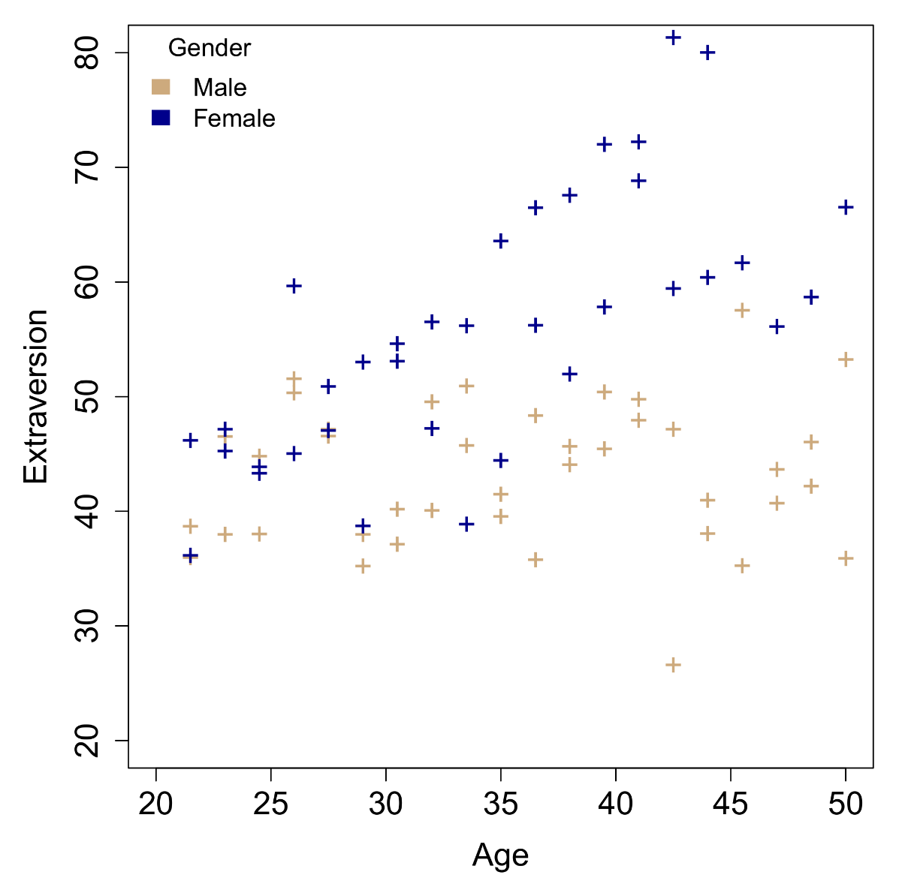
Example data
We consider a simple data problem where we model differences in neuroticism (Y) using Age and a grouping factor Gender. The raw data look as depicted in the scatter plot.
Some visual suggestion of an Age effect as well as a Gender difference.
Let us try to fit different regression models, starting from very simple and going to the most complex. For each model, we will interpret the resulting parameters.

Slide 7
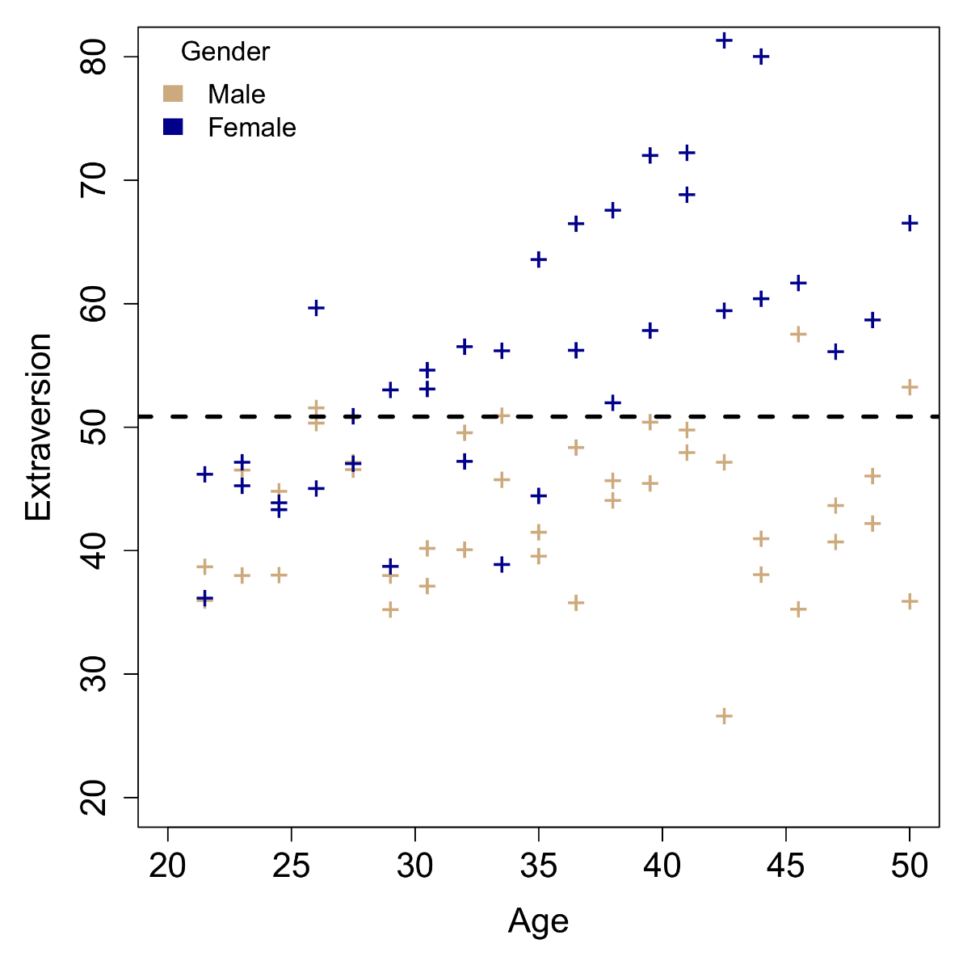
Intercept-only model
E(Extra) = β₀
With only an intercept, the coefficient reflects the grand/marginal mean of Y.

Slide 8
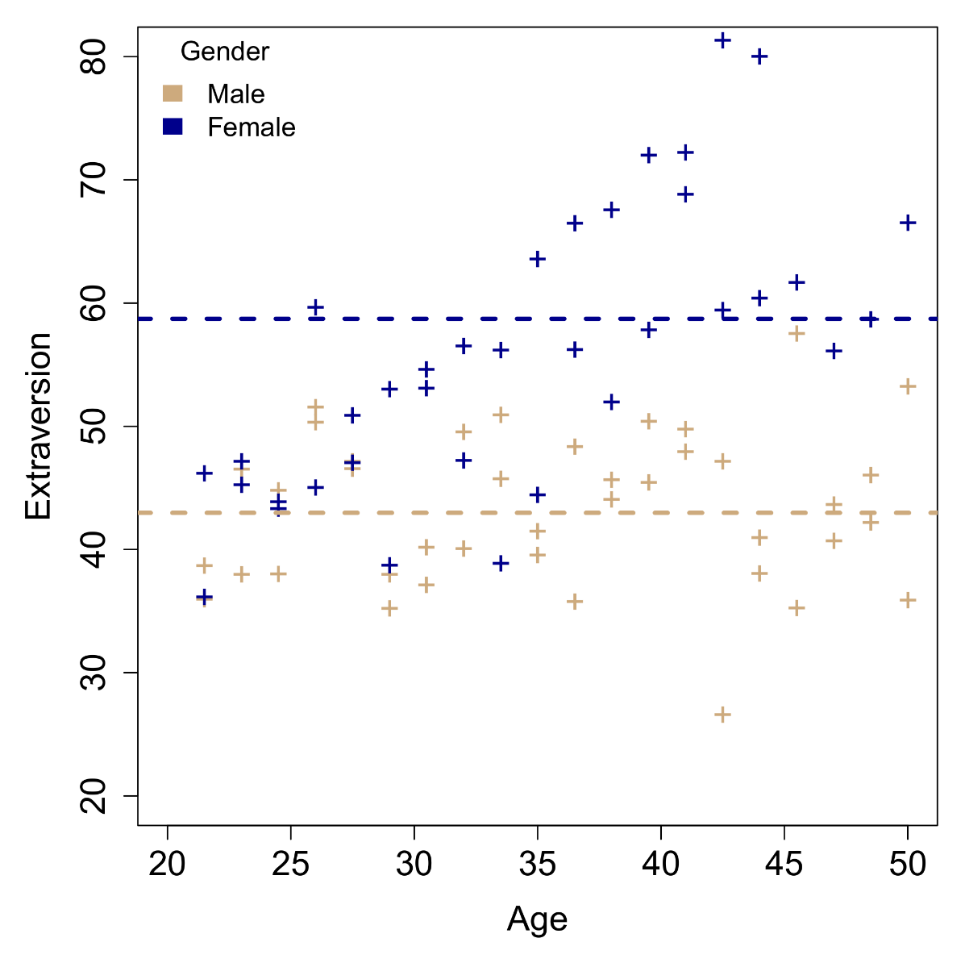
Gender main effect
E(Extra) = β₀ + β₁Gender_{M}
By adding the Gender main effect, we allow mean Extraversion to differ between males and females.
Here, the Gender factor is coded Female=0 and Male=0. Females are the so-called reference category or baseline. Thus:
β₀ = Mean extraversion for females
β₀+β₁ = Mean extraversion for males
The β₁ coefficient encodes the difference in mean extraversion between males and females.
Note that β₀ has changed interpretation with the introduction of gender! It is now a conditional mean.

Slide 9
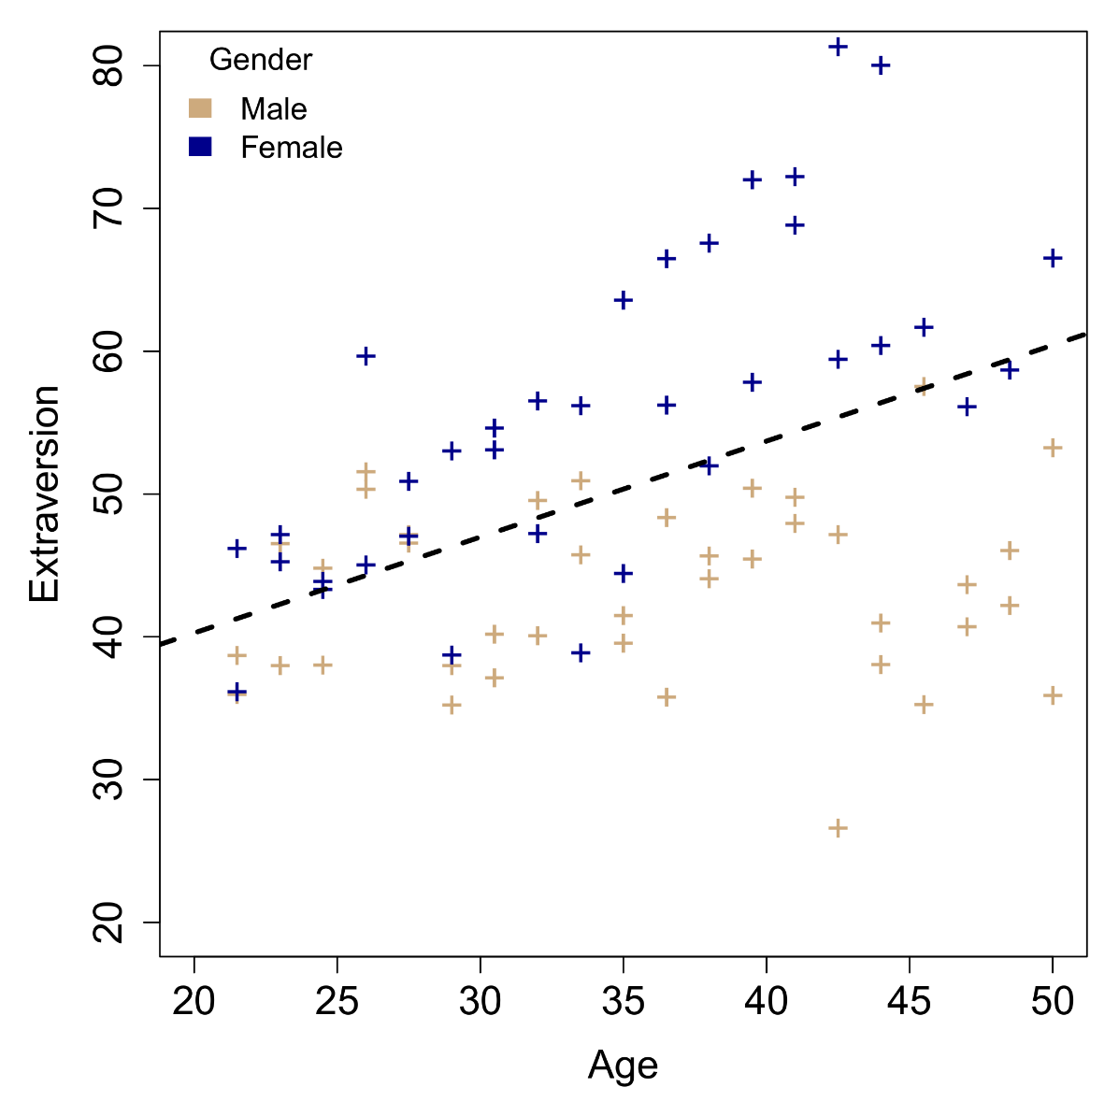
Age main effect
E(Extra) = β₀ + β₂Age
By adding the Age main effect, we allow mean Extraversion to change as a function of Age values.
β₀ = Mean extraversion when Age=0
β₂ = Change in mean extraversion when Age increases by 1 year.
Once again, the β₀ parameter has changed interpretation by the introduction of a main effect!
Here β₀ is non-sensical, since 0-aged do not exist. This is a reason why continuous predictors are sometimes centered on a more interesting 0 value, such as the mean (e.g., Age – mean(Age)).

Slide 10
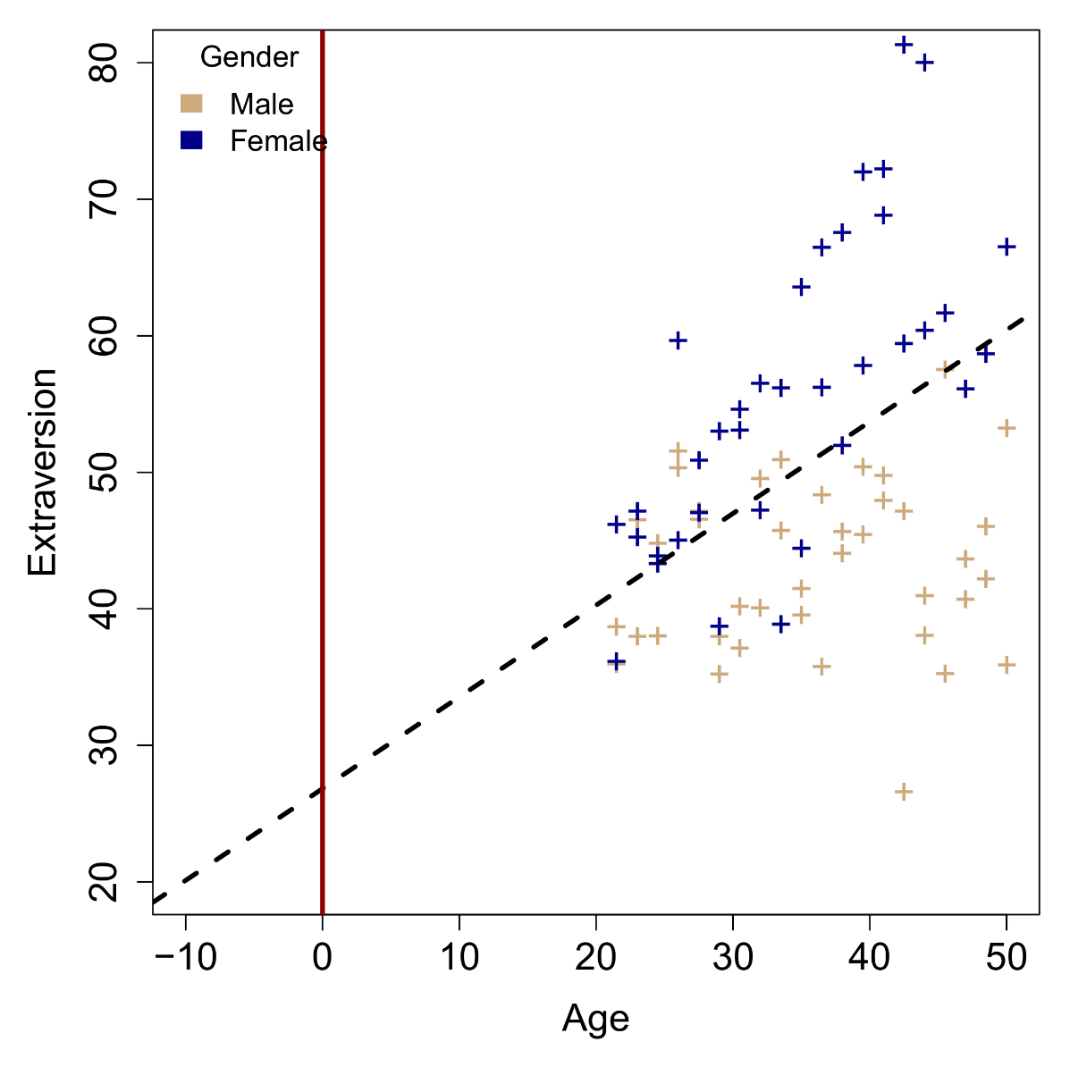
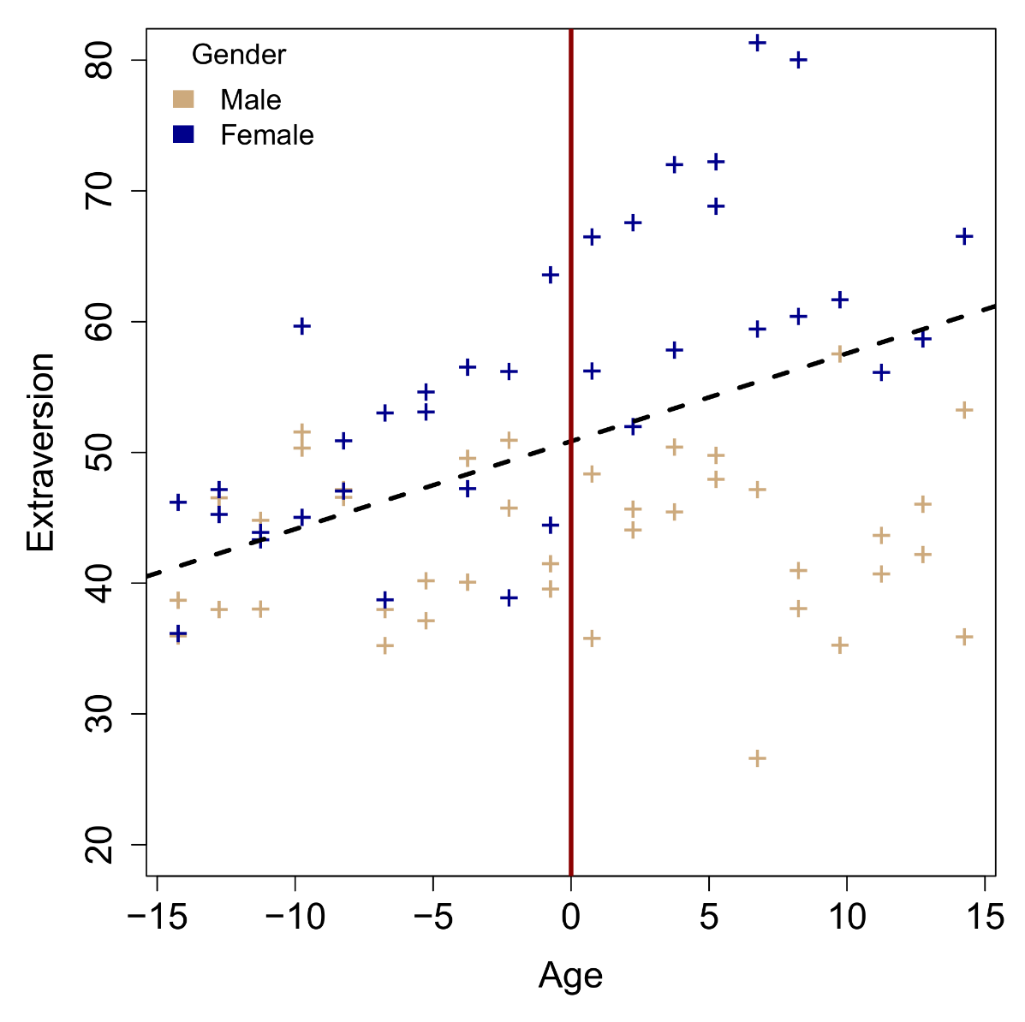
Centering age around its mean – No change in the slope!

Slide 11
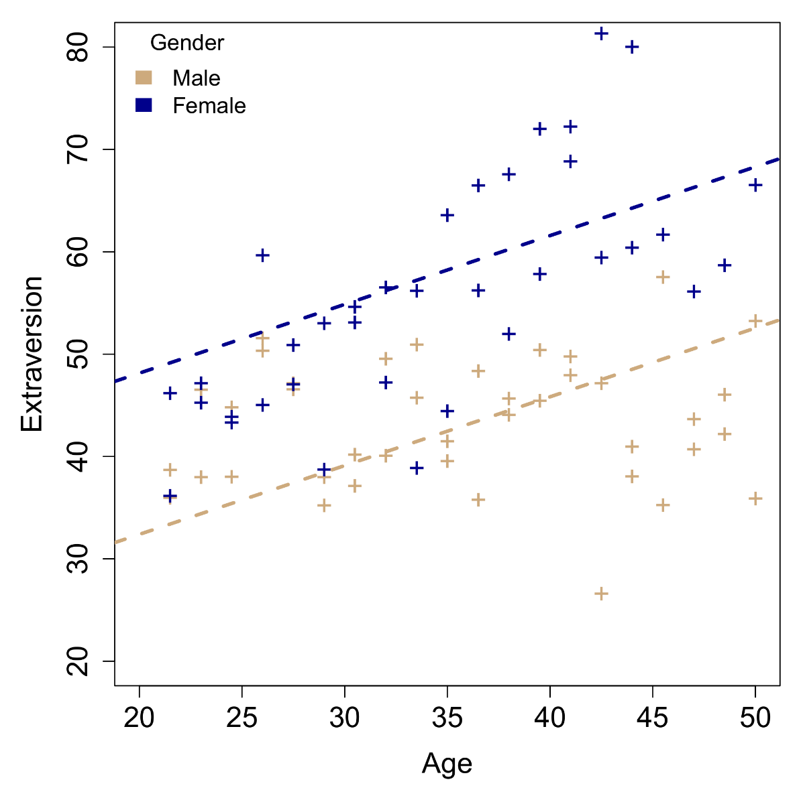
Gender and age main effects – Parallel slopes model
E(Extra) = β₀ + β₁Gender_{M} + β₂Age
Both main effects allow changes in mean Extraversion between genders and ages, but independently. This model is known as the parallel slopes model, with:
β₀ = Mean extraversion for females at Age=0
β₁ = Mean extraversion difference between males and females, when Age remains fixed.
β₂ = Age slope, when Gender remains fixed.
β₀+β₂ = Age model for females
(β₀+β₁)+β₂ = Age model for males
β₀ now has a doubly-conditioned interpretation (gender and age must be 0).
The two main effects are not strictly conditioned on the other being 0, as long as they remain fixed.

Slide 12
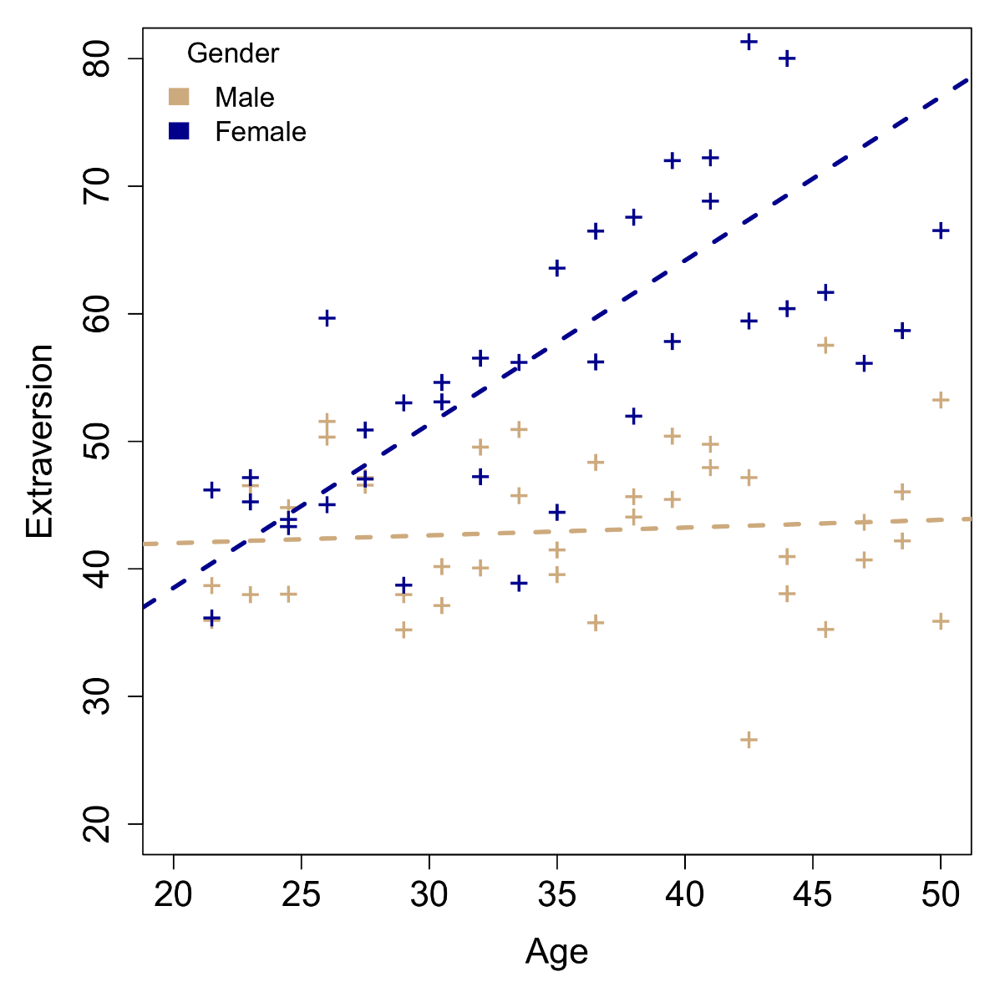
Gender and age interaction effect – Intersecting slopes model
E(Extra) = β₀ + β₁Gender_{M} + β₂Age + β₃(Gender_{M}×Age)
Genders are now allowed to have their own intercept and slope. This model is known as the intersecting slopes model, with:
β₀ = Mean extraversion for females at Age=0
β₁ = Mean extraversion difference between males and females, when Age=0.
β₂ = Age slope, when Gender=0=female.
β₃ = Mean extraversion difference between males and females, for a 1-year Age difference.
β₀+β₂ = Age model for females
(β₀+β₁)+(β₂+β₃) = Age model for males
This time, the so-called "main effects" parameters have a fully conditional interpretation, requiring the other to be 0!

Slide 13
Regression parameters
In the example, the meaning of each individual regression parameter can be derived by setting other variables to 0, so that their respective coefficients cancel out.
Lower-order parameters change interpretation with the addition of higher-order parameters!
The intercept starts as the unconditional grand mean of Y, but switches to a conditional mean for Age=0 or Gender=0 when main effects are added, and a conditional mean for Age=0 and Gender=0, when the interaction is added.
The main effects parameters for Age and Gender first reflect the marginal Age|Y and Gender|Y effects in the main effects model, but become conditional contrasts in the interaction model!
If we would change the meaning of "0" for a variable, we would have different tests, e.g., making Male=0 or centering Age such that the mean age becomes 0.
This parametrization has implications for ANOVA breakdowns…

Slide 14
2. ANOVA breakdown

Slide 15
ANOVA breakdowns
The following table shows how effects tests are constructed for each ANOVA type, in terms of the underlying model comparison ("1" refers to the intercept):
Effect | Model | Type I | Type II | Type III
Age | Reduced | 1 | 1+Gender | 1+Gender+Age×Gender
 | Full | 1+Age | 1+Age+Gender | 1+Age+Gender+Age×Gender
Gender | Reduced | 1+Gender | 1+Age | 1+Age+Age×Gender
 | Full | 1+Age+Gender | 1+Age+Gender | 1+Age+Gender+Age×Gender
Age × Gender | Reduced | 1+Age+Gender | 1+Age+Gender | 1+Age+Gender
 | Full | 1+Age+Gender+Age×Gender | 1+Age+Gender+Age×Gender | 1+Age+Gender+Age×Gender

Slide 16
Type I ANOVA
Type I ANOVA are sequential tests. The order of the effects therefore makes a difference.
The Age main effect is tested against the intercept-only model, while the Gender main effect is tested against the Age+Gender model.
Unless the researcher has the explicit intention of building a stepwise model, Type I ANOVA rarely ever makes sense. Nevertheless, it is the default type for base::anova in R!
For factorial designs, the highest-order interaction test will be identical to Type I and Type II ANOVA.

Slide 17
Type II ANOVA
In Type II ANOVA, higher-order effects are removed when testing lower-order effects.
The main effects are identical to those that would have been obtained under the parallel slopes model, 1+Age+Gender. This makes these tests genuine marginal main effects.
Type II ANOVA is the default for car::Anova for glm and glmer models.
Furthermore, Type II ANOVA is invariant against re-parametrization of predictors, e.g., the results will be identical whether Gender is coded as 0/1 or as -1/1, and whether Age is centered or not.
Once again, the highest-order interaction test is identical to Type I and Type III ANOVA.

Slide 18
Type III ANOVA
In Type III ANOVA, effects are tested purely according to the leave-one-effect out principle. The full model in each comparison is always the full-factorial model.
Main effects tests are direct tests on the main effects parameters of the intersecting slopes model. HOWEVER, we have seen earlier that these parameters no longer reflect main effects, but conditional contrasts, and depend on the parametrization of the predictors!
Therefore, the main effect of Age under Type III ANOVA is in fact a test of Age when Gender=0, while the main effect of Gender is a test of Gender differences at Age=0. This is typically not the test researchers are interested in.
Nevertheless, Type III is the default in SPSS, Statistica, SAS, for base::summary, car::Anova on lm and lmer models, and lmerTest:anova on lmer models. Are we being systematically misinformed…?

Slide 19
Type III ANOVA
While Type II ANOVA would normally make the most sense, Type III ANOVA has become the default for historical reasons, partly because it reflects directly the effects tests in the raw parameter output.
SPSS and Statistica play a trick on their users, by re-parametrizing the model for the ANOVA table. Rather than using dummy coding for factors (0/1), they use effect-coding (-1/1). For e.g. Female=-1 and Male=1, this makes 0 an average between the two levels, similar to mean-centering of continuous predictors.
E(Extra) = β₀ + β₁Gender_{M} + β₂Age + β₃(Gender_{M}×Age)
Under this parametrization, the Age main effect corresponds to the age slope averaged across gender levels, so once again a genuine marginal main effect. For the Gender main effect to have a similar interpretation, Age would have to be centered on its mean as well.

Slide 20
Conclusion
For the highest-order interaction, the ANOVA type makes no difference. All three will produce the identical test.
For lower-order effects, only Type II makes sense for producing a genuine marginal breakdown of factorial effects. Type III only works for this purpose under the right parametrization. As John Weiss notes one the help page of car::Anova:
All this being said, does it actually make sense to test main effects in the presence of interactions…?
Warning
Be careful of type-III tests: For a traditional multifactor ANOVA model with interactions, for example, these tests will normally only be sensible when using contrasts that, for different terms, are orthogonal in the row-basis of the model, such as those produced by contr.sum, contr.poly, or contr.helmert, but not by the default contr.treatment. In a model that contains factors, numeric covariates, and interactions, main-effect tests for factors will be for differences over the origin. In contrast (pun intended), type-II tests are invariant with respect to (full-rank) contrast coding. If you don't understand this issue, then you probably shouldn't use Anova for type-III tests

Slide 21
3. Main effects and interactions

Slide 22
Main effects and interactions
By definition, an interaction contradicts the notion of a main effect.
As the name implies, the intersecting slopes model forces that contrasts disappear and reverse, at the point of intersection.
Clearly there cannot be a consistent extraversion difference between males and females.
For this reason, it is not recommended theoretically to report main effects after a significant interaction has been established. Reporting a factorial ANOVA in a paper should therefore also proceed from the highest to the lowest order of effects!

Slide 23
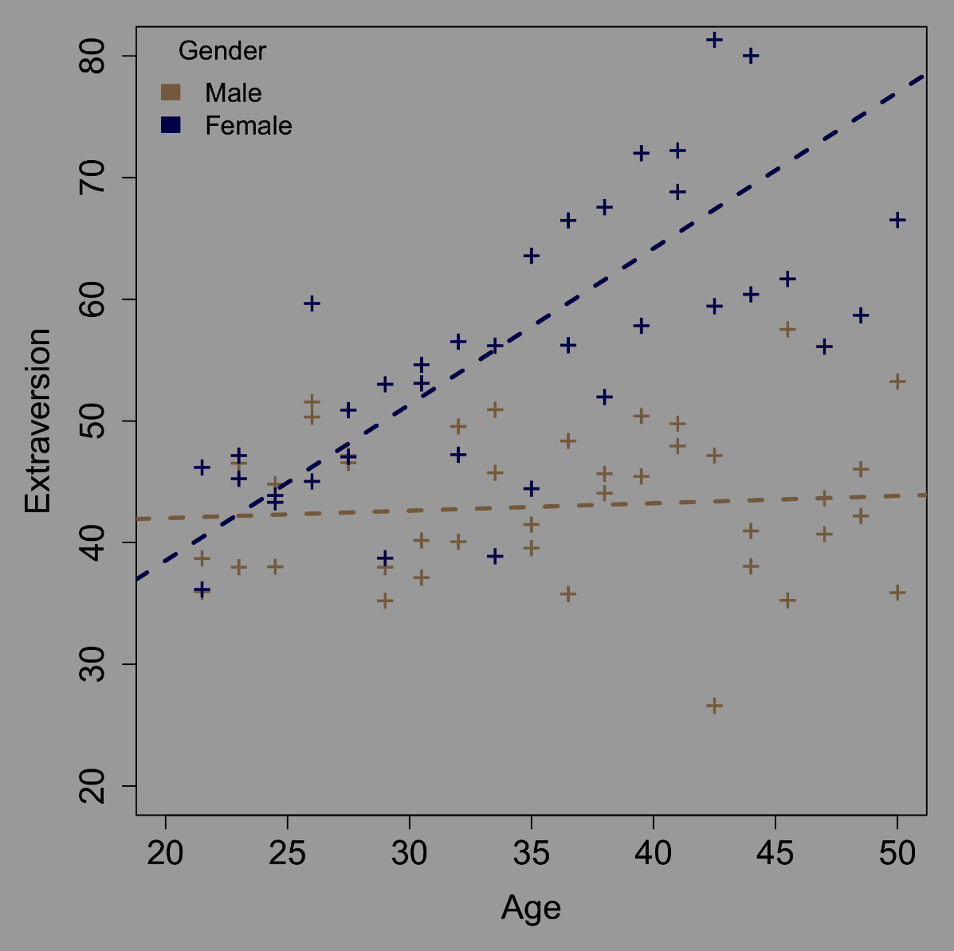
Main effects and interactions
What if we only had observed this part of the data space?
This time, while there is evidence of an interaction, we also have a main effect in the sense that the point of intersection for the two slopes does not occur in the observed data.
Sometimes, the point of intersection may not even be in the observable data! (e.g., at 0 age).
In these cases, it may make sense to interpret main effects in the presence of significant interactions. However, this must be supported by visual/descriptive evidence!

Slide 24
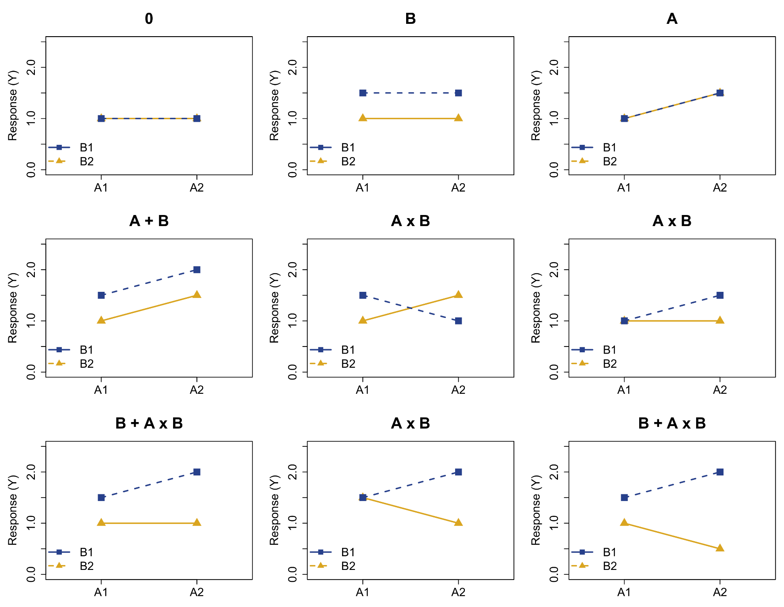
Types of interactions – 2×2 design

Slide 25
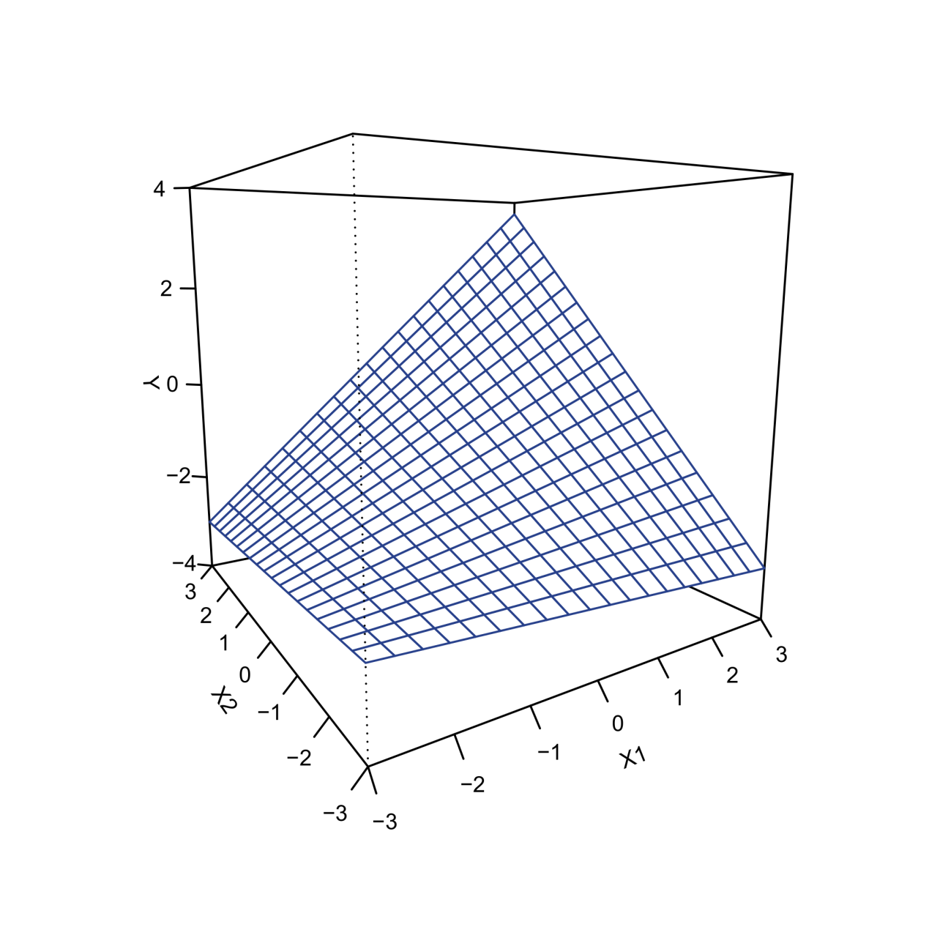
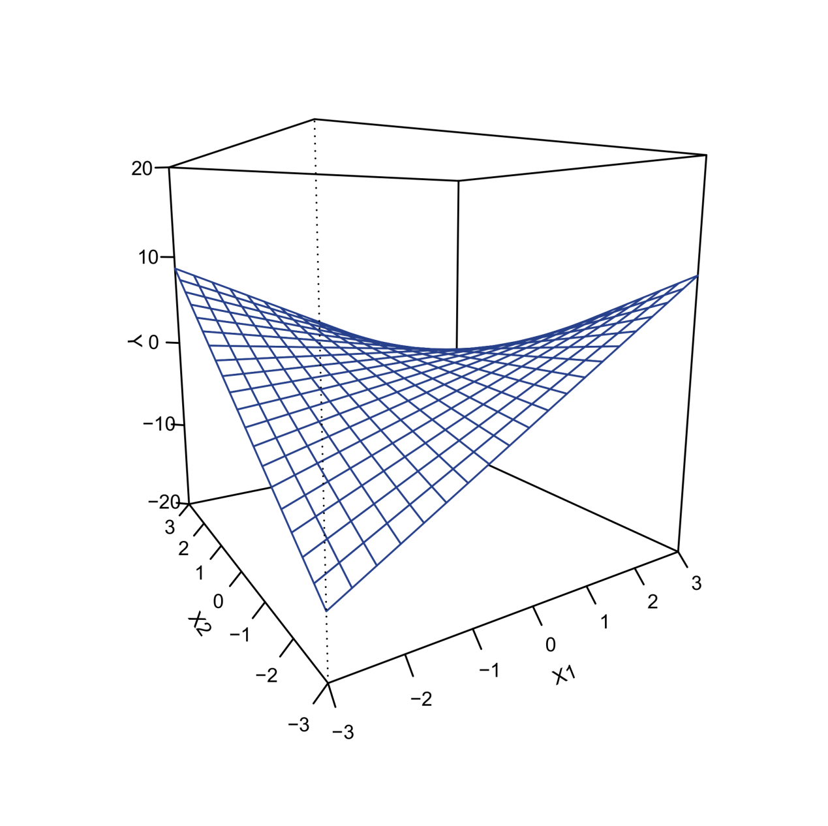
Types of interactions – Continuous predictors
Reinforcement interaction
Interference interaction

Slide 26
Thank you for your attention…!

