Slide 1



Introduction to Machine Learning
PART I
Ben Meuleman, Ph.D.
Swiss Center for Affective Sciences
Workshop on Machine Learning (University of Geneva)
April 22–23, 2024, Geneva

Slide 2
Workshop schedule and contents
22 April |  |  | 23 April
Part 1 – Introduction and principles
09:00 – 09:10 | Introduction
09:10 – 10:00 | Machine learning and social sciences
Break
10:15 – 11:30 | Principles of machine learning
11:30 – 12:00 | R primer and data problem
Part 2 – Machine learning models |  |  | Part 3 – Practical
13:30 – 14:00 | K nearest neighbors |  | 13:30 – 15:30 | ML competition
14:00 – 14:30 | Discriminants |  | Break
Break |  |  | 15:45 – 16:30 | ML competition results
14:45 – 15:45 | Flexible regression with splines
Break
16:00 – 17:00 | Trees and random forests
17:00 – 17:30 | Concluding remarks

Slide 3
1. Introduction

Slide 4

Personal background
2003 – 2007 Bachelor in Psychology
2007 – 2009 Master in Psychology
2009 – 2010 Master in Statistical Data Analysis
2011 – 2015 Ph.D. in Psychology
2016 – 2019 Postdoc in Psychology
2019 – … Statistician
Master thesis in statistics about “Bayesian methods in artificial neural networks”.
Doctoral dissertation—including two publications—written on the application of machine learning to emotion data.
Recent applications of ML to prediction of pulmonary embolisms and psychiatric disorders (publications in preparation).

Slide 5
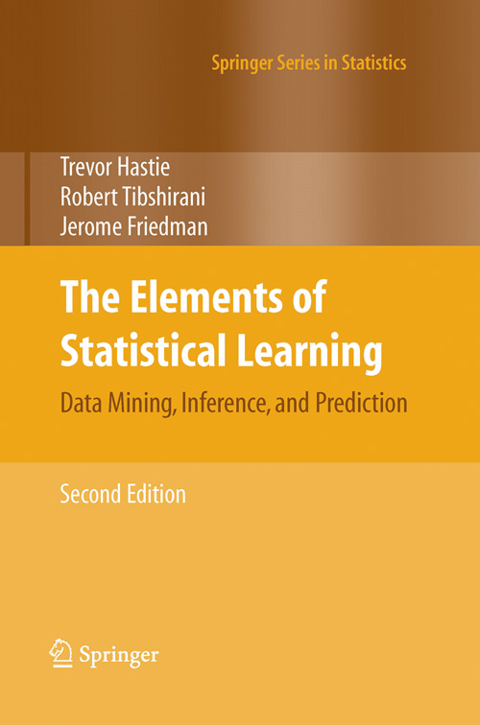
Background literature
Hastie, T., Tibshirani, R., & Friedman, J. (2009). The Elements of Statistical Learning: Data Mining, Inference, and Prediction (2nd ed.). Springer.
Comprehensive treatment of supervised and unsupervised methods for machine learning.
Mathematically detailed but illustrated with practical data problems and many graphs.
Relatively accessible! Many ML books are heavily mathematical and theoretical!
Available online for free (via a university network)!

Slide 6
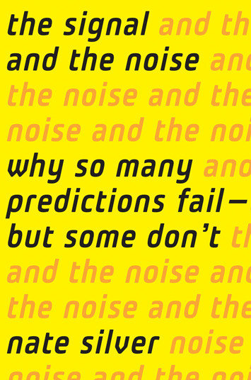
Background literature
Silver, N. (2012). The Signal and the Noise : Why So Many Predictions Fail – but Some Don't. Penguin.
Popular account of ML. Covers recent successes and failures of ML, and explores why.
Chapters are organised according to specific prediction problems, e.g., weather forecasting, volcano eruption detection, sports prediction, computer chess, etc.
Not mathematical but nevertheless offers an accessible introduction to many technical concepts (e.g., Bayesian inference).

Slide 7

Practical part with R
For the analyses, we use the R statistical software (https://www.r-project.org/), which is currently one of the most comprehensive platforms for machine learning (see https://cran.r-project.org/web/views/MachineLearning.html).
Examples on how to run machine learning analyses in R will be presented throughout the theoretical part.
All code can be copied directly from the slides into R, and has been collected in separate scripts per chapter. There is no need to load special data or source code. Data will be loaded from the internet at a SwitchDrive location. Packages are expected to be pre-installed.
Tomorrow, there is a practical part where you can explore ML on your own, compete in groups for several data problems, and consult with me for input on your data sets.

Slide 8

Goals of the workshop
Foremost, I want to demystify machine learning for you. In this workshop I will emphasize links between ML and conventional data analysis in the social sciences.
In Part 1 I will introduce (a) basic concepts of machine learning, (b) why there is a need for such models, and (c) how these models can be evaluated in terms of their predictive accuracy.
In Part 2 I will discuss a several specific models of machine learning individually, including (a) their theoretical background, (b) their relative strengths/weaknesses, and (c) practical applications.
Throughout my presentation, I will make short digressions into the history of machine learning, artificial intelligence, and statistics. These sections are marked by this icon

Slide 9
Goals of the workshop
Although I focus on presenting machine learning in terms of familiar concepts, you will also learn new and advanced concepts, such as:
Cross-validation
Curse of dimensionality
Ensemble learning
Bootstrap aggregation
Splines
In this workshop, I want you to acquire the following skills:
Use your intuition as if it was a machine learner
Evaluate predictor relevance without p-values
Automate the search for interactions and nonlinear effects in your data
Run machine learning models in R

Slide 10
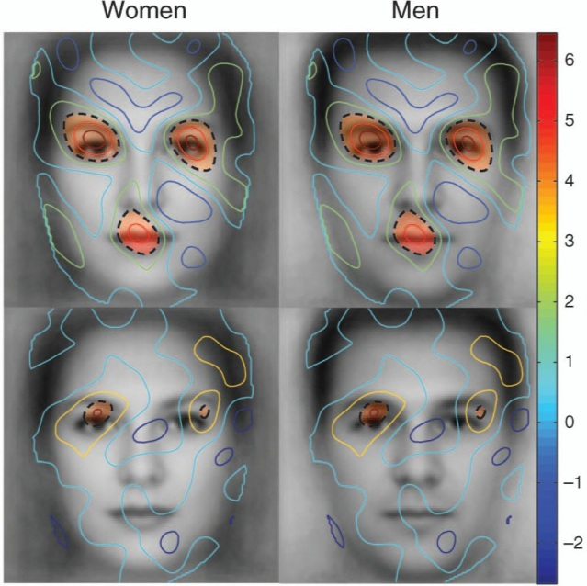


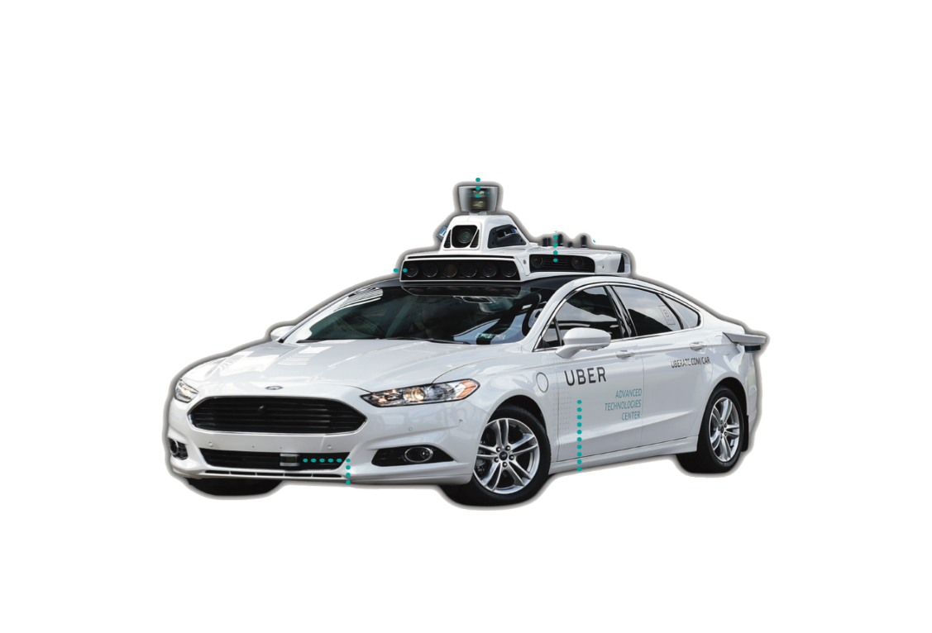

The hype… in 2021
Web page search ranking
Face recognition
Speech recognition
Credit card fraud detection
Self-driving vehicles

Slide 11




The revolution… since 2022
Text generation
Image generation
"Squid and chorizo stuffed mushrooms with a cherry and pistachio salad"

Slide 12


Quiz: Which is AI?
A
B

Slide 13


Quiz: Which is AI?
A
B

Slide 14


Quiz: Which is AI?
A
B
Women laughing eating salad alone

Slide 15


Quiz: Which is AI?
A
B

Slide 16
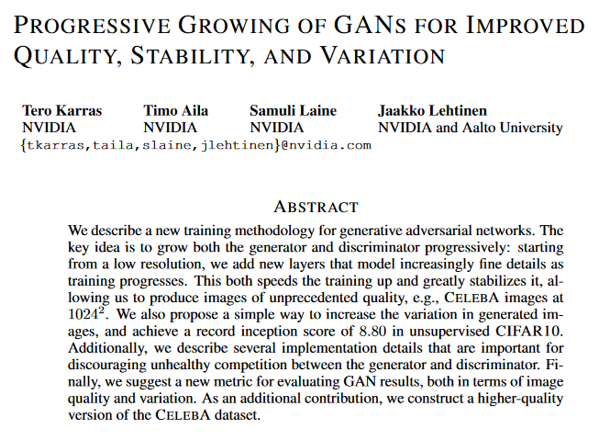
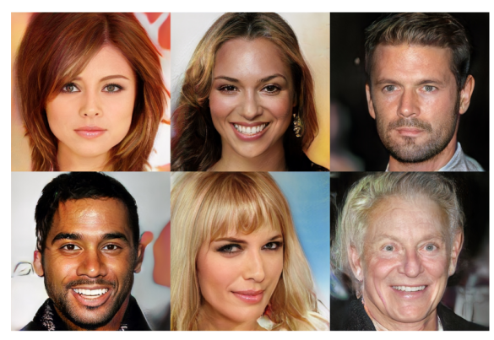

In the news – DeepFakes
https://sploid.gizmodo.com/watching-this-neural-network-render-truly-photorealisti-1819957128
DeepFake video manipulation https://www.youtube.com/watch?v=VWrhRBb-1Ig

Slide 17
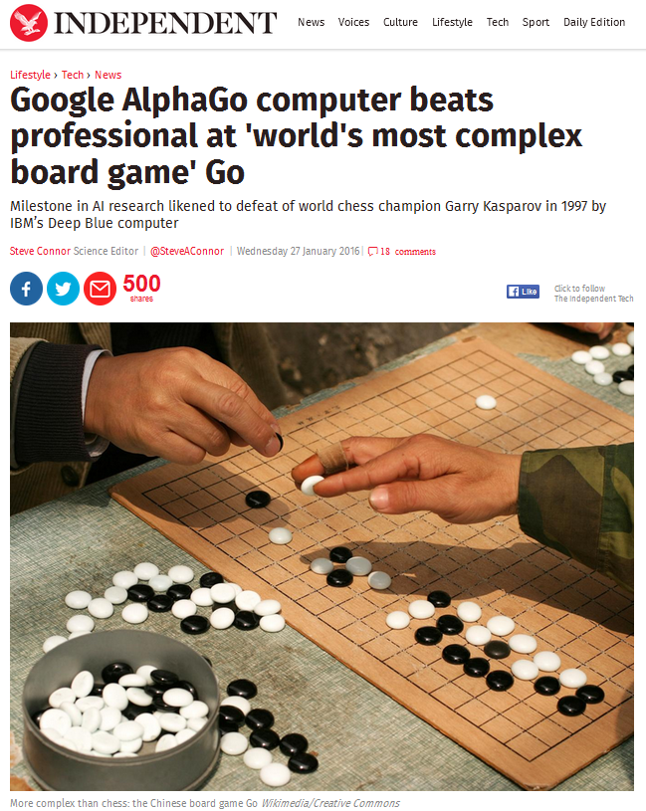


In the news – Boardgames
2016
2019
2023

Slide 18



In fiction
“My CPU is a neural net processor, a learning computer.” – Terminator 2 (1991)

Slide 19
Machine learning as statistics
In the media, machine learning is often presented as a kind of artificial intelligence, implemented in robots capable of imitating human intelligence. This is a sensationalized version of machine learning, and will take decades to achieve!
Likewise, fictional concerns about evil AI running out of control may be exaggerated (but see Russell, Dewey & Tegmark, 2015).
Basically, ML are statistical models. Their purpose is (usually) to predict a certain outcome/dependent, using a number of predictors/independents. This is no different from linear regression modelling.
Synonyms for ML include “pattern recognition” and “data mining”.

Slide 20
Machine learning and deep learning
So-called generative AI has been driving the AI hype since 2022. For text, these models are often called Large Language Models (LLM). They use a particular type of artificial neural network known as deep learning, a massive network of interconnected variables which apply complex transformations to the input data to arrive at a text prediction.
Such models can have billions of parameters, and their input data is different from the type that we are familiar with in (social) science. Input data for deep learning typically has these features:
Very raw (e.g., pixel by pixel images, text, video frames)
Complex hierarchical content at multiple scales
Abundant (cases number into millions)
Not in tabular format
The type of ML we will discuss today resembles much more what we are familiar with in linear regression…

Slide 21
2. Machine learning and social sciences

Slide 22
Linear regression
Analysis name | Dependent / outcome | Independent / predictor
One-way regression | 1 continuous | 1 continuous
Multiple regression | 1 continuous | +1 continuous
Independent samples t-test | 1 continuous | 1 categorical (2 levels)
One-way ANOVA | 1 continuous | 1 categorical (+2 levels)
Multi-way ANOVA | 1 continuous | +1 categorical
ANCOVA | 1 continuous | +1 continuous and categorical
Pearson correlation | 1 standardized continuous | 1 standardized continuous
One-sample t-test | 1 continuous | Intercept only
Paired t-test | 1 continuous difference score | Intercept only
Hotelling's T-test | +1 continuous | 1 categorical (2 levels)
MANOVA | +1 continuous | 1 categorical (+2 levels)
Multivariate multiple regression | +1 continuous | +1 continuous and categorical
All of these are special cases of the standard linear regression model.

Slide 23
Linear regression and hypothesis testing
In linear regression, one predicts a dependent variable, or “outcome”, (e.g., Y), given a number of independent variables, or “predictors” (e.g., the Xs).
The predictors can be observational measurements (e.g., personality scores, age, gender), or experimentally manipulated factors (e.g., drug dosage, stimulus type, therapy condition).
The primary goal of analyses in the social sciences is to find out which predictors have a significant/relevant association with the outcome. This goal is achieved by statistical hypothesis testing.
Hypothesis tests produce p-values, which quantify the probability of an association under the condition of no effect (≈ null hypothesis). When the p-value exceeds a threshold (e.g., 0.05), we reject the null hypothesis and conclude there is a “statistically significant relationship” between predictor and outcome.

Slide 24
A regression data set
PhotoID | AU1 | AU2 | AU4 | AU7 | AU12 | … | AU25 | Anger intensity
ID245 | 0.00 | 0.05 | 0.88 | 0.61 | 0.00 | … | 0.00 | 0.64
ID17 | 0.00 | 0.00 | 0.25 | 0.27 | 0.00 | … | 0.00 | 0.33
ID301 | 0.00 | 0.00 | 0.18 | 0.00 | 0.00 | … | 0.00 | 0.00
ID70 | 0.56 | 0.64 | 0.00 | 0.00 | 0.00 | … | 0.17 | 0.00
ID68 | 0.23 | 0.79 | 0.30 | 0.00 | 0.03 | … | 0.09 | 0.01
ID143 | 0.00 | 0.10 | 0.89 | 0.00 | 0.01 | … | 0.00 | 0.74
… | … | … | … | … | … | … | … | …
ID199 | 0.97 | 0.90 | 0.00 | 0.00 | 0.31 | … | 0.94 | 0.00

Slide 25
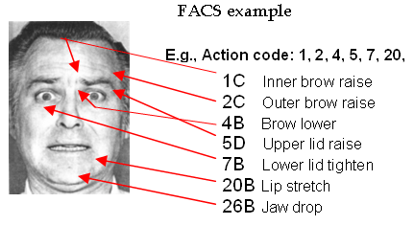
A regression data set
PhotoID | AU1 | AU2 | AU4 | AU7 | AU12 | … | AU25 | Anger intensity
ID245 | 0.00 | 0.05 | 0.88 | 0.61 | 0.00 | … | 0.00 | 0.64
ID17 | 0.00 | 0.00 | 0.25 | 0.27 | 0.00 | … | 0.00 | 0.33
ID301 | 0.00 | 0.00 | 0.18 | 0.00 | 0.00 | … | 0.00 | 0.00
ID70 | 0.56 | 0.64 | 0.00 | 0.00 | 0.00 | … | 0.17 | 0.00
ID68 | 0.23 | 0.79 | 0.30 | 0.00 | 0.03 | … | 0.09 | 0.01
ID143 | 0.00 | 0.10 | 0.89 | 0.00 | 0.01 | … | 0.00 | 0.74
… | … | … | … | … | … | … | … | …
ID199 | 0.97 | 0.90 | 0.00 | 0.00 | 0.31 | … | 0.94 | 0.00
ID245
Photos coded by experts for facial action unit (AU) activity (Ekman & Friesen, 1978).
Independent respondents then rated each photo’s anger intensity.

Slide 26
A regression data set
PhotoID | AU1 | AU2 | AU4 | AU7 | AU12 | … | AU25 | Anger intensity
ID245 | 0.00 | 0.05 | 0.88 | 0.61 | 0.00 | … | 0.00 | 0.64
ID17 | 0.00 | 0.00 | 0.25 | 0.27 | 0.00 | … | 0.00 | 0.33
ID301 | 0.00 | 0.00 | 0.18 | 0.00 | 0.00 | … | 0.00 | 0.00
ID70 | 0.56 | 0.64 | 0.00 | 0.00 | 0.00 | … | 0.17 | 0.00
ID68 | 0.23 | 0.79 | 0.30 | 0.00 | 0.03 | … | 0.09 | 0.01
ID143 | 0.00 | 0.10 | 0.89 | 0.00 | 0.01 | … | 0.00 | 0.74
… | … | … | … | … | … | … | … | …
ID199 | 0.97 | 0.90 | 0.00 | 0.00 | 0.31 | … | 0.94 | 0.00
Independents/predictors Xs
Dependent Y

Slide 27
Regression coefficients, t-values, p-values
PhotoID | AU1 | AU2 | AU4 | AU7 | AU12 | … | AU25 | Anger intensity
ID245 | 0.00 | 0.05 | 0.88 | 0.61 | 0.00 | … | 0.00 | 0.64
ID17 | 0.00 | 0.00 | 0.25 | 0.27 | 0.00 | … | 0.00 | 0.33
ID301 | 0.00 | 0.00 | 0.18 | 0.00 | 0.00 | … | 0.00 | 0.00
ID70 | 0.56 | 0.64 | 0.00 | 0.00 | 0.00 | … | 0.17 | 0.00
ID68 | 0.23 | 0.79 | 0.30 | 0.00 | 0.03 | … | 0.09 | 0.01
ID143 | 0.00 | 0.10 | 0.89 | 0.00 | 0.01 | … | 0.00 | 0.74
… | … | … | … | … | … | … | … | …
ID199 | 0.97 | 0.90 | 0.00 | 0.00 | 0.31 | … | 0.94 | 0.00
Coef. | β_{AU1} | β_{AU2} | β_{AU4} | β_{AU7} | β_{AU12} | … | β_{AU25}
t | 0.02 | 0.08 | 7.56 | 3.01 | 2.22 | ... | 0.00
p | 0.46 | 0.64 | 0.00 | 0.01 | 0.07 | … | 0.13
R² = 0.57

Slide 28
Hypothesis testing and goodness-of-fit
PhotoID | AU1 | AU2 | AU4 | AU7 | AU12 | … | AU25 | Anger intensity
ID245 | 0.00 | 0.05 | 0.88 | 0.61 | 0.00 | … | 0.00 | 0.64
ID17 | 0.00 | 0.00 | 0.25 | 0.27 | 0.00 | … | 0.00 | 0.33
ID301 | 0.00 | 0.00 | 0.18 | 0.00 | 0.00 | … | 0.00 | 0.00
ID70 | 0.56 | 0.64 | 0.00 | 0.00 | 0.00 | … | 0.17 | 0.00
ID68 | 0.23 | 0.79 | 0.30 | 0.00 | 0.03 | … | 0.09 | 0.01
ID143 | 0.00 | 0.10 | 0.89 | 0.00 | 0.01 | … | 0.00 | 0.74
… | … | … | … | … | … | … | … | …
ID199 | 0.97 | 0.90 | 0.00 | 0.00 | 0.31 | … | 0.94 | 0.00
Coef. | β_{AU1} | β_{AU2} | β_{AU4} | β_{AU7} | β_{AU12} | … | β_{AU25}
t | 0.02 | 0.08 | 7.56 | 3.01 | 2.22 | ... | 0.00
p | 0.46 | 0.64 | 0.00 | 0.01 | 0.07 | … | 0.13
R² = 0.57

Slide 29
Machine learning vs traditional regression
Linear regression is itself a statistical “learner” and can be considered a machine learning model. Moreover, many sophisticated models for machine learning can actually be expressed as a linear regression.
In linear regression, we often (a) evaluate the significance/relevance of predictors with p-values, and (b) evaluate the model’s goodness-of-fit to the outcome data with an R² value. These two objectives have more general counterparts in machine learning.
Objective | Traditional regression | Machine learning
Relevance evaluation | Hypothesis testing | Feature selection
Goodness-of-fit | Proportion of explained variance (R²) | Predictive strength (e.g., cross-validated R²)

Slide 30
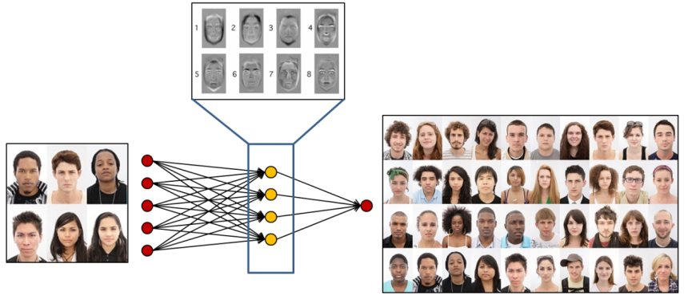
Machine learning vs traditional regression
In ML, relevance evaluation is often considered unimportant versus achieving a model that fits/predicts the outcome variable well.
In ML, model goodness-of-fit is primarily evaluated in terms of predictive strength—or generalisation capacity. That is, we want a model to be accurate not just for one sample of data, but for the population of data...!
Sample of pictures with faces
Population of pictures with faces
Pattern extraction

Slide 31
More terminological connections…
Concept | Traditional regression term | Machine learning term
Data | Observations | Cases
Y variables | Dependents | Responses / Targets / Outcomes
X variables | Independents / Predictors / Regressors | Features / Inputs
Parameters | Coefficients | Weights
Parameter estimation | Least squares estimation | Training / Learning
Model predictions | Fitted values | Predicted values
Relevance evaluation of X variables | Hypothesis testing | Feature selection
Model fit | Proportion of explained variance (R²) | Predictive strength (e.g., cross-validated R²)
≈
≈
≈
* I will mostly use these terms!

Slide 32

Regression as a “neural network”
Weights
= regression coefficients
X₁
β₁
X₂
Input neurons
≈ predictor variables
β₂
$\hat{Y}$
≈
Y
X₃
β₃
Output neuron
≈ fitted values approximating the outcome variable
...
X_{P}
β_{P}

Slide 33
Machine learning as statistical data analysis
Many statistical models ultimately serve the same purpose. We want to find out if there is a systematic relation between an outcome variable and a set of predictor variables.
We define the relations with a model, and then estimate them based on a sample of observed data.
The model can be as simple (e.g., basic regression) or as complex (e.g., SVM) as you choose.
These basic principles make clear that machine learning is not about esoteric artificial intelligence. It is simply a kind of statistical modelling.

Slide 34
Examples of modelling problems
Dependent / Response / Outcome |  | Independents / Predictors / Features
Does a photographed face contain a smile (yes or no)? |  | Images of faces, with individual pixels as variables
Next speed and direction for a self-driving car (km/h, degrees turn). |  | Current and past speed and direction, detected course of the road ahead, detected obstacles, etc.
Is an incoming e-mail spam (yes or no)? |  | Message title, contents, sender, punctuation, spelling, grammar, etc.
Should a patient be diagnosed with cancer (which of type)? |  | Medical images (e.g., X-ray, CT), observational data, demographical characeristics.
Probability of death following COVID19 infection (death vs survival)? |  | Variables related to the patient demographics, illness progression, diagnostic variables, hospital tests, etc.
* Note that these are all observational data problems. Machine learning is typically not suited to the analysis of experimental designs!

Slide 35

Reasons why social scientists are confused
For social scientists ML can be confusing at first. This is because you have to adjust to the following differences:
Evaluating predictor relevance is often ignored
Models that do evaluate predictor relevance never use criteria such as p-values.
Some models have no parameters (e.g., weights) that can be inspected for insight.
Some models are so complex that inspecting the parameters would not yield any insight at all (= black box models).
Social scientists are not used to predicting new data with a model.
ML is typically not concerned with verifying statistical assumptions.*
The R code to run ML can be surprisingly/disappointingly simple.
*

Slide 36
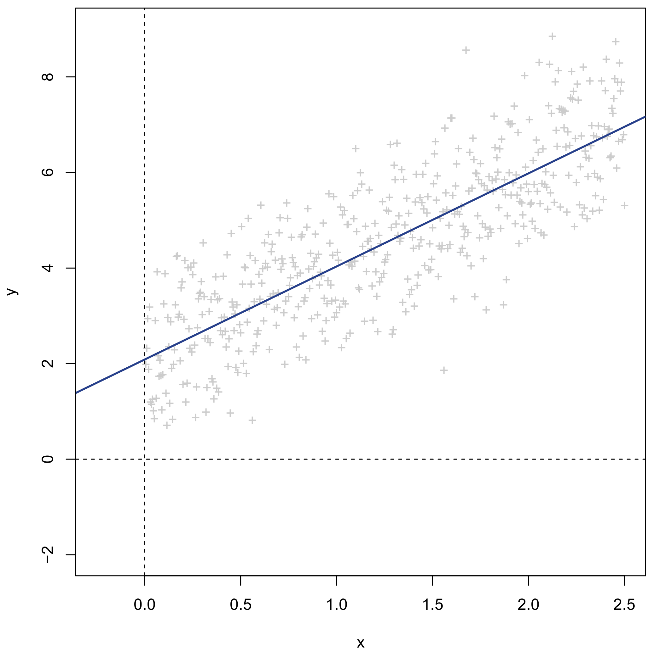
Linear regression recap
Continuous dependent Y
Continuous independent X
Linear regression of Y on X
= Linear approximation of Y using X

Slide 37
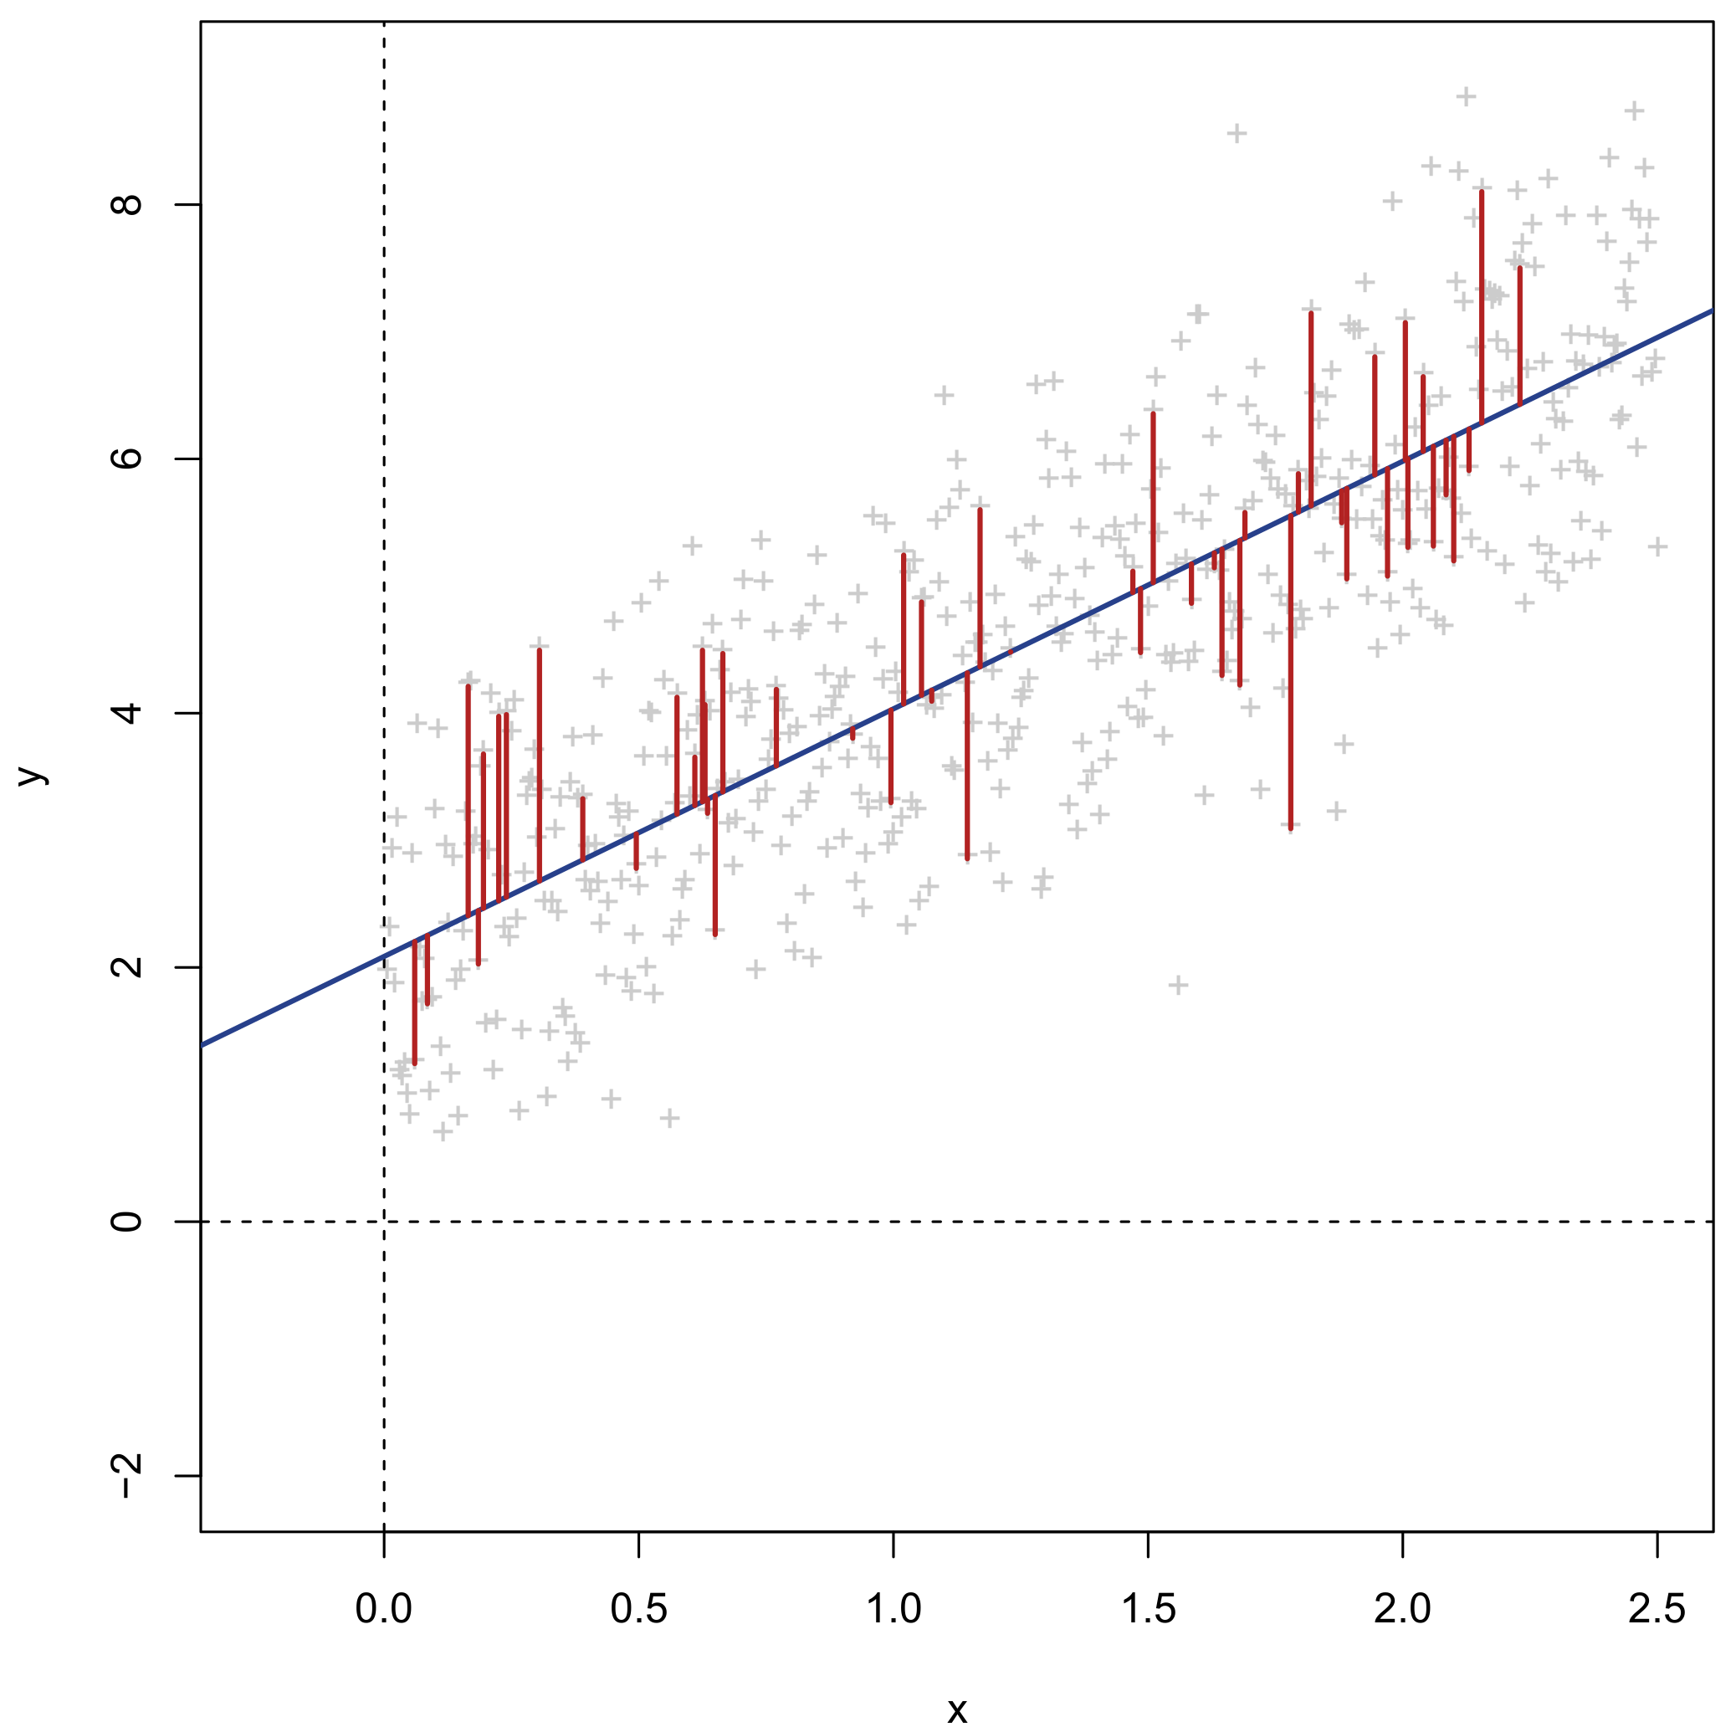
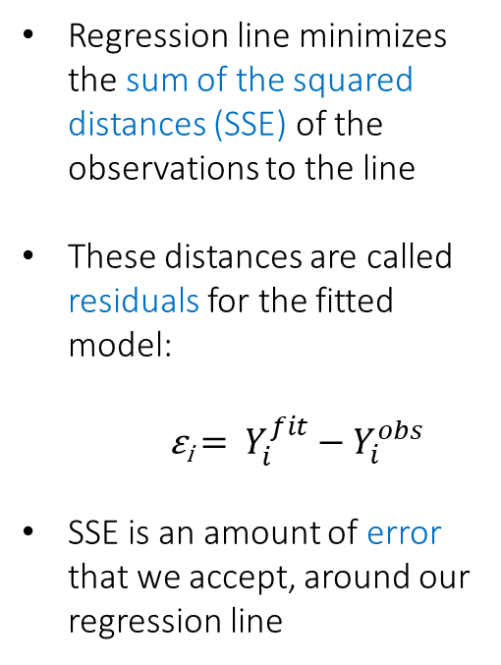
Linear regression recap
Regression line minimizes the sum of the squared distances (SSE) of the observations to the line
These distances are called residuals for the fitted model:
ε_{i} = $Y_{i}^{fit}−Y_{i}^{obs}$
SSE is an amount of error that we accept, around our regression line

Slide 38
Linear regression recap
Y_{i} = β₀ + β₁X_{i} + ε_{i}
β₁ slope
β₀ intercept

Slide 39
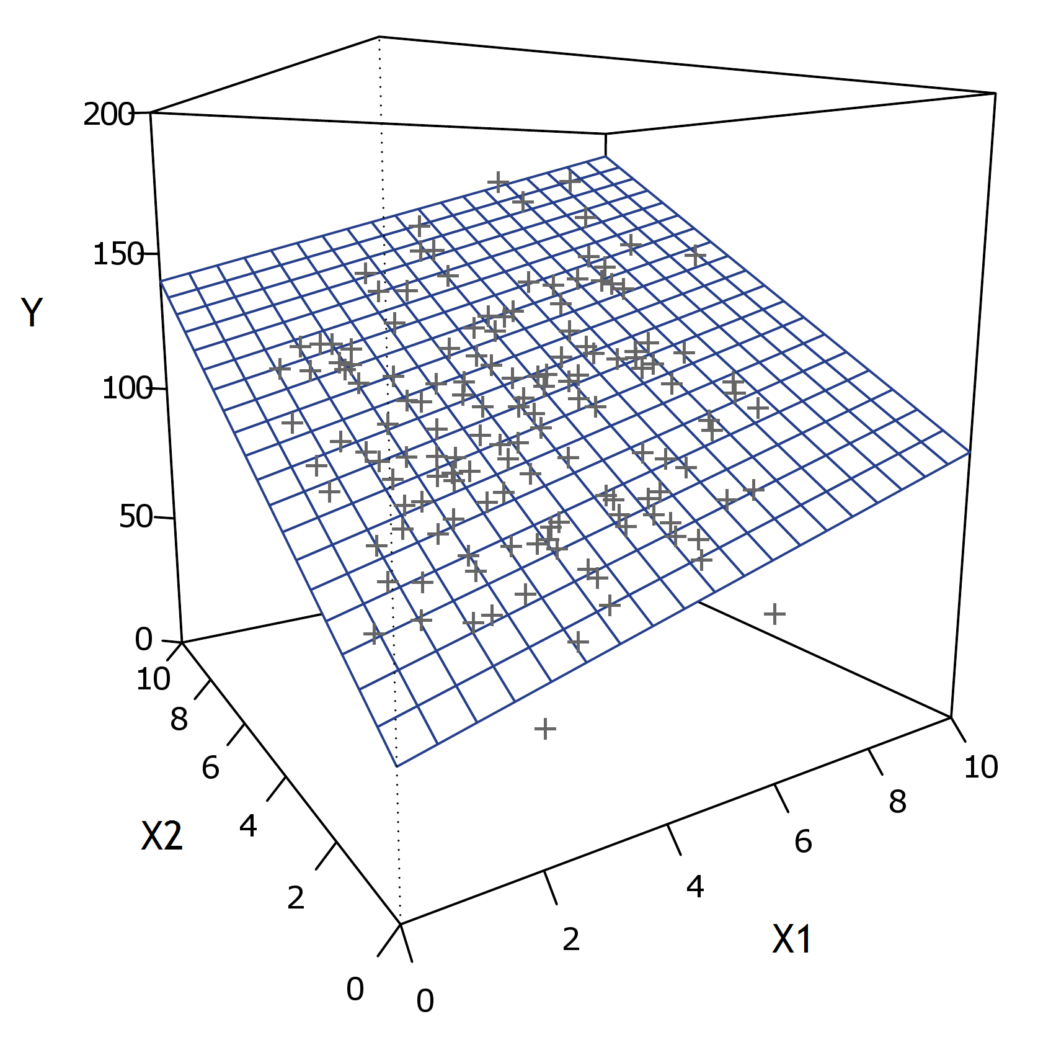
Linear regression recap
Y_{i} = β₀ + β₁X_{i1} + … + β_{p}X_{ip} + ε_{i}

Slide 40
Linear regression recap
β₂
β₁
β₀
Y_{i} = β₀ + β₁X_{i1} + … + β_{p}X_{ip} + ε_{i}

Slide 41
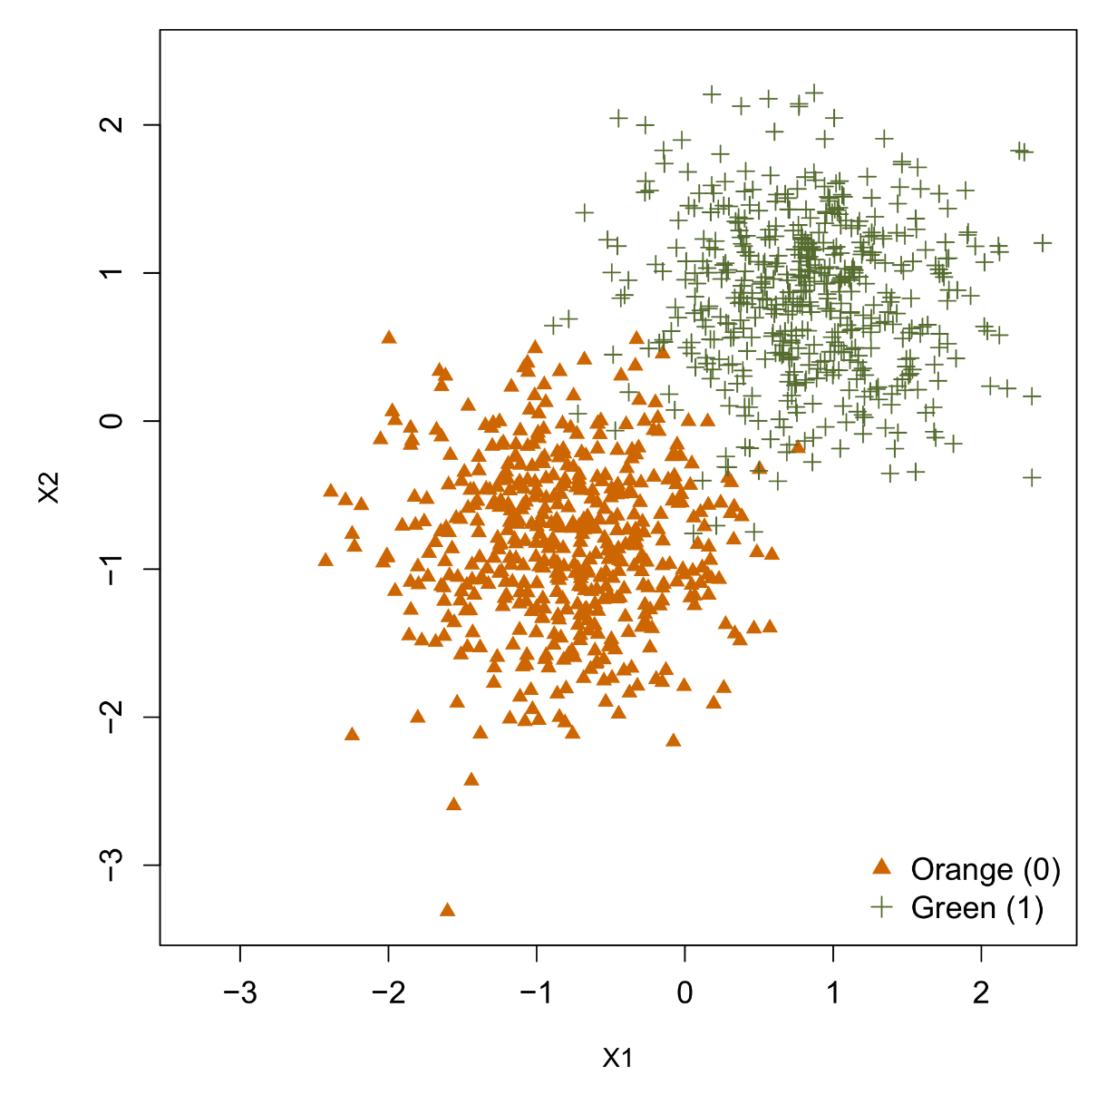
Binary logistic (linear) regression
Categorical dependent Y:
Orange = 0
Green = 1
Two continuous independents X1 and X2
Predicting the class of Y (0 or 1) using the predictors X1 and X2 can be done by binary logistic regression.

Slide 42
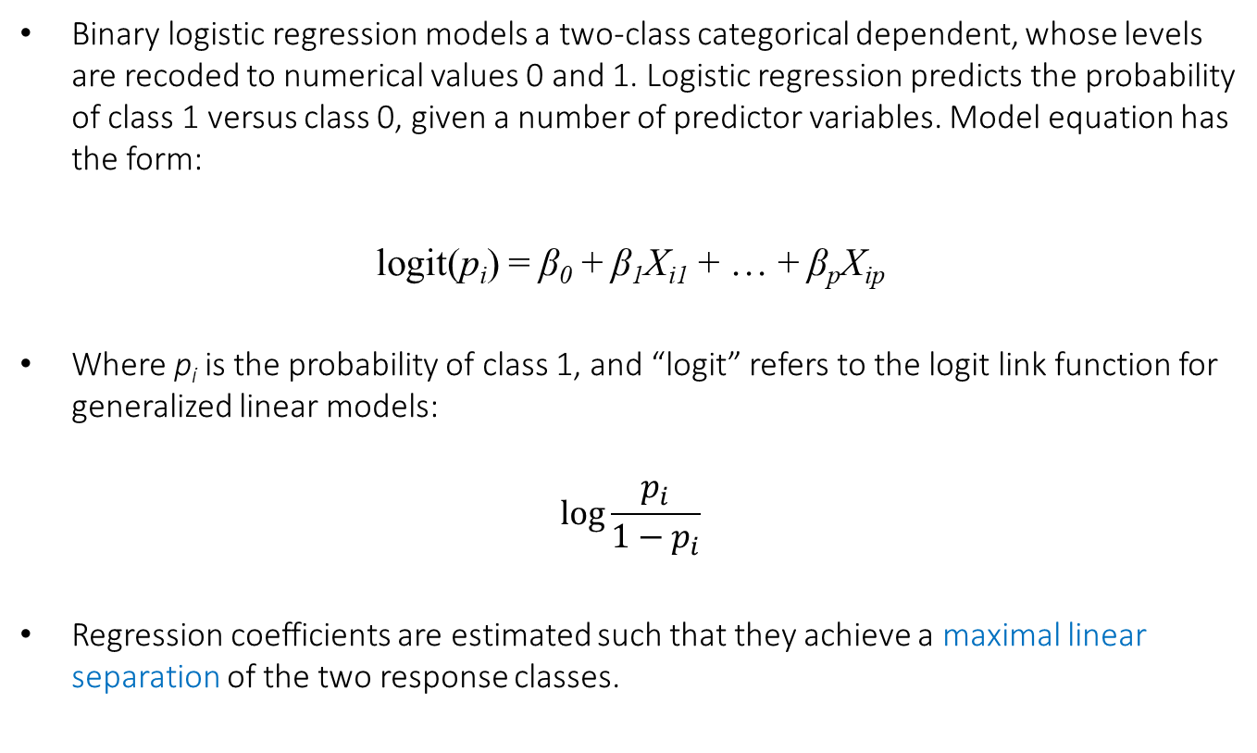
Binary logistic (linear) regression
Binary logistic regression models a two-class categorical dependent, whose levels are recoded to numerical values 0 and 1. Logistic regression predicts the probability of class 1 versus class 0, given a number of predictor variables. Model equation has the form:
logit(p_{i}) = β₀ + β₁X_{i1} + … + β_{p}X_{ip}
Where p_{i} is the probability of class 1, and “logit” refers to the logit link function for generalized linear models:
$$log⁡\frac{p_{i}}{1−p_{i}}$$
Regression coefficients are estimated such that they achieve a maximal linear separation of the two response classes.

Slide 43
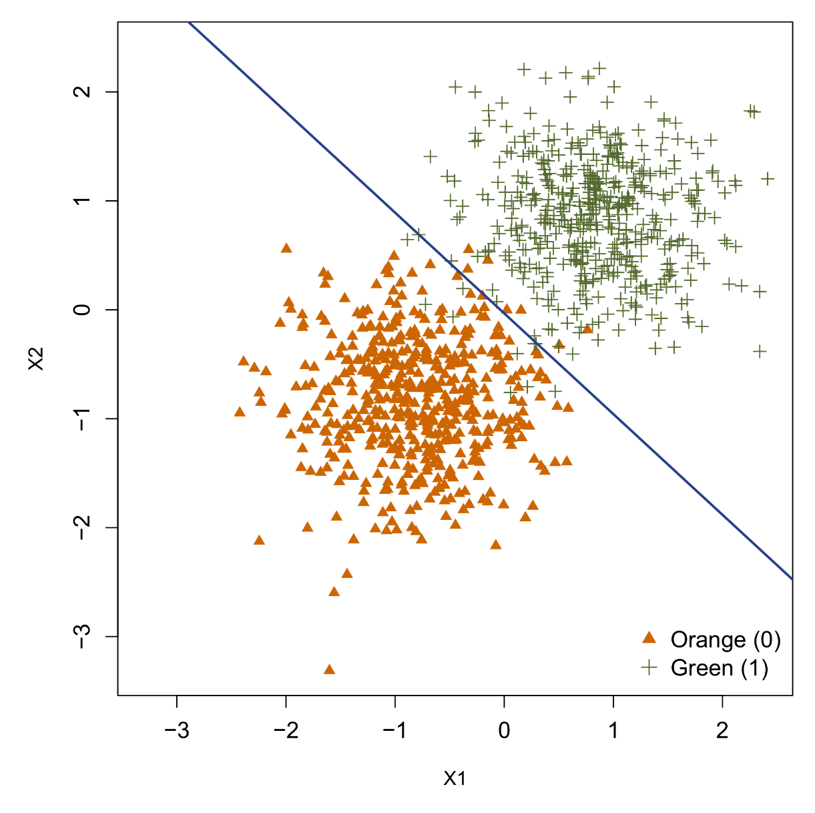
Binary logistic (linear) regression
Logistic regression equation produces a linear decision boundary between the two response classes:
Green side: the model predicts P() > 0.5
Orange side: the model predicts P() < 0.5
Decision boundary can thus be used to “classify” data points into one class or another.

Slide 44
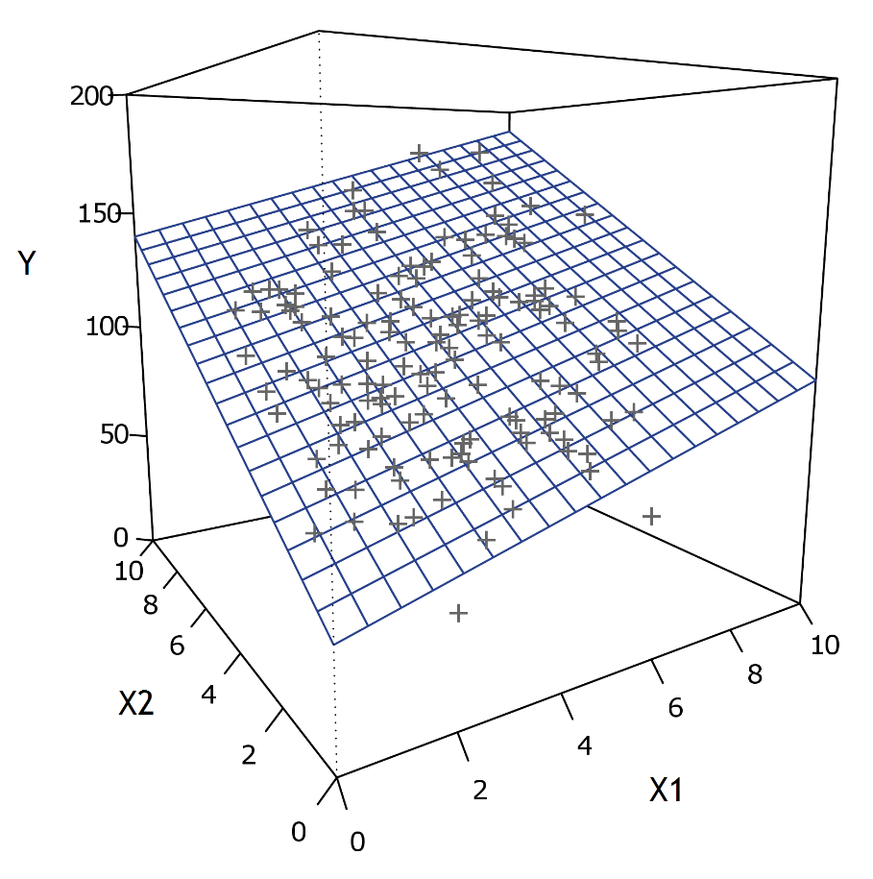

Linearity summary
Continous dependent
“regression model”
Categorical dependent
“classification model”
Basic linear models find an optimal linear equation that minimizes SSE (for continuous dependents) or maximally separates the response classes (for categorical dependents).

Slide 45
R-primer
First we create some random data in R:
set.seed(666)
rdat <- as.data.frame(matrix(rnorm(5000*101),5000,101))
colnames(rdat) <- c("Y",paste("X",1:100,sep=""))
Note that set.seed ensures that the same random numbers are drawn everytime we run a function such as rnorm. We inspect our basic data set as follows:
head(rdat)
dim(rdat)
Which shows the first six rows of the data, and its dimensions, respectively.

Slide 46
R-primer
Conventional regression in R is done with the lm function. Here it is important to understand how the formula interface works for specifying a model:
lin <- lm(Y ~ 1 + X1 + X2, data=rdat)
This will fit a linear regression with Y as dependent and X1 and X2 as additive independent effects. The regression is stored in the newly created lin object.
Reference data set
Dependent
Independent
effects
Intercept

Slide 47
R-primer – Formula variations
Formula | Altern. / Equiv. | Meaning
Y~1+X1+X2 | Y~X1+X2 | X1 and X2 main effects (and intercept)
Y~X1*X2 | Y~X1+X2+X1:X2 | X1 and X2 main effects and interaction
Y~(X1+X2+X3)^2 |  | X1, X2, and X3 up to two-way interaction effects but not X1:X2:X3
Y~(X1+X2+X3)^3 | Y~X1*X2*X3 | X1, X2, and X3 all possible effects/interactions
Y~X1*(X2+X3) |  | X1:X2 and X1:X3 interaction allowed but not X2:X3
Y~X1+I(X1^2) | Y~poly(X1,2) | X1 main effect with X1 quadratic effect*
Y~0+X1 | Y~X1-1 | X1 main effect without intercept
Y~. |  | All other variables in the data except Y entered as independents
* Note that "I" is the priority operator in R formulas, telling R to execute this transformation before applying regression estimation to the given formula. This is the correct approach: X1+X1^2

Slide 48
R-primer
Now we inspect our full regression model with the summary function:
lin <- lm(Y~.,data=rdat)
summary(lin)
This outputs a list of parameter estimates, inference statistics, and model statistics:
Estimate Std. Error t value Pr(>|t|)
(Intercept) 0.0069637 0.0143187 0.486 0.62675
X1 -0.0007295 0.0143362 -0.051 0.95942
...
X100 -0.0123904 0.0141275 -0.877 0.38051
---
Signif. codes: 0 ‘***’ 0.001 ‘**’ 0.01 ‘*’ 0.05 ‘.’ 0.1 ‘ ’ 1
Residual standard error: 1.002 on 4899 degrees of freedom
Multiple R-squared: 0.01859, Adjusted R-squared: -0.001438
F-statistic: 0.9282 on 100 and 4899 DF, p-value: 0.6806

Slide 49
R-primer
Using the car package we could also ask for an ANOVA decomposition
library(car)
Anova(lin,type=2)
This outputs conventional Type II inferential statistics:
Anova Table (Type II tests)
Response: Y
Sum Sq Df F value Pr(>F)
(Intercept) 0.2 1 0.2365 0.626753
X1 0.0 1 0.0026 0.959422
X2 0.8 1 0.7934 0.373107
...

Slide 50
R-primer
Note that the ANOVA tests in this example will be identical to the tests reported in the summary parameter estimates table. This is because in these data, 1 variable = 1 parameter. This would not be the case if the data contained categorical predictors with more than 2 levels, e.g., a 4-level factor = 3 (dummy) parameters.
The regression (hyper) plane that is captured by the regression coefficients constitute the fitted values of the model, a.k.a., the predicted values of the model. In R we can access these values in two different ways:
fitted(lin)
predict(lin)
Visualizing the hyper plane directly is not possible however, since it would require a 100-dimensional plot. What we can do to visualize effects is to create conditional effects plots.

Slide 51
R-primer
Conditional effects plots will depict the regression slope of one variable while keeping the values of the other variables fixed. In R this can be done with the visreg package/function, e.g., for the X1 and X33 effects:
library(visreg)
par(mfrow=c(1,2))
visreg(lin,xvar="X1")
visreg(lin,xvar="X33")
The plots show which variables have a negative and which have a positive relation with the dependent. The actual data are overlaid on top of the regression function, and for lm models visreg also provides a confidence band around the regression line.
Generally, visreg will work for any model that uses R's formula interface, including machine learners (with some exceptions).

Slide 52
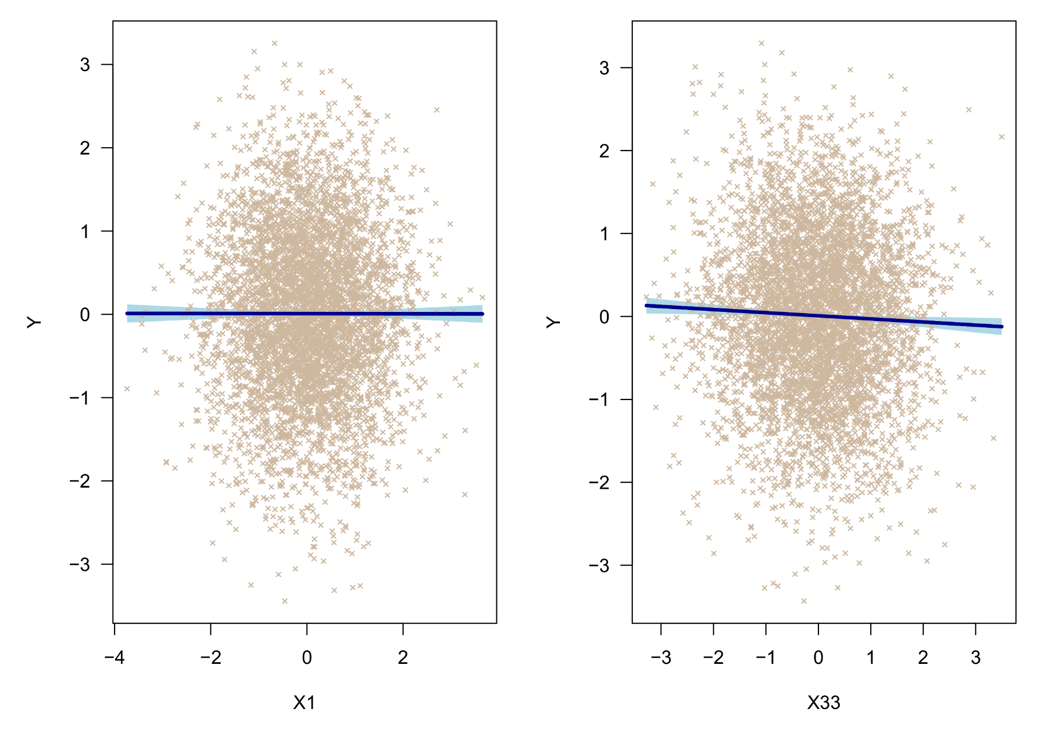
R-primer

Slide 53
3. Principles of machine learning
A. Why do we need it?

Slide 54
Why do we need machine learning?
Machine learning as a field has taken shape gradually, with the realization that there was an overlap between similar algorithms being developed in engineering, computer science, and statistics.
Basic linear models have long performed well—and continue to do so—because of their relative simplicity and low computational cost. However, these models have also been challenged by three critical problems:
Big data
Odd data
Nonlinear data

Slide 55
Big data
The term “big data” is often used in the context of ML, and sometimes as a synonym when discussed as an approach to data analysis.
With increasing computational power and capacity to store data, large data bases have become prevalent. In many fields, sampling data en-masse is the norm, e.g., engineering, chemistry, physics, medicine, biology, etc.
Because of increasing informatization, also many companies (e.g., banks, tech corporations) maintain substantial data traffic (e.g., client information, purchase history), which can be collected at a low cost.
Note that this is typically not true for studies in the social sciences, where data correspond to human participants who must be recruited via conventional channels…

Slide 56
Big data
The primary (statistical) problem that big data pose is a power surplus. In conventional null hypothesis testing with p-values, the significance of the p-value reflects both the effect size and the sample size.
A strong effect can be found to be insignificant when the sample size is too low, but a weak effect can also be found to be significant when the sample size is too high. For large data sets (e.g., N > 5000), everything might be significant.
In principle, one could always subsample data at a desired power level and then proceed with conventional hypothesis testing. However, this strategy wastes potentially useful data.
Ideally, evaluating variable relevance should be based purely on effect size and not depend on sample size. Later I will show examples of these approaches…

Slide 57
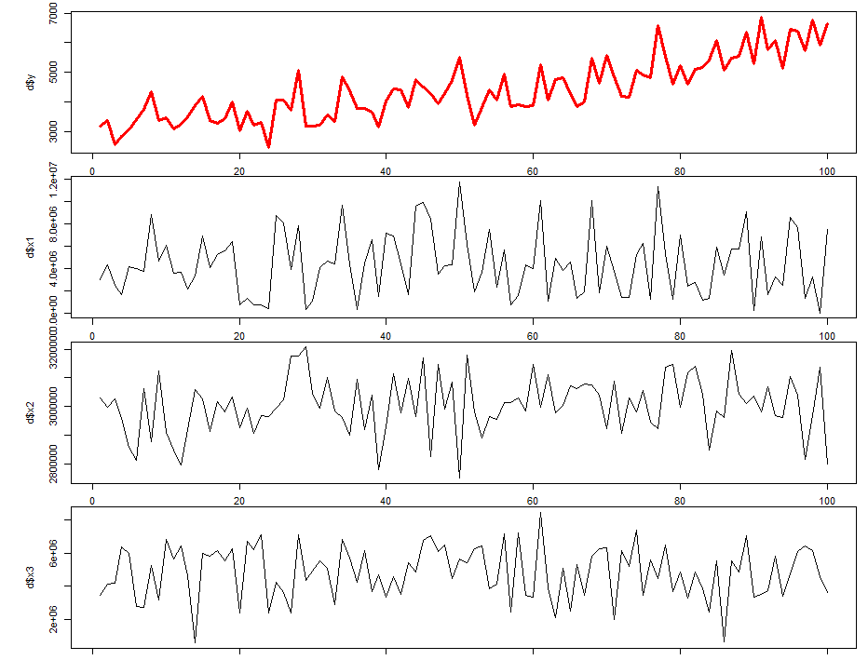
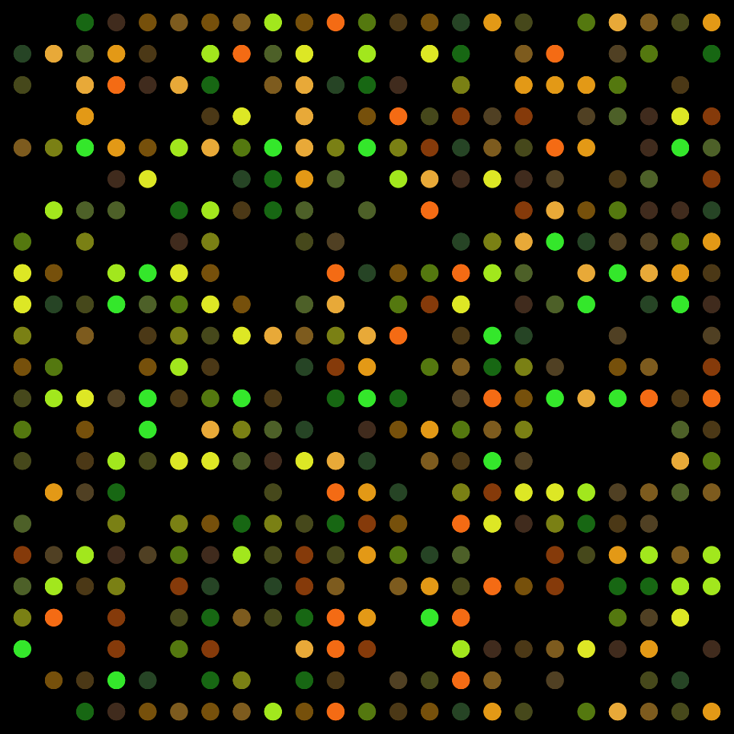
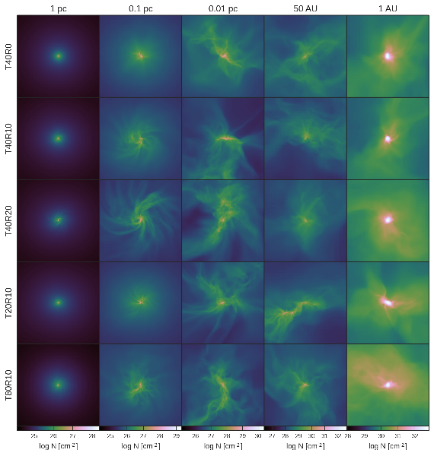
Odd data
Time series
High-dimensional data
Spatial data

Slide 58
Odd data
A classic problem in medicine are DNA micro-arrays, which can contain gene expression data for up to 100,000 genes, measured on a relatively small sample of patients (e.g., 300).
Such problems are known as “P >>> N problems”, because the number of predictor variables P vastly outnumbers the number of observations N.
Conventional regression models are unable to deal with P > N. There is not enough unique data information to estimate the required number of parameters (overparameterization problem), thus parameter estimates will be highly unstable and/or missing.
Other odd data pose different problems, such as data with high multicollinearity among the predictors, data with (substantial) missingness, or data with unusual properties (e.g., time series, spatial data, brain imaging data). These data typically violate the standard assumptions of conventional regression.

Slide 59
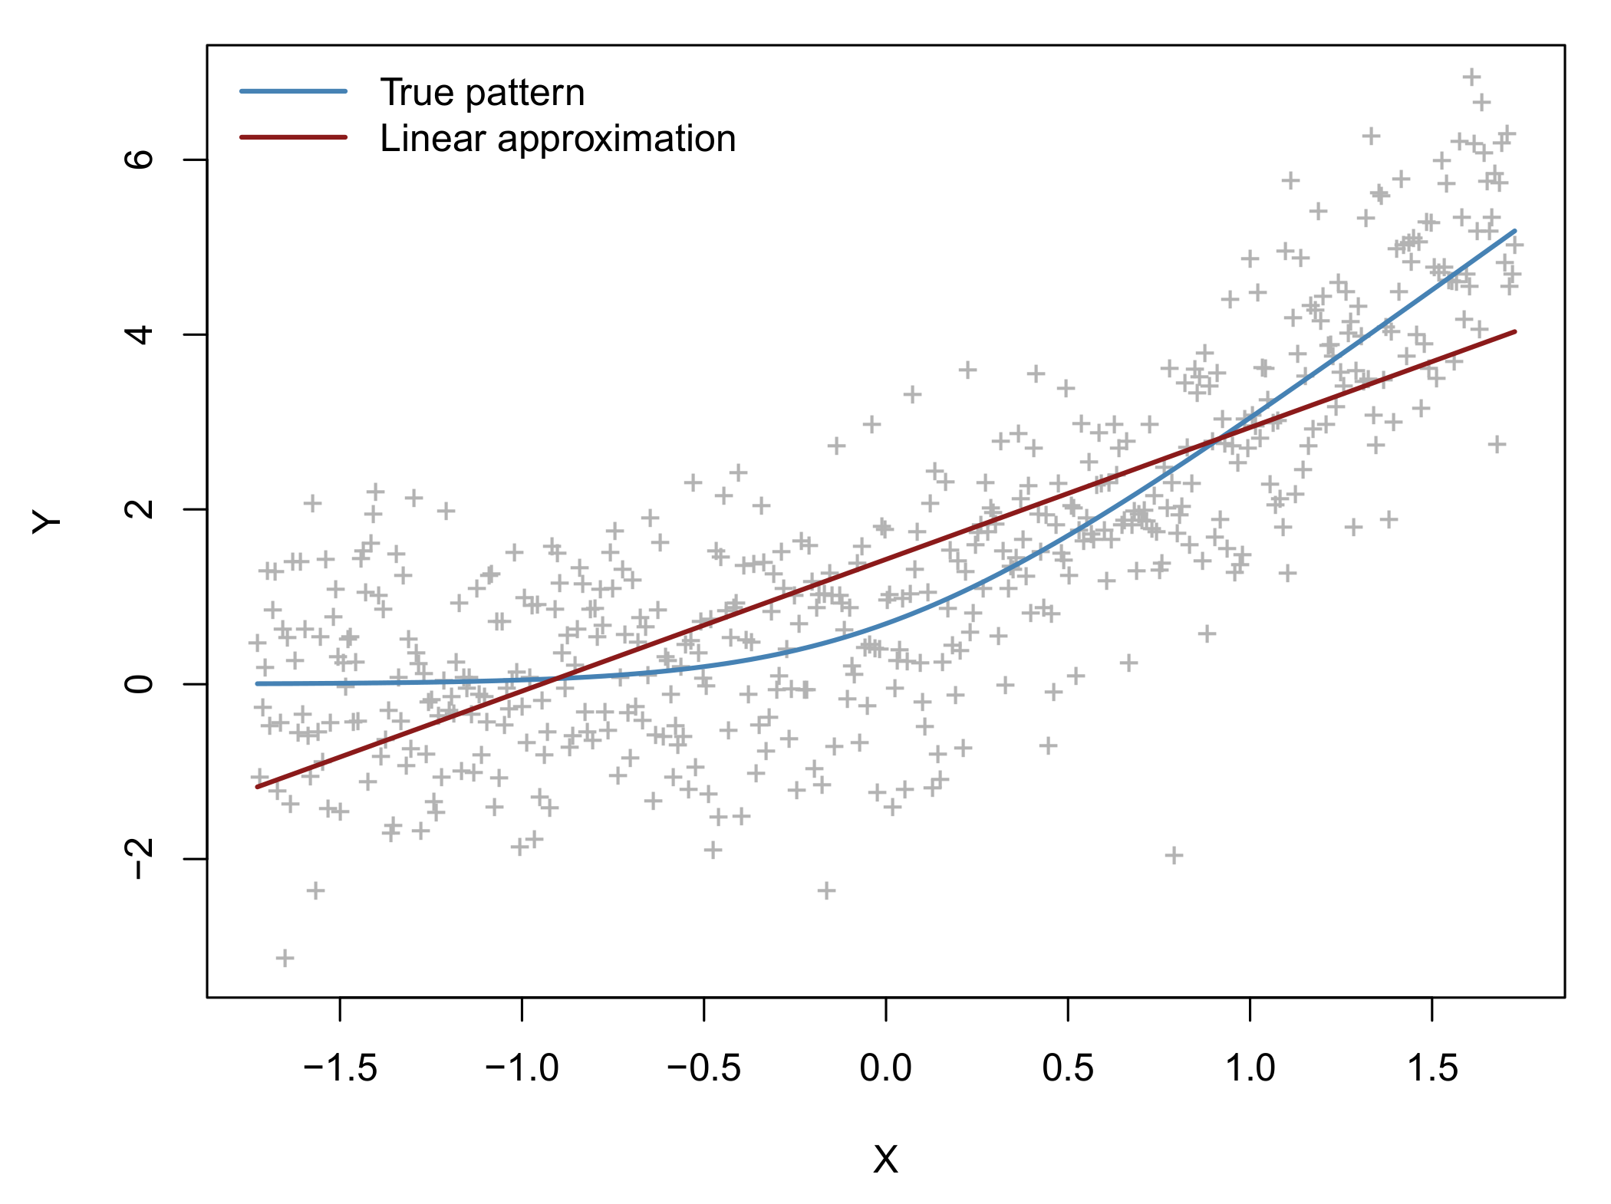
Nonlinearity
Basic linear models perform remarkably well on a large number of pattern recognition problems, even as approximations to nonlinear patterns, e.g.:

Slide 60
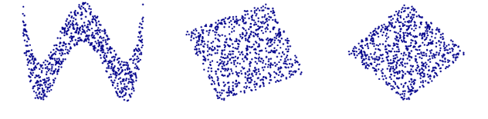
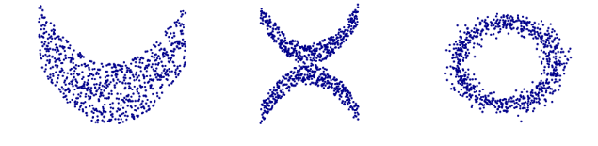
Nonlinearity
However, nonlinear patterns can also be complex, including curvilinear associations or interactions between multiple features simultaneously. Some relations can be non-functional.
A
B
C
D
E
F

Slide 61
Nonlinearity
The primary purpose of most ML models is modelling nonlinearity!
This is true much more than for big or odd data, although these problems are often co-morbid in practice (i.e., big odd nonlinear data).
Historically, the incapability of basic linear models to solve even a simple nonlinear problem was demonstrated most famously by the exclusive OR problem (XOR).
This problem proved to be an early—and so it was thought fatal—stumbling block for the first artificial neural networks.

Slide 62
Logical comparisons and XOR
Features |  | Response
X1 | X2 |  | OR | AND
0 | 0 |  | 0 | 0
0 | 1 |  | 1 | 0
1 | 0 |  | 1 | 0
1 | 1 |  | 1 | 1
2
1
X2
0
1
2
X1

Slide 63
Recall…

Slide 64
Logical comparisons and XOR
Features |  | Response
X1 | X2 |  | OR | AND
0 | 0 |  | 0 | 0
0 | 1 |  | 1 | 0
1 | 0 |  | 1 | 0
1 | 1 |  | 1 | 1
2
1
X2
0
1
2
X1

Slide 65
Logical comparisons and XOR
Features |  | Response
X1 | X2 |  | OR | AND
0 | 0 |  | 0 | 0
0 | 1 |  | 1 | 0
1 | 0 |  | 1 | 0
1 | 1 |  | 1 | 1
2
1
X2
0
1
2
X1

Slide 66
Logical comparisons and XOR
Features |  | Response
X1 | X2 | XOR | OR | AND
0 | 0 | 0 | 0 | 0
0 | 1 | 1 | 1 | 0
1 | 0 | 1 | 1 | 0
1 | 1 | 0 | 1 | 1
2
1
X2
0
1
2
X1

Slide 67
Logical comparisons and XOR
Features |  | Response
X1 | X2 | XOR | OR | AND
0 | 0 | 0 | 0 | 0
0 | 1 | 1 | 1 | 0
1 | 0 | 1 | 1 | 0
1 | 1 | 0 | 1 | 1
2
???
1
X2
0
1
2
X1

Slide 68

XOR
In 1957, Frank Rosenblatt invented an algorithm he called the “perceptron”, which is a simple artificial neural network that strongly resembles binary logistic regression. Rosenblatt made bold claims about this algorithm:
In 1969, Seymour and Papert showed that the perceptron was incapable of solving the XOR problem, due to the linearity of the model. This influential finding caused a temporary decline in the interest and funding for artificial neural networks.
“The perceptron has within it the embryo of an electronic computer that [the Navy] expects will be able to walk, talk, see, write, reproduce itself and be conscious of its existence".

Slide 69
Logical comparisons and XOR
A model for the XOR problem needs to take into account the interaction between X1 and X2 for accurately outputting the XOR response.
This could be achieved simply by adding an interaction term to our data set of features, and then fit a linear model to these expanded data.
Features |  |  | Response
X1 | X2 | X1*X2 | XOR | OR | AND
0 | 0 | 0 | 0 | 0 | 0
0 | 1 | 0 | 1 | 1 | 0
1 | 0 | 0 | 1 | 1 | 0
1 | 1 | 1 | 0 | 1 | 1

Slide 70
Logical comparisons and XOR
Features |  |  | Response
X1 | X2 | X1*X2 | XOR | OR | AND
0 | 0 | 0 | 0 | 0 | 0
0 | 1 | 0 | 1 | 1 | 0
1 | 0 | 0 | 1 | 1 | 0
1 | 1 | 1 | 0 | 1 | 1
2
1
X2
X1*X2
0
1
2
X1

Slide 71
Two types of nonlinear models
Raw feature/predictor set
Nonlinear transformation of raw features
Type I: Linear parameters
Type II: Nonlinear parameters
Generalized additive models,
SVM, MARS, trees,…
Multilayer feedforward neural networks
Outcome variable fitting

Slide 72
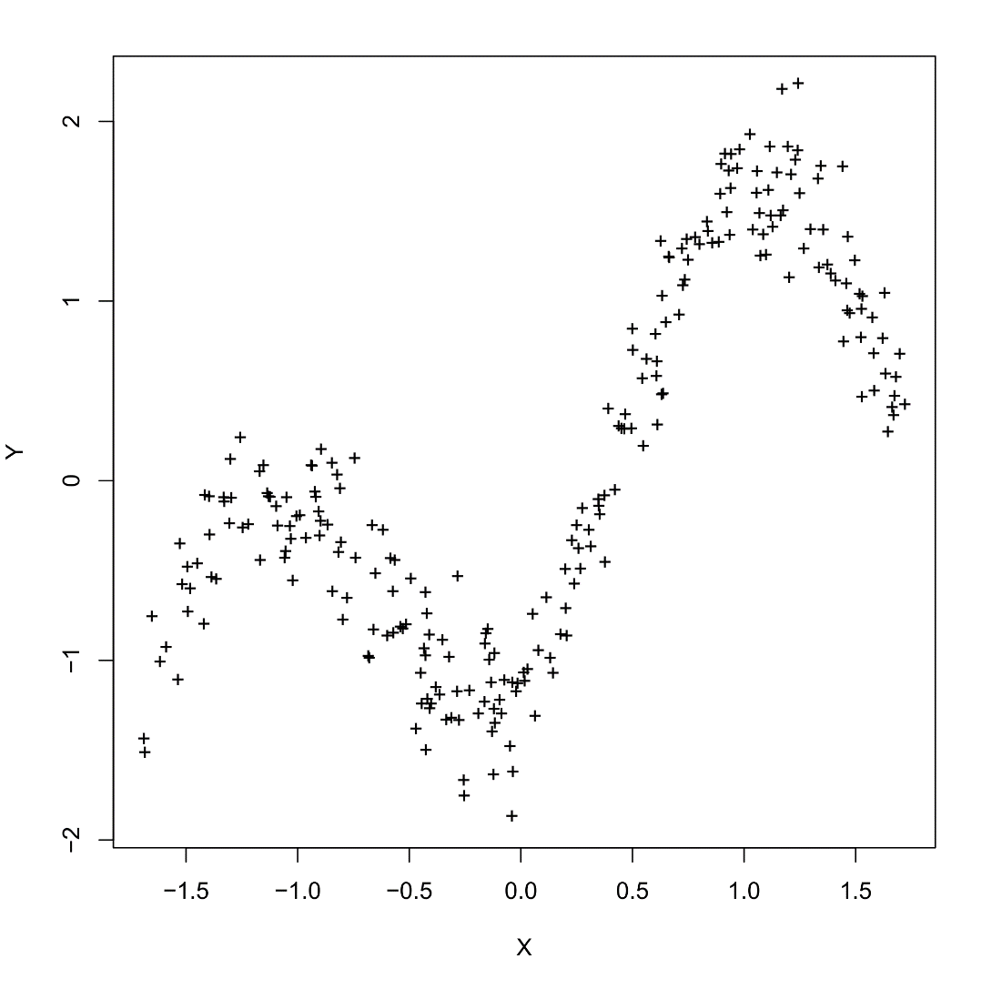
Nonlinear feature transformation
set.seed(668)
x <- 1:500
true <- 100*sin(0.02*x) + 0.5*x
y <- true + rnorm(500,0,25)
plot(x,y,pch="+",col="grey70",
xlab="X",ylab="Y")

Slide 73
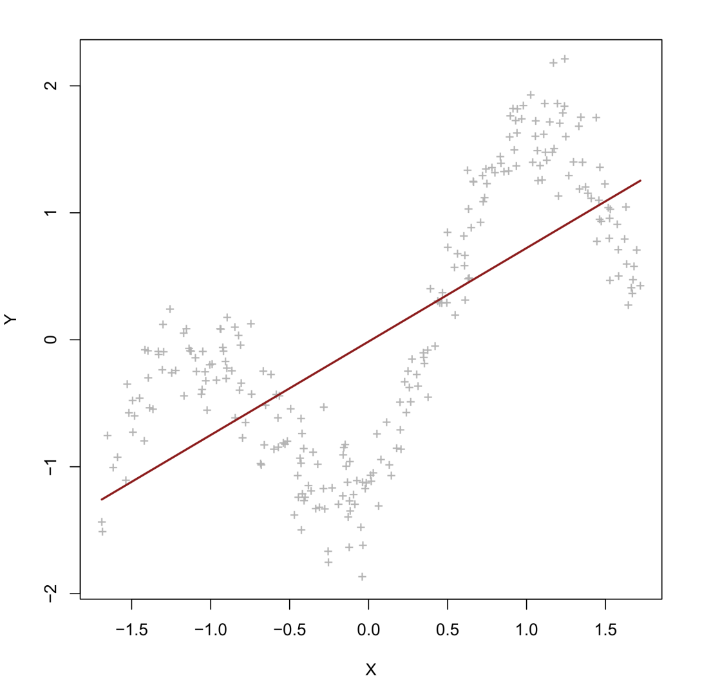
Nonlinear feature transformation
E(Y) = β₀ + β₁X
X | X² | X³ | X⁴
-1.52 | 2.31 | -3.51 | 5.33
-1.23 | 1.51 | -1.86 | 2.28
-0.88 | 0.77 | -0.68 | 0.59
-0.57 | 0.32 | -0.18 | 0.10
0.01 | 0.00 | 0.00 | 0.00
0.39 | 0.15 | 0.05 | 0.02
0.55 | 0.30 | 0.16 | 0.09
1.01 | 1.02 | 1.03 | 1.04
... | ... | ... | ...
Dimension of the feature set: 1

Slide 74
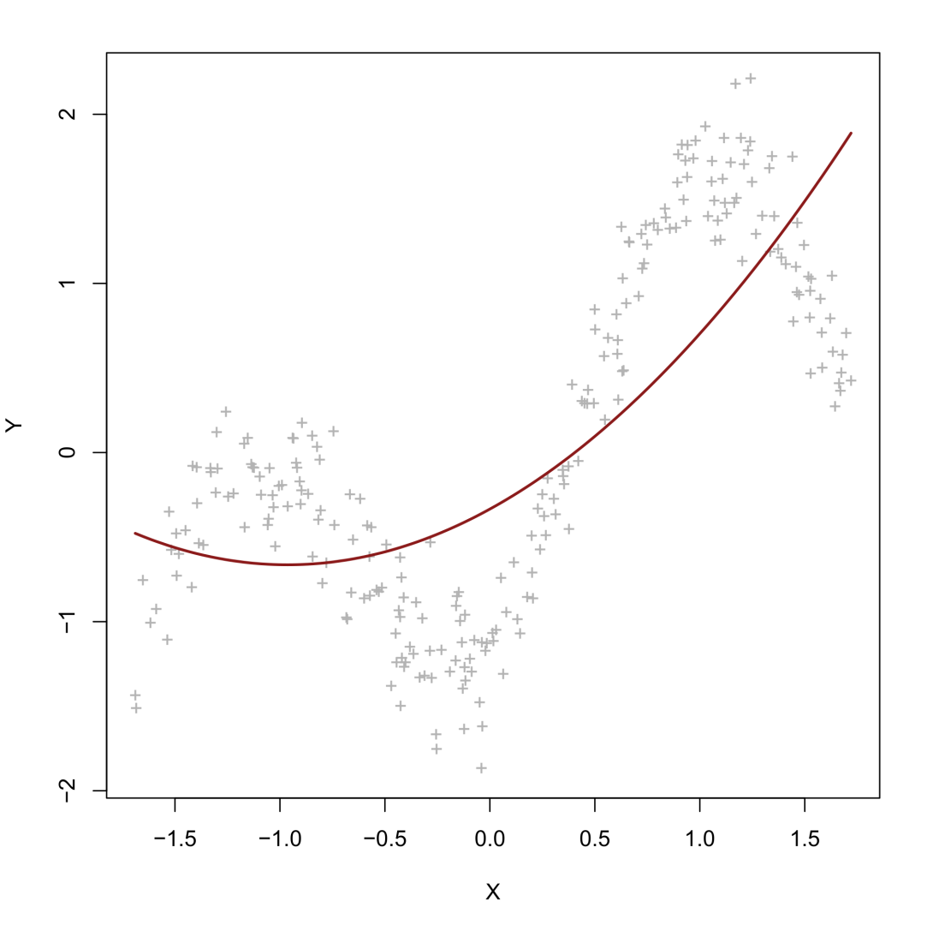
Nonlinear feature transformation
E(Y) = β₀ + β₁X + β₂X²
X | X² | X³ | X⁴
-1.52 | 2.31 | -3.51 | 5.33
-1.23 | 1.51 | -1.86 | 2.28
-0.88 | 0.77 | -0.68 | 0.59
-0.57 | 0.32 | -0.18 | 0.10
0.01 | 0.00 | 0.00 | 0.00
0.39 | 0.15 | 0.05 | 0.02
0.55 | 0.30 | 0.16 | 0.09
1.01 | 1.02 | 1.03 | 1.04
... | ... | ... | ...
Dimension of the feature set: 2

Slide 75
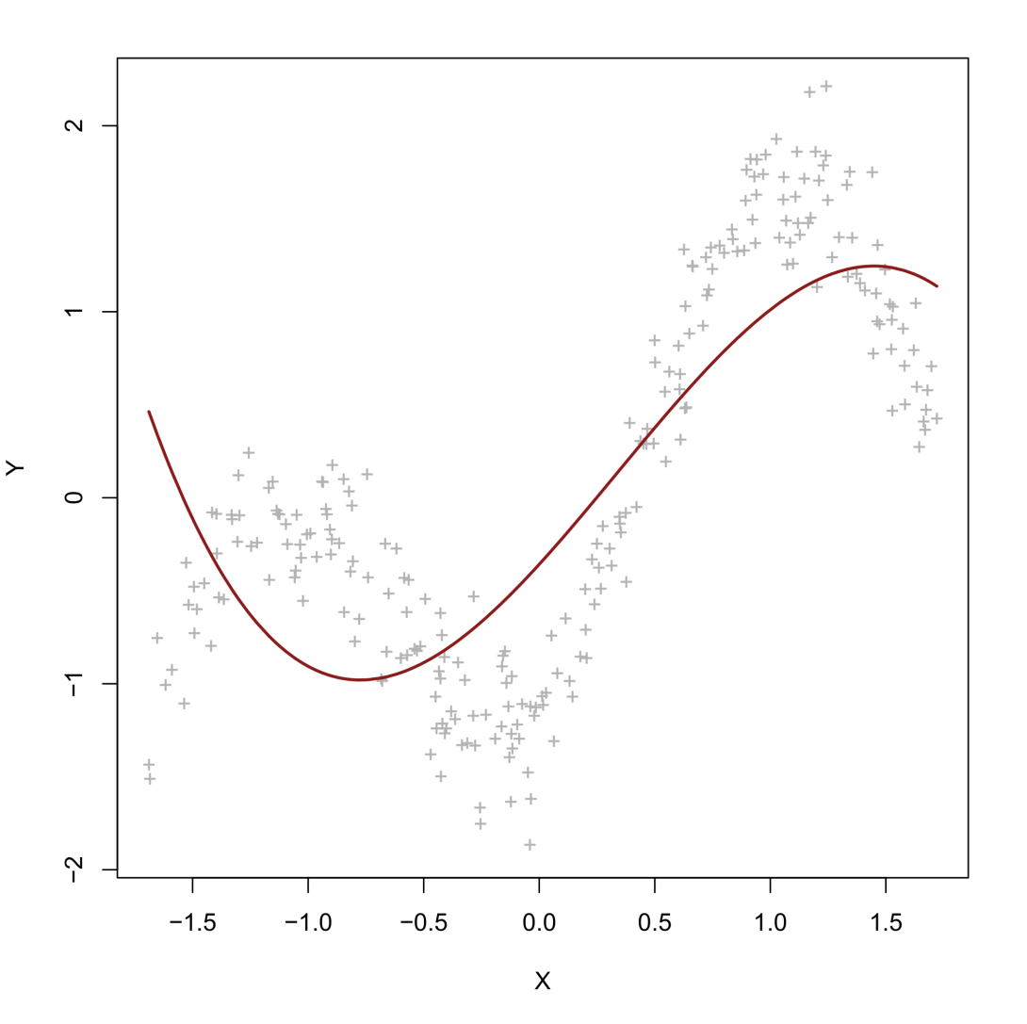
Nonlinear feature transformation
E(Y) = β₀ + β₁X + β₂X² + β₃X³
X | X² | X³ | X⁴
-1.52 | 2.31 | -3.51 | 5.33
-1.23 | 1.51 | -1.86 | 2.28
-0.88 | 0.77 | -0.68 | 0.59
-0.57 | 0.32 | -0.18 | 0.10
0.01 | 0.00 | 0.00 | 0.00
0.39 | 0.15 | 0.05 | 0.02
0.55 | 0.30 | 0.16 | 0.09
1.01 | 1.02 | 1.03 | 1.04
... | ... | ... | ...
Dimension of the feature set: 3

Slide 76
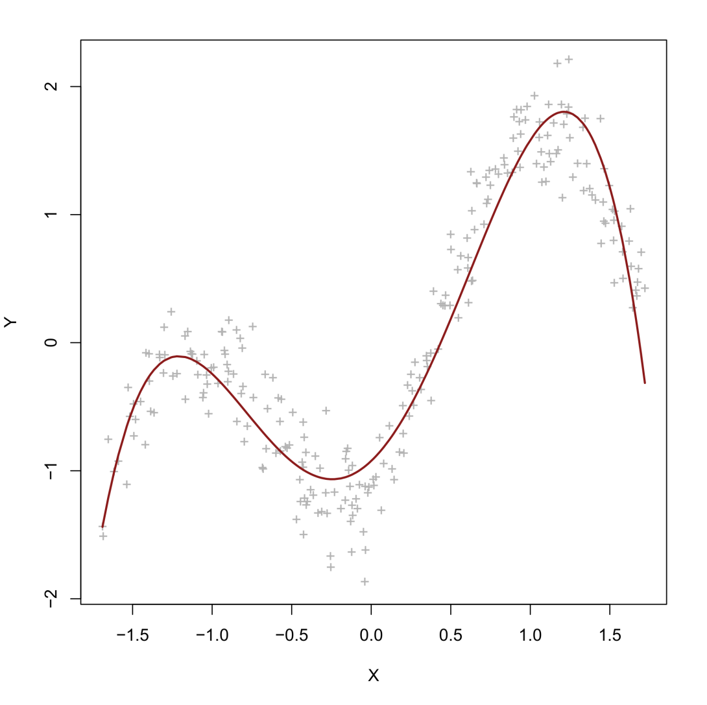
Nonlinear feature transformation
E(Y) = β₀ + β₁X + β₂X² + β₃X³ + β₄X⁴
X | X² | X³ | X⁴
-1.52 | 2.31 | -3.51 | 5.33
-1.23 | 1.51 | -1.86 | 2.28
-0.88 | 0.77 | -0.68 | 0.59
-0.57 | 0.32 | -0.18 | 0.10
0.01 | 0.00 | 0.00 | 0.00
0.39 | 0.15 | 0.05 | 0.02
0.55 | 0.30 | 0.16 | 0.09
1.01 | 1.02 | 1.03 | 1.04
... | ... | ... | ...
Dimension of the feature set: 4

Slide 77
Nonlinear feature transformation
Many ML models operate like this. First they apply a nonlinear transformation to the predictor variables (e.g., polynomial of degree 4). Then they fit a linear model to the transformed predictors (e.g., linear regression).
The preceding model is nonlinear in the predictors but linear in the parameters!*
The example makes nonlinear modelling seem easy but immediately raises important practical questions. For example, how do we decide…
Which nonlinear transformation to apply? (e.g., logarithmic, exponential, polynomial,…?)
When to stop transforming? (e.g., at the 4th, 10th, 100th degree polynomial?)
How to interpret our nonlinear effects?
* As noted, models with nonlinear parameters exist (e.g., neural networks) but are relatively rare in ML. We will not discuss them in this workshop.

Slide 78
3. Principles of machine learning
B. Model selection and generalization

Slide 79
Model evaluation
One of the primary purpose of machine learning is to detect nonlinear patterns in data. Many different models exist that can achieve this. Which one should we pick?
Once we have made our choice, we also want to quantify the model’s ability to generalize to the population of data. How can we do this?
These two questions concern, respectively, (a) model selection and (b) generalization assessment.

Slide 80
Model selection
Model selection usually consumes the most time when running an ML analysis. It involves making choices such as:
X1 | X2 | X2 | X3 | X4 | X5 | …
… | … | … | … | … | … | …
… | … | … | … | … | … | …
… | … | … | … | … | … | …
… | … | … | … | … | … | …
LDA
KNN
SVM
Which specific model to use?
Which predictors/features to use?
Transformation function
Transformation parameters
Number of neighbors
Number of subclusters
…
Which model options to set?

Slide 81
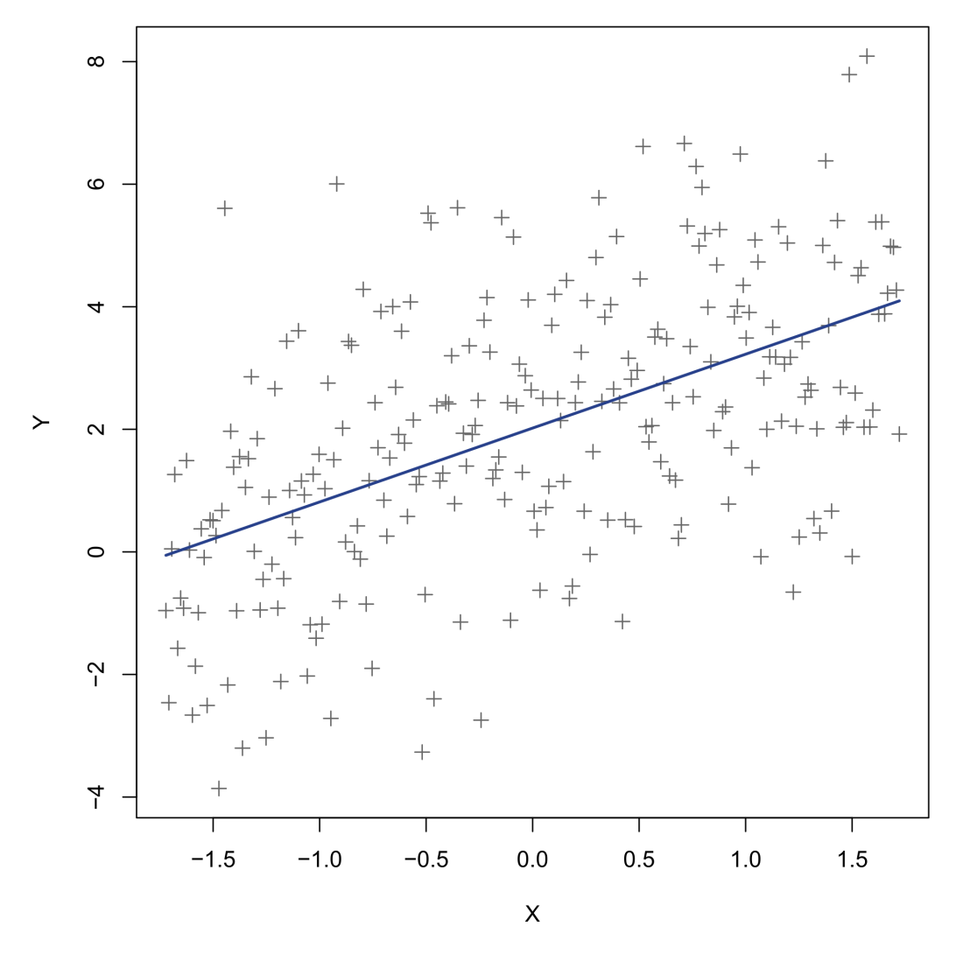
Model selection – Accuracy comparison
One way to select a model is by fitting several alternatives, and compare their accuracy or error on the outcome data. Let us consider some simple data, and once again fit polynomial regressions. We start with a basic model:
Standard linear model (polynomial 1):
RMSE = 1.980
R² = 0.2698
What do these quantities mean?

Slide 82
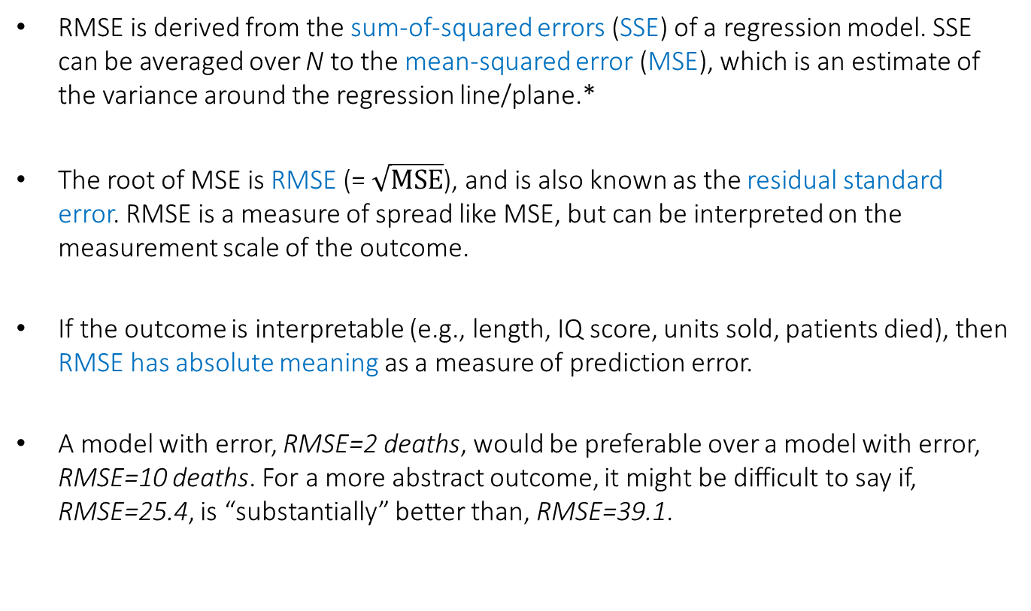
Root mean squared error (RMSE)
RMSE is derived from the sum-of-squared errors (SSE) of a regression model. SSE can be averaged over N to the mean-squared error (MSE), which is an estimate of the variance around the regression line/plane.*
The root of MSE is RMSE (= $\sqrt{MSE}$), and is also known as the residual standard error. RMSE is a measure of spread like MSE, but can be interpreted on the measurement scale of the outcome.
If the outcome is interpretable (e.g., length, IQ score, units sold, patients died), then RMSE has absolute meaning as a measure of prediction error.
A model with error, RMSE=2 deaths, would be preferable over a model with error, RMSE=10 deaths. For a more abstract outcome, it might be difficult to say if, RMSE=25.4, is “substantially” better than, RMSE=39.1.
* Often assumed to be constant!

Slide 83
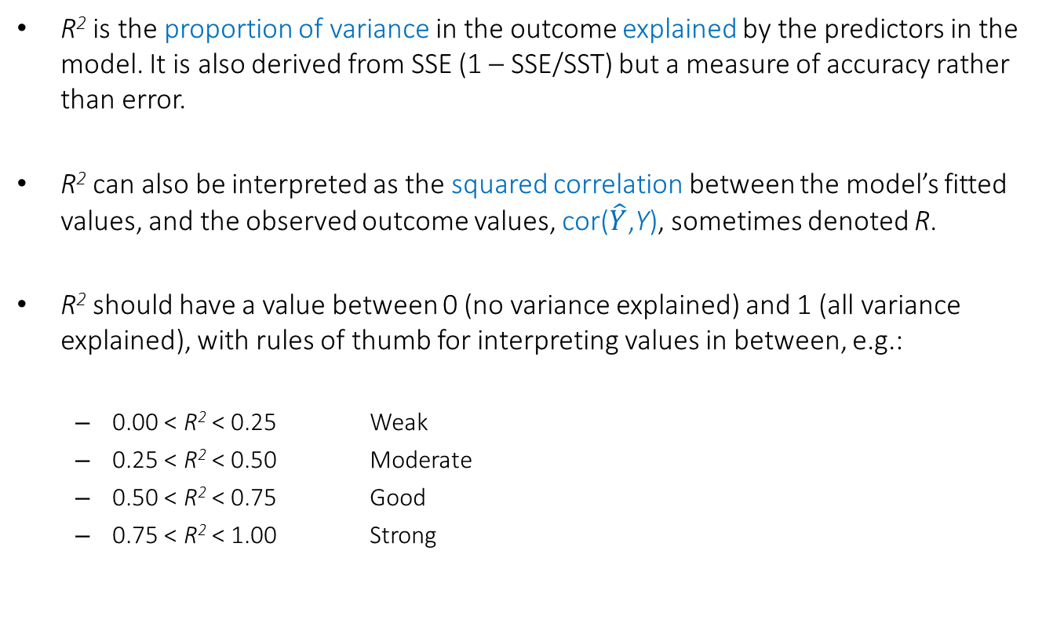
Proportion of explained variance (R²)
R² is the proportion of variance in the outcome explained by the predictors in the model. It is also derived from SSE (1 – SSE/SST) but a measure of accuracy rather than error.
R² can also be interpreted as the squared correlation between the model’s fitted values, and the observed outcome values, cor($\hat{Y}$,Y), sometimes denoted R.
R² should have a value between 0 (no variance explained) and 1 (all variance explained), with rules of thumb for interpreting values in between, e.g.:
0.00 < R² < 0.25 Weak
0.25 < R² < 0.50 Moderate
0.50 < R² < 0.75 Good
0.75 < R² < 1.00 Strong
https://en.wikipedia.org/wiki/Coefficient_of_determination

Slide 84
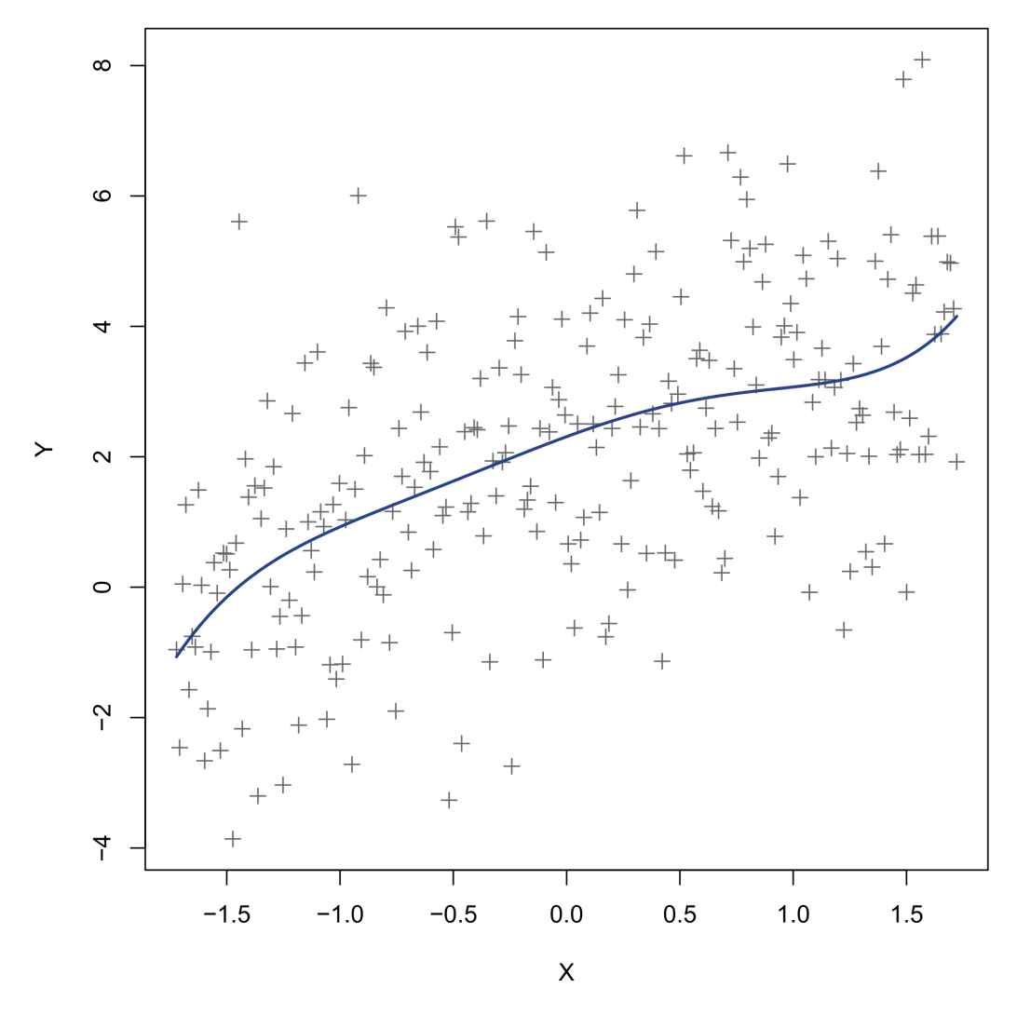
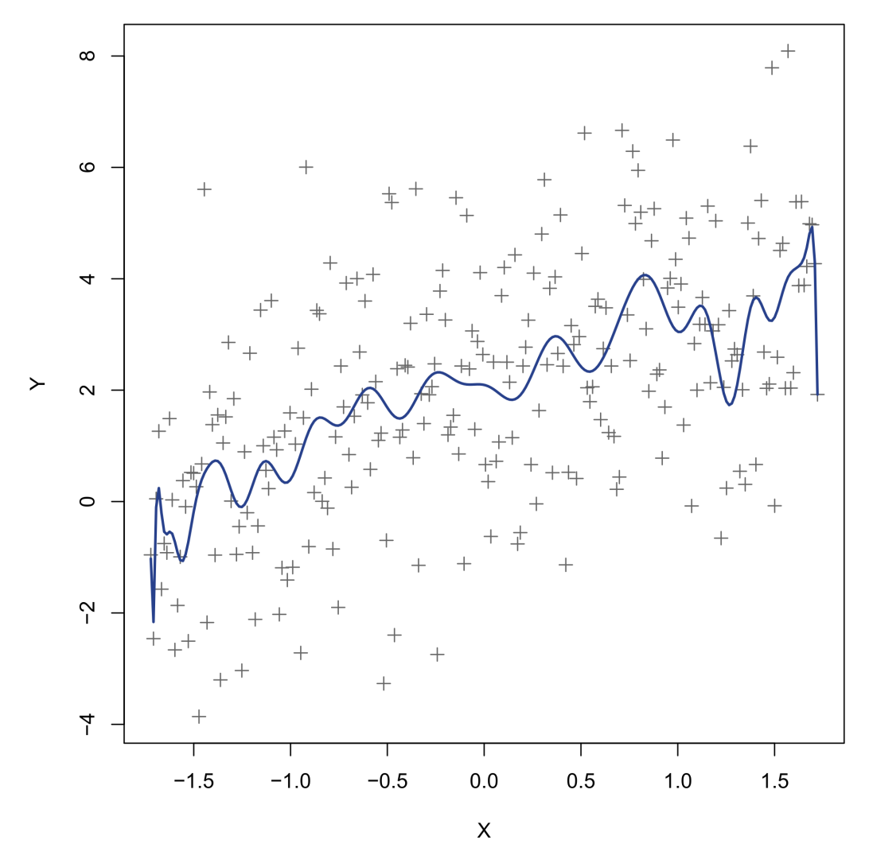
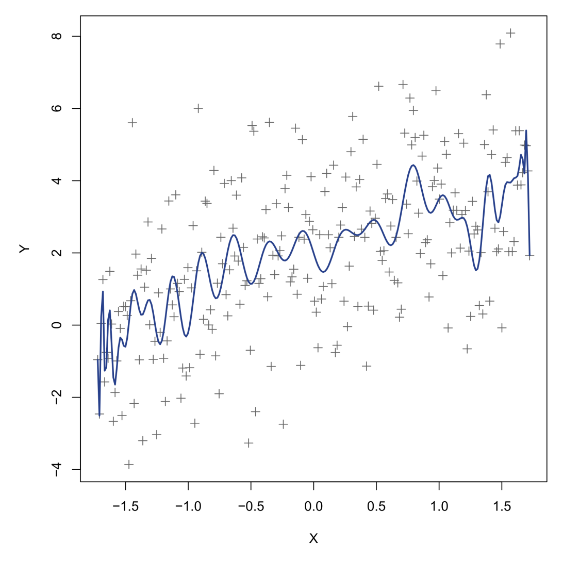
Let’s try more polynomials…
Polynomial 5
Polynomial 50
Polynomial 100
RMSE | 1.977
R² | 0.2773
Adjusted R² | 0.2700
RMSE | 1.936
R² | 0.3509
Adjusted R² | 0.3004
RMSE | 1.937
R² | 0.3639
Adjusted R² | 0.2993
R² keeps increasing! These must be highly complex data, right…?

Slide 85
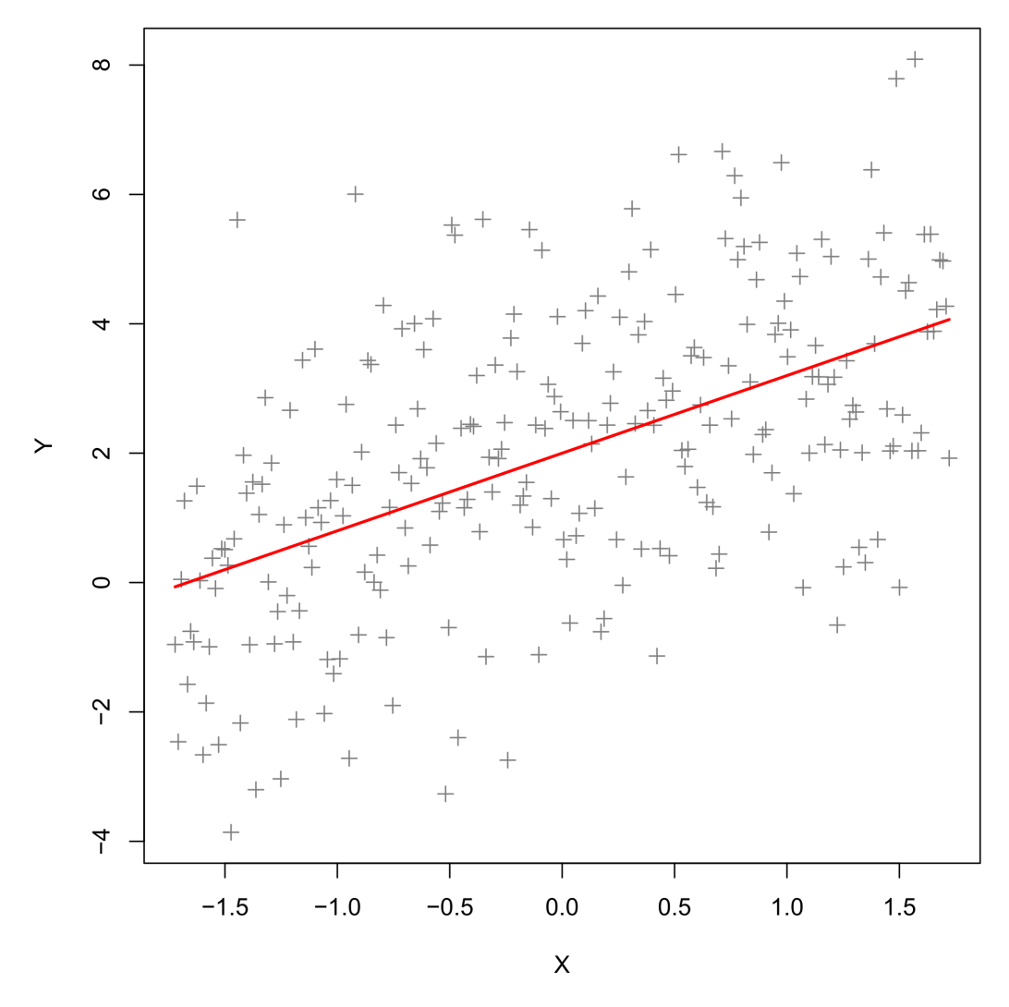
Wrong…!
The sample data were generated from a standard linear regression, with:
True polynomial degree = 1
True RMSE = 2
True R² = 0.25
How is it possible for any model to achieve an error lower than 2…?

Slide 86
Overfitting
Data are assumed to be a combination of patterns and noise.
Noise is expected to change from sample to sample, hence we cannot hope to predict this well, and assign the “noise” part to a distribution function (e.g., normal, binomial, poisson).
Instead, we hope to predict well the patterns. When the model confuses noise for patterns, it is said to be “overfitting” the data.
In the example, adding polynomial transformations continued to improve model fit (R²) to our sample data. By degree 100, the curve was starting to pass through every individual point. Eventually, we could have achieved “perfect fit” with this procedure (R² = 1.00).

Slide 87
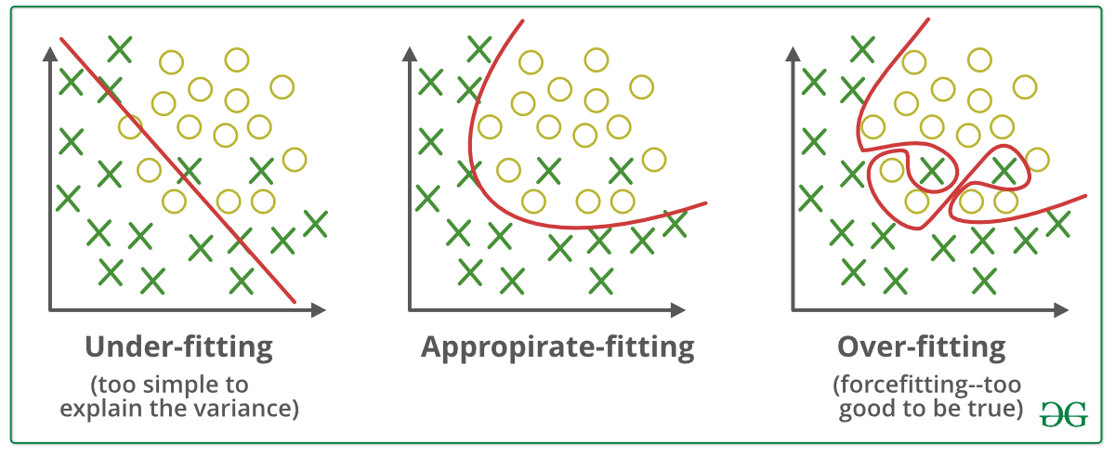
Overfitting and underfitting
Overfitting is a major risk for nonlinear models! Extra parameters and flexibility allow the model to achieve perfect fit on any sample data, but at the cost of poor generalization.

Slide 88
Types of error in prediction
At this point, it is useful to make a distinction between types of error/accuracy, when fitting ML models. Generally speaking, we can distinguish three error types:
Irreducible error
Training error
Test error
Irreducible error is the true error of a prediction problem, and may be non-zero for many data problems. It may reflect pure measurement error on the outcome, or miscellaneous sources of variance that are basically unknown.
ML models will achieve good generalisation if they can minimize prediction error to its irreducible part. Lower would mean the model is overfitting, higher would mean the model is underfitting.

Slide 89
Irreducible error

Slide 90
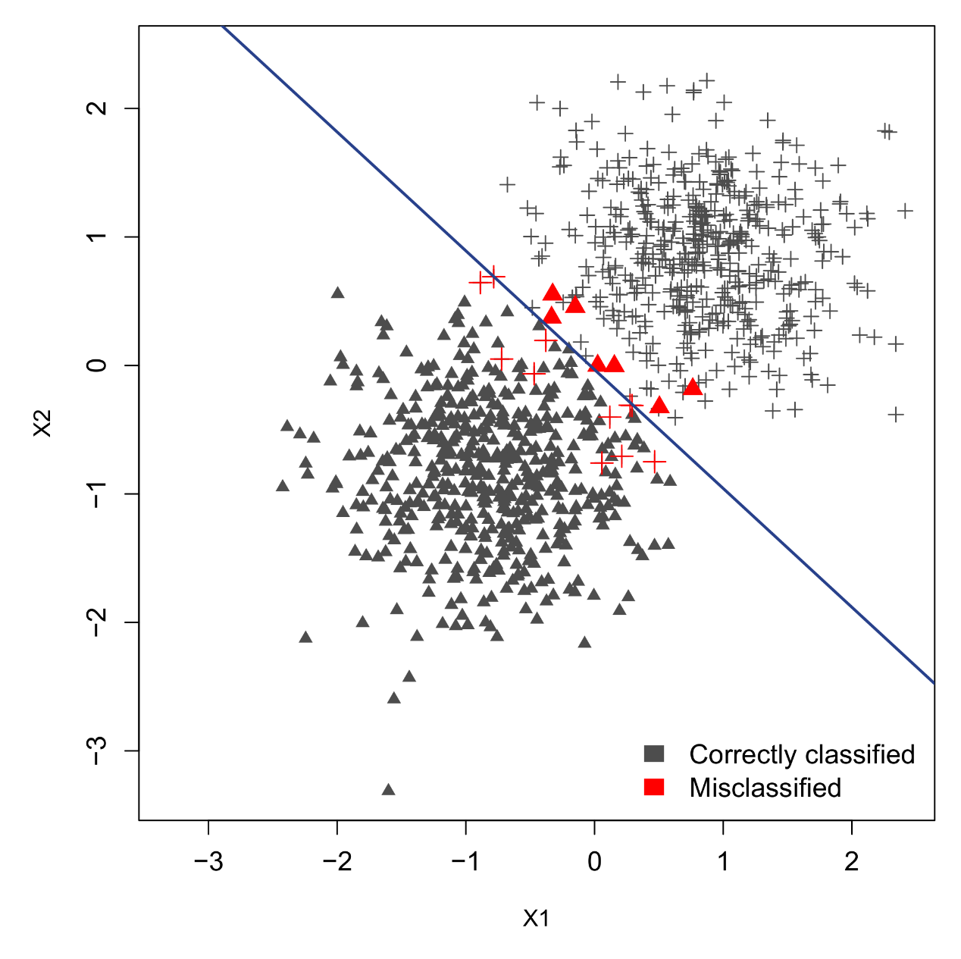
Bayes error rate

Slide 91
Irreducible error
For classification problems, the irreducible error is known as the Bayes error rate. It is the percentage of misclassifications that would occur, even if our fitted model captured exactly the true underlying data distribution:
This implies that perfect separation of classes may not be possible, even by the best machine learner.
However, unlike regression problems—where 0 error is rarely expected—there are classification problems where machine learning has achieved extremely high accuracy, e.g., recognition of handwritten digits (0.7% error; LeCun et al., 1989). These rates are believed to be quite close to the irreducible error.

Slide 92

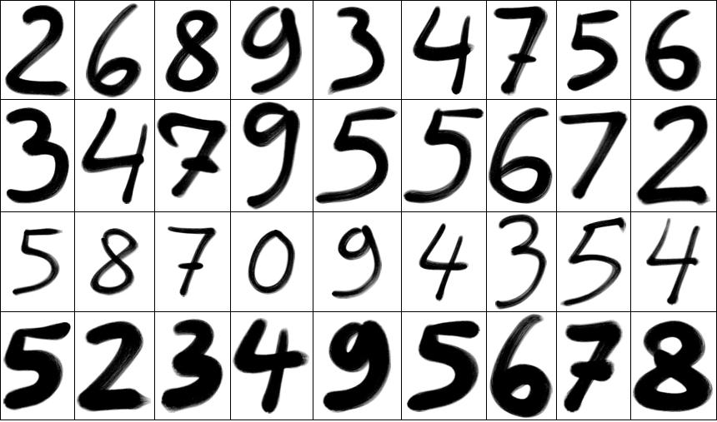
Handwritten digit recognition
Recognition of handwritten digits became a classic ML problem since Yann LeCun’s influential paper on recognition of US ZIP codes (LeCun et al., 1989).
To solve this problem, LeCun used highly layered neural networks that were the forerunners of today’s “deep learning” networks.
The ZIP code data became a benchmark problem for new ML methods, with surprisingly simple models (KNN) now beating LeCun’s neural nets. LeCun is currently director of AI research at Facebook.
ID | px11 | px12 | … | px99 | True N°
img_03108 | 0.12 | 0.45 | … | 0.01 | 2
img_03109 | 0.23 | 0.26 | … | 0.78 | 6
img_03110 | 0.20 | 0.51 | … | 0.73 | 4
… | … | … | … | … | …
Data representation with image pixels as features, and the human-recognized number as outcome.

Slide 93
Types of error in prediction
For most data sets, the true irreducible error will not be known. This is because we typically do not know the true generating process of the data, or have access to the full population of data.
Irreducible error
Training error
Test error
Using just a sample data, ML models must attempt to approximate the irreducible error with a measure of their own performance.
We will now consider two such approximates, training and test error, discuss different statistics to measure them, and discuss how balancing these two errors can avoid underfitting and overfitting.

Slide 94
Training error
Training error refers to the prediction error of a model that it achieves on the sample of data that it was fitted to (=the training data).
We have just discussed RMSE and R² as two measures of training error—or accuracy—for continuous outcomes.
For categorical outcomes, there exist analogous measures of error such as cross-entropy, or measures of accuracy such as the proportion of observations in the training data classified correctly (see later!).
Unfortunately, these measures will not tell us when our model is overfitting, and are therefore poor measures of generalization...

Slide 95
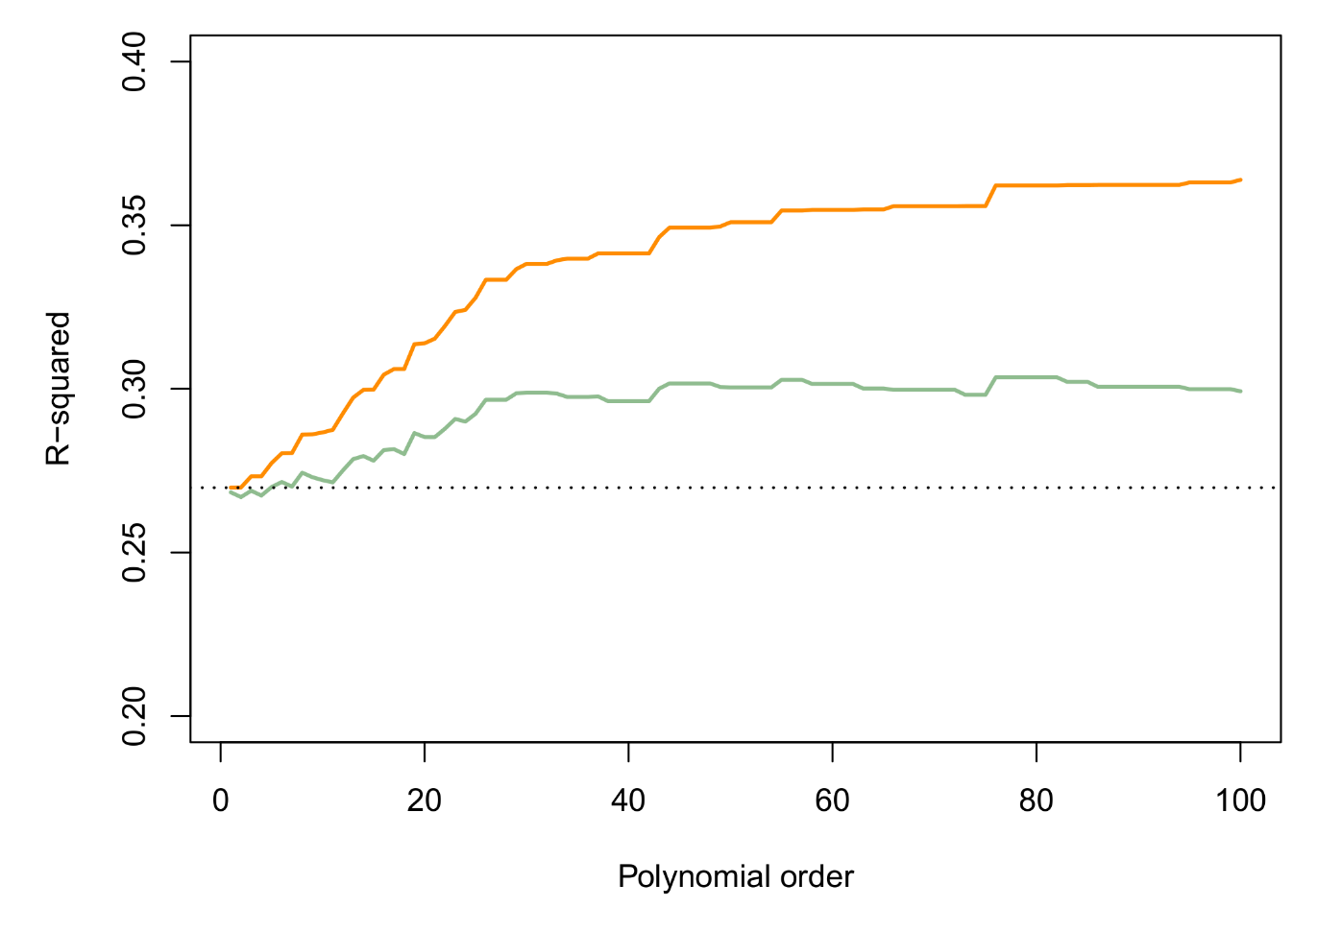
Training error
In the previous example, R² continued to increase despite the model overfitting. The reason is that R² does not penalize a model for adding extra parameters. On the contrary, any random noise that is added as a predictor will increase R²!
R²
Adjusted R²
True R²

Slide 96

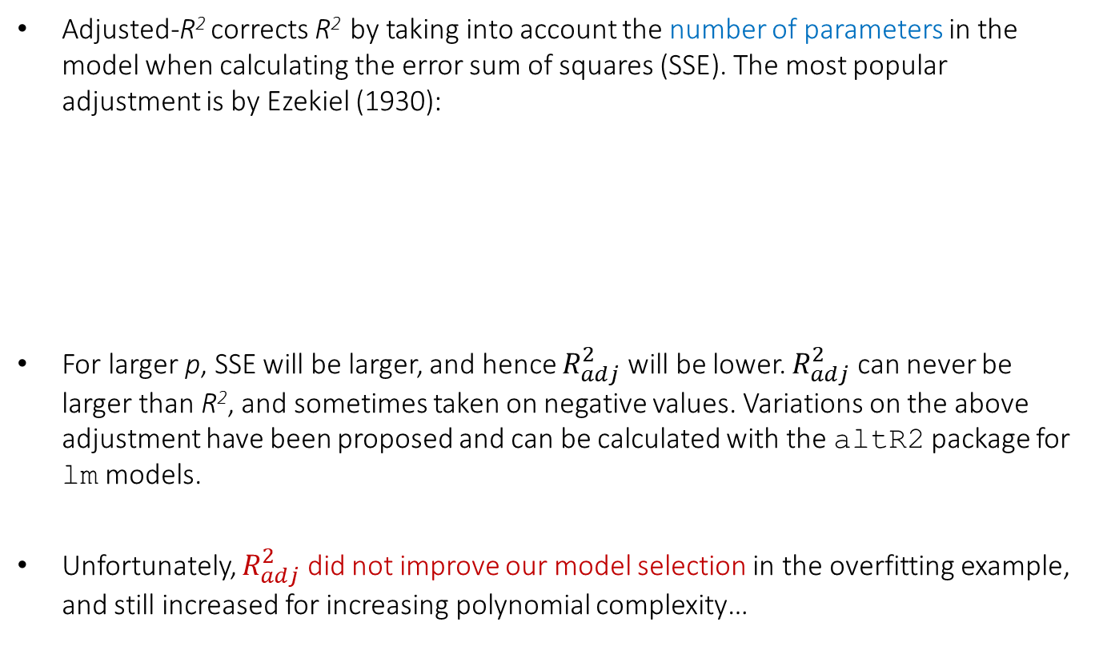
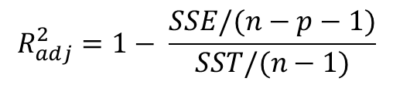
Adjusted R²
Adjusted-R² corrects R² by taking into account the number of parameters in the model when calculating the error sum of squares (SSE). The most popular adjustment is by Ezekiel (1930):
For larger p, SSE will be larger, and hence $R_{adj}^{2}$ will be lower. $R_{adj}^{2}$ can never be larger than R², and sometimes taken on negative values. Variations on the above adjustment have been proposed and can be calculated with the altR2 package for lm models.
Unfortunately, $R_{adj}^{2}$ did not improve our model selection in the overfitting example, and still increased for increasing polynomial complexity…
$$R^{2}=1− \frac{SSE/n}{SST/n}$$
$$R_{adj}^{2}=1− \frac{SSE/(n−p−1)}{SST/(n−1)}$$

Slide 97
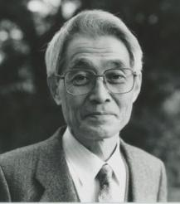
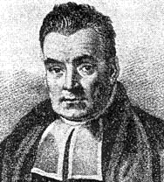
Information criteria
Other measures of training error have also adopted the penalization principle, most famously the information criteria Akaike Information Criterion (AIC) and Bayesian Information Criterion (BIC).
These quantities are related to Bayes factors although they can be motivated from a frequentist probability perspective, too (Burnham & Anderson, 2004).
AIC/BIC are a direct measure of generalization but cannot be interpreted in an absolute sense, only in a relative sense.
Among several competing models for the same outcome data, the model with lowest AIC/BIC should be the one that best generalizes! If multiple models have AIC/BIC values close to each other, differences > 2 are already considered meaningful!
Akaike
Bayes

Slide 98
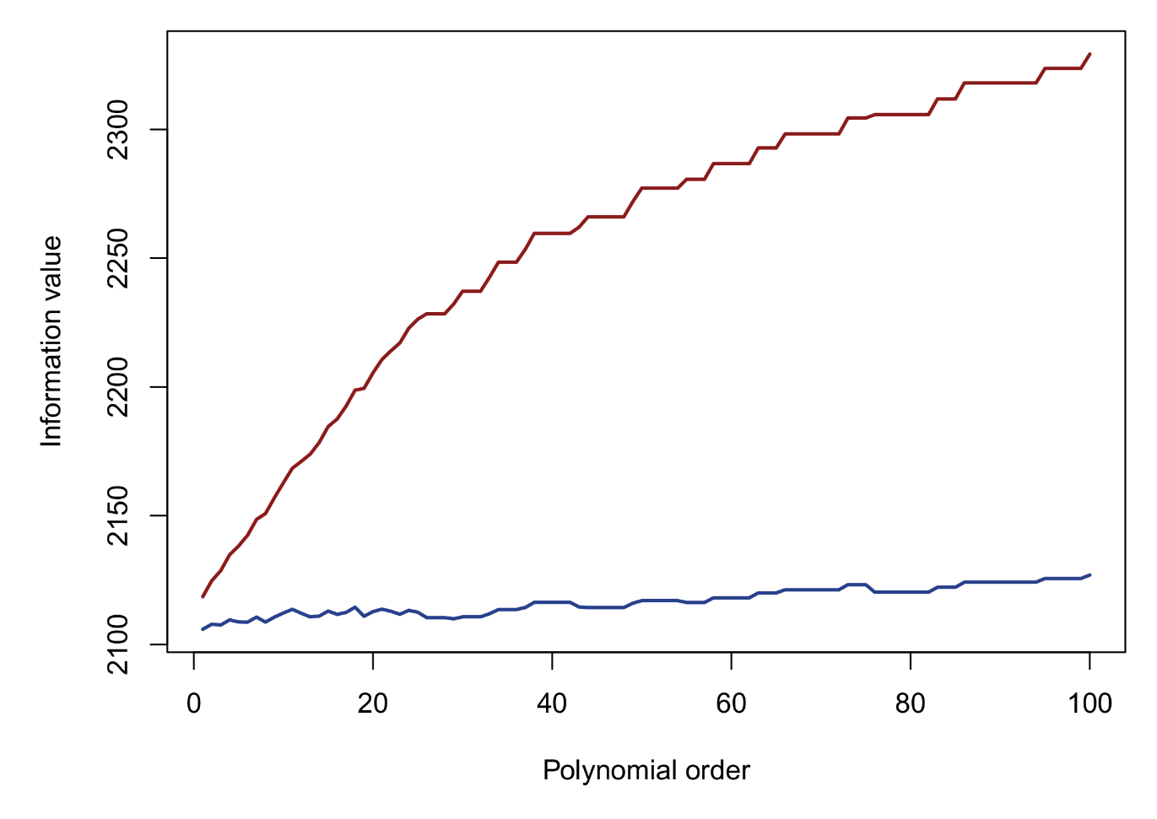
AIC and BIC for model selection
BIC penalizes a model for extra parameters more heavily than AIC. In other words, it favors sparse models. In the overfitting example, minimal AIC/BIC was reached for the standard linear model, which was the true data-generating model!
BIC
AIC

Slide 99

Occam’s Razor
Penalized measures of fit follow the principle known as Occam’s Razor, so named after the 14th century scholastic philosopher William of Occam.
This can be translated directly into statistical modelling terms:
“Given a phenomenon and a set of competing theories to explain that phenomenon, one should always prefer the theory that best explains the phenomenon with the least amount of assumptions"
“Given data and several competing models to explain the data, one should always prefer the model that best explains the data with the least amount of parameters"

Slide 100
Stepwise predictor selection with AIC
We have just seen that AIC could be used to set the appropriate degree of a polynomial transformation (d), in this case d=1.
This principle can generally be applied to the selection of predictor variables. From a set of p variables, one could fit 2p – 1 subsets of variables, and calculate AIC, to search for the “best subset” of predictors.
Alternatively, one could also consider:
Forward search: Starting from an empty model, predictors are added to the model one at a time, until no new addition lowers AIC.
Backward search: Starting from a full model, predictors are eliminated one at a time, until no elimination lowers AIC.
In R, the basic step function allows stepwise regression selection by either AIC or BIC. The more flexible olsrr package does AIC selection…

Slide 101

Stepwise selection – Acrophobia data
The following data contain levels of acrophobia (=fear of heights) for 49 university students. Also measured were demographics, prior experiences with heights, and personality traits. There are 48 predictors, which is too much to fit in a single regression model. Instead we could consider a stepwise selection of predictors:
ID | Gender | Age | Height | Weight | Fallen before | Claustro-phobia | Sensation seeking | … | Acrophobia
6 | F | 22 | 1.65 | 75 | No | 1 | 0.50 | … | 3
7 | M | 30 | 1.80 | 70 | Yes | 3 | 0.25 | … | 3
10 | M | 23 | 1.87 | 75 | No | 0 | 0.50 | … | 0
11 | F | 23 | 1.71 | 63 | No | 1 | -0.25 | … | 2
12 | F | 25 | 1.65 | 48 | Yes | 0 | 1.00 | … | 1
13 | M | 24 | 1.76 | 60 | Yes | 0 | 0.75 | … | 2
21 | F | 23 | 1.70 | 67 | Yes | 0 | -0.50 | … | 2
23 | F | 24 | 1.70 | 60 | No | 2 | 0.25 | … | 2
24 | F | 23 | 1.64 | 48 | No | 0 | 0.00 | … | 3
25 | F | 43 | 1.75 | 64 | No | 1 | 0.25 | … | 2
… | … | … | … | … | … | … | … | … | …

Slide 102
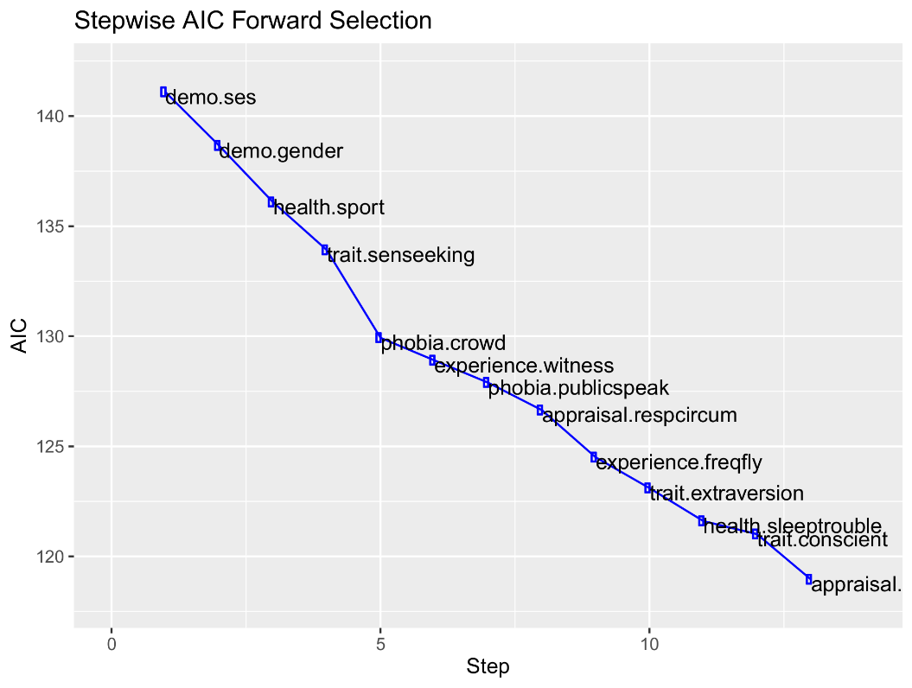
Stepwise selection – Acrophobia data
library(olsrr)
phobia <- read.table("https://drive.switch.ch/index.php/s/5HiEn1NDoAbEci4/download",
header=TRUE,as.is=FALSE)
initial.model <- lm(acrophobia~.,data=phobia)
stepwise <- ols_stepwise_forward_aic(initial.model)
stepwise ; plot(stepwise)
Selection Summary
---------------------------------------------------------------------------
Variable AIC Sum Sq RSS R-Sq Adj. R-Sq
---------------------------------------------------------------------------
demo.ses 141.095 6.806 45.194 0.13088 0.11238
demo.gender 138.658 10.718 41.282 0.20612 0.17160
health.sport 136.096 14.388 37.612 0.27669 0.22847
trait.senseeking 133.920 17.460 34.540 0.33577 0.27539
phobia.crowd 129.930 21.435 30.565 0.41221 0.34386
experience.witness 128.907 23.263 28.737 0.44737 0.36842
phobia.publicspeak 127.893 24.978 27.022 0.48034 0.39162
appraisal.respcircum 126.645 26.711 25.289 0.51367 0.41641
experience.freqfly 124.501 28.762 23.238 0.55311 0.44998
trait.extraversion 123.102 30.319 21.681 0.58306 0.47334
health.sleeptrouble 121.608 31.811 20.189 0.61176 0.49633
trait.conscient 121.009 32.854 19.146 0.63181 0.50908
appraisal.posout 118.957 34.374 17.626 0.66103 0.53513
---------------------------------------------------------------------------

Slide 103
Stepwise selection – Acrophobia data
summary(stepwise$model)
> Coefficients:
> Estimate Std. Error t value Pr(>|t|)
> (Intercept) 2.7553047 0.8007754 3.441 0.001518 **
> demo.ses -0.5803916 0.2160997 -2.686 0.010990 *
> demo.genderM -1.2699955 0.2771633 -4.582 5.63e-05 ***
> health.sport 0.0016849 0.0008112 2.077 0.045208 *
> trait.senseeking -0.6678335 0.1729525 -3.861 0.000465 ***
> phobia.crowd 0.2534667 0.1054557 2.404 0.021670 *
> experience.witness 0.5344210 0.3962075 1.349 0.186051
> phobia.publicspeak 0.3126510 0.1107218 2.824 0.007781 **
> appraisal.respcircum -0.3114243 0.1058593 -2.942 0.005753 **
> experience.freqfly 24.3223367 10.2013978 2.384 0.022669 *
> trait.extraversion 0.1484283 0.0881357 1.684 0.101064
> health.sleeptrouble 0.8161178 0.3984872 2.048 0.048116 *
> trait.conscient -0.1589863 0.0867371 -1.833 0.075325 .
> appraisal.posout 0.2721229 0.1566521 1.737 0.091161 .
> ---
> Signif. codes: 0 ‘***’ 0.001 ‘**’ 0.01 ‘*’ 0.05 ‘.’ 0.1 ‘ ’ 1
>
> Residual standard error: 0.7097 on 35 degrees of freedom
> Multiple R-squared: 0.661, Adjusted R-squared: 0.5351
> F-statistic: 5.25 on 13 and 35 DF, p-value: 4.32e-05

Slide 104
Information criteria
Information criteria are extremely powerful for performing a model selection on training data (e.g., predictor selection, transformation selection). BIC especially is conservative and will not normally lead to overfitting. Whenever these measures are available, they should be used!
Unfortunately, information criteria do have drawbacks:
They do not exist for many ML models (SVM, nearest neighbors, trees, etc.)
There is no guarantee that they will select the “true model” from the set of competing models
They do not quantify the error or generalization of a model in an absolute or even interpretable way
Sensitive to missing values (beware of stepwise regression with missings!)
Quantifying the generalization capacity of a model should be done by calculating a conventional measure of error on an independent sample of test/validation data…

Slide 105
Test error
The most persuasive evidence for the generalization performance of a particular model is by showing that it succesfully predicts data that was not used during training (= test data).
Irreducible error
Training error
Test error
As shown, models can overfit the training data, leading to overly optimistic performance estimates. We would benefit from keeping some data aside for an independent validation.
As such, the first step in an ML analysis is to split the data into a training set and a test set.
Training data
Test data
Total data

Slide 106
Splitting rules
Hastie et al. (2005) make a further distinction between validation data, which is used to guide model selection, and test data, which is used to assess the final generalization performance (test error) of a model:
Rules for what proportion of the data to use for each set depend strongly on the size of the available sample. For large data, a ratio of 50–25–25 is often chosen.
An alternative to an explicit validation set is to divide the training data into a number of folds, and to perform a cross-validation (CV). When conducted on the training data, this is also referred to as an internal cross-validation.
Training
Validation
Test

Slide 107
Cross-validation
Cross-validation first splits the data into K folds (= K-fold CV), then proceeds to fit models and calculate errors according to the principle of leave-one-fold-out. For each model being considered (e.g., different polynomial models), the model is fitted to all-but-one fold, and its error/accuracy then calculated on the left-out fold.
Training data
Test data
Fold 1
Fold 2
Fold 3
Fold 4
Fold 5

Slide 108
5-fold cross-validation
Training data
Step 1
Fold 1
Fold 2
Fold 3
Fold 4
Fold 5
Step 2
Fold 1
Fold 2
Fold 3
Fold 4
Fold 5
Step 3
Fold 1
Fold 2
Fold 3
Fold 4
Fold 5
Step 4
Fold 1
Fold 2
Fold 3
Fold 4
Fold 5
Step 5
Fold 1
Fold 2
Fold 3
Fold 4
Fold 5
Data used to estimate the parameters for a given model (e.g., polynomial degree 5)
Data used to measure the given model’s error (e.g., R², RMSE)

Slide 109






5-fold cross-validation
Training data
Step 1
Fold 1
Fold 2
Fold 3
Fold 4
Fold 5
$$R_{fold5}^{2}$$
+
Step 2
Fold 1
Fold 2
Fold 3
Fold 4
Fold 5
$$R_{fold4}^{2}$$
+
Step 3
Fold 1
Fold 2
Fold 3
Fold 4
Fold 5
$$R_{fold3}^{2}$$
+
Step 4
Fold 1
Fold 2
Fold 3
Fold 4
Fold 5
$$R_{fold2}^{2}$$
+
Step 5
Fold 1
Fold 2
Fold 3
Fold 4
Fold 5
$$R_{fold1}^{2}$$
=
$$R_{cv}^{2}$$
5

Slide 110
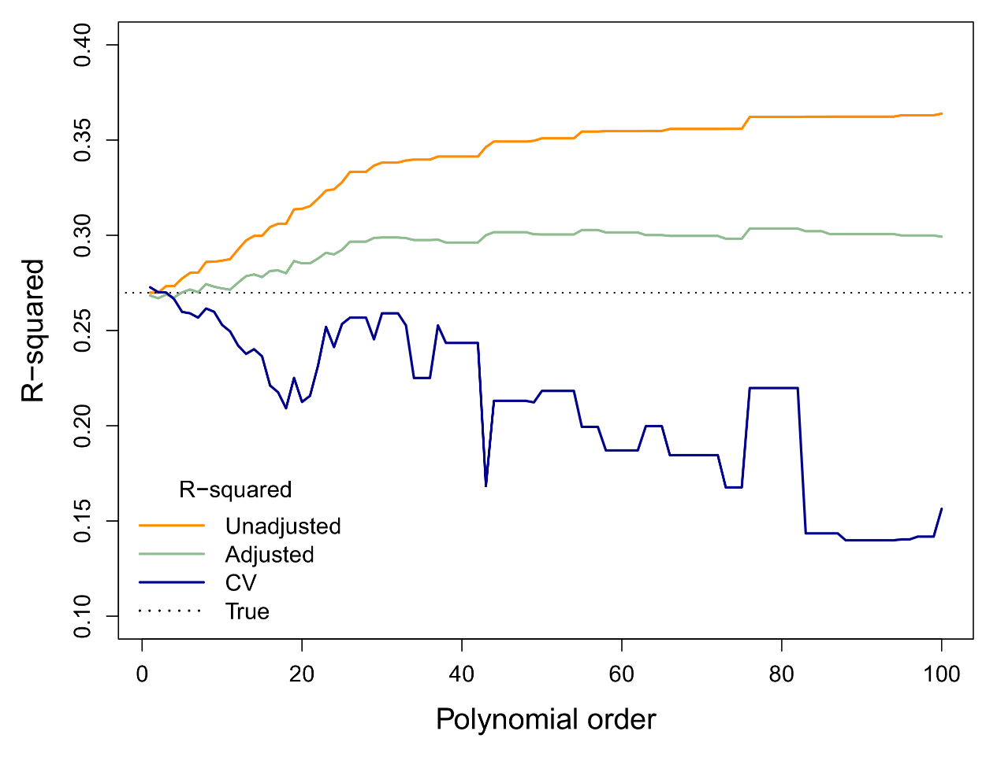
Cross-validation
When considered across all models (e.g., all polynomials), cross-validated R² values can guide model selection:

Slide 111
Leave-one-out CV
I have just discussed K-fold CV, which fits models according to the leave-one-fold-out principle. The number of folds is typically set between 5 and 10, although for large datasets higher numbers are possible.
A more radical approach is to consider each individual observation as a fold. This strategy is known as leave-one-out (LOO) CV.
Although LOO-CV would seem to be most efficient strategy in terms of maximizing the training sample for model selection, there are drawbacks:
Computationally expensive since each model has to be re-run N times, where N is the size of the training data
LOO-CV has a relatively high variance (from sample to sample) as opposed to 5- or 10-fold cross-validation

Slide 112
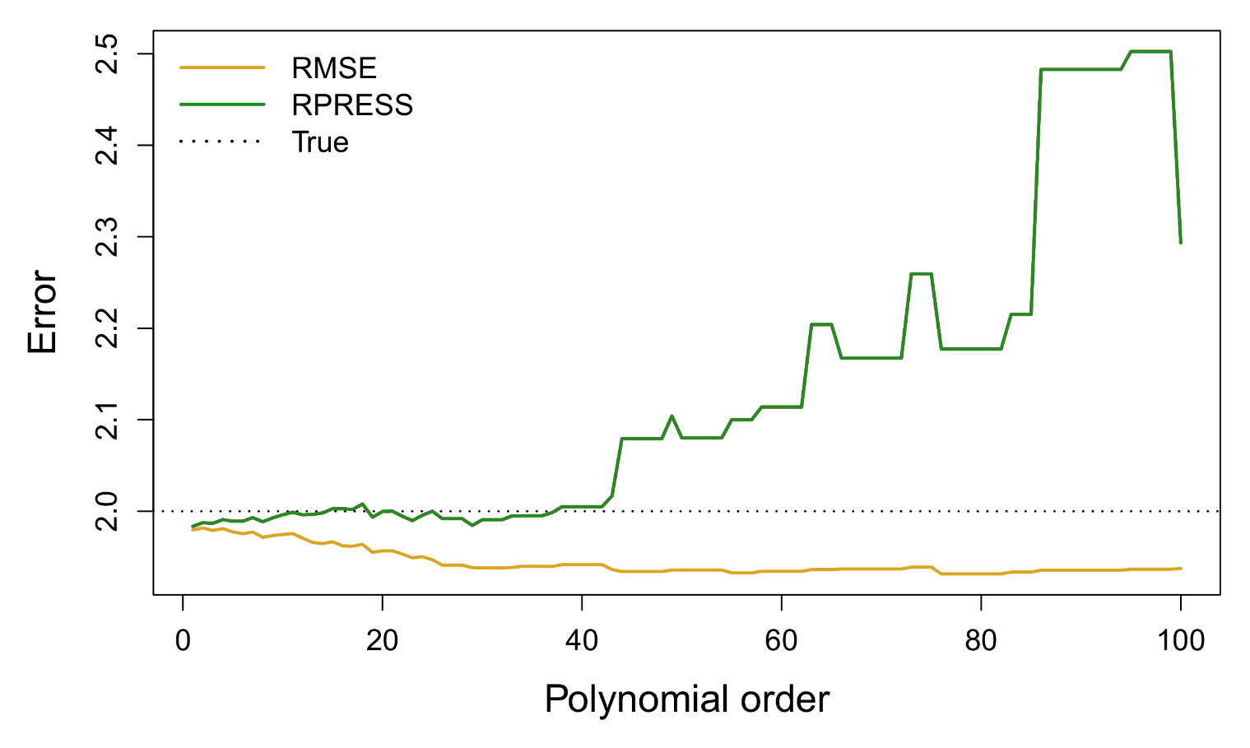
Predictive error sum of squares
For some models, an LOO-CV error can be computed with an equation, without needing to refit the model N times. This equation is available for linear regression and for linear discriminant analysis (LDA). In linear regression, the resulting error measure is known as predictive error sum-of-squares (PRESS):

Slide 113
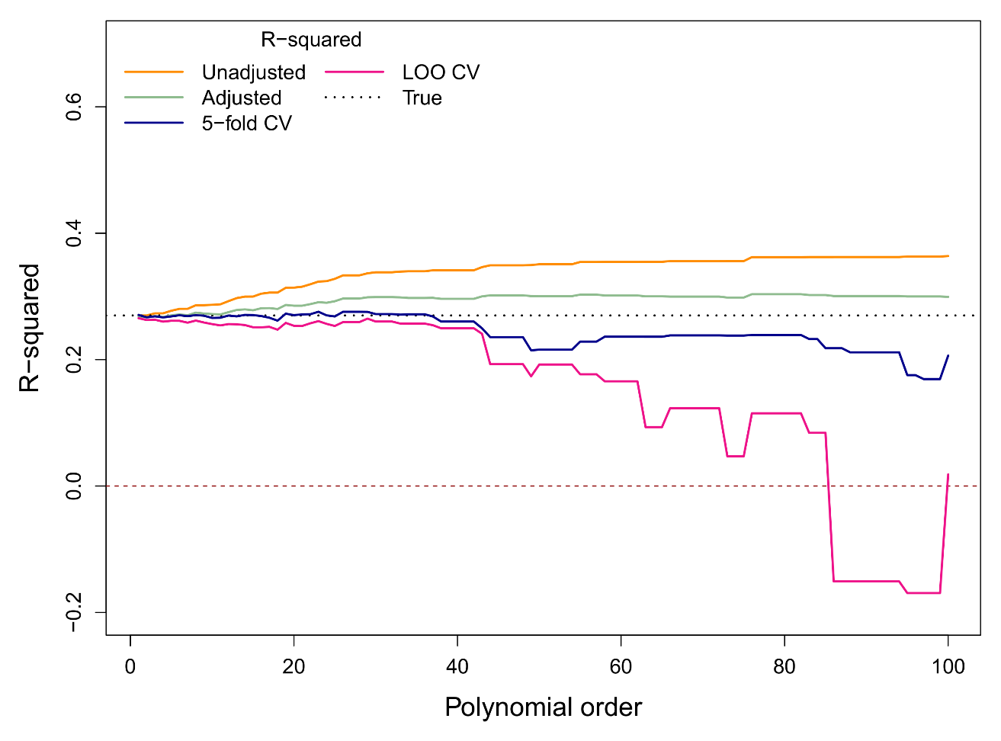
Leave-one-out R²
We can also use PRESS to calculate an LOO-R² measure (PRESS/SST). The resulting graph demonstrates the relative instability of the LOO-CV approach compared to K-fold CV, although both measures correctly identify the simple linear model as the best fit:

Slide 114
CV, validation error, and test error
For K-fold CV, splitting into folds introduces some instability to model selection. With a different set of folds—or indeed on a different sample of data—a different CV performance will be found, and perhaps a different final model (e.g., containing different predictors).
Moreover, the unused fold in each CV-step contribute to the training fit in the other CV-steps! As such, there is an implicit dependency between folds and the final training model.
These two aspects make CV not a measure of true test error or generalization but, at best, an approximation. CV performance is primarily intended for model selection, not generalization assessment!
Training
Validation
Test

Slide 115
CV, validation error, and test error
For large data sets, a researcher may decide to use a single validation data set for model selection, as opposed to an internal K-fold CV on the training data. With a single validation set, there is a general rule for how to select a model:
Error
underfitting
overfitting
Optimum
Stop training?
Validation error
Training error
Model complexity

Slide 116

Error/accuracy measures for regression
Measure | Definition | Training bias | Absolute error?
Correlation
whiteR | Correlation between observed and predicted response values | Strong
Variance
whiteR² | Proportion of variance in the outcome explained by the predictors in the model | Strong
white$R_{adj}^{2}$ | R² adjusted for the number of parameters in the model | Mild
white$R_{cv}^{2}$ / $R_{LOO}^{2}$ | Cross-validated R² | Weak
Error
whiteRMSE | Root mean squared error | Strong | Yes
whiteRM-PRESS | Root mean predictive error sum of squares | Weak | Yes
whiteMAD | Mean absolute deviation of residuals | Strong | Yes
Information
whiteAIC | Akaike information criterion | Weak
whiteBIC | Bayesian information criterion | Weak

Slide 117
Generalization assessment
The last step of an analysis with machine learning consists of a final assessment of generalization on an independent set of data, the test set.
When cross-validation was used for model selection and tuning, the selected model is typically first re-estimated on the full training data (as opposed to a subset of folds). For this model, the final test error is then calculated.
For assessing final generalization, it is recommended to use an absolute measure of error, that is, a measure that is expressed on the same scale as the response variable, such as RMSE, mean root PRESS, or MAD. In other words, the error can be expressed in interpretable units.
For many researchers however, R and R² will also convey a (more or less) “absolute” meaning in the sense that these are widely known effect sizes with standardized guidelines for their interpretation.

Slide 118

Extent of generalization
When we evaluate a model’s capacity to generalise to new data, it makes a difference whether the new data comes from the same sample space as the training data (=interpolation problem), or outside of that space (=extrapolation problem).

Slide 119

Extent of generalization
Extrapolation is a much harder problem than interpolation, especially for models that tend to overfit. Some models impose conservative boundary conditions to prevent extreme extrapolations.

Slide 120
Calculating error measures in R
Calculating the various measures of error that we have just discussed is entirely straightforward in R. First we generate some toy data:
set.seed(668)
x <- 1:500
true <- 100*sin(0.02*x) + 0.5*x
y <- true + rnorm(500,0,25)
par(mar=c(5,5,1,1),cex.lab=1.2,cex.axis=1.2)
plot(x,y,pch="+",col="grey70",lwd=2,xlab="X",ylab="Y")
lines(x,true,col="darkmagenta")
Which generates a linear function with a sinusoidal nonlinear part (see introduction).

Slide 121

Calculating error measures in R

Slide 122
Calculating error measures in R
A basic linear model for these data and its errors:
toy <- lm(y~x)
summary(toy)
> Coefficients:
> Estimate Std. Error t value Pr(>|t|)
> (Intercept) 23.17293 6.46607 3.584 0.000372 ***
> x 0.47530 0.02237 21.251 < 2e-16 ***
> ---
> Signif. codes: 0 ‘***’ 0.001 ‘**’ 0.01 ‘*’ 0.05 ‘.’ 0.1 ‘ ’ 1
> Residual standard error: 72.18 on 498 degrees of freedom
> Multiple R-squared: 0.4756, Adjusted R-squared: 0.4745
> F-statistic: 451.6 on 1 and 498 DF, p-value: < 2.2e-16
Note that RMSE is 72.18 here, which is much higher than the true error, 25.

Slide 123

Calculating error measures in R

Slide 124
Calculating error measures in R
Other measures of error (press requires the DAAG package):
AIC(toy)
> 5702.16
BIC(toy)
> 5714.803
press(toy)
> 2612058
By default the PRESS criterion is expressed as a sum-of-squares. To convert it to its root-mean counterpart we can use:
N <- length(x)
sqrt(press(toy)/N)
> 72.27804

Slide 125
Calculating error measures in R
Now we try a 4th degree polynomial regression:
poly <- lm(y~x+I(x^2)+I(x^3)+I(x^4))
summary(poly)
> Coefficients:
> Estimate Std. Error t value Pr(>|t|)
> (Intercept) -2.656e+01 7.454e+00 -3.564 0.000401 ***
> x 5.074e+00 2.057e-01 24.664 < 2e-16 ***
> I(x^2) -5.123e-02 1.667e-03 -30.726 < 2e-16 ***
> I(x^3) 1.735e-04 4.998e-06 34.706 < 2e-16 ***
> I(x^4) -1.801e-07 4.949e-09 -36.390 < 2e-16 ***
> ---
> Signif. codes: 0 ‘***’ 0.001 ‘**’ 0.01 ‘*’ 0.05 ‘.’ 0.1 ‘ ’ 1
>
> Residual standard error: 32.94 on 495 degrees of freedom
> Multiple R-squared: 0.8915, Adjusted R-squared: 0.8906
> F-statistic: 1017 on 4 and 495 DF, p-value: < 2.2e-16

Slide 126
Calculating error measures in R
Comparing the fit of the linear model to the polynomial in terms of AIC/BIC (recall: lower is better!):
AIC(toy) ; AIC(poly)
> 5702.16
> 4920.452
BIC(toy) ; BIC(poly)
> 5714.803
> 4945.739
These differences are enormous so clearly the polynomial is a better fit. A plot of the model:
plot(x,y,pch="+",col="grey70",xlab="X",ylab="Y",cex=1.2)
lines(x,true,col="darkmagenta",lwd=2.2)
lines(x,fitted(poly),col="blue",lwd=3)

Slide 127

Calculating error measures in R

Slide 128
Calculating error measures in R
Sometimes the aforementioned functions will not work on specific model objects (e.g., models not generated by the lm function). In that case they can always be calculated manually, e.g., in pseudo-code:
sqrt( sum( {fitted(model)-y}^2 ) )
If the fitted function does not work for the particular model it can usually be substituted for the predict function. Likewise, for R²:
cor(fitted(model),y)^2
Be warned that, for test data, R² can have negative values (e.g., when the training model contains only an intercept).

Slide 129
5. Classification performance

Slide 130
Error in classification models
So far I have discussed model selection and generalisation assessment for models with continuous outcomes. For categorical outcomes, the theory involving different types of error, overfitting, cross-validation, and generalisation remains exactly the same.
Previously discussed statistics, such as AIC and BIC, also exist for some classification models (e.g., logistic regression, linear discriminant analysis), and can be used in that context for model selection.
However, as a measure of absolute error in classification, there is no direct analogue to RMSE in continuous regression. Typically, the error functions that classification models minimize during parameter estimation have no straightforward interpretation (e.g., cross-entropy, deviance).
Instead, it is customary to look at various measures of misclassification.

Slide 131

From probability to classification
Most classification models will not directly output class labels as their prediction. Instead they output probabilities. That is, the probability of an observation to belong to a certain class, given the predictor values of that observation.
For generating categorical predictions, the probabilities are typically transformed according to a certain rule, e.g., P > 0.5 for binary logistic regression:

Slide 132
From probability to classification
For multiclass classification, we output the class that achieves the highest probability among all alternatives. Note that, normally, the class probabilities outputted by a classification model should sum to 1.
 | Model’s predicted probabilities
Case | P(Neutral) | P(Joy) | P(Anger) | Class decision | True class
photo01 | 0.39 | 0.45 | 0.16 | Joy | Joy
Photo02 | 0.82 | 0.05 | 0.13 | Neutral | Joy
photo03 | 0.36 | 0.01 | 0.63 | Anger | Anger
…

Slide 133
Confusion matrix
Once we have converted the probabilities to categorical class decisions, we can use the predicted classes to construct a so-called confusion matrix. This is a cross-table that shows the agreement between the class predictions of the model and the true classes observed in the data. E.g., for detecting smiles in photos:
 | Predicted
True | No smile | Smile
No smile | 112 | 61
Smile | 31 | 95
N_{tot} = 300

Slide 134
Classical measures of confusion
 | Predicted
True | No smile | Smile
No smile | 112 | 61
Smile | 31 | 95
 | Predicted
True | No smile | Smile
No smile | True negative (TN) | False positive (FP)
Smile | False negative (FN) | True positive (TP)
Σ(TN,FP) = N_{neg}
Σ(FN,TP) = N_{pos}

Slide 135
Classical measures of confusion
Name(s) | Formula
Sensitivity, recall, hit rate, or true positive rate (TPR) | TP / (TP + FN)
Specificity, or true negative rate (TNR) | TN / (FP + TN)
Precision, or positive predictive value (PPV) | TP / (TP + FP)
Negative predictive value (NVP) | TN / (TN + FN)
Fall-out, or false positive rate (FPR) | 1 − TNR
False discovery rate (FDR) | 1 − PPV
Miss rate, or false negative rate (FNR) | 1 − TPR
Accuracy (ACC) | (TP + TN) / N_{total}
Error, or misclassification rate (ERR) | 1 – ACC
F1 score | 2TP / (2TP + FP + FN)
https://en.wikipedia.org/wiki/Confusion_matrix

Slide 136
Matthews Correlation Coefficient
Many measures of confusion in 2 × 2 tables tend to break down when the underlying predictive model is biased. For example, if the model always predicts “smile”, this will result in perfect accuracy for smiles but perfect error for non-smiles.
One measure that takes the balance among sensitivity and specificity is Matthews Correlation Coefficient (MCC)*, which quantifies the discriminability between the two classes in a value between -1 and 1.
Interpretation of the MCC coefficient is somewhat analogous to the multiple correlation coefficient R for continuous response variables, with:
-1 = | Perfect incorrect discrimination of classes
0 = | No discrimination of classes
1 = | perfect correct discriminable classes
* Also known as Pearson's Phi

Slide 137

Multiclass measures
Many measures of accuracy/error have been developed for basic 2 × 2 confusion tables. Few generalize to larger K × K tables. For this reason we typically rely on classical accuracy/misclassification rate as our measure of performance.
 | Predicted class
True class | A | B | C | D | N_{marg}
A | True A | . | . | . | N_{A}
B | . | True B | . | . | N_{B}
C | . |  | True C | . | N_{C}
D | . | . | . | True D | N_{D}
$$\frac{\text{True} \text{A}\text{+}\text{True} \text{B}\text{+}\text{True} \text{C}\text{+}\text{True} \text{D}}{N_{total}}$$

Slide 138

Unbalanced outcome classes
Sometimes classes will be unbalanced in the test set, for example if the occurrence of the to-be-predicted class is rare (e.g., frowns in pictures). In this case it makes sense to weight individual class accuracies by their total amount of occurrences., e.g.:
Unbalanced classes should be avoided in the training data. Typically it is better for a model to have no prior bias toward one category or another.
Alternatively, individual observations could be weighted such that the most important class to-be-predicted receives the most weight. For example, in many medical prediction problems, false negatives are extremely undesirable.
$$\frac{\frac{\text{True} \text{A}}{N_{A}}+\frac{\text{True} \text{B}}{N_{B}}+\frac{\text{True} \text{C}}{N_{C}}+\frac{\text{True} \text{D}}{N_{D}}}{4}$$

Slide 139
More splitting rules for CV
When splitting a data set for future cross-validation, the best strategy is always to split completely at random. Doing so will guarantee that the subsets have approximately the same data distributions. This is the same principle of randomized condition assignment!
If data splits have different distributions, one might end up engaging in extrapolation!
When the data are unbalanced in the response classes, it may be worthwhile to sample a balanced training data set, that is, by sampling randomly within classes at a fixed sample size (e.g., 100 observations of each class).
This strategy is known as stratified sampling, where the strata correspond to the different response classes.

Slide 140
Confusion tables in R
Calculating the misclassification rate from a confusion matrix can be achieved easily in R. It involves using first the predict function on our machine learning model, storing the predicted class labels, and then tabulating them opposite the observed/true class labels:
toy <- lda(Species~.,data=iris,CV=TRUE)
out <- toy$class
table(True=iris$Species,Predicted=out)
> Predicted
> True setosa versicolor virginica
> setosa 50 0 0
> versicolor 0 48 2
> virginica 0 1 49
The model here is linear discriminant analysis with LOO-CV option, giving an approximation of test performance in the confusion matrix.

Slide 141

Confusion tables in R
The Iris data are a classic data set in statistics:
> Sepal.Length Sepal.Width Petal.Length Petal.Width Species
> 148 6.5 3.0 5.2 2.0 virginica
> 122 5.6 2.8 4.9 2.0 virginica
> 73 6.3 2.5 4.9 1.5 versicolor
> 50 5.0 3.3 1.4 0.2 setosa
> 109 6.7 2.5 5.8 1.8 virginica
> 10 4.9 3.1 1.5 0.1 setosa
> ...

Slide 142
Confusion tables in R
If we store the table into a new object we can easily calculate the misclassification rate:
conf <- table(True=iris$Species,Predicted=out)
1 – sum(diag(conf))/sum(conf)
> 0.02
So the accuracy corresponds to the sum of the tables diagonals, divided by the table total. For error we then calculate 1 – ACC. If we wanted to weight the classes by their distribution, we could use:
1 – sum(diag(conf)/table(out))/nrow(conf)

Slide 143
Confusion tables in R
Finally, we can keep using the MCC coefficient as a measure of discrimination by breaking down the entire confusion matrix into 2 × 2 sub-matrices. The custom MCC function (see R script) achieves this:
MCC(conf)
> setosa versicolor virginica
> setosa 0.00 1.00 1.00
> versicolor 1.00 0.00 0.94
> virginica 1.00 0.94 0.00
> attr(,"values")
> [1] 1.00 1.00 0.94
Which indicates perfect training discrimination between setosa and the other two species classes, and nearly perfect discrimination between versicolor and virginica.

Slide 144
4. Data problem

Slide 145
Data problem
In the afternoon session, we will discuss specific machine learning models. In order to compare them, it is useful to compare their performance on the same data problem. For this purpose we use the two-class data problem from Hastie et al. (2005).
Although the data are very basic, they will allow us to visualize exactly how different models handle nonlinear patterns and construct their decision boundary.
Moreover, since the data were generated artificially, we know the truth about their underlying distribution, and their missclassification error. This means that model fit can even be evaluated in an absolute sense (rather than just relative)!

Slide 146

Two-class data problem
Training sample
Test data / True distribution

Slide 147
Two-class data problem
ID | Class | X1 | X2
1 | Blue | 1.432 | 0.306
2 | Green | 2.489 | 1.358
3 | Green | 0.320 | 0.017
4 | Blue | 3.503 | 1.224
5 | Blue | 0.259 | 1.250
6 | Green | -0.079 | 0.323
… | … | … | …
N | Green | 2.499 | -0.418

Slide 148
Two-class data problem in R
First we load the data into R:
train <-read.csv("https://drive.switch.ch/index.php/s/8nNrBeeIOxilaKP/download",
header=TRUE,as.is=FALSE)
head(train) ; dim(train)
test <- read.csv("https://drive.switch.ch/index.php/s/wS6WmzMYCMTRgzH/download",
header=TRUE,as.is=FALSE)
head(test) ; dim(test)
With quick inspection of the first six rows and the data dimensions. The following code visualizes the training data and the test data:
par(mfrow=c(1,2))
plot(train[,1:2],col=as.character(train[,3]),
xlim=range(test$X1),ylim=range(test$X2),pch=18,cex=1.2)
plot(test[,1:2],col=as.character(test[,3]),pch=“~")

Slide 149
Two-class data problem in R
Training sample
Test data / True distribution

