Slide 1



Introduction to Machine Learning
PART II
Ben Meuleman, Ph.D.
Swiss Center for Affective Sciences
Workshop on Machine Learning (University of Geneva)
April 22–23, 2024, Geneva

Slide 2
Workshop schedule and contents
22 April |  |  | 23 April
Part 1 – Introduction and principles
09:00 – 09:10 | Introduction
09:10 – 10:00 | Machine learning and social sciences
Break
10:15 – 11:30 | Principles of machine learning
11:30 – 12:00 | R primer and data problem
Part 2 – Machine learning models |  |  | Part 3 – Practical
13:30 – 14:00 | K nearest neighbors |  | 13:30 – 15:30 | ML competition
14:00 – 14:30 | Discriminants |  | Break
Break |  |  | 15:45 – 16:30 | ML competition results
14:45 – 15:45 | Flexible regression with splines
Break
16:00 – 17:00 | Trees and random forests
17:00 – 17:30 | Concluding remarks

Slide 3



5. K nearest neighbors

Slide 4
Intuition prelude
Let us forget everything that I have talked about this morning. We also forget about linear regression for a moment.
Instead let us refocus on the following question: how can we make accurate predictions about the world based on our existing knowledge?
To do this, there are models that are far more simple than linear regression, and that nevertheless achieve a high degree of accuracy, even nonlinearly!
Let us consider the following classification problem…

Slide 5







Classification problem
Training set
7 observations
3 classes
Smurf
Gummi bear
Snork

Slide 6




Classification problem
Which class would you predict?
Smurf
Test set
Snork
Gummi bear

Slide 7
Nearest neighbors
Congratulations, you have used a nearest neighbor rule to make a prediction!
The unclassified character resembled most the three Smurf characters, so we easily classify her as a Smurf too.
This reasoning captures the nearest neighbor rule in a nutshell: We classify a (new) observation according to the most similar—or least dissimilar—observation in our known database (i.e., our training set).
As humans, we could rely on intuitive visual resemblance for the Smurfs. An ML model needs to quantify these characters with data, however…

Slide 8
Nearest neighbors
Data | ID | Skin color | Hat | Hat color | Pants | Gender | Class
Training | Papa Smurf | Blue | Yes | Red | Yes | Male | Smurf
Training | Brainy Smurf | Blue | Yes | White | Yes | Male | Smurf
Training | Sassette Smurf | Blue | Yes | White | Yes | Female | Smurf
Training | Casey Kelp | Pink | No |  | No | Female | Snork
Training | Allstar Seaworthy | Yellow | No |  | No | Male | Snork
Training | Cubbi Gummi | Pink | Yes | Blue | No | Male | Gummi Bear
Training | Tummi Gummi | Blue | Yes | Red | No | Male | Gummi Bear
Test | Smurfette | Blue | Yes | White | No | Female | ?
Features/independents
Dependent

Slide 9
Nearest neighbors
Data | ID | Skin color | Hat | Hat color | Pants | Gender | Class
Training | Papa Smurf | Blue | Yes | Red | Yes | Male | Smurf
Training | Brainy Smurf | Blue | Yes | White | Yes | Male | Smurf
Training | Sassette Smurf | Blue | Yes | White | Yes | Female | Smurf
Training | Casey Kelp | Pink | No |  | No | Female | Snork
Training | Allstar Seaworthy | Yellow | No |  | No | Male | Snork
Training | Cubbi Gummi | Pink | Yes | Blue | No | Male | Gummi Bear
Training | Tummi Gummi | Blue | Yes | Red | No | Male | Gummi Bear
Test | Smurfette | Blue | Yes | White | No | Female | ?
No perfect match based on these features, but Smurfette is the most similar to Sassette (4 feature matches; class Smurf). She is the most dissimilar to Allstar Seaworthy (1 feature match; class Snork).

Slide 10
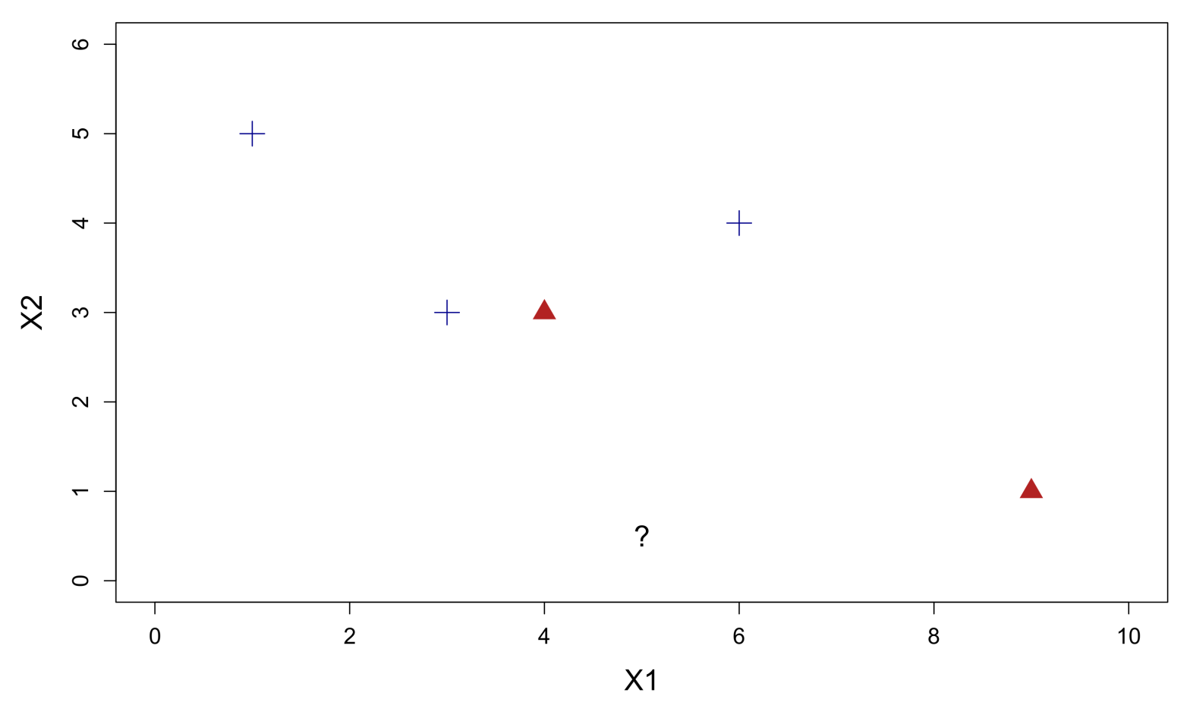
Dissimilarity
There are many ways to quantify dissimilarity between two observations in a data set. One way is to measure the distance between the objects in the feature space. The most well-known distance is Euclidean distance:

Slide 11
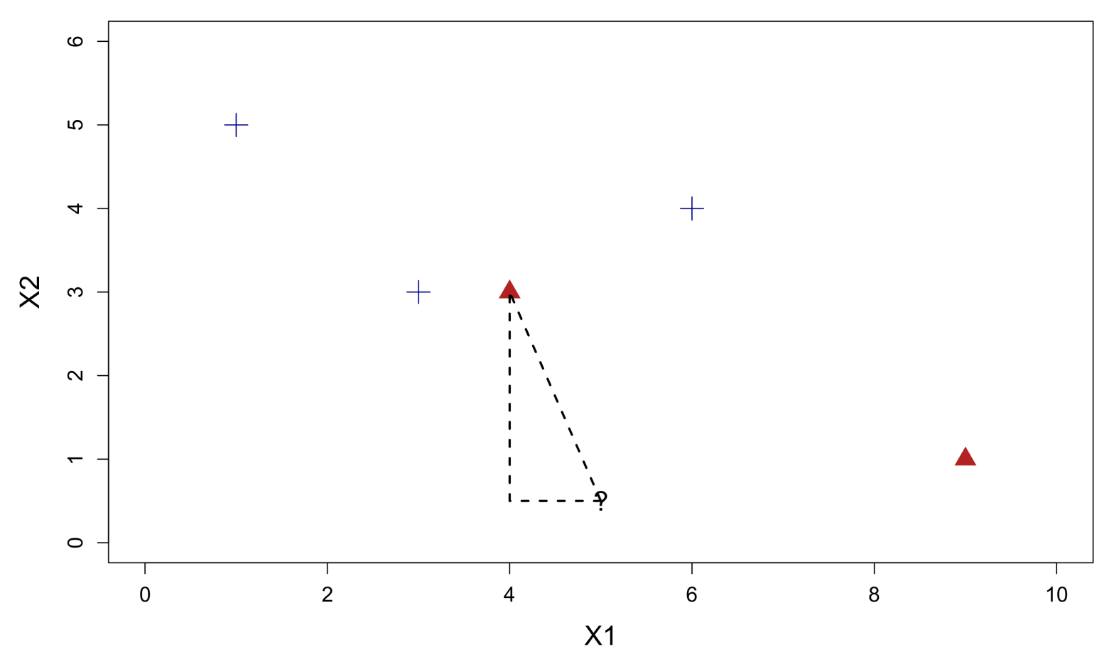


Euclidean distance matching
Euclidean distance between two observations on P features:
$$D_{euc}= \sqrt{{\left(x_{11}−x_{12}\right)}^{2}+{\left(x_{21}−x_{22}\right)}^{2}+ …+{\left(x_{p1}−x_{p2}\right)}^{2}}$$
(4,3)
$\sqrt{{\left(5−4\right)}^{2}+{\left(0.5−3\right)}^{2}}$ = 2.69
(5,0.5)

Slide 12
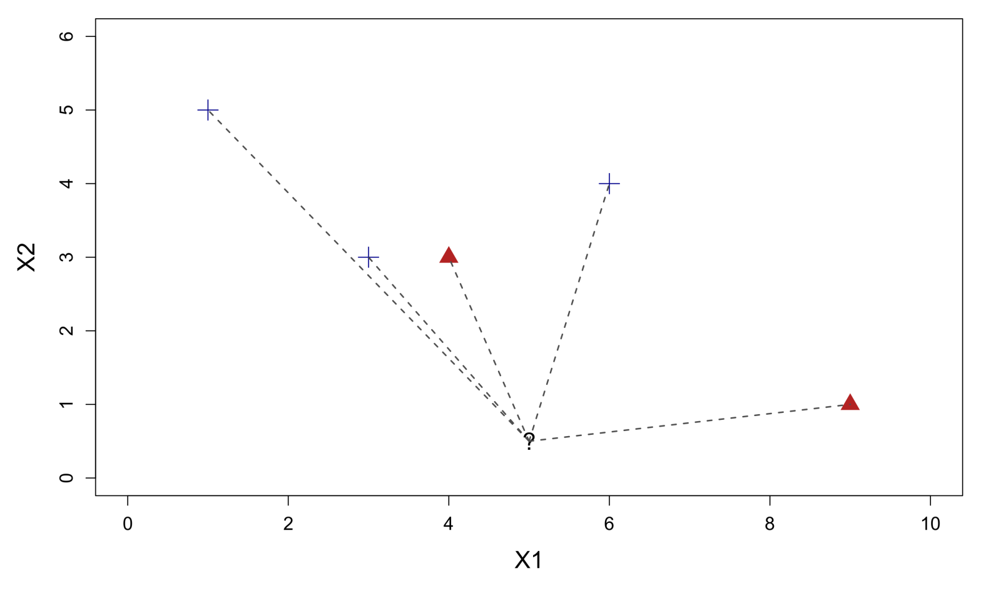
Euclidean distance matching
Calculating all pairwise distances between observations in this manner will yield a (Euclidean) distance matrix that is symmetric and of size N × N. Diagonal elements have 0 distance by definition (self-distance).

Slide 13
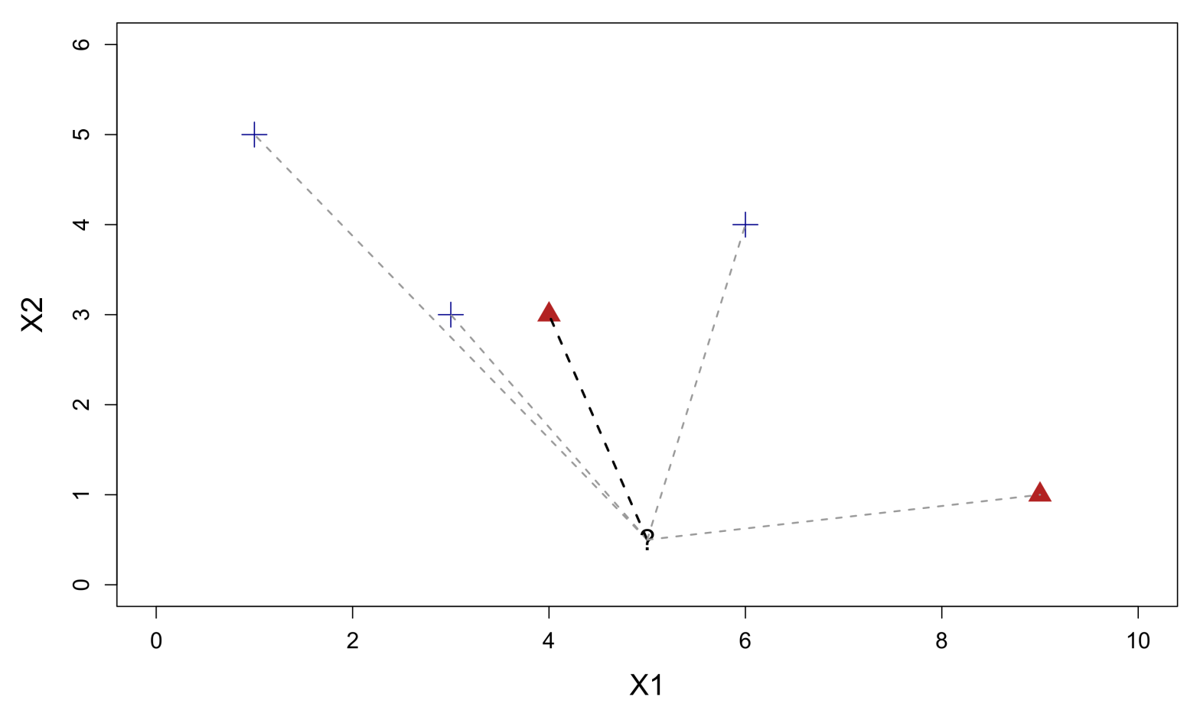
Euclidean distance matching
The nearest neighbor of an observation is another observation that has the shortest distance to the original observation:
Nearest neighbor

Slide 14
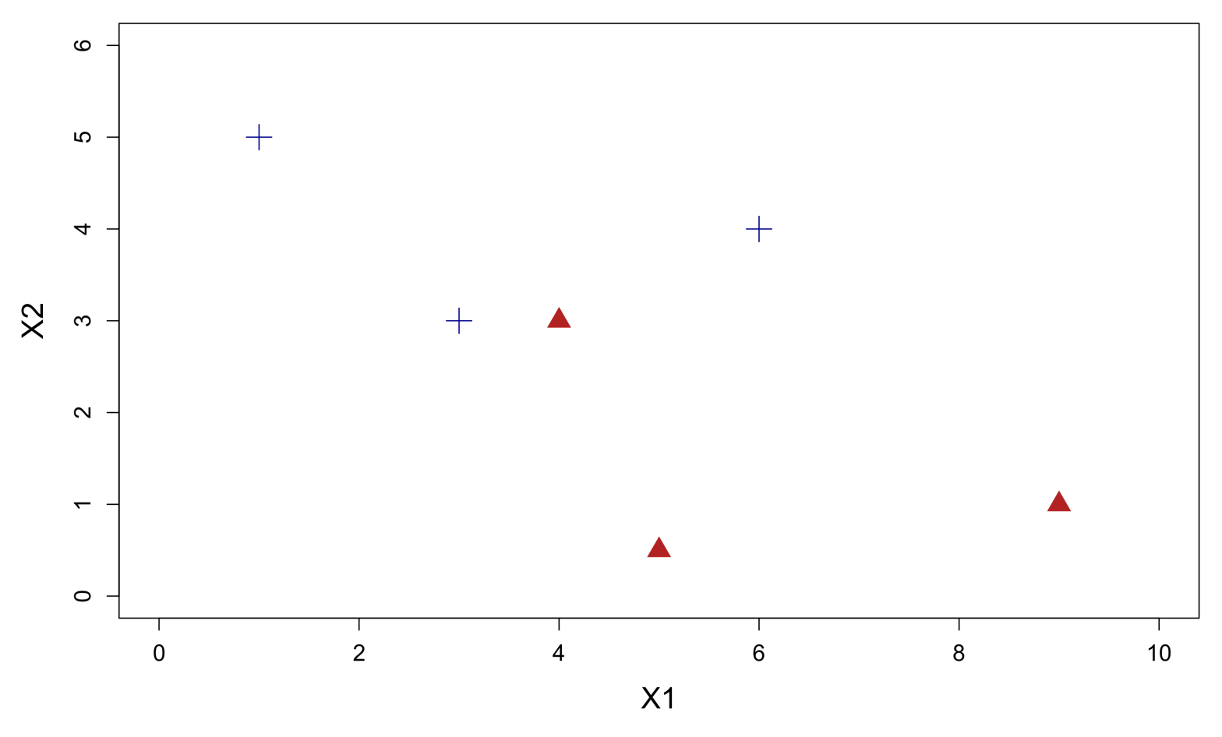
Euclidean distance matching
The predicted class for this observation is then the same as its nearest neighbor:

Slide 15
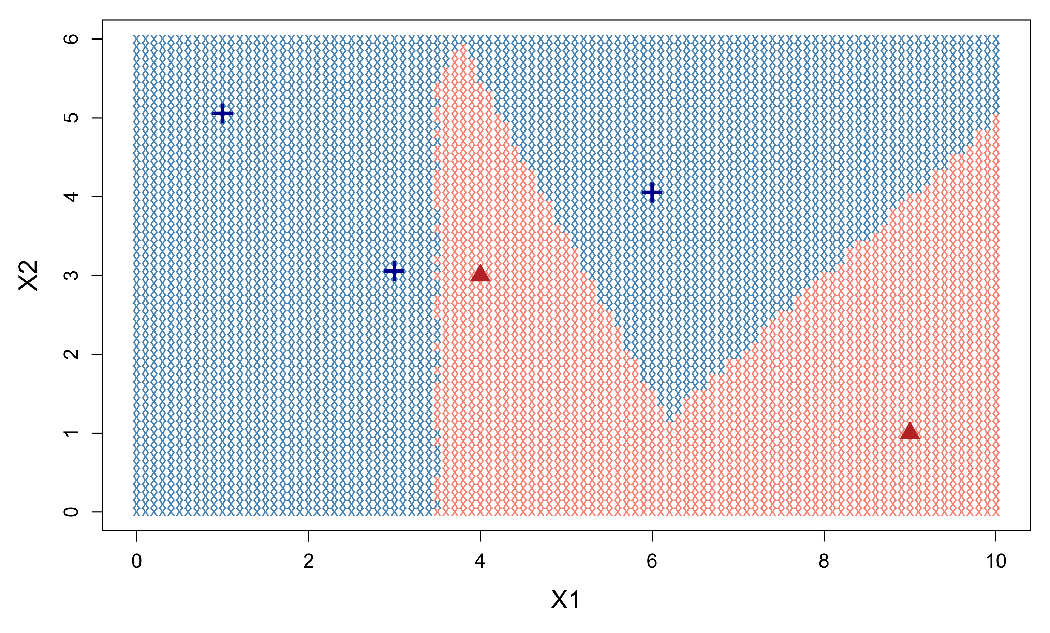
1-nearest neighbor model
The rule described previously is known as the 1-nearest neighbor model (1NN), since prediction is based simply on the nearest neighbor. The decision boundary for this example can be visualized as follows:

Slide 16
1-nearest neighbor model
In the red part of the feature space, the nearest neighbor is always a triangle. In the blue part of the feature space, the nearest neighbor is always a cross.

Slide 17
1-nearest neighbor model
The decision boundary produced by 1NN is nonlinear. How does this come about? What is the “model” for nearest neighbors?
It turns out that there is no model in the conventional sense (e.g., weights, assumptions). Instead the model consists of the entire training set, where every training observation functions as its own sub-model.
That is, the nearest neighbor in a given region of the feature space will act as the model for that space (e.g., if the nearest neighbor is a Smurf, then that Smurf is the model in that region). More generally, one says that the nearest neighbor acts as a local rule for prediction.
1NN with Euclidean distance is locally linear! When adding up all the local models, however, a globally nonlinear decision boundary emerges (e.g., analogous to regression smoothers).

Slide 18

K nearest neighbors
1NN is the simplest version of what is generally known as K nearest neighbors (KNN).
Instead of considering just one neighbor to generate a new prediction, we could consider K neighbors, and aggregate their information to obtain a better prediction. E.g., for the Smurfette problem:
Test set
3 nearest neighbors

Slide 19
K nearest neighbors
Data | ID | Skin color | Hat | Hat color | Pants | Gender | Class
Training | Papa Smurf | Blue | Yes | Red | Yes | Male | Smurf
Training | Brainy Smurf | Blue | Yes | White | Yes | Male | Smurf
Training | Sassette Smurf | Blue | Yes | White | Yes | Female | Smurf
Training | Casey Kelp | Pink | No |  | No | Female | Snork
Training | Allstar Seaworthy | Yellow | No |  | No | Male | Snork
Training | Cubbi Gummi | Pink | Yes | Blue | No | Male | Gummi Bear
Training | Tummi Gummi | Blue | Yes | Red | No | Male | Gummi Bear
Test | Smurfette | Blue | Yes | White | No | Female | ?

Slide 20
Majority voting
Test set
3 nearest neighbors
The simplest way to aggregate information from multiple neighbors is to average their predictions. When the dependent is categorical (classification problem) this amounts to a process of majority voting.
In the example above, 2 out of 3 neighbors predict Smurf. Since this is the majority, the final prediction of this 3NN model for Smurfette is Smurf.

Slide 21
Majority voting
Majority voting allows a KNN model to output more than just a class prediction. The votes of the neighbors can also be expressed as probabilities. In the example, 3NN predicts 66% probability of Smurf versus 33% probability of Gummi Bear.
In order to guarantee a majority, K should be set to an odd number. Otherwise ties may occur.
In the event where a tie does occur, the final classification is typically chosen at random. Note that random choice is also applied to the selection of neighbors, in the case that two or more neighbors share the same distance to the test observation.
Optionally, votes can also be weighted, e.g., by giving more influence in the voting process to the most similar neighbors, or for correcting unbalanced classes. KNN will easily favor the majority class in the training data when it strongly outnumbers the other classes.

Slide 22

Tuning parameter: K
The primary tuning parameter of KNN is the number of neighbors, K. Unless there is a theoretical reason to fix this number in advance, K is usually selected by (internal) cross-validation.
Fortunately, there are many packages in R that automate this selection process, and will return the optimal value for K (see later).
The value of K acts as a kind of smoothing parameter. When K=1, the decision boundary produced by the model can be highly variable/unstable. Setting K to higher values will produce smoother decision boundaries.
For K=N, the model simply defaults to predicting the majority class in the training set. This type of bias will already become evident when K approaches N. For this reason, optimal values of K tend to be relatively small.

Slide 23

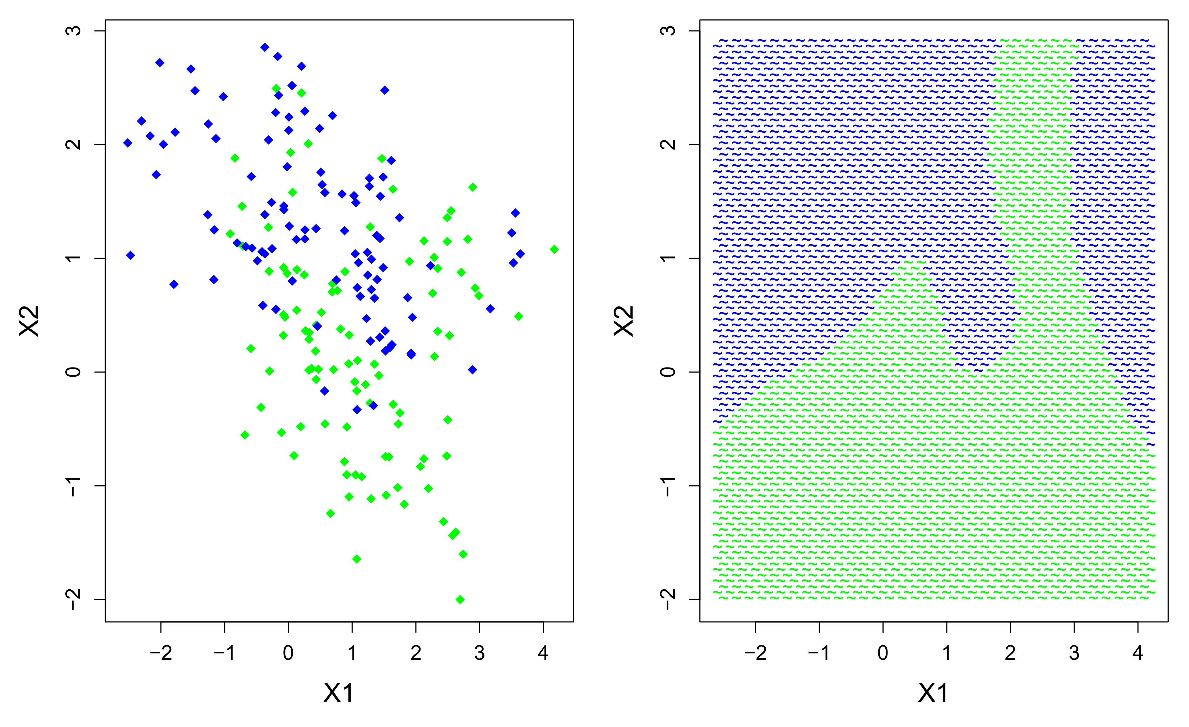
Two-class problem
Training (N=200)
Test/True (N=3415)

Slide 24
KNN in R
There are many packages in R available to fit KNN models, each with their own extensions and special features. We will use the kknn library. With our training and test data loaded, we can fit a basic 1NN model as follows:
library(kknn)
onenn <- kknn(Class~X1+X2,train=train,k=1,test=test)
Note that the function requires the explicit specification of a test set in order to run. This is because there is no estimation involved in KNN on the training data. The training function serves merely as a memory bank that is accessed when test cases are presented.
Calculating the (Euclidean) distance between observations can also be accomplished as follows in R:
dist(train)

Slide 25
KNN in R
For large data sets, calculating an N × N distance matrix directly can be computationally demanding. Indeed, most of the research in KNN has focused on finding computational shortcuts for fast distance calculation.
The kknn package offers a number of useful extensions, such as prediction for continuous and ordinal response variables, and automatic cross-validation for finding optimal values for K.
The object that we just created, onenn, will contain as “fitted values” the predicted classes for the test set. We can visualize the decision boundary that was “found” by the 1NN model as follows:
par(mfrow=c(1,2))
plot(test[,1:2],col=as.character(test[,3]),pch="x")
plot(test[,1:2],col=as.character(onenn$fitted),pch="x")

Slide 26
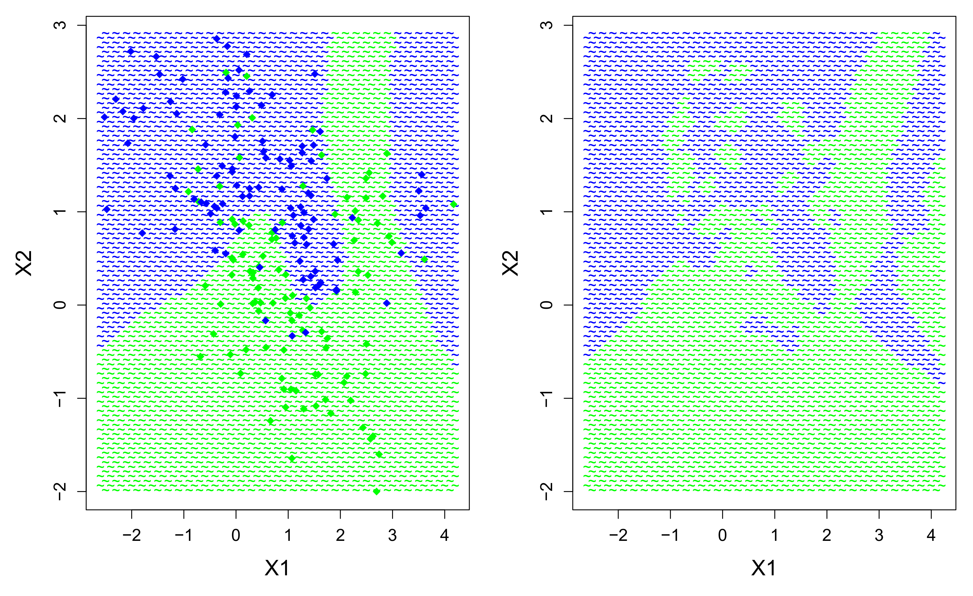
KNN in R
True boundary
1NN boundary

Slide 27
KNN in R
In order to calculate the misclassification rate of the 1NN model, we can ask for the confusion matrix of predicted versus true classes:
table(True=test$Class,NN1=nn1$fitted)
> NN1
> True blue green
> blue 1179 408
> green 263 1565
From this table we could calculate the 1NN error manually but a faster method is:
mean(test$Class!=nn1$fitted)
> 0.1964861
So approximately 20% misclassification. Clearly the 1NN is too sensitive to the overlapping data points in the training data. Higher values for K might do better…

Slide 28
KNN in R
The kknn package includes a handy function for estimating the optimal value of K by leave-one-out CV:
train.kknn(Class~.,data=train,kmax=101)
> Call:
> train.kknn(formula = Class ~ ., data = train, kmax = 101)
>
> Type of response variable: nominal
> Minimal misclassification: 0.155
> Best kernel: optimal
> Best k: 8
According to this CV, K=8 is the optimal number of nearest neighbors for prediction. Note that this function can also select the optimal weighting function for the neighbors (not discussed here), and the optimal distance metric (e.g., Euclidean, Manhattan).

Slide 29
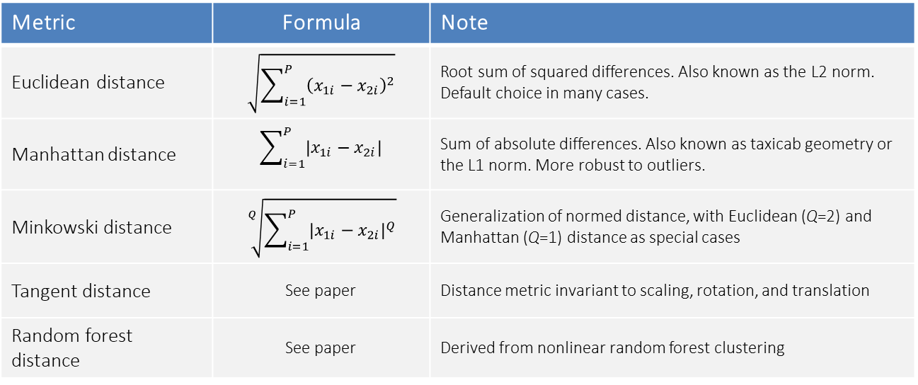
Tuning parameter: Distance metric
KNN uses Euclidean distance by convention. However, there are other distance metrics that could be used for this purpose, for example:
Like K, the optimal distance can be chosen by cross-validation, although this choice tends to be less important for the model than setting K properly.
Metric | Formula | Note
Euclidean distance | $$\sqrt{\sum_{i=1}^{P}{{\left(x_{1i}−x_{2i}\right)}^{2}}}$$ | Root sum of squared differences. Also known as the L2 norm. Default choice in many cases.
Manhattan distance | $$\sum_{i=1}^{P}{\left|x_{1i}−x_{2i}\right|}$$ | Sum of absolute differences. Also known as taxicab geometry or the L1 norm. More robust to outliers.
Minkowski distance | $$\sqrt[Q]{\sum_{i=1}^{P}{{\left|x_{1i}−x_{2i}\right|}^{Q}}}$$ | Generalization of normed distance, with Euclidean (Q=2) and Manhattan (Q=1) distance as special cases
Tangent distance | See paper | Distance metric invariant to scaling, rotation, and translation
Random forest distance | See paper | Derived from nonlinear random forest clustering

Slide 30
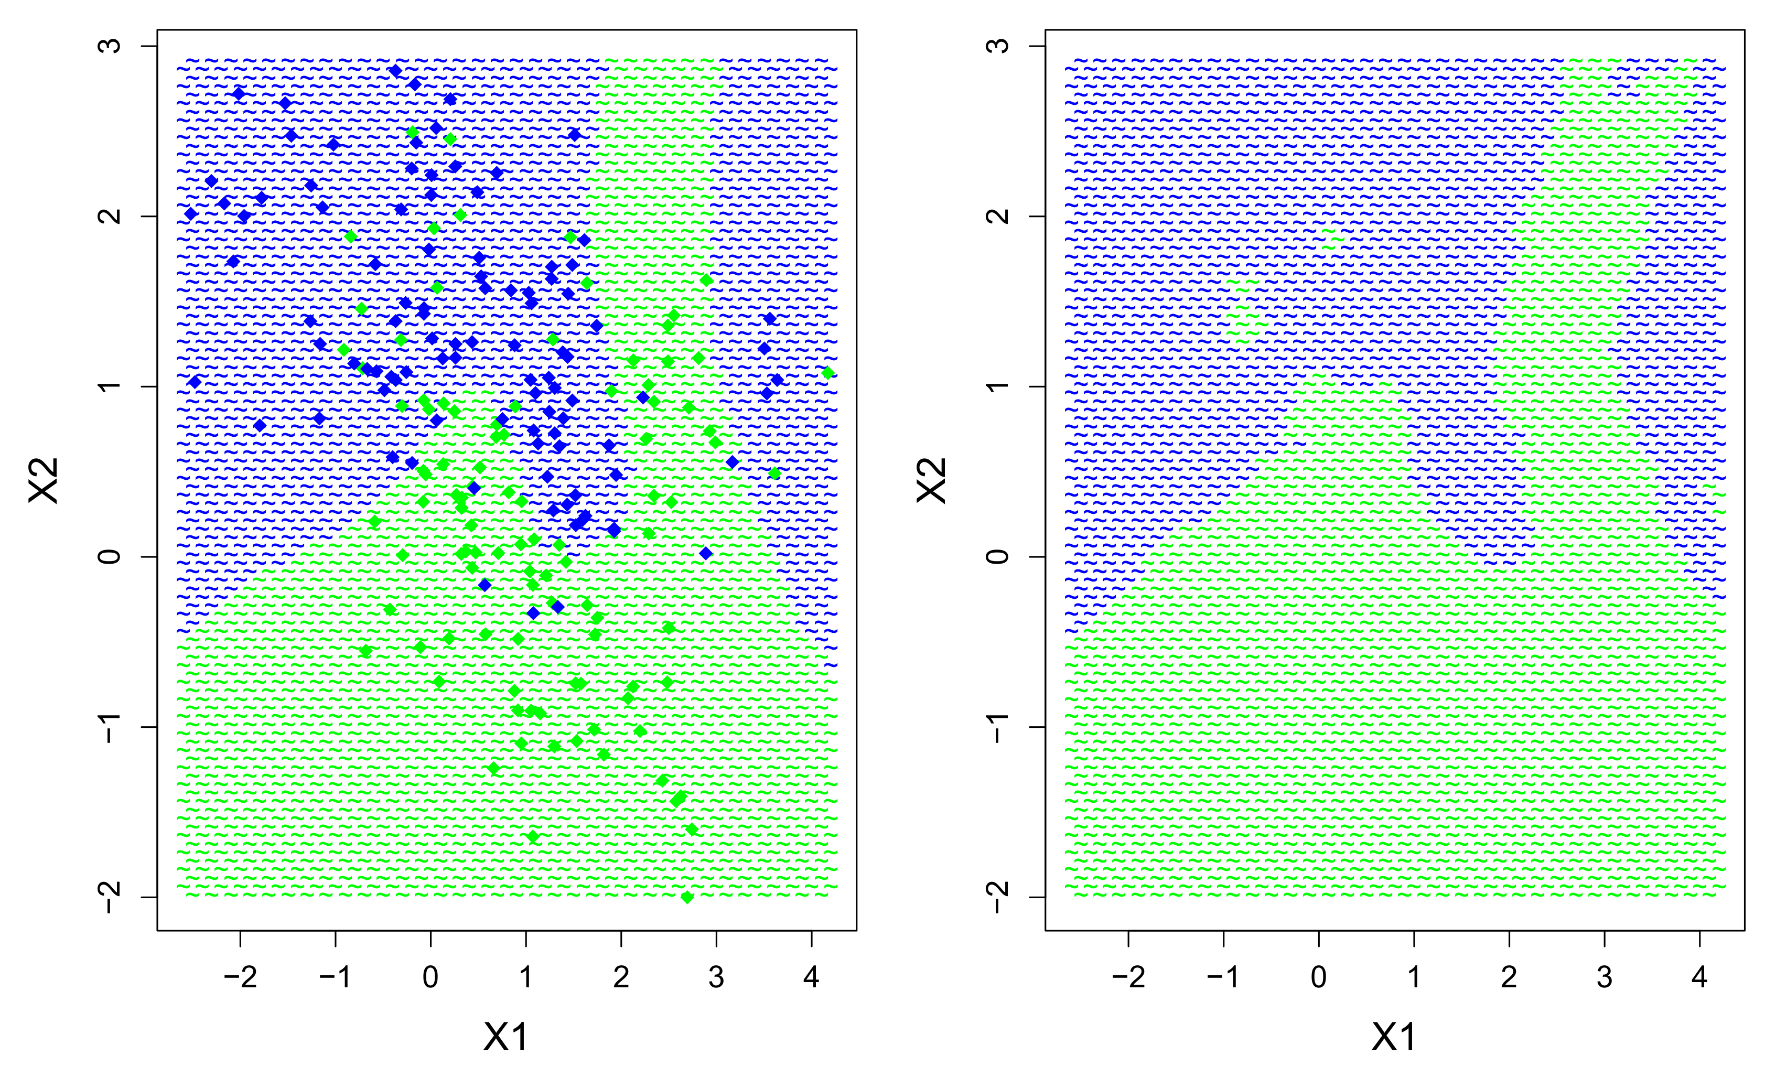
KNN in R
True boundary
8NN boundary

Slide 31
KNN in R
The code for the 8NN model was:
nn8 <- kknn(Class~X1+X2,train=train,k=8,test=test)
The misclassification rate is calculated as before:
mean(test$Class!=nn8$fitted)
> 0.09048316
Which is very low, and visually the 8NN decision boundary is a remarkably good approximation to the true decision boundary.
This is fantastic so we can stop modelling, close our books, and go home… right?

Slide 32
KNN sensitivity to noise
No! What happens if we add completely random features to the data set, and refit the model…
ID | Class | X1 | X2 | R1 | R2 | R3 | … | R20
1 | Blue | 1.432 | 0.306 | 0.110 | 0.676 | 0.706 | 0.513 | 0.604
2 | Green | 2.489 | 1.358 | 0.606 | 0.394 | 0.197 | 0.834 | 0.222
3 | Green | 0.320 | 0.017 | 0.524 | 0.941 | 0.205 | 0.694 | 0.603
4 | Blue | 3.503 | 1.224 | 0.461 | 0.143 | 0.613 | 0.104 | 0.485
5 | Blue | 0.259 | 1.250 | 0.296 | 0.625 | 0.616 | 0.289 | 0.675
6 | Green | -0.079 | 0.323 | 0.038 | 0.334 | 0.781 | 0.237 | 0.759
… | … | … | … | … | … | … | … | …
N | Green | 2.499 | -0.418 | 0.884 | 0.769 | 0.062 | 0.833 | 0.033

Slide 33
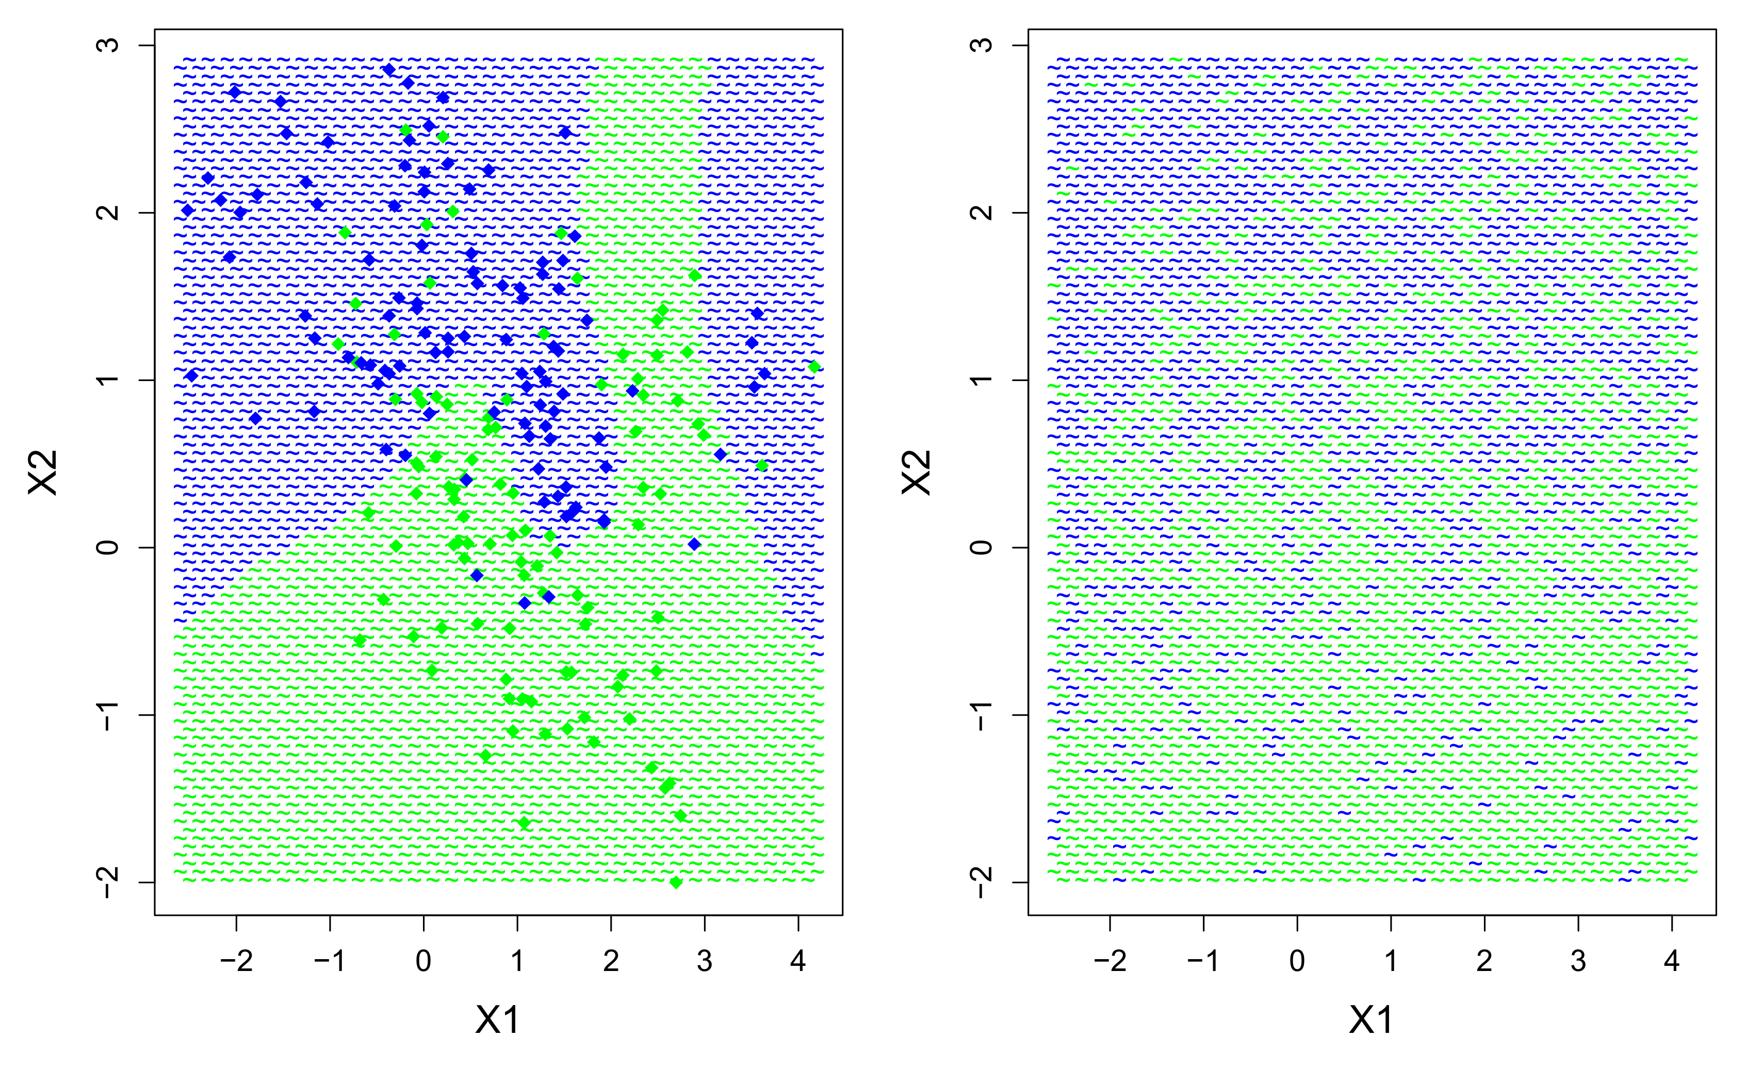
KNN sensitivity to noise
True boundary
8NN with 20 noise variables

Slide 34

Feature relevance in KNN
As a result of the extra noise features, the performance of the 8NN model degraded substantially.
A notable disadvantage of KNN is that it has no intrinsic method for detecting which features are relevant or irrelevant for predicting the outcome. All features receive equal weight when calculating the nearest neighbor distances.
One solution to this problem is to conduct univariate pre-screening of the features in advance, e.g., with t-tests, correlation tests, or even AIC/BIC comparisons, and keep only important features for the ensuing KNN.
Disadvantages of this type of pre-screening are that we re-introduce parametric and linear assumptions with the screening model. We may miss out substantial nonlinear effects in certain features that KNN would otherwise have detected.

Slide 35
Curse of dimensionality
For low-dimensional data (i.e., 1 or 2 features), it is relatively easy to sample data densely, such that we have data from all regions of the feature space.
For increasing feature dimensionality, the sample size required for dense data increases exponentially! The more features, the further individual observations will spread out into the feature space.
In other words, for high feature dimensions:
All data are sparse!
All data are outliers!
This is a major problem for (a) data sets with many predictors/features, (b) models that add features to create flexibility (e.g., polynomial expansions), and (c) models that rely on similarity between observations, such as KNN. The notion of a “neighbor” becomes dubious if that neighbor is in fact an outlier…

Slide 36
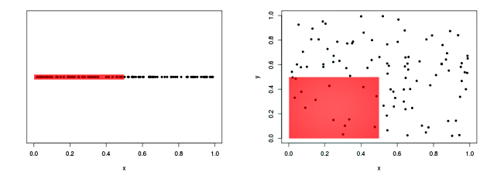
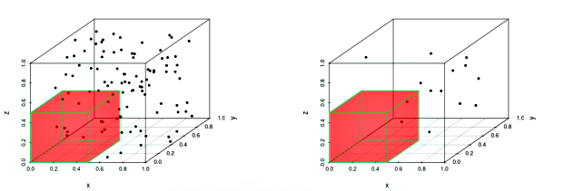
Curse of dimensionality
How much data are covered in the same space, for increasing feature dimensionality?
1D: 42%
2D: 14%
3D: 7%
4D: 3%

Slide 37
KNN for regression
Finally, it is possible to adapt KNN to models where the outcome variable is continuous, rather than categorical. For example, for the curvilinear data pattern from the introduction:
set.seed(668)
x <- 1:500
true <- 100*sin(0.02*x) + 0.5*x
y <- true + rnorm(500,0,25)
train.kknn(y~x,data=data.frame(x,y),kmax=101)
> Type of response variable: continuous
> minimal mean absolute error: 21.72826
> Minimal mean squared error: 743.0118
> Best kernel: optimal
> Best k: 24
knn24 <- kknn(y~x,train=data.frame(x,y),test=data.frame(x=1:5000/10),k=24)

Slide 38
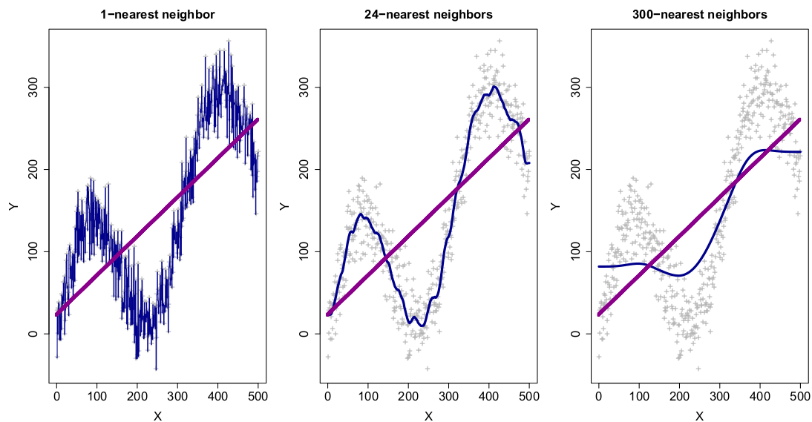
KNN for regression
Plotting different KNN models side by side illustrates their similarity to data “smoothers” (higher K, smoother curve), as well as their non-linearity compared to linear regression:

Slide 39
Why should I use KNN?
In machine learning the choice of model is typically part of the model selection process. Usually there is no a priori reason to prefer one particular model over another. The final model of choice will be the one that achieves the lowest error or highest accuracy.
However, here and for other models that follow, I will discuss how the use of this model could be motivated theoretically for your data analysis.
For example, you might want to use a particular machine learning approach in your paper without comparing it to (many) alternative machine learners. In that case you need to be able to motivate clearly why this particular model was chosen.
Disclaimer

Slide 40
Why should I use KNN?
Nearest neighbor rules may mimic certain cognitive processes of categorization (e.g., semantic, social). The psychological equivalent of KNN is often referred to as exemplar-based categorization, and has been a core topic in the work of Robert Nosofsky (see Nosofsky & Palmeri, 1997).
Thus, KNN could be used to validate exemplar-based models in psychological categorization.
KNN is a relatively non-parametric method for nonlinear modelling. As such, it could be a basic nonlinear benchmark against linear alternatives. This is comparable to using a LOWESS smoother as an alternative against a standard linear model.
For small samples with relatively few features KNN can be quite powerful and interpretable!

Slide 41

KNN evaluation
Advantages:
Intuitive logic of the nearest neighbor rule
Relatively non-parametric
Highly adaptive to nonlinear patterns
Only one real tuning parameter, K, the number of neighbors
Disadvantages
High variance in the 1-nearest neighbor model
Curse of dimensionality
No automatic evaluation of feature relevance
Presence of irrelevant features degrades predictive performance
Computationally expensive

Slide 42


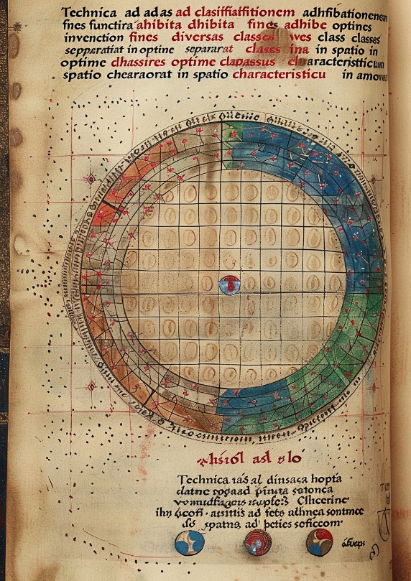
6. Discriminants

Slide 43
Introduction
Discriminants are a class of models that can be used when the outcome variable is categorical, where the values correspond to two or more distinct classes.
From a probabilistic point of view, when attempting to predict an outcome class given certain predictors/features, we are modelling:
That is, the probability of belonging to class g of response variable G, given an observation x from the feature data X. We have seen this definition before, when discussing logistic regression.
P(G=g|X=x)

Slide 44
Visual recap

Slide 45
Bayes’ theorem
We could attempt to model the probability, P(G=g|X=x), directly, as does logistic regression. However, an alternative approach is to first rewrite the probability problem, thanks to a famous equality known as Bayes’ theorem:
Where P(X=x|G=g) is the (conditional) probability of the observation x within class g, P(G=g) is the (prior) probability of belonging to class g, and P(X=x) is the marginal probability of x across all classes of G.
P(X=x|G=g) × P(G=g)
P(G=g|X=x) =
P(X=x)

Slide 46
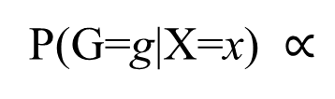
Bayes’ theorem
In practice P(X=x) is assumed to be fixed, and hence does not need to be specified in Bayes’s theorem. P(G=g|X=x) then becomes proportional to:
This implies that in order to model P(G=g|X=x), it suffices to specify/estimate the class-conditional probability of the data x , and the prior probabilities of the classes.
Very often the prior probabilities of the classes, P(G=g), is set to be uniform, that is, all classes assumed to be equally probable.
This finally shifts all the attention for modelling to the class-conditional probabilities P(X=x|G=g). Discriminant models attempt to solve this problem…
P(G=g|X=x) $∝$
P(X=x|G=g) × P(G=g)

Slide 47
Discriminants
For a continuous/numerical set of features X, its class-conditional probabilities can be written as density/distribution functions, e.g., f_{G=g}(x). Different discriminants use different models for these densities:
Model | Abbrev. | Class-conditional density
Linear discriminant | LDA | Multivariate normal with class-shared covariance matrix
Quadratic discriminant | QDA | Multivariate normal with class-specific covariance matrices
Mixture discriminant | MDA | Mixtures of multivariate normal
Kernel discriminant | KDA | Multivariate non-parametric density estimates
Naïve Bayes classifier | NB | Univariate non-parametric density estimates

Slide 48
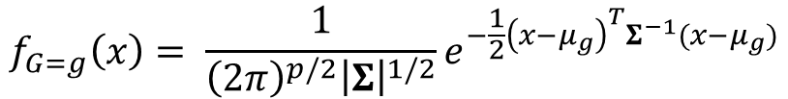
Linear discriminant analysis
The simplest discriminant is linear discriminant analysis (LDA). LDA assumes that, within each class, the data X have a multivariate normal distribution, with class-specific centroids (μ_{g}), and class-shared covariance matrix (Σ):
In practice the values for the centroids and the covariance matrix are not known and therefore need to be estimated from the data (via maximum likelihood estimation).
Comparing the distance of one class versus another with these equations leads to the so-called discriminant functions, which are linear in x, and produce linear decision boundaries between classes.
$$f_{G=g}\left(x\right)= \frac{1}{{\left(2π\right)}^{p/2}{\left|Σ\right|}^{1/2}}e^{−\frac{1}{2}{\left(x−μ_{g}\right)}^{T}Σ^{−1}(x−μ_{g})}$$

Slide 49
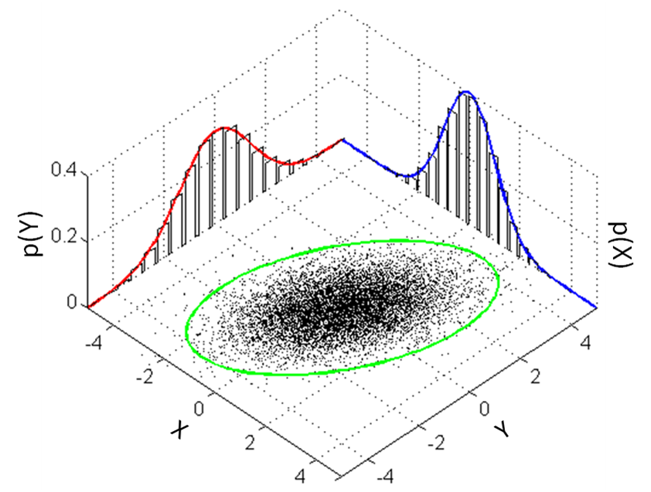
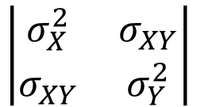
Multivariate normal distribution
μ_{g} = (μ_{X},μ_{Y})
$$\left|\begin{matrix}σ_{X}^{2} & σ_{XY} \\ σ_{XY} & σ_{Y}^{2}\end{matrix}\right|$$
Σ =

Slide 50
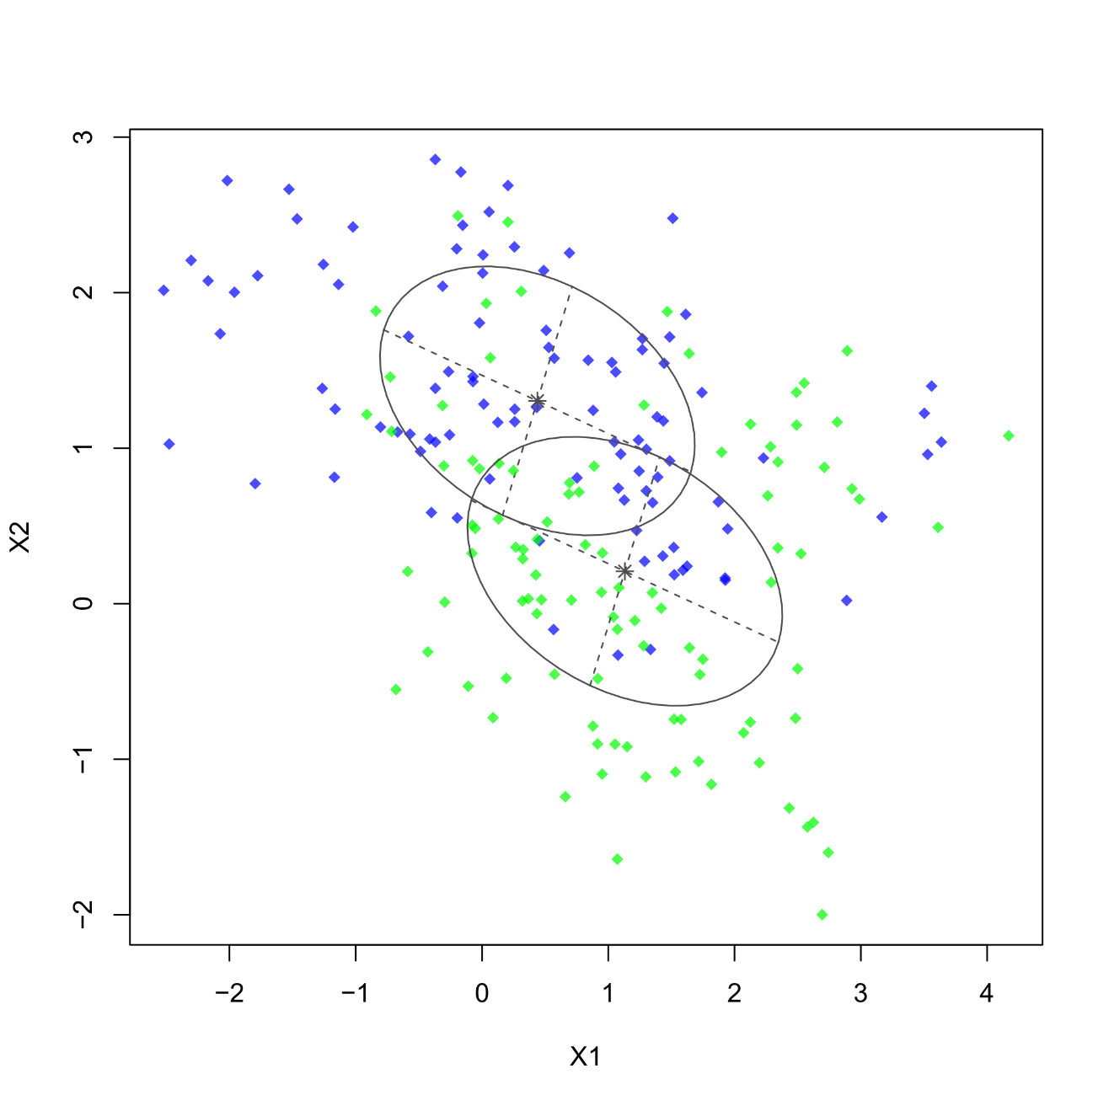
MVN for two-class problem (equal covariance)
Multivariate normality imposed on the two-class data distributions.
Unequal centroids
Equal covariance matrix (=same volume, shape, and orientation of ellipsoid)

Slide 51
LDA in R
Fitting LDA in R can be done with the MASS package. The code is as simple as usual. For the two-class problem:
library(MASS)
ld <- lda(Class~X1+X2,data=train)
ld
Inspecting the fitted object will print class centroids and discriminant functions:
> Group means:
> X1 X2
> blue 0.438205 1.303876
> green 1.131131 0.208162
>
> Coefficients of linear discriminants:
> LD1
> X1 0.09935661
> X2 -1.09553632

Slide 52
LDA in R
Recall that for LDA, it is possible to calculate the leave-one-out CV training error by a direct formula. In R this can be achieved by switching on the CV option:
ld.cv <- lda(Class~X1+X2,data=train,CV=TRUE)
ld.cv$class
mean(ld.cv$class!=train$Class)
> 0.28
Of course, we are interested in visualizing the decision boundary for LDA:
par(mar=c(5,5,1,1),cex.axis=1.2,cex.lab=1.5,mfrow=c(1,2))
plot(test[,1:2],col=as.character(test[,3]),pch="~")
points(train[,1:2],col=as.character(train[,3]),pch=18,cex=1.2)
plot(test[,1:2],col=as.character(predict(ld,newdata=test,
type="class")$class),pch="~")
points(ld$means,col=c("blue","green"),pch=18,cex=2.5)

Slide 53
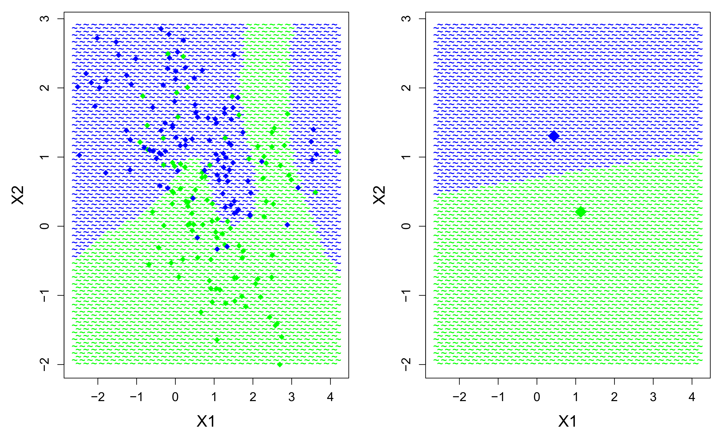
LDA in R
True boundary
LDA boundary

Slide 54
LDA in R
The two large dots on the LDA plot visualize the estimated class centroids
The misclassification rate on the test data is calculated as follows:
ld.pred <- predict(ld,newdata=test)$class mean(ld.pred!=test$Class)
> 0.17
So relatively high but this was expected, given the linear nature of LDA and the nonlinear nature of the true decision boundary.

Slide 55
Feature relevance in LDA
Feature relevance in LDA can be extracted from the estimated discriminant functions. For an outcome variable with G class levels, LDA will estimate G ‒ 1 discriminant functions.
These functions are ordered according to how well they achieve separation between the outcome classes. Their values are “weights” of the features, similar to component loadings in PCA. The relative size of these weights indicates which features are important for separating the response classes:
ld
> Coefficients of linear discriminants:
> LD1
> X1 0.09935661
> X2 -1.09553632
Which confirms the visual conclusion that the decision boundary splits the feature space primarily along the X2 dimension.

Slide 56
Quadratic discriminant analysis
LDA assumes that there is a single, class-shared covariance matrix (Σ). We can relax this assumption and allow class-specific covariance matrices (Σ_{g}). Surprisingly, doing so produces quadratic decision boundaries, hence why this model is called quadratic discriminant analysis (QDA).
qd <- qda(Class~X1+X2,data=train)
qd
mean(predict(qd,newdata=test,type="class")$class,test$Class)
> 0.1710102
par(mar=c(5,5,1,1),cex.axis=1.2,cex.lab=1.5,mfrow=c(1,2))
plot(test[,1:2],col=as.character(test[,3]),pch="~")
points(train[,1:2],col=as.character(train[,3]),pch=18,cex=1.2)
plot(test[,1:2],col=as.character(predict(qd,newdata=test,
type="class")$class),pch="~")
points(qd$means,col=c("blue","green"),pch=18,cex=2.5)

Slide 57
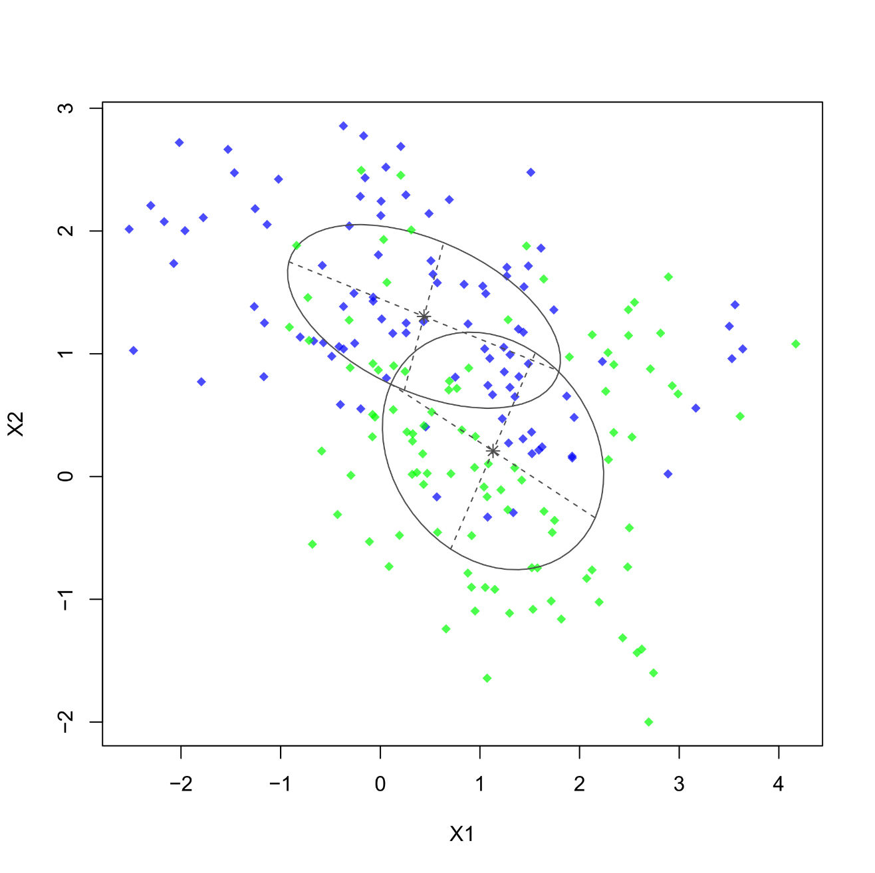
MVN for two-class problem (unequal covariance)
Multivariate normality imposed on the two-class data distributions.
Unequal centroids
Unequal covariance matrix (=different volume, shape, and orientation of ellipsoid)

Slide 58
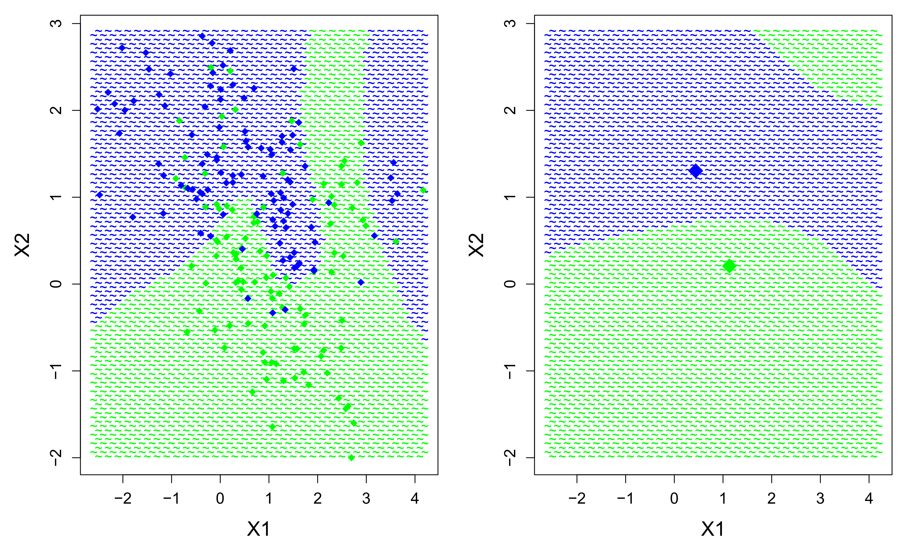
QDA in R
True boundary
QDA boundary

Slide 59
Feature relevance in QDA
Note that, when printing the “qd” object, information on the discriminant functions is no longer provided. These functions do exist but they lack the simple interpretation of LDA. Determining feature relevance in QDA is much more complicated because of the quadratic nature of the discriminant functions.
For this reason, QDA is typically used as a black box machine learner. We fit it to the data and hope to obtain accurate predictions without regard for the model’s internal structure (e.g., centroids, functions, weights).
This will be true for all of the following discriminants that I discuss.

Slide 60
Mixture discriminant analysis
LDA and QDA assume that the class-conditional densities are multivariate normal, each centered on a single centroid.
Mixture discriminant analysis (MDA; Hastie & Tibshirani, 1996) allows that there can be more than one centroid per class. More formally, MDA will model the class-conditional densitities as mixtures of M multivariate normal distributions.
This approach is highly similar to k-means clustering, where a sample of data is subdivided into distinct clusters.
Similar to k-means clustering, MDA will initialize M random centroids for each class, and iteratively find the optimal centroid value by the expectation-maximization (EM) algorithm.

Slide 61
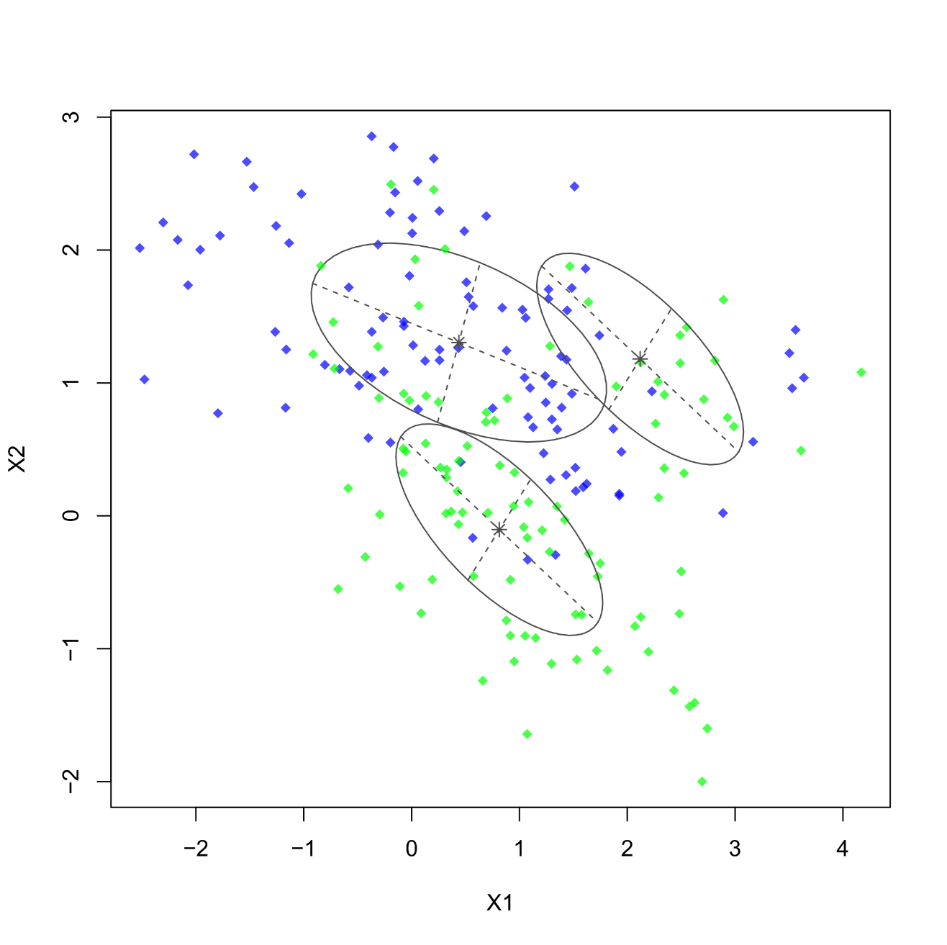
Mixtures of MVN
Mixtures of multivariate normality imposed on the two classes
Unequal centroids
Unequal number of centroids
Unequal covariance matrix (=different volume, shape, and orientation of ellipsoid)

Slide 62
Tuning parameter: M
The number of centroids per class M can either be fixed (e.g., 3 per class), or can be varied per class (e.g., 1 for class blue, 3 for class). Unless the choice of M can be motivated theoretically, we will need to decide on the optimal number somehow…
The R package mda requires manual cross-validation to set the optimal numbers for M, which is cumbersome.
A more convenient solution is provided by the package mclust (function MclustDA), which uses a model-based clustering algorithm to set the optimal M automatically, and allows flexibility in the shape, size, and orientation of subclasses.
The optimal M is chosen by minimizing the Bayesian information criterion (BIC),. Recall that BIC is an approximately unbiased measure of training fit!

Slide 63
Tuning parameter: M
In R, we proceed as follows:
library(mclust)
set.seed(1177)
mcda <- MclustDA(data=train[,-3],class=train[,3])
pred <- predict(mcda,newdata=test[,-3])$class
mean(pred!=test$Class)
> 0.1862372
The output prints information about the estimated number of subclasses. Note that the mda function estimates 3 subclasses as optimal!
summary(mcda)
log.likelihood n df BIC
-593.3331 200 13 -1255.544
Classes n Model G
blue 100 XXX 1
green 100 EEE 2

Slide 64
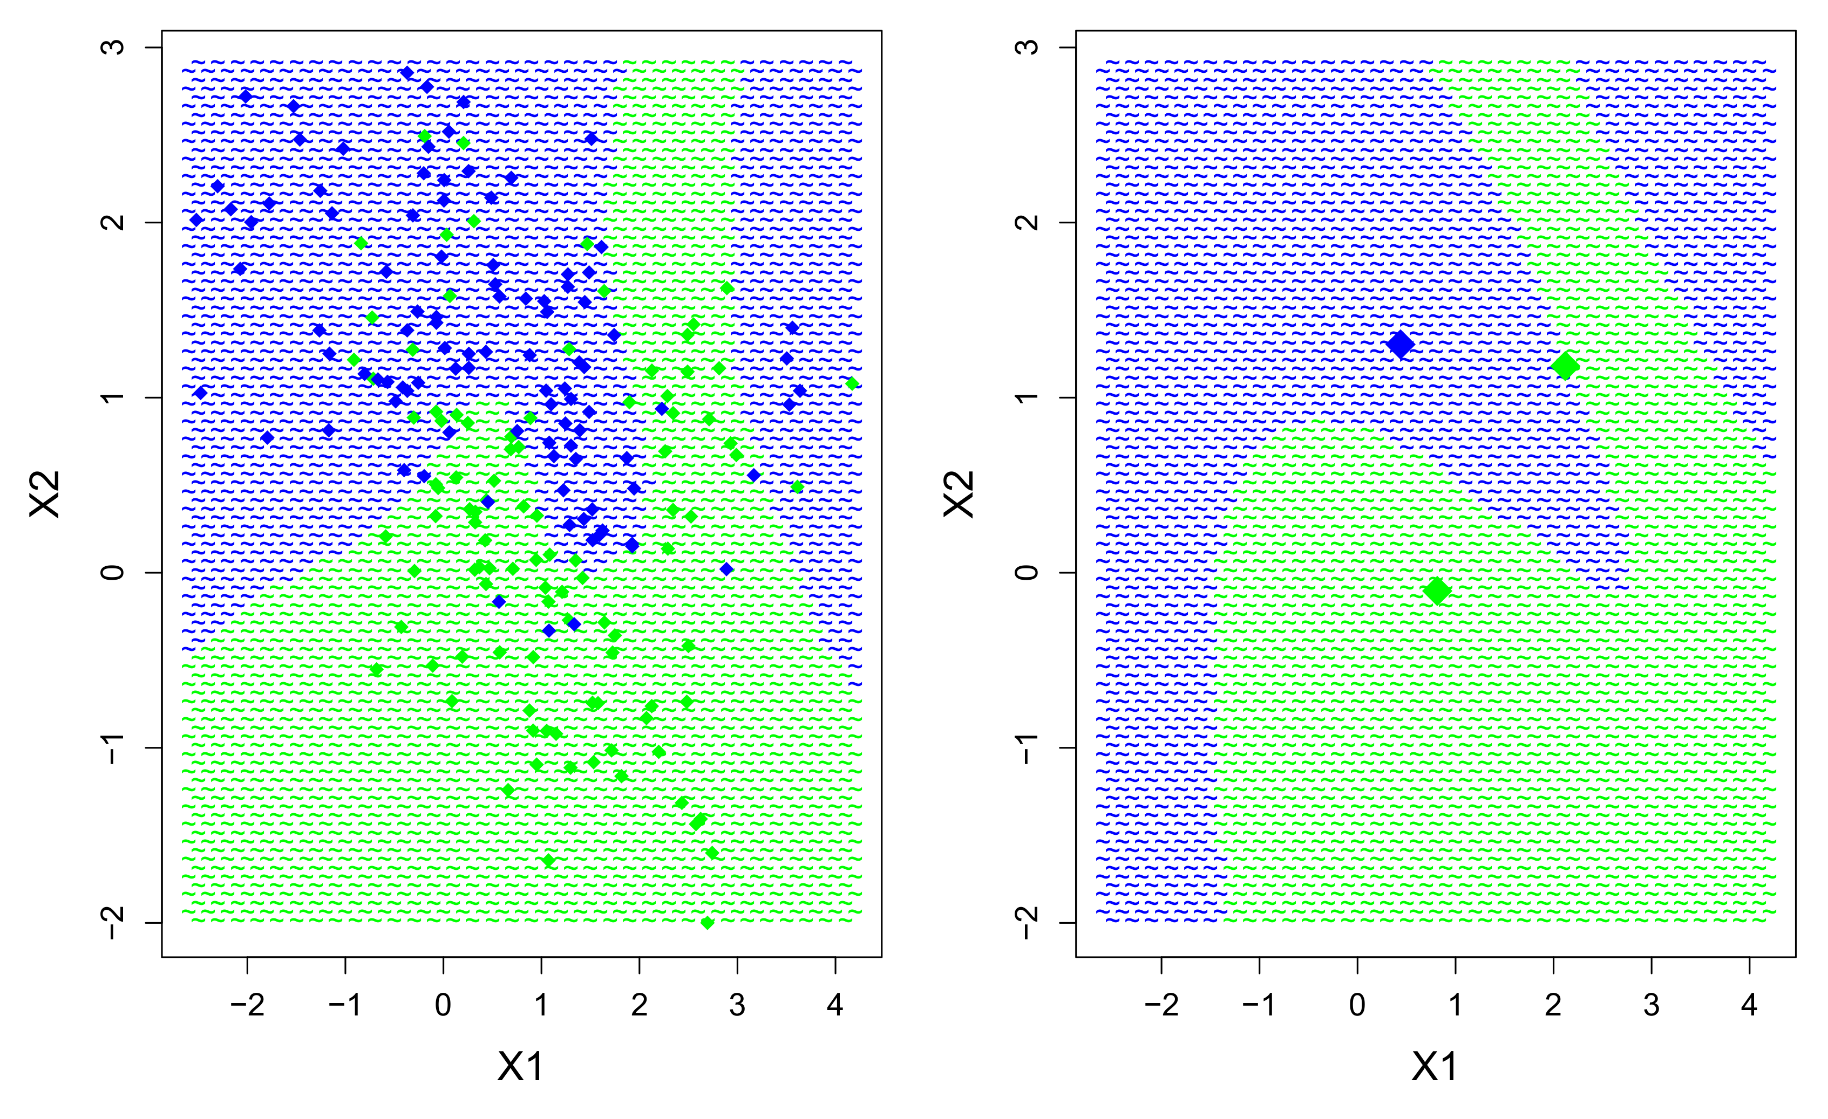
MDA in R – mclust package
True boundary
MDA boundary, M=[1,2]

Slide 65
Discriminants and nearest neighbors
LDA, QDA, and MDA are sometimes referred to as prototype methods, in that they generate their predictions by matching a test observation to a prototype, i.e., the nearest class centroid.
For M=1, MDA is essentially equivalent to LDA or QDA, with one prototype in each class for matching. For M > 1, the prototypes become increasingly local, defined by smaller regions of the feature space.
In the extreme scenario, M=N, and each invididual observation becomes a prototype. This model is equivalent to the 1-nearest neighbor model (1NN), a special case of K-nearest neighbors (KNN).

Slide 66
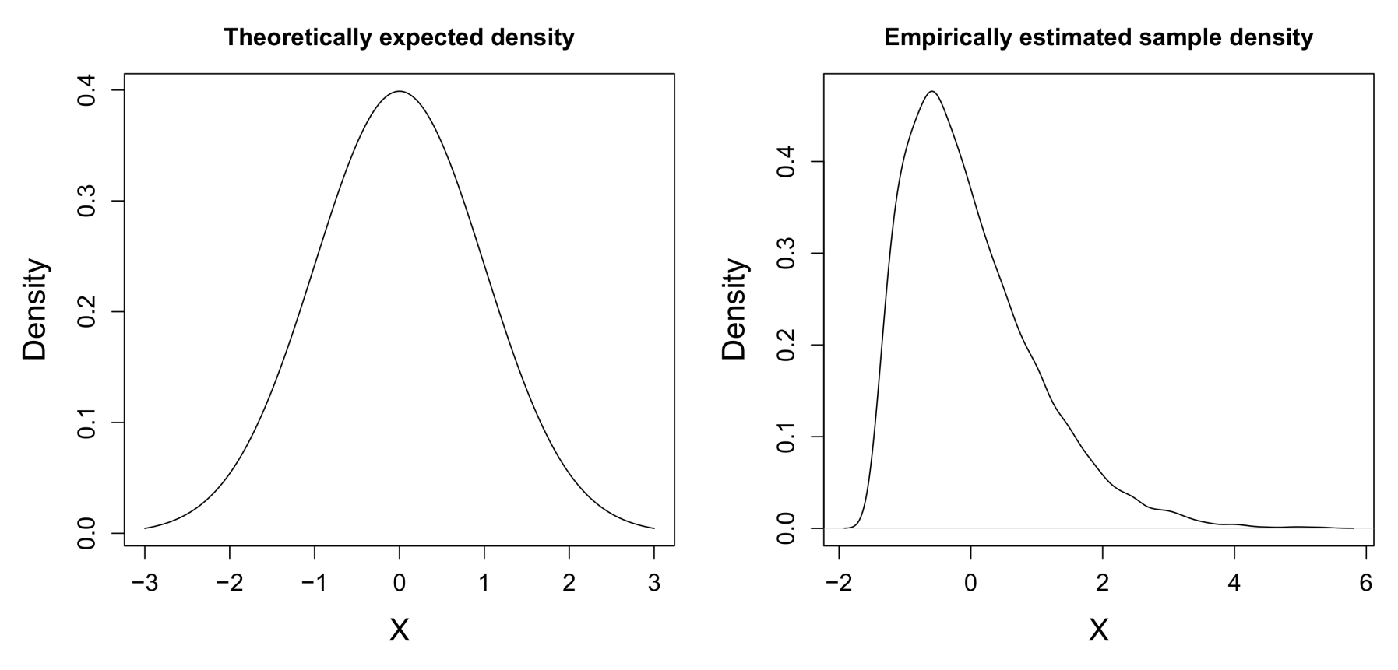
Kernel discriminant analysis
LDA and QDA impose multivariate normality on the class-conditional densities. MDA is more flexible by using mixtures of these, which goes some way toward a fully non-parametric estimation of the class-conditional densities:
Data sample with mean = 0, sd = 1

Slide 67
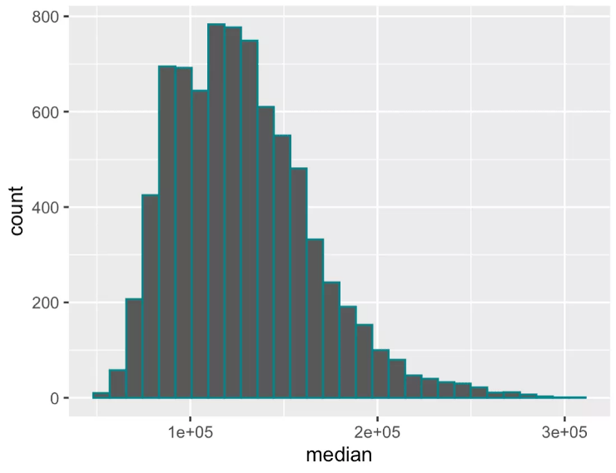
Kernel discriminant analysis
Non-parametric density estimation calculates empirically the density of the data in each region of values. The most popular tool for doing this is the histogram.
The histogram divides the range of X values into categorical bins. However, techniques have also been developed to obtain continuous density estimates. These methods are similar to the windowed estimation of regression smoothers.
Density estimates can be obtained for a univariate sample of data as well as for a multivariate sample of data, in which case the joint density of the variables has to be estimated.
For a discriminant, we could consider plugging these density estimates into our discriminant for P(X=x|G=g), rather than theoretically expected densities. This is the principle of kernel discriminant analysis (KDA).

Slide 68
KDA in R
Fitting a basic KDA model can be accomplished as follows:
library(ks)
set.seed(997)
bndwdth <- Hkda.diag(train[,1:2],train$Class, pre="scale")
kd <- kda(x=train[,-3],x.group=train[,3],
Hs=bndwdth,eval.points=test[,-3])
mean(kd$x.group.est!=test$Class)
> 0.124451
The ks library further allows the visualize the two-dimensional density estimates:
par(mar=c(5,5,3,1),cex.axis=1.2,cex.lab=1.5,mfrow=c(1,2))
plot(kd,y=test[,-3],col=c("blue","green"))
plot(test[,1:2],col=as.character(kd$x.group.est),pch="~")

Slide 69
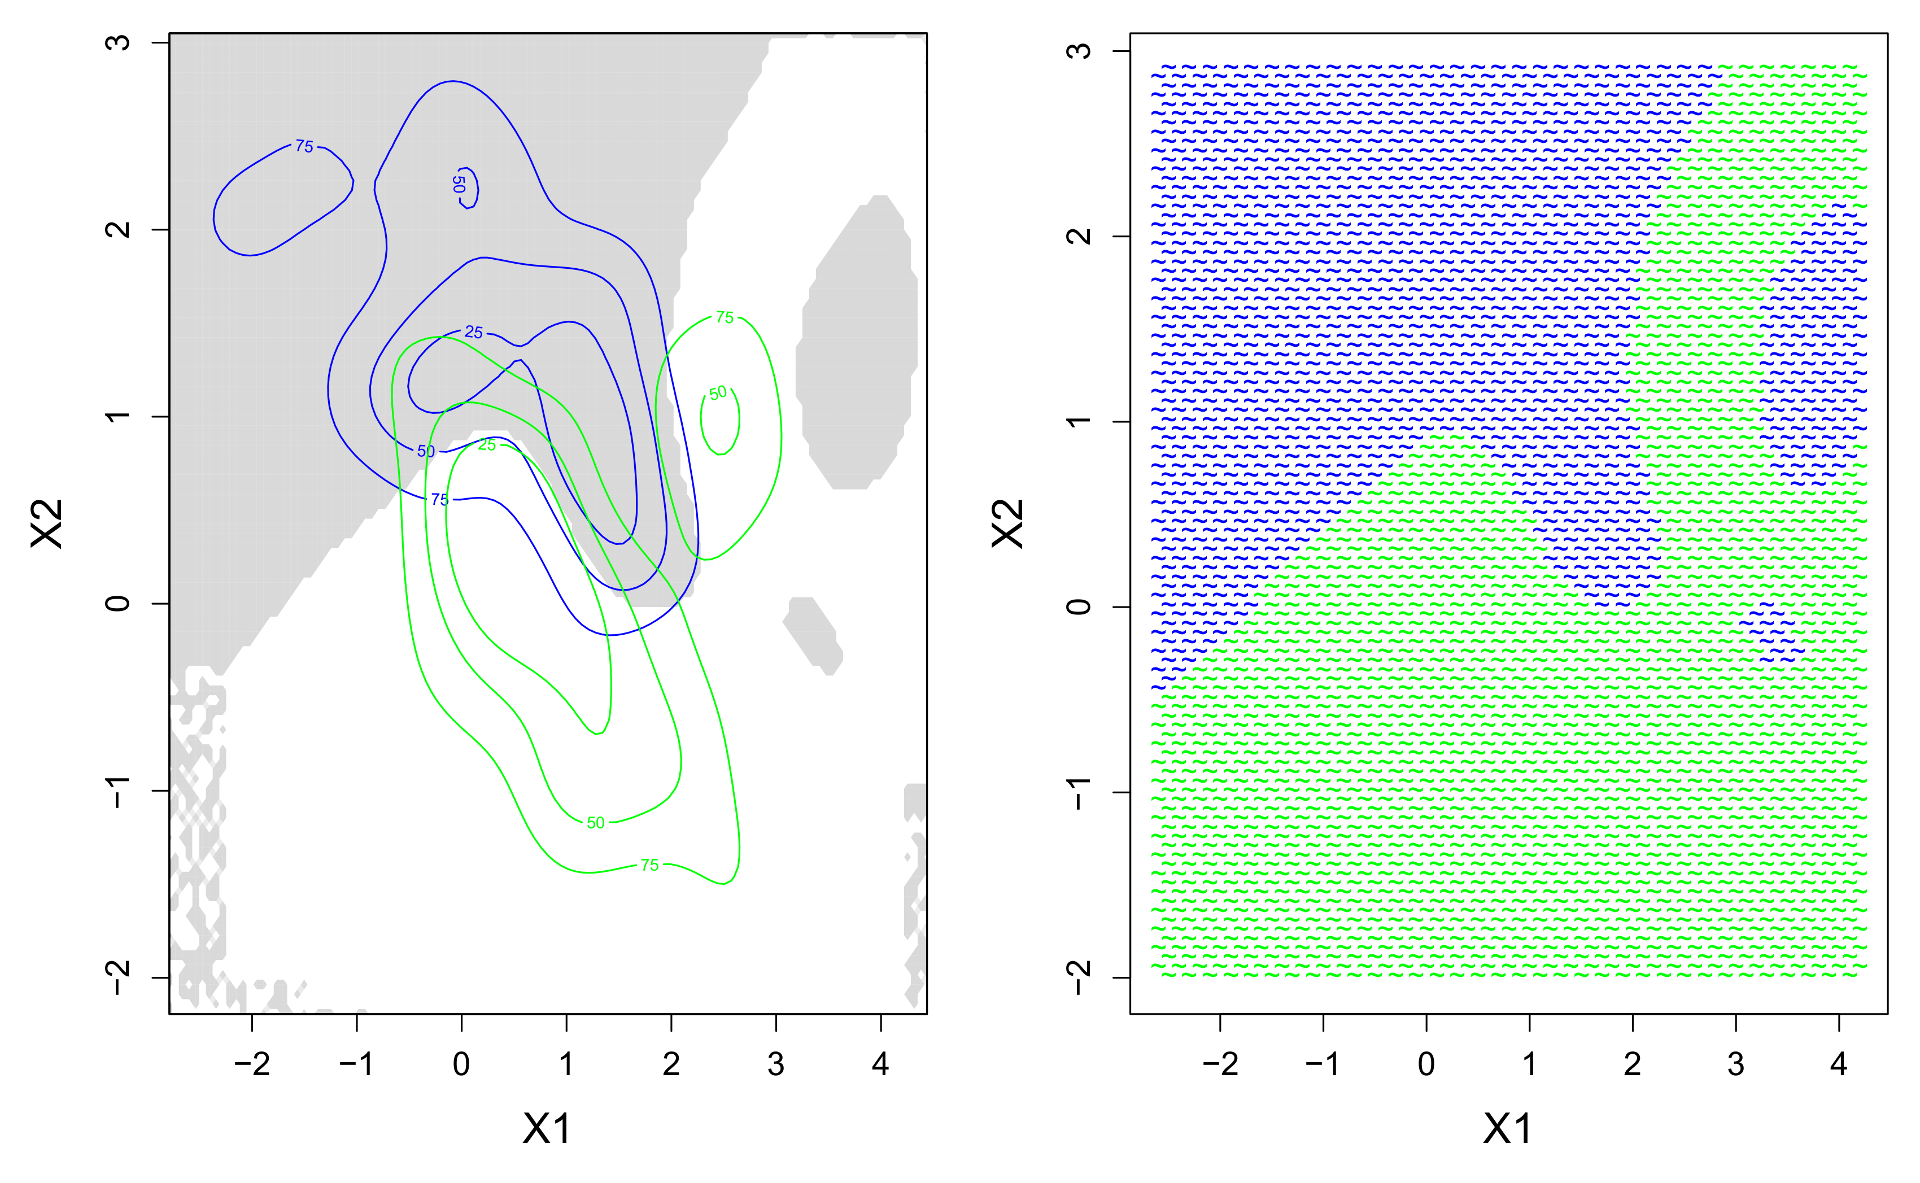
KDA in R
Estimated densities
KDA boundary

Slide 70

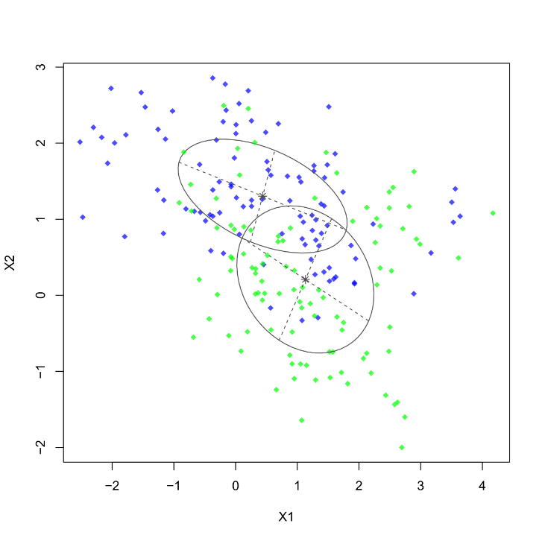
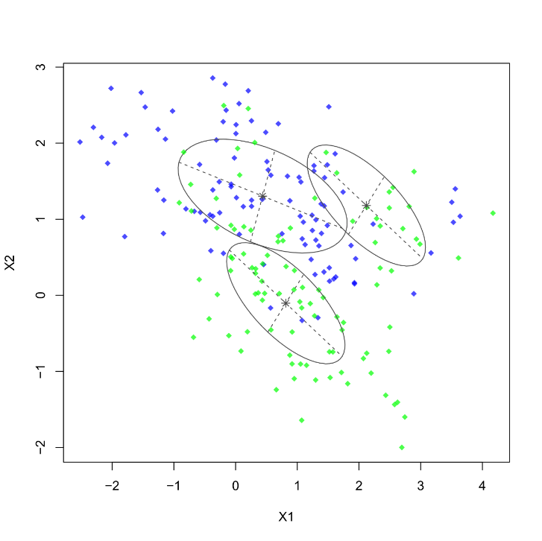
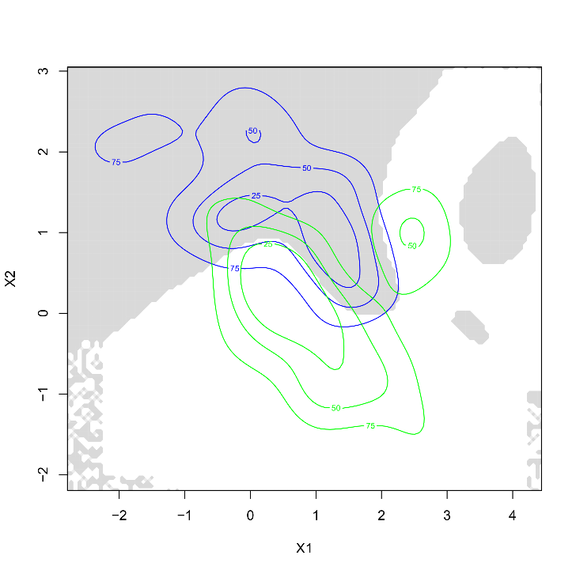
Comparison of discriminant densities
LDA
Theoretical
QDA
Theoretical
MDA
Mixed
KDA
Empirical

Slide 71
Computational limitations to KDA
In most situations we would prefer empirical density estimates over theoretically imposed densities. This would make KDA a favored choice for many classification problems.
Unfortunately, there are severe computational limitations to estimating multivariate densities. At present the ks package does not allow feature sets with more than 6 variables. This means larger feature sets need to be compressed (e.g., PCA) or they cannot be used at all.
In addition, the curse of dimensionality casts doubt on the utility of density estimation for high dimensions. Recall that in high feature dimension, all data are considered sparse!
There is one last trick that can provide more flexibility however…

Slide 72
Naive Bayes classifier
So far we have modelled P(X=x|G=g) as a joint density of the features X in each class (e.g., P_{g}(X1,X2)). An interesting equality in probability theory states that:
Thus, if we assume that the features X are independent of each other, we can replace a multivariate density model in our discriminant by a product of univariate density models (e.g., univariate density estimates).
This discriminant is known as the Naive Bayes classifier (also Idiot Bayes), because it makes the naive assumption that the features X are independent. Although in practice this will rarely be true, Naive Bayes performs remarkably well in a variety of problems.
P(A,B) = P(A) × P(B) if P(A) ⊥ P(B)

Slide 73
Naive Bayes in R
The code will be familiar by now:
library(klaR)
nb <- NaiveBayes(Class~X1+X2,data=train,usekernel=TRUE,adjust=0.8)
nb.pred <- predict(nb,newdata=test)$class
mean(nb.pred!=test$Class)
> 0.1115666
par(mar=c(5,5,1,1),cex.axis=1.2,cex.lab=1.5,mfrow=c(1,2))
plot(test[,1:2],col=as.character(test[,3]),pch="~")
points(train[,1:2],col=as.character(train[,3]),pch=18,cex=1.2)
plot(test[,1:2],col=as.character(nb.pred),pch="~")
Where the usekernel argument ensures that non-parametric density estimates are used, and the adjust argument controls the size of the window for density estimation (default=1).

Slide 74
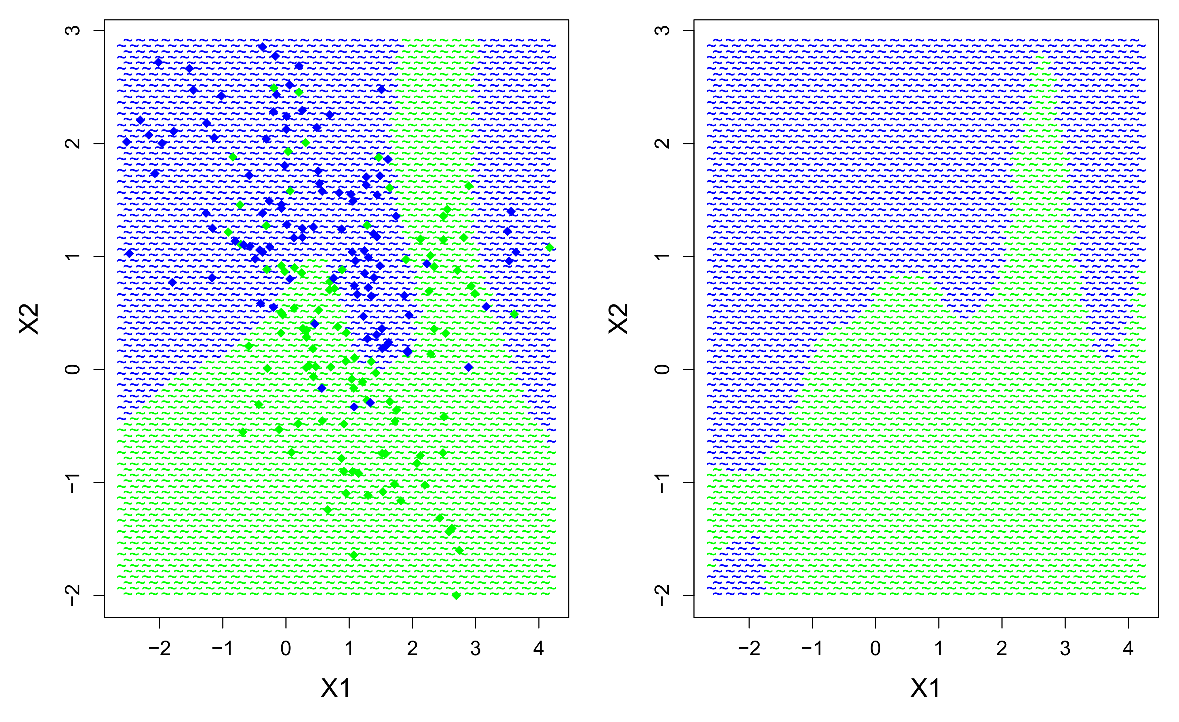
Naive Bayes in R
True boundary
Naïve Bayes boundary

Slide 75

Spam classification
From: <sender@yahoo.com>
To: <person@unige.ch>
Date: Fri, 8 Mar 2013 16:37:51 -0800
Subject: HELLO ME NOT DEAD
Thread-topic: HELLO ME NOT DEAD
Thread-index: Ac4cXlOKuYO0s8HwSzGAKNCzzrVVSg==
Accept-Language: en-US
X-MS-Has-Attach:
X-MS-TNEF-Correlator:
acceptlanguage: en-US
X-NiceBayes: is not spam (0%)
X-Spamc: is not spam (score=2.8, required=5.0)
X-MailCleaner-SpamCheck: not spam, Spamc (score=2.8, required=5.0,BOTNET 2.0,
HTML_MESSAGE 0.0, BAYES_50 0.8),
X-MailCleaner-ReportURL: https://mailcleaner.unige.ch/rs.php
X-MailCleaner-Information: Please contact postmaster@unige.ch for more information
X-MailCleaner-ID: 1UE7nY-0002oA-Ul
X-MailCleaner: Not scanned: please contact postmaster@unige.ch for details
X-MailCleaner-ReportURL: https://mailcleaner.unige.ch/rs.php
X-MS-Exchange-Organization-AuthSource: bravo.isis.unige.ch
X-MS-Exchange-Organization-AuthAs: Internal
X-MS-Exchange-Organization-AuthMechanism: 10
X-MS-Exchange-Organization-AVStamp-Mailbox: MSFTFF;1;0;0 0 0

Slide 76
Spam classification
In 2009, a report by Morrs and Harnett suggested that the probability of an incoming e-mail being spam was, at that time, at least 80%.
Naive Bayes models have achieved notable success with the identification and filtering of spam (Sahami et al., 1998). The earliest such algorithm was used in 1996 and these have become a standard in spam filtering software (e.g., Mozilla Thunderbird has a built-in Bayes filter).
The features that are used to help identify spam consists of words, characters, and style that could be indicative of spam (e.g., subject: “FREE VIAGRA TRIALS!!!”). Often particular words or punctuation are highly predictive of spam.
Moreover, the Naive Bayes filter can be tailored to an individual user by training on that user’s particular database of e-mails, and by learning from explicit manual marking of junk e-mail.
https://en.wikipedia.org/wiki/Naive_Bayes_spam_filtering

Slide 77
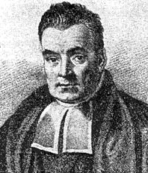
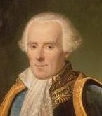
Bayes ≠ Bayesian
Bayes’ theorem was named after the British mathematician Thomas Bayes (1701‒1761). His paper on probability became the foundation of Bayesian statistics.
This legacy is a bit dubious, as it was his colleague Richard Price who developed Bayes’ work in earnest (after his death), and it was Pierre-Simon Laplace who advocated the interpretation of probability that true Bayesian statistics are founded upon.
So far, we have seen the terms Bayesian information criterion, Bayes error rate, Bayes’ theorem, and Naive Bayes classifier. None of these concepts are “Bayesian” in a strict sense.
True Bayesian inference involves the estimation of a posterior data distribution by integrating out fully specified likelihoods, priors, and hyperpriors. Simply applying Bayes’ theorem to a probability problem does not make the analysis Bayesian!
Bayes
Laplace
https://en.wikipedia.org/wiki/Pierre-Simon_Laplace

Slide 78
More discriminants…
Discriminant analysis has generated a vast literature in machine learning. There are more discriminants which I have not discussed here:
Regularized discriminant analysis (RDA): A trade-off parameter allows the user to switch smoothly between LDA and QDA.
Flexible discriminant analysis (FDA): The feature set is pretransformed with a nonlinear transformation (e.g., polynomial expansion), and then put into a standard LDA.
Robust discriminant analysis (RobDA): Estimates for the covariance matrices in LDA or QDA are replaced by robust estimates (i.e., insensitive to multivariate outliers).
Shrinkage discriminant analysis (SDA): Performs an evaluation of feature relevance by shrinking the weights in the discriminant function for irrelevant features.
…

Slide 79
Why should I use discriminants?
QDA and Naive Bayes can be difficult to motivate on their own terms, and should be considered black boxes. KDA—like KNN—has the advantage of non-parametric density estimation, and thus could be considered as a general nonlinear option. In social sciences, KDA is little known.
LDA has a long history of application in social sciences and is a widely accepted tool for binary or multiclass classification (cfr. logistic regression). Reasons to motivate LDA for a study include:
Discriminant functions allow the user to interpret variable relevance
Linearity constraint prevents overfitting
Surprisingly good benchmark for many classification problems
Can be motivated as a follow-up to a classical MANOVA, of which it is a reverse formulation. Like LDA, MANOVA assumes multivariate normality of the continuous variables within each between-class.

Slide 80

Discriminants evaluation
What have we found for the two-class data problem so far…?
Model | Properties | Train error | Test error
LDA | Linear decision boundary | 27.0% | 17.7%
MDA | M=(1,2) | 23.5% | 18.7%
QDA | Quadratic decision boundary | 28.5% | 17.1%
KDA | Multivariate density estimates | 14.5% | 12.4%
NB | Univariate density estimates | 20.0% | 11.1%
KNN | 8 nearest neighbors | 17.5% | 9.0%

Slide 81
Discriminants evaluation
Advantages:
Quick and simple benchmark for many classification problems
LOO-CV measure available for LDA and QDA
Flexibility of MDA for handling subclusters
Data-driven density estimates in KDA and naive Bayes
Disadvantages
Theorical distributional assumptions in LDA and QDA
No automatic elimination of irrelevant features in most discriminants
Unrealistic assumption of feature independence in naive Bayes classifier
Computational limitations to KDA
Discriminants exist only for classification problems!
General limitation of discriminants for handling complex nonlinearity

Slide 82

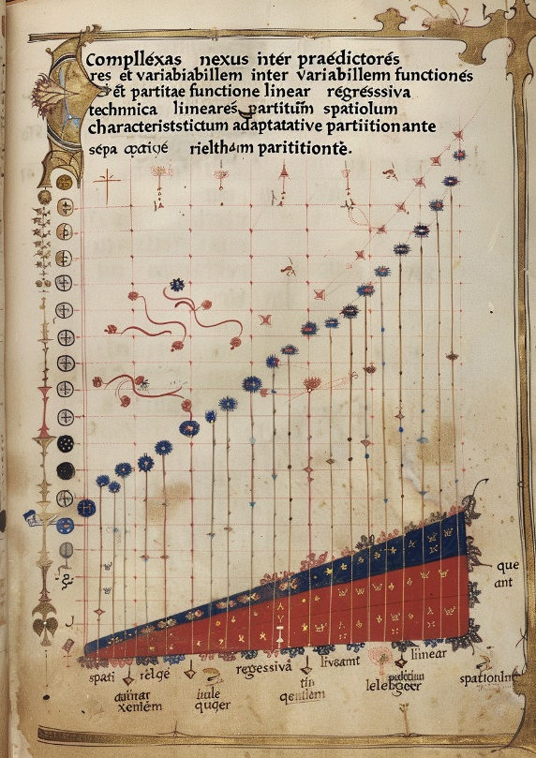

7. Flexible regression with splines

Slide 83
Back to regression…
Discriminant analysis reformulated the problem of modelling P(G=g|X=x) by modelling P(X=x|G=g) instead.
Modelling P(G=g|X=x) directly is what conventional logistic regression does. It assumes that the dependent is binomial distributed, given the independent variables. For continuous regression, we model P(Y|X) and assume that the dependent is normally distributed, given the independent variables.
Both of these models are special cases of the generalized linear model (GLM), which also covers Poisson regression (count response), multinomial logistic regression (multiclass response), gamma regression (exponential response), etc.
We now return to these conventional models, particularly continuous regression, and show how they can be extended to handle non-linearity…

Slide 84
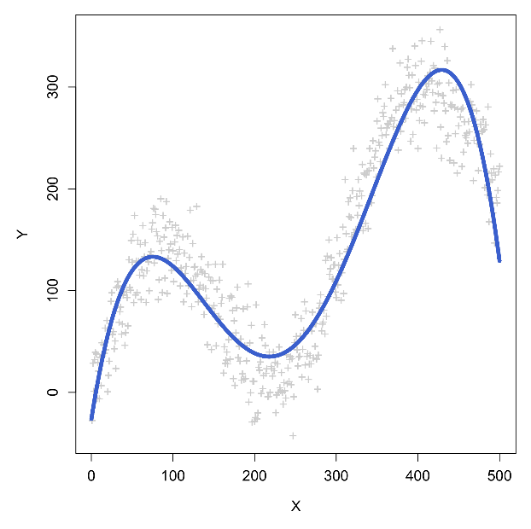
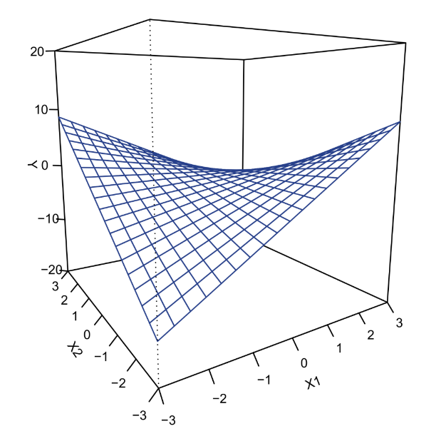
Nonlinearity problem
As noted in the introduction, a common problem in statistical modelling is how to handle nonlinear associations, e.g.:
Nonlinear associations can include not just curves but also interactions among predictor variables, or feedback in time-series data.

Slide 85
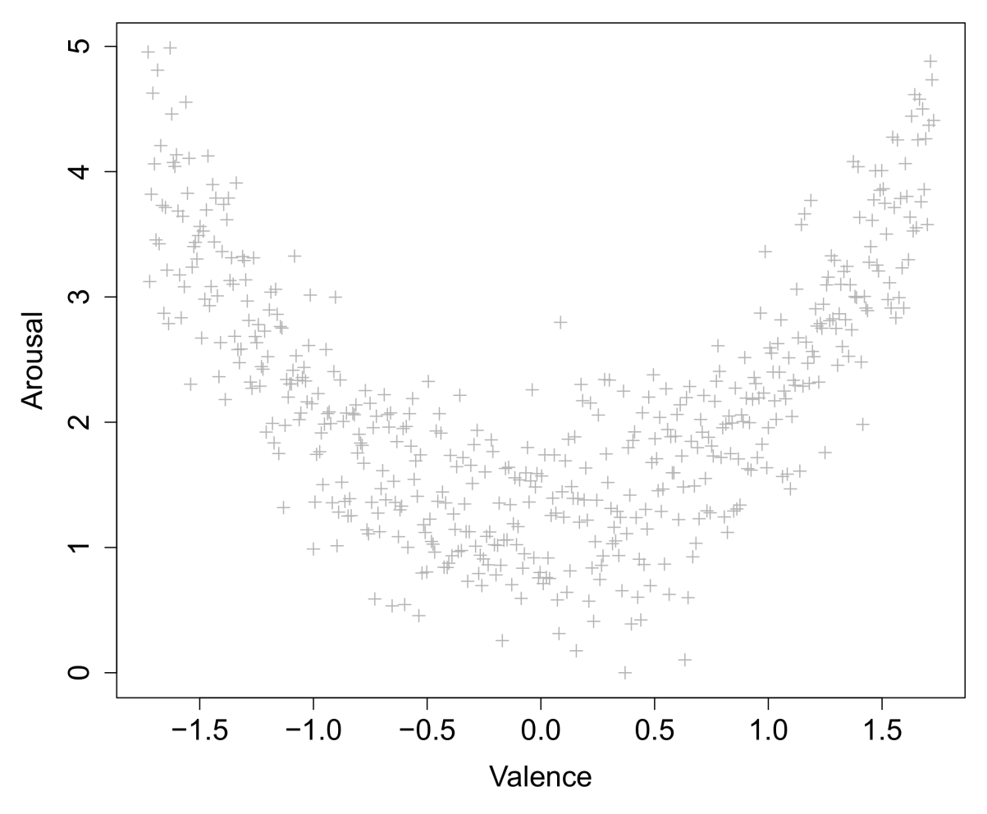
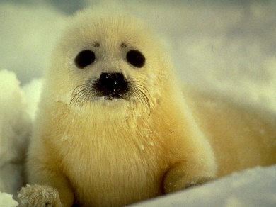
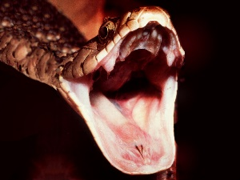


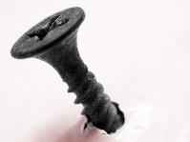
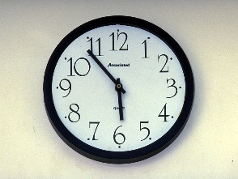
Dealing with curves
Relation between the felt valence (positive – negative) of an image and its felt arousal is known to be parabolic (e.g., IAPS picture database):

Slide 86
Dealing with curves
Relation between the felt valence (positive – negative) of an image and its felt arousal is known to be parabolic (e.g., IAPS picture database):

Slide 87
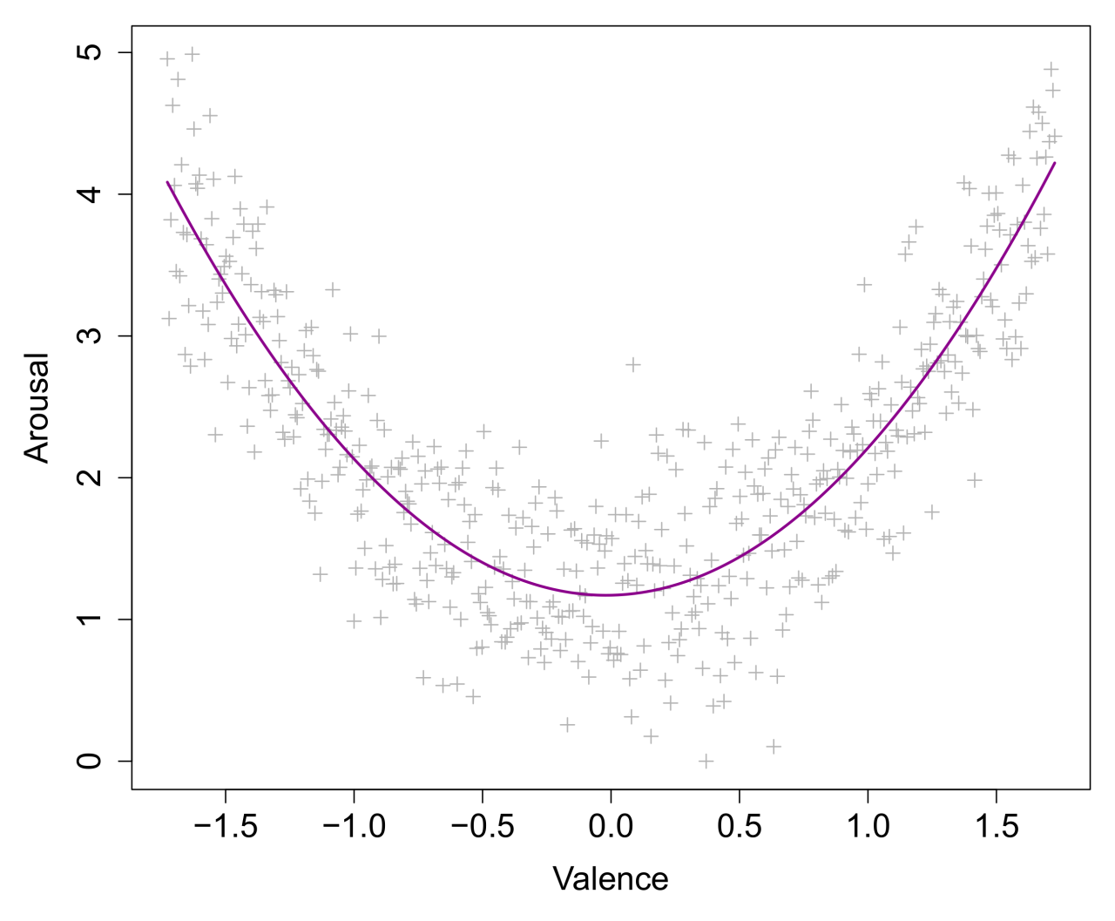
Dealing with curves
E(Y) = β₀ + β₁X + β₂X² What is the interpretation of β₂...?

Slide 88
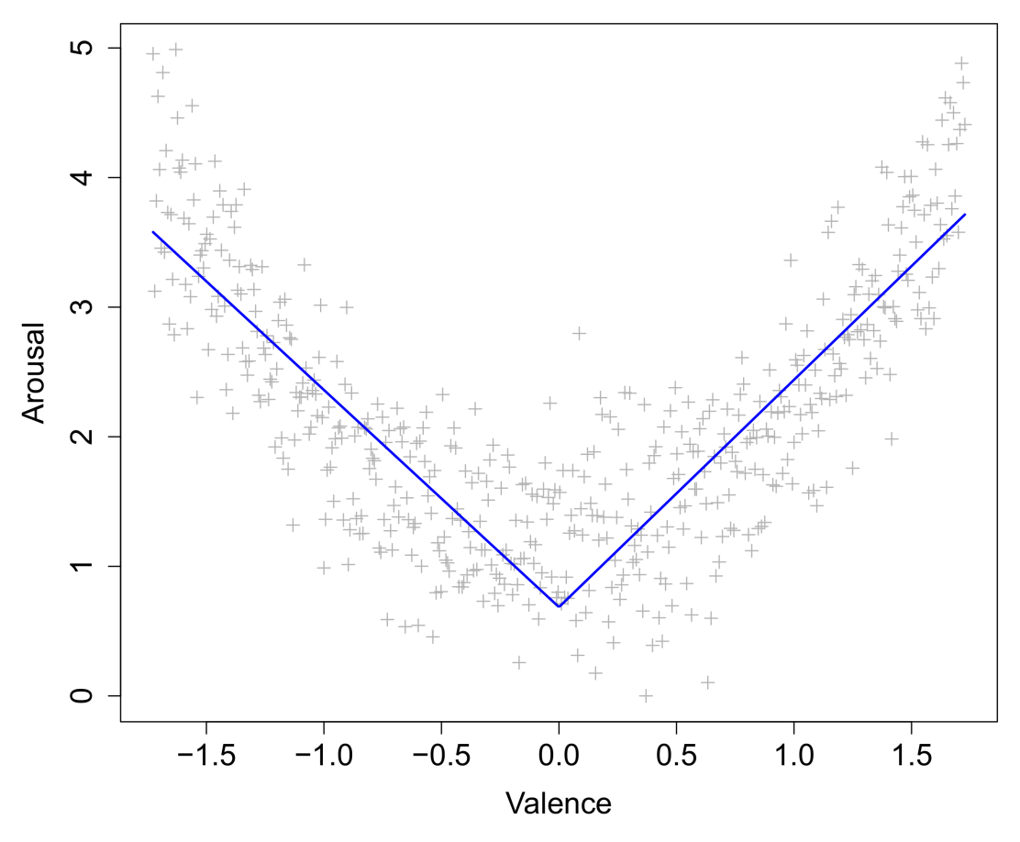
Dealing with curves
Unfortunately, regression parameters related to curves are difficult to interpret. One solution is to approximate a curve by a piecewise linear function:

Slide 89
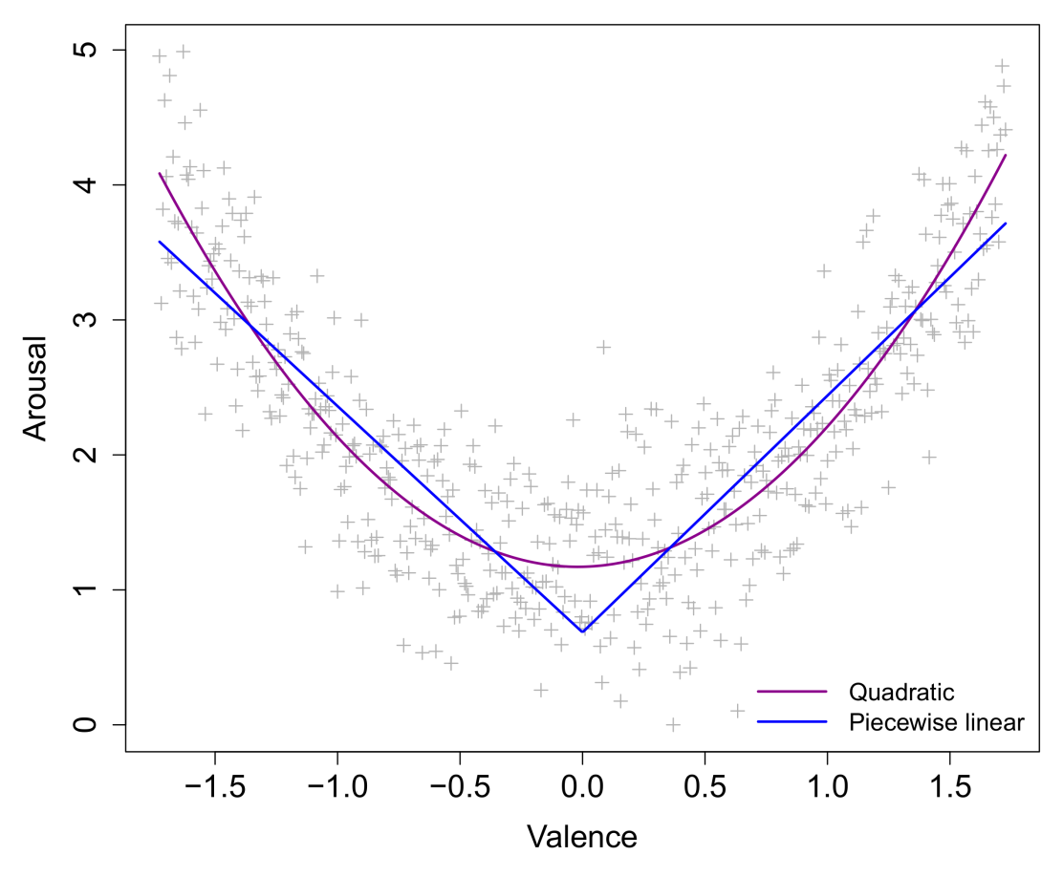
Dealing with curves
As an approximation, this is actually quite good. The interpretation is identical to the one for linear slopes, except now we have a different slope before and after the change point.

Slide 90
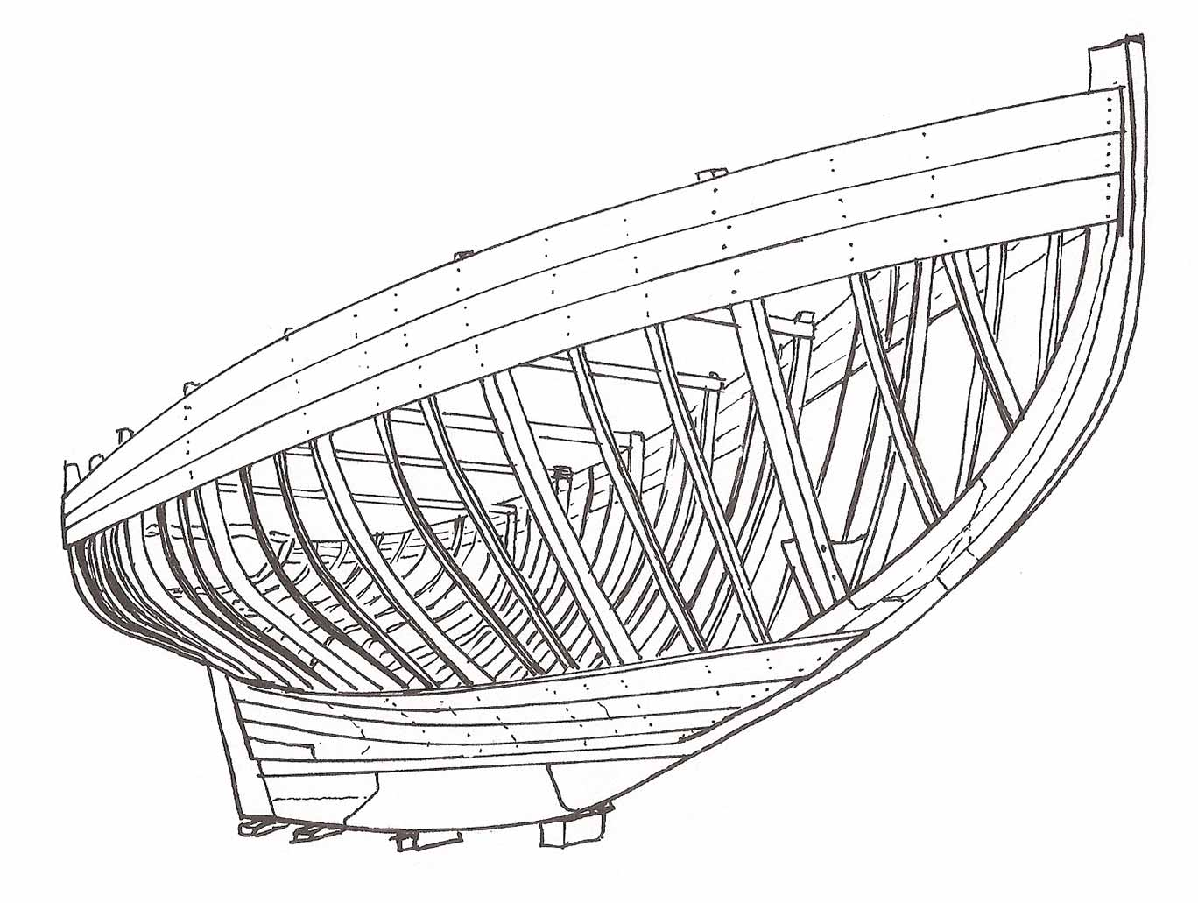
Piecewise regression with splines
Pieces of a piecewise function are called splines. In the previous example, there were two splines.
Splines need not be linear, strictly speaking, but linear splines are by far the most common in modelling, due to their simple interpretation (i.e., constant rate of change for each spline).
Splines are joined together by knots, which are sometimes also called hinges. These are the points where the function can change direction.
In practice, it is easy to fit a simple spline model to data for a chosen knot point. We do this by adding hinge transformations of predictors to our data set.

Slide 91
Piecewise regression with splines
The general notation for a hinge transformation is e.g., (X – k)₊, which denotes: the positive part of X after the value of the knot k is subtracted.
For the transformed variable, values smaller than the knot value will be set to zero. Values larger will be non-zero. Specifically:
X < k X_{hinge} = 0
X > k X_{hinge} = X – k
Now we add this transformed variable as a predictor to a standard linear model…
X | (X−0)₊ | (X−1)₊ | Y
-2.0 | 0.0 | 0.0 | 5.1
-1.5 | 0.0 | 0.0 | 3.4
-1.0 | 0.0 | 0.0 | 2.3
-0.5 | 0.0 | 0.0 | 1.5
0.0 | 0.0 | 0.0 | 0.7
0.5 | 0.5 | 0.0 | 1.4
1.0 | 1.0 | 0.0 | 2.4
1.5 | 1.5 | 0.5 | 3.5
2.0 | 2.0 | 1.0 | 5.2

Slide 92
Piecewise regression with splines
E(Y) = β₀ + β₁X + β₂(X−0)₊ What is the interpretation of β₂...?

Slide 93
Piecewise regression with splines
E(Y) = β₀ + β₁X + β₂(X−0)₊ β₂ reflects the amount of change in β₁ after the point X=0.
β₁
β₁ + β₂

Slide 94
Piecewise regression with splines
Significance tests on spline parameters thus reflect whether or not the current slope is significantly different from the preceding slope. In other words, whether there is significant change after a certain point.
In R, it is easy to manually create a hinge transform function, and use it to fit a linear spline for the curvilinear data:
h <- function(v,k=0) { ifelse(v-k<0,0,v-k) }
lspline <- lm( y~x+h(x,100)+h(210)+h(400) )
R allows you to plug custom functions directly inside model formulas. This is useful for plotting packages like visreg:
visreg(lspline,xvar="x")
summary(lspline)

Slide 95
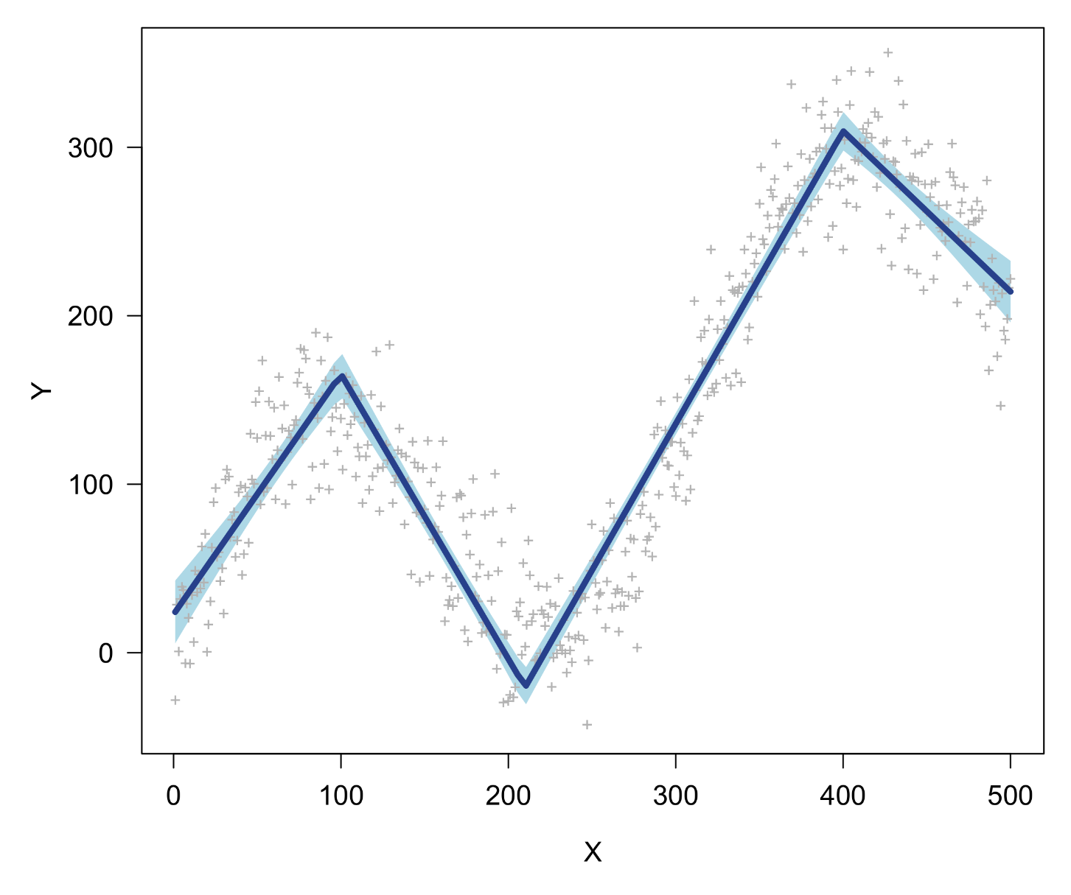
Piecewise regression with splines

Slide 96
Piecewise regression with splines
The parameters and their significance tests have a straightforward interpretation:
Coefficients:
Estimate Std. Error t value Pr(>|t|)
(Intercept) 22.71886 5.69921 3.986 7.72e-05 ***
x 1.42673 0.08058 17.705 < 2e-16 ***
h(x, 100) -3.11756 0.12094 -25.777 < 2e-16 ***
h(x, 210) 3.42884 0.07452 46.011 < 2e-16 ***
h(x, 400) -2.69139 0.09370 -28.723 < 2e-16 ***
---
Signif. codes: 0 ‘***’ 0.001 ‘**’ 0.01 ‘*’ 0.05 ‘.’ 0.1 ‘ ’ 1
Residual standard error: 30.5 on 495 degrees of freedom
Multiple R-squared: 0.9069, Adjusted R-squared: 0.9062
F-statistic: 1206 on 4 and 495 DF, p-value: < 2.2e-16

Slide 97
Piecewise regression with splines
1.43 - 3.12 + 3.43 = 1.74
1.43 - 3.12 = -1.69
1.43 -3.12 + 3.43 - 2.69 = -0.95
1.43

Slide 98
Piecewise regression with splines
Note that the spline model has the same number of parameters as the polynomial fitted earlier (4), but the transformed X variables differ completely. A formal ANOVA comparison (with an F-test) is not possible between these two models, since they are not nested.
However, in such a scenario, we could compare goodness-of-fit measures that do not require this nesting, such as adjusted R², or AIC and BIC (see this morning!). Recall that these measures penalize models for redundant parameters. In R:
AIC(poly4) ; AIC(lspline)
> 4920.452
> 4843.655
The linear spline model has an AIC that is lower by almost 80 points, which is a dramatic difference on a relative AIC scale, where differences of 2 points are typically already considered “meaningful”.

Slide 99
B-splines
While the simple hinge transformations will return a highly interpretable model, the resulting variables might be vulnerable to instabilities, chiefly collinearity between them.
For this reason, one might prefer a B-spline transformation, which is a kind of “normalized” spline transformation. In R*, this can be fitted as follows:
bspline <- lm(y~ bs(x,knots=c(100,210,400),degree=1) )
This model will reduce the collinearity issue while otherwise having the exact same fit (e.g., R², AIC, visual fit).
However, the parameters are much more complicated to interpret than the simple splines presented before…!
* requires splines package

Slide 100
When do we need it?
In psychological data, a need for splines can arise generally from the wish to model nonlinear associations. However, there are some specific cases where splines are particularly useful:
Bipolar scales/factors
Threshold effects
Longitudinal change

Slide 101
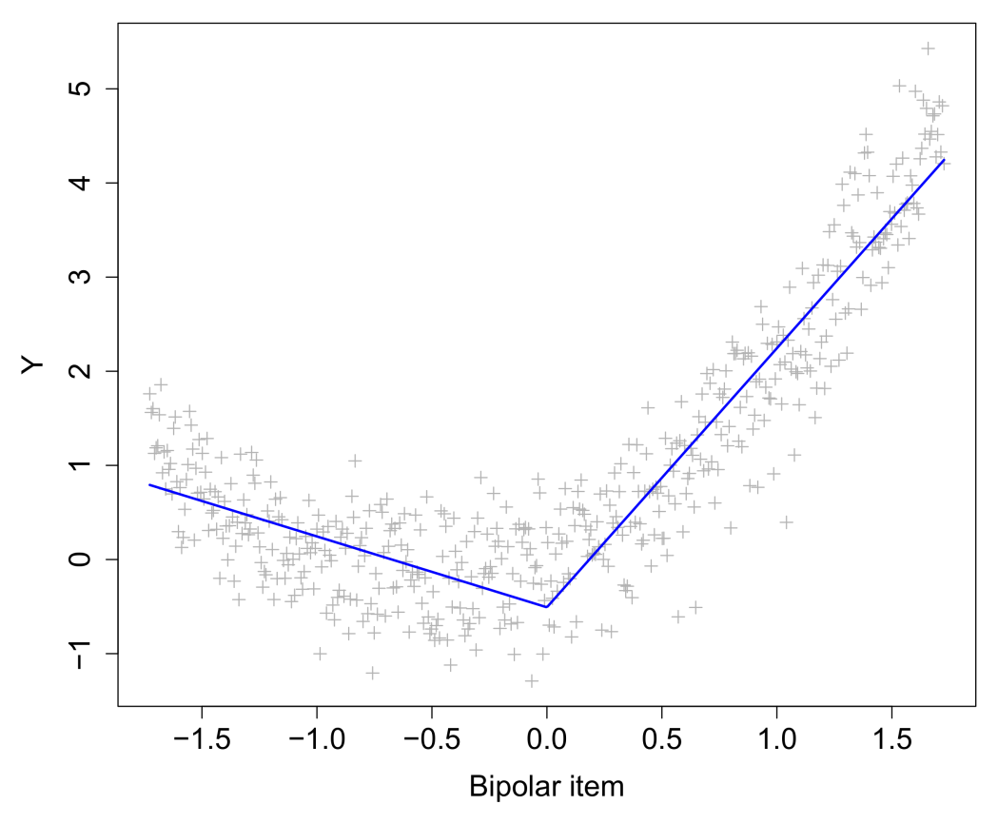
Bipolar scales/factors
Questionnaire items in psychology often consist of bipolar scales (negative–positive; disagree–agree).
The negative part of these scales may have a different relationship with the outcome variable than the positive part
Splines allow these parts to be modelled separately
Bipolarity is also typically observed in latent variables such as principal components and factors in factor analysis!

Slide 102
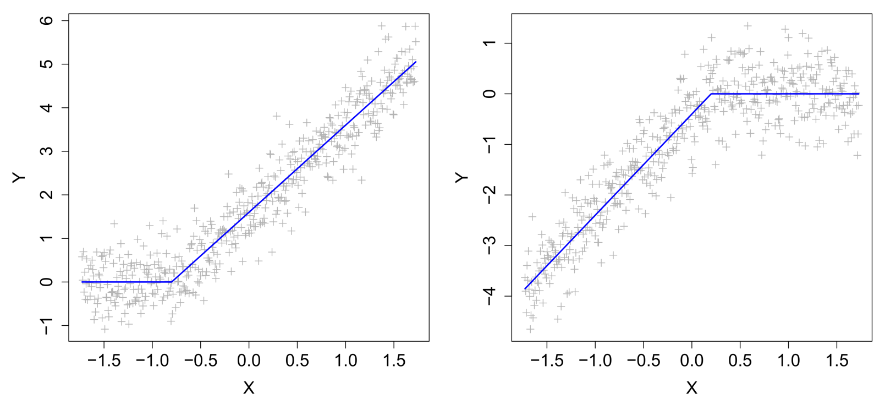
Threshold effects
Sometimes predictors do not impact the outcome variable until they reach a certain value. Sometimes predictors stop impacting an outcome variable after they reach a certain value, i.e., a threshold:
Sometimes these patterns are due to ceiling/floor effects in performance or measurement

Slide 103
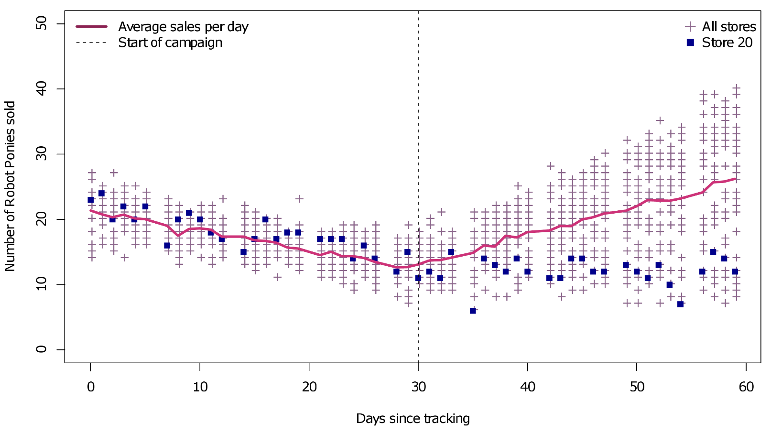
Longitudinal change
Change over time is rarely characterized by linear (or even monotone) changes. Typically, longitudinal data are characterized by alternating periods of stability and change. Sometimes these changes are a consequence of events or interventions:

Slide 104

Longitudinal change
Alternatively, longitudinal data could have been collected without the presence of interventions, or time reflects a cross-sectional pattern of change:

Slide 105
Data format
Splines allow a variable to be simultaneously categorical and continuous. Each spline represents a category, but within that category there can be a continuous relationship between the predictor and the response. The knots ensure that the resulting function has no discontinuities.

Slide 106

Selecting knot points
Sometimes knot points can be selected (a priori) based on theoretical or psychometric reasons:
The mid-point of a bipolar variable
A point of intervention
Pre-defined age categories (e.g., adolescent, young adult)
Other times however it will not be clear where the knots should be placed. In this case we can switch to a data-driven selection of knots.
This is the primary purpose of multivariate adaptive regression splines (MARS; Friedman, 1991).
Jerome Friedman

Slide 107
Multivariate adaptive regression splines
MARS models a dependent variable (Y), given one or more independent variables (X’s), just as linear regression. In addition, it automatically adds meaningful main effects, interactions, and hinge transformations to the model.
This MARS achieves with a stepwise selection procedure that selects:
Relevant predictor variables
The optimal number of knot points per predictor
The optimal values for the knot points per predictor
Interactions between predictors up to a specified degree
These elements are added or removed only when they reduce the model’s generalized cross-validation error (GCVE), which is a penalized measure of model error similar to AIC and BIC.

Slide 108
MARS in R
For the curvilinear data, fitting a MARS model is straightforward:
library(earth)
mars <- earth(y~x)
Unfortunately, visreg is incompatible with the earth package, so we might switch to manual prediction plotting:
xval <- 1:5000/10
predmars <- predict(mars,newdata=data.frame(x=xval))
plot(x,y,pch="+",col="grey80",xlab="X",ylab="Y")
lines(xval,predmars,col="firebrick",lwd=4)
An alternative is to use earth's compatible plotmo package, which offers some of the same functionalities as visreg.

Slide 109

MARS in R

Slide 110
MARS in R

Slide 111
MARS in R
The summary prints the exact values of the slopes in the different value ranges of X, as well as some other highly useful model information:
coefficients
(Intercept) 257.656056
h(x-113) -2.344439
h(228-x) -0.951901
h(x-228) 4.036941
h(x-288) 0.670482
h(x-368) -1.814359
h(x-408) -1.319833
h(x-478) -2.017451
Selected 8 of 8 terms, and 1 of 1 predictors
Termination condition: RSq changed by less than 0.001 at 8 terms
Importance: x
Number of terms at each degree of interaction: 1 7 (additive model)
GCV 879.8306 RSS 413916.3 GRSq 0.911449 RSq 0.9163481

Slide 112
MARS and two-class problem
MARS can be integrated with any standard GLM, such as logistic regression, which we use for the two-class data problem:
library(earth)
mars <- earth(Class~X1+X2,data=train,degree=2,glm=list(family=binomial))
mars.pred <- predict(mars,newdata=test,type="class")
mean(mars.pred!=test$Class)
> 0.16632
par(mar=c(5,5,1,1))
plot(test[,1:2],col=as.character(test[,3]),pch="~")
points(train[,1:2],col=as.character(train[,3]),pch=18,cex=1.2)
plot(test[,1:2],col=as.character(mars.pred)),pch="~",cex=1.2)
Where the degree argument controls the order of interactions allowed. Since the two-class data problem has only two predictors, values larger than 2 are not possible here.

Slide 113

MARS and two-class problem
True boundary
MARS boundary

Slide 114
MARS in R
As before, the values of the knot points, can be extracted with the summary function. Let’s discuss this output for a moment…
summary(mars)
> Call: earth(formula=Class~X1+X2, data=train, degree=2, glm=list(family=binomial))
> coefficients
> (Intercept) 0.2178332
> h(X1-0.8407) -0.4151216
> h(X1-1.3487) 1.1173662
> h(X1-2.491) -1.0377640
> h(1.2614-X2) 0.6774592
> h(X1- -0.8043) * h(1.2737-X2) -0.1637058
> Selected 6 of 17 terms, and 2 of 2 predictors
> Termination condition: Reached nk 21
> Importance: X2, X1
> Number of terms at each degree of interaction: 1 4 1
> GCV 0.1749362 RSS 30.42338 GRSq 0.3072351 RSq 0.3915325

Slide 115

A different data set…
The two-class problem cannot fully demonstrate the stepwise selection power of MARS. Let's look at the etitanic data set that's included in the earth package:
# | survived | pclass | sex | age | sibsp | parch | noise norm | noise unif | noise binom
1 | yes | 1st | female | 29.00 | 0 | 0 | -1.2933 | -0.5936 | 0
2 | yes | 1st | male | 0.92 | 1 | 2 | -1.8854 | 0.8110 | 1
3 | no | 1st | female | 2.00 | 1 | 2 | 0.1692 | -0.2348 | 0
4 | no | 1st | male | 30.00 | 1 | 2 | -0.2159 | -1.4384 | 0
… | … | … | … | … | … | … | … | … | …
1046 | no | 3rd | male | 29.00 | 0 | 0 | 0.9123 | -0.3864 | 1
Index | DV | IVs |  |  |  |  | Noise IVs

Slide 116
Survival on the Titanic
We want to predict/model the probability of survival (0=no, 1=yes) based on the passenger information. We want to select the best predictors for this, their interactions (if any), and any spline effects (if any).
Since we have a binary outcome variable, the underlying model will again be a logistic regression.
To make the Titanic data slightly more challenging for the model, I added three random noise variables (Gaussian, uniform, and binomial noise). Ideally, MARS's stepwise selection procedure should exclude these variables from the final model!
Adding such variables to a dataset can be useful way of detecting problems with overfitting!

Slide 117
Survival on the Titanic
mars <- earth(survived~.,data=etitanic,degree=2,pmethod="exhaustive", ,glm=list(family=binomial))
summary(mars)
GLM coefficients
(Intercept) 2.7189042
pclass3rd -4.3236171
sexmale -2.6807708
pclass2nd * sexmale -1.7478078
pclass3rd * sexmale 0.9930032
pclass3rd * h(3-sibsp) 0.7209374
pclass3rd * h(0.0180345-noise.norm) -0.4315225
sexmale * h(age-16) -0.0274905
sexmale * h(16-age) 0.2124101
h(1-parch) * h(noise.unif-1.55032) -4.5559464
Earth selected 10 of 17 terms, and 8 of 9 predictors
Termination condition: Reached nk 21
Importance: sexmale, pclass3rd, pclass2nd, age, sibsp, parch, noise.unif, noise.norm, noise.binom-unused
Number of terms at each degree of interaction: 1 2 7
Earth GCV 0.140843 RSS 140.7765 GRSq 0.4180988 RSq 0.4428869

Slide 118

Age × Gender interaction

Slide 119
Feature relevance in MARS
A normalized ranking of variable importance in a MARS model can be obtained with the evimp function…
Which prints the improvement in model fit for each predictor, relative to the most predictive one (100 by default).
Contrary to common misconception, not all machine learning models were developed as black boxes. MARS has as explicit purpose to extract data patterns in an intelligible and interpretable fashion!
evimp(mars)
> nsubsets gcv rss
> sexmale 9 100.0 100.0
> pclass3rd 8 56.2 58.9
> pclass2nd 6 36.9 40.5
> age 6 36.9 40.5
> sibsp 5 26.0 30.6
> parch 2 4.8 12.0
> noise.unif 2 4.8 12.0
> noise.norm 1 1.5 8.0

Slide 120
Feature relevance in MARS
As noted, MARS bears similarities to simple stepwise regression, which we saw briefly this morning when discussing the use of AIC and BIC for model selection.
MARS adds to the predictor selection automatic interaction and spline selection, but these options can be switched off, if desired.
Disturbingly, two of the noise variables appear in the final model for the Titanic data! While they are ranked as least important by the evimp ranking, their appearance is still highly undesirable, and shows that “best subset” selection can fail.
Perhaps we can toy around with more tuning parameters to improve our model…?

Slide 121
Tuning parameters
The earth implementation of MARS has a rather large number of different control options and tuning parameters (see its help pages for explanations). Some of the important ones include:
Argument | Details
degree | The order of interactions among predictor variables that you allowed. Typically values between 2 and 4 make the most sense.
pmethod | The procedure for stepwise selection, which can be forward, backward, exhaustive, or fully cross-validated.
nfold | The number of cross-validation folds to consider when pmethod="cv".
penalty | A penalty value for adding knots/splines to the model. Larger values will reduce the number of splines MARS includes in the final model. Simulation studies suggest values in the range of about 2 to 4.

Slide 122
Tuning parameter – pmethod
set.seed(1846)
mars <- earth(survived~.,data=etitanic,degree=3,pmethod="cv",
glm=list(family=binomial),nfold=5)
(Intercept) 2.6210388
pclass3rd -3.6762798
sexmale 16.5330822
pclass2nd * sexmale -2.1665179
pclass3rd * sexmale 1.1304006
pclass3rd * h(sibsp-3) -0.3812213
pclass3rd * h(3-sibsp) 0.6411103
sexmale * h(age-16) 1.4505704
sexmale * h(16-age) -1.1718619
sexmale * h(age-3) -1.4762406
pclass2nd * sexmale * h(age-16) 0.0111782
pclass2nd * sexmale * h(16-age) 0.4326142
pclass3rd * h(3-sibsp) * h(parch-1) -0.2300371
pclass3rd * h(3-sibsp) * h(1-parch) -0.2478007
sexmale * h(16-age) * h(sibsp-1) -0.0858618
sexmale * h(16-age) * h(1-sibsp) 0.0398533
Earth selected 16 of 16 terms, and 6 of 9 predictors using pmethod="cv"
Termination condition: Reached nk 21
Importance: sexmale, pclass3rd, pclass2nd, age, sibsp, parch, noise.norm-unused, noise.unif-unused, noise.binom-unused
Number of terms at each degree of interaction: 1 2 7 6
Earth GRSq 0.4143498 RSq 0.4556279 mean.oof.RSq 0.4211055 (sd 0.0423)

Slide 123

Age × Gender × Class interaction

Slide 124

Tuning parameter – pmethod
Although one would expect fully cross-validated model building to always be superior, it fails for the two-class data problem:
set.seed(1401)
mars <- earth(Class~X1+X2,data=train,degree=2,pmethod="cv",nfold=5)
mean(predict(mars,newdata=test,type="class")!=test$Class)
> 0.1704246

Slide 125
MARS cautions
MARS does not output significance tests for its selected effects! Whether or not an effect (a spline, an interaction) is meaningful is determined by the stepwise selection with GCVE.
If there is an interest in testing a spline effect for significance, it is better to add the spline effect manually to your data and run the analysis with a conventional program/function (even in SPSS or Statistica you can do this).*
In general, MARS will perform better for larger data sets, and be more stable for uncorrelated independent variables. Stepwise selection in the presence of severe confounding (or multicollinearity) can be problematic!
MARS should not be used to analyze data from experimental designs. It is best suited to observational data and for data exploration, for example as a follow-up to a standard inferential regression model.
* Or plug the model matrix directly into a regular regression function in R

Slide 126
More earth…
If you consider a MARS/spline approach for your own data, I highly recommend to look up the earth package's help pages. Its documentation and vignettes are some of the most informative of any package available in R!
See especially, “Notes on the earth package” : http://www.milbo.org/doc/earth-notes.pdf
In addition, earth offers extensions for other types of response distributions (multinomial, poisson) and even multivariate data (i.e., more than one response variable simultaneously). Finally, there is an option model the variance of your data, rather than its mean (e.g., when there is heteroscedasticity)

Slide 127
Why should I use splines?
Spline models can be justified easily due to their high interpretability when compared to curves. Moreover, there may be sound theoretical reasons to allow knot points in the data (e.g., bipolar scales, longitudinal events).
If the values of the knot points can be chosen on theoretical grounds, this is generally recommended.
If the required number of knot points and splines is unknown, MARS is a powerful machine learner that will automate this selection. The same model can be applied to search for promising interactions. An exhaustive search for interactions with inferential tests (p-values) would be practically unfeasible.
MARS has not been widely adopted in social sciences, to date, although its core principles should be familiar to researchers in this field. I have applied MARS in two recent studies…

Slide 128

Example – Action tendencies in emotion
We submitted a paper with Emotion that used multivariate adaptive regression splines (MARS) for modelling emotion data.
The usage of these features could be motivated within appraisal theories of emotion which have predicted these types of nonlinearity.
Meuleman et al. (2019)

Slide 129
Example – Action tendencies in emotion
Meuleman et al. (2019)

Slide 130

Example – Cognitive aging
⬥
Condition A
+
Condition B
Zuber, S., Ihle, A., Blum, A., Desrichard, O., & Kliegel, M. (2017)

Slide 131
MARS evaluation
Advantages:
Models retain their linear interpretability
Automated selection of splines and interaction effects
Multiple rankings of predictor importance (not a black box!)
Extremely well-documented earth package in R
Disadvantages
Unstable in data sets with correlated/collinear predictors
Tends to generate overly complex models in large data sets
Sensitive to the presence of many irrevelant/noise predictors

Slide 132



8. Decision trees and random forests

Slide 133


Time for intuition
Survey respondents rated for 250 photos of smiles whether the smile seemed fake or genuine. Independently, researchers had coded the photos for facial action unit (AU) activity.
❐
Perceived genuine
AU6
AU12

Slide 134
Time for intuition
Based on this plot, can you come up with a good rule for predicting genuine smiles…?
❐
Perceived genuine

Slide 135

Time for intuition
❐
Perceived genuine

Slide 136
Time for intuition
AU6 < 0.6
AU6 > 0.6
+
❐
Fake
100%
Genuine
70%

Slide 137
Time for intuition
❐
Perceived genuine

Slide 138

Time for intuition
❐
Perceived genuine

Slide 139
Time for intuition
AU6 < 0.6
AU6 > 0.6
+
Fake
100%
AU12 < 0.3
AU12 > 0.3
+
❐
Fake
100%
Genuine
100%

Slide 140
Time for intuition
❐
Perceived genuine
AU6 + AU12
(Duchenne smile)
https://en.wikipedia.org/wiki/Smile#Duchenne_smile

Slide 141
Decision trees
We have just “fitted” a basic decision tree to these data. All we have done is construct a sequence of if-else rules to predict the response classes. The statistical version of this logic is known formally as recursive partioning.
At each step, the partitioning algorithm will find the variable (e.g., AU6) and the split-value (e.g., 0.6) that best separate the response classes into rectangular regions (e.g., fake versus genuine smiles).
The algorithm will keep splitting the data space this way, until a stopping criterion is reached. The resulting split rules can be represented as a decision tree.
Decision trees can be used both for categorical response variables (classification) and continuous response variables (regression).

Slide 142

Trees for the two-class data problem
True boundary
Tree boundary

Slide 143

Trees for the two-class data problem

Slide 144
Trees in R
The standard package for trees in R is rpart. In addition, the rpart.plot package is convenient for plotting:
library(rpart)
library(rpart.plot)
tree <- rpart(Class~X1+X2,data=train)
rpart.plot(tree,type=3,fallen.leaves=FALSE, box.palette=list("steelblue1","palegreen"),legend.x=0.8,legend.y=1)
As before, we can generate predictions, generate a confusion table, and calculate the error:
predictions <- predict(tree,newdata=test,type="class")
table(predictions,test$Class)
mean(predictions!=test$Class)
> 0.1341142

Slide 145
Stopping rules
For the smile example it was easy to decide when to stop splitting the tree: at some point all leaves of the tree were pure, i.e., containing observations of only one class. What if the leaf still contained mixtures of classes? Should we keep splitting?
A number of rules exist to guide this decision:
Split until all leaves are pure
A minimum number of observations must remain in a leaf before a new split is attempted (e.g., 10 observations)
Split until a maximal depth of the tree is reached
Split until the degree of class-separation falls below a certain threshold
In the extreme case, it would be possible to keep splitting until every observation in the data was in its own leaf…

Slide 146

Stopping rules

Slide 147
Overfitting
We have previously discussed the problem of overfitting in machine learning. The preceding tree is a good example of this.
Recall that most data are assumed to contain systematic patterns + random noise. A good model should be able to find the patterns, and not confuse noise for a pattern. A model that treats noise as patterns is said to be overfitting the data.
Although the tree fits perfectly to the training data, it is expected to generalize very poorly to independent data that it has not “seen”.
One of the most helpful tuning parameters to prevent overfitting in a decision tree is the so-called cost-complexity criterion (CP value).

Slide 148
Tuning parameter: CP
The CP parameter sets a threshold on the goodness-of-fit increase that is considered meaningful for a new split to be added to the tree.
CP can be considered a penalty on the number of split points. Larger values lead to less complex trees (strong penalty) while smaller values lead to more complex trees. This is similar to penalties imposed by fit-measures like adjusted R² and AIC/BIC.
In R, the rpart package comes with a plotting function that automatically estimates a good cutoff for CP, meaning that manual cross-validation is unnecessary.
tree <- rpart(Class~X1+X2,data=train)
plotcp(tree)

Slide 149

Tuning parameter: CP

Slide 150


Tuning parameter: CP
tree <- rpart(Class~X1+X2,data=train,control=list(cp=0.047))

Slide 151
Feature relevance in trees
Feature relevance in a decision tree is simple. Any variable from the feature set that was selected for the tree construction is relevant for predicting the response classes (≈ stepwise linear regression).
Conversely, features that do not show up in the final decision tree are irrelevant for prediction.*
For the selected features, more detailed rankings of importance can be calculated:
By inspecting the hierarchy of the feature split points (e.g., the primary split point is usually the most important)
By calculating the relative increase in class-separation that each feature split point achieves
However, since decision trees are highly interactive/nonlinear models, it should be noted that measures of variable importance are also nonlinear!
* Or they may be correlated with a better split variable

Slide 152
Nonlinearity of trees
A tree can be viewed as essentially a chain of interactions. This is because the effect of any split rule depends on a value determined by a previous split point.
In fact, a decision tree contains only one genuine “main effect”, which is the top level split rule. Every split rule after that interacts with a previous split. Each level of splitting in a tree is equivalent to an order of interaction (e.g., 3rd level split points represent 3-way interactions)
This makes trees well-suited to an automated hunt for interactions in large data sets. As such, they are highly adaptive to such patterns.
On the other hand, trees can only produce rectangular partitions (for classification problems) or flat lines (for continuous regression problems) in each leaf…

Slide 153

Nonlinearity of trees
One could say that a decision tree model is piecewise constant, as opposed to piecewise linear models, that we saw earlier with MARS:

Slide 154
Why should I use decision trees?
Decision trees are among the simplest statistical models, due to their logic-type format of representation. To a layperson, a decision tree is more understandable than a regression model. This would make it an obvious choice for a basic analysis.
On the other hand, complex trees are highly nonlinear. Most data are unlikely to contain, e.g., 6th degree interactions.
Decision trees have sometimes been used as a follow-up to a classical MANOVA analysis (i.e., categorical predictor, multivariate dependents). When the test comes up significant, the tree is used to find out how the groups differ. However, linear discriminant analysis (LDA) should be considered as the more logical choice of follow-up since its distributional assumptions are identical to MANOVA.
In general, decision trees are best employed as tools for exploratory analysis (e.g., automatic detection of interactions).

Slide 155
Decision trees evaluation
Advantages:
Tree structure is intuitive and highly interpretable
Hard selection/elimination of features
Well-suited to detecting interaction patterns among features
Can handle both continuous and categorical features
Can handle missing data
Disadvantages
Cannot handle simple additive data patterns (such as in ordinary linear regression)
Hierarchical structure makes the model too nonlinear
Poor model for smooth curves
Instability of split points at higher interaction depth

Slide 156
Decision trees evaluation
Disadvantages
Cannot handle simple additive data patterns (such as in ordinary linear regression)
Hierarchical structure makes the model too nonlinear
Poor model for smooth curves
Instability of split points at higher interaction depth
Some of these weaknesses can, in fact, be exploited to create a much better model…

Slide 157


Instability of trees
Decision trees tend to be unstable. That is, small perturbations in the data (e.g., different sample, different noise) can lead to very different split points at high interaction levels, and thus different predictions in the leaves of the tree.
If we had more than one data sample available we could fit multiple trees and compare their structure or predictions to see how bad this problem is:
Sample 2
Sample 1

Slide 158
Ensemble learning
In a group of decision makers, it is often true that the average decision (e.g., majority vote) achieves a better performance than any individual member’s decision (e.g., betting on sports results).
In machine learning, this principle is more generally known as ensemble learning. That is, the average prediction of multiple competing models (for the same data) will often outperform the prediction of any individual model.
The latter is especially true for models that are unstable due to high nonlinearity or numerical optimization algorithms, such as decision trees and neural networks.
The average prediction of a group of decision trees will almost always outperform an individual tree in the group. This is because each individual tree’s instabilities are smoothed out by the aggregation of predictions.

Slide 159


Decision tree committee
In machine learning, an ensemble of models that generate predictions together is often called a committee. When the response variable is categorical, the aggregated prediction of the committee usually occurs by majority vote:
Blue
Blue
Blue
Blue wins
Green

Slide 160
Bootstrap aggregation
But how do we obtain all the data that is needed to fit multiple trees…? Collecting data is often costly and we may not have enough observations to create a sufficient amount of subsamples…
I previously noted that decision trees are sensitive to perturbations in the data. Such perturbations can be simulated by bootstrapping. Bootstrapping a data set means to resample the data with replacement. All cases are put aside and drawn at random with replacement, until we reach a data set equal to the size of the original one.
This process simulates natural variation from bootstrap sample to bootstrap sample, and gives a approximate idea of the variability of certain estimates (e.g., averages, parameters, predictions).
Ensemble learning that is derived from bootstrapped data sets and models is called bootstrap aggregation.

Slide 161
Bootstrap aggregation
Original sample
ID | Gender | Shoe size
1 | Male | 42
2 | Female | 39
3 | Female | 37
4 | Male | 43
ID | Gender | Shoe size
4 | Male | 43
2 | Female | 39
4 | Male | 43
4 | Male | 43
ID | Gender | Shoe size
3 | Female | 37
1 | Male | 42
2 | Female | 39
2 | Female | 39
Bootstrap sample 1
Bootstrap sample 2

Slide 162

Bootstrapping
The term “bootstrapping” references a folk tale of a man who was able to pull himself out of quicksand by his own bootstraps. The implied concept is that one could generate something out of nothing.
However, boostrapping is ultimately not that different from subsampling. In a large data set, we could imagine splitting into subsamples to estimate empirically the variation of certain parameters. Bootstrapping is a type of approximation of that scenario.
In many cases, bootstrapping leads to quite useful and robust estimates for parameters and standard errors, and can be used as a non-parametric alternative to parametric estimation/inference.
Historically, bootstrapping was proposed by Efron (1979). It postdates other resampling procedures such as permutation and jackknife

Slide 163


Bootstrap aggregation
Tree 1
Original data
Bootstrap data 1
Bootstrap data 2
…
Bootstrap data B
Tree 2
Final averaged
prediction
Tree 3
Tree B

Slide 164

Bootstrap aggregation
One decision tree
Ten decision trees

Slide 165

Random forest
The random forest model (Breiman, 2001) uses bootstrap aggregation of decision trees for prediction. Typically, the number of trees in a forest numbers into the hundreds or even thousands.

Slide 166
Random forest
For each split point in an individual tree, the random forest also randomizes the subset of features that it uses to select the split points. This ensures that different features have an equal chance of being considered for prediction.
The random forest performs extremely well on many data sets and on many nonlinear problems, sometimes competing with far more sophisticated models such as deep neural networks or support vector machines.
As of today, it remains one of the best off-the-shelf methods of machine learning. Fitting the model requires the optimization of only one tuning parameter, which is the number of trees in the forest, although the exact number does not seem to affect model fit dramatically. Diagnostic plots can help guide this decision.
Random forests have been developed for regression, classification, survival analysis, quantile regression, unsupervised clustering, and multivariate prediction.

Slide 167

Random forest for two-class data problem
True boundary
Random forest boundary

Slide 168
Random forest for two-class data problem
The approximation looks a bit noisy but otherwise the random forest achieves a very low error for this problem, 9.7% (missclassification).
Due to the popularity of the randomForest package it has become part of R’s core packages that are pre-installed with the program. Fitting a random forest proceeds as follows, e.g., for the two-class problem:
library(randomForest)
set.seed(88661)
rf <- randomForest(Class~X1+X2,data=train,ntree=5000)
plot(rf)
rf
mean(predict(rf,newdata=test,type="class")!=test$Class)
> 0.09604685

Slide 169

Random forest for two-class data problem
The randomForest package includes a diagnostic plot that allows the user the choose the optimal number of trees (ntree parameter). It seems that having around 200 trees for this problem is sufficient. Afterwards the fit stabilizes:

Slide 170
Out-of-bag error optimization
Unlike most other machine learners, the random forest does not use training error to optimize tuning parameters such as the forest size. Instead it uses a criterion called out-of-bag (OOB) error, which can be considered a bootstrap-approximation of cross-validation error.
For every bootstrapped tree in the forest, there are observations in the data that were not resampled for that tree. These observations are referred to as being “out of the bag”, and are used to evaluate goodness-of-fit. This is virtually equivalent to an internal cross-validation.
The final error measure that the random forest outputs will also be the OOB error, which avoids the need to run a separate cross-validation for tuning and immediately gives a good indication of performance.
This makes the random forest somewhat robust (but not immune!) to overfitting.

Slide 171
Is it a black box?
It is not possible to represent a random forest as a single set of decision rules. Although we can average the predictions of the trees, averaging their decision structures would not be appropriate.
Individual trees in the forest could be inspected, in theory, but when the forest counts between 200‒5000 trees potentially this is not practical.
This makes the random forest somewhat of a black box. Its internal structure cannot be interpreted. For researchers interested in explanation—which social scientists usually are—this is undesirable.
However, information about effects could still be obtained by variable importance rankings…

Slide 172

Feature relevance in random forest
Predictor importance rankings are calculated from how often the predictor is selected in the bootstrapped trees, and the accumulated reduction in error on predicting the outcome. An “elbow criterion” (as in PCA) could be applied to this ranking to eliminate predictors, e.g., for the acrophobia data:
Elbow?
Elbow?

Slide 173
Why should I use random forest?
Despite its popularity in machine learning, the random forest is not widely known in the social sciences. It has gained recognition in neurosciences, however, where it is used for the analysis of high-dimensional brain data (e.g., multivoxel pattern analysis).
Given that the model is virtually a black box, it would be hard to motivate the random forest on domain-specific grounds.
In a paper, it could be used as a general powerful nonlinear machine learner. Thus, if you seek to compare a linear analysis in a study to a general nonlinear one, the random forest could be a good choice…

Slide 174
Random forest evaluation
Advantages:
Extremely powerful learner
Easy to use with practically no complex tuning parameters
Can be used for nonlinear clustering (not discussed here)
Good general nonlinear benchmark against linear alternatives
Disadvantages
Has black box characteristics
Simple interpretation of individual decision trees is lost
No hard pruning of irrelevant variables
Some sensitivity to the presence of noise features

Slide 175
9. Concluding remarks

Slide 176
Ranking methods for the two-class problem
Rank | Model | Properties | Nonlinear | Train error | Test error
9 | Mixture discriminant | Mixtures of multivariate normal densities (1;2) | Yes | 23.5% | 18.7%
8 | Linear discriminant | Multivariate normal density with equal var. | No | 27.0% | 17.7%
7 | Quadratic discriminant | Multivariate normal density with unequal var. | Yes | 28.5% | 17.1%
6 | MARS | Piecewise regression with interactions | Yes | 21.0% | 16.3%
5 | Decision tree |  | Yes | 14.0% | 13.4%
4 | Kernel discriminant | Multivariate density estimates | Yes | 14.5% | 12.4%
3 | Naive Bayes | Product of univariate density estimates | Yes | 20.0% | 11.1%
2 | Random forest | 5000 bootstrapped decision trees | Yes | 17.5% | 10.0%
1 | K nearest neighbors | 8 nearest neighbors | Yes | 17.5% | 9.0%

Slide 177
Pure machine learning strategy
No method achieved perfect test performance but the random forest and KNN models obtained a very low missclassification rate.
The two-class example illustrates how, in a typical machine learning analysis, dozens of different models are tested and compared until we find the one that achieves the lowest test error on our validation data.
This is a pure machine learning approach in that it makes absolutely no assumptions in advance about which models would be appropriate for the data.
Likewise, this approach is not overly concerned with determing (and reporting) predictor relevance. As long as the model predicts new data well we are satisfied, no matter how much the model is a black box.

Slide 178
Machine learning for social sciences
For large data sets a pure machine learning strategy could also be employed in the social sciences. However this can be time-consuming and it may not convince reviewers/readers who would like to know why a particular model performs well.
Alternatively, if there is an interest to compare a standard linear model to a general nonlinear alternative, one could choose the most flexible/robust nonlinear model and not run an exhaustive comparison with other nonlinear alternatives. Here, good choices are the random forest and K-nearest neighbors.
If feasible, the most appealing strategy for modelling is to tailor your machine learner specifically to your data. That is, to pick a method and motivate why it is appropriate for your type of data.
Although in publications there is often conservatism toward analysis methods, a well-motivated use of machine learning can make an important contribution to your field!

Slide 179
Should I try it for my data?
Yes, if…
You have a relatively large data set (but not a strict requirement)
You have an enormous data set (N > 1000)
Your data are observational
You suspect there may be important nonlinear effects between predictors and dependent (e.g., interactions)
There is an interest in generating predictions for applications (e.g., detecting faces, predicting mental disorders)
No, if…
You have a small data set (N < 30)*
Your data are experimental
You have repeated measures data (requires specialized models)
There is no reason to believe nonlinear effects play a role
*KNN may be appropriate if the number of features/predictors is small

Slide 180
Do’s and dont’s of ML
Do’s
Add random noise predictors to your data. An ML model should never identify such variables as important predictors!
Split your data as early as you can, and do not look at the test data until you have obtained your final training results!
Use models that you understand (at least in principle)!
For small samples, use models that are robust against overfitting (e.g., regularized regression, random forest)!
Dont’s
Do not use all available data for training!
Do not draw causal conclusions from predictor importance rankings obtained with ML!
Do not impute or factorize (e.g., PCA) your data before splitting into training and test sets. The splitted data will have dependencies, producing overly optimistic performance results!
Do not use “fancy” models if you do not understand them or do not take the time to optimize their many control parameters (e.g., SVM, neural networks)!

Slide 181
More machine learning…
The present workshop has been an introduction to machine learning. We have not been able to go into full detail. Important methods in machine learning have not been discussed:
Regularized regression: Linear regression models that automatically shut down irrelevant predictor variables in the data (using a quasi-Bayesian approach).
Gradient boosting: Variation of bagged trees where each successive tree is re-tuned to focus on predicting the hard-to-classify observations.
Support vector machines: Mathematical extension of logistic regression that seeks to maximize the margin between classes, by focusing on nonlinear transformations of observations near the decision boundary.
Artificial neural networks: Nonlinear regression models that estimate the type of nonlinearity in the data with multiple layers of nonlinear latent feature combinations.
As well, the entire field of unsupervised machine learning, which includes methods for data reduction and clustering…

Slide 182
Today's takeaways
This workshop may have been a lot to digest in one day. However, I hope you retain the following takeaways from what I have presented:
The place of machine learning within the general field of data analysis
The importance of modelling nonlinearity in machine learning
The large variety in approaches to modelling data—some of which vastly differ from classical regression!
The importance of independent validation of your results
Machine learning concepts such as overfitting, decision boundaries, nearest neighbor rules, curse of dimensionality, density estimation, splines, ensemble learning, boostrapping, etc.
Hopefully this material inspires you to attempt more sophisticated modelling of your own…!

Slide 183
Thank you for your attention!

