Slide 1
Multilevel Regression
Part 3: Model selection and diagnostics for multilevel models
Ben Meuleman, Ph.D.
Swiss Center for Affective Sciences
Université de Genève
March 1–4, 2022

Slide 2
Contents
Traditional repeated measures models
Standard linear model
Non-independent data
Challenges to classic approaches
Random intercept and random slope model
Random intercept model
Random slope model
Model selection and diagnostics for multilevel models
Selection of random and fixed effects
Model fit and effect sizes
Problems and residual diagnostics
Hierarchical, trial-level, and longitudinal data
Hierarchical data and post-hoc tests
Crossed random effects and trial-level analysis
Longitudinal data analysis
Miscellaneous topics in multilevel models

Slide 3
3. Model selection and diagnostics
A. Selection of random and fixed effects

Slide 4
Extended sleep data example
Sleep 2
Sleep Harder
Let’s make the sleep data a bit more interesting…
Subject Gender Age Deprivation Bodytemp Attention
1 ID1 Male 23.5 6.4 36.193 -0.4386393
2 ID1 Male 23.5 0.4 36.897 1.3767838
3 ID1 Male 23.5 9.9 36.106 -1.6608681
4 ID1 Male 23.5 4.4 36.143 0.4722538
5 ID1 Male 23.5 3.9 36.159 0.4086486
6 ID1 Male 23.5 1.3 36.684 1.6514260
7 ID1 Male 23.5 2.2 36.290 1.5682040
8 ID1 Male 23.5 8.9 35.736 -1.7360241
9 ID1 Male 23.5 7.9 36.285 -0.7029214
10 ID1 Male 23.5 3.1 36.648 0.7418064
...
Potential fixed variables:
Between-subject varying: Gender, Age
Within-subject varying: Deprivation, Bodytemp
Potential random variables:
Intercepts: Subject
Slopes: Deprivation, Bodytemp

Slide 5
General model selection strategy
In the previous sleep data we had only one IV. Therefore we could focus entirely on the selection of the random effects for model selection. This time we have multiple IVs. How should we proceed with model selection…? The following sequence is recommended (Fitzmaurice, Laird & Ware, 2004):
Step 1: Random effects selection:
Use REML or ML estimation!
Include all possible fixed effects under consideration (i.e., maximal/saturated model)
While keeping these fixed effects constant, fit models with different random effects
Calculate AIC values for each random effects structure
Select as a final random effects structure the one that minimizes AIC
Step 2: Fixed effects selection:
Use ML estimation!
While keeping random effects (from step 1) constant, fit models with different fixed effects
Add/keep fixed effects based on significance tests or based on reduction in AIC/BIC
Select a final fixed effects structure and interpret the output

Slide 6
Extended sleep – Random effects selection
This is the formula for the basic random intercept model:
rint <- lmer(Attention ~ 1
+ Gender + Age + Bodytemp + Deprivation
+ (1|Subject), data=sleep2)
As recommended, we start with a full model for the fixed effects, and start building the random effects from there.
Some more details about the formula syntax:
Technically, we do not need to include the “1” explicitly in the fixed effects part. R adds an intercept automatically to linear models. From here on, I will not write the “1” explicitly in model formulas. For the random effects part, an explicit intercept cannot be omitted!
Variables that vary between-subjects (e.g., Age) should not (typically) appear in the random effects part
The dependent should always vary at the lowest level of the repeated measurements. It is not possible to model a between variable as a dependent using within variables as independents

Slide 7
Extended sleep – Random effects selection
Partial summary and information criteria for the random intercept model:
So three significant fixed effects: Age, Bodytemp, and Deprivation. What is the interpretation of the intercept, or the Bodytemp effect here?
Random effects:
Groups Name Variance Std.Dev.
Subject (Intercept) 0.05708 0.2389
Residual 0.11353 0.3369
Number of obs: 1000, groups: Subject, 50
Fixed effects:
Estimate Std.Error df t-val P-val
(Intercept) -0.001207 0.035458 47.00 -0.034 0.97299
Gender1 0.030175 0.036409 47.00 0.829 0.41142
Age -0.106736 0.036394 47.00 -2.933 0.00518 **
Bodytemp 0.033197 0.015000 953.50 2.213 0.02712 *
Deprivation -0.876990 0.015089 956.00 -58.122 < 2e-16 ***
AIC: 819.6112 BIC: 853.9655

Slide 8
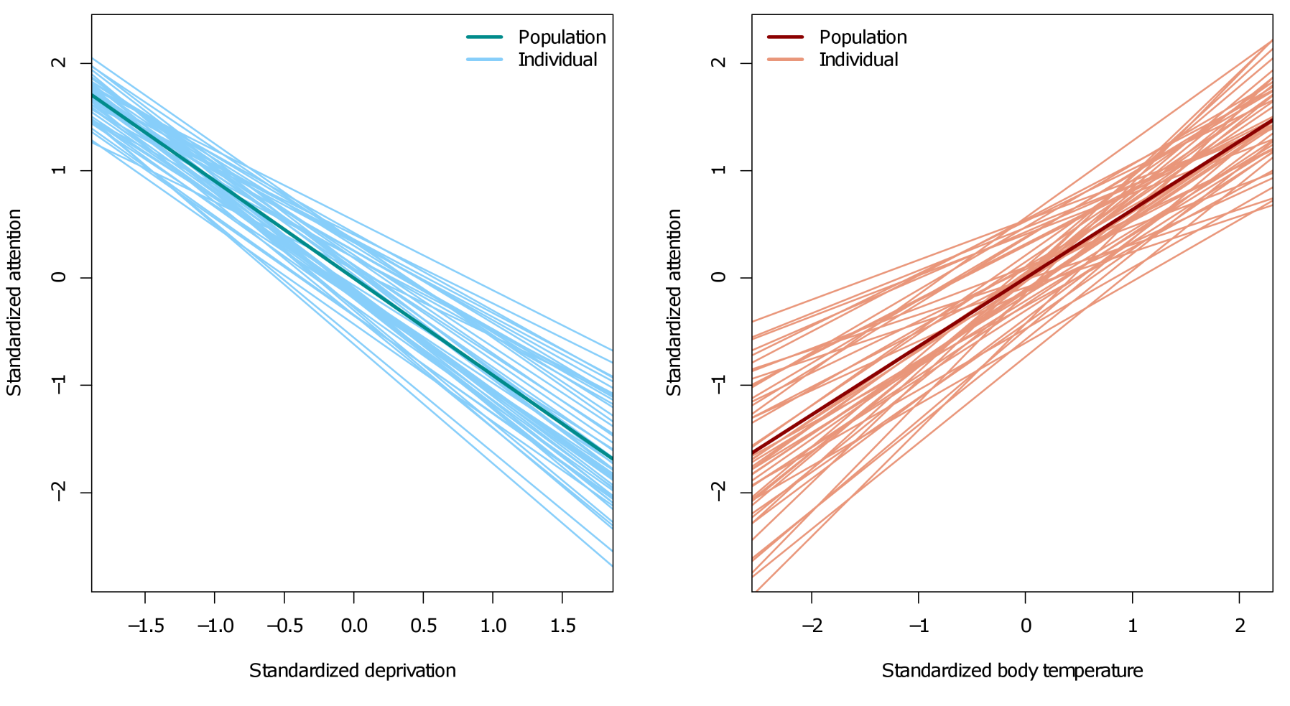
Extended sleep – Random effects selection
What about random slopes for deprivation and/or body temperature? Let’s inspect the sample data first:

Slide 9
Extended sleep – Random effects selection
We compare models with different random effects on their AIC values, without changing the fixed effects formula (!):
The model with random deprivation slopes but no random body temperature slopes is preferred. This means we have evidence that subjects differed individually in their Deprivation-Attention association (some decline quickly, others slowly). For body temperature this is not true, even though its fixed effect is significant!
Random effects model | R syntax | AIC
Intercept | (1|Subject) | 819.61
Intercept + Deprivation | (1+Deprivation|Subject) | 751.26
Intercept + Bodytemp | (1+Bodytemp|Subject) | 782.66
Intercept + Deprivation + Bodytemp | (1+Deprivation+Bodytemp|Subject) | 756.03

Slide 10
Extended sleep – Random effects selection
Partial summary for the random slope model:
It is also interesting to compare the degrees of freedom for the within-subject predictors between this model and the simple random intercept model. For body temperature, the DFs changed from 953.5 (rint) to 94.30 (rslope)!
Attention~1+Gender+Age+Bodytemp+Deprivation+(1+Deprivation|Subject),data=sleep2)
Random effects:
Groups Name Variance Std.Dev. Corr
Subject (Intercept) 0.06359 0.2522
Deprivation 0.01088 0.1043 0.95
Residual 0.10300 0.3209
Number of obs: 1000, groups: Subject, 50
Fixed effects:
Estimate Std.Error df t-val P-val
(Intercept) 7.233e-04 3.711e-02 42.80 0.019 0.9845
Gender1 9.527e-03 2.533e-02 45.90 0.376 0.7086
Age -2.553e-02 2.555e-02 47.90 -0.999 0.3227
Bodytemp 3.356e-02 1.436e-02 94.30 2.337 0.0197 *
Deprivation -8.732e-01 2.060e-02 80.30 -42.395 <2e-16 ***
---
Signif. codes: 0 ‘***’ 0.001 ‘**’ 0.01 ‘*’ 0.05 ‘.’ 0.1 ‘ ’ 1
Age effect disappears!

Slide 11
What about some p-values though…
You may still feel an irresistible urge to test for the significance of random effects with p-values. If you want to insist on doing this, you could run ranova from the lmerTest package. This will produce a marginal breakdown (leave-one-out; Type III logic) of random effects with likelihood ratio tests (LRT):
ranova(rslope)
So massively significant, and we get the same AIC comparison as we calculated manually earlier. However, my experience is that these LRTs tend to be highly significant even when there is little evidence in the parameter estimates or in AIC to support the random effect!
ANOVA-like table for random-effects: Single term deletions
Model:
Attention ~ Gender + Age + Bodytemp + Deprivation + (1 + Deprivation |
Subject)
npar logLik AIC LRT Df Pr(>Chisq)
<none> 9 -366.62 751.24
Deprivation in (1 + Deprivation | Subject) 7 -402.80 819.59 72.348 2 < 2.2e-16 ***
---
Signif. codes: 0 ‘***’ 0.001 ‘**’ 0.01 ‘*’ 0.05 ‘.’ 0.1 ‘ ’ 1

Slide 12
Extended sleep – Random effects selection
Why must we keep a maximal structure for the fixed effects during random effects selection…?
Earlier, I presented a hypothetical example where a covariate was available in the data that was capable of accounting for repeated measures correlation (“decision speed” for RTs).
In a multilevel model, a “decision speed” variable would make the random intercept redundant, since there would be no unmodelled sources of individual differences left.
To avoid any redundant model building, it is therefore a good idea to include as many fixed sources of individual differences in the initial model, to make sure that whatever differences remain after that are accurately reflected in the random effects.
Subject ID | Decision Speed | Prime | Target | RT
ID1 | 1.21 | Positive | Positive | 502
ID1 | 1.21 | Positive | Negative | 553
ID1 | 1.21 | Negative | Positive | 549
ID1 | 1.21 | Negative | Negative | 511
ID2 | 0.94 | Positive | Positive | 555
ID2 | 0.94 | Positive | Negative | 560
ID2 | 0.94 | Negative | Positive | 592
ID2 | 0.94 | Negative | Negative | 549
… | … | … | … | …
ID20 | 1.06 | Positive | Positive | 510
ID20 | 1.06 | Positive | Negative | 571
ID20 | 1.06 | Negative | Positive | 582
ID20 | 1.06 | Negative | Negative | 546

Slide 13
Extended sleep – Fixed effects selection
Once a suitable random effects structure has been chosen, we could select a final structure for the fixed effects. This selection could be based on AIC/BIC, or R², but most often by significance tests. Whether or not any “selection” takes place depends on the nature of the fixed effects:
Design variables: Should always remain in the final model
Confirmatory covariates: Should always remain in the final model (e.g., age, gender)
Exploratory covariates: Should be removed from the final model if non-significant
However, what is important when comparing different fixed effects structures, is to always use maximum likelihood (ML) estimation for the model, not restricted maximum likelihood (REML)! REML produces unbiased estimates for the random effects parameters of a multilevel model. It achieves this by applying a suitable transformation to the fixed effects part, prior to parameter estimation.
However, different random effects structures will require different REML transformations for the fixed effects. Mathematically speaking, this makes fixed effects structures incomparable between different REML-estimated multilevel models (even if they contain the same fixed effects, conceptually)!

Slide 14
Extended sleep – Fixed effects selection
REML estimation is the default for fitting in most software, including the lme4 package. It can be switched off as follows:
model <- lmer(Y~X+(1|Subject),data=example, REML=FALSE)
For the extended sleep data, a model selection for the fixed effects part using AIC requires all models to be fitted using ML, e.g.:
mod1 <- lmer(Attention~Gender+Age+Bodytemp+Deprivation+(1+Deprivation|Subject),
data=sleep2, REML=FALSE)
mod2 <- lmer(Attention~Gender+Age+Deprivation+(1+Deprivation|Subject),
data=sleep2, REML=FALSE)
AIC(mod1)
AIC(mod2)
Which will yield valid AIC comparisons for these fixed effects. As a general caution, if you never wish to make any mistake, you should switch off REML estimation by default in your code (always REML=FALSE).

Slide 15
3. Model selection and diagnostics
B. Model fit and effect sizes

Slide 16
R-squared for multilevel models
Now that we have our final model, we would like to also look at its goodness-of-fit, effect sizes for the main predictors, and diagnose possible model problems (e.g., non-normality, heteroscedasticity).
A obvious choice to quantify goodness-of-fit is R². Unlike AIC/BIC, R² has a more absolute interpretation on its value scale, not just relative between one model and another. In its familiar definition, R² will capture the proportion of variance in the DV that is explained by the IVs.
For a multilevel model, it turns out that this definition is immediately complicated by the presence of the random effects, which has lead to the proposal of two broad types of R² :
Marginal R²: The proportion of variance in the DV that is explained by the fixed effects, collapsed across all sources of random variation. This version is most similar to conventional R² in standard linear regression.
Conditional R²: The proportion of variance in the DV that is explained by the fixed effects, conditioned on sources of random variation (i.e., including individual differences).

Slide 17
R-squared for multilevel models
One possible paradox is that adding a fixed effect may increase marginal R² while decreasing conditional R², or vice-versa.
Another question concerns whether we can decompose our model into partial R², or if we should only be allowed to report a total R² for the whole model. Rights & Sterba (2019) suggest that there are 12 different ways of decomposing R² for a multilevel model. These (and other) issues are a matter of ongoing research (e.g., Ronghui, 2003; Nakagawa & Schielzeth, 2013; Nakagawa et al., 2017; Johnson, 2014).
Function | Package | Reference | # measures | Notes
multilevelR2 | mitml | Grund, Robitzsch & Luedtke (2019) | 4 | Not compatible with the lmerTest package
r.squaredGLMM | MuMIn | Barton (2017) | 2 | Basic but useful
r.squared | / | Lefcheck (2014) | 2 | Custom script provided through Github. May be outdated at this point.
r2beta | r2glmm | Jaeger (2016) | 3 | Performs a semi-partial R² decomposition and reports confidence intervals
r2MLM | / | Rights & Sterba (2019) | 12 | Only accepts 2-level data. Also produces a plot.

Slide 18
R-squared for multilevel models
The value for marginal R² seems to be identical between the different functions. The r2beta function does not report conditional R². However, conditional R² often has a high value, even for models with low marginal R², casting some doubt on its utility as a measure of fit. The r2MLM function is difficult to use in its current implementation, and its outputted values very different from the measures reported by the other function.
In practice, you may find r2beta{r2glmm} the most useful function, although it requires a choice of method (nsj seems to reproduce the marginal R² of other functions):
library(r2glmm)
r2beta(rslope, method="sgv")
Method="sgv"
Effect Rsq upper.CL lower.CL
1 Model 0.898 0.908 0.887
5 Deprivation 0.812 0.830 0.794
3 Age 0.007 0.023 0.000
4 Bodytemp 0.006 0.022 0.000
2 Gender1 0.001 0.010 0.000
Method="kr"
Effect Rsq upper.CL lower.CL
1 Model 0.961 0.971 0.949
5 Deprivation 0.956 0.969 0.942
3 Age 0.019 0.160 0.000
4 Bodytemp 0.006 0.019 0.000
2 Gender 0.003 0.115 0.000
Method="nsj"
Effect Rsq upper.CL lower.CL
1 Model 0.820 0.835 0.804
5 Deprivation 0.691 0.717 0.665
3 Age 0.003 0.014 0.000
4 Bodytemp 0.003 0.014 0.000
2 Gender1 0.000 0.007 0.000

Slide 19
Partial R-squared for multilevel models
The partial R² for the deprivation effect varies wildly depending on the method. We could also attempt to calculate the value manually using one of the alternative functions, e.g.:
mod1 <- lmer(Attention~Gender+Age+Bodytemp+Deprivation+(1+Deprivation|Subject),data=sleep2)
mod2 <- lmer(Attention~Gender+Age+Bodytemp+ (1+Deprivation|Subject),data=sleep2)
r.squaredGLMM(mod1)
r.squaredGLMM(mod2)
This example is wrong for two reasons:
You should never compare different fixed effects structures between models that used REML estimation!
It may be non-sensical to remove the fixed deprivation effect without removing the random deprivation effect. Maybe they should be removed together…?

Slide 20
Partial R-squared for multilevel models
If we dropped the random slope altogether and switched to ML estimation, we could still be tempted to run:
mod1 <- lmer(Attention~Gender+Age+Bodytemp+Deprivation+(1|Subject),data=sleep2,REML=FALSE)
mod2 <- lmer(Attention~Gender+Age+Bodytemp+ (1|Subject),data=sleep2,REML=FALSE)
r.squaredGLMM(mod1)
r.squaredGLMM(mod2)
This suggests that adding deprivation to a model that contains all other fixed effects increases R² by 0.832 – 0.423 = 0.409. However, running r2beta on mod1 produces a partial R² for deprivation of 0.706! This is because r2beta in fact calculates a statistic called semi-partial R² (Jaeger, Edwards, Das & Sen, 2016), which takes a special approach to adjusting for the presence of random effects. For caution, I recommend to avoid manual calculations of partial R²!
R2m R2c
[1,] 0.8221352 0.8950920
R2m R2c
[1,] 0.4232128 0.4872264

Slide 21
Effect size in multilevel models
Semi-partial R² can be considered as a measure of effect for independent variables in a multilevel model. What about other effect sizes? Effect sizes generally come in three types:
Standardized associations (e.g., correlation, odds ratio)
Proportion of variance explained (e.g., R², η²)
Standardized difference of means (e.g., Betas, Cohen’s d, Hedges g).
For a standardized association, our intuitive choice would be a measure like Cohen’s d. Unfortunately, calculation of this effect size is once again complicated by the presence of the random effects. The general form of Cohen's d is:
…where σ is an “appropriately chosen” error term
M₁ – M₂
σ

Slide 22
Cohen’s d in multilevel models
Let's reconsider the random intercept model for the sleep data:
For a multilevel model, some authors suggest that σ for Cohen's d should be taken from the variance components estimates (Rouder et al., 2012; Westfall, 2016), either the residual sd or, better, the summed variance components sd's. For the gender effect, this implies a (pseudo) Cohen's d of 0.030175/sqrt(0.3369²+0.2389²) = 0.073, suggesting a negligible effect size.
Random effects:
Groups Name Variance Std.Dev.
Subject (Intercept) 0.05708 0.2389
Residual 0.11353 0.3369
Number of obs: 1000, groups: Subject, 50
Fixed effects:
Estimate Std.Error df t-val P-val
(Intercept) -0.001207 0.035458 47.00 -0.034 0.97299
Gender1 0.030175 0.036409 47.00 0.829 0.41142
Age -0.106736 0.036394 47.00 -2.933 0.00518 **
Bodytemp 0.033197 0.015000 953.50 2.213 0.02712 *
Deprivation -0.876990 0.015089 956.00 -58.122 < 2e-16 ***
--
http://jakewestfall.org/blog/index.php/2016/03/25/five-different-cohens-d-statistics-for-within-subject-designs/

Slide 23
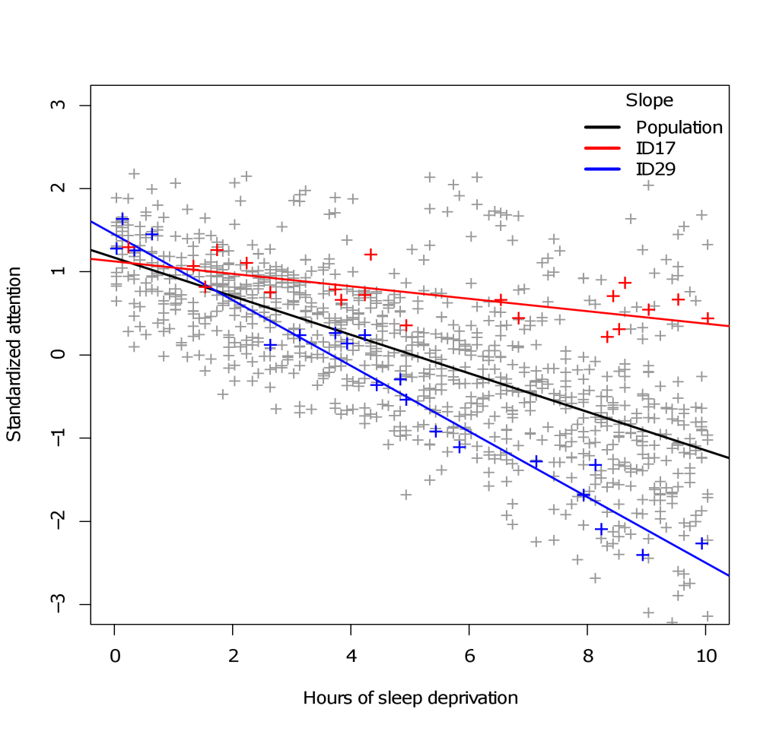
Cohen’s d in multilevel models
For random intercept models, (pseudo) Cohen's d will be a straightforward calculation. For random slopes models, we run into trouble, because the (co)variance of the repeated measures are a function of predictor values.
This means that the pooled error term σ for calculating Cohen's d must now also be a function of predictor values. The effect size no longer has one consistent value!
If you need to report an effect that is connected to a random slope, you will need to condition the effect to an “interesting” value.
Instead of using standardized effect sizes, it may be wiser to report your effects on their original scales (i.e., unstandardized regression coefficients) and simply provide a confidence interval!

Slide 24
Standardized regression parameters
Perhaps the least complicated effect size to report for a multilevel model (at the moment), is a standardized regression parameter (so-called “betas”, reported as β_{z}).
They strongly resemble Cohen’s d but do not adjusting for the model-based variance estimates, only the (model-free) observed variances of the variables.
In R, standardized regression parameters can be obtained either by manually standardizing before fitting the model, or by using the effectsize and parameters packages, e.g.:
parameters(mod1, standardize="refit")
# Fixed Effects
Parameter | Coefficient | SE | 95% CI | t(991) | p
-------------------------------------------------------------------
(Intercept) | 8.33e-04 | 0.04 | [-0.07, 0.07] | 0.02 | 0.982
Gender1 | 9.46e-03 | 0.02 | [-0.04, 0.06] | 0.39 | 0.700
Age | -0.03 | 0.02 | [-0.07, 0.02] | -1.03 | 0.305
Bodytemp | 0.03 | 0.01 | [ 0.01, 0.06] | 2.33 | 0.020
Deprivation | -0.87 | 0.02 | [-0.91, -0.83] | -42.79 | < .001
# Random Effects
Parameter | Coefficient
--------------------------------------------------
SD (Intercept: Subject) | 0.25
SD (Deprivation: Subject) | 0.10
Cor (Intercept~Deprivation: Subject) | 0.97
SD (Residual) | 0.32
For multi-parameter effects (e.g., factors with >2 levels), it is recommended to report the maximum standardized difference between 2 pairs of levels (Maxwell & Delaney, 2002).

Slide 25
Effect size in multilevel models
A final alternative for effect size is to report Bayesian or quasi-Bayesian statistics, such as Bayes factors or information criteria.
The package BayesFactor allows random effects for calculating Bayes factors but with restrictions. lmer objects cannot be plugged directly into, e.g., anovaBF, and random effects are required to be purely additive (e.g., random intercepts only).
As a fallback, one can always report differences/ratios of information criteria, which are approximately related to Bayes factors under simplifying assumptions. For example, an exponentiated difference of two AICs has the following interpretation:
exp( (AIC_{red} – AIC_{full})/2 )
= a value proportional to the probability that the full model will minimize information loss over the reduced model

Slide 26
Visualizing model effects
Visualizing effects from an lmer model can be tricky, especially since most plotting packages do not support such models. The visreg library is a helpful exception:
library(visreg)
visreg(mod1,points.par=list(col="darkgoldenrod3"),line.par=list(col="royalblue4",lwd=4))
This produces so-called conditional effects plots, where the effect of the X-variable on the Y-variable is plotted, while setting other variables in the model to a fixed value (by default this value will be the median in visreg). Alternatively, one can also produce a so-called contrast plot, which visualizes the effect of one variable only, with others collapsed. Only for the contrast plot does visreg allow confidence bands for lmer models.
Random intercept effects are also plotted by visreg, although these will usually be meaningless. Interactions can be plotted using a combination of the xvar and by arguments, and there are options to switch to ggplot graphics, e.g.:
mod.int <- lmer(Attention~Age*Deprivation+(1+Deprivation|Subject),data=sleep2)
visreg(mod.int,xvar="Deprivation",by=”Age”, gg=TRUE)

Slide 27
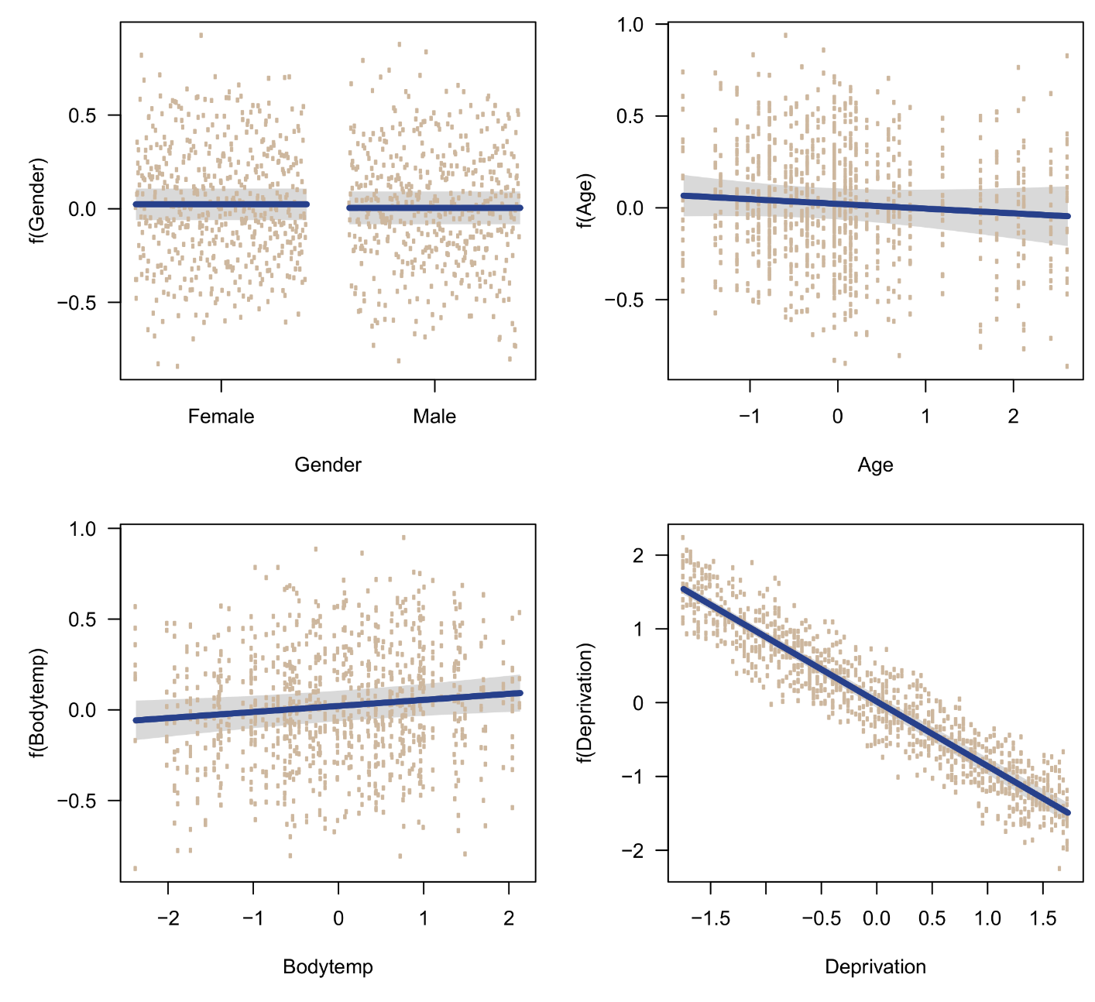
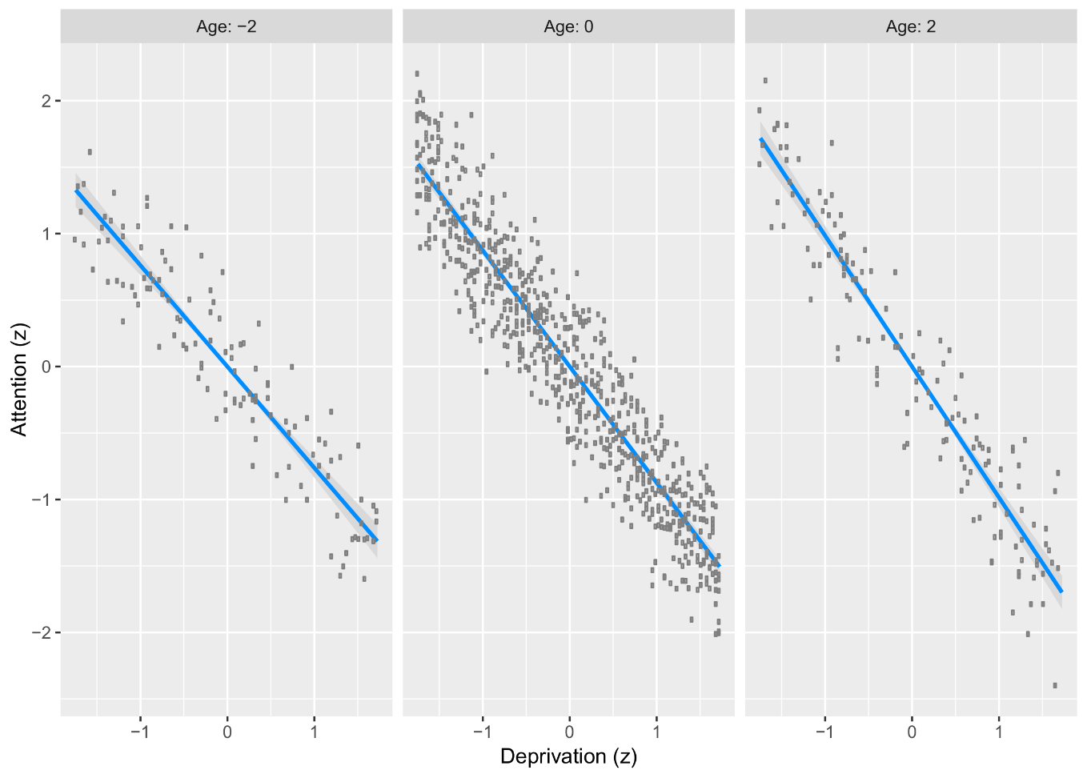
Visualizing model effects

Slide 28
3. Model selection and diagnostics
C. Problems and residual diagnostics

Slide 29
Problems and diagnostics
An important step in model fitting is to verify its underlying assumptions and diagnose potential problems. In multilevel models this proceeds in much the same fashion as for ordinary regression, with (as usual) some extra cautions due to the presence of the random effects.
The most important initial step is to correctly specify the structure of the random effects for the model. Once this has been completed, the following issues should be checked in this order:
Multicollinearity
Outliers and influential cases
Linearity
Variance
Independence
Normality
Data and model adequacy
Distributional assumptions

Slide 30
Multicollinearity
Multicollinearity can be diagnosed easily by checking the variance inflation factors (VIF) of the model. In R this can be accomplished with the vif function from the car package. E.g., for an Age × Deprivation interaction model with two random slopes:
sleep2 <- read.table("https://drive.switch.ch/index.php/s/23DhWwECFnCFH4M/download",
header=TRUE,sep=",")
model <- lmer(Attention~Gender+Bodytemp+Deprivation*Age+(1+Deprivation+Bodytemp|Subject), data=sleep2)
Fitting this model works but will produce several warnings from lme4:
For the moment we will ignore this. We next run the vif function on our model.
Warning messages:
1: In checkConv(attr(opt, "derivs"), opt$par, ctrl = control$checkConv, :
unable to evaluate scaled gradient
2: In checkConv(attr(opt, "derivs"), opt$par, ctrl = control$checkConv, :
Model failed to converge: degenerate Hessian with 1 negative eigenvalues
3: Model failed to converge with 1 negative eigenvalue: -2.0e+02

Slide 31
Multicollinearity
library(car)
vif(model)
A VIF larger than 10 is considered problematic. Here, the values for deprivation and the interaction effect are enormous. However, this kind of multicollinearity is naturally found between main effects and interaction terms, so not necessarily unusual. It can be reduced simply by centering the variables and refitting our model:
sleep2$Age <- hscale(sleep2$Age,sleep2$Subject)
sleep2$Deprivation <- scale(sleep2$Deprivation)
sleep2$Bodytemp <- scale(sleep2$Bodytemp)
So problem solved! Note that refitting the model we only get one warning from lme4 anymore…
Gender Bodytemp Deprivation Age Deprivation:Age
1.059910 1.362747 214.895720 1.076109 214.734951
Gender Bodytemp Deprivation Age Deprivation:Age
1.059768 1.258895 1.256348 2.038048 1.987980

Slide 32
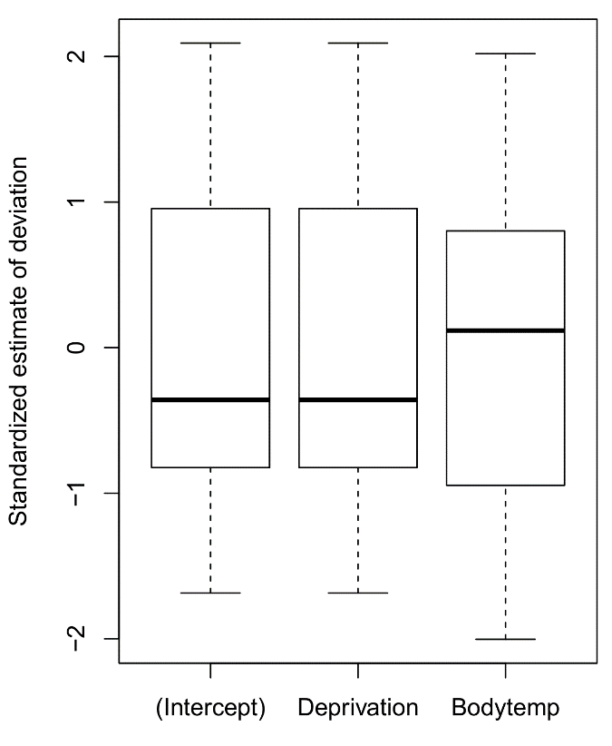
Outliers and influential cases in multilevel models
Multilevel models allow a much richer analysis of outlying data than ordinary regression, in the sense that the estimated random effects values (b_{i}’s) can be inspected to find outliers at multiple levels of the data hierarchy, or find subjects whose effects run counter to the population-level effect (e.g., non-response to a manipulation).
This can be achieved simply by either inspecting the raw deviations (ranef), the subject-specific coefficient estimates (coef), or standardized versions of these with boxplots:
ranef(model)$Subject
coef(model)$Subject
boxplot(scale(ranef(model)$Subject))
$Subject
(Intercept) GenderMale Bodytemp Deprivation Age Dprvtn:Age
ID1 0.17939711 -0.02232497 0.015808421 -0.8201323 -0.1103077 -0.05594964
ID10 0.08073942 -0.02232497 0.031145090 -0.8517005 -0.1103077 -0.05594964
ID11 -0.21785907 -0.02232497 0.044330669 -0.9472452 -0.1103077 -0.05594964
ID12 0.48425579 -0.02232497 0.002066315 -0.7225844 -0.1103077 -0.05594964
ID13 -0.06943112 -0.02232497 0.031734645 -0.8997516 -0.1103077 -0.05594964
ID14 0.40674146 -0.02232497 0.004364209 -0.7473872 -0.1103077 -0.05594964
ID15 -0.15082483 -0.02232497 0.041194400 -0.9257958 -0.1103077 -0.05594964
ID16 -0.07200674 -0.02232497 0.052423202 -0.9005758 -0.1103077 -0.05594964
...

Slide 33
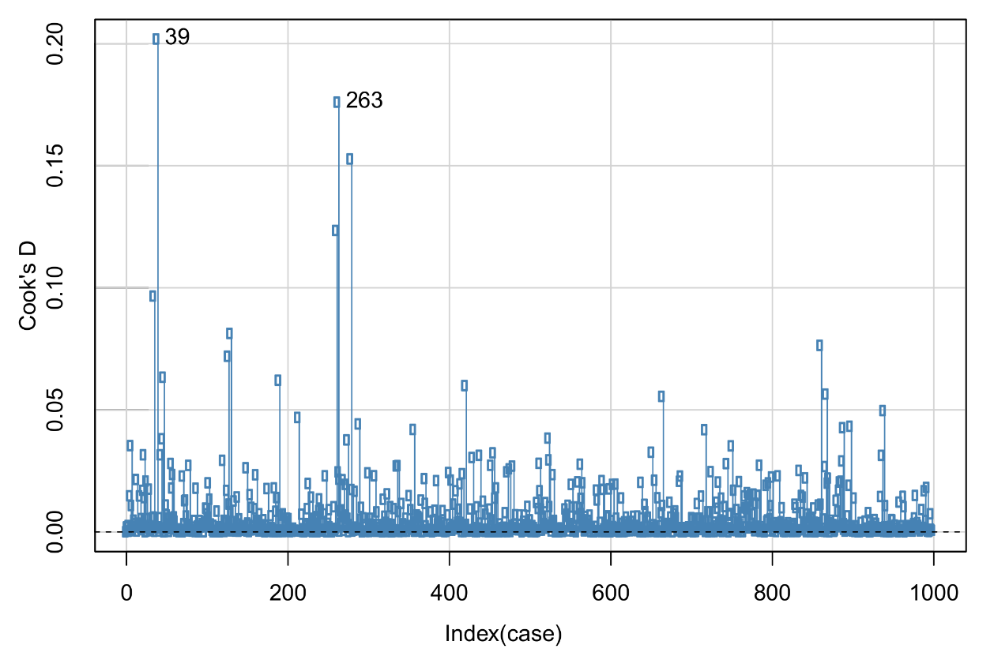
Outliers and influential cases in multilevel models
Influential cases in the model can be diagnosed with the usual measures, such as Cook’s distance (influence of a case on all fitted values) and DFBETAs (influence of a case on individual fixed effects parameters).
Once again, the car package has functions adapted to lmer models that compute these influence measures and identify problematic cases with a plot, e.g.:
set.seed(1816)
im <- influence(model,maxfun=100)
influenceIndexPlot(im,col="steelblue",
vars=c("cookd"))
Note that these diagnostics do not quantify the influence of individual cases on the random effects!
If influential cases are suspected to be problematic, one could consider removing the cases and refitting the model

Slide 34
General residual diagnostics
One would assume that residuals from a multilevel model can be obtained simply by running residuals on the model object. However, these raw residuals have undesirable properties, such as (a) non-constant variance, (b) auto-correlation due to repeated measurements, and (c) correlation with fixed covariates.
These residuals are unsuitable for detecting deviations from linearity, normality, homoscedasticity, and independence (Fitzmaurice, Laird & Ware, 2004; pp. 237–253). Instead, residuals should be properly transformed and “de-correlated”, before they can be used for diagnostic purposes.
A custom script is available with this workshop that has the function tdiagnostic which computes correct transformed residuals and fitted values, according to the formulas by Fitzmaurice et al. (2004). We can run this to compare the diagnostic plots with the raw residuals:
par(mfrow=c(2,2))
hist(residuals(model),breaks=100,main="Untransformed",freq=FALSE,col="slategray",border="white")
lines(density(residuals(model)),lwd=3,col="firebrick")
hist(tdiagnostic(model)$tres,breaks=100,main="Transformed",freq=FALSE,col="slategray",border="white")
lines(density(tdiagnostic(model)$tres),lwd=3,col="firebrick")
qqnorm(residuals(model),pch=4,col="bisque3") ; qqline(residuals(model),col="darkblue",lwd=2)
qqnorm(tdiagnostic(model)$tres,pch=4,col="bisque3") ; qqline(tdiagnostic(model)$tres,col="darkblue",lwd=2)

Slide 35
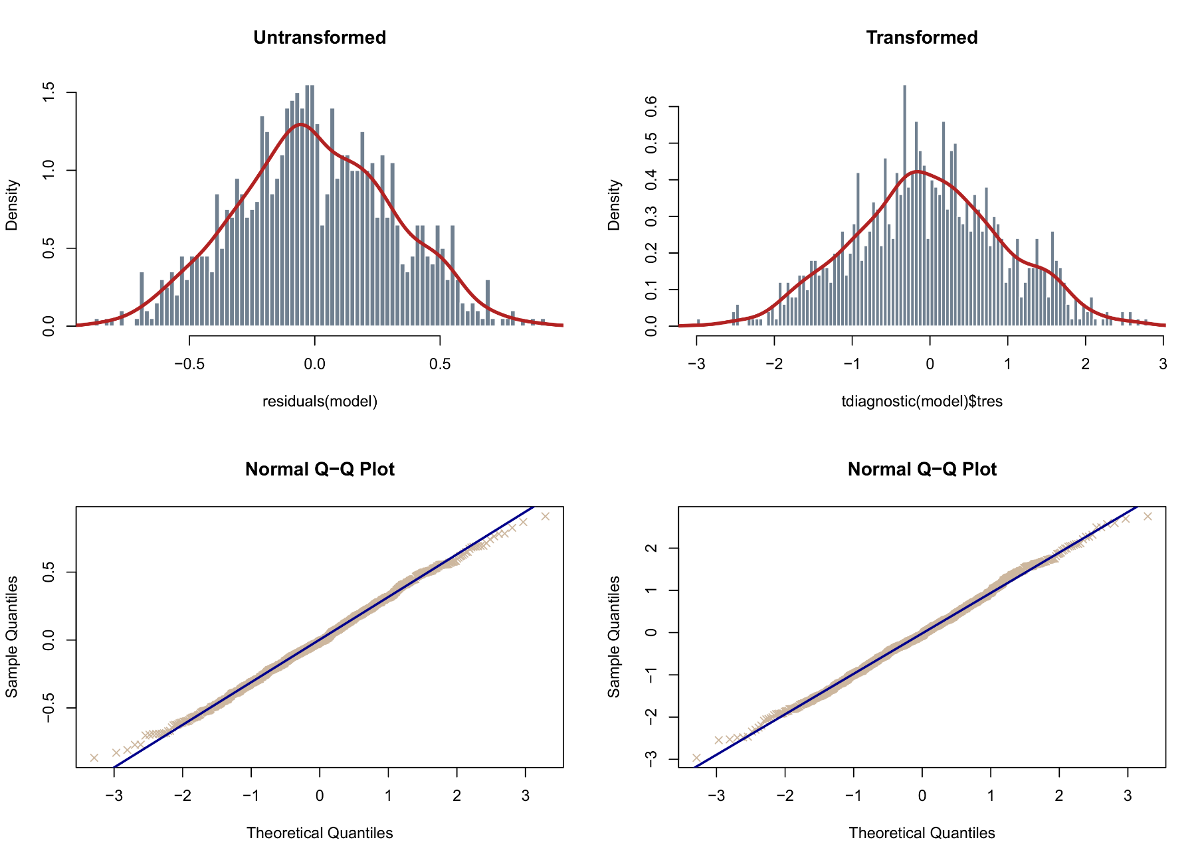
General residual diagnostics

Slide 36
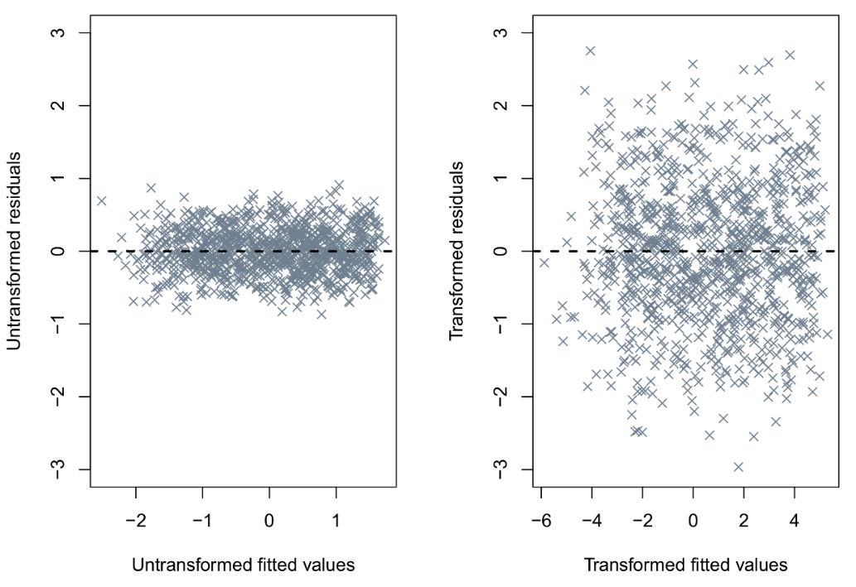
General residual diagnostics
We can also plot the (transformed) residuals agains the (transformed) fitted values, to detect issues with non-linearity or heteroscedasticity:
par(mfrow=c(1,2))
plot(fitted(model),residuals(model))
abline(h=0,lty=2,lwd=2)
plot(tdiagnostic(model)$tfit,tdiagnostic(model)$tres)
abline(h=0,lty=2,lwd=2)
Ideally, we do not want to observe any curvature in the cloud of points against the 0 reference line, nor any differences in variance for different fitted values (e.g., widening of values).
The plots suggest no serious problems, with transformed and untransformed residuals for these data apparently quite similar and normal. For other data the differences can be dramatic, however!

Slide 37
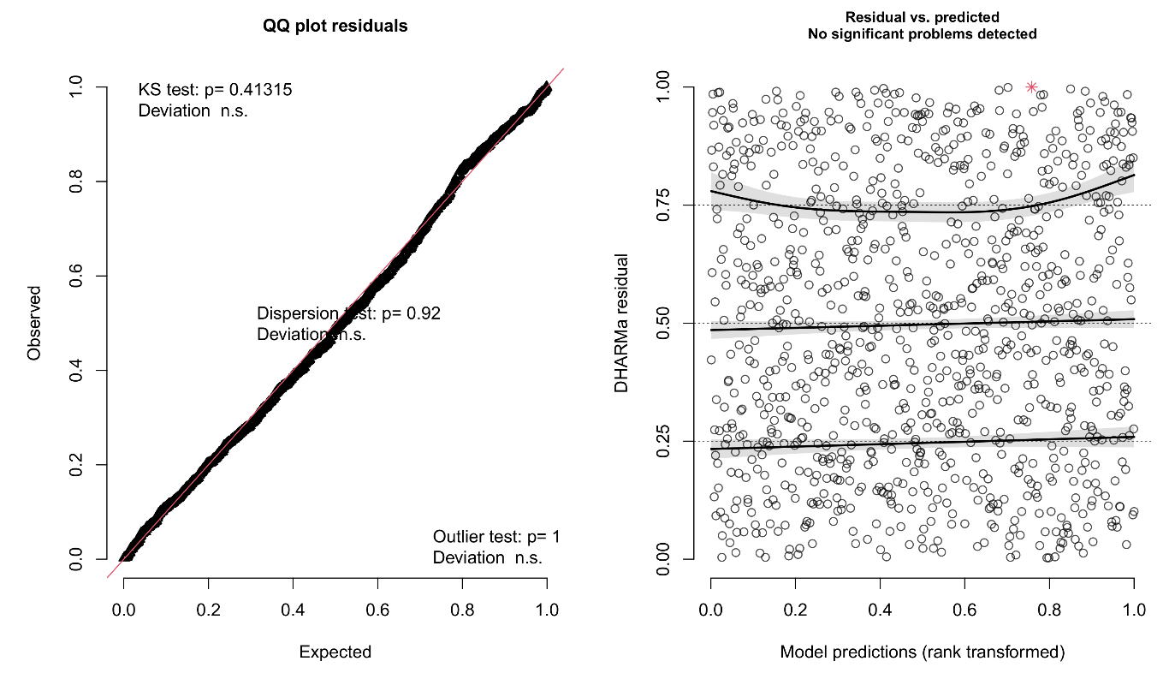
Residual diagnostics with the DHARMa package
Recently, the DHARMa package has implemented simulation-based residual analysis for multilevel models. A wide variety of tests are available to diagnose different types of problems (especially for GLMMs).
simulateResiduals(fittedModel=model, n=1000, plot=TRUE)
Outputted residuals are normalized to values between 0 and 1. The plot automatically includes some diagnostic tests (normality, variance).
The procedure of the authors is not the same as that proposed by Fitzmaurice et al. (2004), leading to somewhat different results! Either method has theoretical support, however.
The DHARMa package vignette offers incredibly detailed further information on how to interpret the residuals and diagnostic tests!*
* http://127.0.0.1:14938/library/DHARMa/doc/DHARMa.html

Slide 38
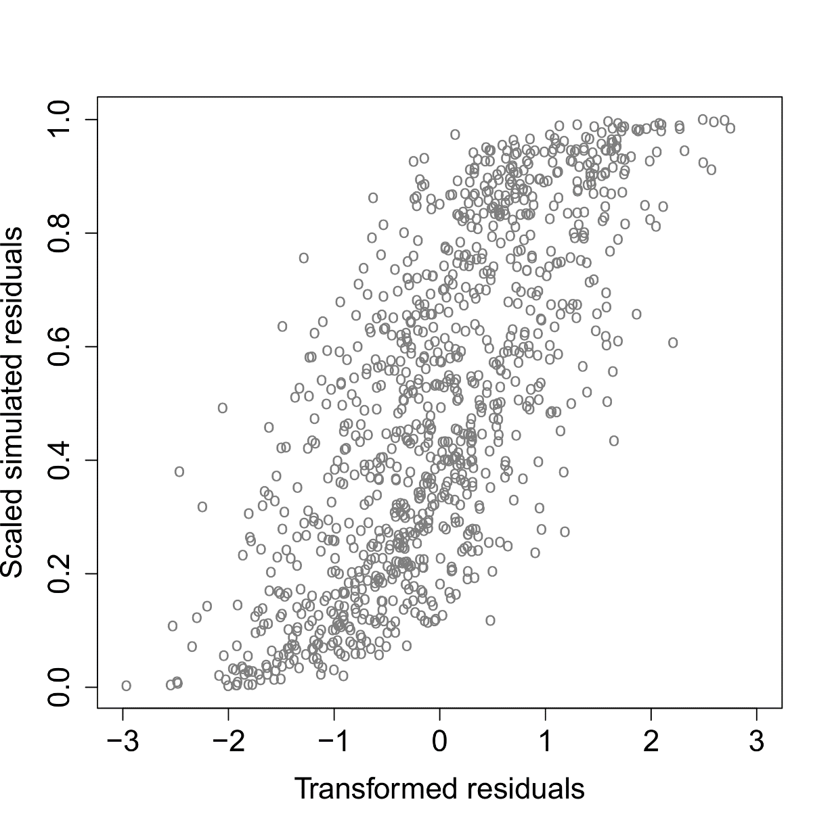
DHARMa residuals versus transformed residuals

Slide 39
Corrections to problems – Non-parametric MLM?
Some problems can be corrected easily, such as removal of collinear predictors, removal of outliers, inclusion of nonlinear effects, and transformations against non-normality. However, there is no general non-parametric alternative to the multilevel model, and some violations cannot be “corrected” (for the moment)!
Nevertheless, the multilevel model already possesses some flexibilities not found in ordinary regression, which grant it some “non-parametric” qualities as a model. These include being able to deal with:
Outliers: Outlying units of repeated data clustering can be modelled and identified with random effects
Variance: Heteroscedasticity can be modelled with random slopes
Missingness: Missing DV data are implicitly imputed from the random effects structure*
As always, non-normality should be the least cause for concern, and with large sample sizes should not substantially distort inference on fixed effects.
*Not discussed in this workshop

