Slide 1
Introduction to Machine Learning
PART III
Ben Meuleman, Ph.D.
Swiss Center for Affective Sciences
Workshop on Machine Learning (University of Geneva)
April 22–23, 2024, Geneva

Slide 2
Workshop schedule and contents
22 April |  |  | 23 April
Part 1 – Introduction and principles
09:00 – 09:10 | Introduction
09:10 – 10:00 | Machine learning and social sciences
Break
10:15 – 11:30 | Principles of machine learning
11:30 – 12:00 | R primer and data problem
Part 2 – Machine learning models |  |  | Part 3 – Practical
13:30 – 14:00 | K nearest neighbors |  | 13:30 – 15:30 | ML competition
14:00 – 14:30 | Discriminants |  | Break
Break |  |  | 15:45 – 16:30 | ML competition results
14:45 – 15:45 | Flexible regression with splines
Break
16:00 – 17:00 | Trees and random forests
17:00 – 17:30 | Concluding remarks

Slide 3
10. Machine learning competition

Slide 4
ML competition
A popular tradition in ML has become the hosting of data challenges or competitions. In such challenges, the host releases a number of data sets for ML to be trained on, and groups of researchers compete to achieve the best-performing model.
Test data are withheld by the host until groups have submitted their final training models, to see which group truly achieved the best performance. Chapter 11 of the Hastie et al. Book contains an example from the NIPS data challenge of 2003.
Often, such competitions are a breeding ground for new ML developments, with the NIPS challenge leading to advances in Bayesian neural networks.
Today, I thought we could repeat this format on a modest scale for the workshop…

Slide 5
How to organize
Organize yourself in groups of max. 4 people, with at least one skilled/expert R user per group.
There are three data problems for you to work on, each with different challenges. You can choose to work on one problem, two, or all of them.
Starting R scripts for each data problem are provided to generate some simple descriptives and fit a linear model…
Validation data sets will be made available at the end of the session, to test the final performance of your models…!

Slide 6
Questions to answer for a data problem
For each data problem, I would like you to address the following:
Explore the data visually and descriptively
Fit a simple linear and model and quantify its performance (e.g., misclassification error/accuracy, RMSE, R²)
Fit ML models and compare their performance
If the ML model allows it, interpret the output feature importance (e.g., significance tests, importance rankings) to gain insight into the success/failure of the model.
If possible, apply a plotting function (from a package) to visualize effects.

Slide 7
Data Problem 1 – Hidden pattern
Data Problem 1 consists of a two-class outcome and three predictor variables. The data were collected by astronomers from the observation of Saturn and its moons.
The two-class outcome represents two distinct groups (A and B). The three variables reflect measurements taken by an array of telescopes on earth.
To make the problem deliberately abstract, the true names of the group levels and variables have been removed.
The full data contained ca. 4000 cases, of which you have 2000 available as a training data set, with groups A and B sampled equally.
The challenge for these data is that nonlinear ML should be able to separate the two groups, but not all models may be successful at it! Note that every predictor in these data is relevant for prediction!

Slide 8
Data Problem 2 – Medical rarity
Data Problem 2 consists of a two-class outcome and 99 predictor variables. The data were collected at several hospitals in Switzerland, by researchers who investigated a particular (life-threatening) medical emergency in patients coming into the emergency room (ER).
The actual emergency is rarely observed at the ER. Non-occurrences (B) vastly outnumber occurrences (A) in these data.
Some of the 99 predictors are authentic medical test and screening measures, while others were added by me as random noise. Once again, true names of the group levels and variables have been removed.
From the original 1000 cases, 500 are available as training data (50 A; 450 B).
The challenges for these data are the imbalanced group outcome, the large number of potential predictors, and the presence of random noise among predictors.

Slide 9
Data Problem 3 – Fear of heights in VR
Data Problem 3 consists of 1 continuous outcome and 12 continuous predictors. The data were taken from an experiment that provoked fear with virtual heights (VR). Each subject was exposed to a certain virtual height (depth), while physiological measurements and self-reports about fear experience were collected.
The goal is to find what predicts subjective intensity of fear (feel_fear), from the other measurements. Self-reports include appraisals of the height (perceived unexpectedness and danger), and motivational tendencies (wanting to escape or freeze). Physiological variables were derived from raw heart frequency and skin conductance recordings.
Of 405 original cases, 200 are available as training data. This time, the original variable names were left intact.
Challenges in these data may be more philosophical than technical…!

Slide 10
11. ML competition results

Slide 11
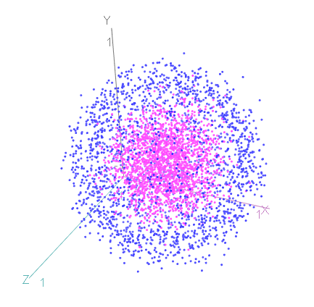
Data Problem 1 – Hidden pattern
Data Problem 1 consists of a two-class outcome and three predictor variables. The data were collected by astronomers from the observation of Saturn and its moons.
The data were, in fact, entirely generated by myself. Groups A and B consisted of two nested spheres, with the measurements X, Y, and Z three-dimensional coordinates sampled from the spheres' surfaces.
It is not entirely obvious that the groups can be discriminated, even in 2 dimensions, due to the larger sphere enveloping the smaller one!

Slide 12
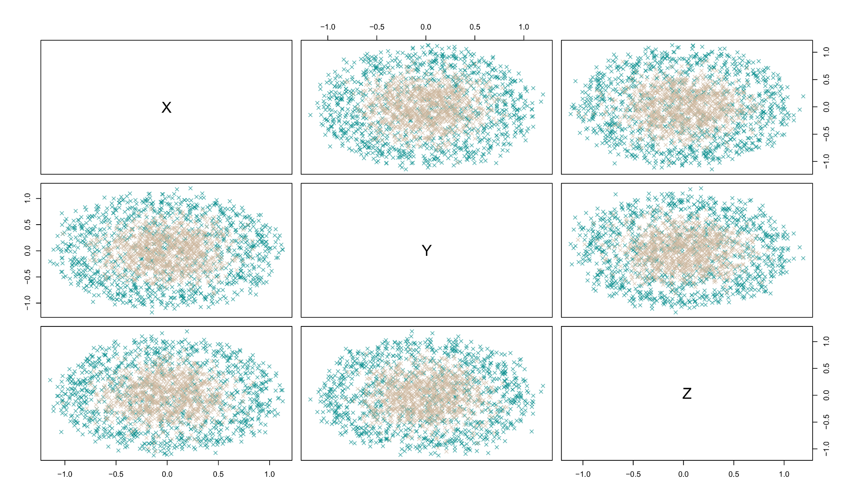
Data Problem 1 – Hidden pattern

Slide 13
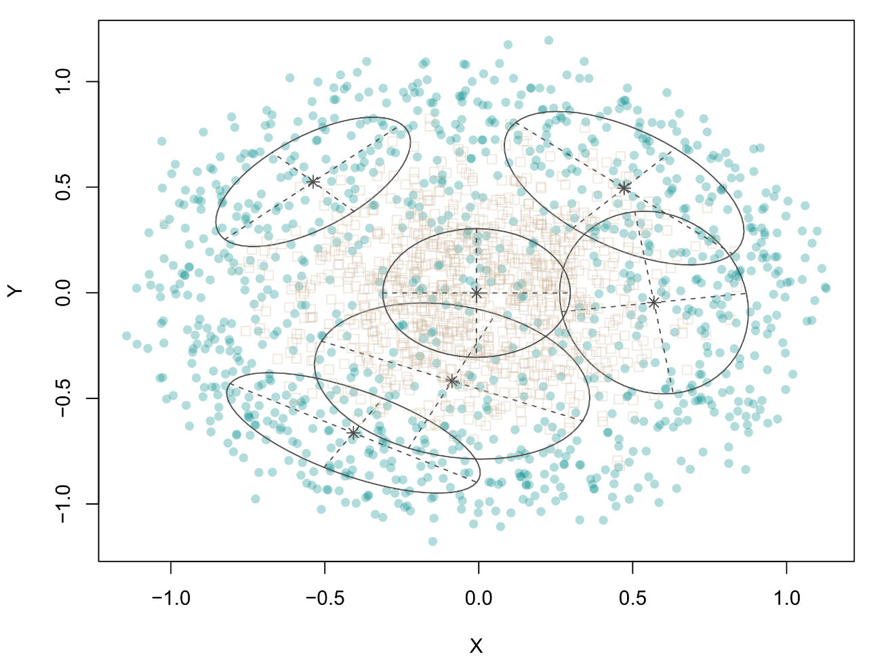
Data Problem 1 – Hidden pattern
Not all nonlinear models are expected to perform well on this problem! Some require awkward solutions to work.
MDA uses 1 cluster for the inner sphere and 5 clusters for the outer sphere.
The decision tree requires 6th-order branching to arrive at the inner sphere.
The best performance is expected by nonlinear models with local rules (KNN, KDA, random forest).
MARS only requires hinge transformations to achieve a good fit, not interactions.
MclustDA model object:
Classes n Model G
A 1000 EEV 5
B 1000 XII 1

Slide 14
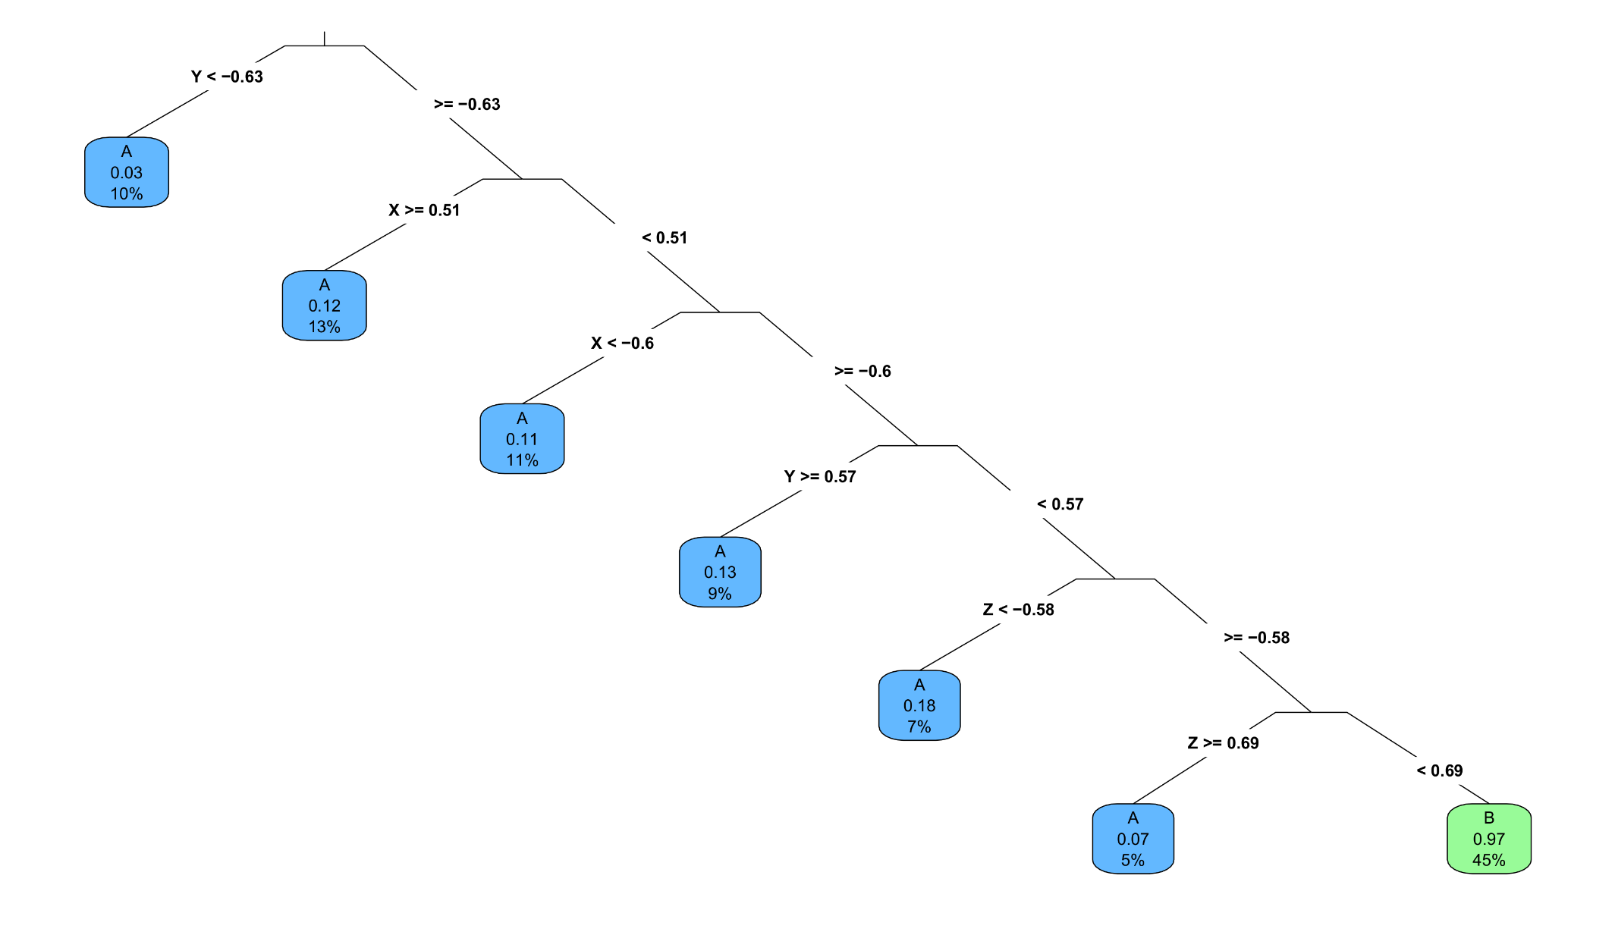
Data Problem 1 – Hidden pattern

Slide 15
Data Problem 1 – Hidden pattern
 |  | Training |  | Test
Model | Rank | Acc. | MCC | Acc. | MCC
Logistic regression | 9 | 0.50 | 0.00 | 0.50 | 0.00
LR with interactions | 9 | 0.50 | 0.00 | 0.50 | 0.00
K-nearest neighbors (K=67) | 1 | 0.94 | 0.87 | 0.97 | 0.93
LDA | 10 | 0.46 | -0.09 | 0.50 | -0.01
QDA | 6 | 0.94 | 0.88 | 0.95 | 0.91
MDA ( M=[5,1]) | 7 | 0.94 | 0.88 | 0.94 | 0.89
KDA | 3 | 0.98 | 0.97 | 0.96 | 0.92
Naïve Bayes | 5 | 0.95 | 0.91 | 0.96 | 0.92
MARS | 2 | 0.96 | 0.92 | 0.97 | 0.93
Decision tree (CP=0.029) | 8 | 0.93 | 0.86 | 0.92 | 0.84
Random forest (T=500) | 4 | 0.95 | 0.90 | 0.96 | 0.92

Slide 16
Data Problem 2 – Medical rarity
Data Problem 2 consists of a two-class outcome and 99 predictor variables. The data were collected at several hospitals in Switzerland, by researchers who investigated a particular (life-threatening) medical emergency in patients coming into the emergency room (ER).
Once again, the data were entirely generated by me. All 99 predictors are random and have no relation to the outcome.
The purpose of this problem was (a) to deal with the data's structural challenges and (b) to adopt a conservative attitude when dealing with a difficult data problem.
It might be tempting to try ML models until you find something, but if models repeatedly come up nothing, it is unlikely you are missing a hidden pattern as in the first data problem 1.

Slide 17
Data Problem 2 – Medical rarity
Weighting unbalanced classes can be achieved with class priors or case weights. Different models have different defaults. Here are some examples of both approaches:
## INSPECT EMPIRICAL CLASS DISTRIBUTIONS
table(prob2$G)
## GENERAL FUNCTION FOR CASE WEIGHTING UNBALANCED CLASSES (MUST SUM TO 1!)
wf <- function(fact) { rep(1/(proportions(table(fact))*sum(nlevels(fact))),
times=table(fact)) }
## CASE WEIGHTING IN MODELS
lr <- glm(G~., data=prob2, family=binomial, weights=wf(G))
tree <- rpart(G~., data=prob2, weights=wf(G))
mars <- earth(G~., data=prob2, glm=list(family=binomial),
degree=2, pmethod="backward", weights=wf(G))
## PRIOR WEIGHTING IN MODELS
ld <- lda(G~., data=prob2, prior=c(0.50,0.50), CV=TRUE)
rf <- randomForest(G~., data=prob2, ntree=500, sampsize=c(50,50))

Slide 18
Data Problem 2 – Medical rarity
There are a few cautions attached to the use of weights!
In GLMs, the size of the weights can affect inferential tests (larger = more significant, smaller = less significant). For this reason the sum of the weights should ideally be equal to the original N.
In earth models, adding weights dramatically increases computation-time, especially for exhaustive or cross-validated model selection (pmethod argument).
In the data problem, balancing class importance may have the accidental side-effect of amplying small-sample biases, resulting in spurious associations being detected between the predictors and the minority class.
Adding your own noise predictors as a benchmark is strongly recommended in data problem 2!

Slide 19
Data Problem 2 – Medical rarity
Inspecting raw accuracies for this problem fails, since models will be strongly biased to predict the majority category all the time, yielding apparently good performance. MCC coefficients are far more informative, and should hover close to 0 for the test data for a "good" model.
MARS actually succeeds in identifying the random nature of the data, since both the unweighted and weighted models select the intercept-only model as best, with pmethod="cv".
Call: earth(formula=G~., data=prob2, weights=wf(G), pmethod="cv", trace=1, degree=2, nfold=5, glm=list(family=binomial))
coefficients
(Intercept) 0.5
Selected 1 of 35 terms, and 0 of 102 predictors (pmethod="cv")
Termination condition: RSq changed by less than 0.001 at 35 terms
Number of terms at each degree of interaction: 1 (intercept only model)
GRSq 0 RSq 0 mean.oof.RSq -0.03804021 (sd 0.0394)
pmethod="backward" would have selected:
26 terms 17 preds, GRSq 0.5707755 RSq 0.6715631 mean.oof.RSq -1.215794

Slide 20
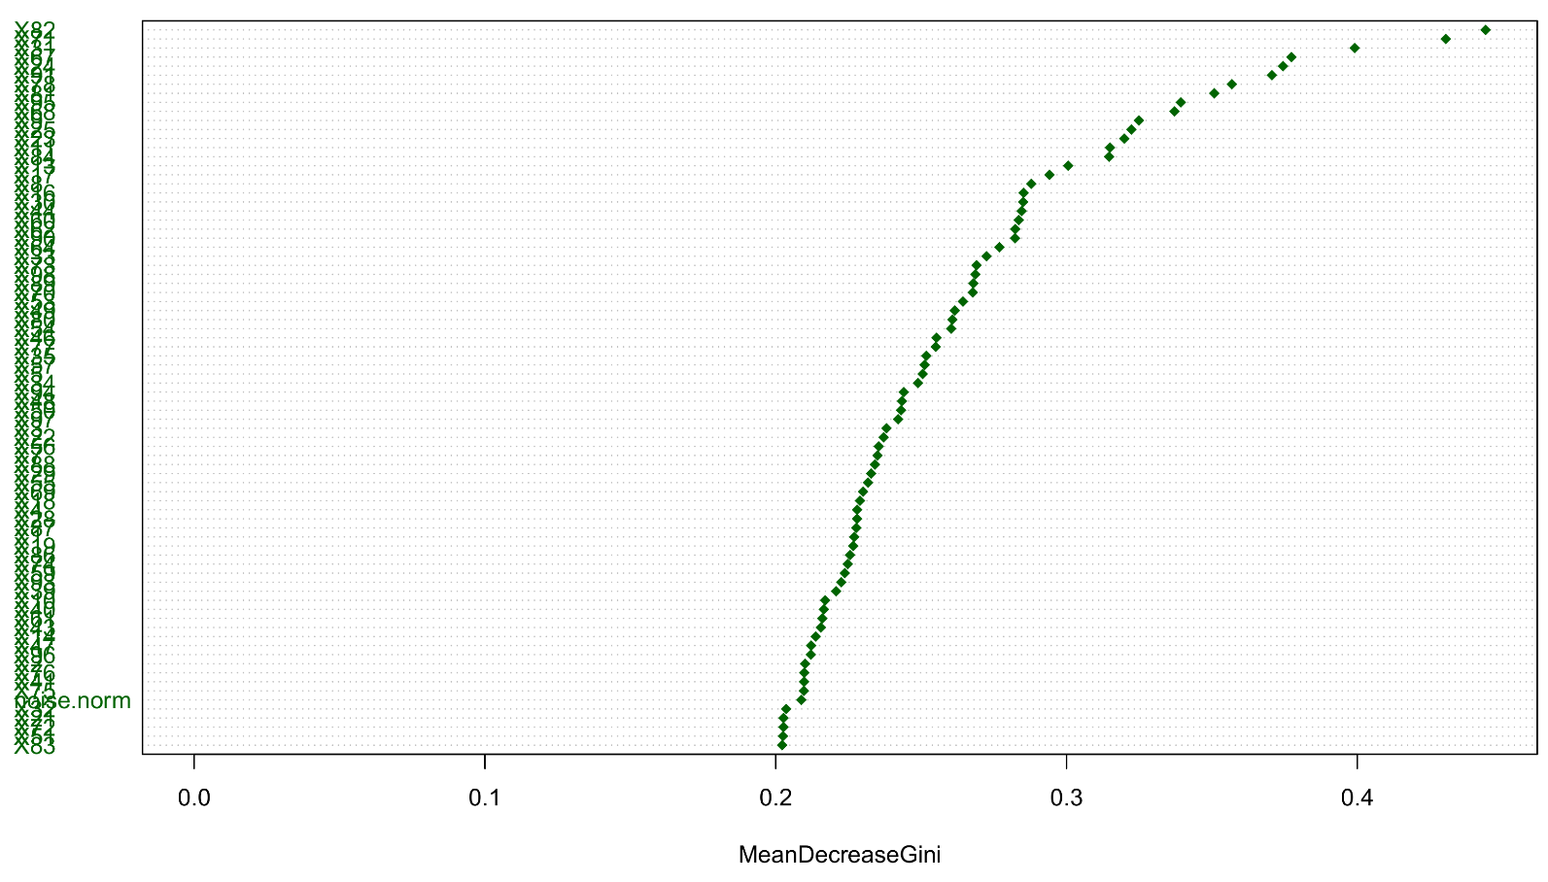
Data Problem 2 – Medical rarity
The random forest is also correctly bad, but the variable importances turned out less informative than expected. The noise variables I added were ranked near the bottom. On the other hand, the importance plot does not seem to have a clear elbow:

Slide 21
Data Problem 3 – Fear of heights in VR
Data Problem 3 consists of 1 continuous outcome and 12 continuous predictors. The data were taken from an experiment that provoked fear with virtual heights (VR). Each subject was exposed to a certain virtual height (depth), while physiological measurements and self-reports about fear experience were collected.
These data are authentic measurements from the described study.
Depth is a manipulation, and has a causal effect on fear intensity. However, the depth effect often disappears when controlling for the other measures. One could therefore falsely conclude that there is no relation between depth and fear.
ML models do not structure the causal relationships between the predictors. However, emotion theories have hypotheses how cognitive, motivational, and physiological variables influence each other to produce an overall feeling. ML will not able to address such hypotheses!

Slide 22
Data Problem 3 – Fear of heights in VR
Emotion process model
Motivational tendencies
Appraisals
Physiological reactions
Feelings
Danger
Approach
Fear intensity
Escape
P-ANS activity
Control
Situation
Freeze
S-ANS activity
Urgency

