Slide 1
Tigrigna Wh-words Hosted by Focus
Macolin, November 28th 2017
Bahareh.Samimi@unige.ch

Slide 2
Tigrigna, a language spoken in Geneva
“Languages of Geneva”, title of fieldwork course on languages spoken in Geneva
Asylum seekers’ languages
Eritrea, the main country of origin of asylum seekers in Switzerland

Slide 3
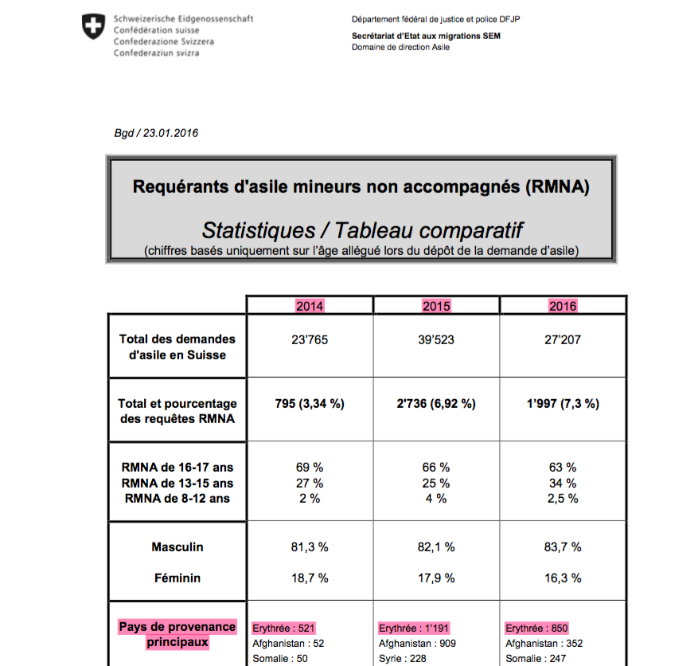
Eritrea, main country of origin: unaccompanied minors

Slide 4
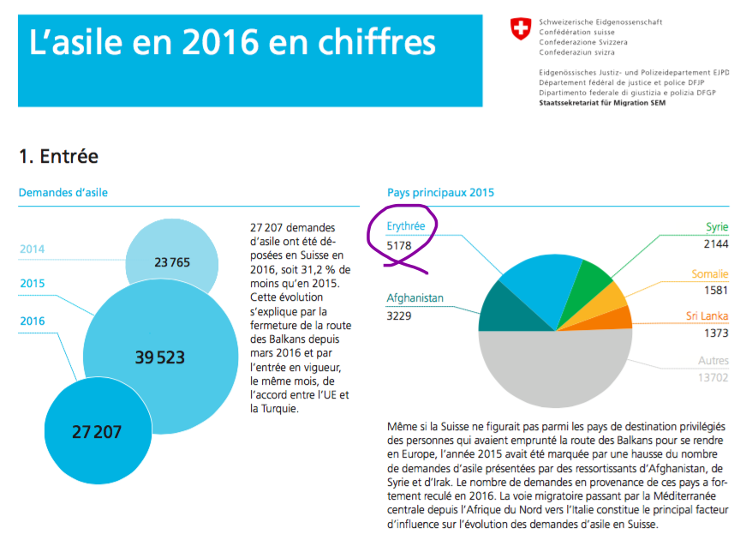
Eritrea, main country of origin: Asylum seekers in Switzerland

Slide 5
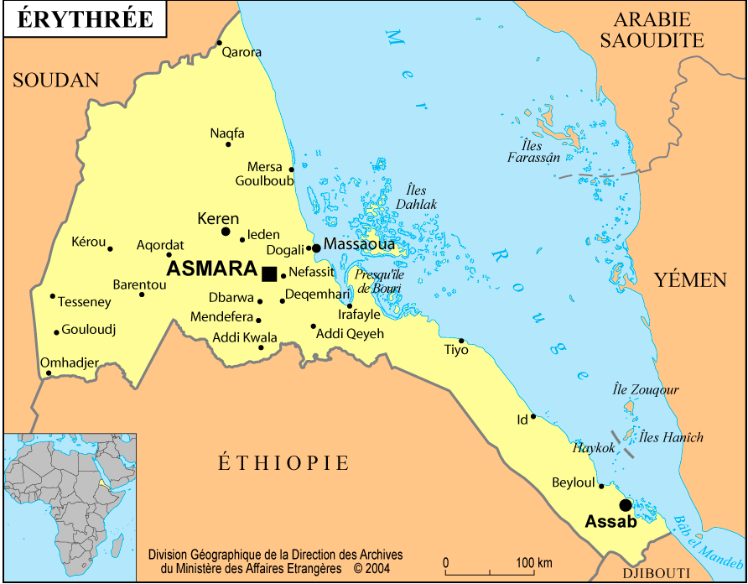
Tigrigna, a language spoken in Eritrea

Slide 6
Wh-interrogatives in Tigrigna
The three topics of study in the fieldwork on Tigrigna
Nominal Phrases
Time and Aspect
Interrogatives
Similarity of interrogative words and focused elements

Slide 7
Head-Final low in the structure
Hierarchy of the clause: [CP [TP [VP]]]
(Subject) Object Verb (SOV) (1) Marie injera tbelie. Marie injera eat.3SG ‘Marie eats injera.’
(Subject) Object Verb Auxiliary (SOVA) (2)Helen injera teblie ala. Helen injera eat.3SG.F has ‘Helen is eating injera.’

Slide 8
Head-Initial high in the structure
Corrective Focus, an element associated with C (Rizzi1997, Cinque and Rizzi 2016).
(3) A: Helen hade kelbi rekiba neyra.
Helen one dog found was
‘Helen has found a dog.’
B: Nska tigage aleka. Nsa hade dimu eya rekiba neyra, hade kelbi aykonen.
You mistaken have. She one cat is.F found was , one dog wasn’t
‘You are mistaken. A CAT she found, not a dog.
Notes:
Rizzi, L. (1997) “The Fine Structure of the Left Periphery” In Elements of Grammar, Springer Netherlands, 281-337.
Rizzi, L., & Cinque, G. (2016) "Functional categories and syntactic theory" Annual Review of Linguistics, 2, 139-163.

Slide 9
Cleft-like interrogatives
The verb ‘to be’ follows interrogative words.
(4) a. Marc hanti tufah nmen eyu zhb zelo?
Marc one apple whom is.M given has
‘To whom did Marc give an apple?’
b. Marc entay eyu nLucie zhba zelo?
Marc what is.M to Lucie given.F has
‘What did Marc give to Lucie?’
c. * Marc entay nlucie eyu zhba zelo?

Slide 10
Similar to English, French and an Italian dialect
The verb ‘to be’ follows interrogative words.
(5) What is it you do? (English)
(6) Qu’est-ce que vous faites? (French) what is-it that you do? ‘What is it you do?’
(6) A chi x-eo ch’el ghe parla? (Trevisan) To whom is-it that he him speaks ‘To whom does he speak?’

Slide 11
Tigrigna: interrogative ‘to be’ agrees with the subject
(3) Nska tigage aleka. Nsa hade dimu eya rekiba neyra, hade kelbi aykonen.
You mistaken have. She one cat is.F found was , one dog wasn’t
‘You are mistaken. A CAT she found, not a dog.
(4) b. Marc entay eyu nLucie zhba zelo?
Marc what is.M to Lucie given.F has
‘What did Marc give to Lucie?’

Slide 12
English, French, Trevisan: ‘to be’ agrees with expletive subject
(8) It snowed. (it expletive– interrogative version: it)
(9) Ça a neigé. (ça expletive – interrogative version: ce)
‘It has snowed.’
(10) a. Ga navega tanto. (null expletive – interrogative version: eo)
has snowed much
‘It has snowed a lot.’
b. Ga.eo nevega tanto?
has it snowed much
‘Has it snowed a lot?’

Slide 13
Tigrigna Wh-words are hosted by Focus
Eyu ‘to be’ marks Focus in Tigrigna
The interrogative words are marked by eyu ‘to be’ in Tigrigna
1. & 2. > interrogatives are hosted by Focus in Tigrigna.

Slide 14
English, French, Trevisan Wh-words are hosted by Focus, too
In these three languages
the wh appears in Foc.
the head Fin is realized as “null” in English, as que in French, as che in Trevisan
(5) What is it _ you do? (English)
(6) Qu’est-ce que vous faites? (French) what is-it that you do? ‘What is it you do?’
(6) A chi x-eo ch’el ghe parla? (Trevisan) To whom is-it that he him speaks ‘To whom does he speak?’

Slide 15
Theoretical account of Wh-questions Split-C
Explain the similarity between the languages above by maintaining a split-C hypothesis which assumes distinct positions such as Focus and Fin in a proliferated C layer.
(11) The fine structure of the CP
[Force [Top* [Int [Top*
eyu, is-it, est-ce, x-eo [Foc
[Top*
[Mod
[Top*
[Qemb null, null, que, che [Fin
[IP ... ]

Slide 16
Yes/No questions do as INT marker in Tigrigna
(12) Nska tsewta rieka do? You.M match saw do ’Did you see the match?’
(13) a. Nska tseweta d-ika tiezeb zeleka? You game Q-BE.2sg play Cont. b. Nska tseweta tiezeb dika zeleka? You game Q-BE.2sg play Cont. ‘Are you watching the game?’

Slide 17
Foc to Int movement to obtain narrower scope of question
The scope of the yes/no question is the whole sentence in (12), and only the focussed elements in (13).
(11) The fine structure of the CP
[Force [Top*
d(o) [Int [Top*
ika [Foc
[Top*
[Mod
[Top*
[Qemb [Fin
[IP ... ]

Slide 18
Speculating: Wh-movement to focus for scope
In Tigrigna yes-no questions, focus is used to determine the scope of the yes/no question.
It seems plausible to put this data next to data on wh-movement languages and favor the hypothesis that the motivation for wh-movement to the left periphery is scope determination.

Slide 19
የቐንየለይ! Yekenyeley
‘Thank you!’

