Slide 1
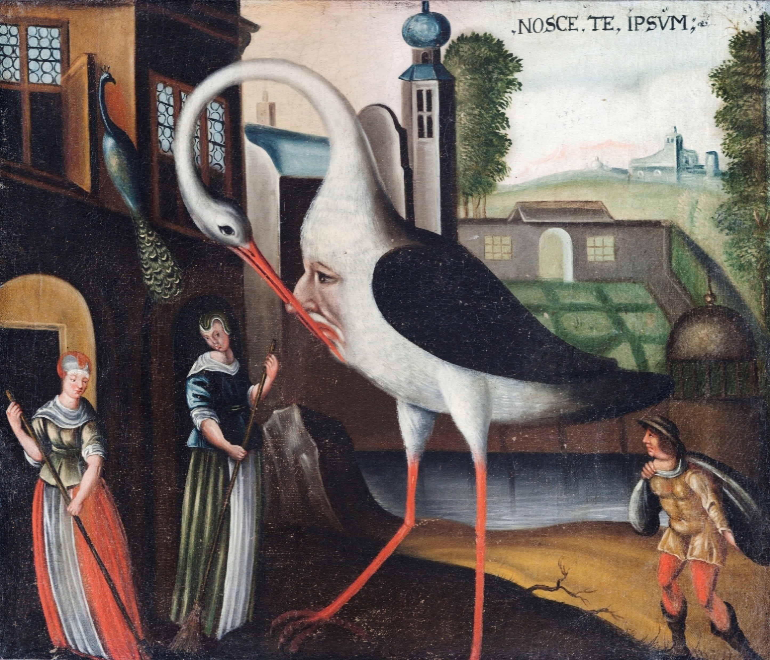

Experience-driven readings and the grammar of Control
Genève, February 24
Denis Delfitto
(University of Verona)
Joint work with Gaetano Fiorin
(University of Trieste)
Università degli Studi di Verona
Måleri, allegorisk bild. Nosce te ipsum. Nyckelord: Stork, 1600-tal, Allegori, Exteriör, Folk, Fåglar, Föremålsbild

Slide 2
PART I:
Control and variaties of de se
PART II:
A simpler syntax of control:
no PRO, no movement, no Form-Copy
PART III:
Debunking Partial Control
Måleri, allegorisk bild. Nosce te ipsum. Nyckelord: Stork, 1600-tal, Allegori, Exteriör, Folk, Fåglar, Föremålsbild

Slide 3
PART I
Control and variaties of de se
Måleri, allegorisk bild. Nosce te ipsum. Nyckelord: Stork, 1600-tal, Allegori, Exteriör, Folk, Fåglar, Föremålsbild

Slide 4
Control and de se
Morgan (1970) Fodor (1975), Higginbotham (1980) Chierchia (1989): control conveys de se
(1) Roberta_{i} pensa che lei_{i} sia intelligente
Roberta thinks that she is_{subj} intelligent
(2) Roberta pensa di essere intelligente
Roberta thinks to be intelligent
(3) Roberta_{i} expects that she_{i} will win the race
(4) Roberta expects to win the race
(5) Roberta expects that she herself will win the race
(6) Roberta expects herself to win the race

Slide 5
Control and implicit de se
Higginbotham (2003): control conveys a stronger form of de se with verbs such as remember/imagine:
(7) (P1) Only Churchill gave the speech
(8) (P2) Churchill remembers giving the speech
______________________________________________________________
(9) (C) Only Churchill remembers giving the speech
(10) (*C) Only Churchill_{i} remembers that he_{i} gave the speech
(11) (C) Only Churchill remembers himself giving the speech
(12) (C) Only Churchill remembers that he himself gave the speech

Slide 6
Control and implicit de se
(13) I remember my grandfather being called “Rufus”
(14) I remember that my grandfather was called “Rufus”
(15) I used to remember walking to school in the 5th grade, but I no longer remember it
(16) # I used to remember that I walked to school in the 5th grade, but I no longer remember it
(17) I imagined flying through space (de se)
(18) I imagined that I was flying through space (ambiguous)

Slide 7
Control and implicit de se
Control reports events as experienced by the subject “from the inside” (Pryor 1999) – that is, from an introspective, first-personal point of view.
Higginbotham (2003): control conveys a form of de se that is immune to error through misidentification (IEM)
Recanati (2007): de se + IEM = implicit de se

Slide 8
Control and IEM
(23) (P1) I remember someone saying that John should finish his thesis by July
(24) (P2) I am now presented a recording of me saying that John should finish his thesis by July
__________________________________________________________
(25) (*C) I now remember saying John should finish his thesis by July
(26) (C) I now remember that I said/my saying that John should finish his thesis by July

Slide 9
Introspection as identification
Delfitto & Fiorin (2018, 2020, 2021), Fiorin & Delfitto (2014, 2015, 2020):
Conscious experience and conscious experiencers ARE part of the ontology of natural language
Naturalistic accounts of perception and cognition (Chalmers 1996; Gallagher 2000; Matthen 2005; Burge 2010; Siegel 2010; Goff 2023)

Slide 10
Intermediate conclusions
Control structures provide crucial evidence for a peculiar form of de se that is specifically first-personal
Their semantics can be properly understood only once we are ready to accept that:
Conscious experiences and experiencers are a legitimate part of the ontology of natural language
De se interpretations and implicit de se interpretations must be carefully taken apart from each other
Phenomena such as partial control interact in an interesting way with de se varieties

Slide 11
PART II
A simpler syntax of control: no PRO, no movement, no Form-Copy
Måleri, allegorisk bild. Nosce te ipsum. Nyckelord: Stork, 1600-tal, Allegori, Exteriör, Folk, Fåglar, Föremålsbild

Slide 12
Coming to grips with Control:
The Classical Puzzle
Sentences like John wants to leave raise a familiar puzzle:
• the embedded predicate introduces an external θ-role
• no overt subject is projected
• yet interpretation is precise and constrained
Why does the structure converge at all?

Slide 13
Standard Approaches
Three dominant traditions:
• PRO-based theories (GB, Minimalism) → Chomsky
• Movement / Form-Copy approaches → Hornstein, Manzini
• Logophoric binding (Landau’s Two-Tiered Theory of Control)
Shared assumption: Control is a syntactic dependency

Slide 14
A Shared Cost
Across approaches:
• reference transmission across clauses (Chomsky, Landau)
• special machinery for partial control (all approaches)
Control is described, not explained.

Slide 15
A Different Perspective
We propose a shift in perspective:
• Control is not a syntactic dependency
• Control is a Transfer/Interface condition
• Grammar reacts to a potential interpretive failure
Key question: How is this Transfer Condition exactly defined?

Slide 16
A theta-violation as the Trigger
John wants to leave/jump/kiss
Embedded infinitives introduce θ-roles:
• leave, jump, kiss → external agent role
If that role is not discharged, interpretation crashes.
The embedded predicate must syntactically discharge the event participants it encodes.

Slide 17
Events vs. Experiences
Crucial distinction:
• Event predicates (leave) describe physical occurrences
• Experience predicates (want) describe lived states
The external argument of an event-referring predicate is an AGENT [+m+c] (Reinhart). There is not only a mental state component, there is also, crucially, a physical causality component

Slide 18
The core tension: The first categorial re-typing
(i) John wants to jump combines:
• an experiential predicate (want)
• an eventive predicate (jump)
The embedded event must be made compatible with experience.
John has the desire of jumping. This desire is a first-personal experience whose content must be interpretable as lived through by a subject of experience. But jump remains an agentive event predicate. What changes is the ontological status of the eventuality it denotes: under volere, the event is required to be construed as an experience/event. Lexically, jump is agentive. Syntactically, it is construed (re-typed) as an experience. Notice that for (i) to be true, no actual jumping needs to take place.

Slide 19
Agentive predicates [+m+c]:
Complements are events, not experiences
(ii) John tried/dared to jump combines:
• an agentive predicate (try)
• an eventive predicate (jump)
Try is agentive: (i) the fact that John tried to jump entails that John intended to jump (+m); (ii) the event of jumping must have started being realized to some degree (+c) (Grano, Pearson). Notice that in order for (ii) to be true, at least a part of the jumping event must have taken place. It follows that the external argument of jump in (ii) is an AGENT, not an experiencer.

Slide 20
Charnavel’s Insight: The role of Op_{Log}
Charnavel (2019): licensing exempt anaphors
• logophoricity licenses local structure
• only when an interface violation would arise
• OP_{LOG} introduced to repair Condition A of BT
Key idea: logophoricity acts as a licensing resource

Slide 21
Extending Op_{Log} to Control
We generalize Charnavel’s logic:
• OP_{LOG} can repair theta-violations
• not only binding-theoretic ones
• same grammatical object, new domain
Control = θ-role repair under logophoric licensing.

Slide 22
The syntax and semantics of Op_{Log}
“I assume that the relevant logophoric center in a given spellout domain can be referenced in the syntax as a silent logophoric pronoun pro_{log} subject of a logophoric operator op_{log} heading a logophoric projection LogP in the left periphery of the domain” (Charnavel 2019).
OP_Log = λα.λx. α from x's first-personal perspective (Charnavel)
OP_LOG denotes SELF(c) (present proposal)
The SELF is a minimal experiencer, i.e.the entity involved in the minimal degree of awareness/agentivity that gives rise to a lived experience (Gallagher 2000)

Slide 23
Feature-driven interpretations
[+m] predicates introduce a formal feature, [LOG], encoding the requirement that the embedded clause be interpreted relative to a perspectival center. [LOG] signals that the embedded domain must contain an argumental element capable of denoting the SELF of a context.
The [LOG] feature is inherited by the embedded phase as an unchecked feature. OP_{log} acs as the checker of [uLOG]:
It values the [LOG] feature inherited from the matrix predicate.
It satisfies the θ-criterion by occupying the external argument position of the embedded predicate.

Slide 24
Contexts and SELF
We want to keep the basic insight in the centered worlds approach, concerning the presence of a center of consciousness, to guarantee that propositions be evaluated with respect to the logophoric center’s perspective; cf. Quine, Lewis, Schlenker, Pearson, etc.
We enrich contexts minimally:
c = ⟨world, time, speaker, addressee, self⟩
Predicates of experience (+m) quantify over such contexts.
SELF is the minimal experiencer in context c. This corresponds to the logophoric center in Charnavel’s approach.

Slide 25
Agentive predicates:
Second categorial re-typing
Remember that in (ii) John tries to jump:
• try introduces a jumping event e
• OP_{Log} = SELF(c′)
The insertion of OP_{Log} circumvents a theta-violation.
However, the minimal experiencer SELF cannot discharge the agentive external argument of jump (remember that jumping in (ii) must be represented ALSO as a (sub)event, not ONLY as an experience).
This means that SELF(c′) is coerced into container-of-SELF(c’) (it is John who brings about the jumping, not the minimal experiencer).
This is a very natural step to be taken, since logophoric centers are syntactically represented as containers-of-SELF

Slide 26
TRY vs. WANT: some qualifications
The problem: Intuitively, trying involves conscious intention, effort, bodily awareness, and thus experience. If control complements of want require experientialization of the embedded event, why should try - which is manifestly intentional and experiential - fail to license the same mechanism?
The answer: Representing an event with a mental state correlate (TRY) IS NOT equivalent to an exclusively experiential representation of the embedded eventuality.
The empirical evidence strongly suggests that these two notions come apart in grammar.

Slide 27
TRY vs. WANT: some qualifications
I remember/imagine lifting the box
I want to lift the box
Misidentification of the experiencer is sharply degraded
(iii) I tried to lift the box
Scenarios involving phantom limb effect, prosthetic embodiment, or Rubber Hand illusion, readily allow misidentification of the agent without contradiction (no IEM!)
(iv) He wanted to kiss (reciprocal reading)
(v) He tried to kiss (no reciprocal reading)

Slide 28
PART III
Debunking Partial Control
Måleri, allegorisk bild. Nosce te ipsum. Nyckelord: Stork, 1600-tal, Allegori, Exteriör, Folk, Fåglar, Föremålsbild

Slide 29
Partial Control: Some examples
(i) Roberta wants to gather in the hall
(ii) Roberta expects to go on vacation together
(iii) Roberta remembers working on the problem as a team
(iv) *Roberta tries to gather in the hall
(v) *Roberta manages to go on vacation together
(vi) *Roberta dares to work on the problem as a team

Slide 30
Partial Control does not require simultaneity
Landau (2000): the availability of future-oriented and past-oriented interpretations is intimately connected with the availability of PC.
(i) Yesterday, John hoped/decided/planned/was eager/was ready to go to the movies tomorrow
(ii) Tomorrow, John will remember/regret going to the movies yesterday
(iii) Yesterday, John dared/tried to go to the movies (*tomorrow)
(iv) Today, John dares to go to the movies (*yesterday)

Slide 31
Partial Control: The basic insight
Because OP_{LOG}:
• satisfies θ-theory
• discharges the external argument of the embedded predicate P as SELF
• does not discharge the agent role lexically associated with P
The event-driven agentive interpretation remains available → pragmatic enrichment

Slide 32
Exemplification
John decided to meet at noon
• OP_{LOG} = SELF(c)
• describes a mental state of decision-making whose content (the meeting) is experienced by the SELF associated with the center of consciousness
• the plurality of the embedded subject is a result of how the event of meeting (not the experience of meeting) is represented in the pragmatics
No special syntax, no plural variables

Slide 33
Why Believe Fails
(i) *John believes to jump
(ii) John believes that pictures of himself are available
Predicates of belief differ from experiential attitude predicates in that they do not select or retype event variables as experience-events. Instead, they introduce representational states whose content may describe events without requiring their experiential instantiation.
Belief predicates license the insertion of a logophoric argument to repair binding-theoretic violations, as in exempt anaphora. In English, they do not, however, select experiential eventualities. As a result, belief predicates license OP_{LOG} for binding, but not for control.

Slide 34
Intensionality vs. Experientialization
John wanted to jump
John wanted that Mary jumped
The contrast between want with infinitival complements and want with finite complements underscores that intensionality alone cannot account for control. Finite complements of want exclude realization of the embedded event in the actual world just as infinitival control complements do, yet they do not trigger obligatory de se readings. This demonstrates that what distinguishes control is not intensionality, but a grammatical requirement that the embedded eventuality be experientialized (i.e. represented as accessible only from the subject’s first-person perspective).

Slide 35
The Kiss Diagnostic
John had been seeing Mary for a long time. Eventually . . .
They kissed
• reciprocal reading via lexical semantics
*He kissed
• ungrammatical (the singular excludes reciprocity)
He wanted to kiss
• grammatical with a reciprocal reading
Singular subject + reciprocity → requires experientialization

Slide 36
Summary: The logic of the proposal
Non-finite embedded predicate: external θ role not overtly discharged.
Transfer risk: unresolved argumenthood would block interpretation.
Repair: embedded [uLOG] is activated; OP_LOG values it.
Effect: event is typed as experienced (SELF-anchored).
Consequence: lexical agentivity remains available for later pragmatic enrichment (Partial Control).

Slide 37
The division of labor
Plural/agentive enrichment is post-compositional: grammar provides experiential anchoring; pragmatics expands event participation

Slide 38
The nature of Control
Control is not a dependency between two subjects; it is an interface repair strategy.
When a non-finite embedded predicate leaves its external role unrealized, Transfer fails. If the matrix predicate is endowed with +m, the grammar can retype the embedded eventuality as an experience.
In the case of agent suppression, grammar inserts OP_LOG/SELF in syntax: this yields experientialization and IEM. With +m+c predicates like TRY, active causation preserves agentive structure: SELF is re-typed as container-of-SELF (de se without IEM).
One-line thesis version:
Control = pre-Transfer experiential repair of an unrealized external argument, with IEM and PC only when SELF fully replaces agentivity.

Slide 39
What we could get rid of
• No PRO
• No movement
• No Form-Copy
• No “want-to-leave” predicate (restructuring)
Only interface repair + logophoric licensing + event experientialization

Slide 40
Conclusions
Logophoric Control is the grammar’s way of:
• Linking de se varieties with number mismatches
• forcing events to be experienced
• by satisfying θ-theory with an indexical argument (OP_{LOG}/SELF)
Control = experiential coercion of events
Måleri, allegorisk bild. Nosce te ipsum. Nyckelord: Stork, 1600-tal, Allegori, Exteriör, Folk, Fåglar, Föremålsbild

