Slide 1


Different events of Armenian history in the textbooks of the 18-19th centuries Armenian settlements
Kristine Melqumyan
ARMENIA, YREVAN

Slide 2
The history of the Armenian people written by a member of the Venice
Mkhitaryan Congregation Mikhail Chamchyan (1738-1823), a three-volume
book of the Armenian History (published in 1784-1886), in the history
books is divided into the following seven stages:
The period of the Haykazunins, Hayk's generation, reign
Judges who rule the loss of the statehood in Armenia before the Artashesians period (189 BC - 1 AC).
The Arshakuni’s period (66-428)
The Coronary period: (456 years)
The Bagratuni’s period (885-1046)
The Rubinyants’s period of the Armenian government of Kilikia (from the beginning in 1080 up to the collapse of the Armenian state of Kilikia in 1374).
After the Armenian state of Kilikia until 1780.

Slide 3
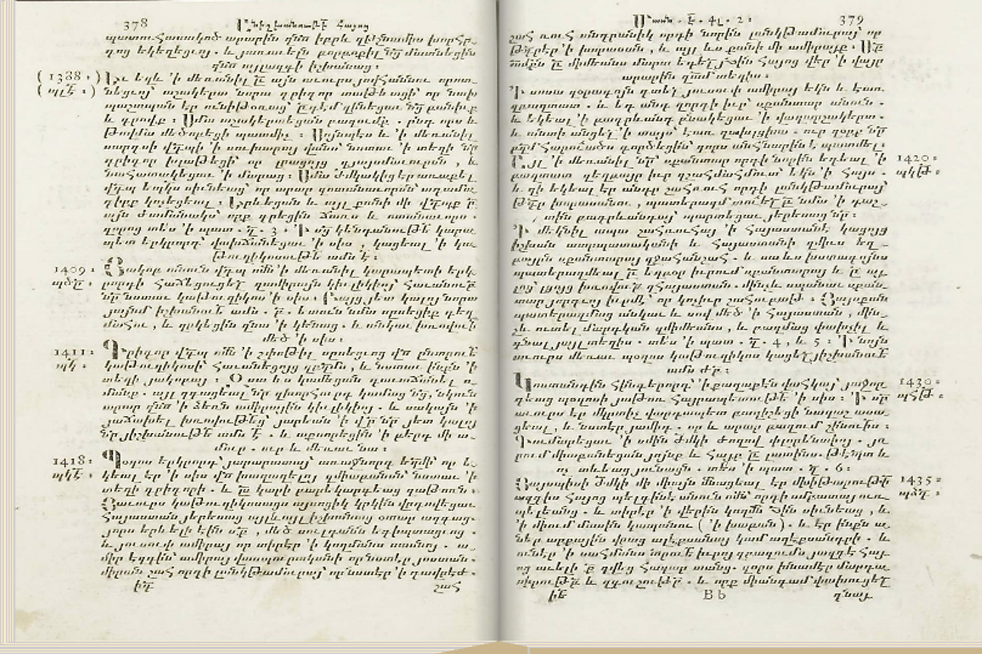

Mikayel Chamchian "The History of the Armenian Feast", Venice, 1811
The growing chronological course of the history is presented in the margins alongside each case by means of the mentioned historical date.
At the bottom of each year is represented the date according to the numerical values of the Armenian alphabet and Armenian cronicles. By adding 551 to the latter we receive the real date.

Slide 4
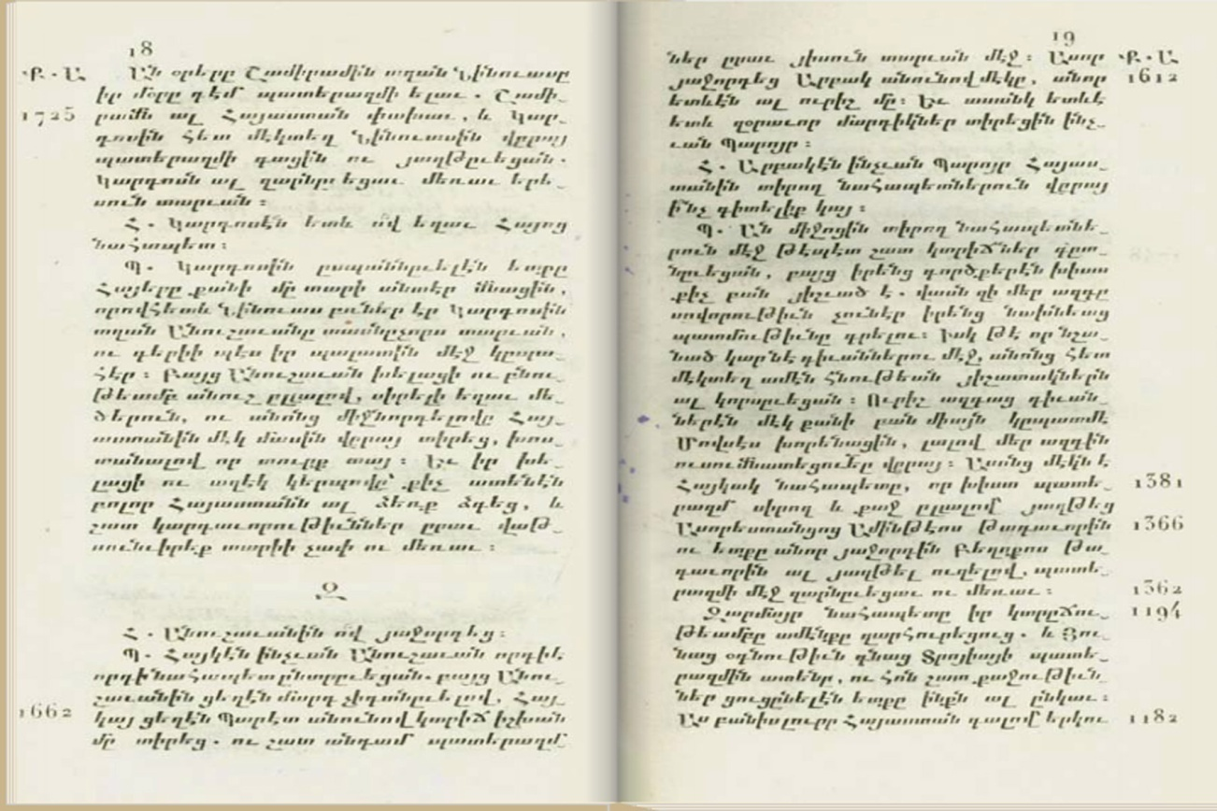
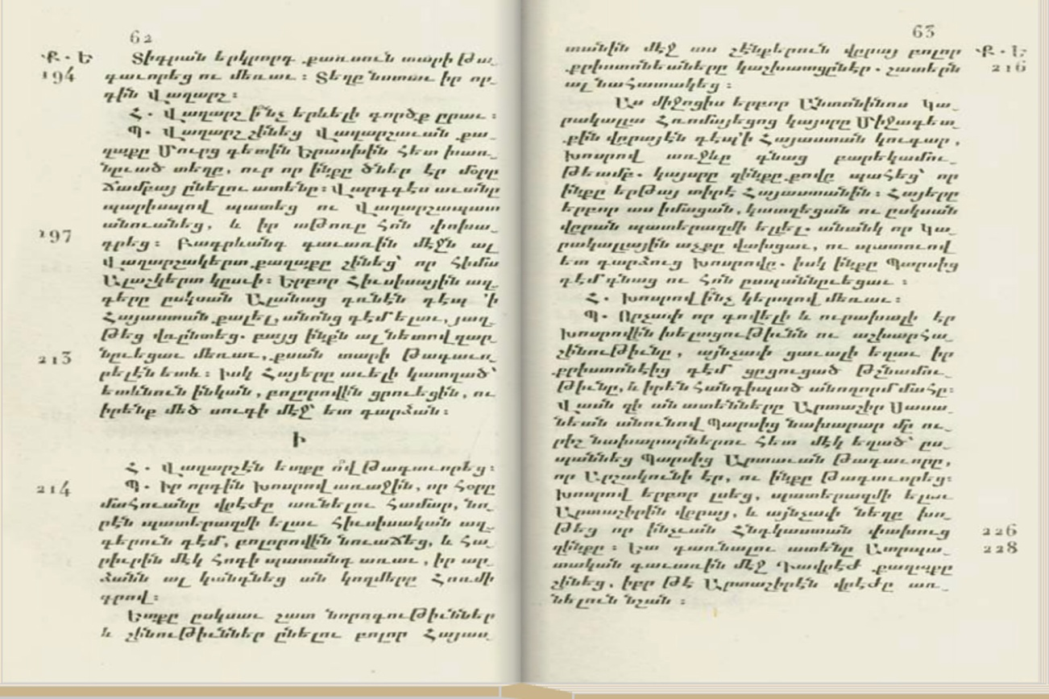
Ephrem Séthian, "The History of Armenia", Venice, 1839.
Either this or other textbooks written in the first half of the 19th century are written in the form of questions and answers, which makes the speech fragmentary to smaller parts and makes it more comprehensible.
Before the beginning of the birth of Christ, the marginal chronology of numbers above is written BC (Ք.Ա.) – Armenian for before Christ.
For the next period, it is written AC (Ք. Ե.) – after Christ.

Slide 5
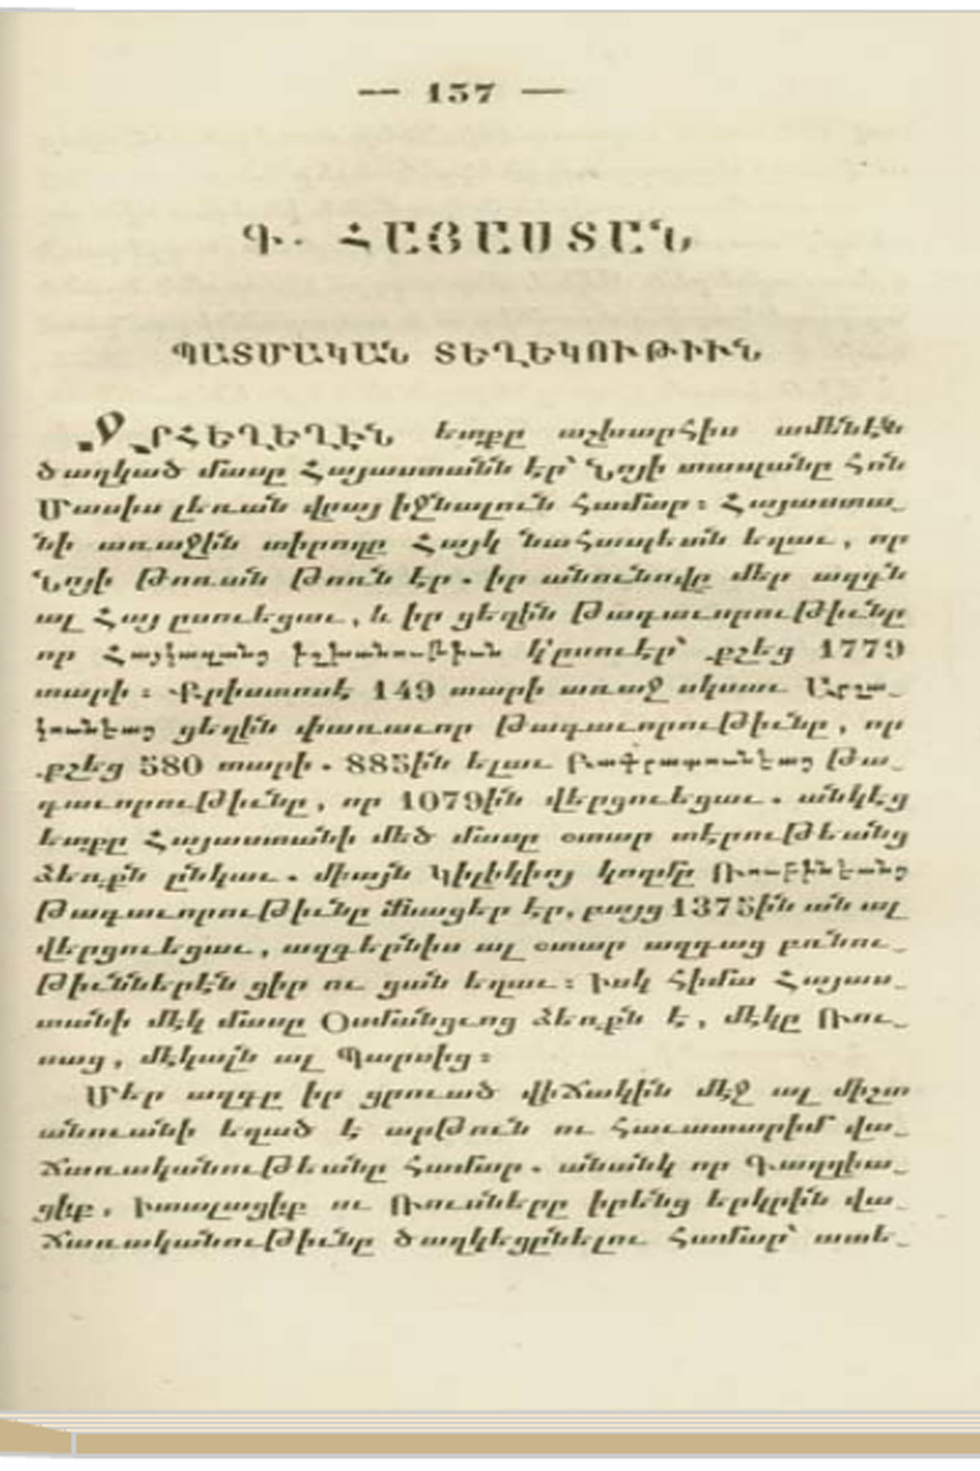
The Concise Geography for the boys school, 1847.
According to Khorenatsi, the chapter dedicated to Armenia starts with the following: "The first Armenian ruler Hayk, the patriarch, who was the grandson of Noah's grandson, and due to his name the nation is also called Armenian."

Slide 6
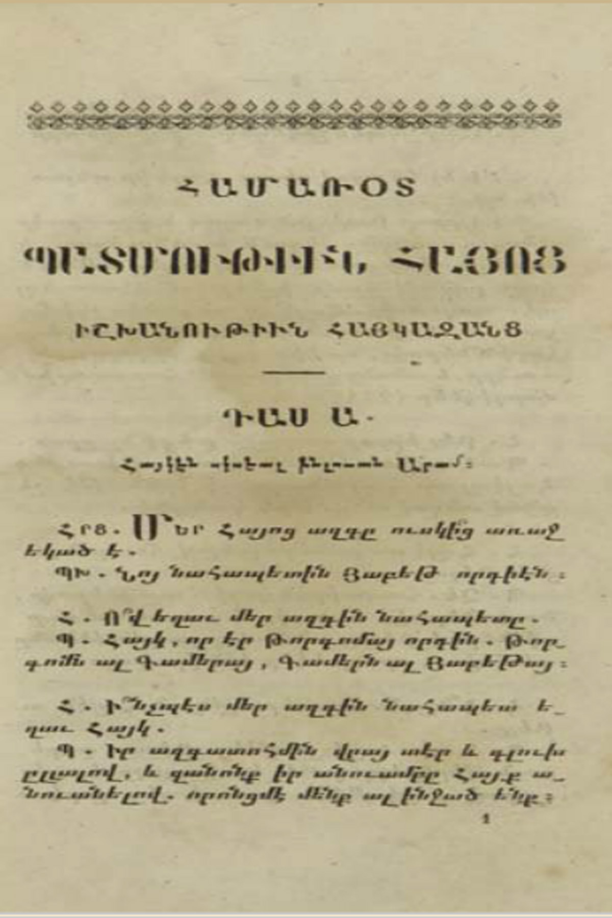
Hamazasp Terzhimanyan, "A Concise History for Armenian Boys schools", Venice, 1848.

Slide 7
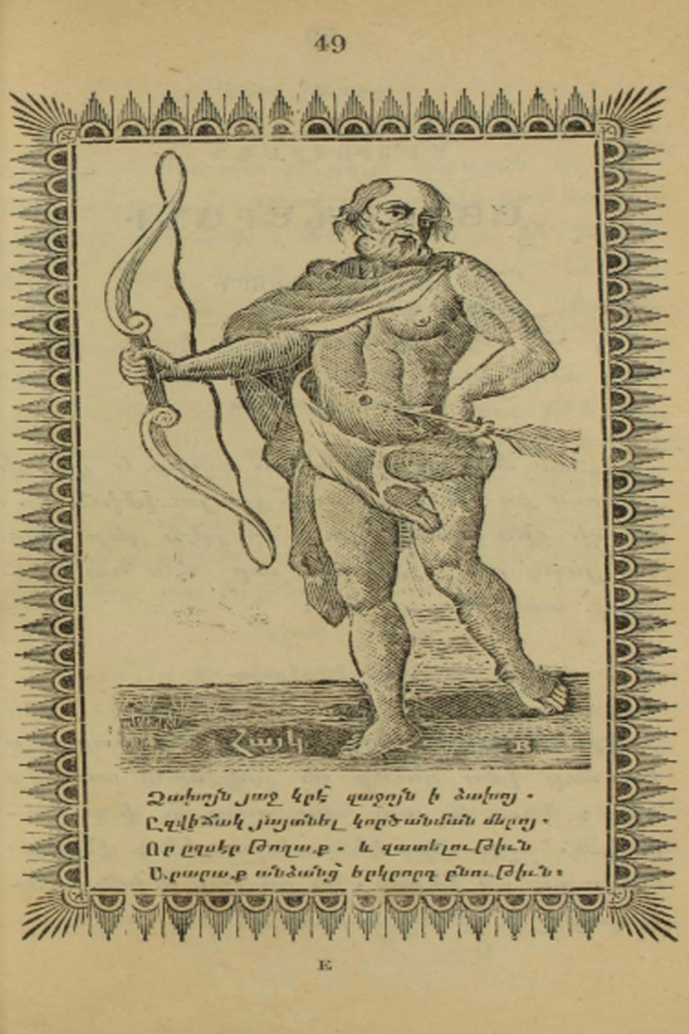
The Alphabet, Calcutta, 1840.
In it Hayk patriarch is depicted with the broad-bent bow, mentioned by Khorenatsi in his left hand and the arrow in his right hand. Below, it is written Haik and a quatrain is quoted which says that the bow is in the left hand and the arrow is in the right, by which the patriarch Hayk foretells the Armenian people about the forthcoming ordeals: that is we are going to forget love and we will make hatred determinable for our character.
The goal of this quatrain was to call for the national unity, meaning that the cause of the Armenians’ misfortunes was the discrepancy.

Slide 8
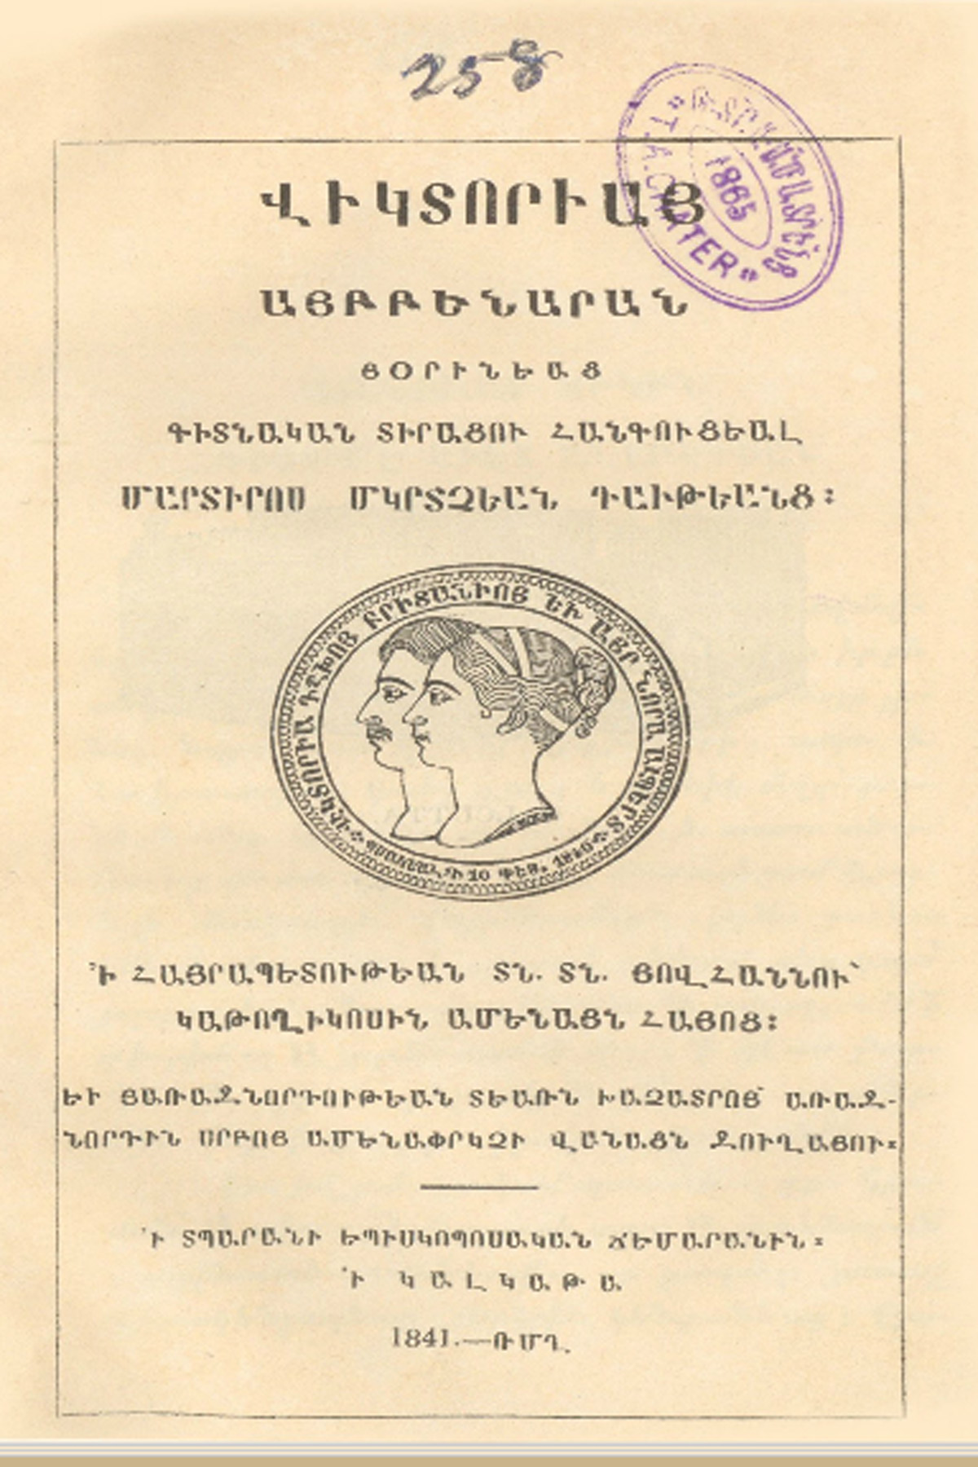
The Victorian Alphabet, Calcutta, 1840.
the front page of the book depicts the picture of Victoria, the Queen of England.

Slide 9
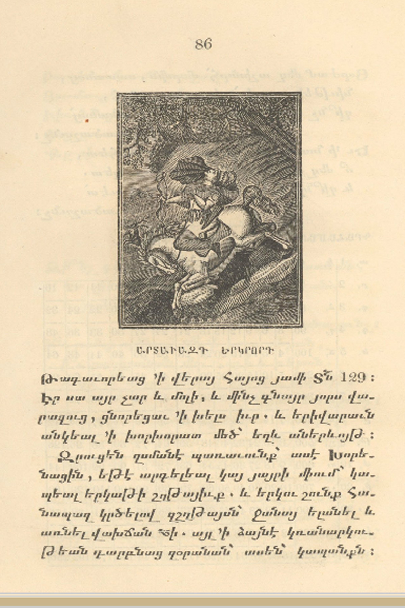
An image of King Artavazd of Armenia during the hunting at Ararat (Great Masis) when, according to Movses Khorenatsi's "Armenian History", he fell into the cleft.

Slide 10
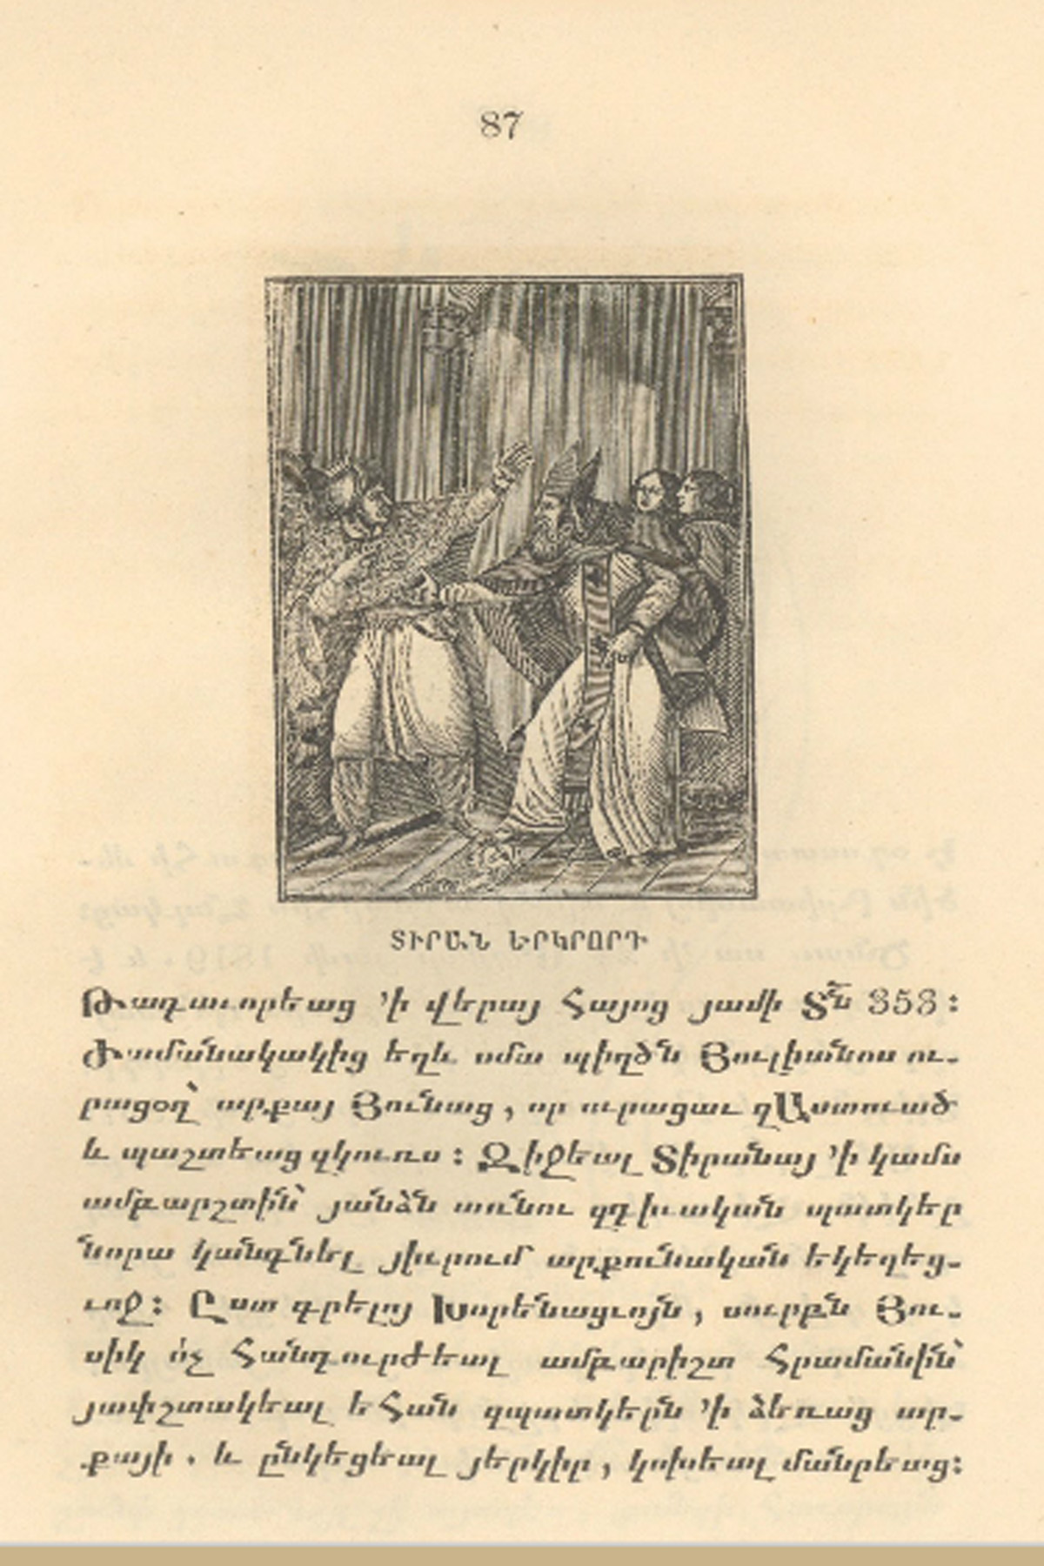
It is depicted the fact when Armenian Catholicos Hosik I did not allow the Armenian King Tiran to enter the church, for which the king ordered to kill the Catholicos in 347.

Slide 11
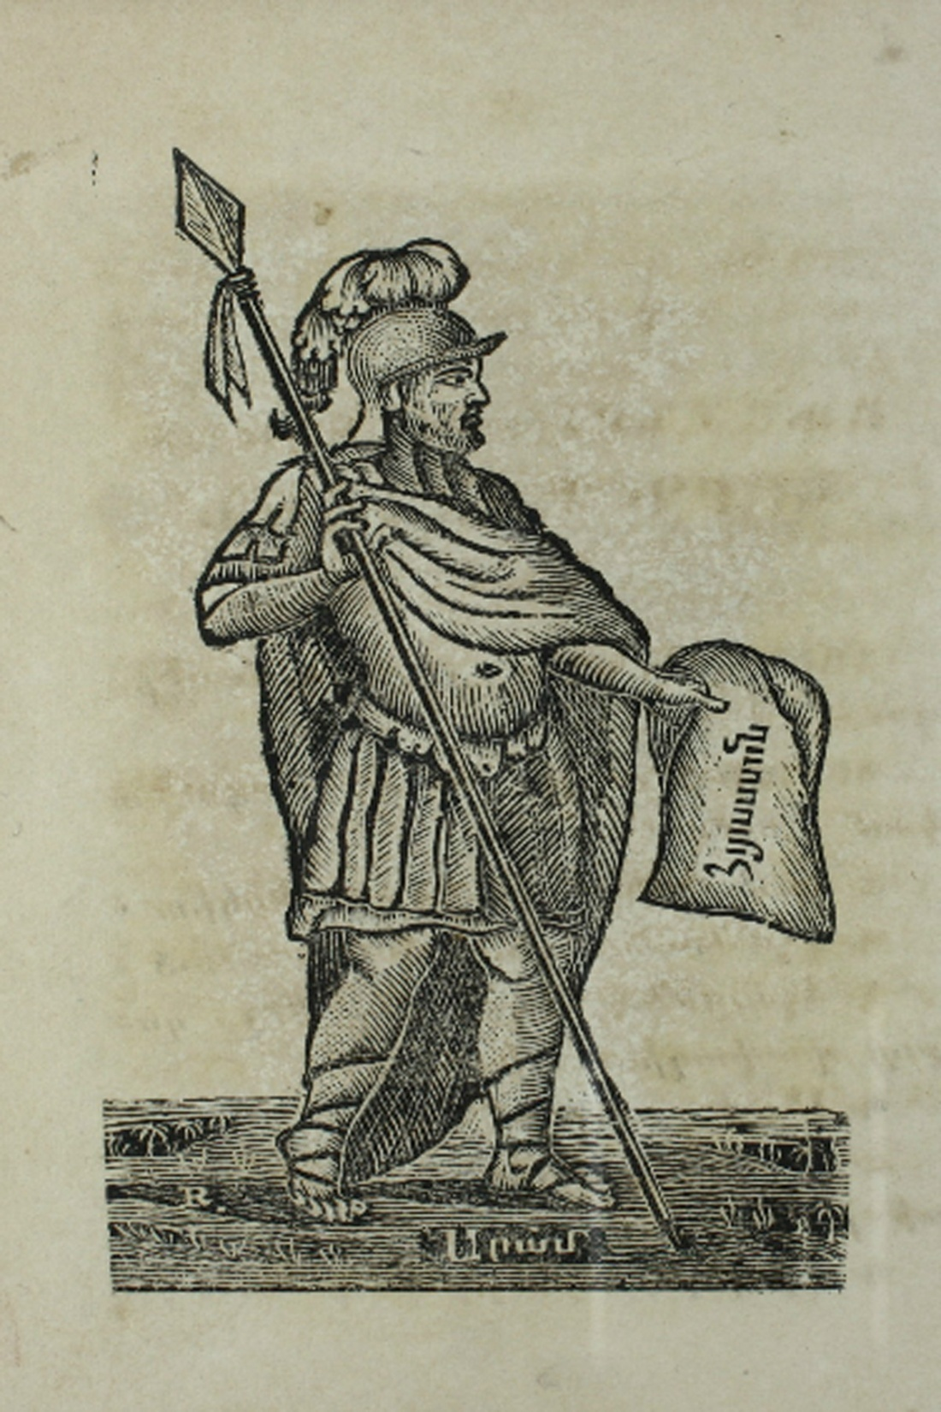
Mesrobbian Leader of Children, Calcutta, 1847.
In the textbook of 1840, Hayk the patriarch was depicted. Here Aram, his heroic heir, is seen. And that is not accidental. Khorenatsi writes that the foreigners acknowledge Armenia by the name of Aram and due to him Hayastan is called Armenia. Being in the Far India Taliadian points out this fact.

Slide 12
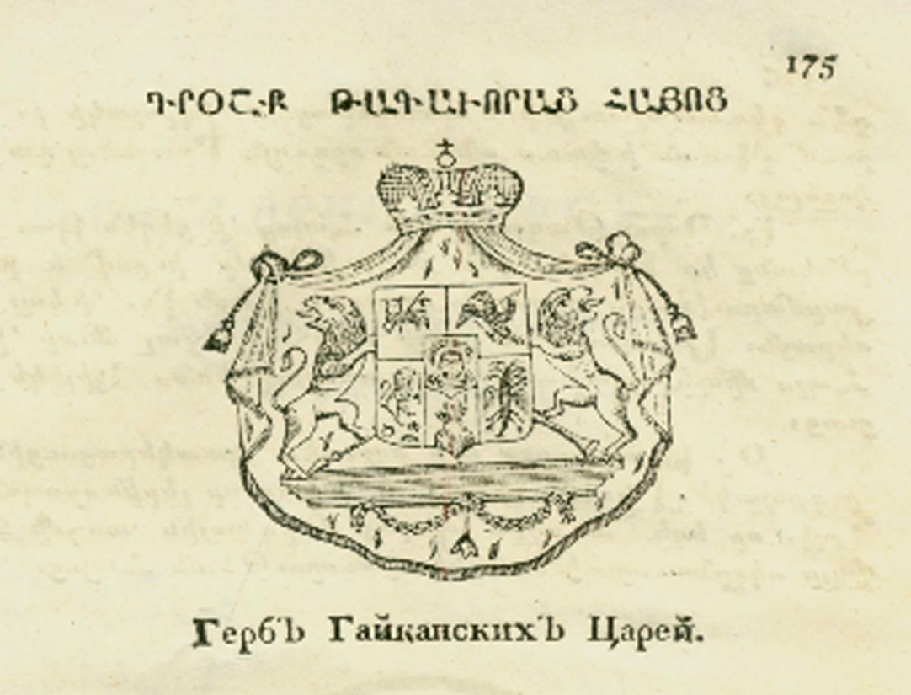
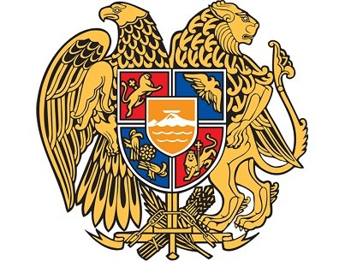
Yerznkian Rostom, The Compilation of the Armenian History. Tiflis, 1843.
As a historic supplement, it presents the kings of the Armenian period and as their coat of arms the following emblem is depicted. As we can see, it has an obvious parallel with the today's coat of arms of the Republicc of Armenia.

Slide 13
THANK YOU

