Slide 1
Infinite cycles in the interchange process in five dimensions
Dor Elboim, Princeton University
Workshop on Mathematical Physics
Les Diablerets, February 2023
Joint work with Allan Sly

Slide 2
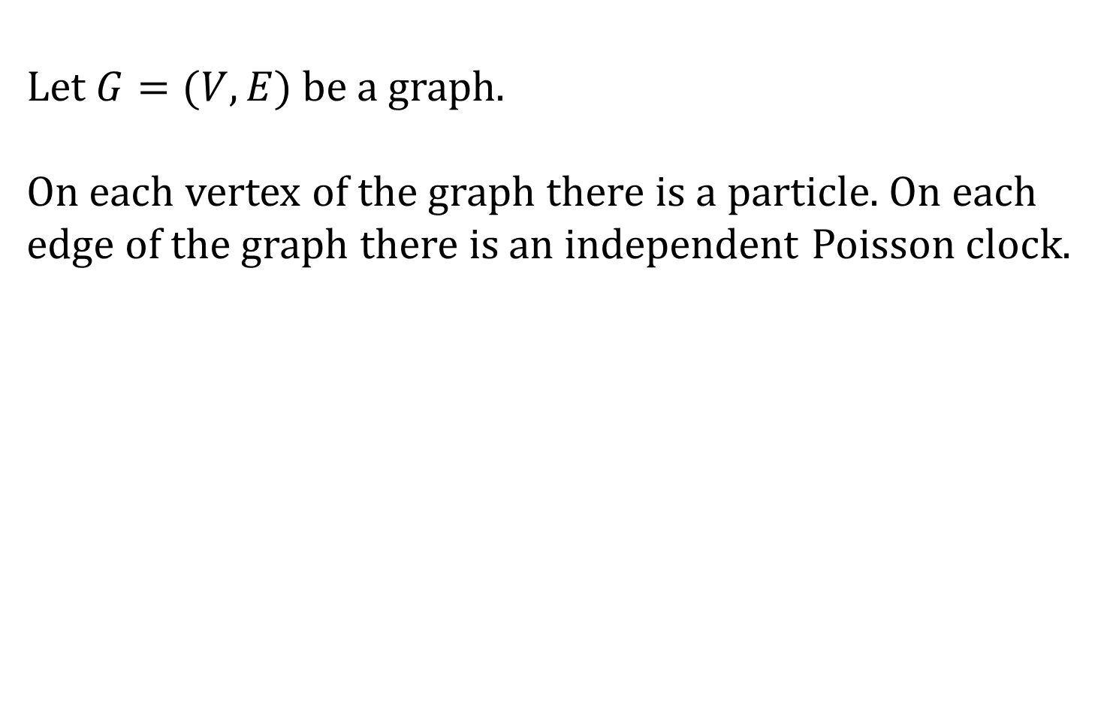
The interchange process - Definition
Let be a graph.
On each vertex of the graph there is a particle. On each edge of the graph there is an independent Poisson clock.

Slide 3
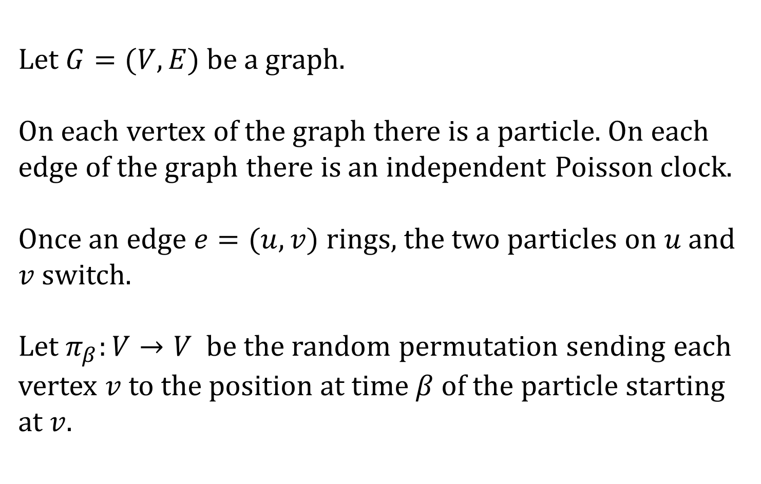
The interchange process - Definition
Let be a graph.
On each vertex of the graph there is a particle. On each edge of the graph there is an independent Poisson clock.
Once an edge rings, the two particles on and switch.
Let be the random permutation sending each vertex to the position at time of the particle starting at .

Slide 4
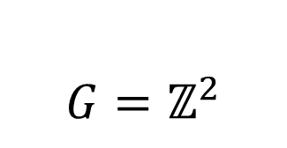
The interchange process - Definition

Slide 5
The interchange process - Definition

Slide 6
The interchange process - Definition

Slide 7
The interchange process - Definition

Slide 8
The interchange process - Definition

Slide 9
The interchange process - Definition

Slide 10
The interchange process - Definition

Slide 11
The interchange process - Definition

Slide 12
The interchange process - Definition

Slide 13
The interchange process - Definition

Slide 14
The interchange process - Definition

Slide 15
The interchange process - Definition

Slide 16
The interchange process - Definition

Slide 17
The interchange process - Definition

Slide 18
The interchange process - Definition

Slide 19
The interchange process - Definition

Slide 20
The interchange process - Definition

Slide 21
The interchange process - Definition

Slide 22
The interchange process - Definition

Slide 23
The interchange process - Definition

Slide 24
The interchange process - Definition

Slide 25
The interchange process - Definition

Slide 26
The interchange process - Definition

Slide 27
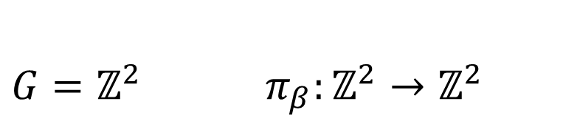
The interchange process - Definition

Slide 28
Previous works, history
Mixing and spectral gap:
Diaconis, Shahshahani (‘81)
Aldous conjecture: Caputo, Liggett, Richthammer

Slide 29
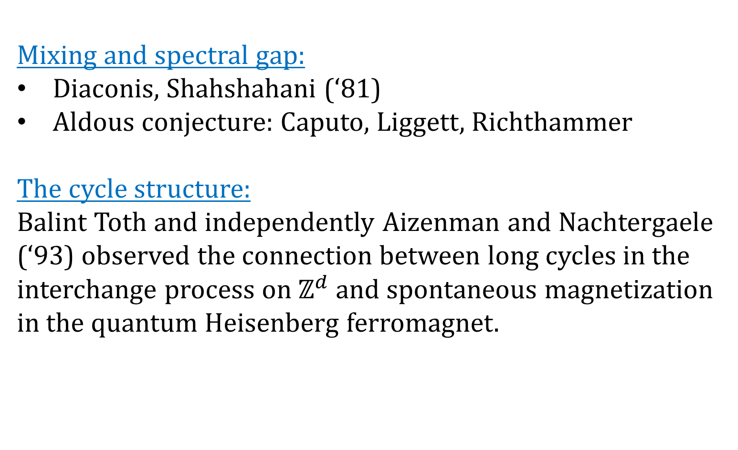
Previous works, history
Mixing and spectral gap:
Diaconis, Shahshahani (‘81)
Aldous conjecture: Caputo, Liggett, Richthammer
The cycle structure:
Balint Toth and independently Aizenman and Nachtergaele (‘93) observed the connection between long cycles in the interchange process on and spontaneous magnetization in the quantum Heisenberg ferromagnet.

Slide 30
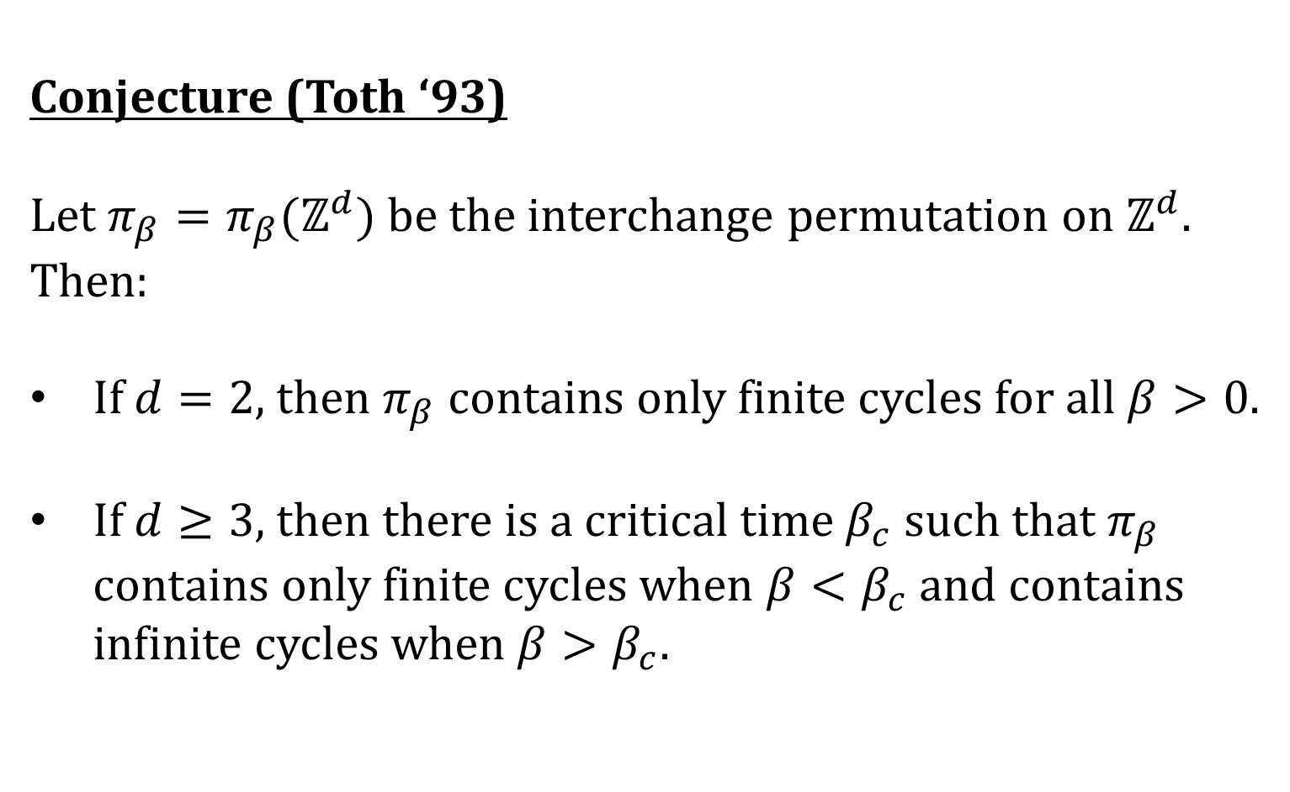
Previous works, history
Conjecture (Toth ‘93)
Let be the interchange permutation on . Then:
If , then contains only finite cycles for all .
If , then there is a critical time such that contains only finite cycles when and contains infinite cycles when .

Slide 31
Previous works, history
The emergence of long cycles has been shown on
The complete graph – Berestycki, Durrett (‘04), Schramm (‘04), Berestycki (‘11) Berestycki, Kozma (‘12)
Trees – Angel (‘03) Hammond (‘13) Hammond (‘15)
The hypercube – Kotecky, Milos, Ueltschi (‘16) Hermon, Salez (‘21)
The Hamming graph – Adamczak, Kotowski, Milos (‘21)
Random regular graphs – Poudevigne (‘22)

Slide 32
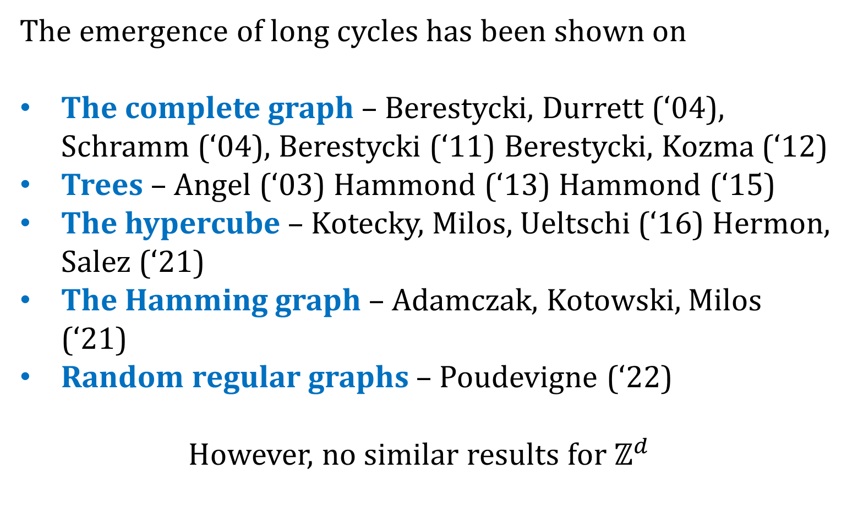
Previous works, history
The emergence of long cycles has been shown on
The complete graph – Berestycki, Durrett (‘04), Schramm (‘04), Berestycki (‘11) Berestycki, Kozma (‘12)
Trees – Angel (‘03) Hammond (‘13) Hammond (‘15)
The hypercube – Kotecky, Milos, Ueltschi (‘16) Hermon, Salez (‘21)
The Hamming graph – Adamczak, Kotowski, Milos (‘21)
Random regular graphs – Poudevigne (‘22)
However, no similar results for

Slide 33
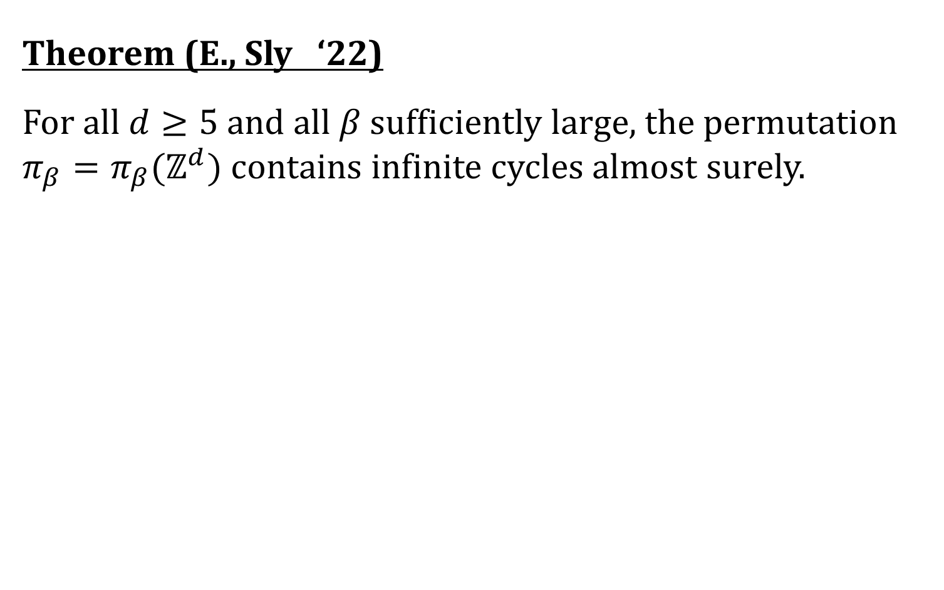
Result
Theorem (E., Sly ‘22)
For all and all sufficiently large, the permutation contains infinite cycles almost surely.

Slide 34
Result
Theorem (E., Sly ‘22)
For all and all sufficiently large, the permutation contains infinite cycles almost surely.

Slide 35
Result
Theorem (E., Sly ‘22)
For all and all sufficiently large, the permutation contains infinite cycles almost surely.
Questions?

Slide 36
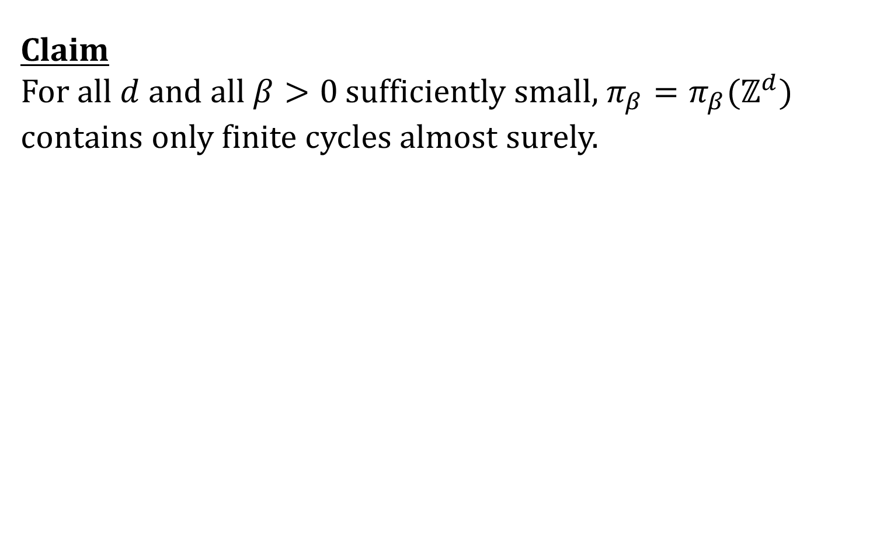
Finite cycles
Claim
For all and all sufficiently small, contains only finite cycles almost surely.

Slide 37
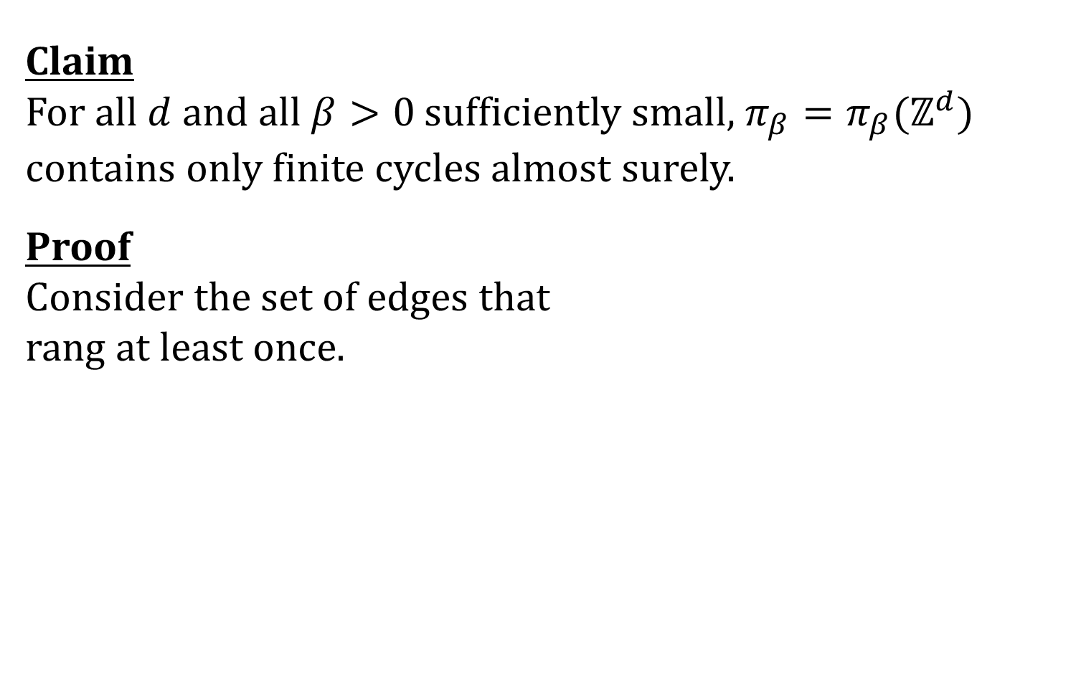
Finite cycles
Claim
For all and all sufficiently small, contains only finite cycles almost surely.
Proof
Consider the set of edges that
rang at least once.

Slide 38
Finite cycles
Claim
For all and all sufficiently small, contains only finite cycles almost surely.
Proof
Consider the set of edges that
rang at least once.

Slide 39
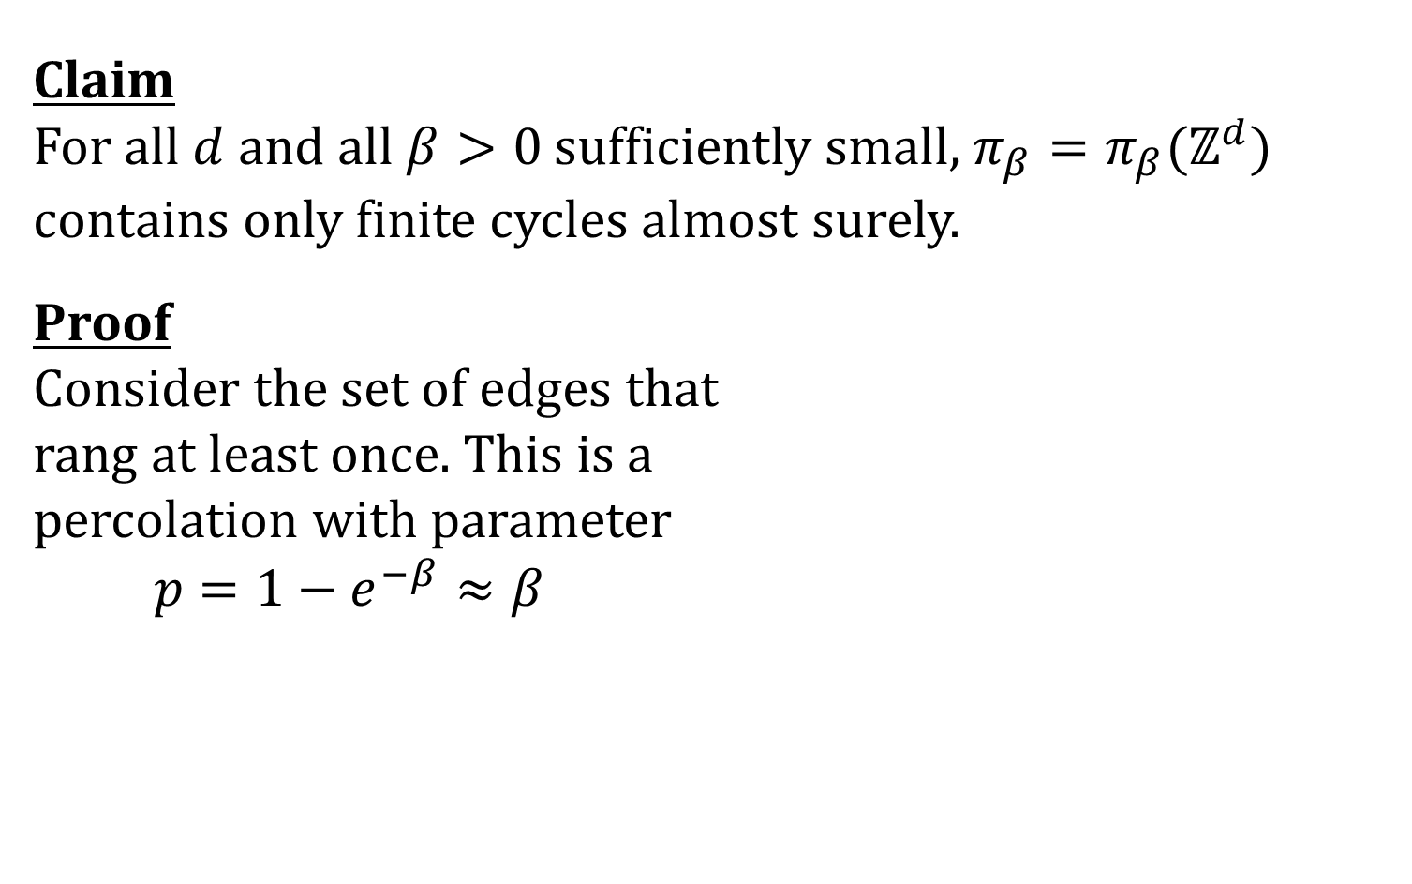
Finite cycles
Claim
For all and all sufficiently small, contains only finite cycles almost surely.
Proof
Consider the set of edges that
rang at least once. This is a
percolation with parameter

Slide 40
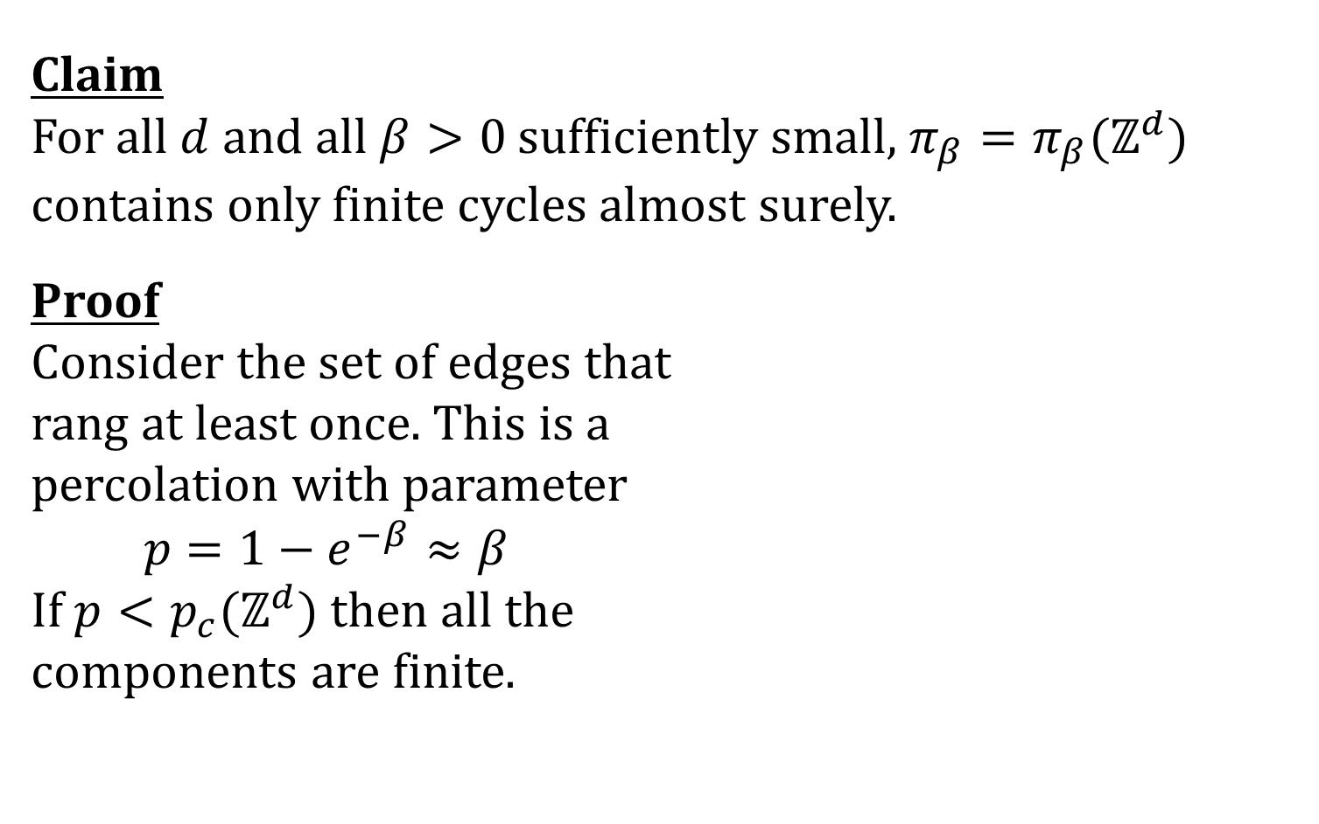
Finite cycles
Claim
For all and all sufficiently small, contains only finite cycles almost surely.
Proof
Consider the set of edges that
rang at least once. This is a
percolation with parameter
If then all the
components are finite.

Slide 41
Finite cycles
Claim
For all and all sufficiently small, contains only finite cycles almost surely.
Proof
Consider the set of edges that
rang at least once. This is a
percolation with parameter
If then all the
components are finite.

Slide 42
Random walk

Slide 43
The cyclic random walk
Consider only the trajectory of the blue particle

Slide 44
The cyclic random walk
Consider only the trajectory of the blue particle

Slide 45
The cyclic random walk
Consider only the trajectory of the blue particle

Slide 46
The cyclic random walk
Consider only the trajectory of the blue particle

Slide 47
The cyclic random walk
Consider only the trajectory of the blue particle

Slide 48
The cyclic random walk
Consider only the trajectory of the blue particle

Slide 49
The cyclic random walk
Consider only the trajectory of the blue particle

Slide 50
The cyclic random walk
Consider only the trajectory of the blue particle

Slide 51
The cyclic random walk
Consider only the trajectory of the blue particle

Slide 52
The cyclic random walk
Consider only the trajectory of the blue particle

Slide 53
The cyclic random walk
Consider only the trajectory of the blue particle

Slide 54
The cyclic random walk
Consider only the trajectory of the blue particle

Slide 55
The cyclic random walk
Consider only the trajectory of the blue particle

Slide 56
The cyclic random walk

Slide 57
The cyclic random walk

Slide 58
The cyclic random walk

Slide 59
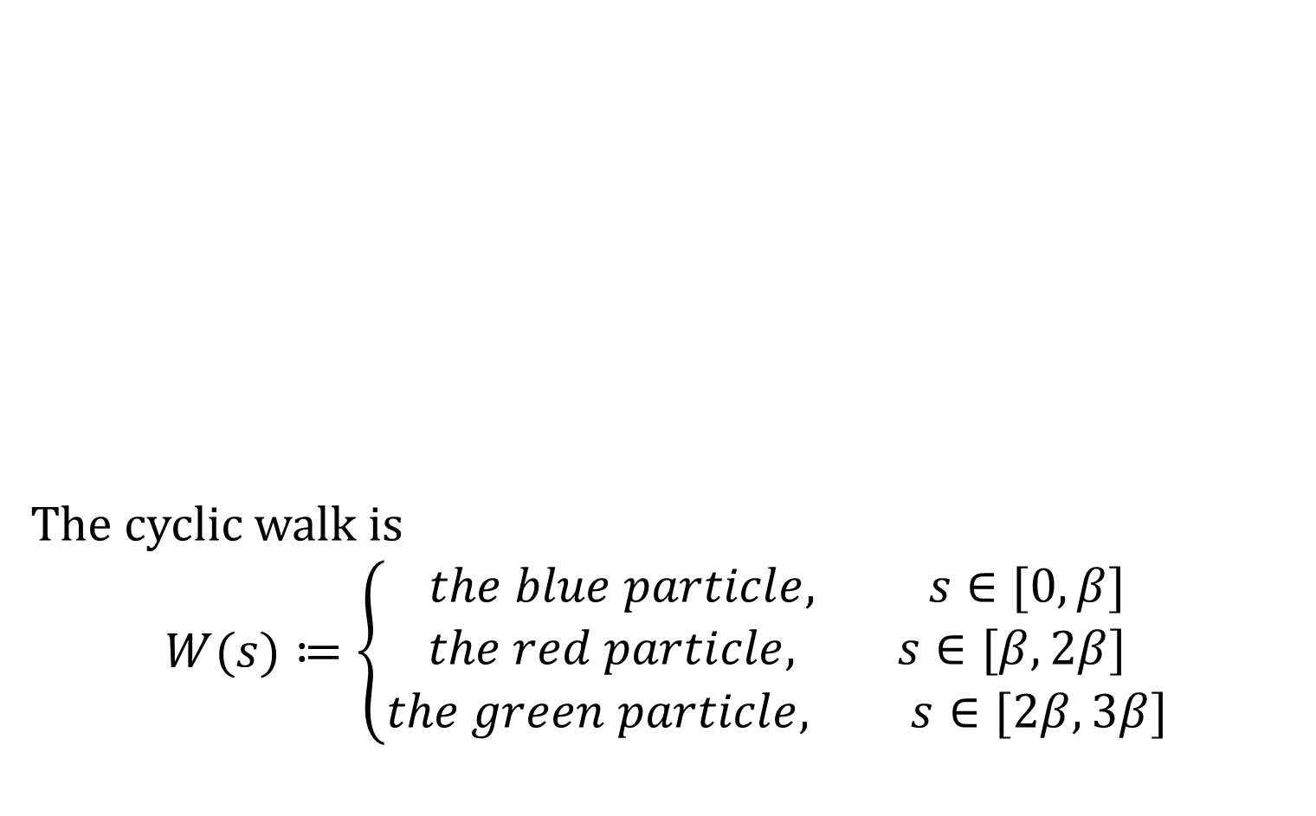
The cyclic random walk
The cyclic walk is

Slide 60
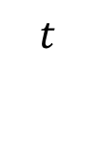
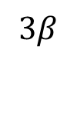
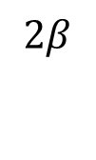
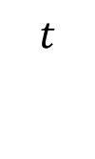
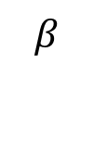
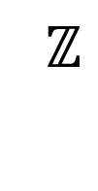
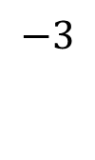
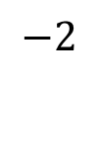
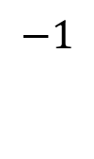




The cyclic random walk

Slide 61
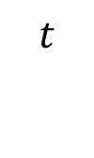
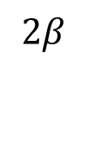
The cyclic random walk

Slide 62
The cyclic random walk

Slide 63
The cyclic random walk

Slide 64
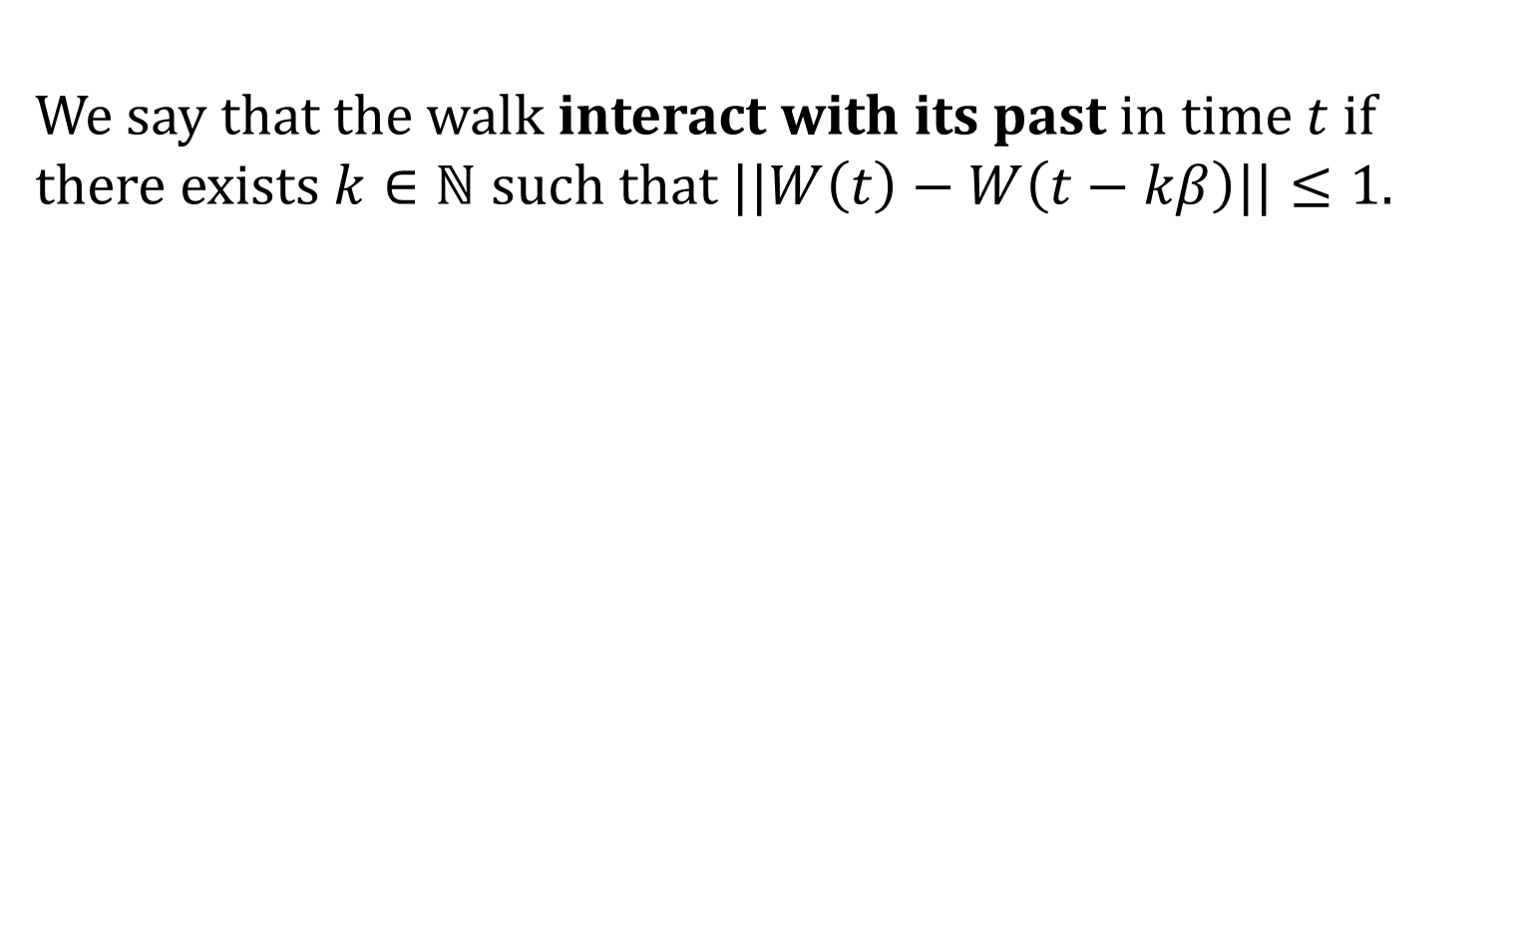
The cyclic random walk
We say that the walk interact with its past in time if there exists such that .

Slide 65
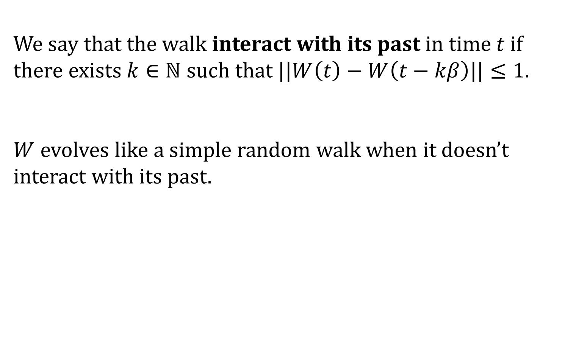
The cyclic random walk
We say that the walk interact with its past in time if there exists such that .
evolves like a simple random walk when it doesn’t interact with its past.

Slide 66
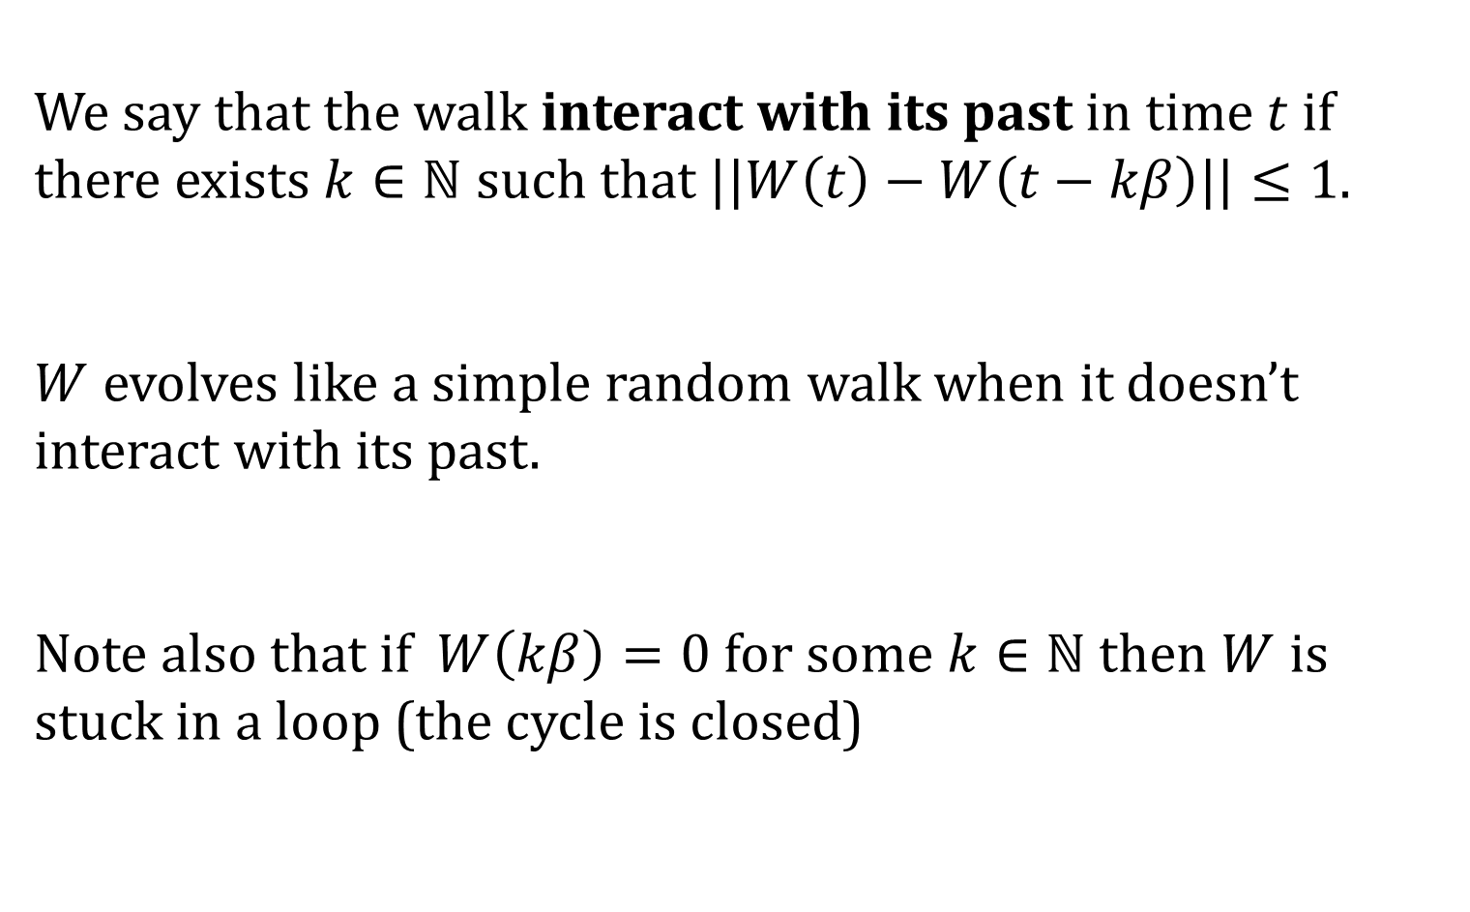
The cyclic random walk
We say that the walk interact with its past in time if there exists such that .
evolves like a simple random walk when it doesn’t interact with its past.
Note also that if for some then is stuck in a loop (the cycle is closed)

Slide 67
Proof ideas

Slide 68
Proof ideas
The cyclic walk behaves like a random walk
The cyclic walk does not intersect its past often

Slide 69
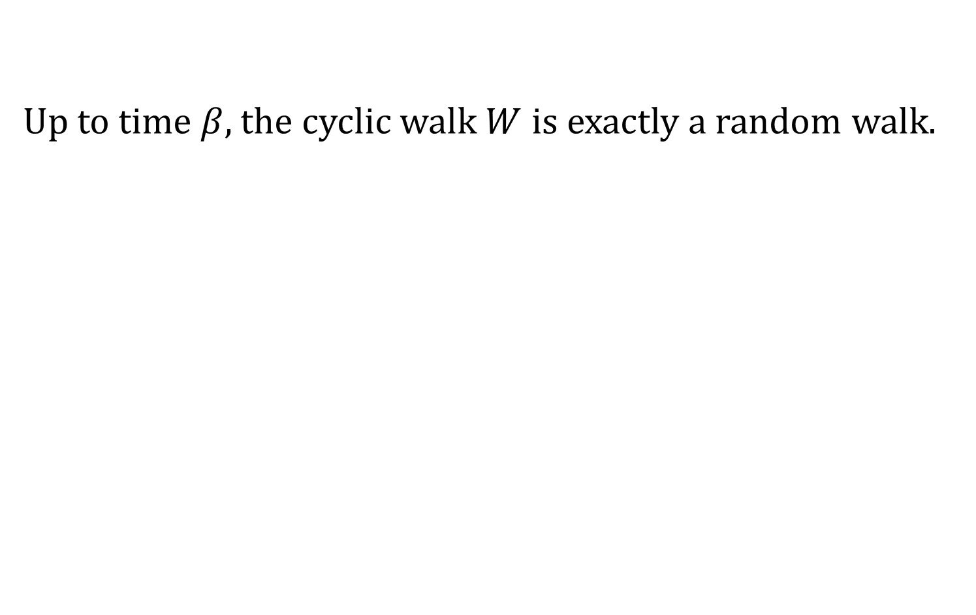
Proof ideas – Induction
Up to time , the cyclic walk is exactly a random walk.

Slide 70
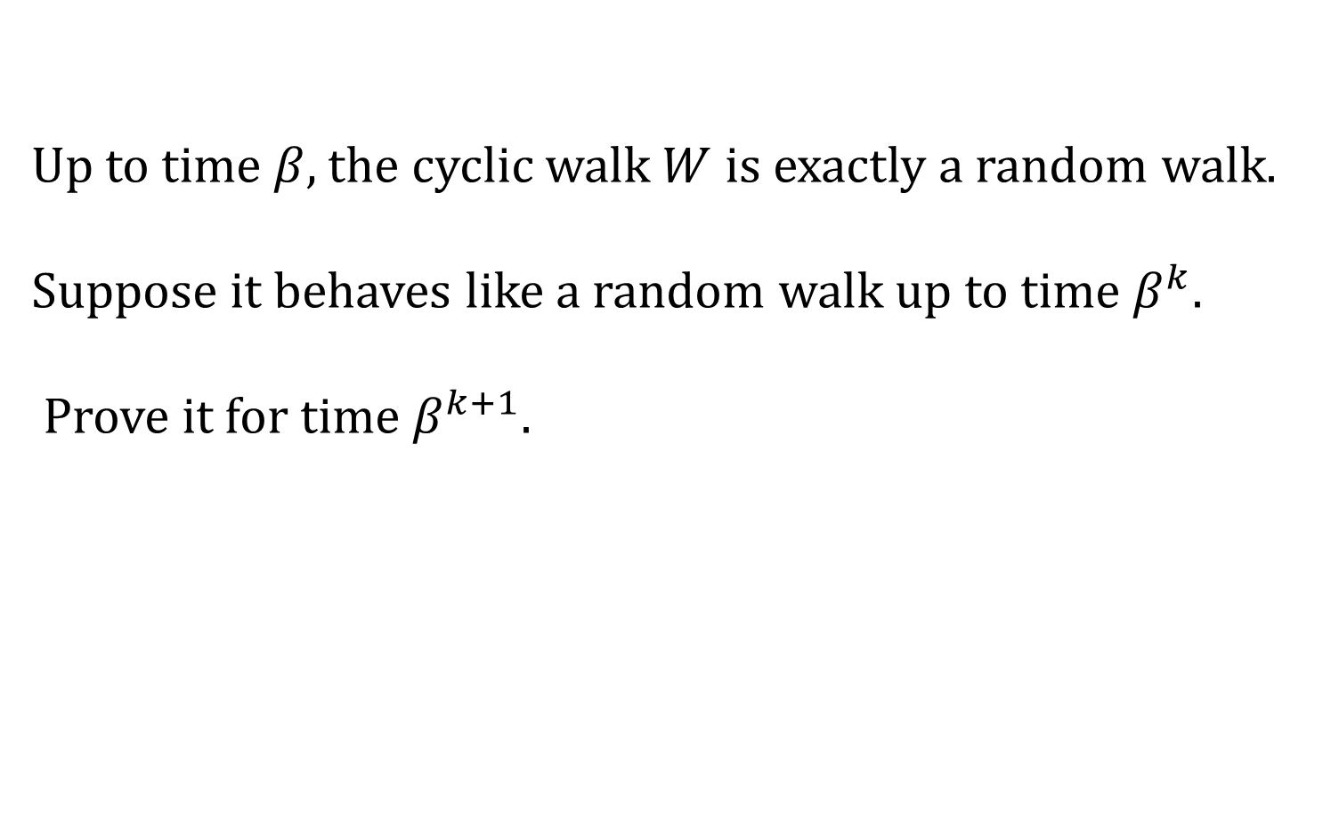
Proof ideas – Induction
Up to time , the cyclic walk is exactly a random walk.
Suppose it behaves like a random walk up to time .
Prove it for time .

Slide 71
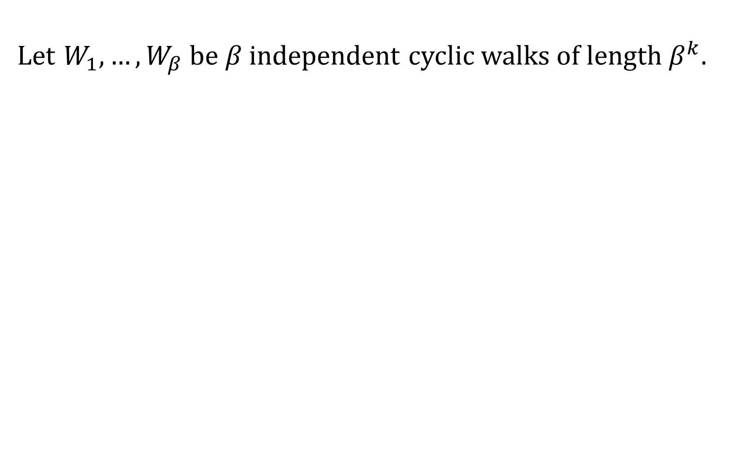




Proof ideas – Concatenation
Let be independent cyclic walks of length .
$W_{1}$
$W_{2}$
$W_{3}$
$……$

Slide 72
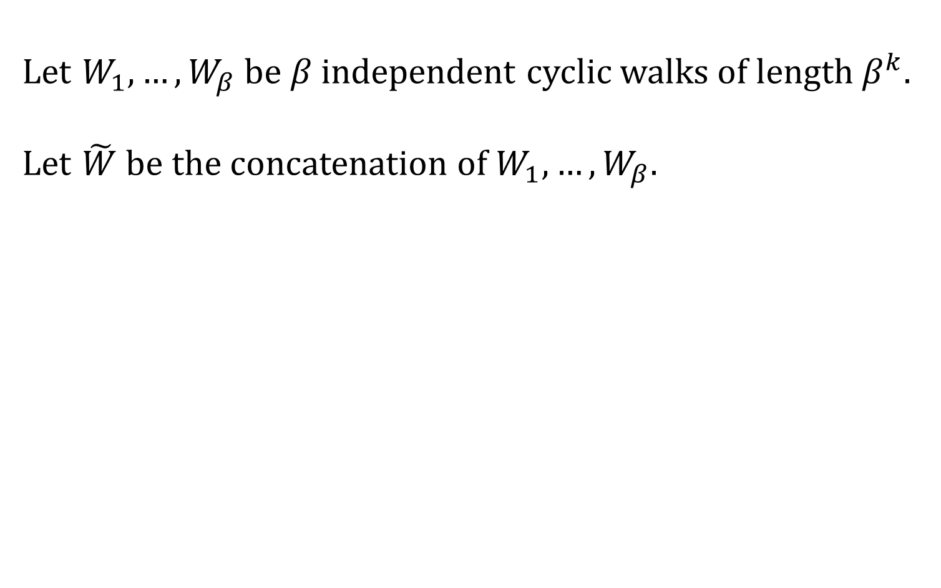
Proof ideas – Concatenation
Let be independent cyclic walks of length .
Let be the concatenation of .
$W_{1}$
$W_{2}$
$W_{3}$
$……$

Slide 73
Proof ideas – Concatenation
Let be independent cyclic walks of length .
Let be the concatenation of .

Slide 74
Proof ideas – Concatenation
Let be independent cyclic walks of length .
Let be the concatenation of .

Slide 75
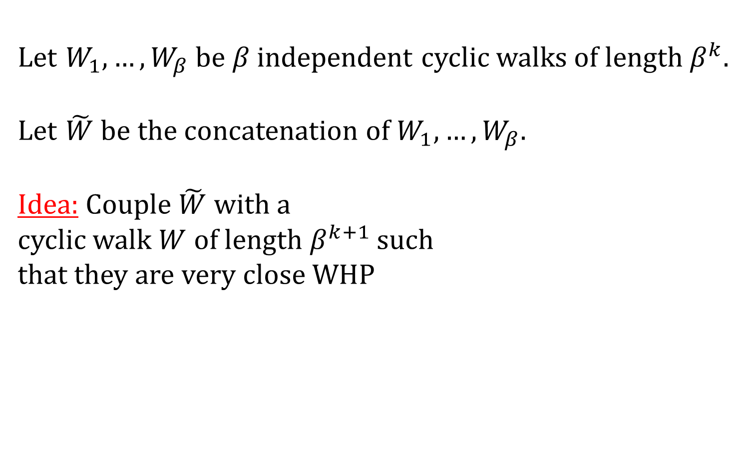
Proof ideas – Concatenation
Let be independent cyclic walks of length .
Let be the concatenation of .
Idea: Couple with a
cyclic walk of length such
that they are very close WHP

Slide 76
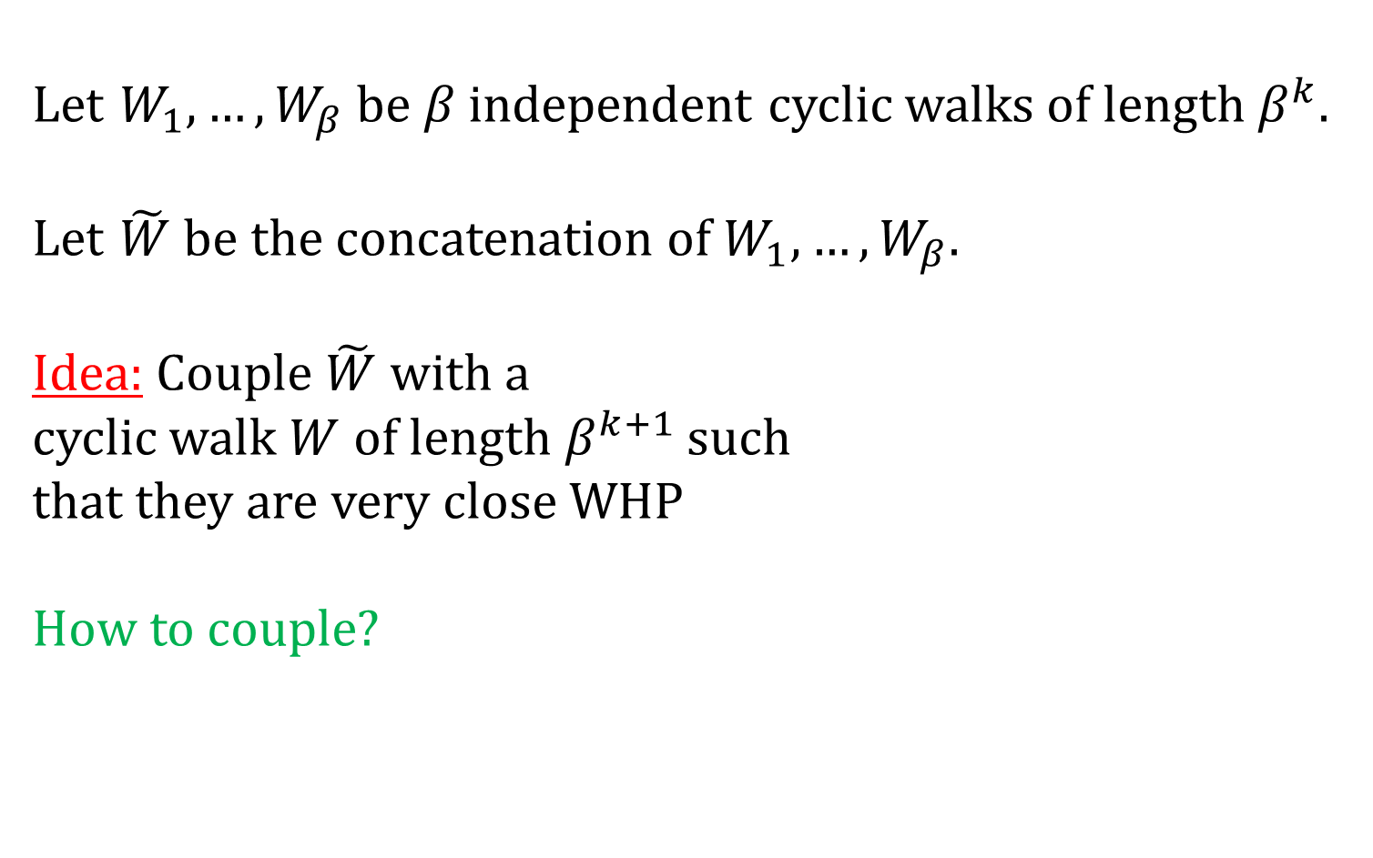
Proof ideas – Concatenation
Let be independent cyclic walks of length .
Let be the concatenation of .
Idea: Couple with a
cyclic walk of length such
that they are very close WHP
How to couple?

Slide 77
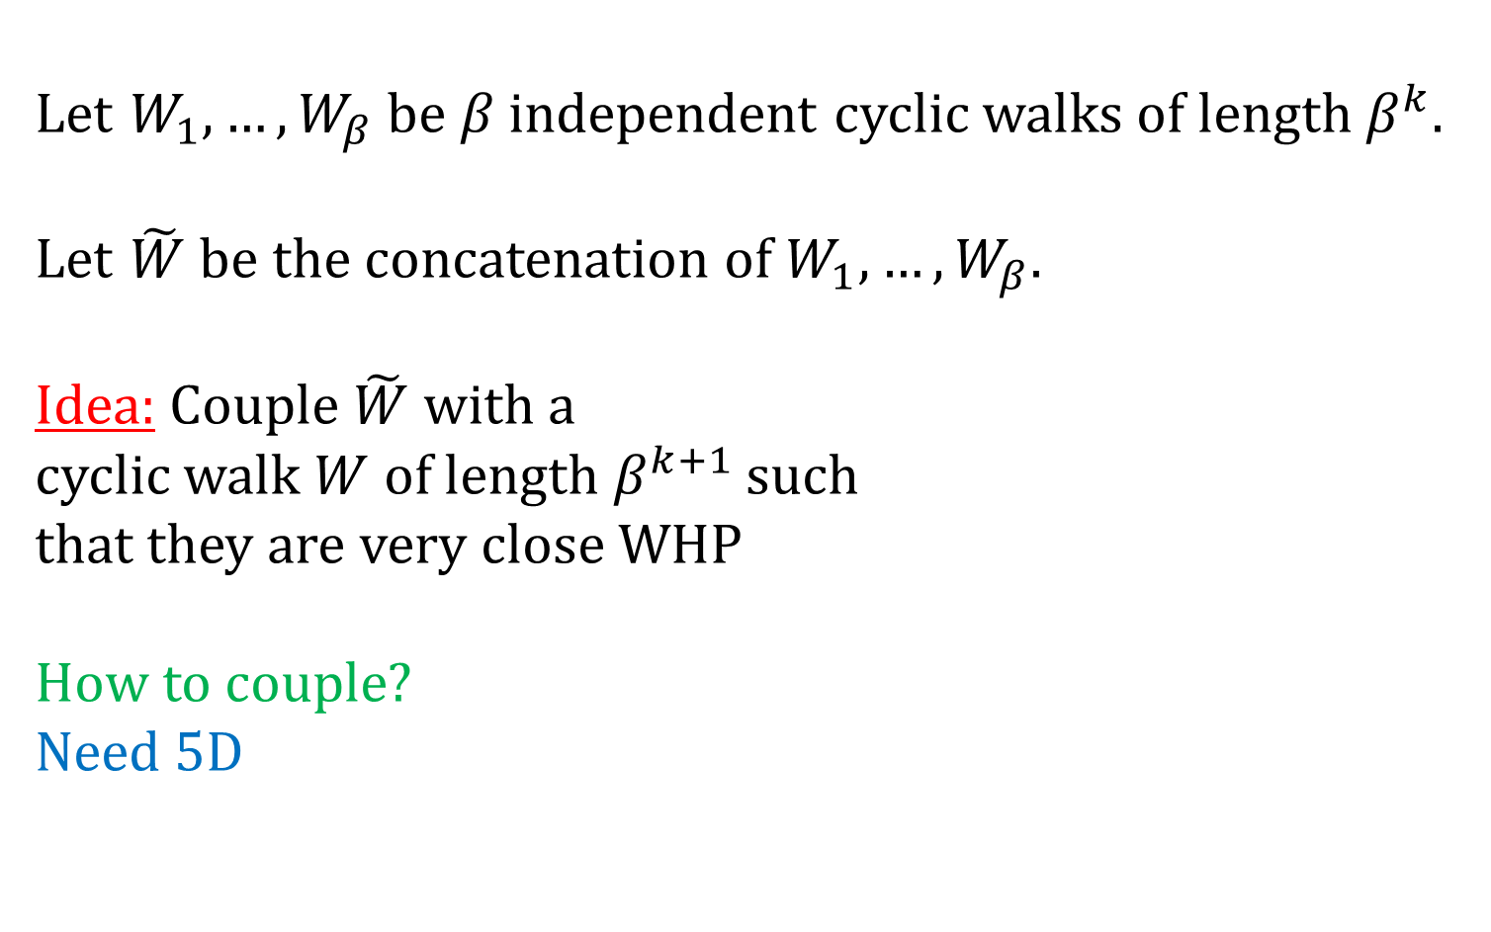
Proof ideas – Concatenation
Let be independent cyclic walks of length .
Let be the concatenation of .
Idea: Couple with a
cyclic walk of length such
that they are very close WHP
How to couple?
Need 5D

Slide 78
The escape algorithm

Slide 79
The escape algorithm
We have to be able to deal with local catastrophes:

Slide 80
The escape algorithm
We have to be able to deal with local catastrophes:

Slide 81
The escape algorithm
We have to be able to deal with local catastrophes:

Slide 82
The escape algorithm
We have to be able to deal with local catastrophes:

Slide 83
The escape algorithm
We have to be able to deal with local catastrophes:

Slide 84
The escape algorithm
We have to be able to deal with local catastrophes:

Slide 85
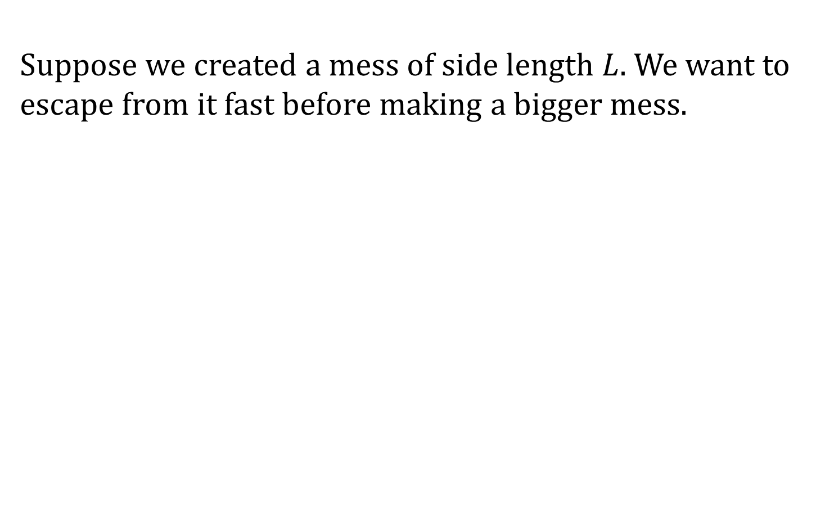

The escape algorithm
Suppose we created a mess of side length . We want to escape from it fast before making a bigger mess.
$L$

Slide 86
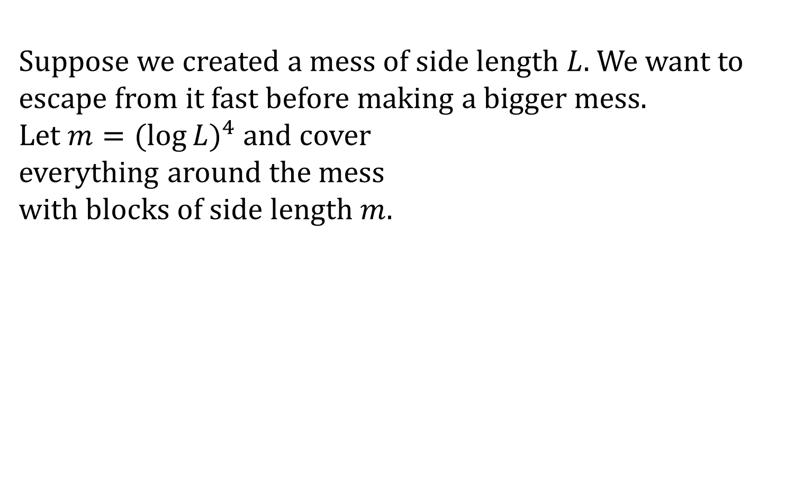
The escape algorithm
Suppose we created a mess of side length . We want to escape from it fast before making a bigger mess.
Let and cover
everything around the mess
with blocks of side length .
$L$

Slide 87
The escape algorithm
Suppose we created a mess of side length . We want to escape from it fast before making a bigger mess.
Let and cover
everything around the mess
with blocks of side length .
$L$

Slide 88
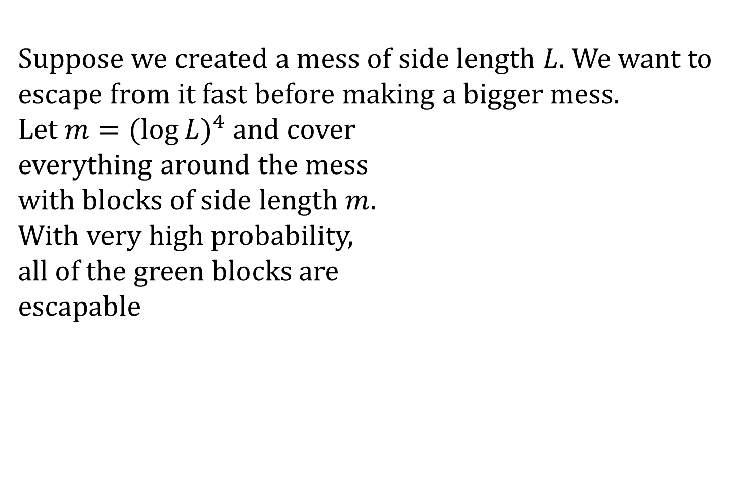
The escape algorithm
Suppose we created a mess of side length . We want to escape from it fast before making a bigger mess.
Let and cover
everything around the mess
with blocks of side length .
With very high probability,
all of the green blocks are
escapable
$L$

Slide 89

The escape algorithm
Suppose we created a mess of side length . We want to escape from it fast before making a bigger mess.
Let and cover
everything around the mess
with blocks of side length .
With very high probability,
all of the green blocks are
escapable
$B$
$L$

Slide 90
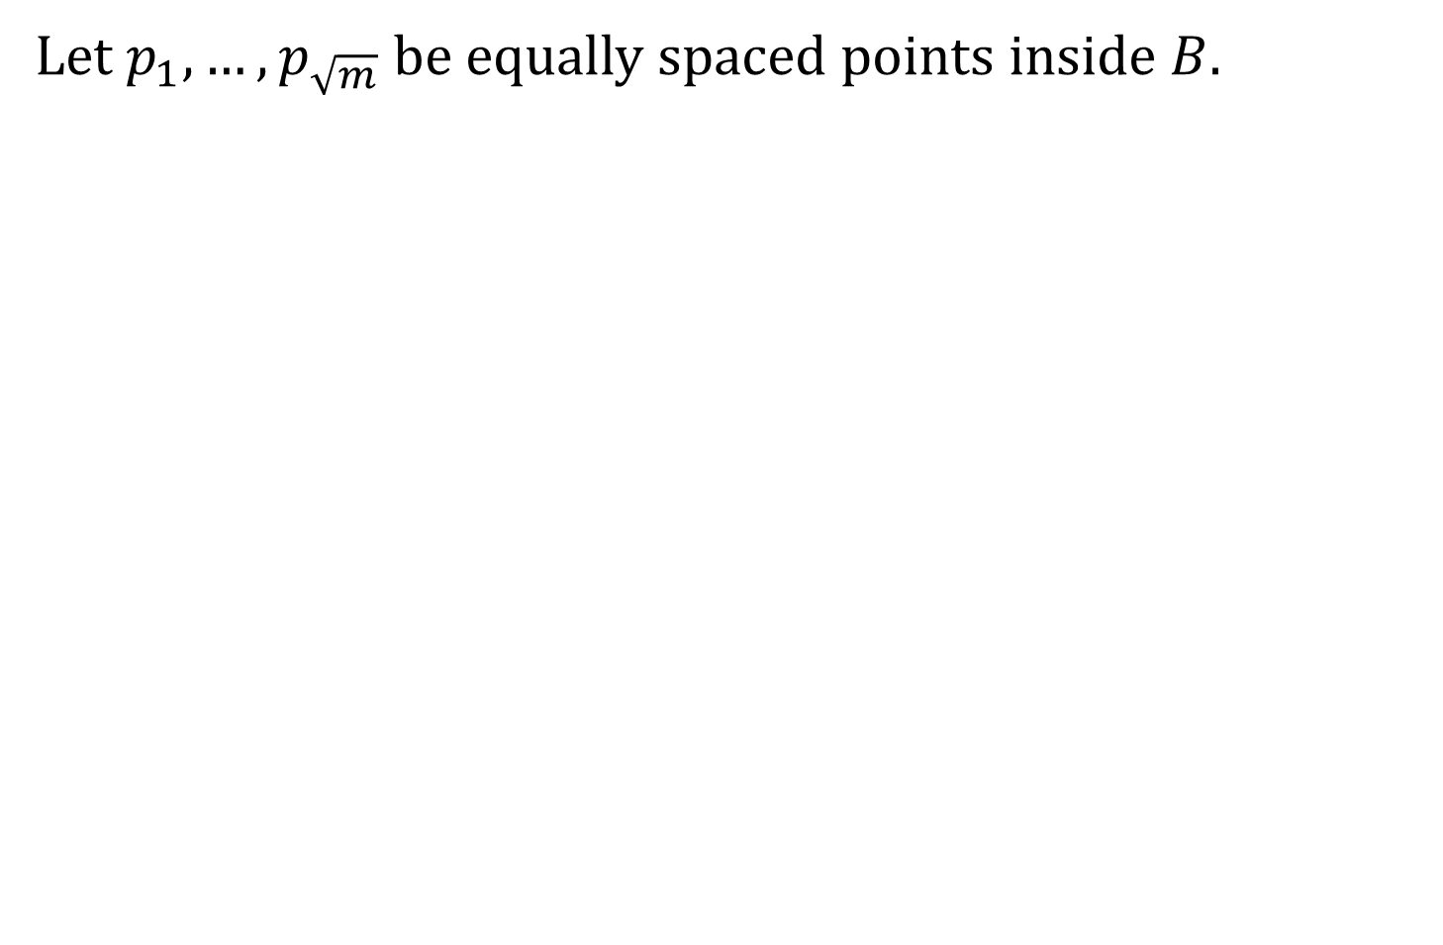
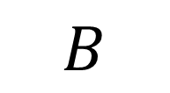

The escape algorithm
Let be equally spaced points inside .
$B$
$m$

Slide 91
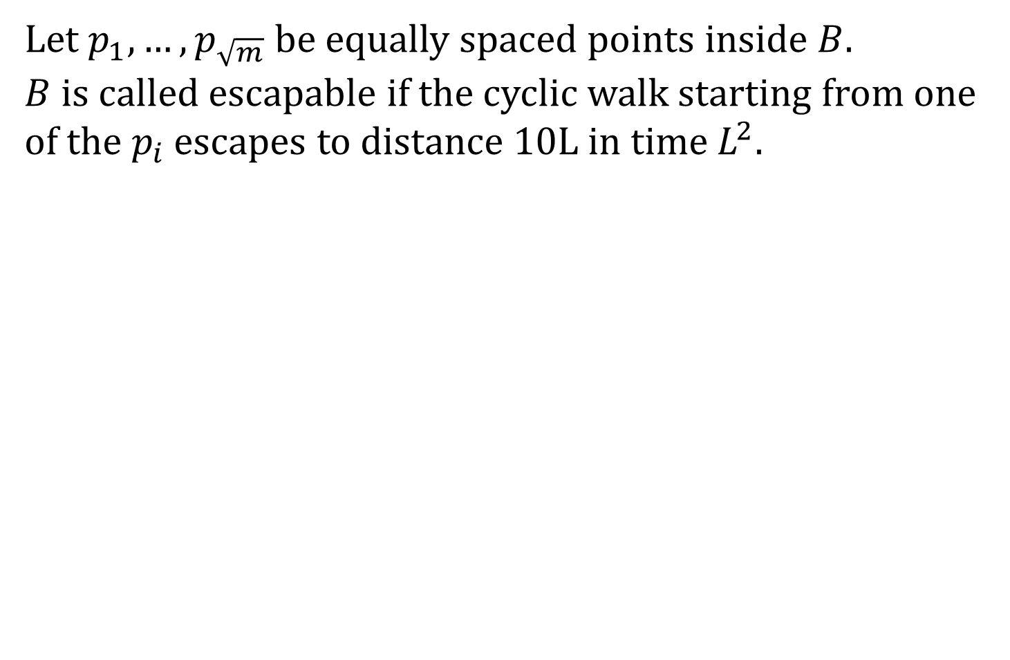
The escape algorithm
Let be equally spaced points inside .
is called escapable if the cyclic walk starting from one of the escapes to distance 10L in time .
$B$
$m$

Slide 92
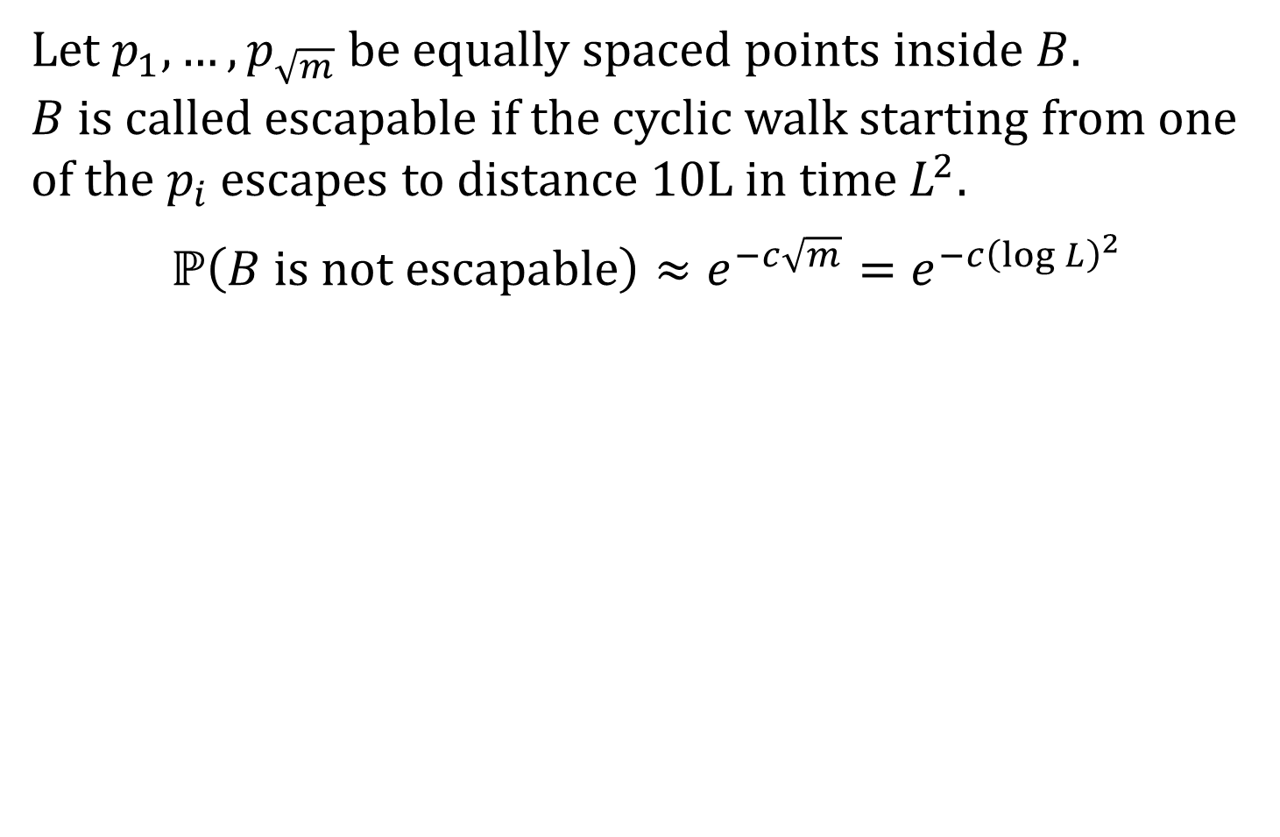
The escape algorithm
Let be equally spaced points inside .
is called escapable if the cyclic walk starting from one of the escapes to distance 10L in time .
$m$

Slide 93
The escape algorithm
Let be equally spaced points inside .
is called escapable if the cyclic walk starting from one of the escapes to distance 10L in time .
$m$

Slide 94
The escape algorithm
Let be equally spaced points inside .
is called escapable if the cyclic walk starting from one of the escapes to distance 10L in time .
$m$

Slide 95
The escape algorithm
Let be equally spaced points inside .
is called escapable if the cyclic walk starting from one of the escapes to distance 10L in time .
$m$

Slide 96
The escape algorithm
Let be equally spaced points inside .
is called escapable if the cyclic walk starting from one of the escapes to distance 10L in time .
$m$

Slide 97
The escape algorithm
Let be equally spaced points inside .
is called escapable if the cyclic walk starting from one of the escapes to distance 10L in time .
$m$

Slide 98
The escape algorithm
Let be equally spaced points inside .
is called escapable if the cyclic walk starting from one of the escapes to distance 10L in time .
$m$

Slide 99
The escape algorithm
Let be equally spaced points inside .
is called escapable if the cyclic walk starting from one of the escapes to distance 10L in time .
$m$

Slide 100
The escape algorithm
Once we enter a new green block
$L$

Slide 101
The escape algorithm
Once we enter a new green block, we know that at least one blue path escapes from it
$L$

Slide 102
The escape algorithm
$m$

Slide 103
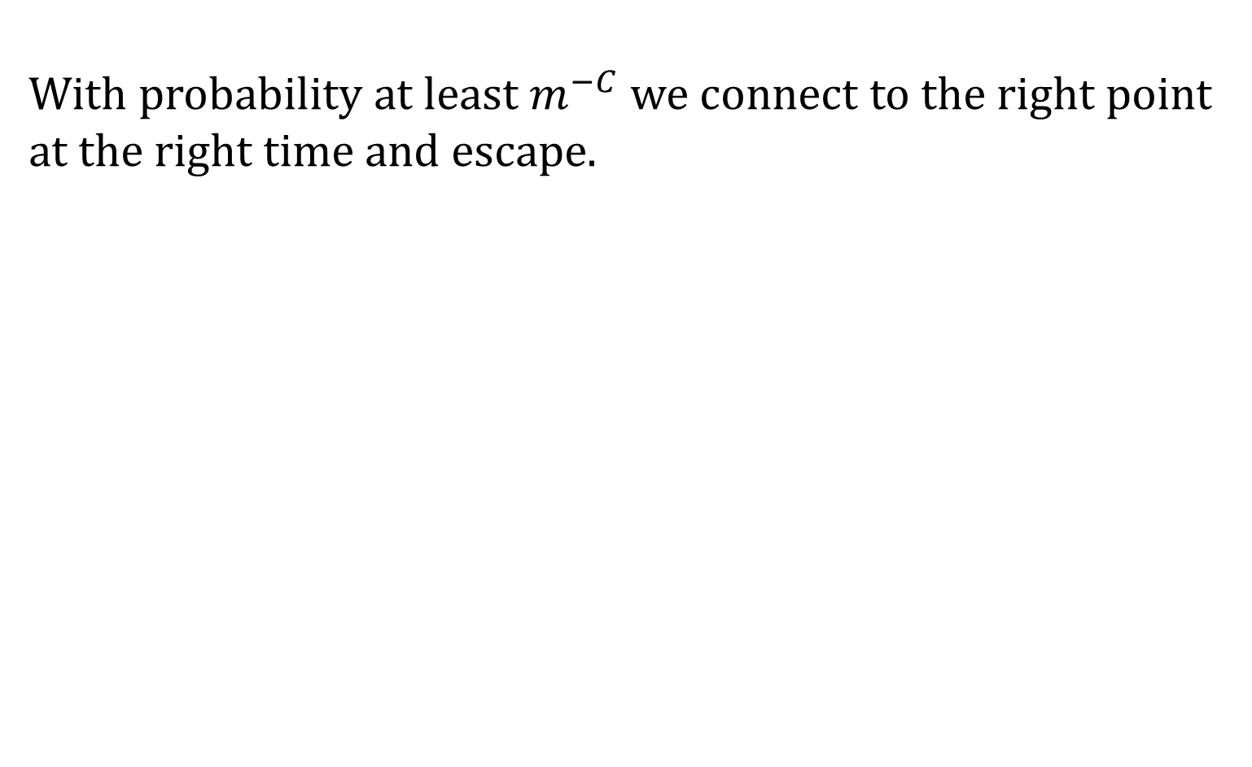
The escape algorithm
With probability at least we connect to the right point at the right time and escape.
$m$

Slide 104
The escape algorithm
Once we enter a new green block, we know that at least one blue path escapes from it
$L$

Slide 105
The escape algorithm
$L$

Slide 106
The escape algorithm
If we did not connect to the right point
$L$

Slide 107
The escape algorithm
If we did not connect to the right point, try again with a different green block.
$L$

Slide 108
The escape algorithm
If we did not connect to the right point, try again with a different green block.
$L$

Slide 109
The escape algorithm
If we did not connect to the right point, try again with a different green block.
$L$

Slide 110
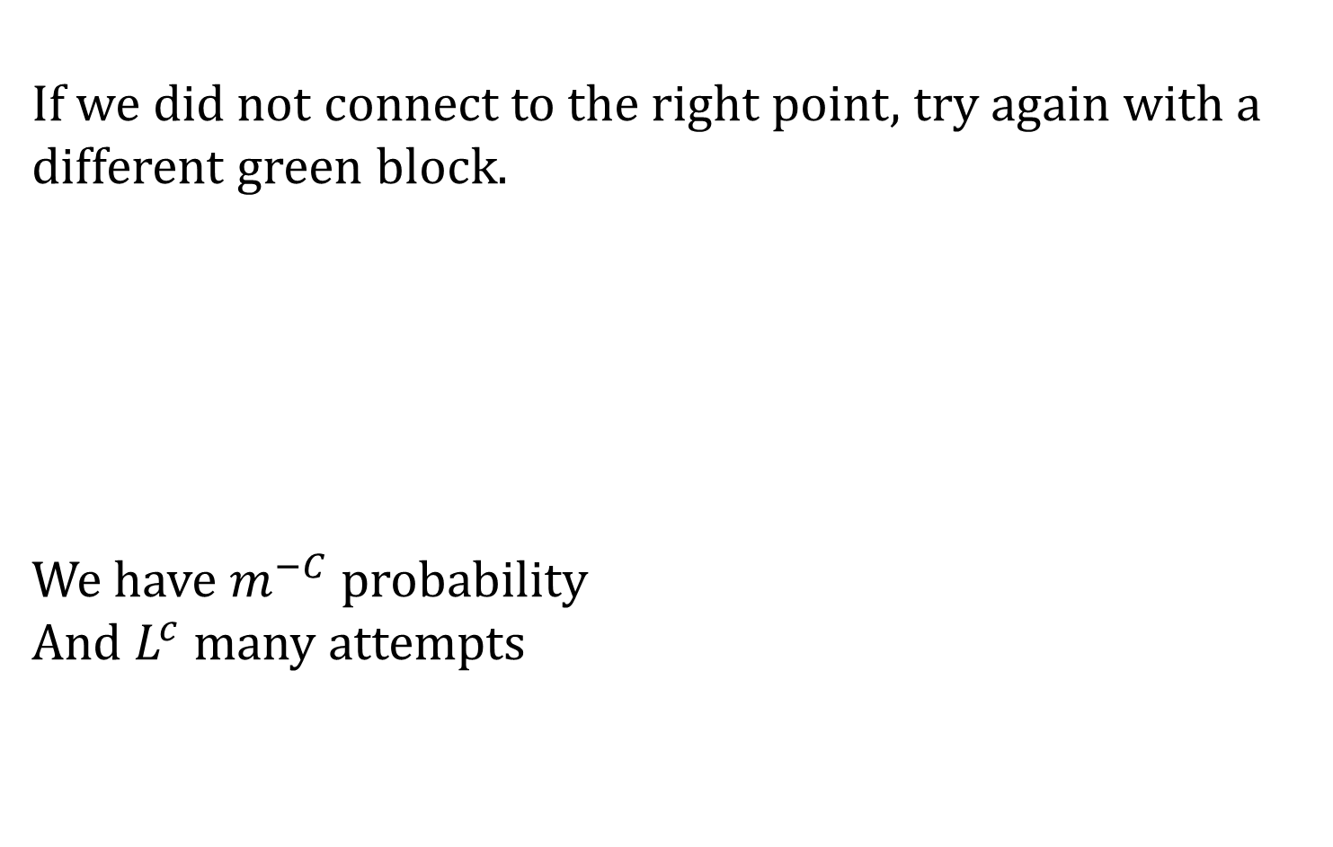
The escape algorithm
If we did not connect to the right point, try again with a different green block.
We have probability
And many attempts
$L$

Slide 111
Collect all the ideas to a multiscale proof

Slide 112
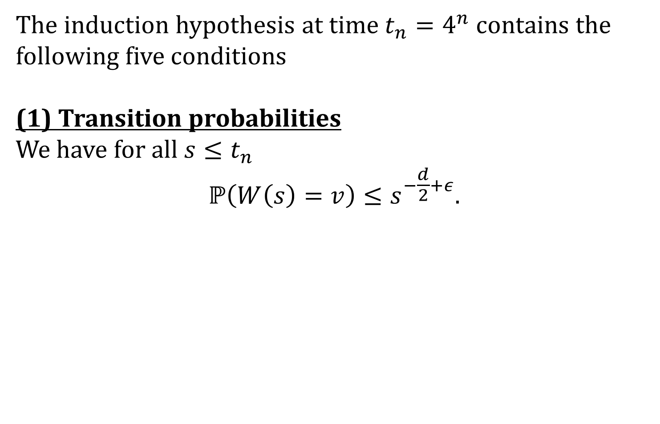
Induction hypothesis – Global properties
The induction hypothesis at time contains the following five conditions
(1) Transition probabilities
We have for all

Slide 113
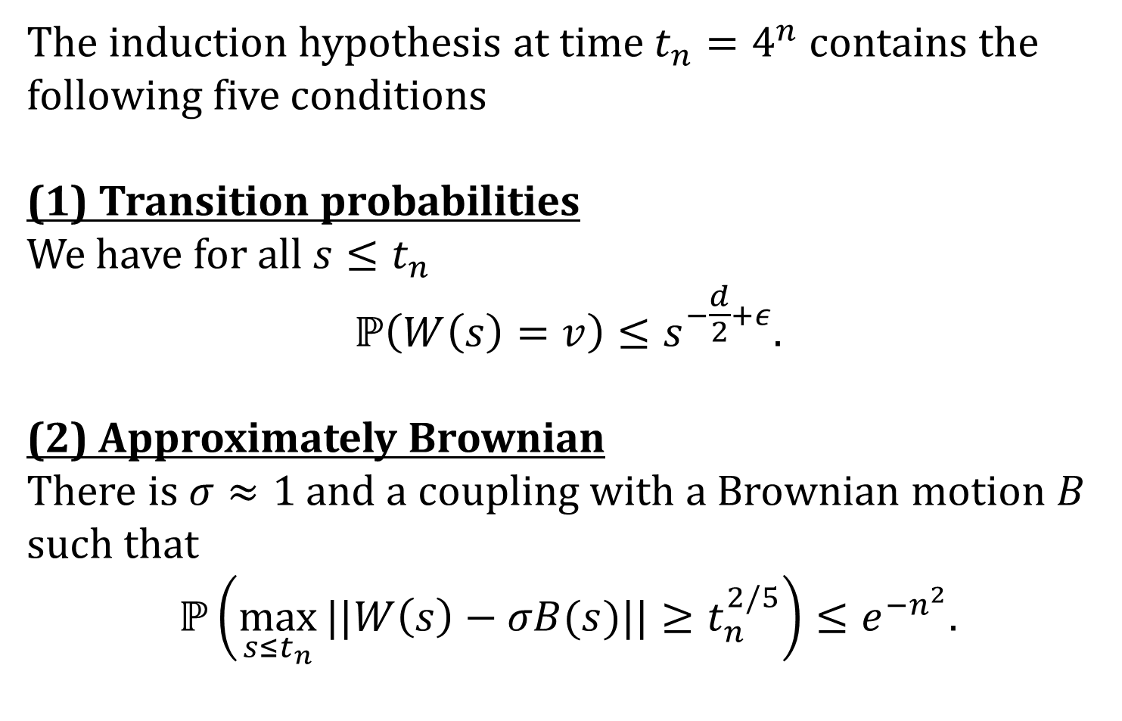
Induction hypothesis – Global properties
The induction hypothesis at time contains the following five conditions
(1) Transition probabilities
We have for all
(2) Approximately Brownian
There is and a coupling with a Brownian motion such that

Slide 114
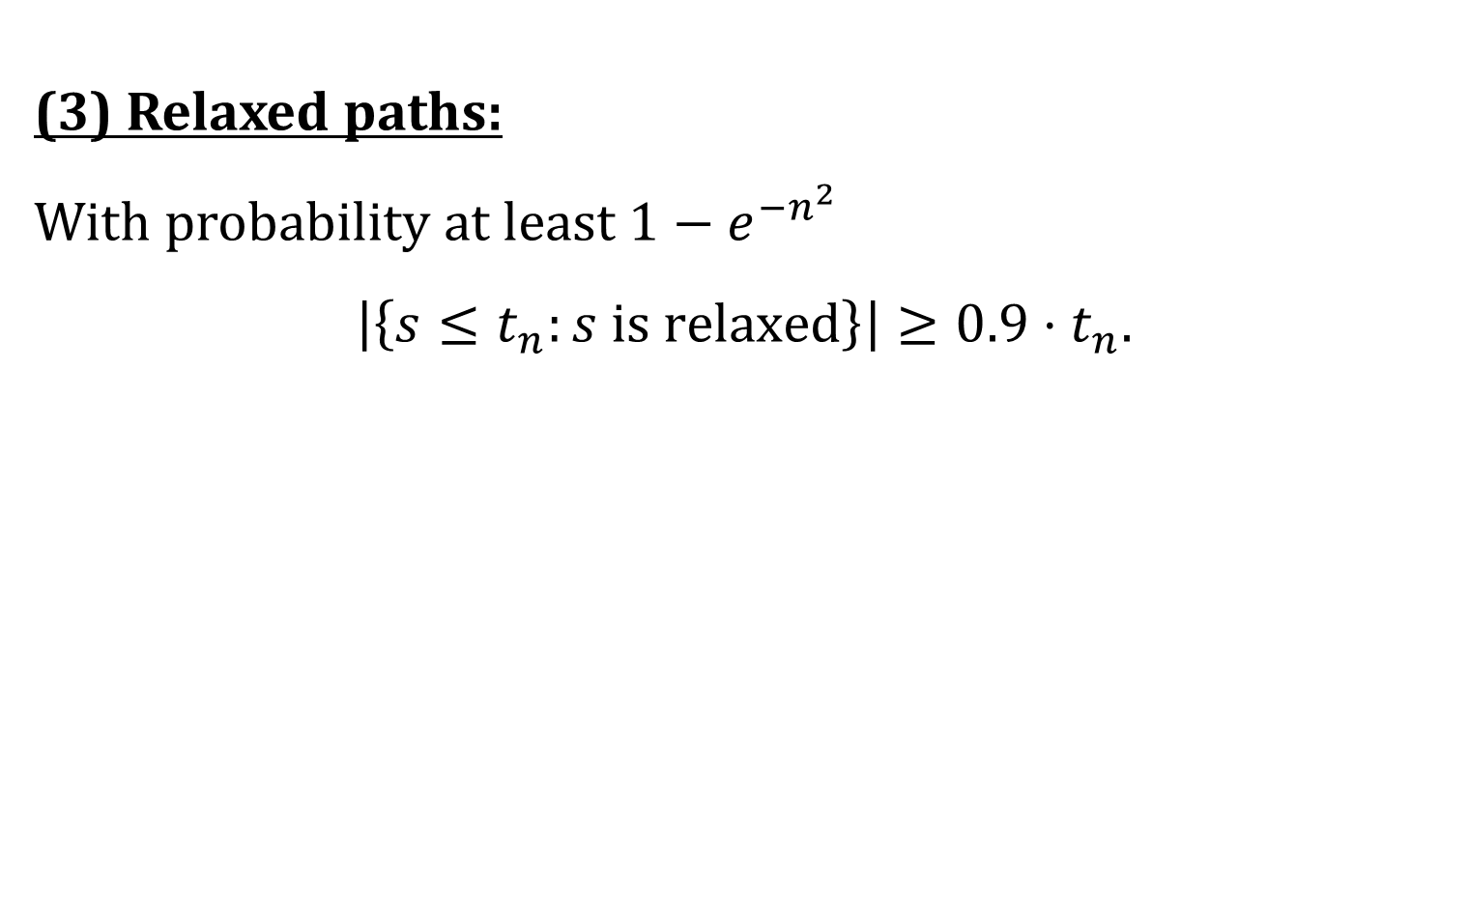
Induction hypothesis – Local properties
(3) Relaxed paths:
With probability at least

Slide 115
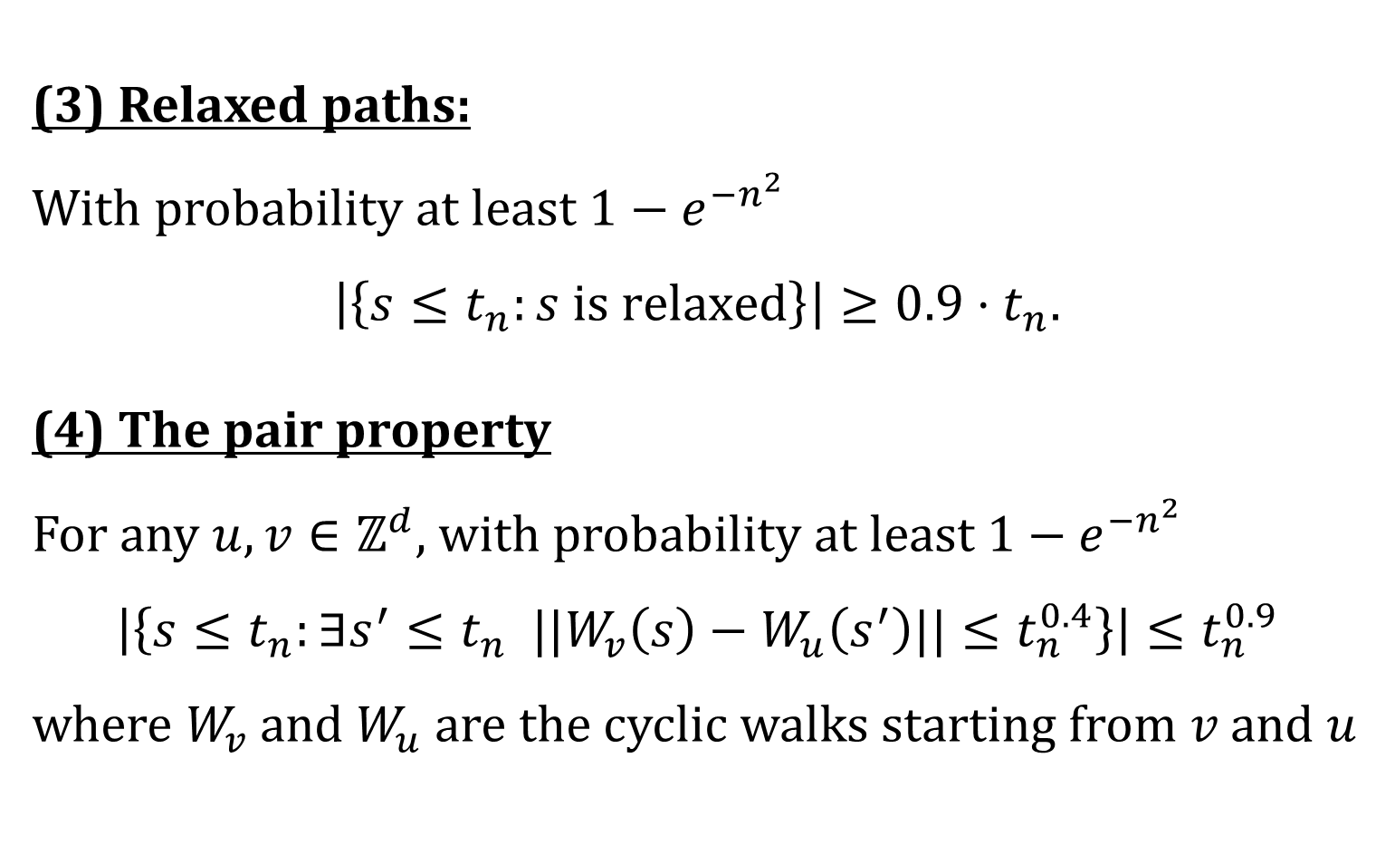
Induction hypothesis – Local properties
(3) Relaxed paths:
With probability at least
(4) The pair property
For any , with probability at least
where and are the cyclic walks starting from and

Slide 116
The multiscale improvement

Slide 117
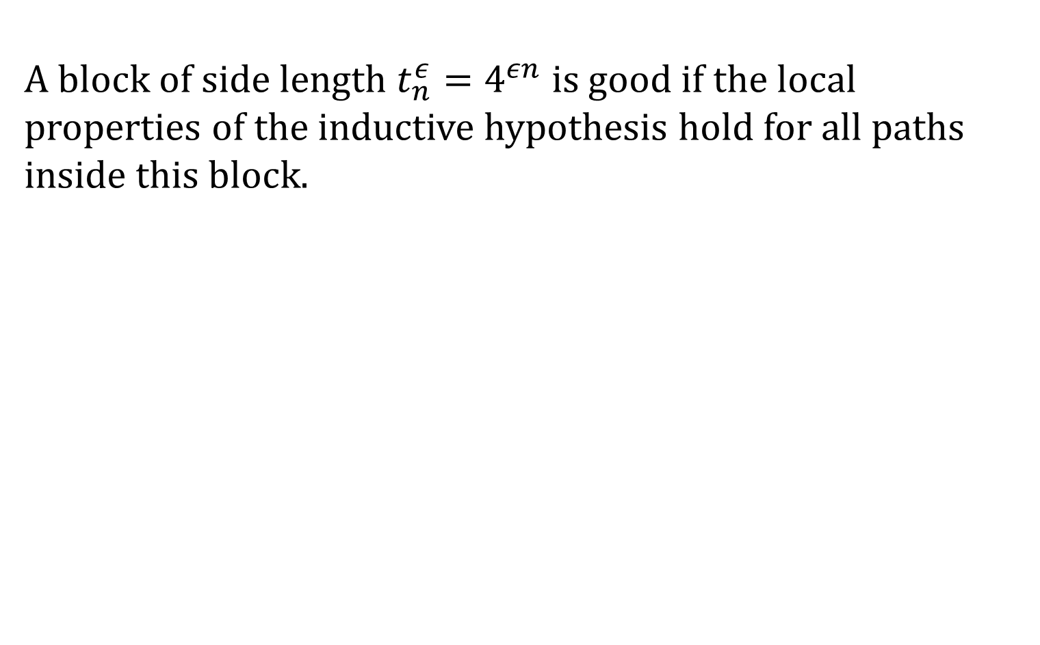
The multiscale improvement
A block of side length is good if the local properties of the inductive hypothesis hold for all paths inside this block.

Slide 118
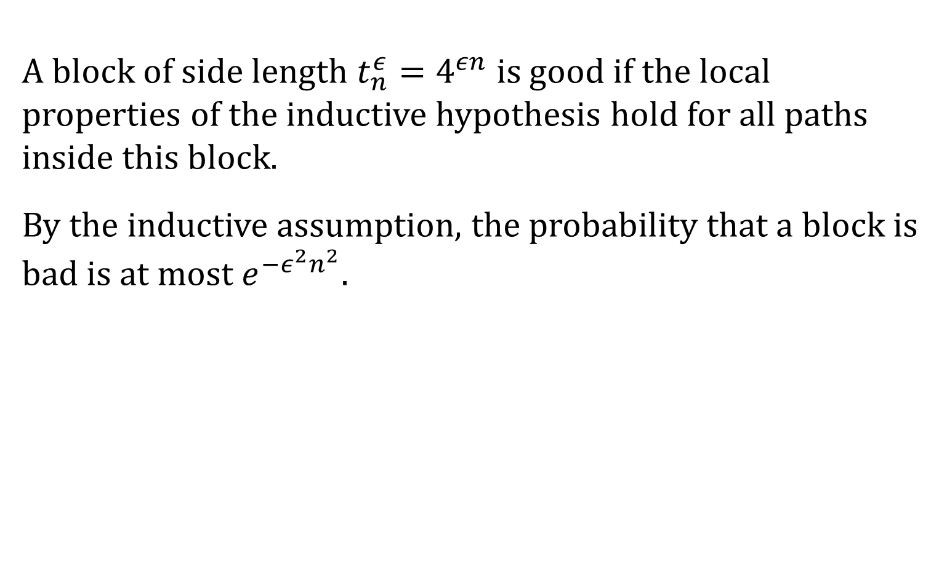
The multiscale improvement
A block of side length is good if the local properties of the inductive hypothesis hold for all paths inside this block.
By the inductive assumption, the probability that a block is bad is at most .

Slide 119
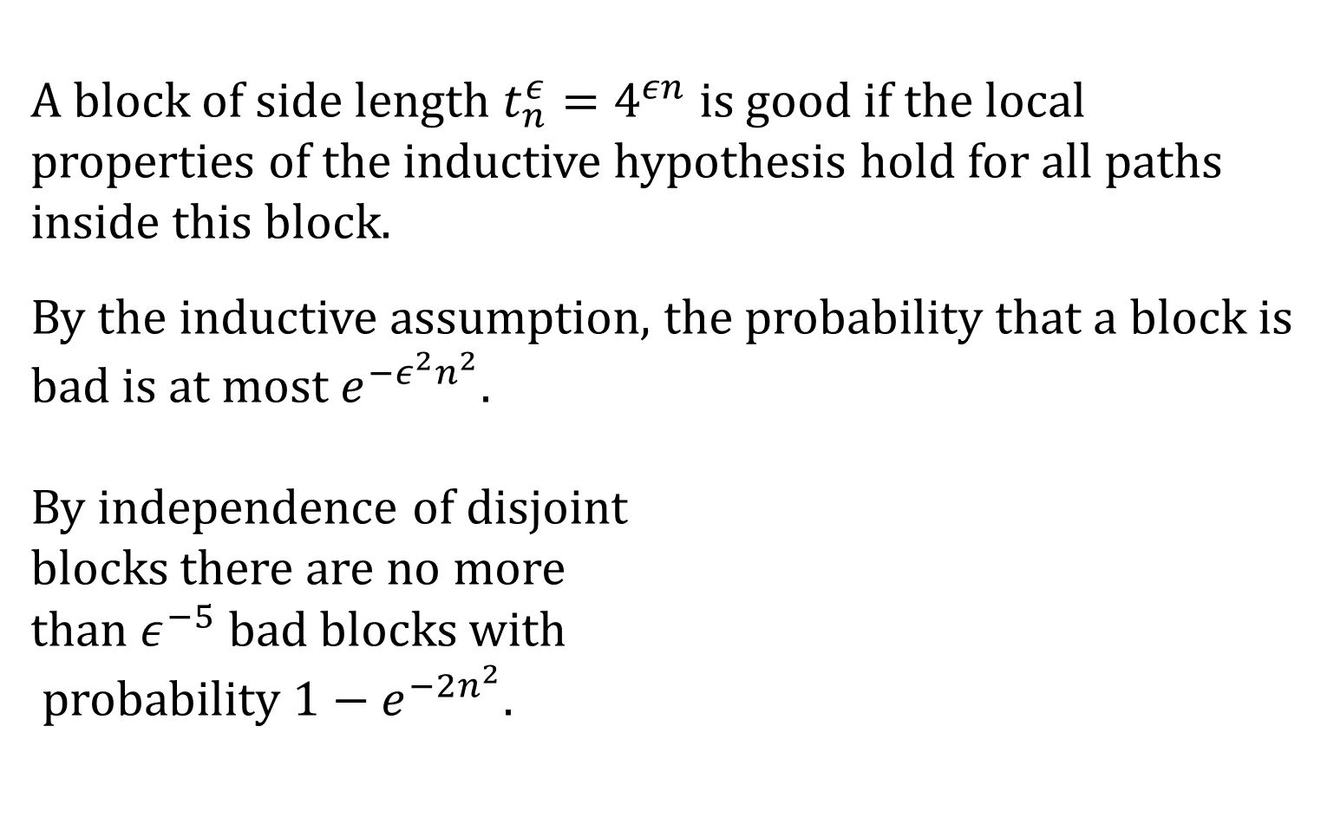
The multiscale improvement
A block of side length is good if the local properties of the inductive hypothesis hold for all paths inside this block.
By the inductive assumption, the probability that a block is bad is at most .
By independence of disjoint
blocks there are no more
than bad blocks with
probability .

Slide 120

The key estimates
Lemma 1 (heavy blocks)
With probability at least , all blocks of side length are not heavy
Lemma 2 (relaxed times)
With probability at least for all there exists a relaxed time .

Slide 121


The key estimate – Heavy blocks
Proof. Let be a block of side length .
$B$

Slide 122

The key estimate – Heavy blocks
Proof. Let be a block of side length .
By the escape algorithm, every time we enter a new blue block of side length in , we have an chance of escaping in time and never returning.
$B$

Slide 123

The key estimate – Heavy blocks
Proof. Let be a block of side length .
By the escape algorithm, every time we enter a new blue block of side length in , we have an chance of escaping in time and never returning.
If the escape didn’t work, try
again with a new blue block.
$B$

Slide 124
The key estimate – Heavy blocks
Proof. Let be a block of side length .
By the escape algorithm, every time we enter a new blue block of side length in , we have an chance of escaping in time and never returning.
If the escape didn’t work, try
again with a new blue block.
$B$

Slide 125
The key estimate – Heavy blocks
Proof. Let be a block of side length .
By the escape algorithm, every time we enter a new blue block of side length in , we have an chance of escaping in time and never returning.
If the escape didn’t work, try
again with a new blue block.
$B$

Slide 126
The key estimate – Heavy blocks
Proof. Let be a block of side length .
By the escape algorithm, every time we enter a new blue block of side length in , we have an chance of escaping in time and never returning.
If the escape didn’t work, try
again with a new blue block.
$B$

Slide 127
The key estimate – Heavy blocks
Proof. Let be a block of side length .
By the escape algorithm, every time we enter a new blue block of side length in , we have an chance of escaping in time and never returning.
If the escape didn’t work, try
again with a new blue block.
$B$

Slide 128
The key estimate – Relaxed times

Slide 129

The key estimate – Relaxed times
Proof. Let . We want to quickly reach a time such that for all large , the blocks are not heavy.

Slide 130

The key estimate – Relaxed times
Proof. Let . We want to quickly reach a time such that for all large , the blocks are not heavy.
When the block is not heavy by Lemma 1.

Slide 131


The key estimate – Relaxed times
If we are in a bad block, we first wait at most time to
enter a good block .
$W\left(s\right)$

Slide 132

The key estimate – Relaxed times
If we are in a bad block, we first wait at most time to
enter a good block .
$W\left(s\right)$
$B$

Slide 133



The key estimate – Relaxed times
Since is good, most of the times are relaxed with respect to the blue path.
$B$
$W\left(s′\right)$

Slide 134

The key estimate – Relaxed times
Since is good, most of the times are relaxed with respect to the blue path. But what about the ancient history in ?
$B$
$W\left(s′\right)$

Slide 135

The key estimate – Relaxed times
Since is good, most of the times are relaxed with respect to the blue path. But what about the ancient history in ?
By Lemma 1, there are at most red paths inside the block.
$B$
$W\left(s′\right)$

Slide 136

The key estimate – Relaxed times
Since is good, most of the times are relaxed with respect to the blue path. But what about the ancient history in ?
By Lemma 1, there are at most red paths inside the block. By the pair property, most of the time we are far from all of them.
$B$
$W\left(s′\right)$

Slide 137

The key estimate – Relaxed times
Since is good, most of the times are relaxed with respect to the blue path. But what about the ancient history in ?
By Lemma 1, there are at most red paths inside the block. By the pair property, most of the time we are far from all of them.
Thus, the blocks
are
not heavy when .
$B$
$W\left(s′\right)$

Slide 138
Overview of the proof
The escape algorithm
No large heavy blocks
A multiscale scheme
Many relaxed times
Concatenation
The induction step

Slide 139
Overview of the proof
The escape algorithm
No large heavy blocks
A multiscale scheme
Many relaxed times
Concatenation
Questions?
The induction step

