Slide 1


Noise sensitivity for the top eigenvector
of a sparse random matrix

Slide 2
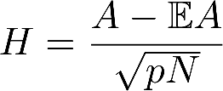

Top eigenvector of sparse random matrices

Slide 3

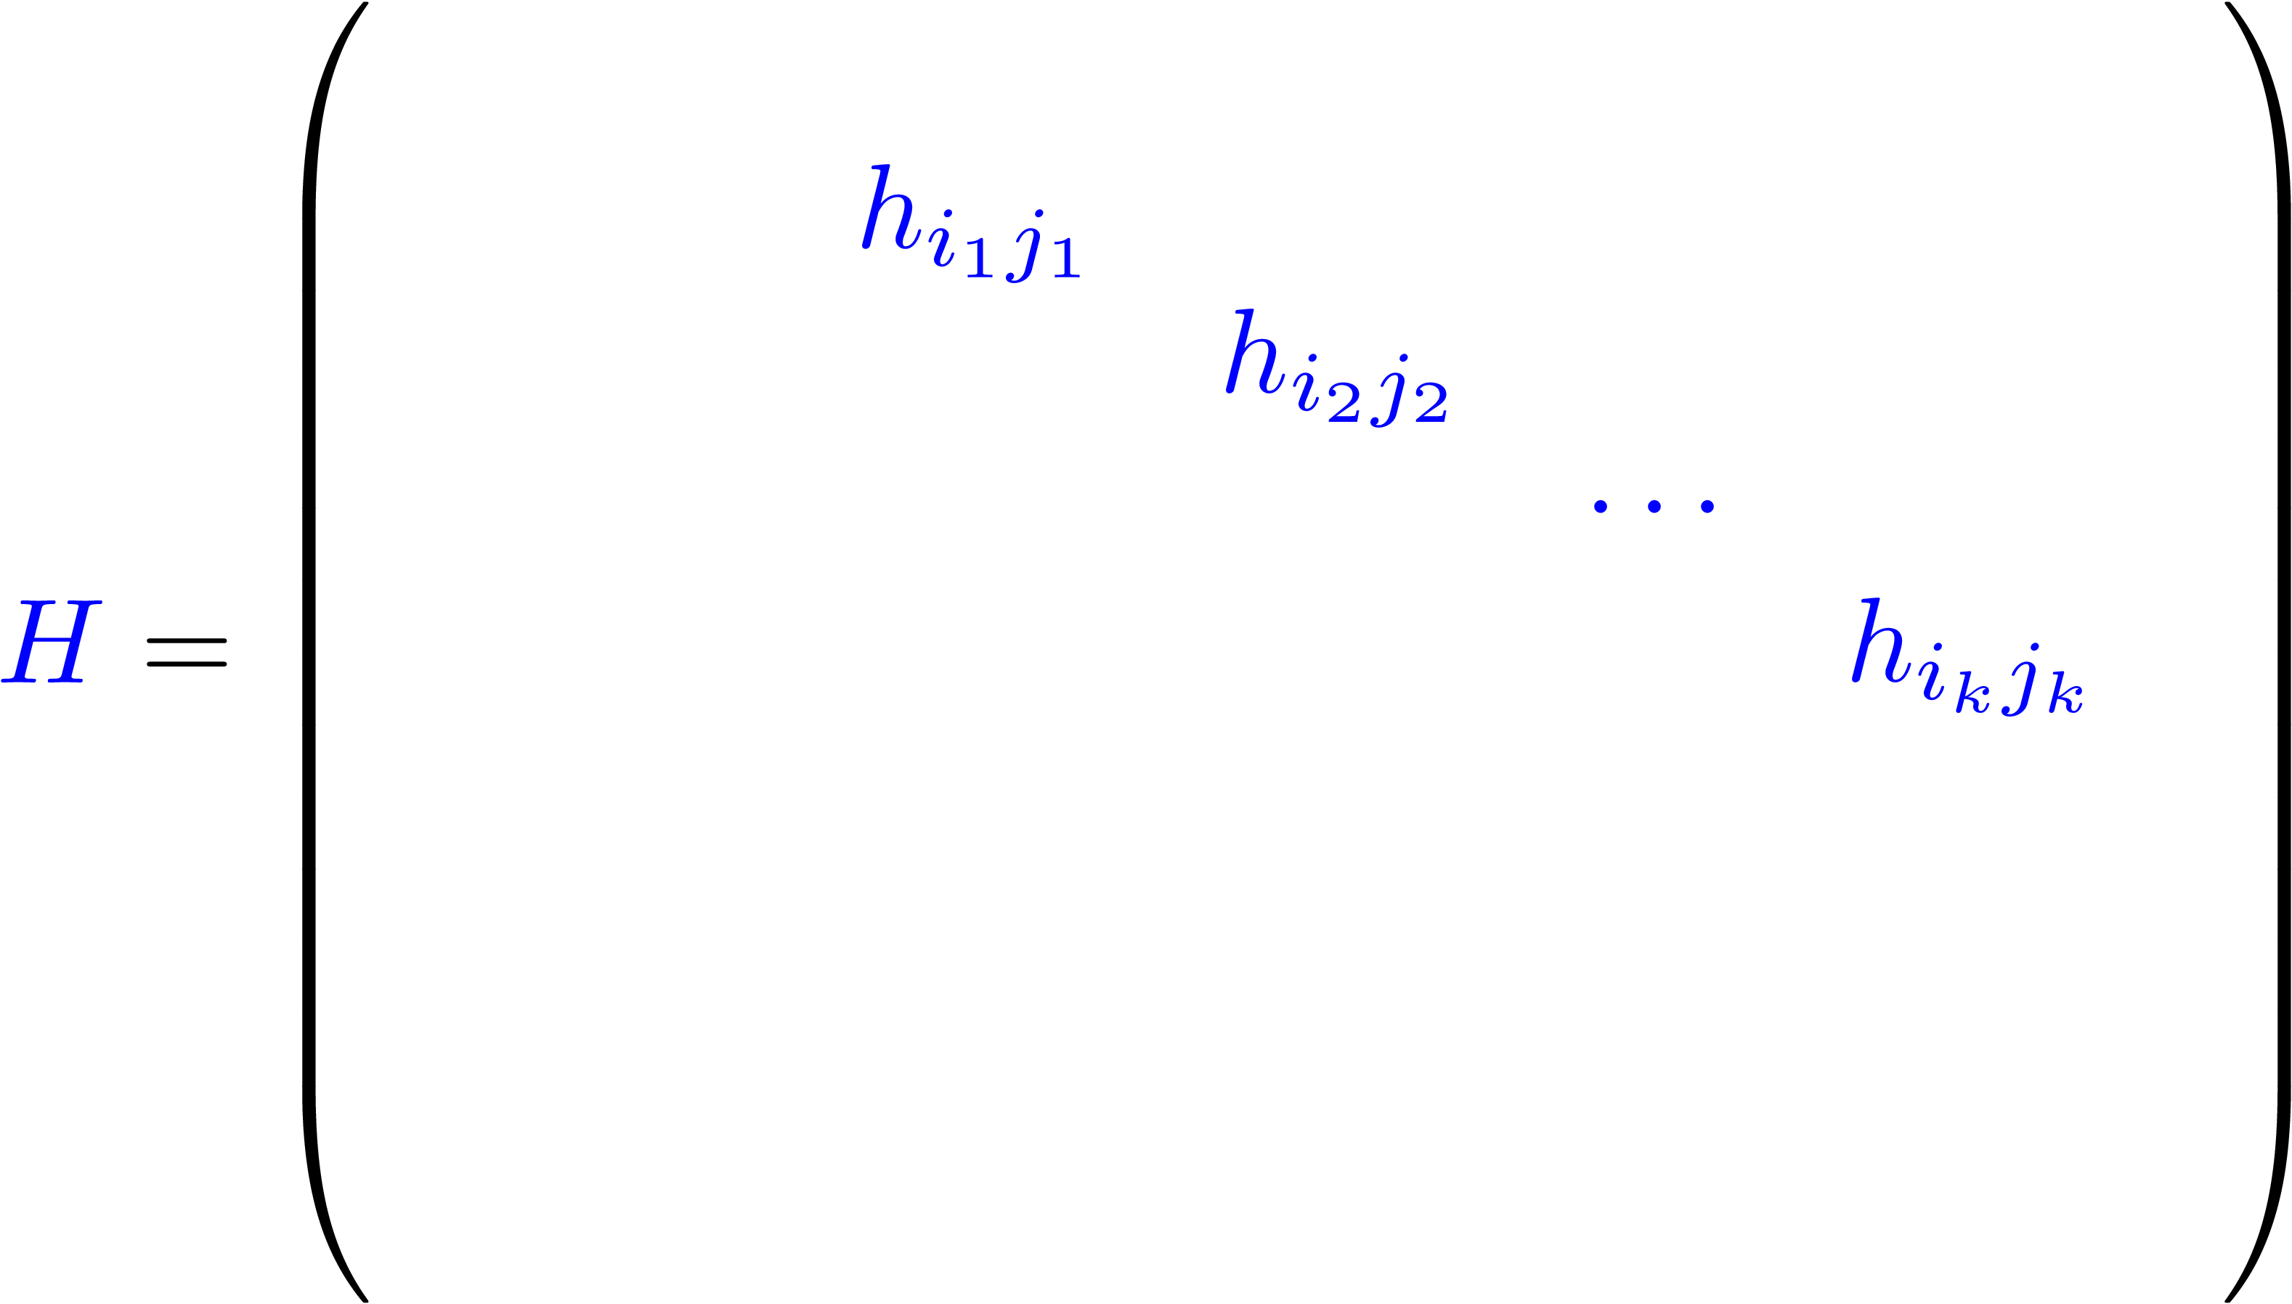
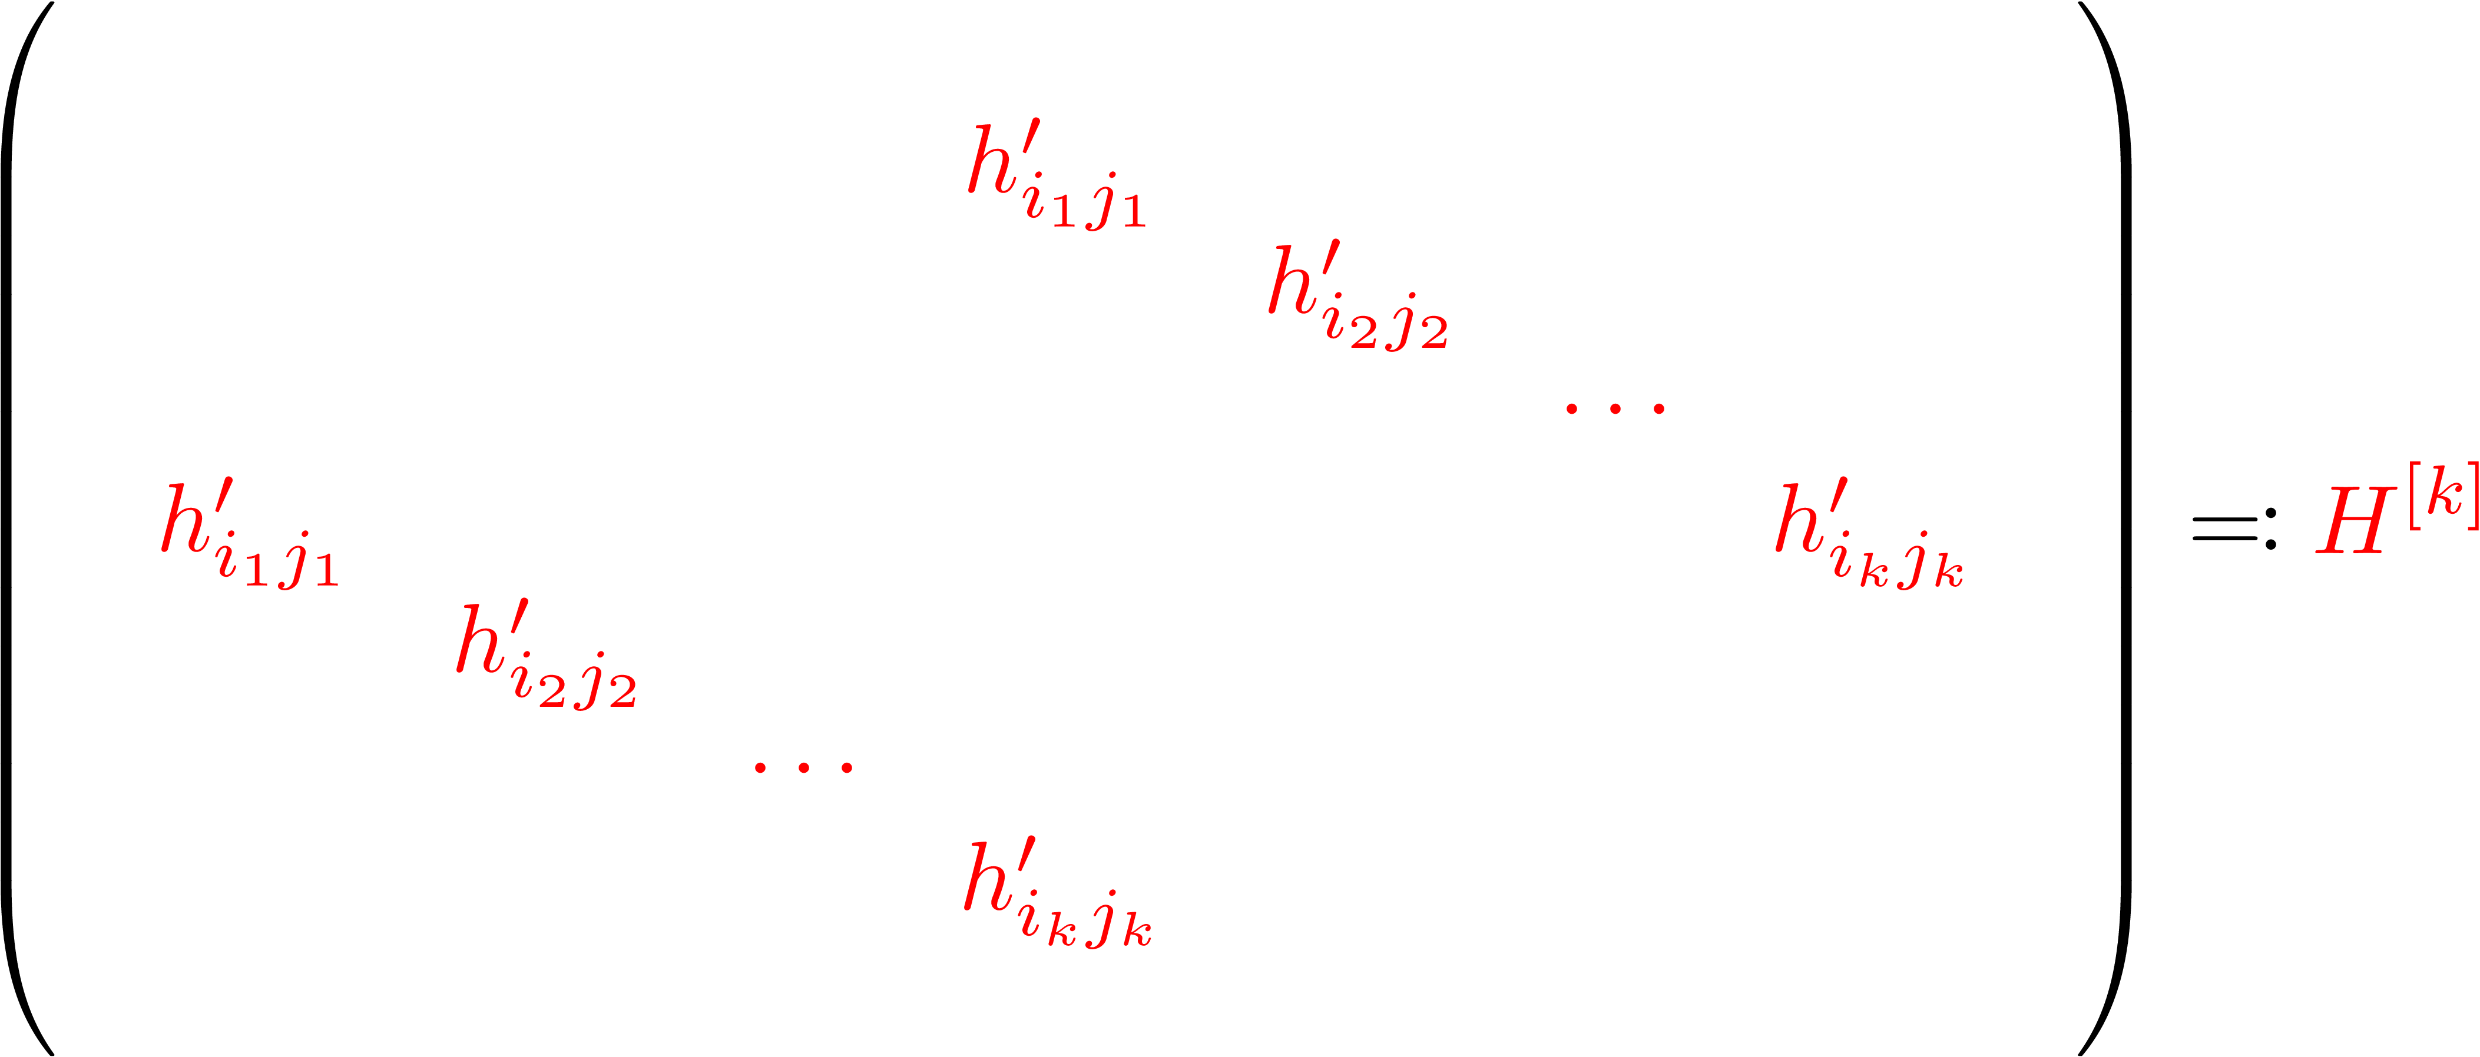

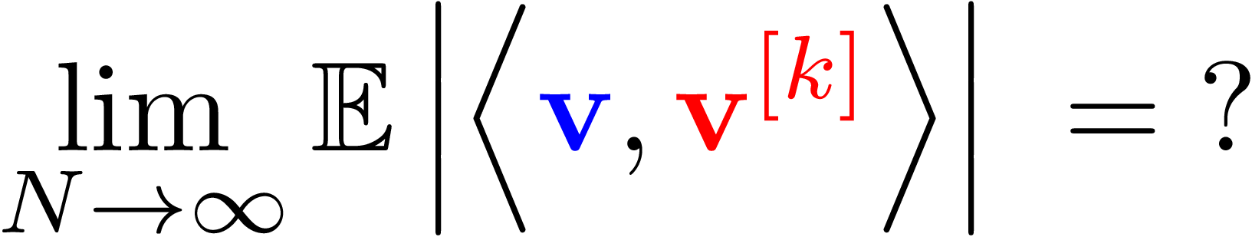
Resampling procedure

Slide 4

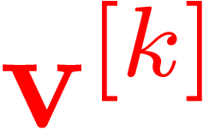




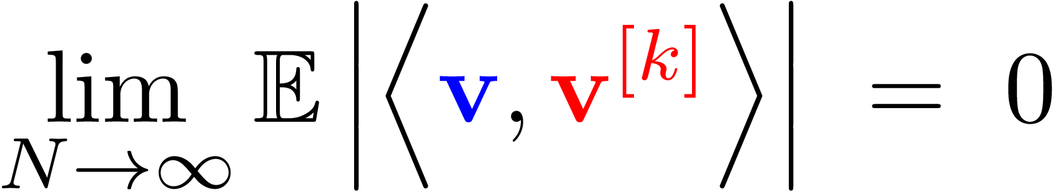


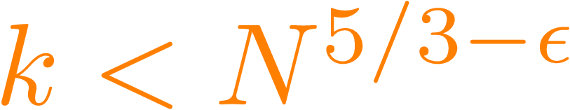
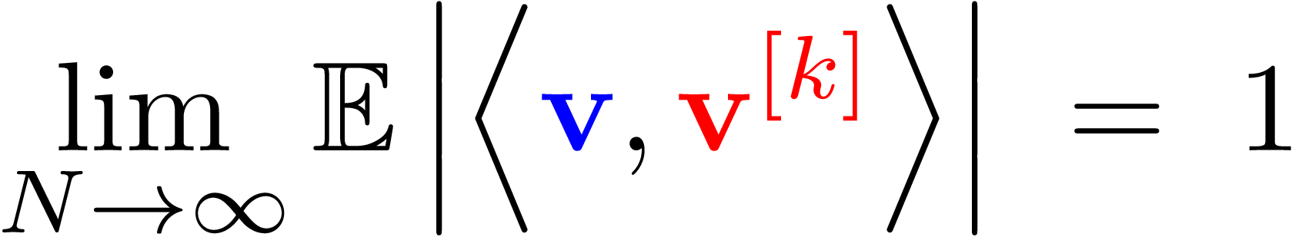
Result: threshold phenomenon

Slide 5
Result: threshold phenomenon
Thank you and see you soon!

Slide 7

Result: threshold phenomenon
Related works

