Slide 1
University of Geneva Faculty of Medicine
General presentation
August 2024

Slide 2
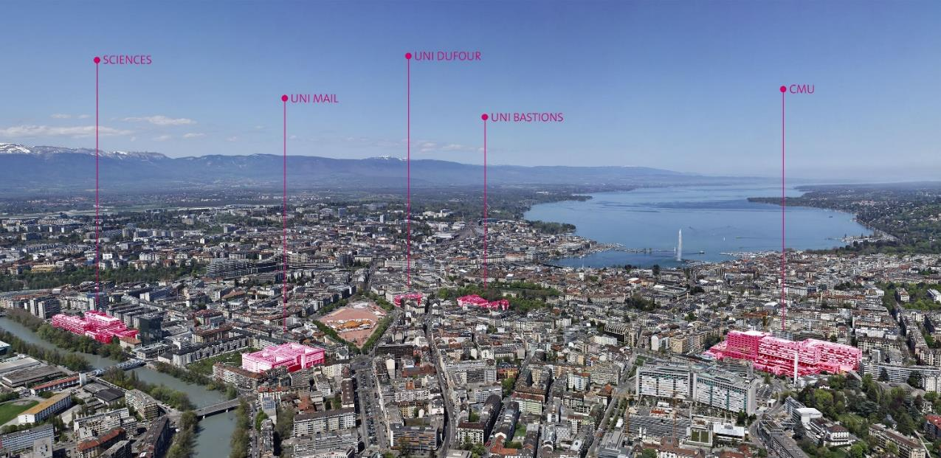
The University of Geneva An urban campus

Slide 3
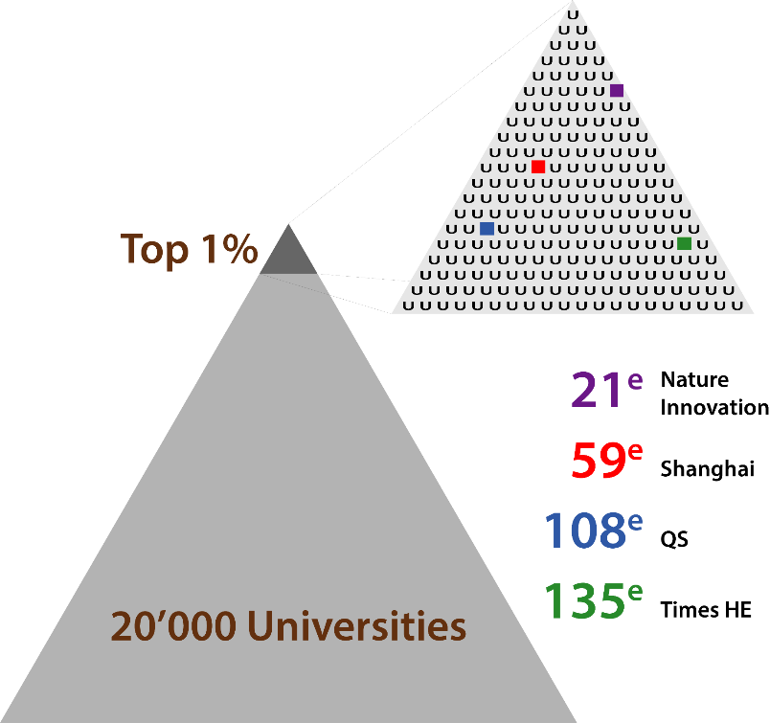
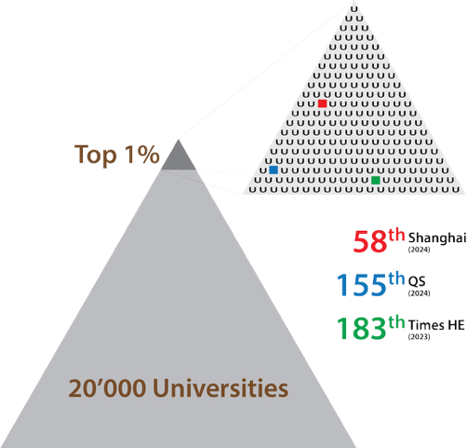
The University of Geneva among top world universities
2024

Slide 4

Shanghai Ranking
2024
# 58
# 19
# 19
Worldwide
European universities
Non-English-speaking universities worldwide
# 3
# 5
# 34
Swiss
universities
French-speaking universities worldwide (after Paris-Saclay university, PSL University, Sorbonne University and EPFL)
in Dental Medicine (2023)

Slide 5

Global level, local missions
Attract the best
Ensure social responsibility
Interact globally
Train and teach excellence
Lead cutting-edge research
Foster innovation

Slide 6

A polyvalent university
9
17 681
faculties
students
14
159
interfaculty centres
countries
represented
1559
foundation of the University of Geneva
worldwide university
(Shanghai Ranking)
6 586
# 58
staff members
6 765
diplomas awarded in 2021
391
103
continuous education programmes with
undergraduate programmes and
91
9 481
PhD programmes
students

Slide 7
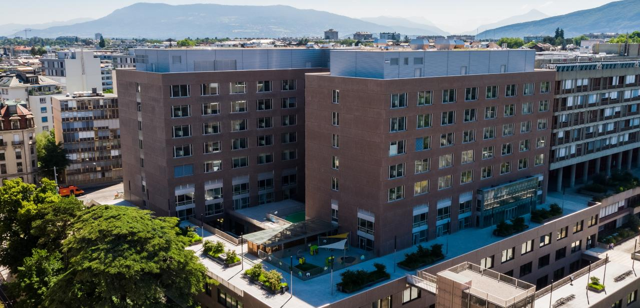
Faculty of Medicine

Slide 8
The 3 missions of the Faculty
Training future physicians, dentists and researchers
Promoting innovative research in biomedical science (basic, translational and clinical)
Reaching out to the Community: dental care provided by the University Clinic of Dental Medicine & a wide range of public events that aims to share research advances and to participate to the public debate on health and science

Slide 9
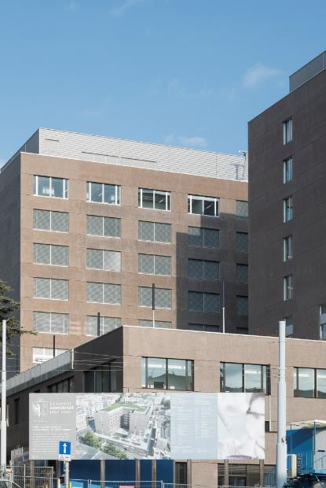
University Medical Centre (CMU)
60 years of history for one of the largest state-sponsored building projects in Geneva
More than 75 000m² floor space (laboratories, practical training rooms, teaching auditoriums, etc.) with the new extension opened in 2016
The University Medical Centre also houses the Institute of Pharmaceutical Sciences of Western Switzerland

Slide 10
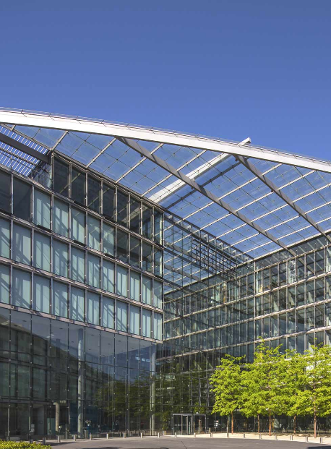
Campus Biotech
A new centre of excellence in biotechnology and life science
An innovative ecosystem that joins together 9 institutions and fosters an interdisciplinary approach to life science
It also houses Faculty of Medicine researchers in human neurosciences, the Institute of Global Health as well as specialists of medical informatics and telemedicine.

Slide 11

International scope
Geneva, at the heart of international health
A core dimension for the Faculty, represented by its Institute of Global Health
Strong links with WHO, IOs and NGOs
Large training offer in global health
Awareness to North-South issues from the very beginning of medical studies
Important research focus on health and environment
Bachelor-Master Programme in human medicine in Mauritius based on the Geneva curriculum

Slide 12
International scope
a few projects
Geneva Health Forum: global health stakeholders meet in Geneva every two years: NGOs, IOs, academics as well as healthcare front liners
Telemedicine and cyberhealth: various projects aiming to use technology in healthcare, including in low- and middle-income countries
Many North-South collaborations, including in the field of communicable diseases
Involvement of HUG/UNIGE physicians and scientists in the management of international health crises (COVID-19, Ebola, etc.)
Internships in local communities or abroad for 3rd year students

Slide 13
3 Sections, 16 Departments
Fundamental Medicine
Clinical Medicine
Dental Medicine
Basic Neurosciences
Cell Physiology and Metabolism
Genetic Medicine and Development
Microbiology and Molecular Medicine
Pathology and Immunology
Anaesthesiology, Pharmacology, Intensive Care and Emergency Medicine
Clinical Neurosciences
Community Health and Medicine
Medicine
Paediatrics, Gynaecology and Obstetrics
Psychiatry
Readaptation and Geriatrics
Radiology and Medical Informatics
Surgery
Oro-facial Rehabilitation
Preventive and Primary Care Dental Medicine

Slide 14
Faculty Institutes and Centres |  | Interfaculty Institutes and Centres
Diabetes Centre Geneva Centre for Inflammation Research Institute of Global Health Geneva Tumours Register iEH2 – Ethics, History and Humanities Institute Primary Care Institute University Institute for Primary Care (IuMFE) Synapsy Centre for Neuroscience and Mental Health Translational Biomarker Centre Translational Research Centre in Oncohaematology Unit of Development and Research in Medical Education (UDREM) |  | Centre of Biomedical Imaging (CIBM) Geneva Centre for Humanitarian Studies Geneva Genetics and Genomics Institute (IGE3) Geneva Neuroscience Centre Interfaculty Centre of Affective Sciences Interfaculty Centre of Bioethics and Medical Humanities Interfaculty Centre of Children’s Rights Interfaculty Centre of Gerontology and Vulnerability Studies Swiss Cancer Center Léman Swiss Centre of Applied Human Toxicology (SCAHT) Swiss Institute of Bioinformatics University Centre of Bioinformatics University Centre of Information Technologies University Centre of Legal Medicine – Western Switzerland
With the Geneva University Hospitals (HUG)
With the Geneva University Hospitals (HUG)
Clinical Research Centre Geneva Centre of Emerging Viral Diseases Centre for Primary Care Medicine
Clinical Research Centre Geneva Centre of Emerging Viral Diseases

Slide 15
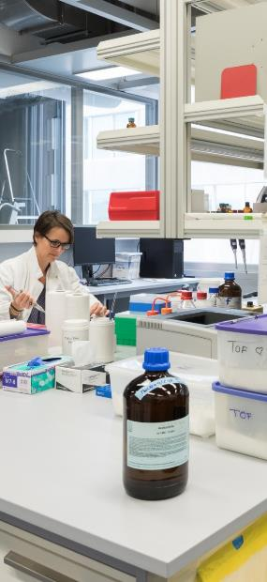
Staff
2023
2 004 staff members, including:
308 Professors
123 Full Professors 106 Associate Professors 41 Assistant Professors 38 Adjunct and Visiting Professors
1 156 Research and Teaching Staff
540 Administrative and Technical Staff

Slide 16
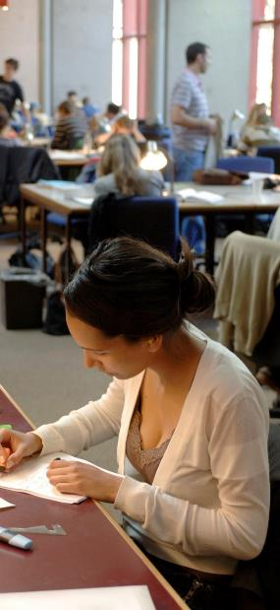
Students
2023
1 728 undergraduate students
1 325 students in human medicine 216 students in dental medicine 132 students in biomedical sciences 55 students in neurosciences
2 077 postgraduate students
612 PhD students 1 441 CAS-DAS-MAS students 24 students in specialised training

Slide 17
Budget
2023
External funding
Operational budget CHF 104.2 millions (including salaries CHF 95 millions)
Investment budget 2020 CHF 2.3 millions
Swiss National Science Foundation (SNF) funding CHF 29.7 millions
Other CHF 66.8 millions
Notes:
Trouver les chiffres de Harvard ou Yale ou une moyenne des Universités américaines pour contrer l’argument du «trop plein» ou du rôle de l’état.

Slide 18

Faculty of Medicine & HUG
The Geneva University Hospitals (HUG): the largest hospital in Switzerland
Shared strategic orientations
Fruitful translational and clinical research collaborations
Strong complementarity in training
an essential partnership

Slide 19



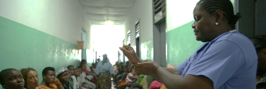

Research
June 2024
200 research groups
67 in basic research
126 in translational and clinical research
2 in medical education
5 in dental medicine

Slide 20
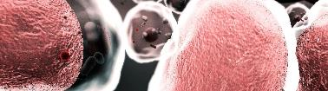
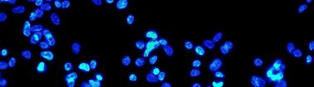
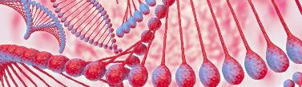
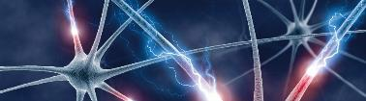
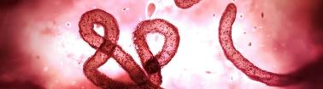
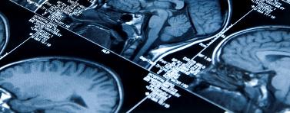
Main research focus
Metabolic diseases and diabetes
Genetic medicine
Humanitarian medicine and international health
Digital and precision medicine
Neurosciences
Immunology and host-infection relations
Oncology (in coordination with the Swiss Cancer Centre-Léman, an initiative of UNIL, CHUV, EPFL, UNIGE and HUG)
Notes:
Citer les département correspondants- Quid Onco?
Si nécessaire intégrer axes HUG? Ou «projets des grandes envergures» de manière à intégrer l’onco

Slide 21


Translational research
Translational research
Knowledge transfer for medical applications
Clinical research
Guides fundamental research
Basic research
from bench to bedside… and back again
Understands mechanisms
Understands nature
Drafts models
Builds theories
Diseases diagnosis and treatment

Slide 22
A research of international visibility
Internationally-recognized experts in the Faculty’s main research areas

Slide 23
A research of national visibility
Members of the Faculty of Medicine are part of many national research institutions and networks, such as:
SNF Research Council and Evaluation Bodies
Swiss Academy of Medical Sciences
Swiss Cancer Centre – Léman (SCCL), with HUG, UNIL, CHUV and EPFL
NCCRs: Synapsy, Evolving Language and Chemical Biology

Slide 24
Core facilities for research
Animal Facility
Biocode: RNA to Proteins (R2P)
Bioimaging
Bioinformatics
Biomedical Imaging
Biosafety Level 3 Laboratory
Clinical Research Centre
Electronic Microscopy
Flow Cytometry
Genomics
Histology
Humanafly
Murine Behaviour
Phenotyping of small animals
Proteins, peptides and RNA to proteins
Proteomics
Radiology imaging
R³ (Recombining Antibodies, READS, Zebrafish)
Small Animal preclinical imaging
Transgenesis
Vectorlab
21 transversal platforms tools for state-of-the-art research in all areas of life science

Slide 25
ERC Grants
ERC Advanced Grants
Prof. Denis JABAUDON Department of Basic Neurosciences
Nature_Nurture: Intrinsic and extrinsic determinants of neuronal identity (2020-2025)
Prof. Pedro HERRERA Department of Genetic Medicine and Development
Merlin: Metabolic Cell Reprogramming for the Recovery of Lost INsulin-Producing Cells (2020-2024)
Prof. Christian LÜSCHER Department of Basic Neurosciences
F-Addict: Convergence of positive and negative reinforcement in fentanyl addiction (2020-2025)
ERC Synergy Grants
Prof. Alan CARLETON Department of Basic Neurosciences
& Prof. Ivan RODRIGUEZ Faculty of Sciences, Department of Genetics and Evolution
Claustrum function in cortical processing and putative claustral dysfunction in schizophrenia (2020-2026)
2020
Consolidator Grants
Prof. Camilla BELLONE Department of Basic Neurosciences
Circuit and synaptic plasticity mechanisms of approach and avoidance social behavior
(2020-2025)
Prof. Doron MERKLER Department of Pathology and Immunology
Molecular pathology of anti-viral T cell responses in the central nervous system (2020-2025)

Slide 26
SNSF Grants
2022
Starting grants
Prof. Ilaria SANI
Department of Basic Neurosciences
In the object’s shoes: Unveiling a ventro-temporal hub for object-centered space and object-based attention
Prof. Simone BECATTINI
Department of Pathology and Immunology
Biobehavioral mechanisms underpinning affective response during physical activity (BioAffect)

Slide 27


National and international collaborations
National centres of competence in research (NCCR)
WHO Collaborating centres (with HUG)
Training and research in mental health
Education and Long-Term Follow-up Strategies for Chronic Diseases
e-Health
Humanitarian Medicine and Disaster Management
Infection Prevention and Control and Antimicrobial Resistance
Epidemic and Pandemic Diseases (Geneva Centre for Emerging Diseases)

Slide 28
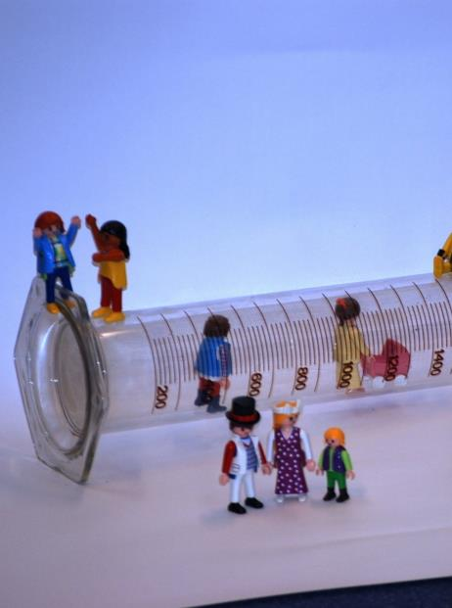
Fostering young academic talents
Tools to support young academic talents
Mentoring & career development
Grants and awards to support the establishment of independant researchers:
«Tremplin» Grants
«Chef-fes de clinique et internes scientifiques»
SNSF career grants
Fondation Cloëtta Grants

Slide 29
Teaching
First school of human medicine in Switzerland certified by the World Federation of Medical Education
Only school of dental medicine in Western Switzerland
A dynamic partnership with the University Hospitals of Geneva (HUG)
A pioneering experience in problem-based medical education
Innovative and evidence-based training approaches
No selective entry test («numerus clausus»), but a competitive examination to access the 2nd year of human medicine
An innovative Bachelor and Master in biomedical sciences
An international scope and numerous MOOCs that promotes a wider access to scientific knowledge

Slide 30
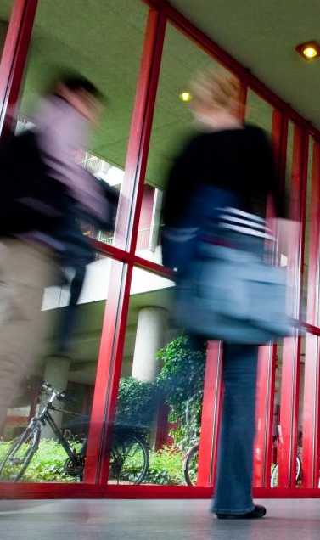
For future professionals open to the world
Wide implementation of interprofessional training
A strong focus on primary care medicine as a means to respond to the needs of the population
Promotion of scientific research within the curriculum
Numerous collaborations in global and international health
Enrollment capability: ~ 160 in human medicine (as of 2nd year) ~ 30 in dental medicine and ~ 30 in medical biosciences

Slide 31
Special tracks in Human Medicine
Starting in the 2nd year of the Bachelor's programme, students in Human Medicine have the possibility to personalise their studies by choosing a special track.
These tracks allow students to gain additional expertise on a specific medical discipline aligned with their interests and the career path they wish to pursue.
Medical education
Primary care – Family medicine (Médecine de premier recours – médecine de famille MPR – MF)
Global health & humanitarian medicine
Research

Slide 32
Medical studies
what for?
Research
Prevention
Teaching
Industry
Public Health
Law
Clinical Care
Insurances

Slide 33

Bachelor and Master in Biomedical Sciences
Innovative training in human biology
An overarching perspective on drug and medical devices development
Mastering scientific communication
An inside knowledge of industry
A wide range of career oportunities in research, drug development, startups, pharma companies, biotech, etc.
in coordination with the Faculty of Science

Slide 34
Studies structure

Slide 35
A great variety of structures supporting training
Development and research in medical education Unit (UDREM) Supports innovative teaching, quality evaluation, and research in medical education
Interprofessional Simulation Centre (CiS) A pioneering centre for interprofessional undergraduate, postgraduate and continuous training that uses multimodal simulation tools
University Institute for Primary Care (IuMFE) Stimulates primary care medicine and promote its specialization
Research programme for medical students (PREM) Identifies and coaches students interested in research as early as 2nd year to foster future research talents

Slide 36
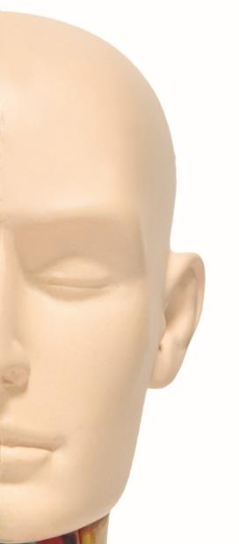
Interprofessional Simulation Centre (CiS)
Opened in 2013
4 partner institutions (UNIGE, HEdS, HUG, imad) to ensure the training of students and healthcare professionals
Interprofessional communication as key to patient safety
Trains several hundreds people each year
A wide range of scenarios using high-fidelity dummies or actors impersonating patients

Slide 37
MAS and clinical specialisations
Masters of Advances Studies (MAS) in clinical medicine: 22 degrees, designed mainly for holders of non-EU medical degrees
The specialisations in clinical medicine are issued by the Swiss Institute of postgraduate and continuous medical training (ISFM)
Master of Advanced Studies (MAS) in dental medicine: a specialised programme with federal certification
Master of Advanced Studies (MAS) in public health, not restricted to medical degrees holders (upon selection)

Slide 38

Doctoral programmes
Doctoral programme in human medicine (MD) or dental medicine (DMD)
Doctoral programme in medical science «MD-PhD»
PhD in biomedical sciences (in global health, bioethics, forensic medicine, or medical education)
PhD in neurosciences (University of Geneva, University of Lausanne, EPFL)
PhD in life science (Faculties of Medicine and Science, University of Geneva)

Slide 39

Other training programmes
A large variety of Diplomas of Advanced Studies (DAS), Certificates of Advances Studies (CAS) and Certificates of Open Studies en anglais (COS)
For physicians as well as for other professionals

Slide 40
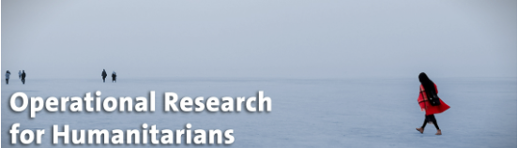
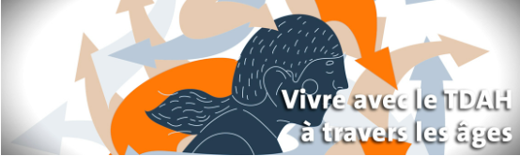



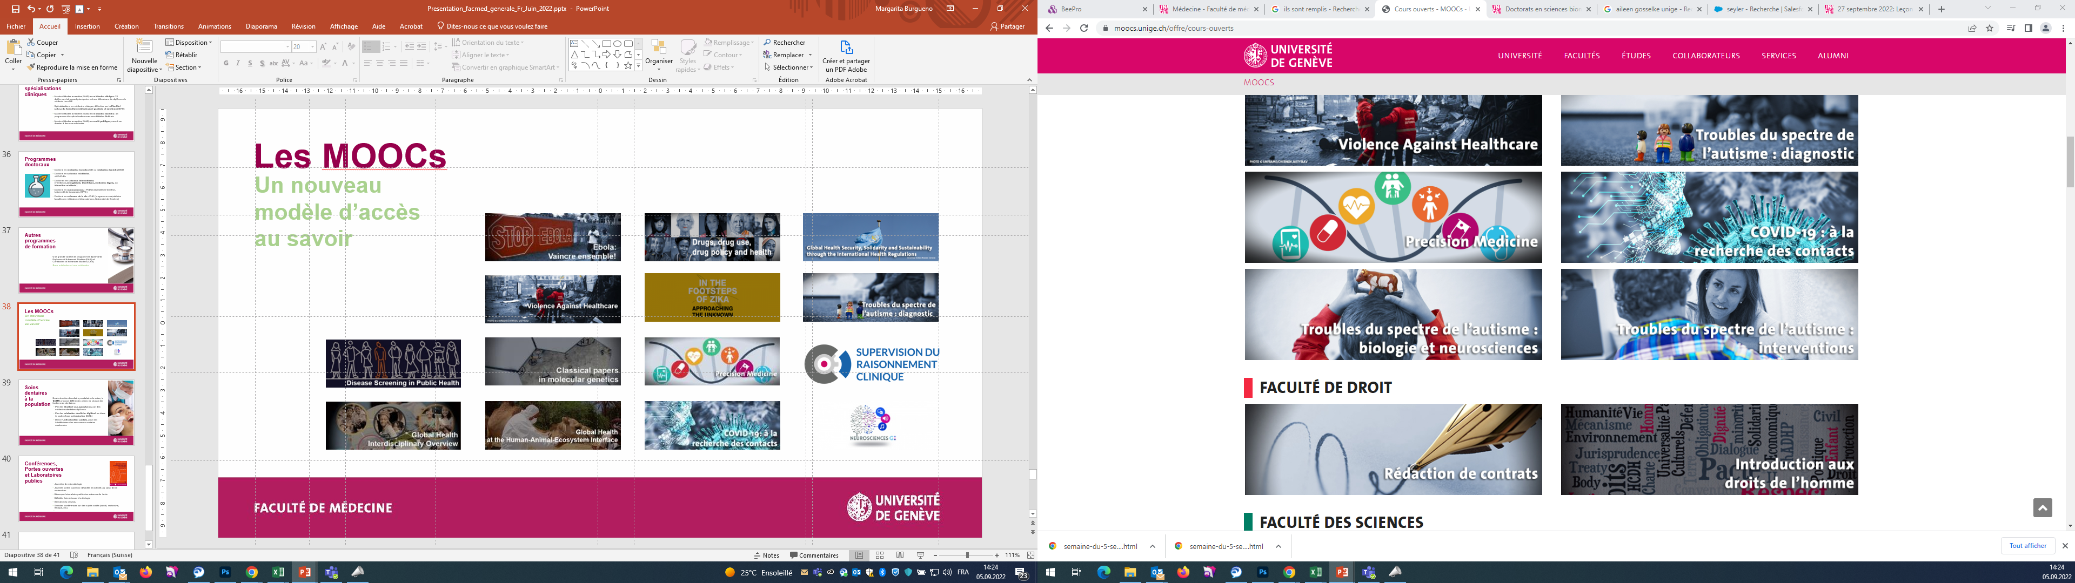











MOOCs
a new and open access to knowledge

Slide 41
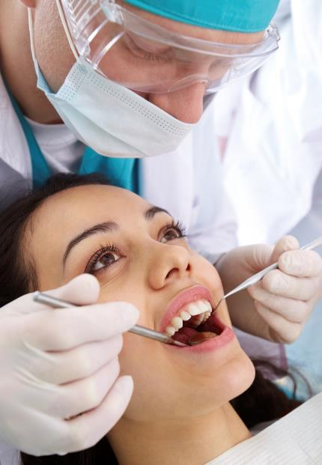
Dental care for all
Only healthcare provider within the Faculty, the University Clinic of Dental Medicine offers various types of dental care:
By students under the supervision of licenced dentists
By licenced dentists undertaking a Master of Advances Studies (MAS)
By the Social Action Unit, for patients addressed by Geneva Social Services

Slide 42
Conferences, open doors and public laboratories
Open doors «Diabetes Day: Meet the researchers»
Bioscope: public laboratory of life science
BiOutils: discovering biology
Brain Week
Public Conferences on various subjects (health, research, ethics and much more)
…

Slide 43


