Slide 1
Colloque du 8 décembre 2021 (Alexandra Calmy)
Introduction
Les antiviraux à action directe (administration orale)
Les anticorps monoclonaux
Perspectives

Slide 2
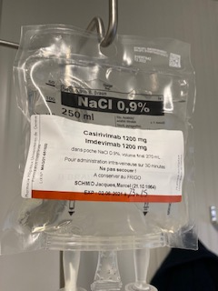
From repositioned drugs to a specific human monoclonal antibodies in just a year…
Lopinavir/ritonavir: a repositioned, well-known anti-HIV drug that has been on the market for 20 years
REGN COV-2: a cocktail of monoclonal antibodies targeting the Spike protein.
1st clinical trial started in June 2020,
Temporary use authorization in November 2020 (FDA)
March 2020
June 1, 2021

Slide 3
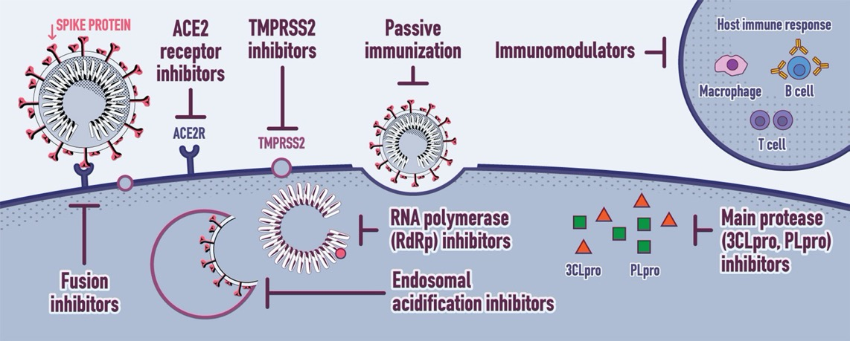
mAbs
ACE2 Inhibitors
Angiotensin 2 receptor blockers
Tocilizumab, sarilumab, adalimumab, corticosteroides, eculizumab, JAK inhibiteurs, azithromycine, chloroquine, colchicine
mAbs, DARPin® ensovibep
Molnupiravir
Remdesivir
Lopinavir/r
Pfizer’ 332
Range of treatments according to their mode of action
(hydroxy)QC
Baracitinib
Uminefovir
Clinical Microbiology and Infection 2020 26988-998DOI: (10.1016/j.cmi.2020.05.019)
Notes:
Mais à nouveau, comme pour l’hépatite C; ou encore le VIH, la connaissance du cycle de multiplication virale permet d’envisager d’autres molécules, soit des bloqueurs de l’entrée du virus dans la cellule, comme les anticorps monoclinaux, soit des inhibiteurs de la fusion, comme le baracitinib, ou encore des antiviraux inhibant la polymérase, et enfin des antiprotéases, de la famille du lopinavir/ritonavir. De nombreux anti-inflammatoires ont et sont testés, agissant eux sur la réponse immunitaire de l’hôte.

Slide 4
Colloque du 8 décembre 2021 (Alexandra Calmy)
Introduction
Les antiviraux à action directe (administration orale)
Les anticorps monoclonaux
Perspectives

Slide 5

LES ANTIVIRAUX A ACTION DIRECTE DIRECT ACTING ANTIVIRALS (DAA) Molnupiravir
Mjöllnir – marteau à manche court de Thor, le dieu de la foudre et du tonnerre
MOLNUPIRAVIR
Université Emory d’Atlanta: lutter contre le virus de l’encéphalomyélite équine (epizootie sur le continent américain)
2015: MERS-CoV (résultats prometteurs)
2020: Ridgback Therapeutics: SARS-COV2
Notes:
C’est un analogue de ribonucléotide qui comme la ribavirine agit en augmentant le taux de mutation atteignant ce que l’on appelle « l’error catsatrophy » un niveau tel de mutation que le virus n’y survit pas, c’est fascinant car cela marche pour des Virus comme la grippe qui ont déjà un taux de mutation élevé (la notion de quasi-espèce) et il n’est pas nécessaire d’augmenter beaucoup ce taux de mutation pour dépasser ce qui est viable.
C’est intéressant car cela semble marcher pour le Corona qui doit avoir un taux de mutation plus bas (activité proof-reading)
En ce qui concerne l’effet mutagène sur l’ADN, à priori en tant que ribonucléotide il ne peut pas être incorporé que dans l’ARN et pas dans l’ADN ce qui exclu un possible effet mutagène.
En ce qui concerne l’incorporation dans l’ARN cellulaire, on peut imaginer qu’elle est peu efficace, susceptible d’induire des effets secondaires (j’imagine que ces effets secondaires sont décrits) mais sans « conséquence » au niveau mutagénèse de l’ADN.
Molnupiravir acts by introducing mutations into the viral genome during viral replication. A metabolite of the drug is picked up by a viral enzyme called RNA-dependent RNA polymerase and incorporated into the viral genome, eventually causing so many errors that the virus can no longer survive.
Human cells have a DNA, rather than an RNA, genome, but some laboratory experiments have suggested that molnupiravir could cause mutations in human DNA as well¹.
A full course of treatment with molnupiravir is only five days long. But regulators might be cautious, particularly when it comes to treating pregnant people, says Kim. “There’s probably going to be warnings around the use of this antiviral because of the potential risk,” he says.
Paxlovid acts by inhibiting an enzyme that’s needed to process some viral proteins into their final, functional form. But the drug is a combination of an antiviral and another drug, called ritonavir, which helps to prevent enzymes in the liver from breaking down the antiviral before it has a chance to disable the coronavirus. Ritonavir, a component of some HIV treatment cocktails, can affect how some other medications are metabolized by the body. A wide range of drugs should not be given with it, including some that are commonly used to treat heart conditions, suppress the immune system and reduce pain.
This means that many people might not be able to tolerate the combination of Paxlovid and ritonavir. But Mellors notes that this antiviral drug regimen also lasts only a few days, and physicians might find ways to work around some drug–drug interactions. “There’s going to be a learning curve as to when it can be used, and when it can’t,” he says.

Slide 6
LES ANTIVIRAUX A ACTION DIRECTE DIRECT ACTING ANTIVIRALS (DAA) Molnupiravir et PF-332
MOLNUPIRAVIR (nucleotide analog)
PFIZER ‘332+ritonavir (antiprotease)
Université Emory d’Atlanta: lutter contre le virus de l’encéphalomyélite équine (Estearn Equine Encephalitis - epizootie sur le continent américain)
2015: MERS-Co (résultats prometteurs)
2020: Ridgback Biotherapeutics: SARS-COV2
Rolf Hilgenfeld, Lubeck (2000): coronavirus de la diarrhée épidémique porcine (PEDV)
2003: SARS COV-1 protéase virale identique à celle de PEDV (structure-based drug design)
Printemps 2020: SARS COV-2
Zhang et al (Holgenfeld), Science, March 2020
Boras B et al, Nat Commun 2021 Oct 18;12(1):6055
https://www.nature.com/articles/d41586-021-03074-5
Zhou, S. et al. J. Infect. Dis. 224, 415–419 (2021)
Notes:
In theory, the drugs should be effective against known coronavirus variants, including the highly transmissible Delta variant. These variants are primarily characterized by mutations in the viral spike protein and other regions that are targeted by the immune system — and by vaccines.
The targets of molnupiravir and Paxlovid are different, but researchers will still need to show that the drugs work against variants, says Mellors. Merck has done laboratory studies indicating that molnupiravir is effective against Delta and other variants — including the Beta variant, which was first identified in South Africa.
(Boras et al) SARS-CoV-2 produces two large viral polyproteins, pp1a and pp1ab, which are processed by two virally encoded cysteine proteases, the main protease, also called 3C-like protease (3CL protease or 3CLpro) and the papain-like protease. Mutagenesis experiments with other coronaviruses have demonstrated that the activity of the 3CLpro is essential for viral replication
Similar to other nucleoside analogs, molnupiravir targets the SARS-CoV-2 RNA-dependent RNA polymerase (RdRp), which mediates replication and transcription of the coronavirus genome. Viral RdRps are proven effective targets for inhibition, with several licensed nucleoside analogs that are used therapeutically^{1,4}. Indeed, the only currently clinically approved antiviral used for the treatment of COVID-19 is remdesivir (Veklury), which targets the RdRp⁵. Similar to remdesivir, molnupiravir has been re-investigated as a coronavirus antiviral agent that leads to increased frequency of G-to-A and C-to-U transition mutations^{6,7,8,9}. Molnupiravir was also shown to inhibit propagation of the SARS-CoV, MERS-CoV and SARS-CoV-2 viruses, re-enforcing its pan-coronaviral inhibitory profile^{8,10}. Treatment with molnupiravir failed to induce viral-resistance mutations, which suggests a high genetic barrier to immune evasion^{6,7}. Notably, in contrast to the antiviral nucleoside analogs fluorouracil (5-FU) and ribavarin^{11,12,13}, molnupiravir is resistant to the proofreading exoribonuclease encoded by coronaviruses⁷, which makes it an attractive target for further development. Thus, understanding the molecular basis of inhibition of molnupiravir reveals the lethal mutagenesis mechanism that will aid the informed design of related inhibitors.
Paxlovid acts by inhibiting an enzyme that’s needed to process some viral proteins into their final, functional form. But the drug is a combination of an antiviral and another drug, called ritonavir, which helps to prevent enzymes in the liver from breaking down the antiviral before it has a chance to disable the coronavirus. Ritonavir, a component of some HIV treatment cocktails, can affect how some other medications are metabolized by the body. A wide range of drugs should not be given with it, including some that are commonly used to treat heart conditions, suppress the immune system and reduce pain.
This means that many people might not be able to tolerate the combination of Paxlovid and ritonavir. But Mellors notes that this antiviral drug regimen also lasts only a few days, and physicians might find ways to work around some drug–drug interactions. “There’s going to be a learning curve as to when it can be used, and when it can’t,” he says.

Slide 7
LES ANTIVIRAUX A ACTION DIRECTE ACTE 1 – les données
1
2
MSD Molnupiravir
PF-07321332 (‘332)
3
ROCHE ATEA AT 527

Slide 8
Molnupiravir Essai de phase 3
«Phase 3, randomized, placebo-controlled, double-blind, multi-site study of non-hospitalized adult patients with laboratory-confirmed mild to moderate COVID-19, at least one risk factor associated with poor disease outcomes, and symptom onset within five days prior to randomization».
Outpatient – MOVe-OUT
NCT04575597

Slide 9
Press release – Decision to stop the phase 3 registrational trial (MOVE OUT) (Oct 1st)
The planned interim analysis evaluated data from 775 patients who were initially enrolled in the Phase 3 MOVe-OUT trial on or prior to Aug. 5, 2021.
At the recommendation of an independent Data Monitoring Committee and in consultation with the U.S. Food and Drug Administration (FDA), recruitment into the study is being stopped early due to these positive results
NCT04575597
Notes:
https://www.merck.com/news/merck-and-ridgebacks-investigational-oral-antiviral-molnupiravir-reduced-the-risk-of-hospitalization-or-death-by-approximately-50-percent-compared-to-placebo-for-patients-with-mild-or-moderat/In this interim analysis:
Molnupiravir reduced the risk of hospitalization or death by approximately 50%
7.3% of participants who received molnupiravir vs 14.1% of placebo-treated patients were hospitalized or died through Day 29 (p=0.0012) [Primary efficacy endpoint]
Through Day 29, no deaths were reported in patients who received molnupiravir, as compared to 8 deaths in patients who received placebo
Incidence of any adverse event and incidence of drug-related adverse events were comparable in the molnupiravir and placebo groups
Fewer subjects discontinued study therapy due to an adverse event in the molnupiravir group compared to the placebo group
Additionally, at the recommendation of an independent Data Monitoring Committee and in consultation with the FDA, recruitment into MOVe-OUT is being stopped early due to these positive results.

Slide 10
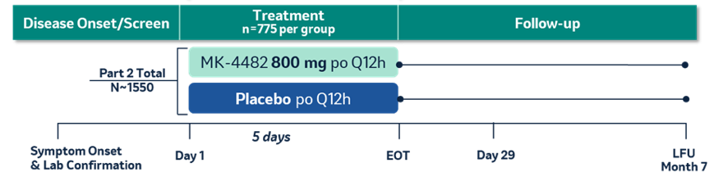
Dessin de l’étude MOVE OUT: chez les patients avec une infection SARS-COV-2 <5d
Population
Patients ambulatoires
Symptômes depuis moins de 5 jours avant la randomization
Tous les patients ont au moins un facteur de risque d’évolution défavorable.
>60 years of age (13%)
Active cancer
CKD
COPD
Obesity (BMI ≥ 30) (76%)
Critère de jugement primaire: évaluer l’efficacité du MOL comparé au placebo en évaluant le pourcentage de participants qui sont hospitalisés, ou décèdent, jusqu’à 29 jours après la randomisation.
Serious heart conditions
(CAD, heart failure, cardiomyopathies) (10%)
Diabetes mellitus (13%)
N=775 (interim analysis)
Notes:
Phase 3, randomized, placebo-controlled, double-blind, multi-site study of non-hospitalized adult patients with laboratory-confirmed mild to moderate COVID-19, at least one risk factor associated with poor disease outcomes, and symptom onset within five days prior to randomization.
The primary efficacy objective of MOVe-OUT is to evaluate the efficacy of molnupiravir compared to placebo as assessed by the percentage of participants who are hospitalized and/or die from the time of randomization through Day 29.

Slide 11
MOVe-OUT Analyse intermédiaire (Phase 3): Résultats d’efficacité
Molnupiravir significantly reduced the risk of hospitalization or death, by approximately 50%, at a planned interim analysis of the Phase 3 MOVe-OUT trial
Summary of Hospitalization or Death Through Day 29 Modified Intent-to Treat Population Interim Analysis (N=762)
 | MK-4482 800 mg |  | Placebo |  | p-value
 | n | (%) | n | (%)
Participants in population | 385 |  | 377
Hospitalization or Death | 28 | (7.3) | 53 | (14.1) | 0.0012
Hospitalization | 28 | (7.3) | 52 | (13.8)
Death | 0 | (0.0) | 8 | (2.1)
n= number of participants with the corresponding event. Every participant is counted a single time for each applicable row and column. Participants who died may have been hospitalized prior to death; such participants are counted once each in the Hospitalization and Death rows. Unknown Day 29 survival status is treated as failure
Molnupiravir reduced the risk of hospitalization and/or death across all key subgroups
Efficacy was not affected by timing of symptom onset or underlying risk factor
Molnupiravir Positive Interim Analysis Phase 3 Press Release

Slide 12
COUP DE THEATRE 1er novembre 2021
Mjöllnir – marteau à manche court de Thor, le dieu de la foudre et du tonnerre
MOLNUPIRAVIR
Résultats de la deuxième phase (« post-interim analysis »)
Notes:
C’est un analogue de ribonucléotide qui comme la ribavirine agit en augmentant le taux de mutation atteignant ce que l’on appelle « l’error catsatrophy » un niveau tel de mutation que le virus n’y survit pas, c’est fascinant car cela marche pour des Virus comme la grippe qui ont déjà un taux de mutation élevé (la notion de quasi-espèce) et il n’est pas nécessaire d’augmenter beaucoup ce taux de mutation pour dépasser ce qui est viable.
C’est intéressant car cela semble marcher pour le Corona qui doit avoir un taux de mutation plus bas (activité proof-reading)
En ce qui concerne l’effet mutagène sur l’ADN, à priori en tant que ribonucléotide il ne peut pas être incorporé que dans l’ARN et pas dans l’ADN ce qui exclu un possible effet mutagène.
En ce qui concerne l’incorporation dans l’ARN cellulaire, on peut imaginer qu’elle est peu efficace, susceptible d’induire des effets secondaires (j’imagine que ces effets secondaires sont décrits) mais sans « conséquence » au niveau mutagénèse de l’ADN.
Molnupiravir acts by introducing mutations into the viral genome during viral replication. A metabolite of the drug is picked up by a viral enzyme called RNA-dependent RNA polymerase and incorporated into the viral genome, eventually causing so many errors that the virus can no longer survive.
Human cells have a DNA, rather than an RNA, genome, but some laboratory experiments have suggested that molnupiravir could cause mutations in human DNA as well¹.
A full course of treatment with molnupiravir is only five days long. But regulators might be cautious, particularly when it comes to treating pregnant people, says Kim. “There’s probably going to be warnings around the use of this antiviral because of the potential risk,” he says.
Paxlovid acts by inhibiting an enzyme that’s needed to process some viral proteins into their final, functional form. But the drug is a combination of an antiviral and another drug, called ritonavir, which helps to prevent enzymes in the liver from breaking down the antiviral before it has a chance to disable the coronavirus. Ritonavir, a component of some HIV treatment cocktails, can affect how some other medications are metabolized by the body. A wide range of drugs should not be given with it, including some that are commonly used to treat heart conditions, suppress the immune system and reduce pain.
This means that many people might not be able to tolerate the combination of Paxlovid and ritonavir. But Mellors notes that this antiviral drug regimen also lasts only a few days, and physicians might find ways to work around some drug–drug interactions. “There’s going to be a learning curve as to when it can be used, and when it can’t,” he says.

Slide 13
MOLNUPIRAVIR Efficacy results: interim vs final results
The mystery of the post interim analysis population

Slide 14
MOVe-OUT Phase 3: Trial Locations
The Phase 3 portion of the MOVe-OUT trial was conducted globally, including in more than 170 planned sites in countries including:
Recruitment in Latin America, Europe, and Africa accounted for 55%, 23%, and 15% of the study population, respectively. (Deuxième phase – plus de patients Europe de l’Est, Russie)
Argentina | France | Mexico | Sweden
Brazil | Germany | Philippines | Taiwan
Canada | Guatemala | Poland | Ukraine
Chile | Israel | Russia | United Kingdom
Colombia | Italy | South Africa | United States
Egypt | Japan | Spain
What did really happen?
Molnupiravir Positive Interim Analysis Phase 3 Press Release

Slide 15
LES ANTIVIRAUX A ACTION DIRECTE ET ENTRE TEMPS….
1
2
MSD Molnupiravir
PF-07321332 (‘332)
3
ROCHE ATEA AT 527

Slide 16
PF-332-ritonavir Essai phase 3
«Interim Analysis of the Phase 2/3 EPIC-HR Study
of PF-07321332-ritonavir in non-hospitalized symptomatic high risk adult participants with COVID-19»
Outpatient – EPIC trial
NCT04960202

Slide 17
Communiqué de presse– décision d’interrompre l’essai de phase 2/3(EPIC) (1er novembre 2021)
The primary analysis of the interim data set evaluated data from 1,219 adults enrolled by Sept 29, 2021
Each patient was randomised (1:1) to receive PF-07321332;ritonavir or placebo orally every 12 hours for five days¹
At the recommendation of an Independent Data Monitoring Committee, and in consultation with the U.S. Food and Drug Administration (FDA), enrolment into the study ceased due to efficacy
1. https://www.pfizer.com/news/press-release/press-release-detail/pfizers-novel-covid-19-oral-antiviral-treatment-candidate (Accessed November 2021). 2. Clinicaltrials.gov (Online) Available from https://clinicaltrials.gov/ct2/show/NCT04960202 [Accessed November 2021].
Notes:
https://www.merck.com/news/merck-and-ridgebacks-investigational-oral-antiviral-molnupiravir-reduced-the-risk-of-hospitalization-or-death-by-approximately-50-percent-compared-to-placebo-for-patients-with-mild-or-moderat/In this interim analysis:
Molnupiravir reduced the risk of hospitalization or death by approximately 50%
7.3% of participants who received molnupiravir vs 14.1% of placebo-treated patients were hospitalized or died through Day 29 (p=0.0012) [Primary efficacy endpoint]
Through Day 29, no deaths were reported in patients who received molnupiravir, as compared to 8 deaths in patients who received placebo
Incidence of any adverse event and incidence of drug-related adverse events were comparable in the molnupiravir and placebo groups
Fewer subjects discontinued study therapy due to an adverse event in the molnupiravir group compared to the placebo group
Additionally, at the recommendation of an independent Data Monitoring Committee and in consultation with the FDA, recruitment into MOVe-OUT is being stopped early due to these positive results.

Slide 18
EPIC HR analyse intermédiaire: efficacité (Pfizer slides)
1,219 adultes inclus jusqu’au 20 septembre 2021 (5 jours PF’332 vs placebo)
Critères d’éligibilité: confirmed diagnosis of SARS-CoV-2 infection within five days prior to randomization, onset of mild to moderate symptoms within five days of randomization, at least one characteristic associated with an increased risk of developing severe illness from COVID-19
Pas de pre-print, pas de publication…
Efficacy outcome results
Patients with COVID-19-related hospitalisation or death from any cause through Day 28
 | PF-07321332; ritonavir | Placebo | P-value
Primary endpoint Treatment within 3 days of symptom onset, n (%) | 3/389 hospitalised with no deaths (0.8%) | 27/385 hospitalised with 7 subsequent deaths (7.0%) | p<0.0001
Secondary endpoint Treatment within 5 days of symptom onset, n (%) | 6/607 hospitalised with no deaths (1.0%) | 41/612 hospitalised with 10 subsequent deaths (6.7%) | p<0.0001
https://www.pfizer.com/news/press-release/press-release-detail/pfizers-novel-covid-19-oral-antiviral-treatment-candidate (Accessed November 2021).
Analyse intermédiaire: réduction de 89% réduction du risque d’hospitalisation ou décès lié à chez les patients traités dans les 3 jours du début des symptômes cause (primary endpoint)

Slide 19
Direct acting antivirals in phase 3
 | PF-332 /rt (PAXLOVID™) | Molnupiravir
Primary end point | Hospitalization or death within 28 days | Hospitalization or death within 28 days
Population | Symptoms <3d High risk patients | Mild/moderate At least 1 risk factor
Efficacy data | 3/389(0.8%) (PAXLOVID™) 27/385 (7.0%) (placebo) p<0.0001 RRR =89% | 48/709 (6.8%) (molnupiravir) 68/699 (9.7% ) (placebo) p=0.022 RRR= 30%
Possible effect on omicron | Probably effective (boosted protease inhibitor) | Probably effective (nucleoside analogue)
Publication | Press release interim results 05.11.21 (Pfizer) | Press release (MSD) 01.10.21 and 26.11.21 (final)

Slide 20
Other early drugs
 | Colchicine | Fluvoxamine | Inhaled budesonide
Primary end point | % of hospital admissions or death up to D29 | Retention in a COVID-19 emergency setting (>6h) or transfer to tertiary hospital due to COVID-19 up to D28 | % Hospital admissions or deaths – illness duration
Population | High-risk outpatients, diagnosis within 24h of enrollment For RECOVERY : hospitalized | High-risk outpatients <7d from symptoms onset | >65yo or >50 yo with comorbidities <15d from symptoms onset
Efficacy data | 104/2235 (4.7%) (Tx) 131/2253 (5.8%) (PCB) OR: 0.79 (95%CI 0.61-1.03, p=0.081) Recovery : RR=1.01 RRR= 19% | 79/741 (11%) (Tx) 119/756 (16%) (PCB) RR: 0.68 (95%CI 0.52-0.88) RRR = 32% | 6.8% (budesonide) 8.8% (placebo) OR: 0.75 (95% BCI 0.55 to 1.03) RRR = 22.7%
Possible effect on omicron | NA | NA | NA
Publications | Tardif, Lancet Resp Dis, 27.05.21 RECOVERY, Lancet Respi Dis 18.10.21 | Reis, Lancet Global Health 27.10.2021 | Yu, Lancet 10.08.2021

Slide 21
LES ANTIVIRAUX A ACTION DIRECTE DIRECT ACTING ANTIVIRALS (DAA)
Points clefs
Antiviraux à action directe (petites molécules) ☞ faciles à fabriquer/coût accessible (modèle VIH, MPP)
Pourraient agir contre divers variants (les cibles ne sont pas la Spike protein) - en combinaison ?
Doit être administré tôt (dans les 5 jours) après le diagnostic – testing indispensable, circuit d’accès.
Décentralisation indispensable, via une pharmacie centralisée, sur ordonnance des praticiens de ville
Mais à l’heure actuelle, toutes les prévisions ont été déstabilisées
Notes:
In theory, the drugs should be effective against known coronavirus variants, including the highly transmissible Delta variant. These variants are primarily characterized by mutations in the viral spike protein and other regions that are targeted by the immune system — and by vaccines.
The targets of molnupiravir and Paxlovid are different, but researchers will still need to show that the drugs work against variants, says Mellors. Merck has done laboratory studies indicating that molnupiravir is effective against Delta and other variants — including the Beta variant, which was first identified in South Africa.

Slide 22
Colloque du 8 décembre 2021 (Alexandra Calmy)
Introduction
Les antiviraux à action directe (administration orale)
Les anticorps monoclonaux
Perspectives

Slide 23
LES ANTICORPS MONOCLONAUX (Switzerland)
MONOCLONAL ANTIBODIES (mAbs)
1
Casirivimab/imdevimab
Casirivimab/imdevimab REGN-COV-2) outpatients phase 3 (ROCHE), inpatients (RECOVERY)
Sotrovimab: outpatient phase 3 (COMET ICE)
2
Sotrovimab

Slide 24
CASIRIVIMAB/IMDEVIMAB (REGN-COV) Weinreich (phase 3, ambulatory)
Weinreich et al, preprint, May 21st, 2021, New Eng J Med, Sept 2021
1
«When considering placebo-treated patients only, there was an association between baseline viral load and Covid-19-related hospitalization or all-cause death – irrespective of baseline antibody status».
Gupta et al, New Eng J Med, Nov 1st, 2021

Slide 25
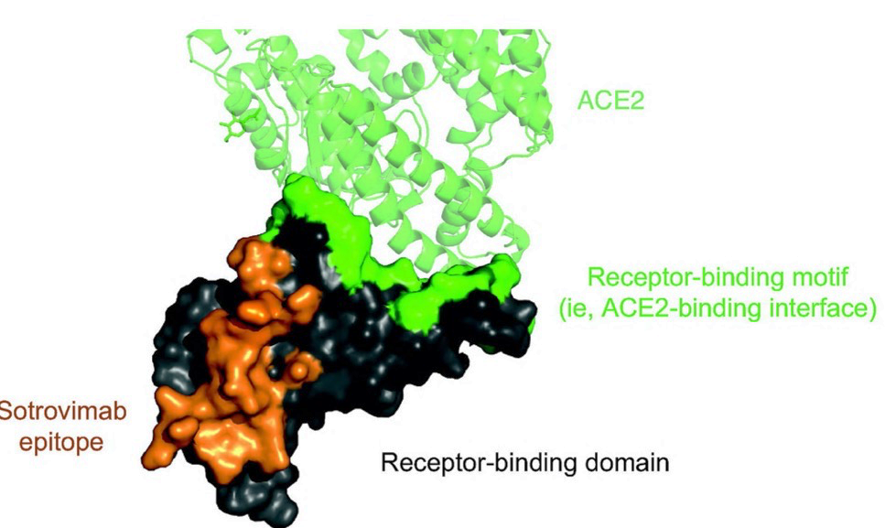
2
LES ANTICORPS MONOCLONAUX (Switzerland) SOTROVIMAB – VIR 7831 (GSK)
Engineered human monoclonal antibody that neutralizes SARS-CoV-2 and multiple other sarbecoviruses (SARS-CoV-1)
L’hypothèse étant qu’un virus qui neutralize tous les sarbecovirus cible un épitope conservé et garderait une efficacité lors de l’évolution du SARS CoV-2
La plupart des autres mAb en développement ciblent le motif qui engage le récepteur angiotensin-converting enzyme 2 (ACE2), lequel est une des régions les plus prompte aux mutations.
Figure 1. The conserved, pan-sarbecovirus binding site of sotrovimab on the spike protein of SARS-CoV-2. The SARS-CoV-2 receptor-binding domain is shown, with the ACE2 receptor-binding motif in green and the sotrovimab epitope in orange.
ACE2 denotes angiotensin-converting enzyme 2.
Gupta et al, New Eng J Med, Nov 1st, 2021

Slide 26
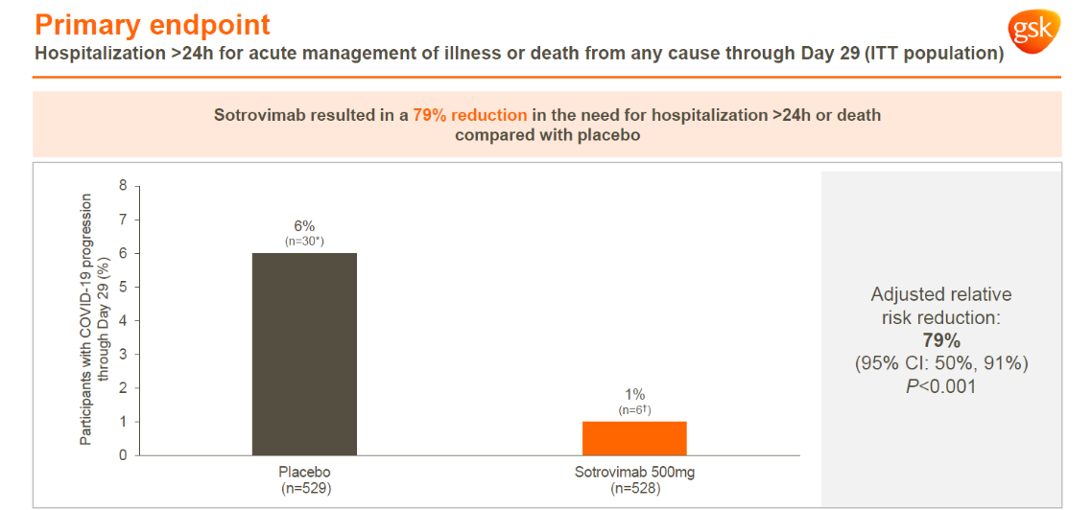
Efficacy data (slides: GSK) – ITT population
6%, (n=30)
1%, (n=6)
New Eng – RRR 85%
Interim results in the New Eng J Medicine, November 1st, 2021
Notes:
1:11The NEJM publication is based on the intent-to-treat Interim Analysis, which at the time included n= 583 patients in its analysis (Placebo: 292, Sotrovimab: 291). à This population includes participants randomized on or before January 19, 2021.
The Day 29 full study population result Slides includes n=1057 patients (Placebo: 529, Sotrivmab: 528). The full population includes all participants who were randomly assigned to the study treatment (including the ones after January 19, 2021).
Study design is the same for both analysis.

Slide 27
Qui est éligible en Suisse actuellement? (55 ambulatoires, 73 hospitalisés)
General criteria
Patients > 80 years old
High risk patients:
Hospitalized patients
PCR (or Ag test) +
No more than 5 days after onset of symptoms * (exceptions may be made for highly immunosuppressed patients)
(negative serologies?)
No other risk criteria if the general criteria are met
If vaccinated >6 months
If vaccinated <6months: if serology is negative
According to the FOPH list, and document 1 (criteria specified)
Priority for immunosuppressed patients (item 5 of the FOPH list)
Pregnancy
If they meet the general criteria
…but are not hospitalized for severe COVID
Severe COVID: only if serology negative regardless of symptoms start. (only REGN CoV)
Nosocomial infections (to be discussed on a case-by-case basis)
Currently:
No reimbursement for post-exposure prophylaxis
Guaranteed hospital reimbursement (SwissDRG) – casirivimab/imdevimab (ROCHE) and sotrovimab (GSK)
Notes:
En UK, cette semaine, le chef des NHS England (Sir Simon Stevens: «But in order to be able to administer them, we’re going to need community services that are able to deliver through regional networks this type of infusion in patients before they are hospitalised - typically within a three-day window from the date of infection«). This quotes highlights the dificulties to use infusions in ambulatoire services (alredy saw last year in US with Lily's mAb, with doses expirign even if donated ) , and the need to use them <3 days after onset of symptoms. This last point is extrmely challenging in LMICs, and we are working to ensure rapid Ag testing is increased.

Slide 28
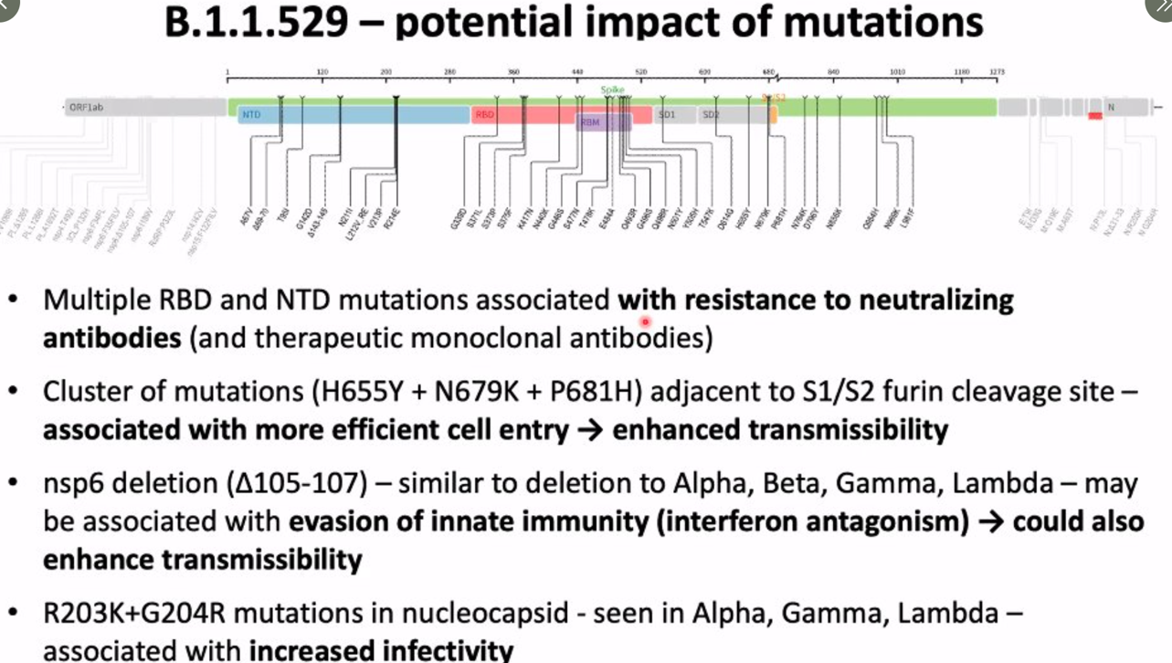
Viral Escape to known mAb?
REGN COV 2 sensitive to mutations on the Spike protein?
Is sotrovimab more robust to mutations in the RBD?
So far, little or nothing is known
Mia Malan on Twitter

Slide 29
Monoclonal antibodies (phase 3 completed)
Drug | REGN-COV2 | AZD7442 | Sotrovimab | Bamlanivimab/ etesivimab | Regdanvimab
Primary end point | Hospitalization or death within 29 days | Severe disease or death within 29 days | Hospitalization or death within 29 days | Hospitalization or death within 29 days | Hospitalization, O2-therapy or death within 28 days
Population | Cohort 1 ≥18 y Cohort 2 <18 y Cohort 3 pregnant | Mild/moderate, 90% high risk patients | Symptoms <5d At least 1 risk factor | Mild/moderate, 50% adolescents/women | Mild/moderate disease
Efficacy data | 18/1355 (1.3%) (REGN-COV2) 62/1341 (4.6%) (placebo) P<0.001 RRR= 71% | 18/407(4.4 %) (AZD) 37/415 (8.9 %) (placebo) RRR= 51% | 3/291 (1%) (sotrovimab) 21/292 (7%) (placebo) P=0.002 RRR = 85% | 11/518 (2.1%) (bamla/etse) 36/517 (placebo) P<0.001 RRR=70% | 14/446 (3.1 %) (Regdanvimab) 48/434 (11.1%) (placebo) P < 0.0001 RRR= 72%
Possible effect on omicron | Probably massively reduced (targets RBD) | Probably effective | Probably effective (outside RBD) | Probably reduced (targets RBD) | Probably massively reduced (targets RBD)
Publication | Weinreich, NEJM 02.12.21 | Press release 11.10.21 (AZ) Publication pending | Gupta, NEJM 18.11.21 | Dougan, NEJM 07.10.21 | Abstract ID week Press release 11.11.21 (EMA); publication pending
Regn-COV2: https://www.nejm.org/doi/full/10.1056/NEJMoa2108163 ----AZD7442: https://www.astrazeneca.com/content/astraz/media-centre/press-releases/2021/azd7442-phiii-trial-positive-in-covid-outpatients.html Sotrovimab: https://www.nejm.org/doi/full/10.1056/NEJMoa2107934 ---- Regdanvimab: https://www.natap.org/2021/IDWeek/IDWeek_43.htmC

Slide 30
LES ANTICORPS MONOCLONAUX (Switzerland)
MONOCLONAL ANTIBODIES (mAbs)
Points clefs
Aujourd’hui, en Suisse, seuls les anticorps monoclonaux ont un effet prouvé, publié, et reconnu pour le traitement précoce des formes modérées de COVID.
Les antiviraux à action directe ont le potential d’être au moins aussi efficace que les mAb, et seront moins impactés par les mutations de SARS CoV-2.
Les négotiations en CH sont en cours pour accéder à des DAA efficaces
La saga du molnupiravir nous a rendu prudents.
Notes:
In theory, the drugs should be effective against known coronavirus variants, including the highly transmissible Delta variant. These variants are primarily characterized by mutations in the viral spike protein and other regions that are targeted by the immune system — and by vaccines.
The targets of molnupiravir and Paxlovid are different, but researchers will still need to show that the drugs work against variants, says Mellors. Merck has done laboratory studies indicating that molnupiravir is effective against Delta and other variants — including the Beta variant, which was first identified in South Africa.

Slide 31
Colloque du 8 décembre 2021 (Alexandra Calmy)
Introduction
Les antiviraux à action directe (administration orale)
Les anticorps monoclonaux
Comment positionner les molecules disponibles

Slide 32
A POSSIBLE STRATEGY OF COVID-19 DRUG ADMINISTRATION in SARS-CoV-2 EXPOSITION (PEP) OR INFECTION
mild/moderate symptoms
Severe/critical pneumonia (oxygen dependence)
Patients at risk (see practical recommendations):
Consider early treatment
(within 5 days of diagnosis)
Monoclonal antibodies single dose
(and?) Direct acting antivirals (5 days, twice daily, oral drug)
To be prescribed systematically:
Oxygen therapy
Corticosteroids 7-10 days
Dexaméthasone 6mg 1x/day IV ou PO
Alternatives: prednisone, hydrocortisone, methylprednisolone Corticosteroids and COVID-19
These treatments can be administered concomitantly
If deterioration or no improvement in 12-24 hours, prescribe:
- Tocilizumab 1 ou 2 doses; baracitinib 4 mg 14 days
Patients at risk
Consider PEP (within 7 days of exposition)
Monoclonal antibodies single dose or
Direct acting antivirals (5 days, twice daily, oral drug)
To be evaluated on a case-by-case basis
Only if serology is negative and after multidisciplinary discussion:
Monoclonal antibodies single dose*
Immunosuppressed or vulnerability criteria:
Consider remdesivir if < 7 days after symptom onset Remdesivir

Slide 33
Merci pour votre
attention
Notes:
In theory, the drugs should be effective against known coronavirus variants, including the highly transmissible Delta variant. These variants are primarily characterized by mutations in the viral spike protein and other regions that are targeted by the immune system — and by vaccines.
The targets of molnupiravir and Paxlovid are different, but researchers will still need to show that the drugs work against variants, says Mellors. Merck has done laboratory studies indicating that molnupiravir is effective against Delta and other variants — including the Beta variant, which was first identified in South Africa.

