Slide 1
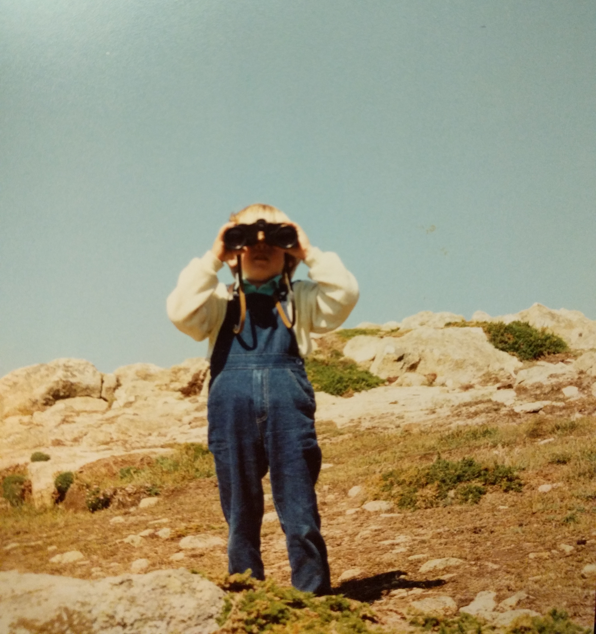
Semantic-driven approach for exploration of clinical datasets
Christophe Gaudet-Blavignac
GESAN Journal Club 22.02.2023

Slide 2
Previously
October 2021

Slide 3







Previously
Care institution
Care institution
Pharmacists
Nurses
Laboratory experts
Clinicians
Geneticians
Patients
Information sharing

Slide 4
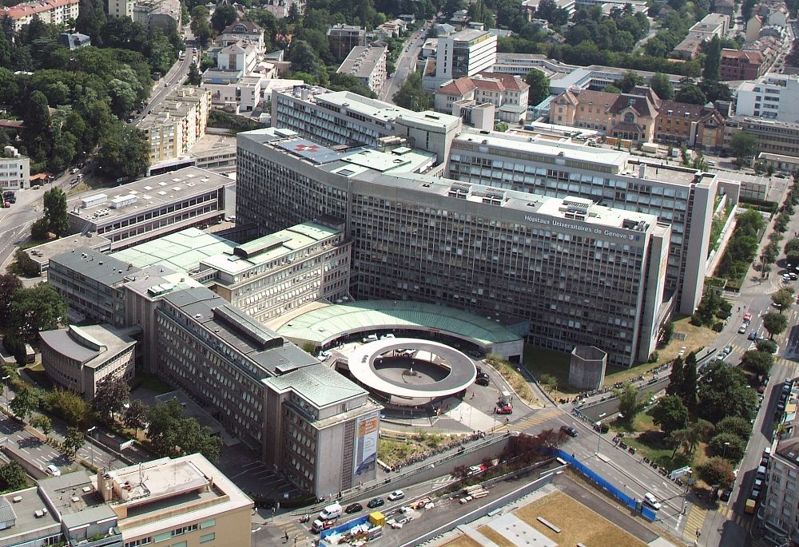










Limited reuse
Why?
Patients having a pathology or procedure related to the thoracic region?

Slide 5



Digitalisation
Digitalisation
Photographer: Ursus Wehrli

Slide 6
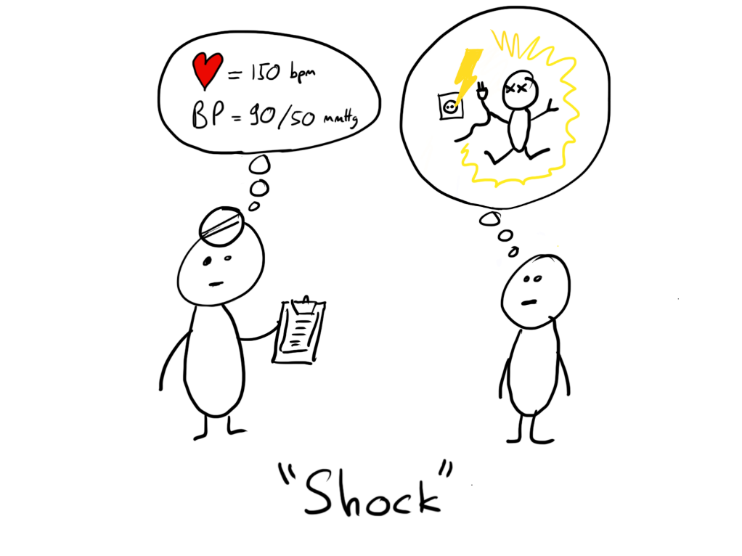

Too many languages
GTIN
Commercial units
ICNP
Nursing procedures
CHOP
CH – Surgical procedures
MedDRA
Medical products
LOINC
Observations and laboratory exams
ICNP
Nursing procedures
ICD-10
Diseases
Orphanet
Orphan diseases

Slide 7
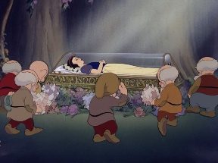
Encoding damages information
Real world
Narrative representation
ICD-10 representation
R40.2 Coma
T57.0 Toxic effect of Arsenic and its compounds
Z63 Other problems related to primary support group, including family circumstances
E34.3 Short stature, not elsewhere classified
Snow white asleep, surrounded by the mourning dwarves.
Quantity of information

Slide 8
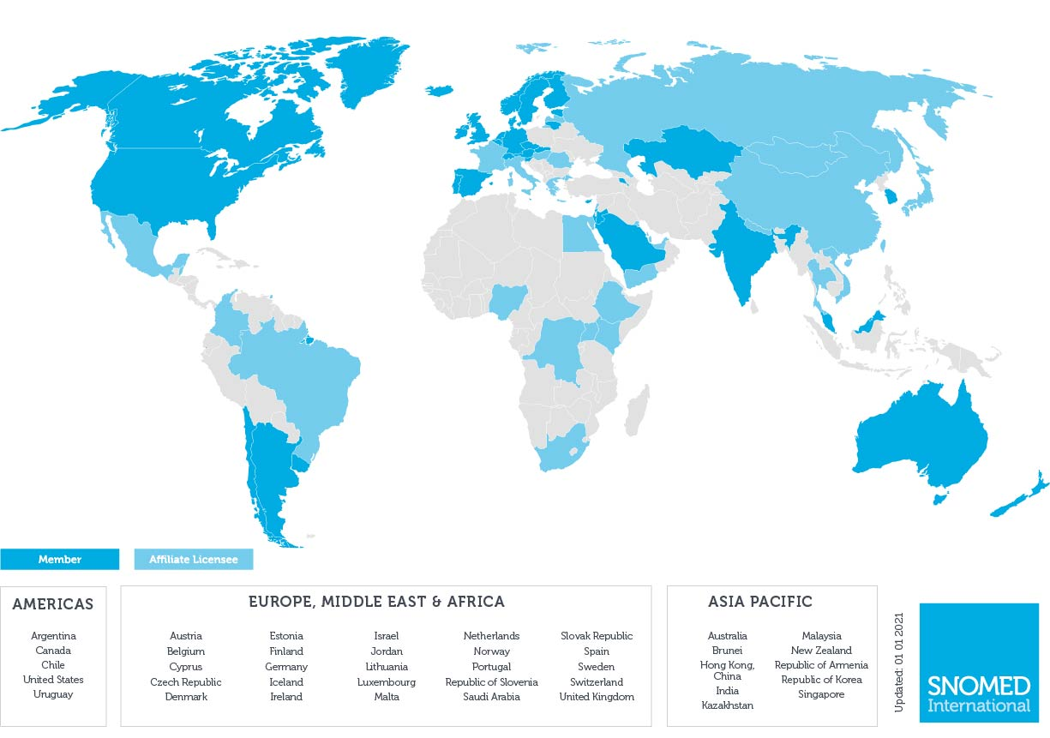

Born in 2001 (CTV3 – SNOMED RT)
Owned by its 40 members countries
Free to use for members
Non-profit organization: SNOMED International
The most comprehensive, multilingual clinical healthcare terminology in the world
https://www.snomed.org/our-customers/members

Slide 9
Composition of SNOMED CT
880529761000119102 |Lower respiratory infection caused by Severe acute respiratory syndrome coronavirus 2|
Concepts
354,448
Descriptions
1,506,185
Relationships
3,043,425
713084008 |Pneumonia caused by Human coronavirus|
Is a
Is a
Pneumonia caused by Severe acute respiratory syndrome coronavirus 2
882784691000119100
COVID-19 pneumonia
Pneumonia caused by 2019 novel coronavirus
Pathologic process
441862004 |Infectious process|
Finding site
39607008 |Lung structure |
Causative agent
840533007 |SARS-CoV-2|
https://browser.ihtsdotools.org/qa/#/descriptive-statistics

Slide 10
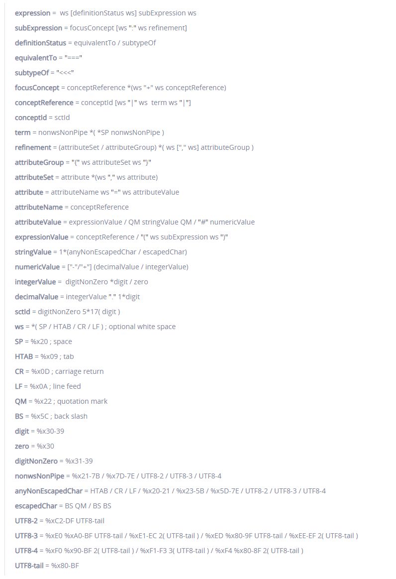
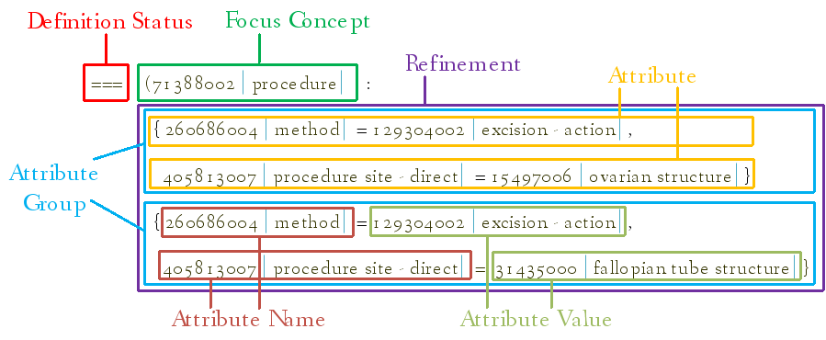
Compositional possibilities
Compositional grammar
Postcoordinated concept
https://confluence.ihtsdotools.org/display/DOCSCG

Slide 11

Temporality
Past
Future
Multiple iterations
Missing documentation
Semantic drift
20 years history
Semantic representation from the start
Involve data creators
Hersh et al., “Caveats for the Use of Operational Electronic Health Record Data in Comparative Effectiveness Research.”

Slide 12



Approach
List every structured data elements used in HUG
Choose a standard to represent those data
Represent those data elements using the chosen standard
International
Broad
Compositionnal

Slide 13

HUG’s patient
Care institution
Formularies
Lab analysis
Nursing diagnosis
Sample material
Fields
Radiologic exam
Indication
Problems
Concrete values
Observations
Droplists
Care interventions
Prescriptions
Substances
Diagnosis
Clinical scales
Administration
Galenic form
Procedures
Route
Notes:
From the concatenation of the production databases, an implicit semantic model emerges.
Numerous limitations
Useful to understand data

Slide 14
HUG data elements
Data elements | Progress | Coverage
Formularies | 125 / 2080 complete forms | 6% 55% forms instances 26% droplists
Problem list | 24’872 / 25’350 | 98%
Laboratory analysis | 4’826/12'142 analyses | 40% 92% instances
Units | 11’999/12’121 | 99%
Sample Material | 130
Observations (patient value) | 1’068/1’939 | 55% 90% instances
Radiology exams | 1’397/1’443 | 97% 99% instances
Nurse diagnosis | 498/498 | 100%
Care interventions | 1’718/1’882 | 91%
Administration routes | 417/444 | 94%
Galenic forms | 290/290 | 100%
Substances | 5’385/14’158 | 38% 99% instances

Slide 15
Lands Between
Number of represented data elements
62’224
Number of distinct representations
29’460
Number of distinct SCT concepts used
26’836
SCT concepts
Data elements
SCT representation
112981000119107 |Osteoarthritis of bilateral knee joints (disorder)|
gonarthrose tricompartimentale des deux genoux
112981000119107 |Osteoarthritis of bilateral knee joints (disorder)|:
363698007 |Finding site (attribute)| =
729789004 |Entire knee joint cavity (body structure)|
363698007 |Finding site (attribute)|
gonarthrose tricompartimentale bilatérale
729789004 |Entire knee joint cavity (body structure)|

Slide 16
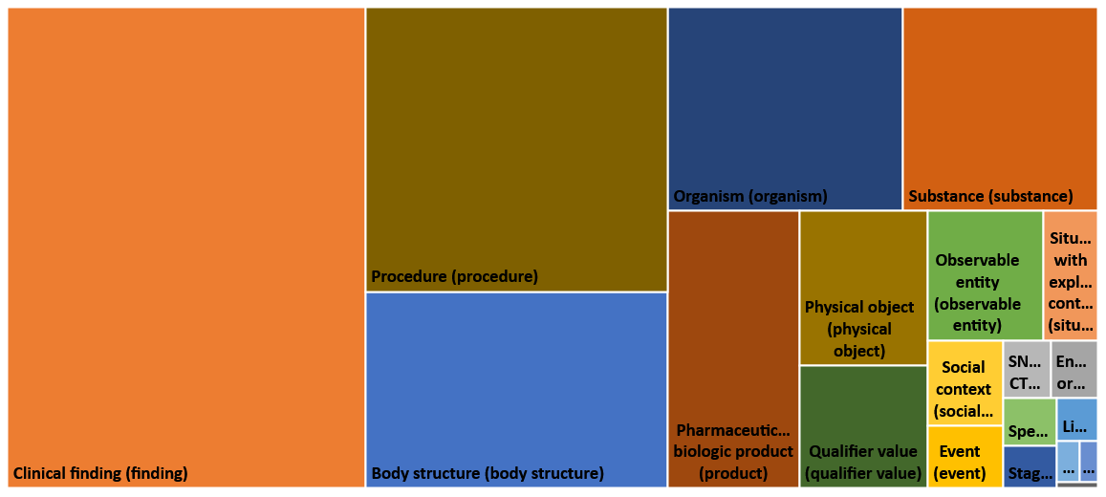
SNOMED CT

Slide 17
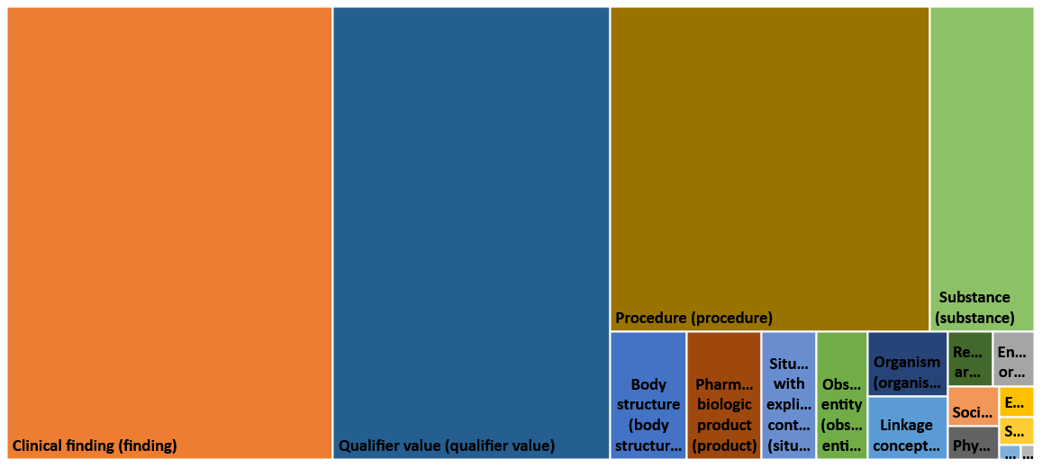
HUG data elements

Slide 18
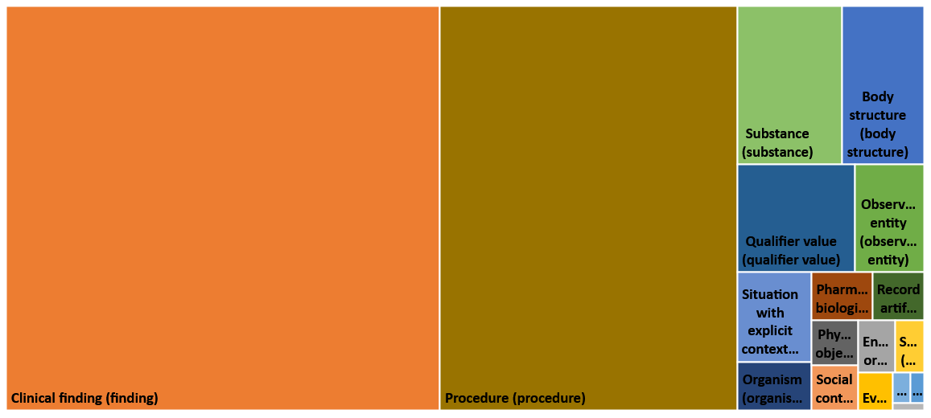
HUG SCT representations

Slide 19
Overall

Slide 20
Most redundant concepts
Concepts (Overall) | # of data elements
258684004|milligram (qualifier value)| | 7920
276727009|Null (qualifier value)| | 1595
258773002|Milliliter (qualifier value)| | 1181
228914009|International unit/24 hours (qualifier value)| | 884
258685003|microgram (qualifier value)| | 778
373067005|No (qualifier value)| | 606
373066001|Yes (qualifier value)| | 594
258718000|millimole (qualifier value)| | 302
258682000|gram (qualifier value)| | 124
703852005|Narrative comment section (record artifact)| | 115
786134002|Product containing calcium electrolyte and colecalciferol (medicinal product)| | 91
74964007|Other (qualifier value)| | 84
104381000|Allergen specific immunoglobulin E antibody measurement (procedure)| | 78
38112003|1 (qualifier value)| | 72
19338005|2 (qualifier value)| | 72
414175005|Product containing ezetimibe and simvastatin (medicinal product)| | 71
258997004|international unit (qualifier value)| | 69
18414002|Colecalciferol (substance)| | 68
250401004|Irregular blood group antibody (substance)|+430925007|Measurement of substance (procedure)| | 67
127800008|Microscopic urinalysis (procedure)| | 57
768800004|Product containing candesartan and hydrochlorothiazide (medicinal product)| | 49

Slide 21
Most redundant concepts
Concepts (Procedure) | # of data elements
104381000|Allergen specific immunoglobulin E antibody measurement (procedure)| | 78
250401004|Irregular blood group antibody (substance)|+430925007|Measurement of substance (procedure)| | 67
127800008|Microscopic urinalysis (procedure)| | 57
11900001|Semen analysis (procedure)| | 38
84101006|Human coronavirus (organism)|+9718006|Polymerase chain reaction analysis (procedure)| | 35
271036002|Lymphocyte percent differential count (procedure)| | 35
122406000|Staphylococcus species culture (procedure)| | 33
122208001|Candida species culture (procedure)| | 32
88960003|Chromosome analysis (procedure)| | 31
312681000|Bone density scan (procedure)| | 28
441689006|Measurement of total hemoglobin concentration (procedure)| | 26
46215003|Antibody to extractable nuclear antigen measurement (procedure)| | 25
58800005|Genus Streptococcus (organism)|+61594008|Microbial culture (procedure)| | 24
407498006|Human parainfluenza viruses (organism)|+9718006|Polymerase chain reaction analysis (procedure)| | 24
58396001|Calculus analysis, qualitative (procedure)| | 23
70901006|Creatinine measurement (procedure)| | 22
36048009|Glucose measurement (procedure)| | 22
26758005|Albumin measurement (procedure)| | 22
117263002|Measurement of ganglioside antibody (procedure)| | 22
59573005|Potassium measurement (procedure)| | 20
25197003|Sodium measurement (procedure)| | 20

Slide 22
Most redundant concepts
Concepts (Disorders) | # of data elements
231504006|Mixed anxiety and depressive disorder (disorder)| | 14
698247007|Cardiac arrhythmia (disorder)| | 13
3527003|Antibody measurement (procedure)|+31384009|Polymyositis (disorder)| | 13
90708001|Kidney disease (disorder)| | 10
64779008|Blood coagulation disorder (disorder)| | 10
67195008|Acute stress disorder (disorder)| | 10
44376007|Dissociative disorder (disorder)| | 10
406506008|Attention deficit hyperactivity disorder (disorder)| | 10
195951007|Acute exacerbation of chronic obstructive airways disease (disorder)| | 10
190633005|Folic acid deficiency (disorder)| | 10
15188001|Hearing loss (disorder)| | 10
85670002|Vitamin deficiency (disorder)| | 9
62014003|Adverse reaction caused by drug (disorder)| | 9
38341003|Hypertensive disorder, systemic arterial (disorder)| | 9
399114005|Adhesive capsulitis of shoulder (disorder)| | 9
34713006|Vitamin D deficiency (disorder)| | 9
25702006|Alcohol intoxication (disorder)| | 9
109992005|Polycythemia vera (disorder)| | 9
74732009|Mental disorder (disorder)| | 8
66590003|Alcohol dependence (disorder)| | 8
74142004|Feeding disorder of infancy OR early childhood (disorder)| | 8

Slide 23

Semantic exploration
DATA
Patients having a pathology or procedure related to the thoracic region?
RadioloGY
Radiographie thorax
US Ponction thorax
formAL SEMANTICS
<< 138875005 |SNOMED CT Concept |:
363704007 |Procedure site| = << 51185008 |Thoracic structure|
or 363698007 |Finding site| = << 51185008 |Thoracic structure|
Observations
pv.ventilation.exams
radio_thorax
FormulaRIES
Anesth – Consultation :
traumatisme thoracique
Anesth – Anesthésie (hors obst.) :
pas de pneumothorax
Dossier de naissance :
Malformation Thorax
Patients PROBLEMS
Fracture thoracique
Notes:
Redonner du sens aux données

Slide 24




Semantic bridge
Implicit semantic
OMOP
Patient
name
Birthdate
Deathdate
Gender
…
Visit
date
…
i2b2
SCT representation of HUG model
CDISC
Problems
Label
Startdate
…
Procedures
Label
Startdate
…
…
Laboratory
Analysis
Startdate
Sample
…

Slide 25
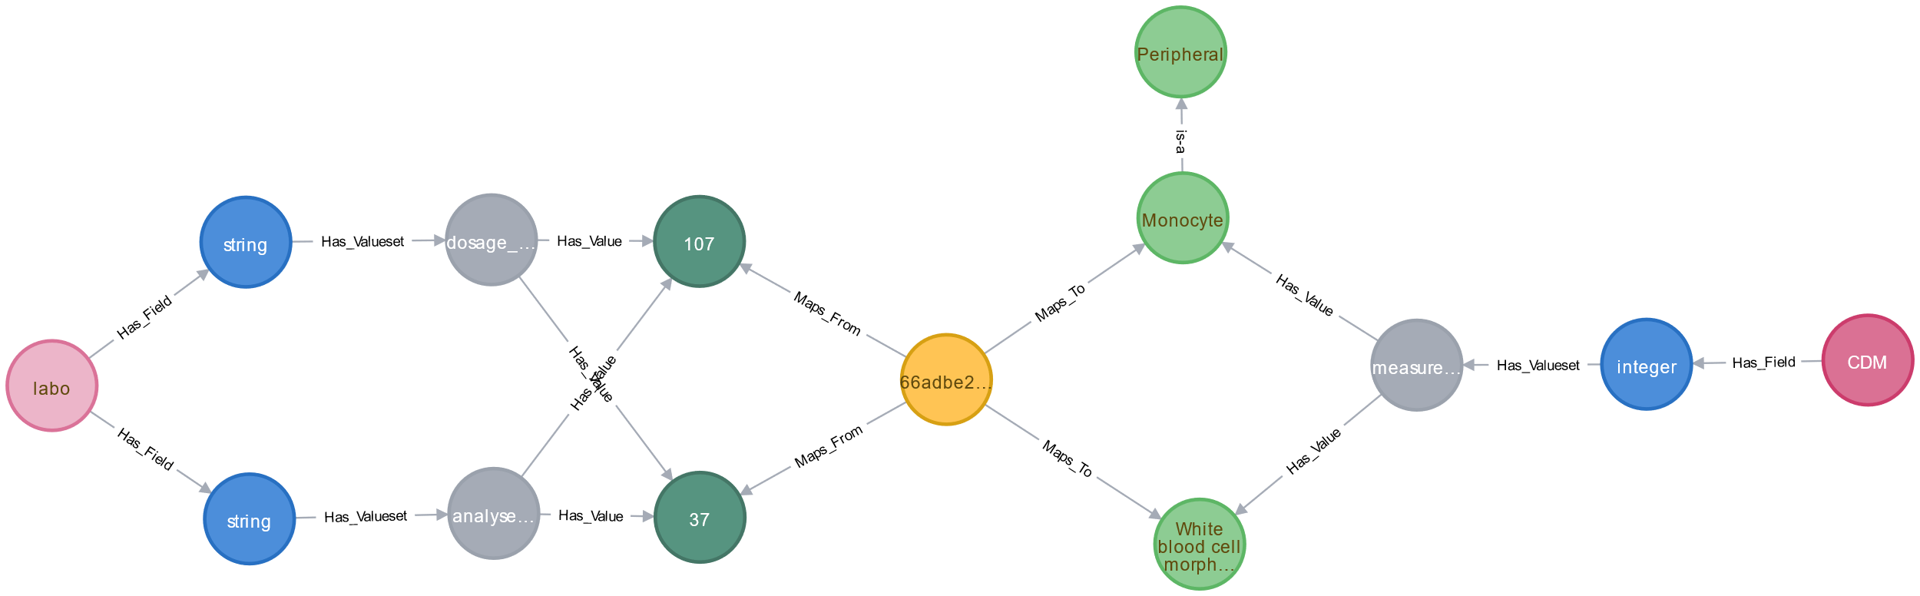
Semantic bridge

Slide 26
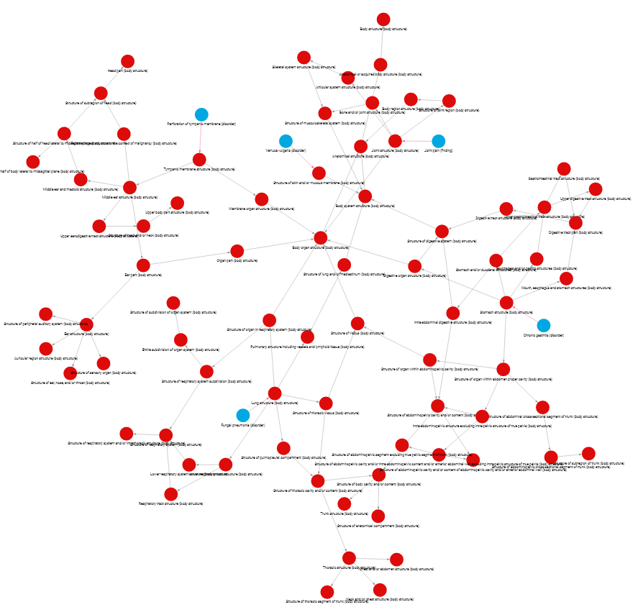
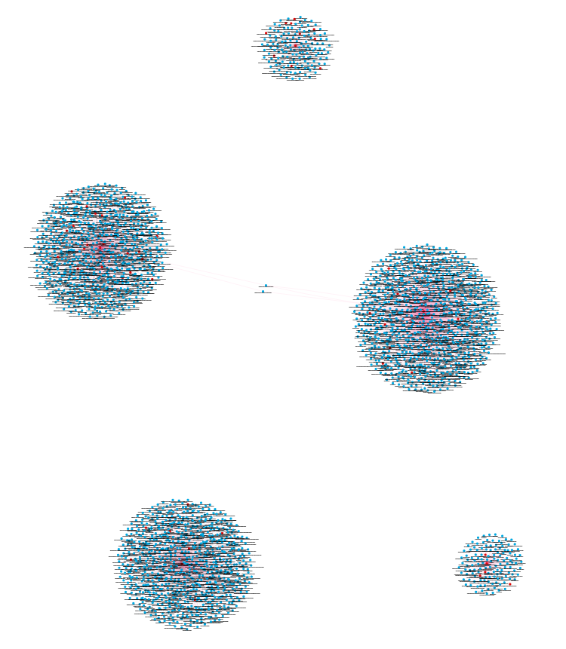
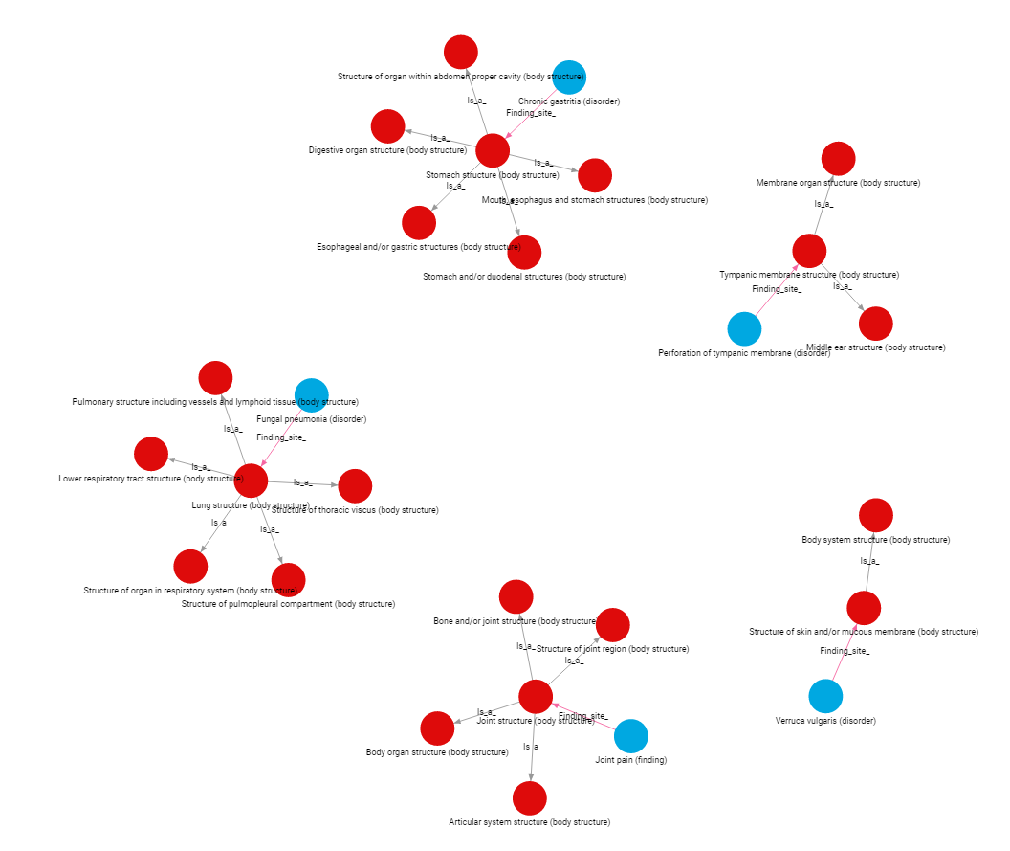
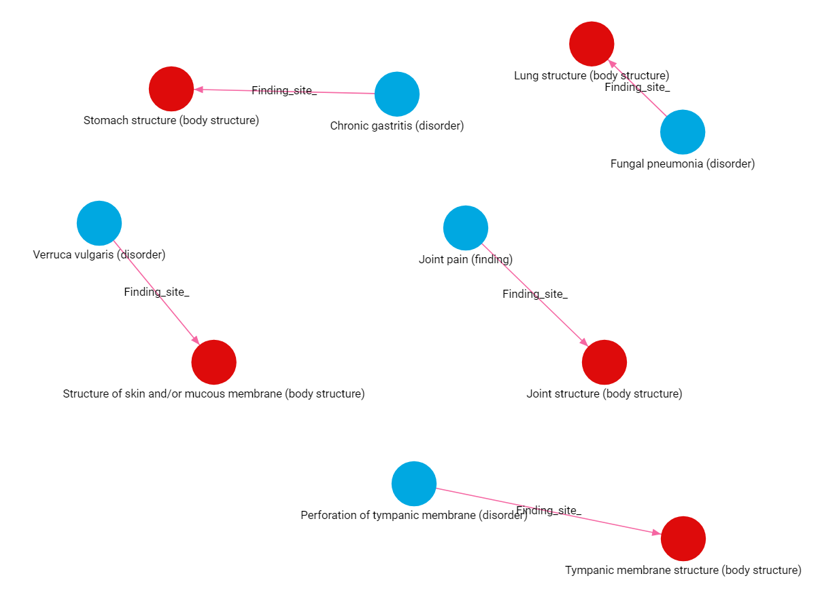
Challenge
Not every SNOMED CT concept is relevant for HUG

Slide 27

Challenge
Implicit semantic
Relevant semantic
Explicit semantic
Visit
date
…
SNOMED-CT Concept
Patient
name
Birthdate
Deathdate
Gender
…
Relevant SNOMED CT subset to represent and explore HUG data elements
……….
……….
Antibody-mediated activation and inactivation (disorder)
Toxic goiter (disorder)
……….
Problems
Label
Startdate
…
Procedures
Label
Startdate
…
Autoimmune endocrine disease (disorder)
Laboratory
Analysis
Startdate
Sample
…
Graves’ disease

Slide 28
Next steps
Relevant SNOMED CT subset creation
Measure impact
Guidelines for representation

Slide 29
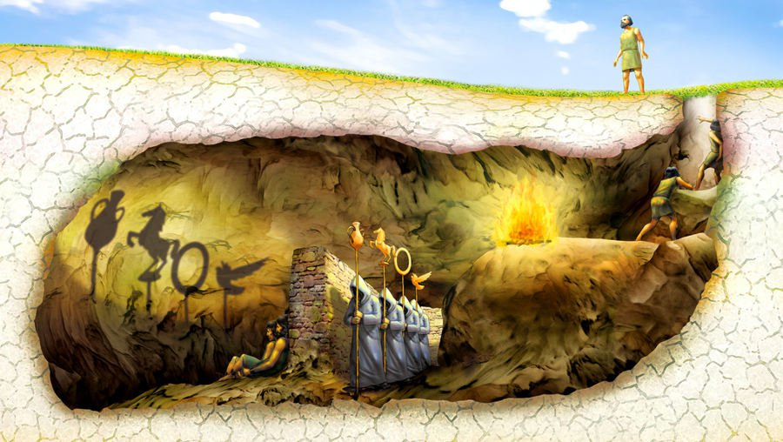
Thank you for your attention!

