Slide 1


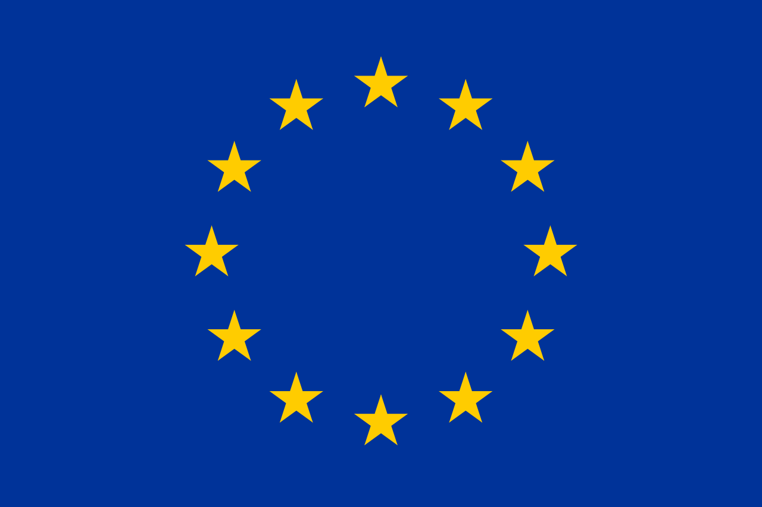

Scope of application of personal data protection laws
Loi sur l’information du public, l’accès aux documents et la protection des données personnelles (LIPAD) [only in French]. According to the UNIGE’s memento, “The LIPAD applies to cantonal and communal public law establishments and corporations, as well as to their administrations and the commissions that depend on them. As the University of Geneva is an institution governed by cantonal public law, the LIPAD is applicable to it.” | Federal Act on Data Protection (FADP) Applies to the processing of data of natural and legal persons by private persons or federal bodies, when the processing takes place in Switzerland. This applies, for example, to research carried out at the EPFL and ETHZ, as these are federal institutions. | General Data Protection Regulation (GDPR) The RGPD applies to the European Union. Its territorial scope may concern Switzerland in two cases: Establishment in the EU: data processing in the context of the activities of a Swiss institution or company that has a branch in the EU, or processing by a Swiss company acting as a subcontractor for an EU company ; Targeting: processing of data of EU residents by a Swiss institution or company that offers goods and services in the EU, or that monitors their behavior (whether the residents are EU citizens or not).
Federal Act on Research involving Human Beings (HRA) Applies to research concerning human diseases and concerning the structure and function of the human body, carried out on persons, on deceased persons, on embryos and fetuses, on biological material and on personal data related to health. If the research falls within the scope of the HRA, the latter applies and not the cantonal or federal law.
Bibliothèque de l’Université de Genève, 2026. Under Creative Commons Attribution 4.0 (CC BY).

