Slide 1


The use of Artificial Intelligence in Open Science. Opportunities, limitations, and ethical considerations FPSE – Journal Club - Unige
Prof. Giovanna Di Marzo Serugendo
Dr. Maria Assunta Cappelli
Notes:
60 minutes —
Ethique
Où trouver les bases de rappel + bibliothèque qui a émis des recommendations
Ce qu’il est possible de faire ou pas
Faire attention aux résultats
Open science —
Reproductibilité — jamais deux fois pareil — guidelines —
Utilsier l’IA dans une expérience —> avec mêmes prompts —> on ne garantit pas la reproductibilité
Comment garantir la reproductibilité avec l’IA?
Générer sur un base statistique —
Fiabilité — qualité des résultats
En ligne
Faire un avatar pour les participants — agents —
Apertus — LLM de l’EPFL-ETH —> suivi des principes

Slide 2
Agenda
START-UP Best practices Institutional tools How to connect to MS Copilot
RECOMMENDATIONS Library reminders Publishing houses
OPERATING PRINCIPLES Neural networks Impact
ETHICS Ethical principles Practical aspects
OPEN SCIENCE Importance AI and open source
REPRODUCIBILITY Reproducibility badges (FAIR) Impact of AI on reproducibility
CONCLUSION Key considerations

Slide 3
START-UP
Best practices
Institutional tools
Copilot

Slide 4

UNIGE Practical Guide
septembre 2024
Acces to guide on-line

Slide 5
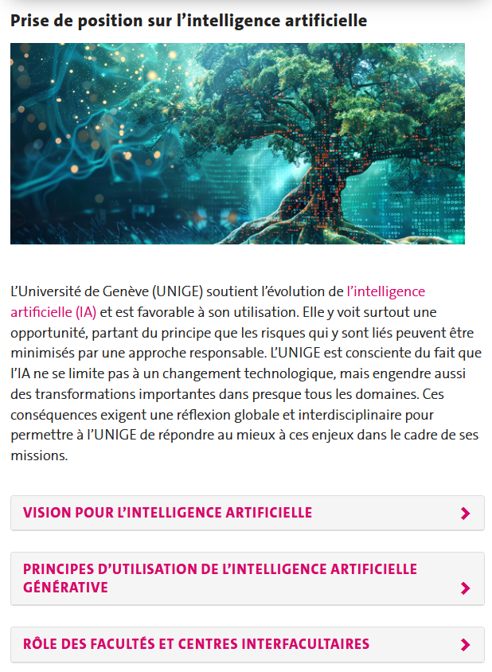
Institutional Position Statement
1er juillet 2024
Role of faculties and interfaculty centres.
Principles for Using Generative AI
Liability
Legality
Academic integrity and transparency
Economy and Ecology
Link to the official position statement
Faculties and interfaculty centres are responsible for determining how AI is integrated into their teaching activities and for defining specific conditions for the use of generative AI tools in research, teaching, and learning..
Liste des recommandations facultaires (blog CIEL)

Slide 6

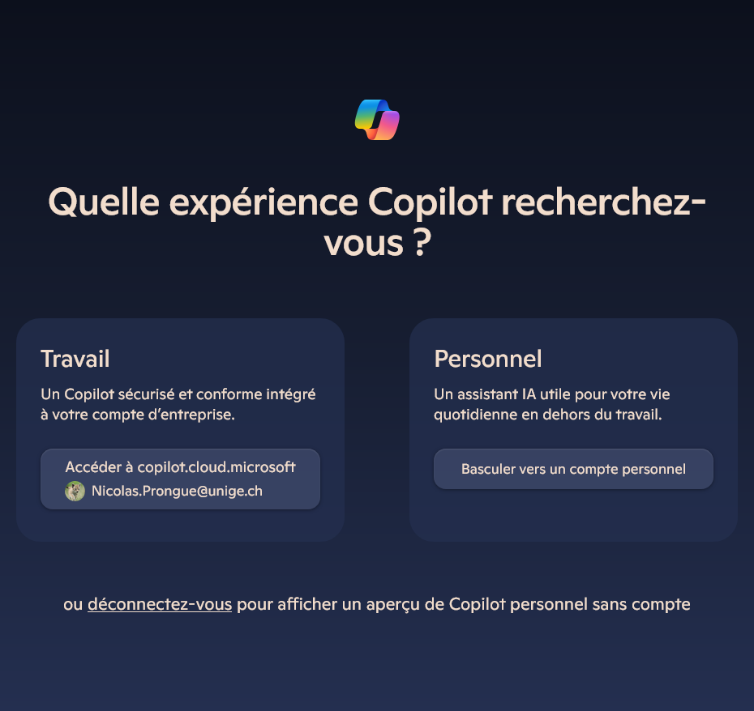
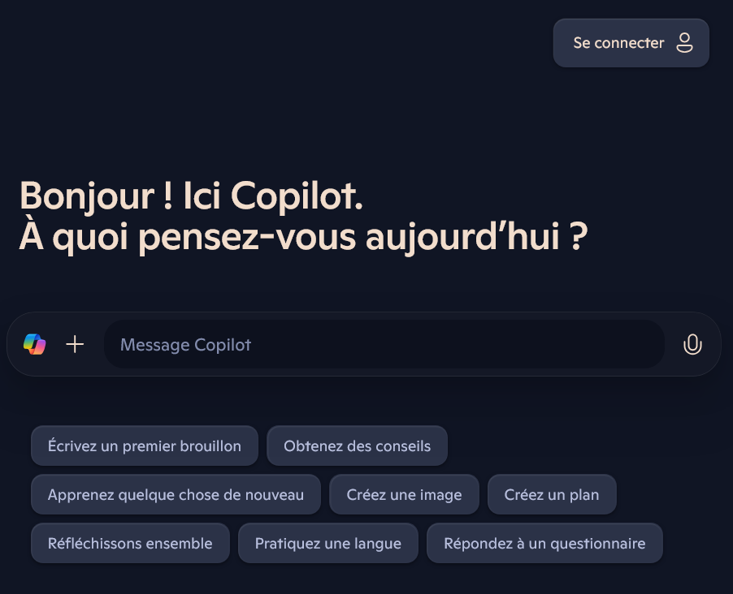
How to connect to Copilot?
m365.cloud.microsoft/chat OR where to search online for ‘Copilot’
then: login ISIS UNIGE
Ici: cliquer "Se connecter"
Ici: insérer e-mail UNIGE
Ici: sélectionner Travail

Slide 7
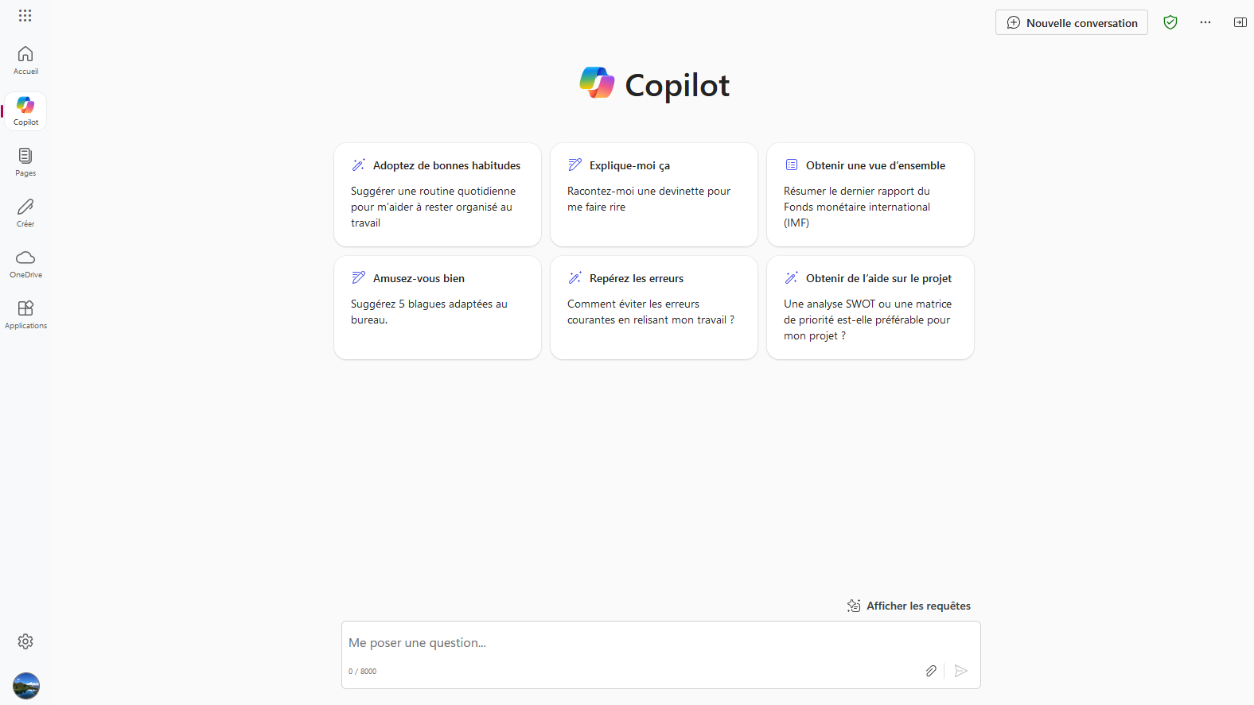
How to connect to Copilot?
login ISIS UNIGE​

Slide 8
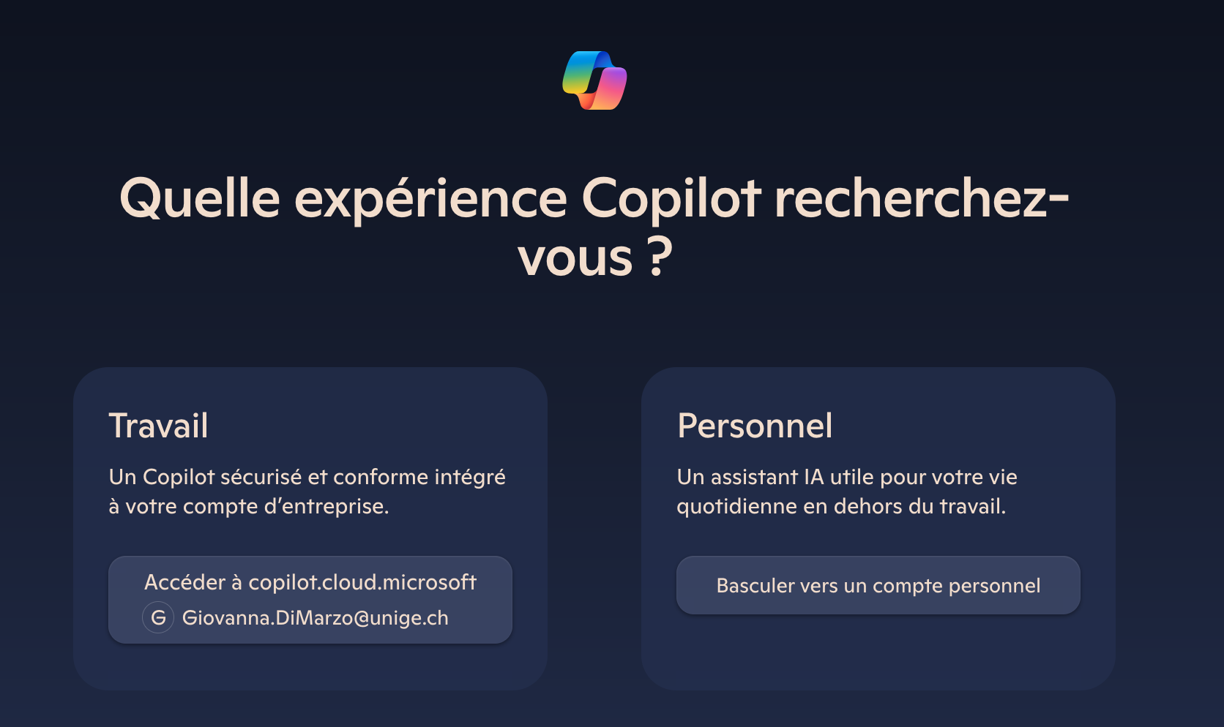
Other ways to log in
https://m365.cloud.microsoft/
https://copilot.microsoft.com/
https://bing.com/chat (switching to a professional account)
Unige credentials: email + password / ISIS
For further information
https://plone.unige.ch/distic/pub/microsoft-365/microsoft-copilot-chat

Slide 9
Recommendations
Unige library / Publishers

Slide 10
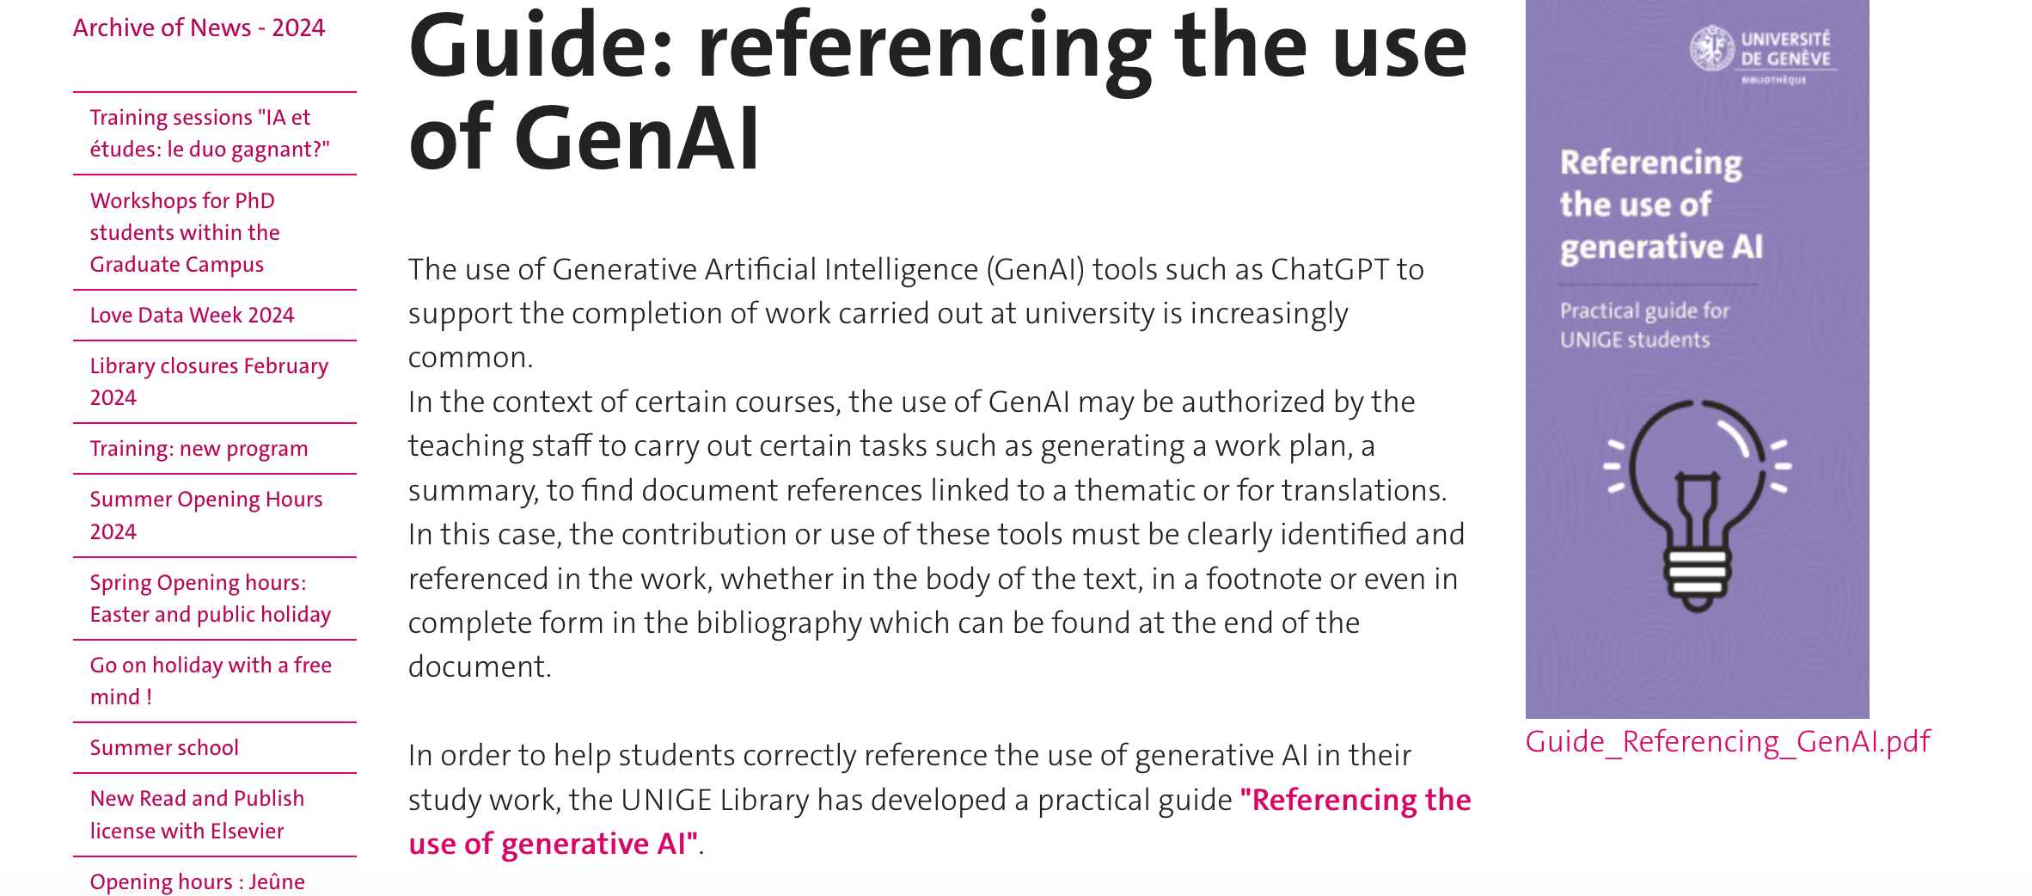
Unige Library Guide to Reference use of AI
https://www.unige.ch/biblio/en/news/archive/2024/guide-iag/
https://www.unige.ch/biblio/index.php/download_file/10807/4662/

Slide 11
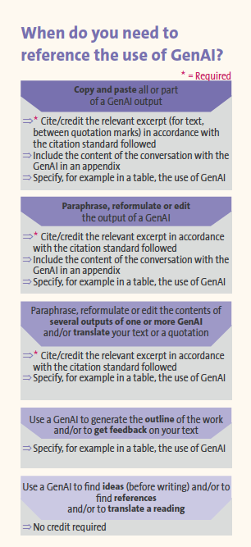
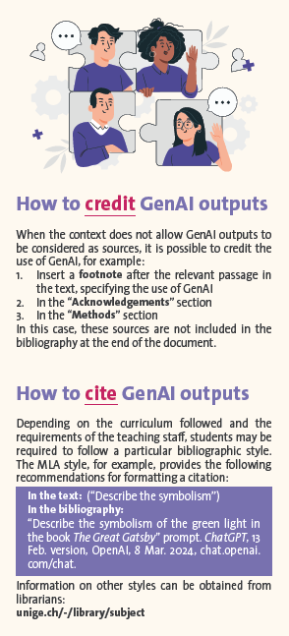
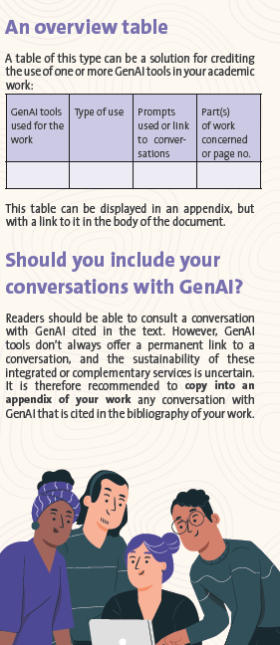
Unige Library Guide to Reference use of AI
https://www.unige.ch/biblio/en/news/archive/2024/guide-iag/
https://www.unige.ch/biblio/index.php/download_file/10807/4662/

Slide 12
Journal psycho

Slide 13
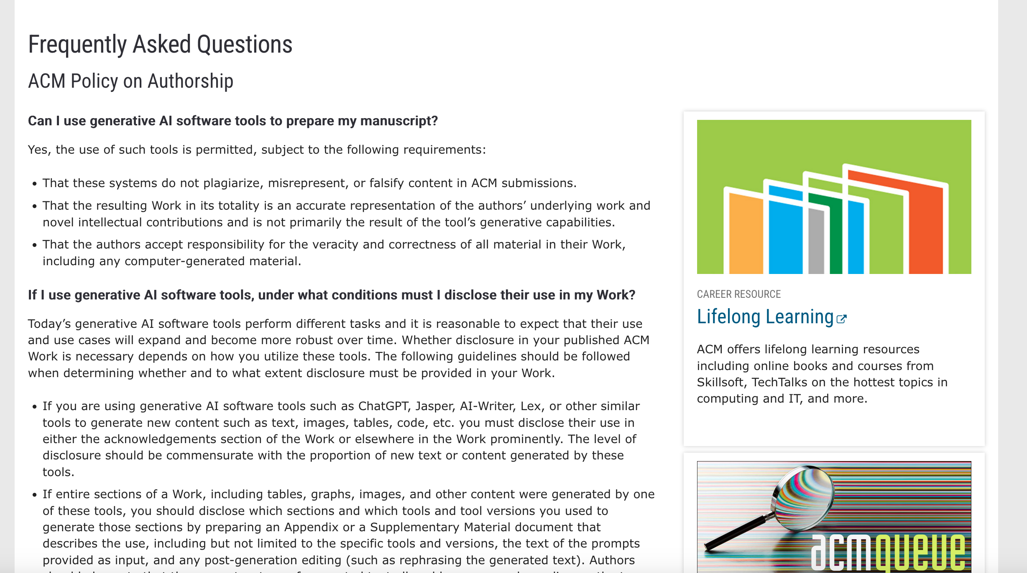
Publishers Guide to Reference use of AI
https://www.acm.org/publications/policies/frequently-asked-questions

Slide 14
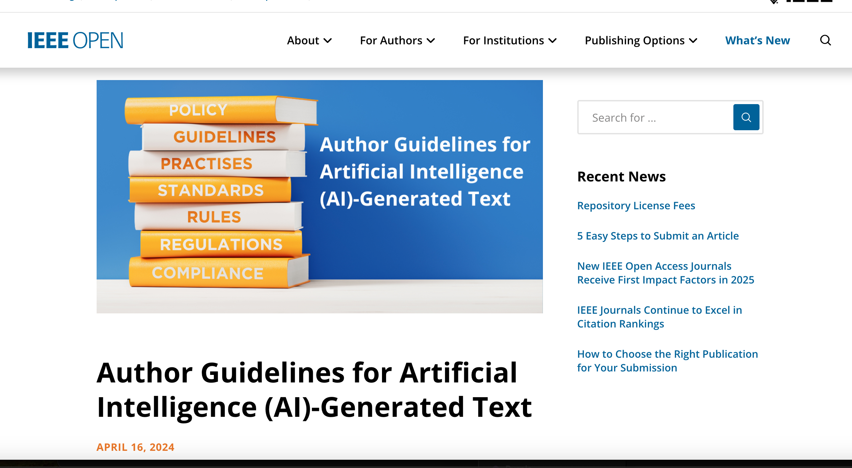
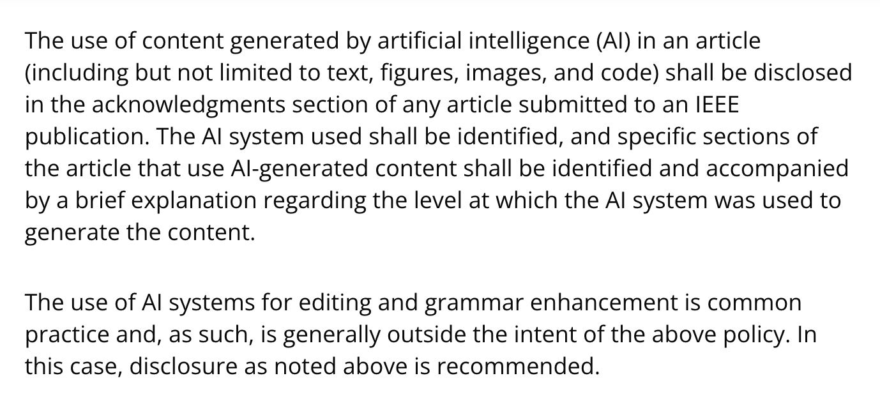
Publishers Guide to Reference use of AI
https://open.ieee.org/author-guidelines-for-artificial-intelligence-ai-generated-text/

Slide 15
Operating Principles
Machine Learning / Deep Learning
Impact

Slide 16
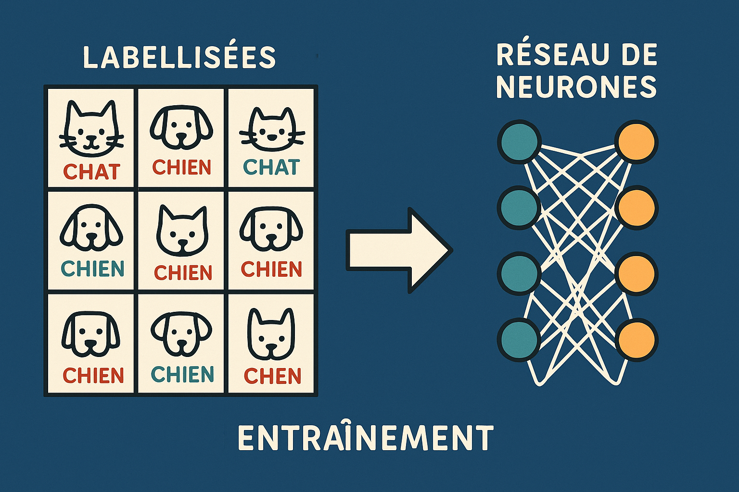
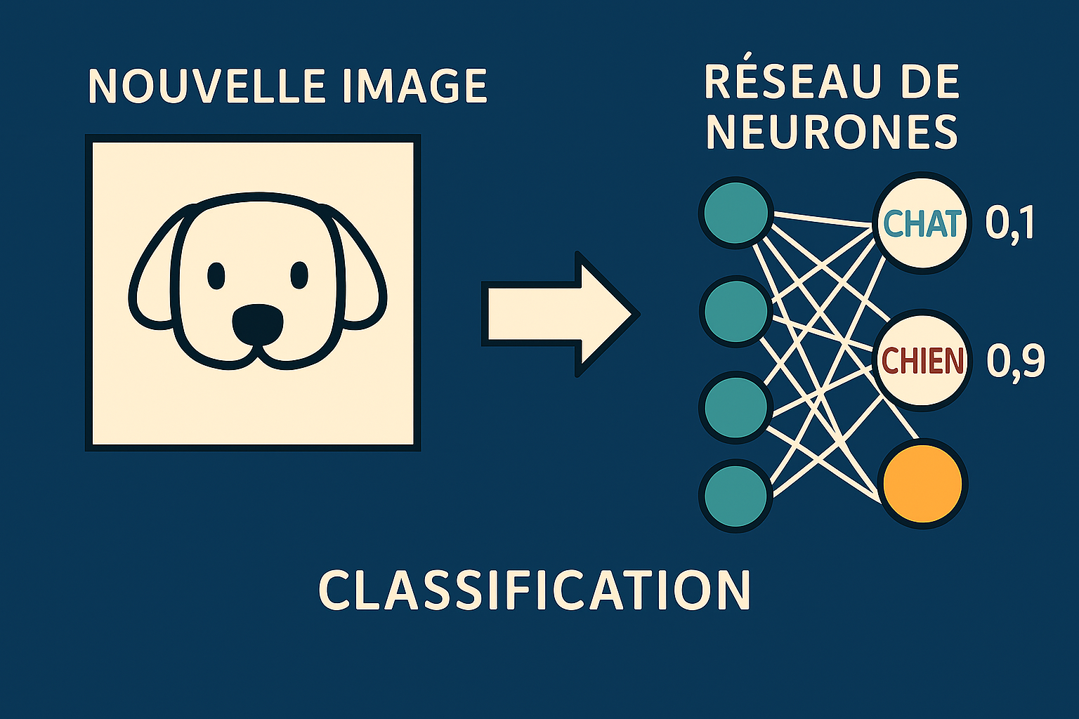
Machine Learning / Deep Learning
Generated by Copilot
Generated by Copilot

Slide 17
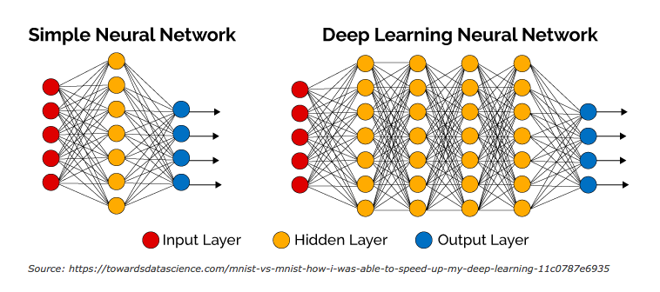
Deep neural networks and their impact
See: https://www.youtube.com/watch?v=aircAruvnKk
Notes:
L'apprentissage profond^{1,2} ou apprentissage en profondeur¹ (en anglais : deep learning, deep structured learning, hierarchical learning) est un ensemble de méthodes d'apprentissage automatique tentant de modéliser avec un haut niveau d’abstraction des données grâce à des architectures articulées de différentes transformations non linéaires^{[réf. souhaitée]}. Ces techniques ont permis des progrès importants et rapides dans les domaines de l'analyse du signal sonore ou visuel et notamment de la reconnaissance faciale, de la reconnaissance vocale, de la vision par ordinateur, du traitement automatisé du langage. Dans les années 2000, ces progrès ont suscité des investissements privés, universitaires et publics importants, notamment de la part des GAFAM (Google, Apple, Facebook, Amazon, Microsoft)³.
Pour le deep learning:Les données en entrées sont en rouge et les données en sortie sont en bleu. Les données en entrée représentent ce que le réseau doit "reconnaître" ou "identifier", par exemple une image. Les données en sortie en bleu représentent ce que le réseau a reconnu ou identifié sur l'image. Les éléments intermédiaires en orange, représentent des valeurs que le réseau doit apprendre pour pouvoir (après avoir appris) identifier au mieux les données qui lui sont fournies (en rouge). Cette vidéo explique bien (avec plus de détails le concept): https://www.youtube.com/watch?v=aircAruvnKk

Slide 18
Impact
Reliability of results: statistical, not necessarily reproducible
Explainability: many layers, billions of parameters
Training: which data?, copyright, bias
Retraining: new version, different results

Slide 19
ETHICS
Ethical principles
Practical considerations

Slide 20
Why discuss ethics in IA?
Influence on research
Present across all disciplines Alters data collection, analysis, and interpretation Can reshape scientific conclusions
Risk of bias
Models may reproduce or amplify inequalities Training data may contain stereotypes or errors Findings can be distorted if biases are not addressed
Regulatory requirements
Mandatory transparency regarding training and data Scientific responsibility for generated outputs Compliance with ethical principles and legislation

Slide 21
Ethical and Regulatory principles for AI
Level | Source | Key ethical and normative principes
International | UNESCO – Recommendation on the Ethics of Artificial Intelligence (2021) | Transparency; accountability; fairness and non-discrimination; respect for human dignity and fundamental rights; environmental sustainability; equitable access to AI.
Européen | Regulation (EU) 2024/1689 – EU AI Act EU Commission, guidelines on prohibited AI Practices (February, 2025) | Risk-based approach; obligations for high-risk systems; national and European supervisory authorities; penalties for non-compliance..
Suisse | Overview of AI Regulation (2025) | Pragmatic, sector-specific approach; application of data-protection law (LPD) to AI systems; required transparency and documentation; prevention of discriminatory decisions.

Slide 22
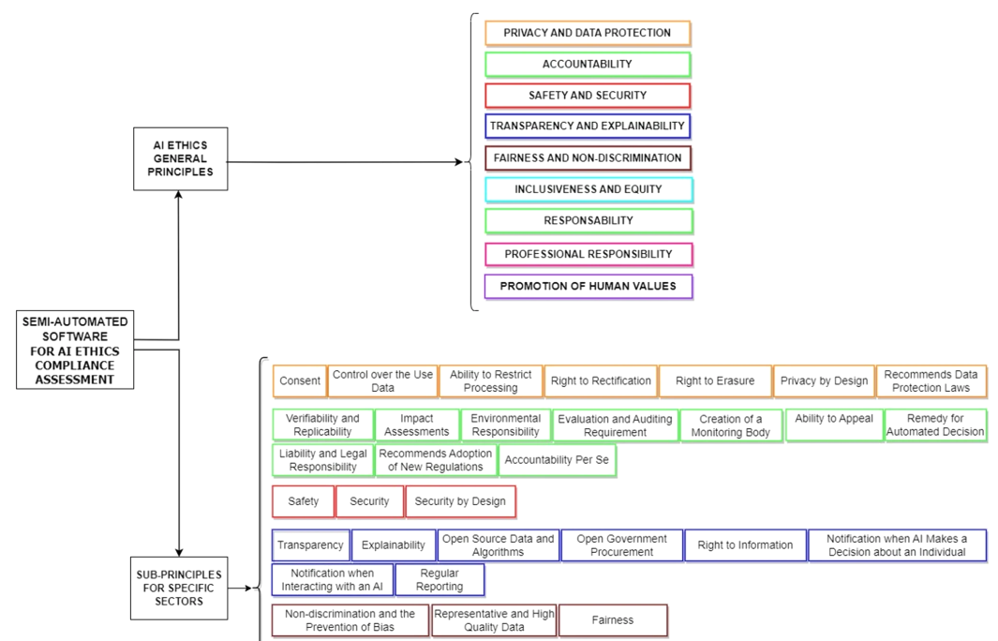
Ethical and Regulatory principles for AI
Cappelli, M.A., Di Marzo Serugendo, G. A semi-automated software model to support AI ethics compliance assessment of an AI system guided by ethical principles of AI. AI Ethics 5, 1357–1380 (2025). https://doi.org/10.1007/s43681-024-00480-z

Slide 23
Beyond Copyright: Practical Ethical Challenges
Data provenance
Who produced the data, and under what conditions?
Copyright compliance
EU AI Act: public summary of training data.
Protection of individuals
Privacy, sensitive data, consent.
Bias and discrimination
Risk of reinforcing and amplifying inequalities.
Impact social
Reliability of scientific results derived from opaque models

Slide 24
OPEN SCIENCE
Importance
AI and Open Source

Slide 25
Why is Open Science important in the context of AI?
Enable verification, reuse, and reliability of results
Example: sharing code and data allows other teams to reproduce the performance of a medical AI model.
Support interdisciplinary collaboration
Example: AI researchers and clinicians can work together using shared public datasets.
Reduce dependence on proprietary “black-box” systems
Example: access to open models and open formats makes it possible to understand, adapt, and audit algorithms according to research needs.

Slide 26
How to make your AI research genuinely open?
Applying the FAIR principles to AI
Findable Assign a DOI to your datasets and models. Include complete metadata: description, authors, date, version.
Accessible Deposit your resources on open platforms (Zenodo, Hugging Face). Specify a clear usage licence.
Interoperable Use simple, widely compatible formats (CSV, JSON, etc.); avoid closed formats.
Reusable Provide full documentation, including requirements, usage examples, and known limitations. Enable other researchers to reproduce and adapt your work.
FAIR FULLY OPEN

Slide 27
L’IA / LLM et ”Open Source”
Code (architecture) is available
Model weights are visible
Training data are available
Test data are available
Freely usable locally
Code (architecture) is modifiable
Model weights are modifiable
Model can be retrained
Test code are available
Evaluation outcomes are available
Misused term: “freely usable” is not equivalent to open source
Open source in AI is more complex than in traditional software
No clear, established definition exists
https://arxiv.org/abs/2403.13784
https://opensource.org/osd

Slide 28
Open source
Watch out for versions
Same architecture – different versions → different results
Hactar @ CUI (Unige)
Internal GPU node with 40+ open-source LLMs
Pretrained LLMs available

Slide 29

Apertus
First large-scale Swiss model, a collaboration between EPFL, ETH Zurich, and the Swiss National Supercomputing Centre (CSCS)
Fully open source: architecture, model weights, training data, code, intermediate checkpoints are all publicly available
Training data exclusively from public sources
Two versions: Apertus-8B, Apertus-70B
Relatively “small”: Apertus-70B – 64 layers, 70 billion parameters
Compliant with the EU AI Act
https://www.swiss-ai.org/apertus

Slide 30
Institutional choices
Query Web
Query Web
Cloud
Cloud
Cloud
chatGPT
Agent
chatGPT
(Limited use with link)
Open Source
LLM
Copilot
institutional
(contract)
On Premises
UNIGE
Query Web

Slide 31
REPRODUCTIBILITY
Reproducibility badges (FAIR)
Impact of AI on reproducibility

Slide 32
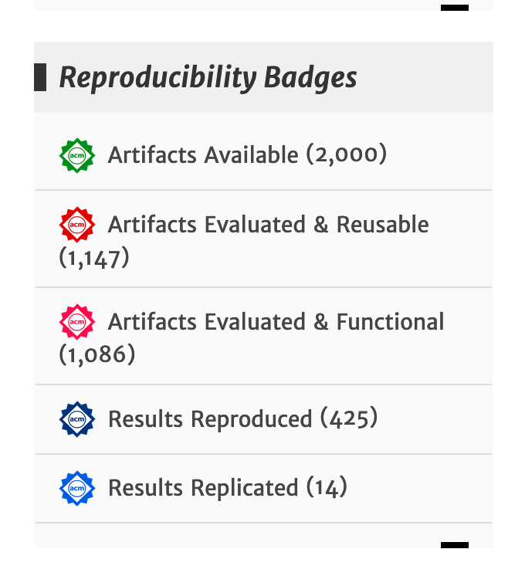
Artifacts and reproducibility badges
Goal - Promoting
Integrity of research
FAIR (Findable, Accessible, Interoperable, Reusable)
Repeatability (Same team, same experimental setup)
Reproducibility (Different team, same experimental setup)
Replicability (Different team, different experimental setup)
Digital artifact - review
https://www.acm.org/publications/policies/artifact-review-and-badging-current

Slide 33
How generative AIs works?
Aspect | Description | Example
Statistical models | Models do not apply explicit rules; they learn patterns. | A diagnostic model recognises an infection after seeing thousands of records, without an explicit medical rule.
Dependence on training data | Slight changes in the data strongly affect results. | Removing 5% of images from a hospital dataset → 10% drop in radiology accuracy.
Dependence on prompt phrasing | The way a question is asked influences the answer. | “Summarise this article” ≠ “Give a 3-line summary”.
Stochastic learning | Same code + same data → slightly different results. | Two trainings of the same network → different predictions (random initialisation).
Sensitivity to data | Bias or noise strongly influences model behaviour. | A facial recognition system trained mostly on light-skinned faces poorly recognises dark-skinned faces.
Black box / lack of explainability | The model does not show why it plans. | A model flags a scan as “abnormal” without indicating the affected area.
Reproducibility of AI results is challenging

Slide 34
How to promote reproducibility of AI results?
Role of the researcher
Document every step Record software versions, parameters, and data sources used.
Test with variations
Slightly change the prompt or an element of the dataset to check if results remain stable.
Report uncertainties and limitations
Specify when results depend on a small sample or a specific context.
Check consistency and stability before publication Repeat analyses multiple times to ensure results do not vary.

Slide 35
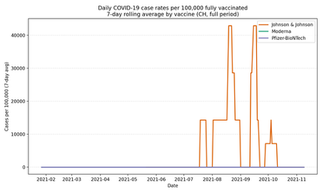
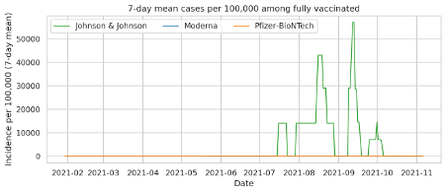
Exemple - Covid Data (1)
Tests - Sept 4th 2025 (Copilot with chaptGPT5 activated)
Tests – Nov 14th 2025 (Copilot with chaptGPT5 activated)
Notes:
Pas la même séquence de discussion
Pas les mêmes graphiques
Voir fichiers annexés

Slide 36
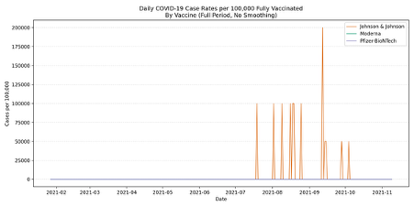
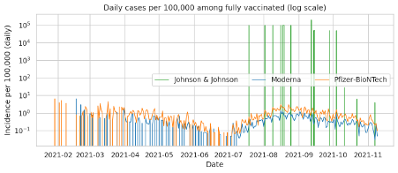
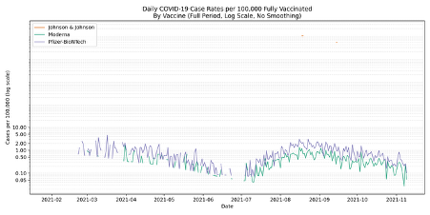
Exemple - Covid Data (2)
Tests - Sept 4th 2025 (Copilot with chaptGPT5 activated)
Tests – Nov 14th 2025 (Copilot with chaptGPT5 activated)
No coherences: 20000 cases for 100000 vaccinated …

Slide 37
Ultimately…
Not the same discussion sequence
Not the same charts
Difficult to reproduce
New version of Copilot?
Statistical effects
See files: EssaisCovid.doc et EssaisCovid-Reproductibilite.doc

Slide 38
Comment garantir la reproductibilité des resultats de l'IA?
Fiabilité
Les résultats sont-ils cohérents avec des sources fiables ? Ex: comparer les réponses à des articles scientifiques, archives ou documents officiels.
Le modèle admet-il ses limites ? Ex : indique-t-il quand il manque de données ou de compétences sur un sujet ?
etc...
Le modèle invente-t-il des réponses ? Ex: cite-t-il des références, des lois ou des faits inexistants ?
Les réponses changent-elles si la question change légèrement ? Ex : obtenir des conclusions différentes pour deux formulations similaires

Slide 39
CONCLUSION
Key points to remember

Slide 40
Reminder – Key points to consider
Transparency in AI usage
Consult best practice guides
Reliability
Bias
Hallucinations
Reproducibility is difficult or even impossible
Statistical effects
Version changes
Data protection
Be aware of the framework (cloud, on-premises, institutional contract, etc.)
Ethical principles are not always guaranteed
Bias, copyright issues

Slide 41
References
Cappelli, M.A., Di Marzo Serugendo, G. A semi-automated software model to support AI ethics compliance assessment of an AI system guided by ethical principles of AI. AI Ethics 5, 1357–1380 (2025). https://doi.org/10.1007/s43681-024-00480-z
European Union. (2024). Regulation (EU) 2024/1689 of the European Parliament and of the Council of 13 June 2024 laying down harmonised rules on artificial intelligence (Artificial Intelligence Act). Official Journal of the European Union. https://eur-lex.europa.eu/legal-content/EN/TXT/?uri=CELEX%3A32024R1689
Federal Council of Switzerland. (2025). Overview of Switzerland’s regulatory approach to artificial intelligence, https://share.google/WUvjpN7nEquil8VNa
UNESCO. (2021). Recommendation on the Ethics of Artificial Intelligence (UNESCO General Conference, 41st session, 23 November 2021). UNESCO. https://unesdoc.unesco.org/ark:/48223/pf0000381137
Recommandation bibliothèque Unige: https://www.unige.ch/biblio/en/news/archive/2024/guide-iag/
Prise de position Unige: https://www.unige.ch/universite/politique-generale/prise-de-position-sur-lintelligence-artificielle/
Guide de l'IA Unige: https://www.unige.ch/numerique/ia-generative-guide-unige

